Slide 2
Immunotherapy in
Metastatic Gastric Cancer
Efrat Dotan, MD, MTR
Fox Chase Cancer Center
Philadelphia, PA, USA
March 2020

Slide 3
DISCLAIMER
Please note:
The views expressed within this presentation are the personal opinions of the author. They do not necessarily represent the views of the author’s academic institution or the rest of the GI CONNECT group.
Disclosures:
Dr. Dotan has the following financial disclosures:
  Research Grant support paid to institution from Lilly and Pfizer
  Honorarium from Boston Medical and Pfizer
  Clinical trial funding to institution from: AstraZeneca, Merck, Incyte, Boston Medical, GSK, Medimmune

Slide 4
Checkpoint inhibitors in the 3rd-line setting
KEYNOTE-059^{1,2}: (NCT02335411)
Phase II, 3 single-arm cohorts
Cohort 1 – Nth-line therapy with pembrolizumab 200 mg q3w
N=259 patients
PD-L1+ /-
Primary end point ORR and safety
ATTRACTION-2³: (NCT02267343)
Phase III, Asian study
Patients with advanced gastric or gastro-oeasophageal junction cancer with at least 2 prior therapies
Patients randomized between nivolumab 3 mg/kg q2w (n=330) and placebo (n=163)
PD-L1 agnostic
Primary endpoint OS
Nth-line, 3rd-line or beyond; ORR, objective response rate; OS, overall survival; PD-L1, programmed death ligand 1; q2w, every 2 weeks; q3w, every 3 weeks.
1. Fuchs CS, et al. JAMA Oncol. 2018;4(5):e180013; 2. Wainberg ZA, et al. 2019 ASCO Annual Meeting abstract 4009;
3. Kang Y-K, et al. Lancet. 2017;390(10111):2461-71.

Slide 5
Checkpoint Inhibitors Approved in 3rd-line Gastric Cancer
 | KEYNOTE-059^{1,2} (Pembrolizumab 200 mg q3w) |  |  | ATTRACTION-2³ (Nivolumab 3 mg/kg q2w)
 | PD-L1+ CPS >1 (N=148) | PD-L1- (N=109) | PD-L1- (N=100) | PD-L1 agnostic (N=268)
Objective response | 15.5% | 6.4% | 6.4% | 11%
Complete response | 2.0% | 2.8% | 2.8% | 0
Partial response | 13.5% | 3.7% | 3.7% | 11%
Stable Disease | 17.6% | 14.7% | 14.7% | 29%
Disease control | 33.1% | 19.3% | 19.3% | 40%
Duration of response, median | 16.3 mo | 6.9 mo | 6.0 mo | 9.53 mo
Median PFS | 2.0 months |  |  | 1.61 months
Median OS | 5.6 months |  |  | 5.26 months
12-month OS | 26.2% |  | 15.1% | 26.2%
24-month OS | 20.2% |  | 9.2%
CPS, combined positive score; OS, overall survival; PD-L1, programmed death ligand 1; PFS, progression-free survival; q2w, every 2 weeks; q3w, every 3 weeks.
1. Fuchs CS, et al. JAMA Oncol. 2018;4(5):e180013; 2. Wainberg ZA, et al. 2019 ASCO Annual Meeting abstract 4009;
3. Kang Y-K, et al. Lancet. 2017;390(10111):2461-71.
Notes:
These two studies led to the approval of checkpoint inhibitors in the 3rd line setting and beyond. Both Pembrolizumab and Nivolumab showed improvement in RR and OS compared to PSC
The Keynote 059 study stratified patients based on PDL-1 status and showed greater benefit among patients with PDL1+ disease in terms of response rate, DCR and OS.

Slide 6
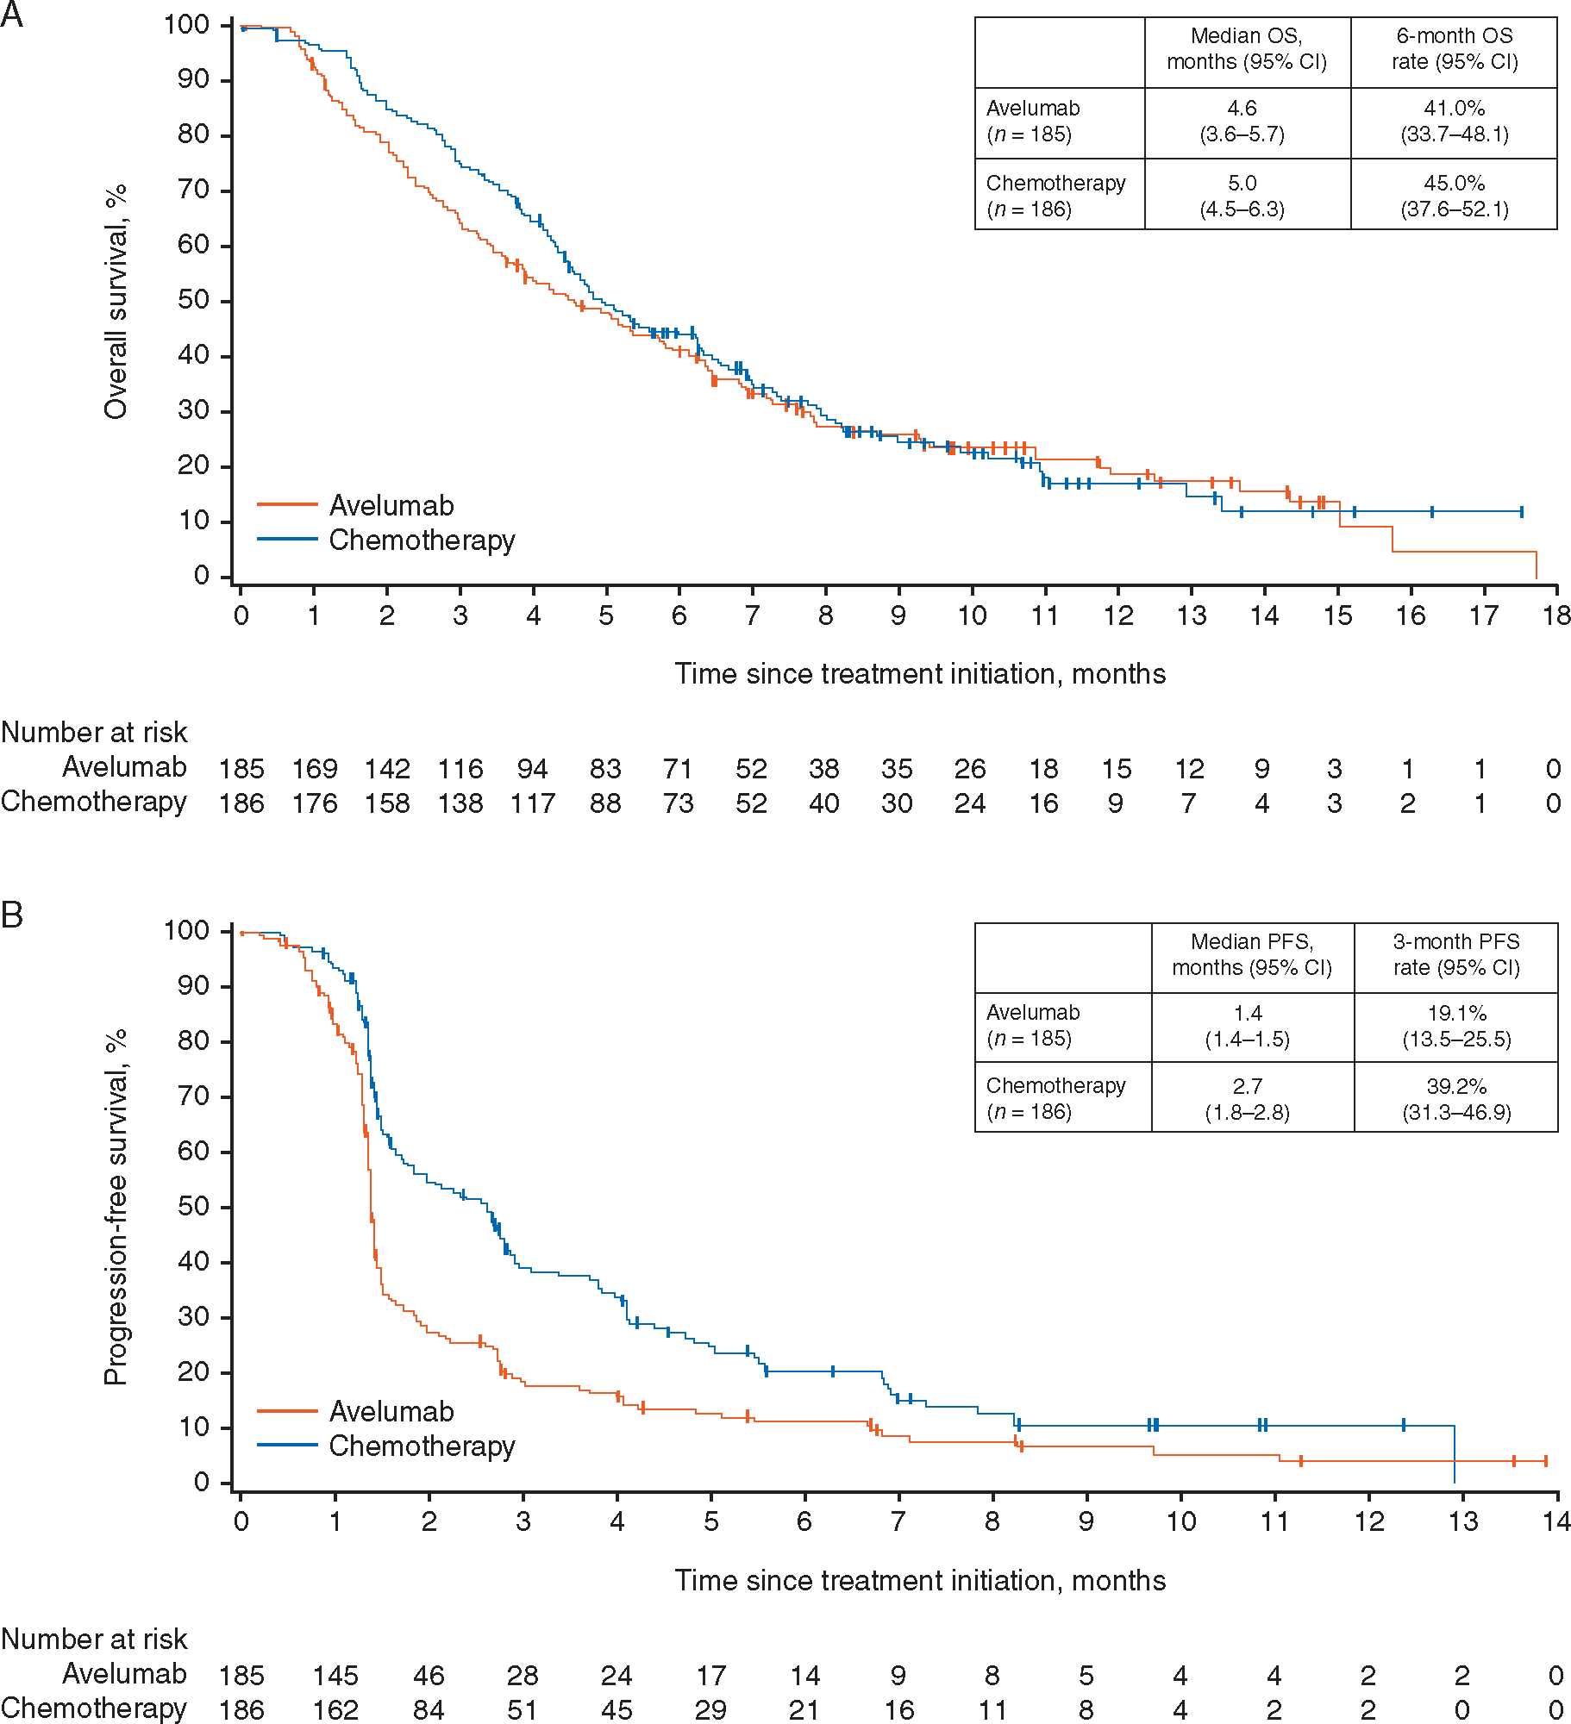
JAVELIN Gastric 300: Avelumab vs Chemotherapy in the 3rd-line setting
Phase 3, international, randomized controlled trial of avelumab vs. physician’s choice chemotherapy (paclitaxel/irinotecan)
371 patients with advanced GC/GEJC who had received two prior lines of therapy were randomized
Avelumab 10 mg/kg q2w (n=185)
advanced GC/GEJC
Received 2 prior lines of therapy
Paclitaxel 80 mg/m² days 1, 8, and 15
Or
Irinotecan 150 mg/m² days 1 and 15
(n=186)
 | Med OS | Med PFS | ORR | DCR
Avelumab | 4.6 mo | 1.4 mo | 2.2% | 22.2%
Chemo | 5.0 mo | 2.7 mo | 4.3% | 44.1%
CI, confidence interval; DCR, disease control rate; GC/GEJC, gastric cancer/gastro-oesophageal junction cancer; Med, median; mGC, metastatic gastric cancer; ORR, objective response rate; OS, overall survival; PFS, progression-free survival; q2w, every 2 weeks.
Bang YJ, et al. Ann Oncol. 2018;29(10):2052-60.
Notes:
While we know that immune checkpoint inhibitors may be better than best supportive care in 3rd line gastric cancer, the JAVELIN 300 study suggests that they may not be better than chemotherapy in this setting. In this international randomized phase 3 study of patients who had received two prior lines of therapy were randomized to either avelumab or physician’s choice of paclitaxel or irinotecan. The study did not meet its primary overall survival endpoint, as avelumab did not improve survival over chemotherapy. In fact, disease control rates were higher with chemotherapy, but avelumab had a better side effect profile. Thus, this study suggests that immunotherapy is an option in this setting, and deciding between chemotherapy and immunotherapy may be patient-specific based on prior toxicities and disease burden.

Slide 7
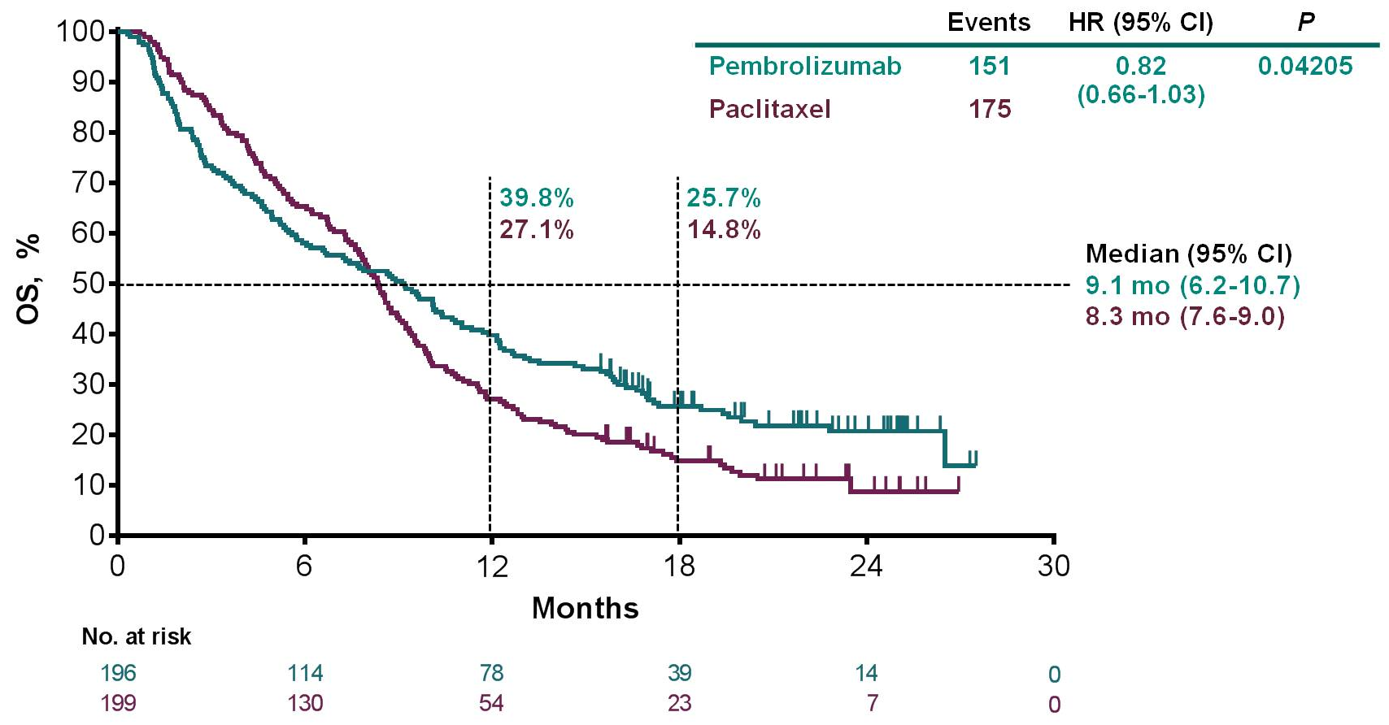
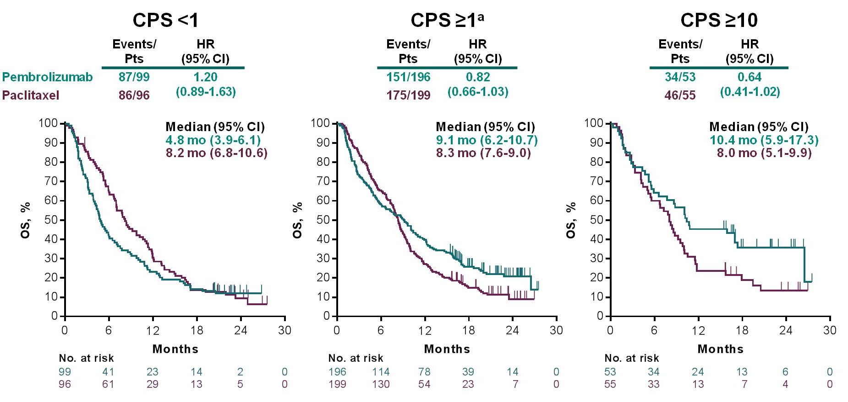
KEYNOTE-061: Checkpoint inhibitors in the 2nd-line setting
GEJ/gastric adenocarcinoma
Progressed on 1st-line platinum/fluoropyrimidine
PD-L1+ (CPS ≥1)
N=592 randomized (395 CPS ≥1)
Pembrolizumab 200 mg q3w (up to 2 years)
N=296 (196 CPS ≥1)
Paclitaxel 80 mg/m² days 1, 8, 15 of 4-week cycles
N=296 (199 CPS ≥1)
Overall Survival: CPS ≥1
Overall Survival by PD-L1 CPS
Data cutoff date: October 26, 2017. ªPrimary end point.
CI, confidence interval; CPS, combined positive score; GEJ, gastro-oesophageal junction; HR, hazard ratio; OS, overall survival; PD-L1, programmed death ligand 1; q3w, every 3 weeks.
Fuchs CS, et al. 2018 ASCO Annual Meeting abstract 4062; Shitara K, et al. Lancet. 2018;392(10142):123-33.
Notes:
Pembrolizumab has also been evaluated in the second-line setting versus weekly paclitaxel. Keynote-061 was a randomized phase 3 study of pembrolizumab versus weekly paclitaxel in GEJ/gastric cancer adenocarcinoma patients who had progressed on front-line platinum/fluoropyrimidine therapy. Although it initially enrolled patients regardless of PD-L1 status, after the enrollment of 489 patients, the IDMC recommended restricting enrollment to PD-L1 positive patients. The primary endpoint was overall survival and PFS in the CPS ≥ 1 group, the middle curve in this slide. In the intent to treat population, there was no difference in survival between the two arms. A post-hoc analysis of patients whose tumors had a CPS ≥ 10, demonstrated a trend toward improvement in survival, with a 2.4 month improvement seen in those treated with pembrolizumab. In those whose tumors were negative with a CPS < 1, treatment with chemotherapy was better than that seen with pembrolizumab.

Slide 8
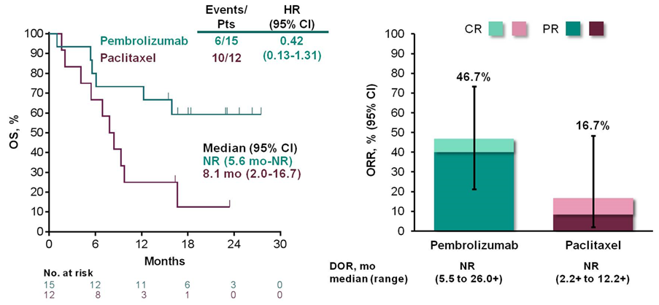
KEYNOTE-061: Checkpoint inhibitors in the 2nd-line setting
OS, ORR, and DOR for MSI-H Tumorsª
(5% of patients)
ªPost-hoc subgroup analysis. Data cutoff date: October 26, 2017.
CI, confidence interval; CR, complete response; DOR, duration of response; HR, hazard ratio; MSI-H, microsatellite instability-high; NR, not reached; ORR, overall response rate; OS, overall survival; PR, partial response; Pts, patients.
Presented by Kohei Shitara at 2018 ASCO Annual Meeting (Abstract 4062).
Notes:
5% of patients enrolled on the trial were microsatellite high, as centrally assessed by PCR. Greater effect of pembrolizumab was seen in this group of patients, with an overall survival that was not reached in the pembrolizumab arm versus 8.1 months with chemotherapy. Pembrolizumab also resulted in a higher response rate than paclitaxel, with a duration of response that was not reached in the pembrolizumab arm.

Slide 9
KEYNOTE-062: Checkpoint inhibitors in the 1st-line setting
KEYNOTE-062 STUDY DESIGN (NCT02494583)
Key Eligibility Criteria
Locally advanced, unresectable or metastatic gastric or gastroesophageal adenocarcinoma
HER2/neu-negative, PD-L1-positive disease (CPS ≥1)
ECOG PS 0 or 1
Pembrolizumab 200 mg Q3W
for up to 35 cycles
N=256
Pembrolizumab 200 mg Q3W
(to 35 cycles)
+
Chemotherapy
Until unacceptable
toxicity, disease
progression, or
patient/physician
withdrawal decision
N=763
R
1:1:1
N=257
Stratification Factors
Region
Locally advanced or metastatic disease
5-FU or capecitabine
N=250
Placebo
+
Chemotherapy
Primary endpoints: OS and PFS
Secondary endpoints: ORR, DOR, QoL
Events: N (%) | Pembro | P + C | Chemo
CPS ≥10 | 92 (36%) | 99 (39%) | 90 (36%)
MSI-H | 14 (5%) | 17 (7%) | 19 (8%)
MSI-H + CPS ≥10 | 11 (79%) | 11 (65%) | 10 (53%)
5-FU, 5-fluorouracil; C, chemotherapy; Chemo, chemotherapy; CPS, combined positive score; DOR, duration of response; ECOG PS, Eastern Cooperative Oncology Group performance status; HER2, human epidermal growth factor receptor 2; MSI-H, microsatellite instability-high; ORR, overall response rate; OS, overall survival; P, pembrolizumab; Pembro, pembrolizumab; PD-L1, programmed death ligand 1; PFS, progression-free survival; Q3W, every 3 weeks; QoL. Quality of life; R, randomization.
Presented by Josep Tabernero at 2019 ASCO Annual Meeting (Abstract LBA4007).
Notes:
At this year’s ASCO Annual Meeting, the results of KEYNOTE-062 were presented. This study evaluated pembrolizumab in treatment-naïve, PD-L1 positive gastric and GEJ cancers and had three different arms: one evaluating pembrolizumab alone, one combining pembrolizumab with platinum/fluoropyrimidine standard chemotherapy, and one arm including standard chemotherapy and placebo. The study had complex statistics. With initial analysis of non inferiority between Pem vs. Chemo, and then superiority for the combination vs. chemo. Study was considered positive if any of the OS or PFS hypotheses were positive.

Slide 10
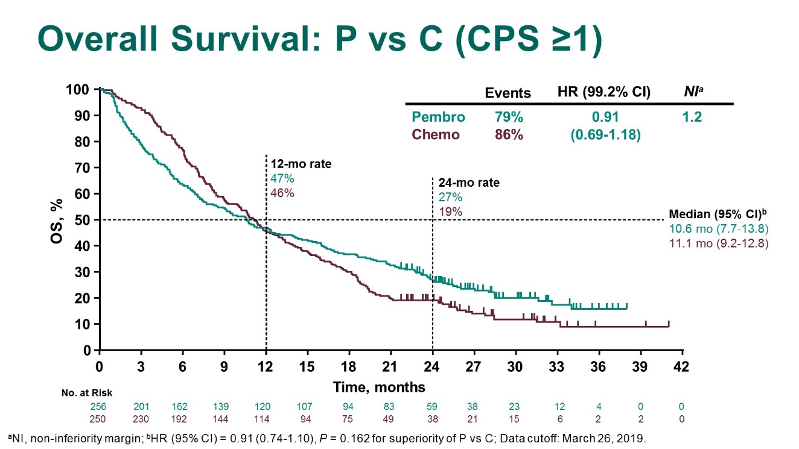
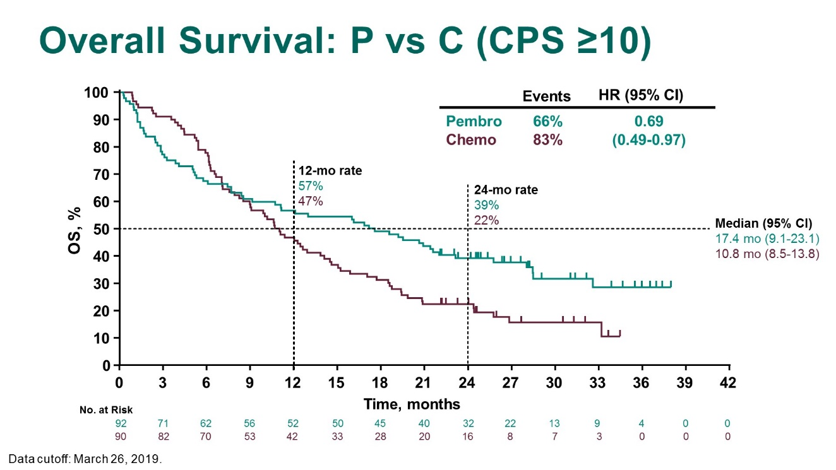
KEYNOTE-062: Checkpoint inhibitors in the 1st-line setting
Overall Survival: P vs C (CPS ≥1)
Overall Survival: P vs C (CPS ≥10)
Primary end point was met, pembrolizumab was non-inferior to chemotherapy for OS
In CPS ≥10 – pembrolizumab is better than chemotherapy especially at 12 and 24 months
There is initial drop in the first few months, highlighting the concern with IO therapy early on in the disease
ªNI, non-inferiority margin; ^{b}HR (95% CI) = 0.91 (0.74–1.10), P=0.162 for superiority of P vs C. Data cutoff date: March 26, 2019.
C, chemotherapy; Chemo, chemotherapy; CI, confidence interval; CPS, combined positive score; HR, hazard ratio; IO, immuno-oncology; NI, non-inferiority margin; OS, overall survival; P, pembrolizumab; Pembro, pembrolizumab.
Presented by Josep Tabernero at 2019 ASCO Annual Meeting (Abstract LBA4007).
Notes:
The study was considered positive because pembrolizumab was deemed non-inferior to chemotherapy, meeting the criteria for the first hypothesis. Pembrolizumab demonstrated a median overall survival of 10.6 months, similar to the overall survival seen with platinum/fluoropyrimidine-based chemotherapy of 11.1 months. Based on prespecified criteria, the non-inferiority hazard ratio boundaries fell below 1.2, the prespecified boundary. Interestingly, pembrolizumab performed poorer than chemotherapy in the early months of treatment, but by 12 months, overall survival rates were the same, slightly less than 50% while 2-year OS rates were higher in pembrolizumab-treated patients, suggesting that those who did obtain a benefit maintained it for longer than that seen with chemotherapy. When high PD-L1 expressors were evaluated, there was a more favorable overall survival for pembrolizumab with a median OS of 17.4 months for pembrolizumab versus 10.8 months for chemotherapy and a bigger difference in survival rates at 12 and 24 months.

Slide 11
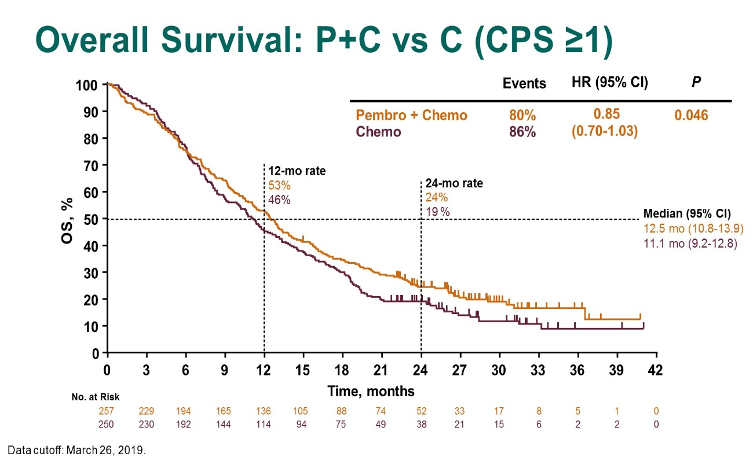
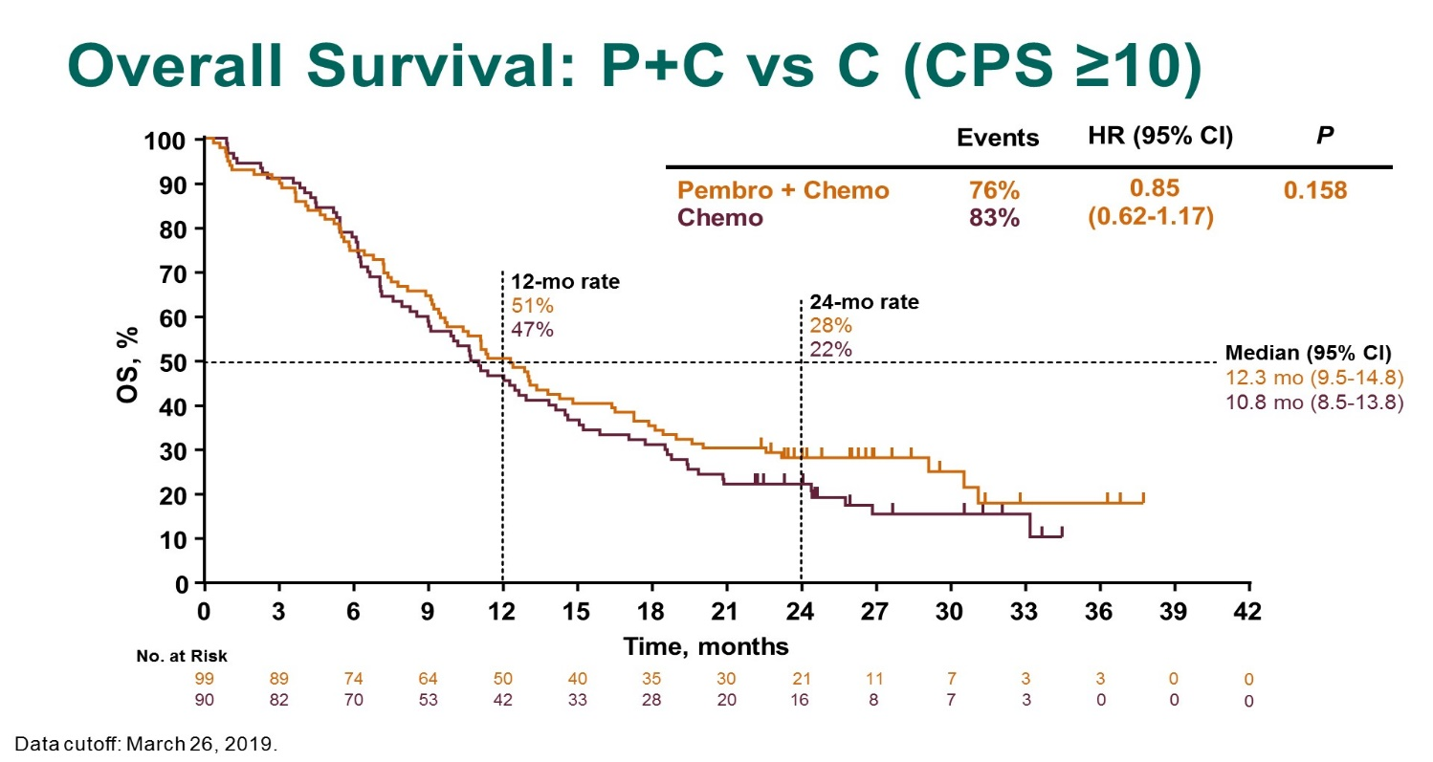
KEYNOTE-062: Checkpoint inhibitors in the 1st-line setting
Overall Survival: P+C vs C (CPS ≥1)
Overall Survival: P+C vs C (CPS ≥10)
Comparison of the combination of chemotherapy + pembrolizumab vs chemotherapy alone did not show any improvement in OS, in CPS ≥ 1 and CPS ≥ 10 groups
PFS was not improved by the addition of pembrolizumab
Data cutoff date: March 26, 2019.
C, chemotherapy; Chemo, chemotherapy; CI, confidence interval; CPS, combined positive score; HR, hazard ratio; OS, overall survival; P, pembrolizumab; Pembro, pembrolizumab; PFS, progression-free survival.
Presented by Josep Tabernero at 2019 ASCO Annual Meeting (Abstract LBA4007).
Notes:
When we look at the comparison between chemotherapy and pembrolizumab versus chemotherapy alone, the study did not meet the primary endpoint of superiority for the combination. In fact, the chemotherapy alone arm performed quite well, with a median overall survival of 11.1 months and 12.5 months for chemotherapy alone and chemotherapy plus pembrolizumab. Even in the population with a CPS ≥ 10, there was no significant difference between the two arms, with similar survival rates at 12 and 24 months. Progression-free survival was also quite similar between the two arms, although there appears to be a trend favoring pembrolizumab with longer time from treatment initiation.

Slide 12
KEYNOTE-062: Pembrolizumab first in MSI-High Gastric Cancer?
 | MSS CPS ≥1 |  |  | MSI-H CPS ≥1 |  |  | MSI-H CPS ≥10
 | Pembro | Chemo | HR | Pembro | Chemo | HR | Pembro | Chemo | HR
ORR |  |  |  | 57.1% | 36.8%
DOR |  |  |  | 21.2 mo | 7.0 mo
PFS |  |  |  | 11.2 mo | 6.6 mo | 0.72
OS | 9.5 mo | 11.2 mo | 0.94 | NR | 8.5 mo | 0.29 | NR | 13.6 mo | 0.21
 | MSI-H CPS ≥1 |  |  | MSI-H CPS ≥10
 | Pembro + Chemo | Chemo | HR | Pembro + Chemo | Chemo | HR
ORR | 64.7% | 36.8%
DOR | NR | 7.0 mo
PFS | NR | 6.6 mo | 0.45
OS | NR | 8.5 mo | 0.37 | NR | 13.6 mo | 0.26
CPS, combined positive score; Chemo, chemotherapy; DOR, duration of response; HR, hazard ratio; MSI-H, microsatellite instability-high; MSS, microsatellite stable; NR, not reached; ORR, overall response rate; OS, overall survival; Pembro, pembrolizumab; PFS, progression-free survival.
Shitara K, et al. ESMO Congress 2019 abstract LBA44.
Notes:
At this year’s ESMO meeting in Barcelona, data on the MSI-high population from KEYNOTE-062 was presented. This was a small population in each arm of the trial, less than 20 patients in each arm and the majority having a CPS ≥10. The microsatellite stable patients had a median survival that ranged from 9.5 months with pembrolizumab to 11.2 months with chemotherapy. However, the overall survival was not reached in the microsatellite high population, regardless of whether the CPS cutoff was ≥1 or ≥10. In considering the MSI-high population from the intent to treat analysis (CPS ≥1), response rate with pembrolizumab alone was 57.1% with a median duration of response of 21.2 months and median PFS of 11.2 months. When chemotherapy and pembrolizumab were given together, the overall response rate increased to 64.7% and the duration of response and median progression-free survival had not been reached at the time of data cutoff.

Slide 13
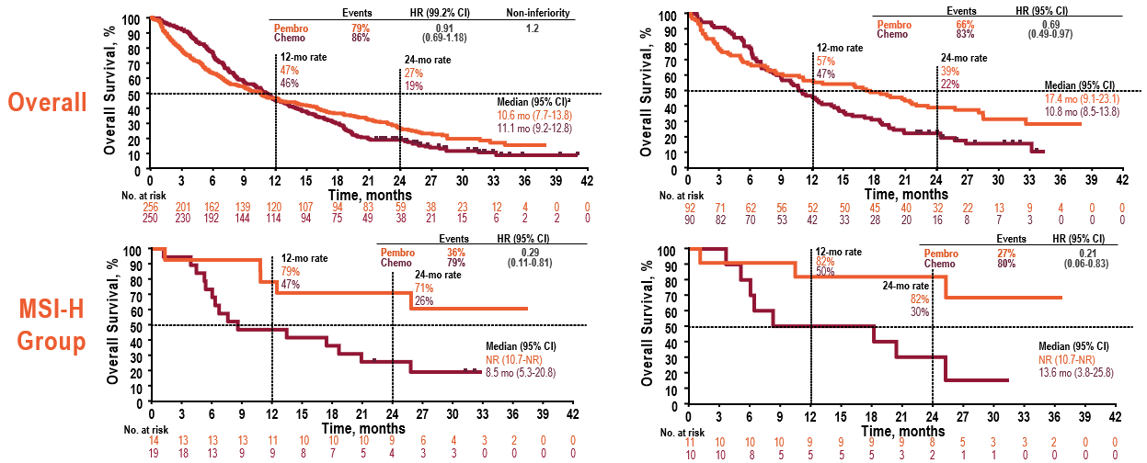
Keynote-062: overall survival Pembrolizumab monotherapy
CPS ≥1
CPS ≥10
ªHR (95% CI) = 0.91 (0.74-1.10); Data cutoff date: March 26, 2019.
CI, confidence interval; CPS, combined positive score; Chemo, chemotherapy; HR, hazard ratio; MSI-H, microsatellite instability-high; NR, not reached; Pembro, pembrolizumab.
Chung HC, et al. ESMO Asia Congress 2019 abstract 125O.
Notes:
When comparing pembrolizumab to chemotherapy, the study demonstrated non-inferiority between pembrolizumab and chemotherapy. Pembrolizumab improved overall survival in the CPS ≥ 10 group, but this was not a planned analysis. However, if you look closely at these curves, the pembrolizumab arm initially does worse, with the curves crossing at approximately 12 months in the CPS ≥ 1 group and between 6 and 9 months in the CPS ≥ 10 group, suggesting that chemotherapy may be more beneficial in the initial months of systemic therapy in this disease. Excluding the MSI-high population from the overall study population does not significantly alter the outcomes in CPS ≥ 1 and CPS ≥ 10 groups. In the MSI-high population, however, pembrolizumab significantly improved survival in both the CPS ≥ 1 and CPS ≥ 10 groups, where median overall survival was not reached in the MSI-high group treated with pembrolizumab. There was less of an early separation of the curves in this subset, but this was a very small group and too small to draw conclusions. Overall response rate was also higher in the MSI-high cohort with a CPS ≥ 10, but not in the CPS ≥ 1 cohort. PFS was not different between the two arms, but with a faster drop-off in the pembrolizumab arm early in follow-up.

Slide 14
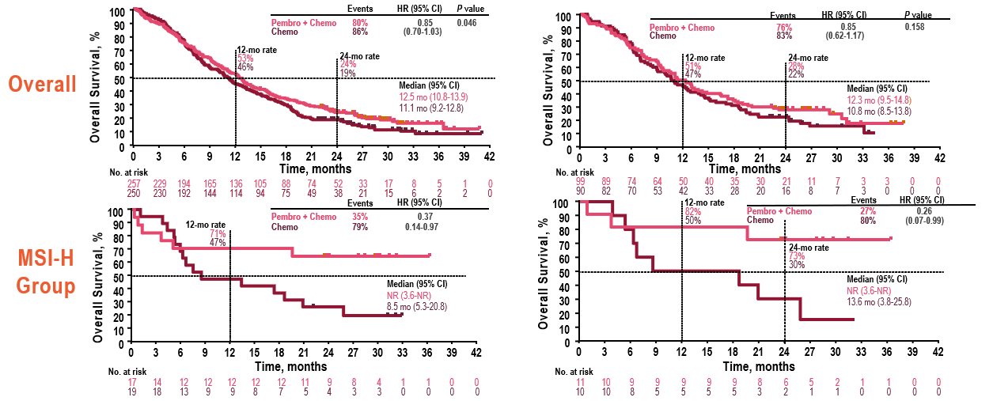
Keynote-062: overall survival Pembrolizumab + chemotherapy
CPS ≥1
CPS ≥10
Data cutoff date: March 26, 2019.
CI, confidence interval; CPS, combined positive score; Chemo, chemotherapy; HR, hazard ratio; MSI-H, microsatellite instability-high; NR, not reached; Pembro, pembrolizumab.
Chung HC, et al. ESMO Asia Congress 2019 abstract 125O.
Notes:
When looking at the combination of pembrolizumab plus chemotherapy versus chemotherapy alone, while there was a trend toward improved overall survival with the combination of pembrolizumab plus chemotherapy in the CPS ≥ 1 and CPS ≥ 10 groups, this did not meet statistical significance in either group and therefore was not superior in either arm. However, when you look at the MSI-high subgroups in each CPS cohort, median overall survival was not reached with pembrolizumab versus 8.5 months with chemotherapy in the CPS ≥ 1 and 13.6 months in the CPS ≥ 10 months. Excluding the MSI-high population from the overall study population does not significantly alter the outcomes in CPS ≥ 1 and CPS ≥ 10 groups. Adding pembrolizumab to chemotherapy did not significantly improve progression-free survival in either arm.

Slide 15
Results of the JAVELIN Gastric 100 phase 3 trial: avelumab maintenance following first-line (1L) chemotherapy (CTx) vs continuation of CTx for HER2− advanced gastric or gastroesophageal junction cancer (GC/GEJC)
Moehler, et al. ASCO GI 2020, abst #278
Avelumab – PD-L1 inhibitor that showed activity in gastric and GEJ cancers

Slide 16
JAVELIN GASTRIC 100
AN INTERNATIONAL, OPEN-LABEL, PHASE 3 TRIAL
Efficacy and safety measured from randomization
(after induction)
Induction phase
12 weeks
N=805
Re-baseline
10 days
Maintenance phase
N=499
Primary endpoint:
OS
Primary analysis
populations:
All randomized patients
PD-L1+ population‡
Secondary endpoints:
PFS,§ BOR,§ safety,
PROs/QoL
Previously
untreated,
unresectable,
locally advanced
or metastatic,
HER2-
GC/GEJC
Avelumab
10 mg/kg IV Q2W
n=249
Oxaliplatin +
5-FU +
leucovorin
or
Oxaliplatin +
capecitabine
Patients
without
PD*
R
Continuation of
1L chemotherapy
or BSC alone†
n=250
Stratification:
Asia vs non-Asia
Enrollment:
Dec 2015 to Nov 2017
Treatment until confirmed PD,
unacceptable toxicity,
or withdrawal
(investigator assessed)
*Eligibility for randomization based on absence of PD was confirmed by an independent radiologist. †Choice of chemotherapy or BSC decided by investigators prior to randomization. ‡≥1% of tumor cells PD-L1+ using the 73-10 pharmDx assay (Dako). §Based on investigator assessment per RECIST 1.1.
1L, first-line; 5-FU, 5-fluorouracil; BOR, best overall response; BSC, best supportive care; GC/GEJC, gastric cancer/gastro-oesophageal junction cancer; HER2, human epidermal growth factor receptor 2; IV, intravenous; OS, overall survival; PD, progressive disease; PD-L1, programmed death ligand 1; PFS, progression-free survival; PRO, patient-reported outcome; Q2W, every 2 weeks; QoL, quality of life; R, randomization; RECIST, Response Evaluation Criteria In Solid Tumors.
Presented by Markus Moehler at 2020 ASCO GI Meeting (Abstract 278).
Notes:
Study design – randomized phase III study
Patient with HER2 negative mGC received 5-FU based therapy + oxaliplatin for 12 weeks. Patients without PD were randomized between avelumab and chemo or BSC.
Primary end point was OS

Slide 17
Javelin Gastric 100
Patient’s characteristics were well balanced between the 2 groups
Very low numbers of patients with MSI-H tumors (14 in the avelumab arm vs. 8 in the chemotherapy arm)
PD-L1 was positive (with 73-10 assay) in about 30% of patients
Results:
Similar ORR in both arms: about 50% with CR or PR and almost 50% with SD
Primary endpoint was not met with similar OS in both arms:
median 10.4 vs. 10.9 months
CR, complete response; MSI-H, microsatellite instability-high; ORR, overall response rate; OS, overall survival; PD-L1, programmed death ligand 1; PR, partial response; SD, stable disease.
Presented by Markus Moehler at 2020 ASCO GI Meeting (Abstract 278).

Slide 18
Javelin Gastric 100
Analysis by PD-L1 (73-10 assay) showed similar results and no
survival advantage
Analysis by CPS score ≥1 showed improved survival with avelumab
(14.9 vs. 11.6 months), with end of the curve for avelumab and sustained benefit
No difference in PFS
AEs were as expected for each arm
Duration of response was higher with avelumab
Proportion of ongoing treatments was higher for avelumab:
  12-month rates for duration of response: 62.3% vs. 28.4%
  24-month rates for duration of response : 51% vs. 13%
AE, adverse event; CPS, combined positive score; PD-L1, programmed death ligand 1; PFS, progression-free survival.
Presented by Markus Moehler at 2020 ASCO GI Meeting (Abstract 278).

Slide 19

REACH GI CONNECT VIA
TWITTER, LINKEDIN, VIMEO & EMAIL
OR VISIT THE GROUP’S WEBSITE http://www.giconnect.info
Follow us on Twitter
@giconnectinfo
Follow the
GI CONNECT
group on LinkedIn
Watch us on the
Vimeo Channel
GI CONNECT
Email
antoine.lacombe
@cor2ed.com

Slide 20
Dr. Antoine Lacombe
Pharm D, MBA
Phone: +41 79 529 42 79
antoine.lacombe@cor2ed.com
Dr. Froukje Sosef
MD
Phone: +31 6 2324 3636
froukje.sosef@cor2ed.com

