Slide 2
meeting summary
ASH ANNUAL MEETING 2021
Dr. Matthew J. Matasar, MD
Memorial Sloan Kettering Cancer Center
New York, NY, USA highlights from LYMPHOMA & MYELOMA CONNECT 2021
December 2021

Slide 3
Conflict of Interest and Funding
This LYMPHOMA & MYELOMA CONNECT programme is supported through an independent educational grant from Bayer. The programme is therefore independent, the content is not influenced by the supporters and is under the sole responsibility of the experts.
Please note: The views expressed within this presentation are the personal opinions of the authors.
They do not necessarily represent the views of the author’s academic institution, or the rest of the LYMPHOMA & MYELOMA CONNECT group.
Dr. Matthew Matasar has received financial support/sponsorship for research support or consultation from the following companies:
Research funds from Genentech, Roche, GlaxoSmithKline, IGM Biosciences, Bayer, Pharmacyclics, Janssen, Rocket Medical, Seattle Genetics, Immunovaccine Technologies
Stock/other ownership interests from Merck
Honoraria from Genentech, Roche, GlaxoSmithKline, Bayer, Pharmacyclics, Janssen, Seattle Genetics, Immunovaccine Technologies, Takeda
Consulting/advisory roles for Genentech, Bayer, Merck, Juno Therapeutics, Roche, Teva, Rocket Medical, Seattle Genetics, Daiichi Sankyo, Takeda
Reimbursement for travel/accommodation/expenses from Genentech, Roche, Seattle Genetics, Bayer

Slide 4
First-line treatment of DLBCL

Slide 5
The POLARIX Study: pola-R-CHP Vs R-CHOP Therapy in PTS with Previously Untreated DLBCL
Tilly H, et al.
ASH Annual Meeting 2021. Abstract #LBA-1. Oral presentation
DLBCL, diffuse large B-cell lymphoma; POLA-R-CHP, polatuzumab vedotin, rituximab, cyclophosphamide, doxorubicin, prednisone;
PTS, patients; R-CHOP, rituximab, cyclophosphamide, doxorubicin, vincristine, prednisone

Slide 6
study design
randomised, double-blind phase 3 POLARIX trial:
pola-R-CHP vs R-CHOP in Previously Untreated DLBCL
Primary endpoint:
Investigator-assessed PFS
Key secondary endpoints:
EFS
PET/CT-CR rate at end of treatment (IRC)
OS
DFS
Safety endpoints
Incidence, nature, and severity
of AEs
Polatuzumab vedotin (1.8 mg/kg)
R-CHP + vincristine placebo
Pola-R-CHP
Patients
Previously untreated DLBCL
Age 18-80 years
IPI 2-5
ECOG PS 0-2
Rituximab
375 mg/m²
Cycles 7 & 8
R
1:1
Cycles 1–6
(1 Cycle = 21 days)
R-CHOP +
polatuzumab vedotin placebo
R-CHOP
Stratification factors
IPI score (2 vs 3-5)
Bulky disease (<7.5 vs ≥7.5 cm)
Geographic region (Western Europe, US, Canada & Australia vs Asia vs rest of world)
AE, adverse event; CR, complete response; DFS, disease-free survival; DLBCL, diffuse large B-cell lymphoma; ECOG PS, Eastern Cooperative Oncology Group performance status; EFS, event-free survival; IPI, international prognostic index; IRC, Independent Review Committee; OS; overall survival; PET/CT, positron emission tomography/computed tomography; PFS, progression-free survival; (Pola-)R-CHP, (polatuzumab vedotin), rituximab, cyclophosphamide, doxorubicin, prednisone; R, randomised; R-CHOP, rituximab, cyclophosphamide, doxorubicin, vincristine, prednisone
Tilly H, et al. ASH Annual Meeting 2021. Abstract #LBA-1. Oral presentation

Slide 7
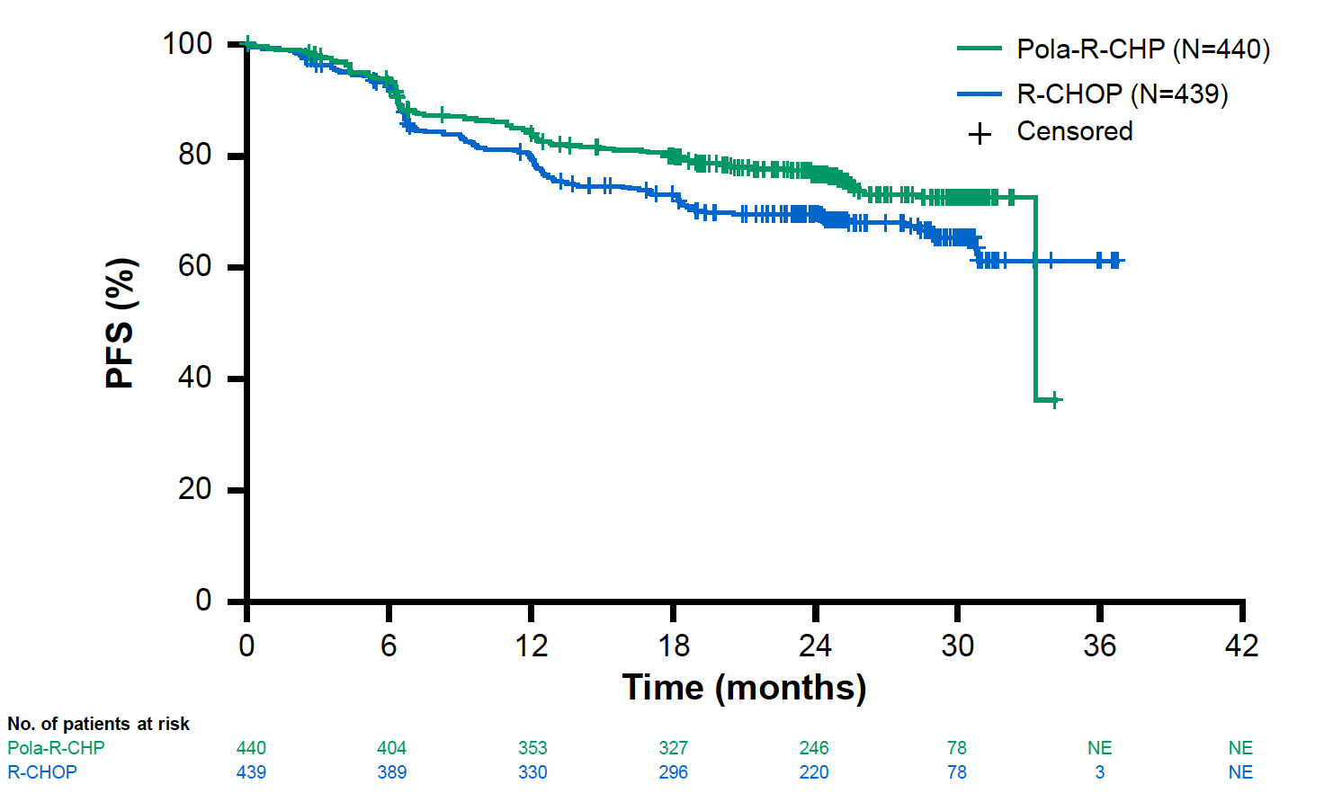
RESULTS
Efficacy
Pola-R-CHP significantly improved PFS versus R-CHOP, with a 27% reduction in the relative risk of disease progression, relapse, or death and an absolute improvement of 6.5% at 24 months
EFS was improved as well (HR 0.75, p=0.02)
OS was comparable in both arms (HR 0.94, p=0.75); the final OS analysis is expected in 2022
Progression-free survival
 | Pola-R-CHP (n=440) | R-CHOP (n=439)
24-month PFS | 76.7% | 70.2%
Stratified HR (95% CI) | 0.73 (0.57-0.95) P<0.02
Safety
The safety profile was comparable in both arms, except an increased rate of diarrhoea and febrile neutropenia with Pola-R-CHP
No difference in neuropathy or dose adjustments/discontinuations due to adverse events
CI, confidence interval; EFS, event-free survival; HR, hazard ratio; OS; overall survival; PFS, progression-free survival; Pola-R-CHP, polatuzumab vedotin, rituximab, cyclophosphamide, doxorubicin, prednisone; R-CHOP, rituximab, cyclophosphamide, doxorubicin, vincristine, prednisone
Tilly H, et al. ASH Annual Meeting 2021. Abstract #LBA-1. Oral presentation

Slide 8
Author Conclusions and Clinical interpretation
Pola-R-CHP significantly prolongs PFS vs R-CHOP in intermediate-and high-risk previously untreated DLBCL, with a comparable safety profile
These results support Pola-R-CHP as initial treatment of DLBCL IPI 2+
DLBCL, diffuse large B-cell lymphoma; IPI, international prognostic index; PFS, progression-free survival; Pola-R-CHP, polatuzumab vedotin, rituximab, cyclophosphamide, doxorubicin, prednisone; R-CHOP, rituximab, cyclophosphamide, doxorubicin, vincristine, prednisone
Tilly H, et al. ASH Annual Meeting 2021. Abstract #LBA-1. Oral presentation

Slide 9
SEcond-line treatment of DLBCL

Slide 10
Data on CAR-T cell therapy in lBCL presented at ASH 2021
TRANSFORM¹
BELINDA³
Liso-cel vs SOC with salvage CT followed by ASCT as 2L treatment in R/R LBCL
ZUMA-7²
Axi-cel vs SOC in R/R LBCL
Tisa-cel vs SOC in primary refractory or relapsed aggressive B-cell NHL
Negative trial: tisa-cel did not show a higher EFS vs SOC
Three phase 3 trials
Positive trial
Positive trial
2L, second-line; ASCT, autologous stem cell transplantation; axi-cel, axicabtagene ciloleucel; CAR, chimeric antigen receptor; CT, chemotherapy; EFS, event-free survival; LBCL, large B-cell lymphoma; liso-cel, lisocabtagene maraleucel; NHL, non-Hodgkin lymphoma; R/R, relapsed or refractory; SOC, standard of care; tisa-cel, tisagenlecleucel
1. Kamdar M, et al. ASH Annual Meeting 2021. Abstract #91. Oral presentation; 2. Locke FL, et al. ASH Annual Meeting 2021. Abstract #2. Oral presentation; 3. Bishop MR, et al. ASH Annual Meeting 2021. Abstract #LBA-6

Slide 11
liso-cel, a CD19-Directed CAR-T Cell Therapy, Vs SOC with Salvage CT Followed By ASCT As 2L Treatment in Pts with R/R LBCL:
Results from the Randomized Phase 3 Transform Study
Kamdar M, et al.
ASH Annual Meeting 2021. Abstract #91. Oral presentation
2L, second-line; ASCT, autologous stem cell transplantation; CAR, chimeric antigen receptor; CT, chemotherapy; LBCL, large B-cell lymphoma; liso-cel, lisocabtagene maraleucel; PTS, patients; R/R, relapsed or refractory; SOC, standard of care

Slide 12
study design
phase 3 TRANSFORM trial:
liso-cel vs SOC as 2L therapy in R/R LBCL
PET^{b}
LDC^{c}
Key eligibility
Age 18-75 years
Aggressive NHL
  DLBCL NOS (de novo or transformed
  from indolent NHL), HGBCL
  (double/triple hit) with DLBCL
  histology, FL3B, PMBCL, THRBCL
R/R ≤12 months after
1L treatment containing an
anthracycline and a CD20-targeted agent
ECOG PS ≤1
Eligible for HSCT
Secondary CNS lymphoma allowed
LVEF >40% for inclusion
No minimum absolute lymphocyte count
Bridging
therapy
allowedª
Liso-cel arm
(100 × 10⁶ CAR⁺ T-cells)
Response
assessments
Weeks 9 and 18
Months 6, 9, 12, 18,
24 and 36
Primary endpoint
EFS (per IRC)
Key secondary endpoints
CR rate, PFS, OS
Other secondary endpoints
Duration of response, ORR,
PFS on next line of treatment
Safety, PROs
Exploratory endpoints
Cellular kinetics
B-cell aplasia
Stratification
Refractory vs relapsed
sAAIPI: 0/1 vs 2/3
Screening + leukapheresis
1:1 Randomisation
SOC arm^{d}
3 cycles of salvage CT,
followed by HDCT + ASCT
Crossover to liso-cel allowed
Failure to respond by 9 weeks post-randomisation
PD at any time
Start of new antineoplastic therapy after ASCT
ª Patients may have received a protocol-defined SOC regimen to stabilise their disease during liso-cel manufacturing
^{b} Only for patients who received bridging therapy
^{c} Lymphodepletion with fludarabine 30 mg/m² and cyclophosphamide 300 mg/m² for 3 days
^{d} SOC was defined as physician’s choice of R-DHAP, R-ICE, or R-GDP
1L, first-line; 2L, second-line; ASCT, autologous stem cell transplantation; CAR, chimeric antigen receptor; CNS, central nervous system; CR, complete response; CT, computed tomography; DLBCL, diffuse large B-cell lymphoma; ECOG PS, Eastern Cooperative Oncology Group performance status; EFS, event-free survival; FL3B, follicular lymphoma grade 3B; HDCT, high-dose chemotherapy; HGBCL, high-grade B-cell lymphoma; HSCT, haematopoietic stem cell transplantation; IRC, independent review committee; LBCL, large B-cell lymphoma; LDC, lymphodepleting chemotherapy; liso-cel, lisocabtagene maraleucel; LVEF, left ventricular ejection fraction; NHL, non-Hodgkin lymphoma; NOS, not otherwise specified; ORR, overall response rate; OS, overall survival; PD, progressive disease; PET, positron emission tomography; PFS, progression-free survival; PMBCL, primary mediastinal large B-cell lymphoma; PRO, patient-reported outcome; R-DHAP, rituximab, dexamethasone, cytarabine, cisplatin; R-GDP, rituximab, gemcitabine, dexamethasone, cisplatin; R-ICE, rituximab, ifosfamide, carboplatin, etoposide phosphate; R/R, relapsed or refractory; sAAIPI, secondary age-adjusted International Prognostic Index; SOC, standard of care; THRBCL, T-cell/histiocyte-rich large B-cell lymphoma; Kamdar M, et al. ASH Annual Meeting 2021. Abstract #91. Oral presentation

Slide 13
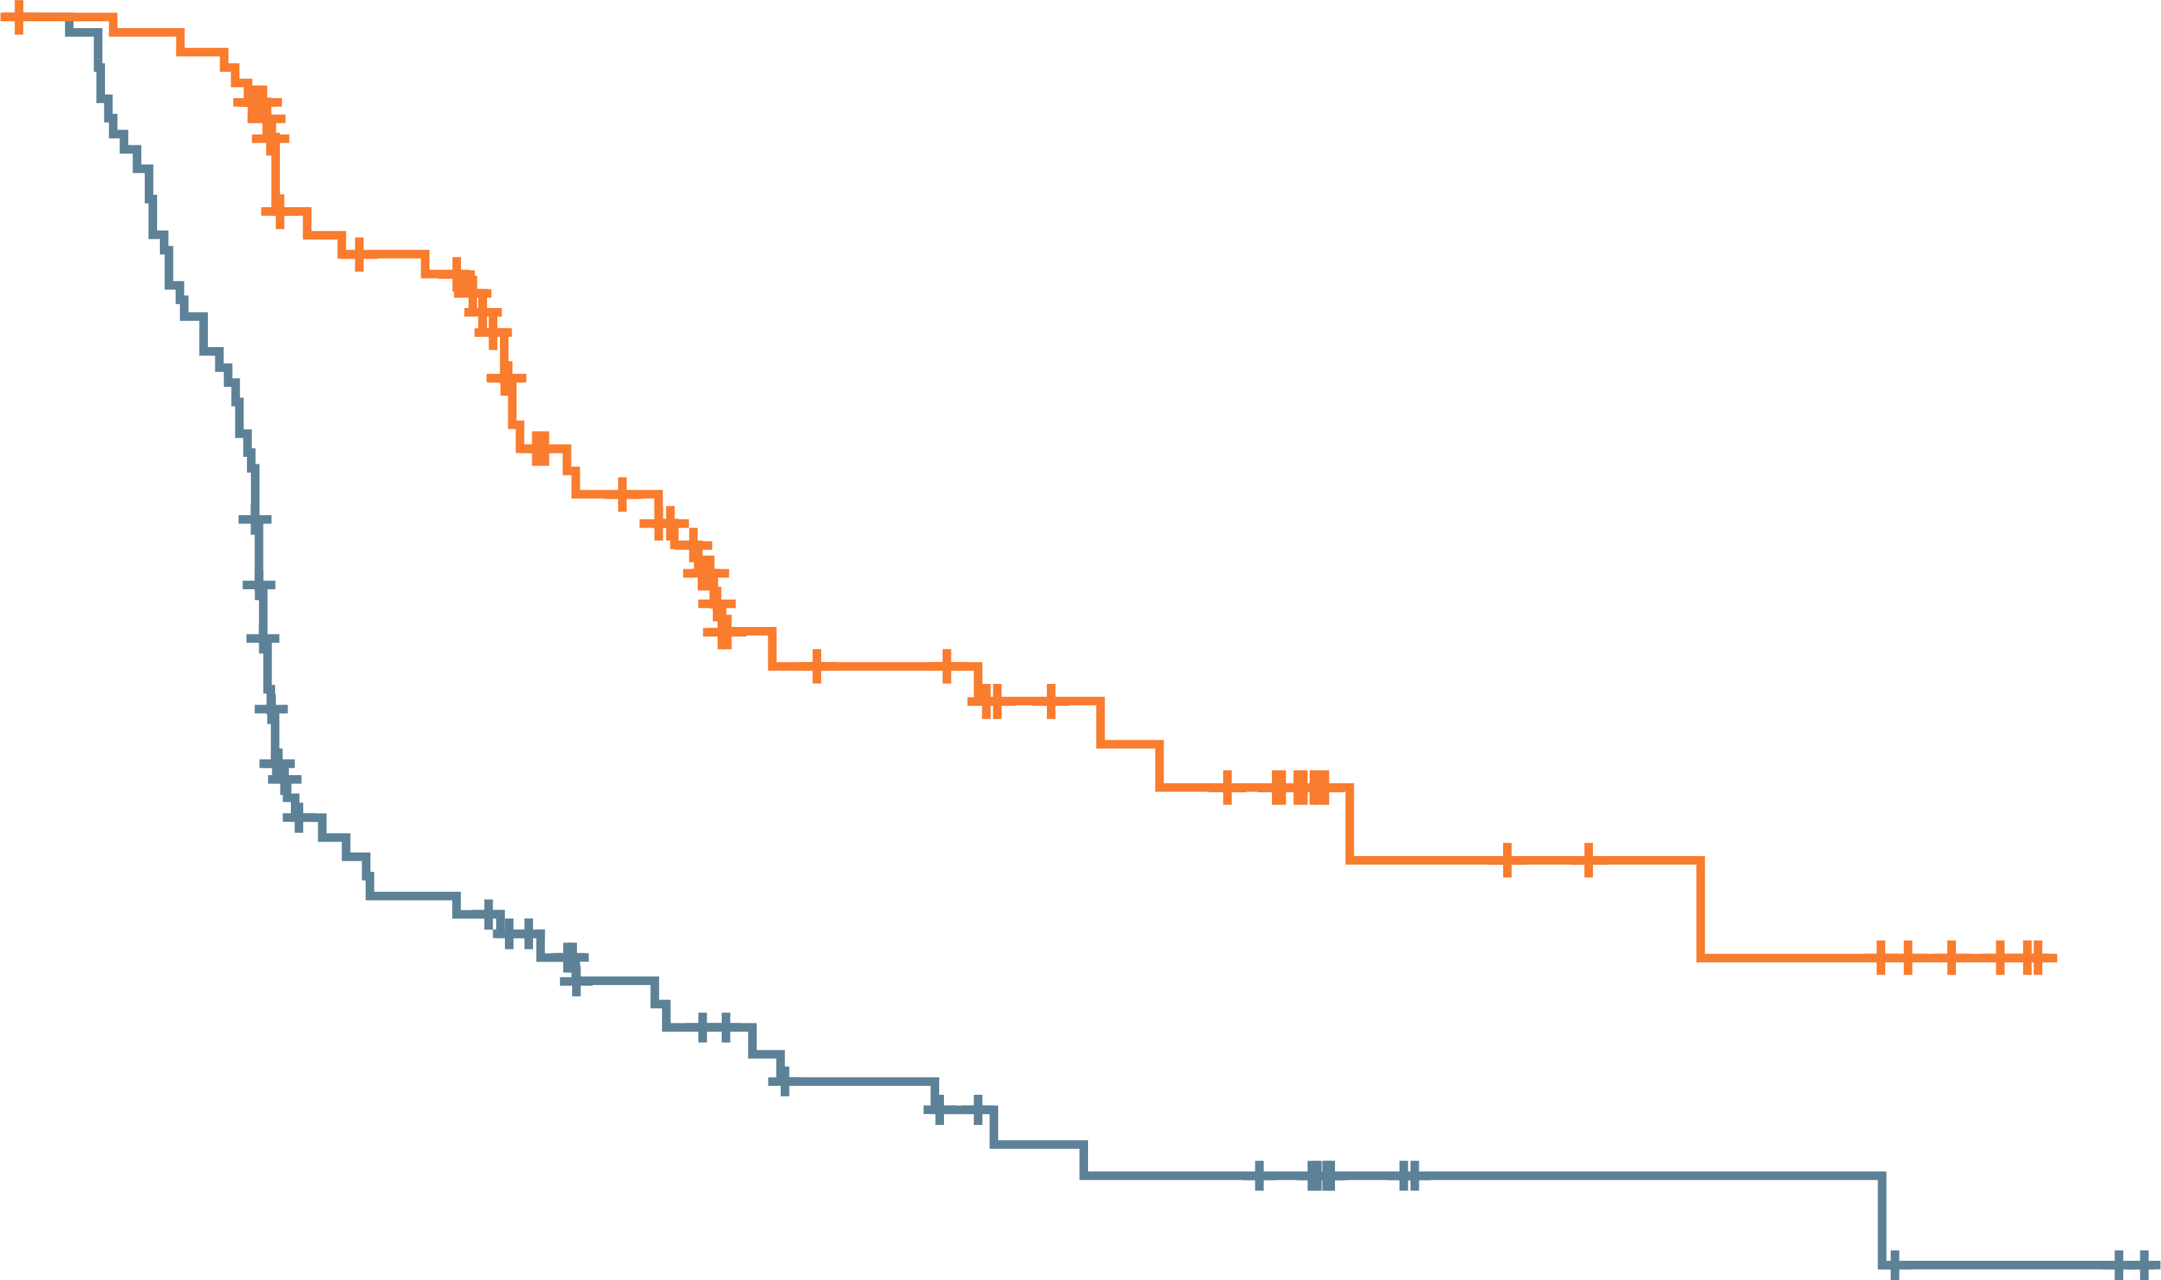
RESULTS
Efficacy
Liso-cel demonstrated superiority over SOC, with highly statistically significant and clinically meaningful improvements in EFS, CR rate, and PFS
  The primary EFS endpoint was met, representing a 65% reduction in risk of events
  CR rate was 66% vs 39% (p<0.0001)
  Median PFS was 14.8 vs 5.7 months (HR 0.406;
  p=0.0001
The median OS was not reached with liso-cel vs
16.4 months for SOC (HR 0.509; p=0.0257)
  Not significant per protocol statistics
Event-free survival
100
 | Liso-cel arm (n=92) | SOC arm (n=92)
Patients with events, n | 35 | 63
Stratified HR (95% CI) | 0.349 (0.229-0.530) p<0.0001
90
80
70
60
Event-free survival (%)
50
40
30
Median follow-up in both arms: 6.2 months
20
10
SOC median EFS:
2.3 months
95% CI, 2.2-4.3
Liso-cel median EFS:
10.1 months
95% CI, 6.1-NR
0
0
1
2
3
4
5
6
7
8
9
10
11
12
13
14
15
16
17
18
19
No. at risk
Liso-cel arm
SOC arm
Time from randomisation (months)
92 | 89 | 86 | 66 | 62 | 43 | 36 | 27 | 26 | 21 | 19 | 17 | 9 | 9 | 7 | 6 | 6 | 4 | 0
92 | 83 | 66 | 35 | 32 | 23 | 21 | 16 | 16 | 12 | 11 | 10 | 6 | 4 | 4 | 4 | 4 | 2 | 2 | 0
Safety
Consistent with the safety profile in ≥3L LBCL
  1 case of grade 3 CRS; no grade 4/5 events
  12% neurological events (4% grade 3)
3L, third-line; CI, confidence interval; CR, complete response; CRS, cytokine release syndrome; EFS, event-free survival; HR, hazard ratio; LBCL, large B-cell lymphoma; NR, not reached; OS, overall survival; PFS, progression-free survival; SOC, standard of care
Kamdar M, et al. ASH Annual Meeting 2021. Abstract #91. Oral presentation

Slide 14
Author Conclusions
Liso-cel improved outcomes versus salvage CT followed by HDCT and ASCT and exhibited a favourable safety profile
TRANSFORM data support liso-cel as a potential new 2L standard of care in early relapsing or refractory LBCL
2L, second-line; ASCT, autologous stem cell transplantation; CT, computed tomography; HDCT, high-dose chemotherapy; LBCL, large B-cell lymphoma
Kamdar M, et al. ASH Annual Meeting 2021. Abstract #91. Oral presentation

Slide 15
Primary Analysis of ZUMA‑7:
A Phase 3 Randomised Trial of
Axi-Cel Vs SOC Therapy in PTS with R/R LBCL
Locke FL, et al.
ASH Annual Meeting 2021. Abstract #2. Oral presentation
Axi-cel, axicabtagene ciloleucel; LBCL, large B-cell lymphoma; PTS, patients; R/R, relapsed or refractory; SOC, standard of care

Slide 16
study design
phase 3 ZUMA-7 trial:
Axi-Cel Vs SOC as 2L Therapy in R/R LBCL
R/R LBCL
N=359
77 sites
Key eligibility:
Aged ≥18 y
LBCL
R/R ≤12 mo of 1L therapyª
Intended to proceed to
HDT-ASCT
Stratification:
Response to 1L therapy
Second-line age-adjusted
IPI (sAAIPI)
Optional steroid-only bridging (no chemotherapy)
Primary endpoint:
Event-free survival^{e} by blinded central review
Key secondary endpoints:
ORR
OS
Secondary endpoints:
PFS
Safety
PROs
No protocol-specified crossover
Axi-Cel (n=180)
Conditioning
chemotherapy +
axi-cel^{b}
Day 100 assessment
Day 150 assessment
1:1 Randomisation
Initial disease assessment (Day 50)
LTFU assessment
Responders
(CR or PR)
Proceed to
HDT-ASCT
SOC (n=179)
Investigator-selected
platinum-based
chemoimmunotherapy^{c}
Cycle 1
Cycle 2
Cycle 3
(optional)
Nonresponders
Additional
treatment off
protocol^{d}
ª Refractory disease was defined as no CR to 1L therapy; relapsed disease was defined as CR followed by biopsy-proven disease relapse ≤12 months from completion of 1L therapy
^{b} Axi-cel patients underwent leukapheresis followed by conditioning chemotherapy with cyclophosphamide (500 mg/m²/day) and fludarabine (30 mg/m²/day) 5, 4, and 3 days before receiving a single axi-cel infusion (target intravenous dose, 2 × 10⁶ CAR T cells/kg)
^{c} Protocol-defined SOC regimens included R-GDP, R-DHAP, R-ICE, or R-ESHAP
^{d} 56% of patients received subsequent cellular immunotherapy
^{e} EFS was defined as time from randomisation to the earliest date of disease progression per Lugano Classification, commencement of new lymphoma therapy, or death from any cause
1L, first-line; 2L, second-line; ASCT, autologous stem cell transplantation; axi-cel, axicabtagene ciloleucel; CAR, chimeric antigen receptor; CR, complete response; EFS, event-free survival; HDT, high-dose therapy; LBCL, large B-cell lymphoma; LTFU, long-term follow-up; mo, month; ORR, overall response rate; OS, overall survival; PFS, progression-free survival; PR, partial response; PRO, patient-reported outcome; R/R, relapsed or refractory; SOC, standard of care; R-DHAP, rituximab, dexamethasone, cytarabine, cisplatin; R-ESHAP, rituximab, etoposide, methylprednisolone, cytarabine, cisplatin; R-GDP, rituximab, gemcitabine, dexamethasone, cisplatin; R-ICE, rituximab, ifosfamide, carboplatin, etoposide phosphate; sAAIPI, secondary age-adjusted International Prognostic Index
Locke FL, et al. ASH Annual Meeting 2021. Abstract #2. Oral presentation

Slide 17
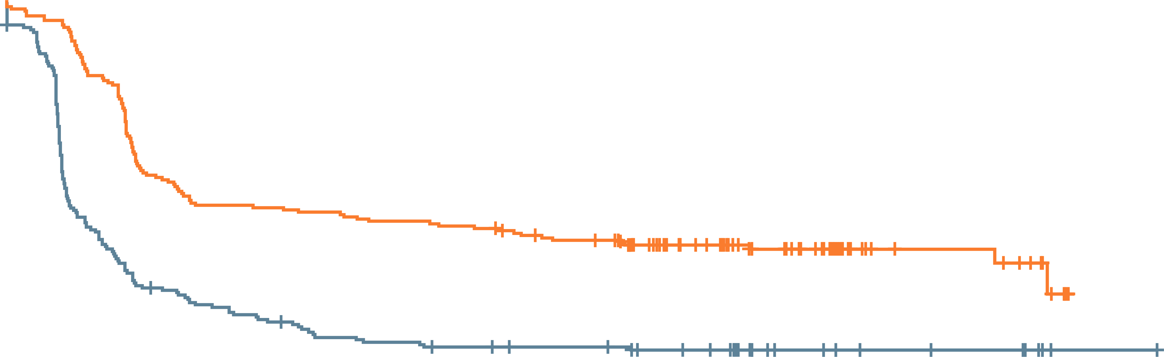
RESULTS
Efficacy
Axi-cel showed superior efficacy versus 2L SOC
  >4-fold greater median EFS (8.3 vs 2.0 months)
  Nearly 2.5-fold greater 2‐year EFS (40.5% vs 16.3%)
  33% higher ORR (83% vs 50%)
  Double the CR rate (65% vs 32%)
The median OS was not reached with axi-cel vs
35.1 months for SOC (HR 0.73; p=0.027)
Nearly 3 times more patients in the axi-cel arm
received definitive therapy vs the SOC arm
Event-free survival
HR 0.398 (95% CI, 0.308-0.514); p<0.0001
100
 | Median EFS (95% CI), mo | 24-mo EFS rate (95% CI), %
Axi-cel (n=180) | 8.3 (4.5-15.8) | 40.5 (33.2-47.7)
SOC (n=179) | 2.0 (1.6-2.8) | 16.3 (11.1-22.2)
80
60
Event-free survival (%)
Median EFS
40
8.3 mo
20
2.0 mo
0
Median follow-up 24.9 mo
0
2
4
6
8
10
12
14
16
18
20
22
24
26
28
30
32
34
No. at risk
Axi-cel
SOC
Months
180 | 163 | 106 | 92 | 91 | 87 | 85 | 82 | 74 | 67 | 52 | 40 | 26 | 12 | 12 | 6
179 | 86 | 54 | 45 | 38 | 32 | 29 | 27 | 25 | 24 | 20 | 12 | 9 | 7 | 6 | 3 | 1 | 0
Safety
Consistent with the safety profile in previous studies
  92% CRS (6% grade 3/4) with axi-cel
  60% neurological events (21% grade 3/4) with axi-cel vs 20% (1% grade 3/4) with SOC
2L, second-line; CI, confidence interval; CR, complete response; CRS, cytokine release syndrome; EFS, event-free survival; HR, hazard ratio; mo, month; ORR, overall response rate; OS, overall survival; SOC, standard of care
Locke FL, et al. ASH Annual Meeting 2021. Abstract #2. Oral presentation

Slide 18
Author Conclusions
ZUMA-7 represents a paradigm shift
Axi-cel should be the new standard in 2L treatment of early relapsing or refractory LBCL
2L, second-line; LBCL, large B-cell lymphoma
Locke FL, et al. ASH Annual Meeting 2021. Abstract #2. Oral presentation

Slide 19
Clinical interpretation
CAR-T therapy will become a standard of care in the treatment of high-risk, early relapsing or refractory LBCL
Trial design, as well as differences in costimulatory domains between the different cellular products, may have impacted the negative outcome of the BELINDA trial
CAR, chimeric antigen receptor; LBCL, large B-cell lymphoma; R/R, relapsed or refractory

Slide 20
Follicular lymphoma

Slide 21
Mosunetuzumab Monotherapy Is an Effective and Well-Tolerated Treatment Option for Pts with R/R FL Who Have Received ≥ 2 Prior Lines of Therapy: Pivotal Results from a Phase I/II Study
Budde EL, et al.
ASH Annual Meeting 2021. Abstract #127. Oral presentation
FL, follicular lymphoma; PTS, patients; R/R, relapsed or refractory

Slide 22
study design
Single-arm Phase 2 expansion trial of Mosunetuzumab Monotherapy
in R/R FL after ≥2 prior therapies
Key eligibility criteria:
FL (Grade 1-3a)
ECOG PS 0-1
≥2 prior regimens, incl:
  ≥1 anti-CD20 Ab
  ≥1 alkylating agent
Mosunetuzumab iv
Q3W
C1 step-up dosing (CRS mitigation)
Fixed-duration treatment: 8 cycles if CR after C8 / 17 cycles if PR/SD after C8
No mandatory hospitalisation
Primary endpoint:
CR (best response) rate by IRFª –assessed vs 14% historical control CR rate
Key secondary endpoints:
ORR
DoR
PFS
Safety and tolerability
D15:
60 mg
D1:
60 mg
21-day cycles
D8:
2 mg
D1:
30 mg
D1:
30 mg
D1:
1 mg
C1
C2
C3
C8 / C17
ª Assessed by CT and PET-CT using Cheson 2007 criteria
Ab, antibody; C, Cycle; CR, complete response; CRS, cytokine release syndrome; CT, computed tomography; D, Day; DoR, duration of response; ECOG PS, Eastern Cooperative Oncology Group performance status; FL, follicular lymphoma; IRF, independent review facility; ORR, objective response rate; PET, positron emission tomography; PFS, progression-free survival; PR, partial response; Q3W, once every 3 weeks; R/R, relapsed or refractory; SD, stable disease
Budde EL, et al. ASH Annual Meeting 2021. Abstract #127. Oral presentation

Slide 23
RESULTS
Baseline characteristics
˜50% of the 90 patients included were double refractory to anti-CD20 and alkylator therapy
˜50% were POD24
Efficacy
The primary endpoint was met: the CR rate with mosunetuzumab was significantly greater than historical controls
    CR rate: 60% vs 14% in historical controls (p<0.0001)
ORR rate: 80%
Median DoR: 22.8 months (95% CI: 9.7, NE)
Median PFS: 17.9 months (95% CI: 10.1, NE)
Safety
44% CRS (1.1% grade 3 and 1.1% grade 4); primarily occurring in Cycle 1. All events resolved
4.4% ICANS (all grade 1/2)
CI, confidence interval; CR, complete response; CRS, cytokine release syndrome; DoR, duration of response; NE, not estimable; ORR, objective response rate; PFS, progression-free survival; POD24, progression of disease within 2 years; ICANS, immune effector cell-associated neurotoxicity syndrome
Budde EL, et al. ASH Annual Meeting 2021. Abstract #127. Oral presentation

Slide 24
Author Conclusions and Clinical interpretation
Fixed-duration mosunetuzumab monotherapy resulted in deep and durable responses in heavily pre-treated/high-risk R/R FL
Mosunetuzumab is the first T-cell-engaging
bispecific antibody to demonstrate clinically meaningful phase 2 outcomes in R/R FL
Mosunetuzumab is a potentially promising
off-the-shelf, outpatient therapy
FL, follicular lymphoma; R/R, relapsed or refractory
Budde EL, et al. ASH Annual Meeting 2021. Abstract #127. Oral presentation

Slide 25
REACH LYMPHOMA & MYELOMA CONNECT
VIA TWITTER, LINKEDIN, VIMEO & EMAIL
OR VISIT THE GROUP’S WEBSITE https://lymphomamyelomaconnect.cor2ed.com/
Follow us on Twitter
@LYM_MM_CONNECT
Follow the
LYMPHOMA & MYELOMA CONNECT
group on LinkedIn
Watch us on the
Vimeo Channel
LYMPHOMA & MYELOMA CONNECT
Email
froukje.sosef
@cor2ed.com

