Slide 2
Symptomatic control of functioning pancreatic NET
Dr. Wouter T. Zandee, MD, PhD
University Medical Center Groningen, The Netherlands
December 2020

Slide 3
Disclaimer and disclosures
Please note: The views expressed within this presentation are the personal opinions of the author.
They do not necessarily represent the views of the author’s academic institutions or the rest of the
NET CONNECT group.
This content is supported by an independent educational grant from Ipsen.
Dr. Wouter Zandee has no relevant financial relationships to disclose.

Slide 4
BACKGROUND Pancreatic NET
Pancreatic neuroendocrine tumours (panNETs) account for approx. 1-2% of all pancreatic tumours
PanNETS can be divided into 2 groups based on the functional activity of the tumour:
  Functioning pancreatic NET
  Non-functioning pancreatic NET
Around 60-90% of panNETs are non-functioning and often only diagnosed as a result of an incidental finding for a different indication
Functioning panNETs secrete active hormones, most commonly insulin or gastrin, leading to symptoms even when the tumour is small
Functioning panNET, include:
  Insulinoma – secrete insulin. Signs/symptoms: hypoglycaemia
  Glucagonoma – secrete glucagon. Signs/symptoms: diabetes mellitus, necrolytic migratory erythema, deep vein thrombosis and depression
  Gastrinoma (Zollinger-Ellison Syndrome) – secrete gastrin. Signs/symptoms: gastroesophageal reflux, peptic ulcers, diarrhoea
  VIPoma – produce vasoactive intestinal peptide. Signs/symptoms: watery diarrhoea, achlorhydria, and hypokalaemia
Rare functioning panNET: somatostatinoma, cholecystokinin-producing tumours (CCKoma), ghrelinoma
NET, neuroendocrine tumour
Falconi M, et al. Neuroendocrinology. 2016;103:153-71; Hopper A, et al. Frontline Gastroenterol. 2019;10:269-74; Bartolini I, et al. Gastroenterol Res Pract 2018: doi.org/10.1155/2018/9647247; Rehfeld J, et al. Scand J Gastroenterol 2016; 51: 1172-1178; Tsolakis A, et al. J Clin Endocrinol Metab 2004, 89: 3739–3744; Zandee W, et al. https://www.ncbi.nlm.nih.gov/books/NBK279041/

Slide 5
Diagnosis of functioning panNET
Clinical syndrome in combination with inappropriately increased hormone
Not diagnostic:
Immunohistochemical staining of hormones on tumour specimen
Screening for elevated hormones without clinical syndrome
panNET, pancreatic neuroendocrine tumour
Falconi M, et al. Neuroendocrinology 2012; 95; 120-134; Falconi M, et al. Neuroendocrinology. 2016;103:153-71; Hofland J, et al. Nat Rev Endocrinol. 2018;14:656-69

Slide 6
Diagnosis – FUNCTIONING pannet
INSULINOMA
VIPoma
GLUCAGONOMA
Either spontaneous or during
72-hour fast:
Blood glucose levels
≤2.1 mmol/l
insulin levels >18 pmol/l
C-peptide levels ≥0.2 nmol/l
proinsulin levels ≥5 pmol/l;
β-hydroxybutyrate levels
≤2.7 mmol/l
Negative screening of OHA (eg.no sulfonylurea metabolites) in the plasma and/or urine
VIP levels 1-3 × upper limit of normal (ULN) considered inconclusive: re-test
Diagnostic for VIPoma:
plasma VIP levels
>3 × ULN are considered indicative of a VIP-producing tumour
Fasting plasma glucagon
>500 pg/ml (reference range, 70-160 pg/ml) is diagnostic for glucagonoma
panNET, pancreatic neuroendocrine tumour; OHA, oral hypoglycaemic agents; ULN, upper limit of normal; VIP, vasoactive intestinal peptide
Falconi M, et al. Neuroendocrinology. 2016;103:153-71; Hofland J, et al. Nat Rev Endocrinol. 2018;14:656-69; Zandee W, et al. https://www.ncbi.nlm.nih.gov/books/NBK279041/; de Herder W, et al. https://www.ncbi.nlm.nih.gov/books/NBK278981/Accessed 27-Nov-20; Bloom, SR. Am J Dig Dis 1978;23:373-6; Cryer P, et al. JCEM 2009; 94: 709-728

Slide 7
Diagnosis of gastrinoma
Zollinger-Ellison Syndrome
Suspicion of ZES
Measure FSG level
Not elevated
<1% ZES
Elevated
>99% ZES
ZES unlikely, but if strong
clinical suspicion, perform
gastrinoma resection
ZES possible
Measure gastric PH
Repeat FSG measurement
PH ≤2
PH >2
Not elevated, but still
suspicion of basal acid
output, perform secretin test
FSG >10×
increased
FSG <10×
increased
On acid-suppressive drug
R/O retained
antrum by history
Prov. test (Secretin test if
possible), basal acid output
Yes
No
➝
Try dose/ interval
➝
Not ZES
? Atrophic gastritis
? H. pylori
ZES
Positive
If not successful, refer
to speciality center
or
Taper and/or start H₂RA
(high dose), stop PPI,
repeat pH, FSG
Assess for MEN1 (plasma PTH, ionised Ca²⁺, prolactin)
Tumour localisation/staging
CT/MRI, SRS
BAO, basal acid output; CT, computerized tomography; FSG, fasting serum gastrin; H2RA, H2 receptor antagonist; MEN1, multiple endocrine neoplasia type 1; MRI, magnetic resonance imaging; PPI, proton pump inhibitor; PTH, parathyroid hormone; R/O, rule out; SRS, stereotactic radiosurgery; ZES, Zollinger-Ellison Syndrome
Falconi M, et al. Neuroendocrinology. 2016;103:153-71

Slide 8
Treatment options
If radical resection is feasible: curative surgery is recommended
Metastatic/non-resectable panNET:
  Combination of anti-proliferative and anti-hormone therapies
Symptom control is essential:
  Signs and symptoms of a functional pancreatic NET depend on the type of hormone being made
  Excessive secretion of hormones can impair a patient’s quality of life and prognosis
  Symptomatic control is required to safely perform surgery or treat with systemic therapy
NET, neuroendocrine tumour; panNET, pancreatic neuroendocrine tumour
Pavel M, et al. Neuroendocrinology. 2016;103:172-85; Falconi M, et al. Neuroendocrinology. 2016;103:153-71; Akirov A, et al. Cancers 2019; 11; 828; doi:10.3390/cancers11060828

Slide 9
Functioning panNET: first-line therapy
SOMATOSTATIN ANALOGUES
Antiproliferative effect in panNET¹
  lanreotide (120 mg every 4 weeks) significantly prolonged PFS compared with placebo [HR 0.47*, (95% CI 0.30-0.73)]
Low toxicity¹
SSAs reduces hormone secretion in approx. 50-70% of patients²
Consider dose escalation, if standard dosing proves ineffective
  An increased dose frequency of lanreotide (120 mg every
  14 days) demonstrated favourable PFS and DCR data³
Insulinoma: some SSAs also decreases glucagon secretion^{4,6}
In a minority of insulinoma patients SSA increases hypoglycemia⁵
  initiate treatment with short-acting octreotide in a clinical setting⁶
CLARINET TRIAL: PFS
*HR for progression or death
CI, confidence interval; DCR, disease control rate; HR, hazard ratio; panNET, pancreatic neuroendocrine tumour; PFS, progression free survival; SSA, somatostatin analog; sc, subcutaneous
1. Caplin M, et al. N Engl J Med. 2014;371:224-33; 2. Grozinsky-Glasberg S, et al. Endocr Relat Cancer. 2008;15:701-20; 3. Pavel M, et al. ESMO 2020. Abstract #1162MO. Mini oral presentation; 4. Lins P-E, et al. Metabolism 1980; 29; 728-731; 5. Kulke M, et al. Pancreas 2010;39:735-52; 6. Akirov A, et al. Cancers 2019; 11; 828; doi:10.3390/cancers11060828

Slide 10
Insulinoma: symptomatic treatment
MANAGING hypoglycaemia
Dietary management
Frequent meals, slowly absorbable carbohydrates
Diazoxide inhibits the release of insulin by β cells
Stimulates gluconeogenesis
Side effects: sodium retention (treated with thiazide-diuretic), hirsutism
de Herder W, et al. https://www.ncbi.nlm.nih.gov/books/NBK278981/Accessed 27-Nov-20; https://www.drugs.com/sfx/diazoxide-side-effects.html. Accessed 08-Dec-2020

Slide 11
OTHER Functional panNET: symptomatic treatment
Gastrinoma – gastric acid hypersecretion:
Protonpump inhibitors
VIPoma
Replacement of fluid and electrolyte losses
Glucagonoma
Correct malnutrition and hyperglycaemia
Consider low-molecular weight heparin to prevent venous thrombosis
panNET, pancreatic neuroendocrine tumour
Falconi M, et al. Neuroendocrinology. 2016;103:153-71; Hopper A, et al. Frontline Gastroenterology. 2019;10:269-74; Vinik, A. https://www.ncbi.nlm.nih.gov/books/NBK278960/. Accessed 27-Nov-20; Zandee W, et al. https://www.ncbi.nlm.nih.gov/books/NBK279041/. Accessed 27-Nov-20

Slide 12
Functioning panNET: Second-line therapy
If first-line treatment with SSAs do not provide adequate control of symptoms or after radiological progression, then consider (depending on local availability and patient characteristics):
PRRT with Lu¹⁷⁷-DOTATATE
Targeted therapies – everolimus and sunitinib
Palliative debulking surgery – in the presence of unresectable liver metastases
Liver-directed therapies
Lu¹⁷⁷, lutetium 177; PRRT, peptide receptor radionuclide therapy; SSA, somatostatin analog
Falconi M, et al. Neuroendocrinology. 2016;103:153-71; Hopper A, et al. Frontline Gastroenterology. 2019;10:269-74; Andreasi V, et al. Curr Treat Options in Oncol 2020; 21: DOI 10.1007/s11864-020-00736-w

Slide 13
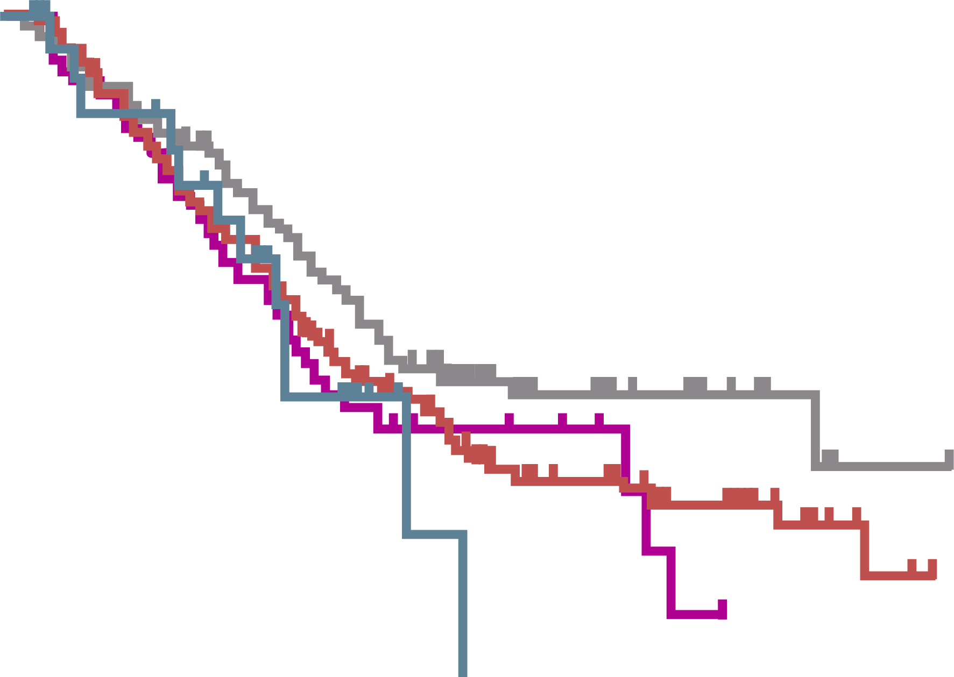
PROSPECTIVE, SINGLE-ARM TRIAL
Approx. 1,200 patients treated with PRRT
[¹⁷⁷Lu-DOTATATE] since the year 2000
Subgroup analysis n=443 (panNET=133)
  Treated with a cumulative dose of
  ≥600 mCi (22.2 GBq) ¹⁷⁷Lu-DOTATATE before 2013
panNET results
  Objective response: 55%
  median PFS: 30 months
Long-term toxicity: MDS: 1.5% / AML: 0.7%
MEDIAN OS BY LOCATION OF PRIMARY TUMOUR
100
Median overall survival
Bronchial: 52 months (95% CI 40-55)
Pancreatic: 71 months (95% CI 56-86)
Midgut: 60 months (95% CI 52-68)
Unknown: 53 months (95% CI 44-62)
Cumulative survival (%)
50
Bronchial
Midgut
Pancreatic
Unknown
0
0
50
100
150
200
Months
No. at risk
Bronchial
Midgut
Pancreatic
Unknown
23
181
133
82
10
92
71
31
0
28
17
7
0
7
4
0
AML, acute myeloid leukaemia; CI, confidence interval; Lu177, lutetium 177; MDS, myelodysplastic syndromes; OS, overall survival; panNET, pancreatic neuroendocrine tumour; PFS, progression free survival; PRRT, peptide receptor radionuclide therapy
Brabander T, et al. Clin Can Res. 2017;23:4617-24

Slide 14
PRRT: Lu¹⁷⁷-DOTATATE for functioning panNET
Functioning panNET can safely be treated with PRRT, however preventive therapy for hormone symptoms is required.
High Symptomatic and radiological response
Symptomatic response: 71%
Radiological response: 59%
Increased Quality of Life (EORTC QLQ-C30 )
Symptomatic response often persists despite
radiological progression
1,000
Gastrin
p=0.13
VIP
p=0.45
Glucagon
p=0.03
100
Hormone level (×ULN)
10
1
0.1
 | All (n=34) | Insulinoma (n=14) | Gastrinoma (n=7) | VIPoma (n=5) | Glucagonoma (n=8)
Symptomatic response N (%) | 17 (70.8) | 6 (66.7) | 2 (66.7) | 4 (80.0) | 5 (71.4)
Before PRRT
Before PRRT
Before PRRT
6 months after last PRRT
6 months after last PRRT
6 months after last PRRT
EORTC, European Organisation for Research and Treatment of Cancer; Lu177, lutetium 177; panNET, pancreatic neuroendocrine tumour; PRRT, peptide receptor radionuclide therapy; ULN, upper limit of normal; VIP, vasoactive intestinal peptide
Zandee W, et al. J Clin Endocrinol Metab. 2019;104:1336-44

Slide 15
Treatment: targeted therapy
Everolimus
Associated with reduced tumour proliferation in NET¹
Improves PFS in patients with advanced panNET
  11 months with everolimus vs 4.6 months with placebo¹
Insulinoma: control recurrent hypoglycaemia²
Potential reduction of glucagon and gastrin,³ associated with new onset diabetes⁴
Sunitinib
Improved PFS, OS, and ORR as compared with placebo among patients with advanced panNET. May be due to anti-apoptotic and antiproliferative effect⁵
VIPoma: reduction of diarrhoea in case reports⁶
Insulinoma: sunitinib might increase insulin secretion (increase of hypoglycaemias?)⁷
ORR, objective response rate; OS, overall survival; (pan)NET, (pancreatic)neuroendocrine tumour; PFS, progression free survival
1. Yao J, et al. N Engl J Med. 2011;364:514-23; 2. Bernard V, et al. Eur J Endocrinol. 2013;168:665-74; 3. Pavel M, et al. Pancreas 2017;46:751-7; 4. Vergès B, et al. Diabetes Research and Clinical Practice 2015; 110: 101-108; 5. Raymond E, et al. N Engl J Med. 2011;364:501-13; 6. de Mestier L, et al. Eur J Endocrinol. 2015;172:K1-3; 7. Thijs AM, et al. Br J Clin Pharmacol. 2016 2015;81:768-72

Slide 16
Liver-directed therapies
Severity of symptoms is often associated with tumour burden
Reduction of liver tumour burden could potentially reduce symptoms (from mass and hormonal hypersecretion)
Liver metastases can be resected or treated by (depending on local availability):
  Transarterial bland embolisation
  Radioembolisation/selective internal radiation therapy (SIRT)
  radiofrequency ablation (RFA)
  microwave and cryoablation
  high-intensity focused ultrasound (HIFU)
  Laser ablation
  brachytherapy and irreversible electroporation (IRE)
Frilling A, et al. Lancet Oncol. 2014;15(1):p.e8-21; Lee SY, et al. In J Hepatol 2012;2012:146590. doi:10.1155/2012/146590; de Herder W, et al. https://www.ncbi.nlm.nih.gov/books/NBK278981/Accessed 27-Nov-20

Slide 17
ConclusionS
Functioning panNETs are rare: adequate symptomatic control is essential
Treatment options
Reduce secretion: somatostatin analog often first line
Combine with specific symptomatic treatment (e.g diet for insulinoma)
Second-line: PRRT is especially effective for symptom control
panNET, pancreatic neuroendocrine tumour; PRRT, peptide receptor radionuclide therapy

Slide 18
REACH NET CONNECT VIA
TWITTER, LINKEDIN, VIMEO & EMAIL
OR VISIT THE GROUP’S WEBSITE http://www.net-connect.info
Follow us on Twitter
@net-connectinfo
Follow the
NET CONNECT
group on LinkedIn
Watch us on the
Vimeo Channel
NET CONNECT
Email
antoine.lacombe
@cor2ed.com

