Slide 2
young-Onset Colorectal Cancer: the nurse’s perspective
Natasha Pinheiro
Nurse Practitioner
Memorial Sloan Kettering Cancer Center
NY, USA

Slide 3
Introduction

Slide 4
Incidences of young-onset CRC are increasing worldwide
Age-standardised incidence rate during 2008-2012
for colorectal cancer among adults ages 20-49 years²
Incidence rate ratio by birth cohort in the United States¹
Korea (5 registries)
Australia
USA, SEER (9 registries)
Slovakia*
Japan (4 registries)
New Zealand
Netherlands
Canada†
Norway
Croatia
Slovenia
Ireland
Brazil, Goiania
Italy (8 registries)
Israel
Cyprus
Spain (9 registries)
Germany (2 registries)
Kuwait: Kuwaiti‡
Sweden
Bulgaria
Denmark
United Kingdom
France (9 registries)
Switzerland (6 registries)
Iceland‡
Philippines, Manila
Colombia, Cali‡
China (5 registries)
Malta
Turkey (2 registries)
Poland, Kielce
Austria
Bahrain, Bahraini‡
Estonia
Lithuania
Thailand (4 registries)
Costa Rica¶
Ecuador, Quito‡
Chile, Valdivia‡
Uganda, Kampala‡
India, Chennai
3.00
2.75
2.50
2.25
2.00
1.75
Incidence rate ratio
1.50
1.25
Shading indicates trend in incidence rates based on 10- year average annual per cent change
Statistically significant increase
1.00
Statistically significant decrease
Stable or insufficient number of
cases for trend analysis (‡)
1930
1940
1950
1960
1970
1980
1990
Birth cohort
Rate per 100,000
Rate for Finland unavailable.*Rate based on data during 2008-2010.†Excludes Nunavut, Quebec, and Yukon. ‡Excluded from trend analysis due to insufficient number of annual cases. ¶Rate based on data during 2008-2011.
CRC, colorectal cancer
1. Stoffel EM, Murphy CC. Gastroenterology. 2020;158:341–53; 2. Siegel RL, et al. Gut. 2019;68:2179–85

Slide 5
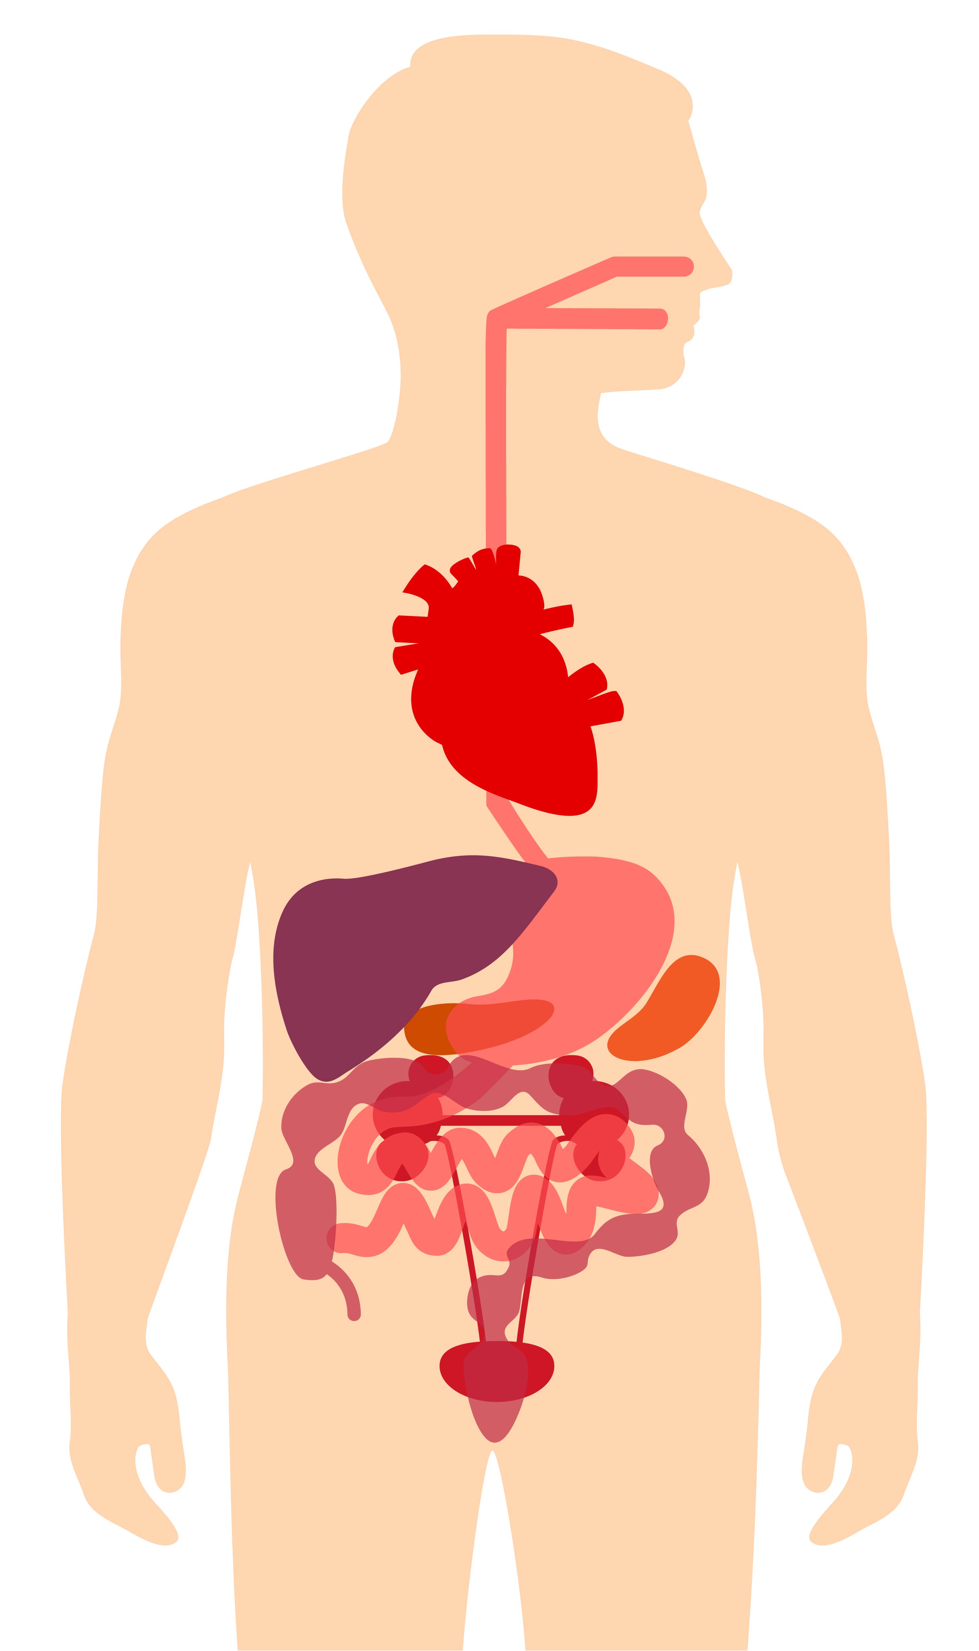
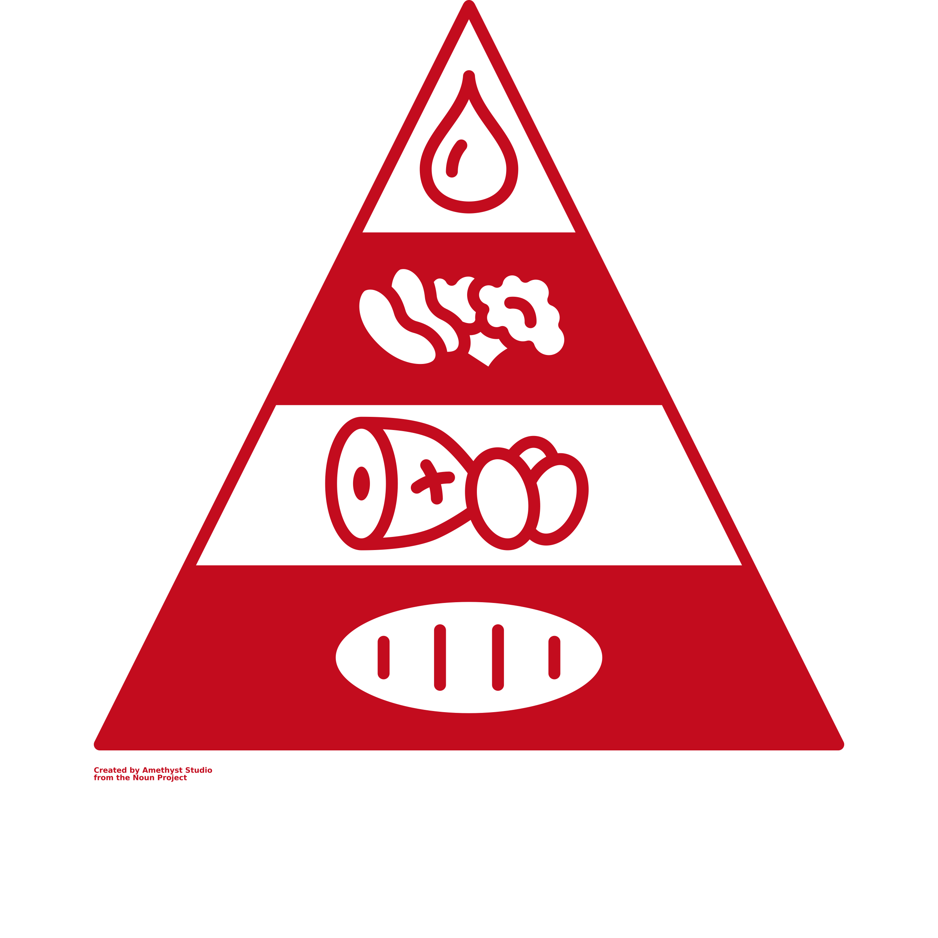


young-onset CRC: What is the aetiology?
Dietary intake has numerous effects on human health, including increasing risk of young-onset CRC^{1–3}
Studies in women have linked lifestyle and dietary factors to increased risk of young-onset CRC:
  Childhood intake of sugar sweetened beverages²
  Lower vitamin D intake³
  Sedentary lifestyle⁴
  Obesity⁵
1. Dietary intake
Protein, fat,
carbs, polyphenols,
pre/probiotics
4. Host disease
CVD, T2DM,
Obesity, Metabolic
syndrome,
Autoimmune disease
2. Altered
gut bacteria
Changes in
Bifidobacteria,
Lactobacilli,
Akkermansia,
etc.
3. Biologic effects
Alters host metabolism,
immune system
production
of pro- and anti-
inflammatory
metabolites
CRC, colorectal cancer; CVD, cardiovascular disease; T2DM, type 2 diabetes mellitus
1. Singh RK, et al. J Transl Med. 2017;15:73; 2. Hur J, et al. Gut. 2021;70:2330–2336; 3. Kim H, et al. Gastroenterology. 2021;161:1208–1217.e9; 4. Nguyen LH, et al. JNCI Cancer Spectrum. 2018;2pky073; 5. Liu P, et al. JAMA Oncol. 2019;5:37–44

Slide 6
young and average onset CRC
Are they different diseases?

Slide 7
Most CRC cases are sporadic, regardless of age
Prevalence of pathogenic variants by age at CRC diagnosis
Age <35 years
Age <50 years
Age >50 years
Lynch syndrome
Polyposis syndromes
Other variant
None
CRC, colorectal cancer
1. Stoffel EM, Murphy CC. Gastroenterology. 2020;158:341-53

Slide 8
Presenting symptoms are similar regardless of age of onset
Higher prevalence of rectal bleeding and abdominal pain in YO CRC
Frequency of symptoms (%)
AO, average onset; CRC, colorectal cancer; YO, young onset; GI, gastrointestinal
Cercek A, et al. J Natl Cancer Inst. 2021;113:1683-92

Slide 9
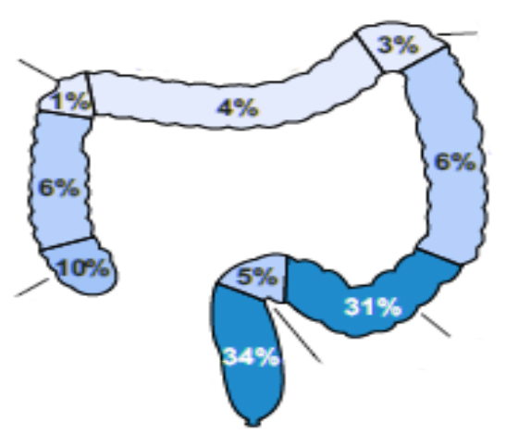
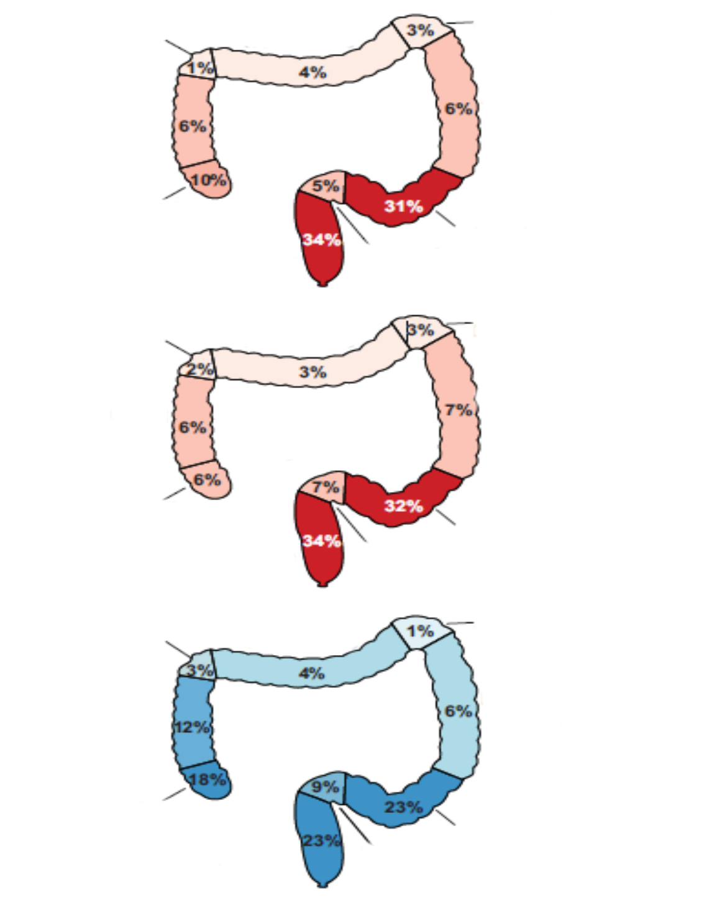
Clinical characteristics are similar regardless of age of onset
Percent of patients
Splenic
flexure
0%
25%
50%
75%
100%
Hepatic
flexure
Transverse
YO 14-35
YO 36-49
AO 50+
Gender
Female
Male
79%
Ascending
colon
Young onset
ages 14-35
Descending
colon
YO 14-35
YO 36-49
AO 50+
Race
White
Black or African American
Far-East Asian or Indian
Other
Not available
Cecum
Sigmoid
Rectum
Rectosigmoid
BMI
Underweight
Normal
Overweight
Obese
Not available
Hepatic
flexure
Transverse
Splenic
flexure
YO 14-35
YO 36-49
AO 50+
82%
Ascending
colon
Young onset
ages 36-49
Descending
colon
YO 14-35
YO 36-49
AO 50+
Smoking status
Never
Ever
Not available
Cecum
Sigmoid
Rectum
Rectosigmoid
YO 14-35
YO 36-49
AO 50+
Stage at diagnosis
Stage I
Stage II
Stage III
Stage IV
Hepatic
flexure
Transverse
Splenic
flexure
Ascending
colon
Descending
colon
62%
Average onset
Average onset
YO 14-35
YO 36-49
AO 50+
Tumour grade
Well-differentiated
Well-to-moderately-differentiated
Moderately-differentiated
Moderately-to-poorly-differentiated
Poorly-differentiated
Not available
Cecum
Sigmoid
Rectum
Rectosigmoid
No significant clinical or histological differences
Young onset less likely to be diagnosed early
Higher incidence of left sided tumours in YO CRC
AO, average onset; CRC, colorectal cancer; YO, young onset
Cercek A, et al. J Natl Cancer Inst. 2021;113:1683-92

Slide 10
Delayed diagnosis of young-onset CRC likely contributes to late-stage disease
41% waited > 6 months before
seeking medical attention
67% saw two or more physicians
prior to diagnosis
71% diagnosed with
stage III/IV disease
<3 months
3-6 months
1 physician
2 physicians
0
I
II
III
IV
6-12months
12+ months
3 physicians
>4 physicians
CRC, colorectal cancer
Colorectal Cancer Alliance 2018 Young-Onset Colorectal Cancer Survey Report. Available from: https://www.ccalliance.org/about/never-too-young/survey/2018-young-onset-colorectal-cancer-survey-report (accessed 11 Feb 2022)

Slide 11
Treat by stage not by age
Relative survival by age at diagnosis¹
5-year relative survival (%)
Aggressive treatment regimens based solely on the age at diagnosis are not warranted²
1. Siegel RL, et al. CA Cancer J Clin. 2020;70:145-64; 2. Cercek A, et al. J Natl Cancer Inst. 2021;113:1683-92

Slide 12
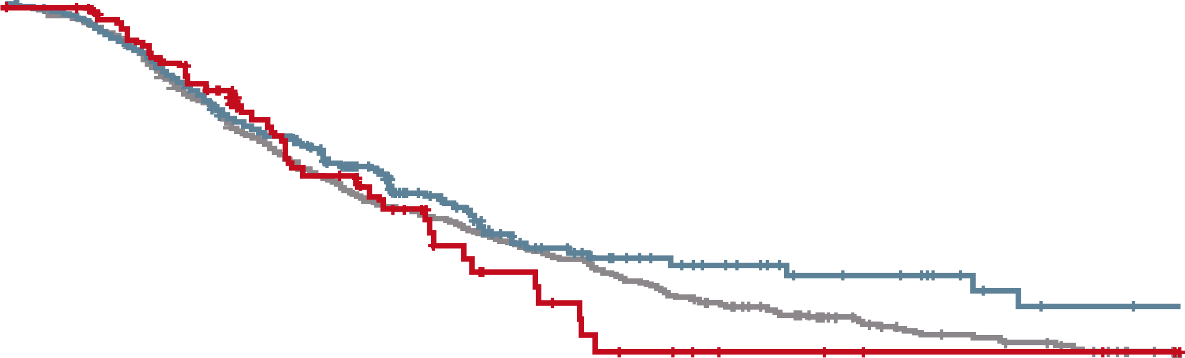
outcomes are similar REGARDLESS OF AGE OF ONSET
Best response to first-line
treatment at time of metastasis
100%
100%
75%
75%
Survival (%)
50%
First-line response (% )
AO ages 50+
YO ages 36-49
YO ages 14-35
50%
25%
25%
Log-rank test p value = 0.31
0%
0
12
24
36
48
60
72
84
96
108
120
0%
Months from metastasis
YO ages 14-35
AO ages 50+
% of cases at risk
574 | 529 | 417 | 320 | 230 | 149 | 103 | 85 | 63 | 53 | 42
454 | 348 | 209 | 120 | 73 | 46 | 34 | 24 | 19 | 12 | 10
111 | 86 | 57 | 33 | 18 | 11 | 7 | 4 | 2 | 2 | 1
YO ages 36-49
Not available
No response
Any response
AO, average onset; CRC, colorectal cancer; YO, young onset
Cercek A, et al. J Natl Cancer Inst. 2021;113:1683-92

Slide 13
young-onset CRC
The individuals are the difference

Slide 14
People with young-onset CRC are a DIFFERENT population
People with YO CRC:
Needs and challenges^{1,2}
Quality of life³
85%
experienced anxiety or depression during or after treatment.
55%
sought treatment for anxiety
or depression.
Sexual health and fertility
Psychological impact of diagnosis
Potential toxicities of treatment
Financial burden
Surveillance intervals
80%
had children under the age of 18 when diagnosed.
64%
said a medical professional did not talk to them about fertility preservation during diagnosis or treatment.
61%
did not have a health care proxy or medical directive in place, which lets another person legally make health care decisions in the event the patient is unable.
64%
took a leave of absence or quit a job or schooling because of their diagnosis.
62%
experienced financial difficulties.
CRC, colorectal cancer; YO, young onset
1. Adapted from Memorial Sloan Kettering Cancer Center internal data, courtesy of Hadley Maya, LMSW; 2. Mendelsohn R, et al. Oncologist. 2021;26:625-29; 3. Colorectal Cancer Alliance 2018 Young-Onset Colorectal Cancer Survey Report. Available from: https://www.ccalliance.org/about/never-too-young/survey/2018-young-onset-colorectal-cancer-survey-report (accessed 11 Feb 2022)

Slide 15
Unique population, unique support: social work, psychology, and psychiatry
Unique dilemmas for people with young-onset CRC
Isolation
From healthy peers
  From the general population
  of people with CRC
  Most ≥50 years of age
  From research
  Most young-onset CRC research is in adolescent and young adult populations
  40-50 year-olds excluded
Stigma
CRC has a unique and damaging stigma
  Bowel movements
  Digestive/GI symptoms
  Ostomy bags
  Impact on body image, sexual functioning and intimacy
Family system
Many patients are in relationships and caring for children
Many patients are caring for their ageing parents
Life stage
Most are juggling various
roles
  Marriage/partnerships
  Caring responsibilities
  Career development
  Education
Premature confrontation with mortality
CRC, colorectal cancer; GI, gastrointestinal
Adapted from Memorial Sloan Kettering Cancer Center internal data, courtesy of Hadley Maya, LMSW

Slide 16
REACH NURSES CONNECT VIA
TWITTER, LINKEDIN, VIMEO & EMAIL
OR VISIT THE GROUP’S WEBSITE https://ginursesconnect.cor2ed.com/
Follow us on Twitter
@nursesconnect
Follow the
NURSESCOR2ED
Group on LinkedIn
Watch us on the
Vimeo Channel
NURSES CONNECT
Email
antoine.lacombe
@cor2ed.com

