Slide 2
TRK fusion-positive cancer highlights from ASCO 2022
Prof. David S. Hong
Medical Oncologist
MD Anderson Cancer Center, Houston, TX, USA
JUNE 2022

Slide 3
Disclosures
Please note: Views expressed within this presentation are the personal opinions of the author.
They do not necessarily represent the views of the author’s academic institution or the rest of
NTRK CONNECT group.
This content is supported by an independent educational grant from Bayer.
Disclosures: Prof. David S. Hong has received honoraria from the following:
Research/Grant Funding : AbbVie, Adaptimmune, Adlai-Nortye, Amgen, AstraZeneca, Bayer, Bristol-Myers Squibb, Daiichi-Sankyo, Deciphera, Eisai, Endeavor, Erasca, Roche, Fate Therapeutics, Genentech, Genmab, Ignyta, Infinity, Kite, Kyowa Kirin, Eli Lilly, LOXO, Merck, Medimmune, Mirati, Mologen, Navier, NCI-CTEP, Novartis, Numab, Pfizer, Pyramid Bio, SeaGen, Takeda, TCR2, Teckro, Turning Point Therapeutics, VM Oncology
Consulting, Speaker, or Advisory Role: Abbvie, Adaptimmune, Alpha Insights, Acuta, Alkermes, Amgen, Aumbiosciences, Axiom, Baxter, Bayer, Boxer Capital, BridgeBio, COR2ed, COG, Cowen, Ecor1, Gennao Bio, Genentech, Gilead, GLG, Group H, Guidepoint, HCW Precision, Immunogen, Infinity, Janssen, Liberium, MedaCorp, Medscape, Numab, Oncologia Brasil, Pfizer, Pharma Intelligence, POET Congress, Prime Oncology, RAIN, SeaGen, ST Cube, Takeda, Tavistock, Trieza Therapeutics, Turning Point Therapeutics, WebMD, YingLing Pharma, Ziopharm

Slide 4
Selected abstrActs from ASCo 2022
Updated clinical efficacy and safety data from the currently approved first-generation TRK inhibitors:
  larotrectinib: Long-term efficacy and safety of larotrectinib in a pooled analysis of patients with tropomyosin receptor kinase fusion cancer. Presented by Drilon A.E. et al.
  entrectinib: Updated analysis of the efficacy and safety of entrectinib in patients with locally advanced/metastatic NTRK fusion-positive solid tumors.
  Presented by Krzakowski M.J. et al.
Preliminary and promising clinical evidence for a next-generation TRK inhibitor:
  ICP-723: Safety, pharmacokinetics, and clinical efficacy of ICP-723, a highly selective next‑generation pan-TRK inhibitor, in patients with solid tumor. Presented by Wei XL. et al.
NTRK, neurotrophic receptor tyrosine kinase; Trk, tropomyosin receptor kinase

Slide 5
Long-term efficacy and safety of larotrectinib in a pooled analysis of patients with tropomyosin receptor kinase (TRK) fusion cancer
Drilon AE, et al.
ASCO 2022. Abstract #3100. Poster presentation

Slide 6
Background
larotrectinib = first-in-class, highly selective, CNS-active TRK inhibitor approved to
treat adult and paediatric patients with TRK fusion cancer
Adult in Phase 1
Advanced solid tumours
NCT02122913
Paediatric in Phase 1/2
Advanced solid tumours
SCOUT: NCT02637687
Adult/adolescent in Phase 2
Advanced solid tumours
NAVIGATE: NCT02576431
Data cut-off: 20 July 2021
Total of 244 patients with non-primary CNS TRK-fusion cancer treated with larotrectinib
CNS, central nervous system; TRK, tropomyosin receptor kinase

Slide 7
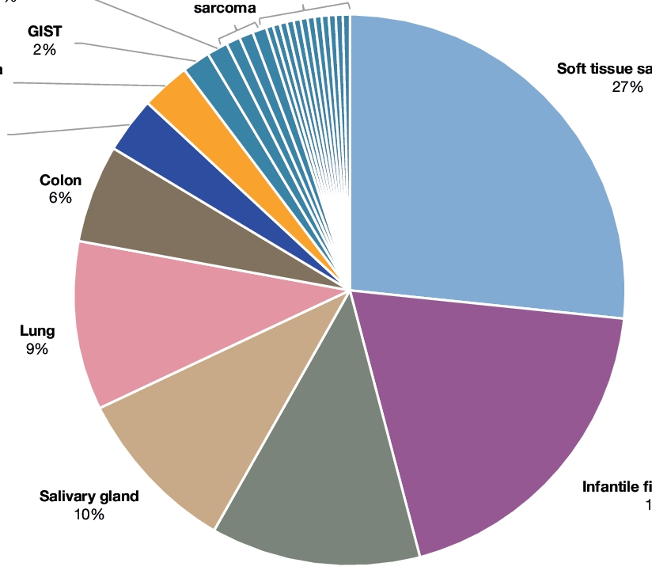
Integrated dataset: various tumour types treated with larotrectinib with high ORR
Patient population by tumour type (N=244)
Efficacy assessments
Each 1%: Pancreas,
congenital mesoblastic
nephroma, bone
sarcoma
Each <1%: Cancer of unknown primary, prostate, appendix,
gastric, hepatic, cervix, rectal, external auditory canal,
uterus, oesophageal, duodenal,ª urothelialª
 | Integrated dataset
Evaluable patients, n | 244
ORR, % (95% CI) | 69 (63-75)
Best response, n (%)
Complete response | 51 (21)
Pathological complete response | 13 (5)
Partial response | 104 (43)
Stable disease | 41 (17)
Progressive disease | 20 (8)
Not determined^{b} | 15 (6)
^{b} Patients who discontinued study drug without evaluable post-baseline assessments
Cholangiocarcinoma
1%
GIST
2%
Melanoma
3%
Breast
3%
Soft tissue sarcoma
27%
Colon
6%
Lung
9%
Salivary gland
10%
Infantile fibrosarcoma
19%
Thyroid
12%
ª Tumour types not represented in previous integrated data cut
CI, confidence interval; GIST, gastrointestinal stromal tumour; ORR, objective response rate

Slide 8
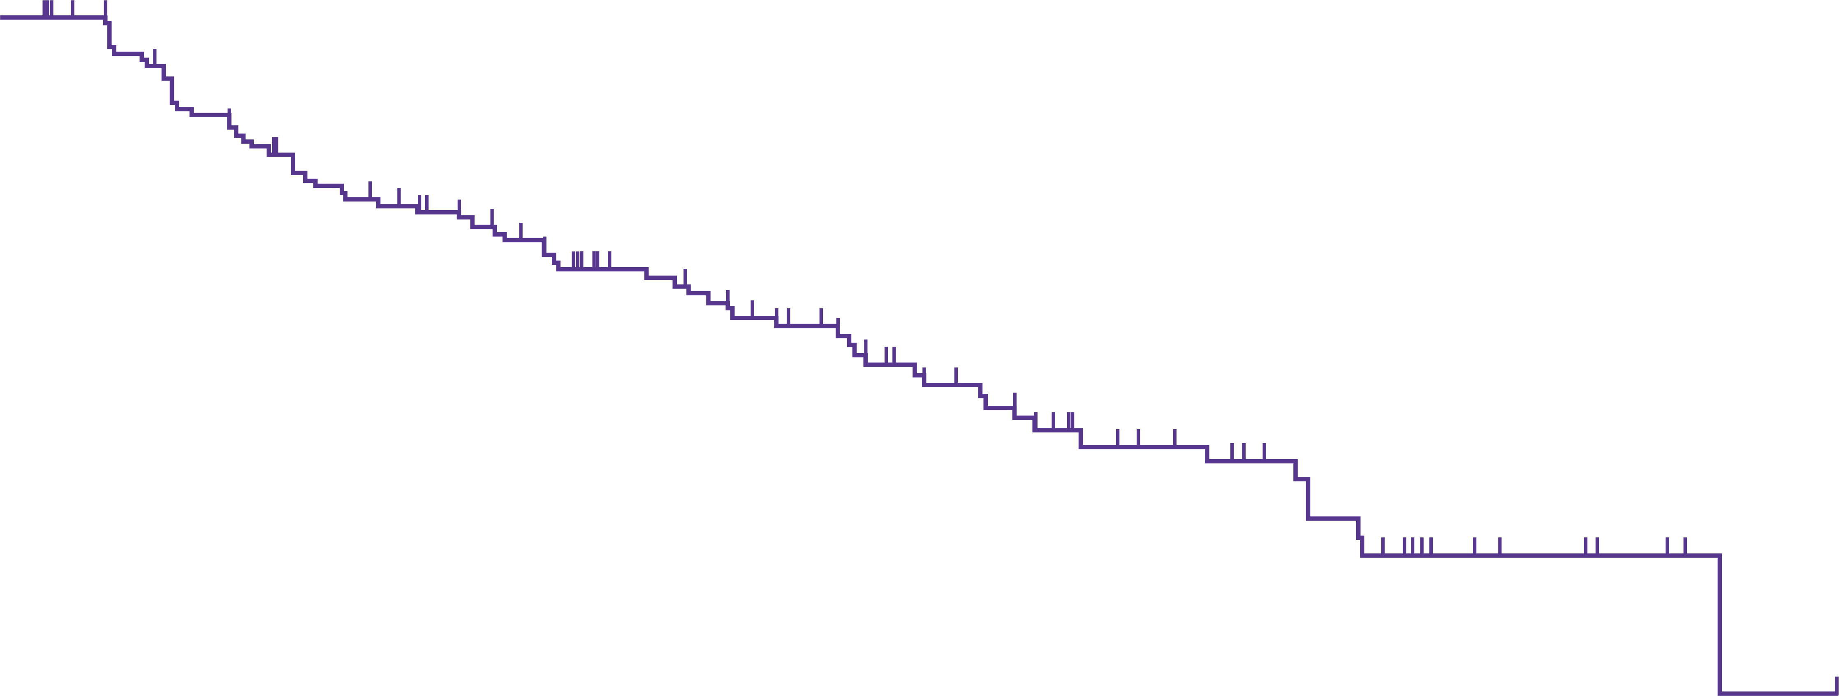
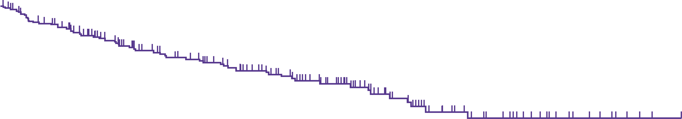
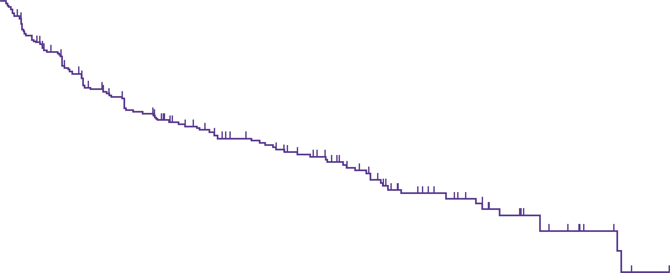
Efficacy: Dor, pfs, and os in patients with trk fusion cancer
DoR
100
Median DoR = 32.9 months (95% CI 27.3-41.7)
Median follow-up = 28.3 months
75
DoR (%)
50
OS
100
Median OS = NR (95% CI NE-NE)
Median follow-up = 32.2 months
25
82%
0
75
64%
0
6
12
18
24
30
36
42
48
54
60
Months from start of response
OS (%)
50
No. at risk
139
113
96
76
60
40
26
16
6
2
0
PFS
100
Median PFS = 29.4 months (95% CI 19.3-34.3)
Median follow-up = 29.3 months
25
75
0
0
6
12
18
24
30
36
42
48
54
60
66
72
Months from start of response
PFS (%)
50
No. at risk
244
216
175
144
122
102
69
47
30
17
8
3
0
25
0
0
6
12
18
24
30
36
42
48
54
60
66
Months from start of response
No. at risk
244
169
117
93
74
58
31
22
14
5
1
0
CI, confidence interval; DoR, duration of response; NE, not estimable; NR, not reached; OS, overall survival; PFS, progression-free survival;
TRK, tropomyosin receptor kinase

Slide 9
Safety: no new signal identified
AEs that occurred in ≥10% of patients
TEAEs (all AEs)
TRAEs (AEs related to larotrectinib)
Alanine aminotransferase increased
Aspartate aminotransferase increased
Vomiting
Constipation
Cough
Anaemia
Diarrhoea
Pyrexia
Nausea
Fatigue
Dizziness
Arthralgia
Upper respiratory tract infection
Weight increased
Myalgia
Headache
Oedema peripheral
Pain in extremity
Dyspnoea
Neutrophil count decreased
Back pain
Urinary tract infection
Rash
Abdominal pain
Decreased appetite
Nasopharyngitis
White blood cell count decreased
Nasal congestion
Blood creatinine increased
Dry skin
Lymphocyte count decreased
Grade
1
2
3
4
40
30
20
10
0
10
20
30
40
Patients (%)
AE, adverse event; TEAE, treatment-emergent adverse event; TRAE, treatment-related adverse event

Slide 10
Updated analysis of the efficacy and safety of entrectinib in patients with locally advanced/metastatic NTRK fusion‑positive solid tumors
Krzakowski MJ, et al.
ASCO 2022. Abstract #3099. Poster presentation
NTRK, neurotrophic receptor kinase

Slide 11
Background
entrectinib = CNS-active, potent inhibitor of TRK, ROS1 and ALK tyrosine kinase
ALKA-372-001: Phase 1
Solid tumours
EudraCT 2012-000148-88
STARTRK-1: Phase 1/2
Solid tumours
NCT02097810
STARTRK-2: Phase 2
Solid tumours
NCT02568267
Data cut-off: 2 August 2021
Total of 150 adults with advanced/metastatic NTRK fusion-positive solid tumour types, who received ≥1 dose of entrectinib and had ≥12 months follow up from first tumour assessment
ALK, anaplastic lymphoma kinase; CNS, central nervous system; NTRK, neurotrophic receptor tyrosine kinase; ROS1, ROS proto-oncogene 1;
TRK, tropomyosin receptor kinase

Slide 12
Patient characteristics and key efficacy results
Patient characteristics:
  150 patients with 17 different NTRK fusion‑positive tumours types
  Median survival follow-up: 30.6 months
Efficacy:
  Time-to-event endpoints
    Median DoR was 20.0 months (Table)
    Median PFS was 13.8 months and median OS was 37.1 months (Table)
Overall efficacy
Parameter | Efficacy population (N=150) | Baseline CNS metsª (n=31) | No baseline CNS metsª (n=119)
ORR^{b}, n (%) [95% CI] Complete response, n (%) Partial response, n (%) Stable disease, n (%) Progressive disease, n (%) Non-CR / non-PD, n (%) Missing / unevaluable^{c}, n (%) | 92 (61.3) [53.1-69.2] 25 (16.7) 67 (44.7) 15 (10.0) 18 (12.0) 7 (4.7) 18 (12.0) | 19 (61.3) [42.2-78.2] 2 (6.5) 17 (54.8) 4 (12.9) 2 (6.5) 0 6 (19.4) | 73 (61.3) [52.0-70.1] 23 (19.3) 50 (42.0) 11 (9.2) 16 (13.4) 7 (5.9) 12 (10.1)
Median DoR^{b}, months [95% CI) | 20.0 [13.2-31.1] | 17.2 [9.0-33.3] | 20.0 [14.8-NE]
Median PFS^{b}, months [95% CI) | 13.8 [10.1-20.0] | 11.7 [4.9-30.3] | 13.8 [10.2-20.4]
Median OS, months [95% CI) | 37.1 [27.2-NE] | 20.0 [7.9-NE] | 40.5 [30.4-NE]
ª CNS metastases status at baseline per investigator. ^{b} Assessed by BICR per RECIST v1.1. ^{c} Includes patients with unevaluable on-study scans or those who discontinued treatment prior to obtaining adequate scans to evaluate or confirm response
BICR, blinded independent central review; CI, confidence interval; CNS, central nervous system; CR, complete response; DoR, duration of response; mets, metastases;
NE, not estimable; NTRK, neurotrophic receptor tyrosine kinase; ORR, objective response rate; OS, overall survival; PD, progressive disease; PFS, progression-free survival; RECIST, Response Evaluation Criteria in Solid Tumours

Slide 13
Safety: no new signal identified
Safety:
  Safety analysis set = 235 patients
  Median dose intensity: 93.7% (range 11.8-106.1)
  TRAEs:
    Mostly grade 1/2
    Most frequent: dysgeusia (36.6%), diarrhoea (29.8%), weight increase (28.5%)
    Led to dose interruption: 32.8%
    Led to dose reduction: 24.3%
    Led to dose discontinuation: 7.2%
TRAE, treatment-emergent adverse event

Slide 14
Safety, pharmacokinetics, and clinical efficacy of ICP-723, a highly selective next-generation pan-TRK inhibitor, in patients with solid tumor
Wei XL, et al.
ASCO 2022. Abstract #3106. Poster presentation
TRK, tropomyosin receptor kinase

Slide 15
ICP-723 is a potent next-generation TRK inhibitor
Mechanism of action:
  Potent inhibitor of wild-type TRKA/B/C
  Highly active against resistant mutations (G595R, F589L or G667C/A/S)
Clinical development status:
  First-in-human trial ongoing (first patient enrolled in September 2020) to evaluate the safety, tolerability, PK and preliminary efficacy of ICP-723 (NCT04685226)
PK, pharmacokinetic; TRKA/B/C, tropomyosin receptor kinase A/B/C

Slide 16
Study design
A multicentre, open-label, non-randomised, phase 1/2 clinical trial of ICP-723 in the treatment of advanced solid tumours
Phase 1:
Dose escalation study with 28-day continuous dosing
Objective: evaluate safety, tolerability and PK of ICP-723 in advanced solid tumours
Phase 2:
Objective: Preliminary evaluation of the clinical efficacy in NTRK treatment naïve patient
Cut off date: 11 February 2022
17 patients in phase 1 dose escalation treated with ICP-723 at dose levels from 1 mg QD to
8 mg QD
NTRK, neurotrophic receptor tyrosine kinase; PK, pharmacokinetic; QD, once a day

Slide 17
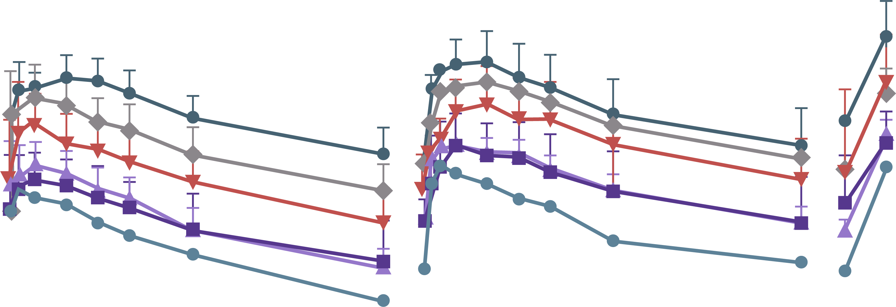
Results: safety, PK and efficacy
Safety
  DLT has not been observed in the six dose groups (1, 2, 3, 4, 6 and 8 mg)
  Most treatment-related adverse events (TRAEs) were Grade 1-2
  Grade 3 TRAEs were reported in three patients. No Grade 4 or Grade 5 TRAEs
  were observed
  The most common TRAEs (>20%) were asthenia, increased ALT, increased AST and anaemia
  Grade 3 TRAEs were increased ALT, increased AST, increased CPK, neutrophil count decreased and pain
Pharmacokinetic (PK) analysis
  The plasma concentrations of ICP-723 over time on day 1 and day 15 are shown
  in the figure below
  Plasma exposure to ICP-723 increased in a dose proportional manner across the dosage levels
Efficacy
  Among the six patients with NTRK fusion, the ORR was 66.7% (four PR), the DCR was 100% (Table). There was no response in patients without NTRK fusion, but there were SD patients
    All the NTRK fusion positive patients treated with ICP-723 at dose levels of 4 mg and above (n=4) responded to the treatment (ORR: 100%)
  Among the four PR patients, the remission depth gradually deepened with higher dose
  All patients who achieved shrunk SD or above have maintained sustained responses to the date of data cut-off
  One patient achieved PR with the target brain lesion shrunk from 10 mm to 3 mm with 5 months DoR to date. The signal of oedema region markedly reduced after treatment
Efficacy assessment in NTRK fusion (+) patients
 | Total (N=16ª) | NTRK fusion (+) (N=6) | NTRK fusion (-) (N=6)
ORR (CR+PR+uPR), n (%)^{b} | 4 (25.0) | 4 (66.7) | 0 (0.0)
DCR (CR+PR+uPR+SD), n (%) | 11 (68.8) | 6 (100.0) | 4 (80.0)
BOR, n (%)
CR | 0 (0.0) | 0 (0.0) | 0 (0.0)
PR | 3 (18.8) | 3 (50.0) | 0 (0.0)
uPR | 1 (6.3) | 1 (16.7) | 0 (0.0)
SD | 7 (43.8) | 2 (33.3) | 4 (80.0)
PD | 5 (31.3) | 0 (0.0) | 1 (20.0)
NE | 0 (0.0) | 0 (0.0) | 0 (0.0)
1000
1 mg
2 mg
3 mg
4 mg
6 mg
8 mg
100
Plasma concentration (ng/mL)
30
10
0
4
8
12
16
20
24
336
340
344
348
352
356
360
648
652 hr
C0D1
Time (hr)
C1D15
C1D28
Plasma concentration versus time profiles
ª There was one patient non-evaluable for efficacy analysis, for whom tumour scan not performed. b The ORR will be 80% (four PR out of five patients) if excluding the patient who was considered not being able to form RNA fusion. All the NTRK fusion positive patients treated with ICP-723 at dose levels of 4 mg and above responded to the treatment (ORR: 100%)
ALT, alanine aminotransferase; AST, aspartate aminotransferase; BOR, best overall response; C, cycle; CPK, creatine phosphokinase; CR, complete response; D, day; DCR, disease control rate; DLT, dose-limiting toxicity; DoR, duration of response; hr, hour; NE, non evaluable; NTRK, neurotrophic receptor tyrosine kinase; ORR, objective response rate; PD, progressive disease; PR, partial response; uPR, unconfirmed partial response; SD, stable disease

Slide 18
conclusions

Slide 19
COnclusions
First generation TRK inhibitors:
  larotrectinib and entrectinib demonstrate a robust clinical efficacy with a manageable safety profile in various solid tumour types
  larotrectinib and entrectinib show a high survival benefit (PFS and OS) and high response rate with long durability in patients with NTRK fusion-positive solid tumours
Next generation TRK inhibitors:
  Are required to overcome the resistance mechanisms seen with larotrectinib and entrectinib
  ICP-723 could be an effective and well-tolerated second-generation TRK inhibitor
    Phase 2 investigation is ongoing with NTRK fusion positive patients, including those who developed acquired resistance to first-generation TRK inhibitor
Testing is critical in order to find patients:
  Presence of NTRK gene fusions must be tested for in order to identify patients who can benefit from larotrectinib and entrectinib
NTRK, neurotrophic receptor tyrosine kinase; OS, overall survival; PFS, progression-free survival; TRK, tropomyosin receptor kinase

Slide 20
REACH NTRK CONNECT VIA
TWITTER, LINKEDIN, VIMEO & EMAIL
OR VISIT THE GROUP’S WEBSITE https://ntrkconnect.cor2ed.com/
Follow us on Twitter
@ntrkconnectinfo
Follow the
NTRK CONNECT
group on LinkedIn
Watch us on the
Vimeo Channel
NTRK CONNECT
Email
Iain.murdoch
@cor2ed.com

