Slide 2
Drug Therapies Post Acute Coronary Syndrome Event
Prof. Dr. Kurt Huber, MD
Sigmund Freud University, Medical Faculty, and Wilhelminenspital
Vienna, Austria

Slide 3
Disclaimer and disclosures
Please note: The views expressed within this presentation are the personal opinions of the authors.
They do not necessarily represent the views of the author’s academic institution, or the rest of the CORONARY CONNECT group.
These slides are adapted from the virtual ACS Forum event which was held in December 2020.
The ACS Forum and this content are supported by an Independent Educational Grant from Amgen.
Prof. Dr. Kurt Huber, MD has received financial support/sponsorship for research support, consultation or speaker fees from the following companies:
Amgen, AstraZeneca, Bayer, Brahms, Boehringer Ingelheim, Daiichi-Sankyo, Ferrer, Medtronic, Novartis, Orion, Pfizer, Vifor Pharma

Slide 4
INTRODUCTION
Antithrombotic treatment with and without invasive management is a fundamental component of acute coronary syndrome (ACS) management
Dual antiplatelet therapy (DAPT) combining aspirin and a P2Y12 receptor inhibitor has been consistently shown to reduce recurrent major adverse cardiovascular events (MACE) in patients with ACS or undergoing percutaneous coronary intervention (PCI) for stable coronary artery disease (CAD) compared with aspirin monotherapy, but at the expense of an increased risk of major bleeding
  The choice of anti-thrombotic treatment, the combination and time of initiation should therefore reflect the ischaemic and bleeding risk of the patient
Other pharmacological therapies should be initiated for long term maintenance after an ACS event including high-intensity lipid lowering agents, ACE inhibitors or ARBs and beta-blockers
  The timing of initiation of these various treatments remains a topic for debate
Collet J-P, et al. Eur Heart J. 2020. DOI: 10.1093/eurheartj/ehaa575

Slide 5
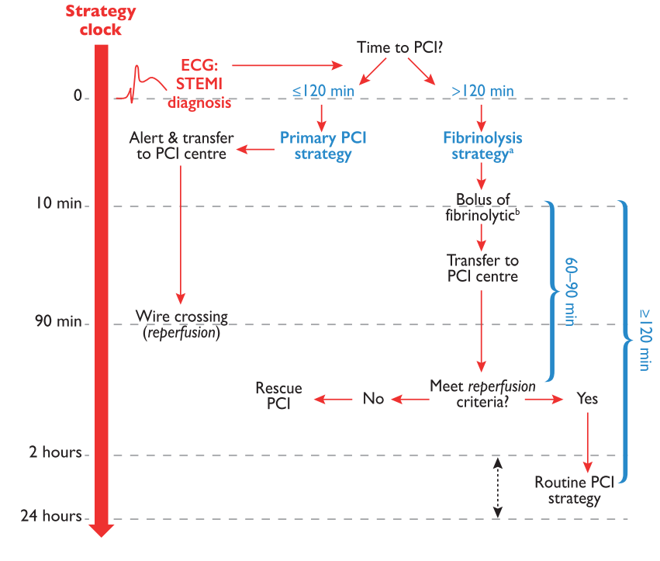

Presentation with ACS (STEMI or high-risk NSTEMI)
Maximum target times according to reperfusion-strategy selection in patients presenting via emergency medical services (EMS) or in a non-percutaneous coronary intervention (non-PCI) centre
ª If fibrinolysis is contraindicated, direct for primary PCI strategy regardless of time to PCI; ^{b} 10 min. is the maximum target delay time from STEMI diagnosis to fibrinolytic bolus administration, however, it should be given as soon as possible after STEMI diagnosis (after ruling out contraindications)
ACS, acute coronary syndrome; ECG, electrocardiogram; NSTEMI, non-ST-segment elevation myocardial infarction; PCI, percutaneous coronary intervention;
STEMI, ST-segment elevation myocardial infarction
Ibanez B, et al. Eur Heart J. 2017;39:119-77

Slide 6
Antithrombotic therapy

Slide 7
Antithrombotic therapy and risk stratification
Determinants of antithrombotic treatment in coronary artery disease
Patient
characteristics
Age
Sex
Race
History of ischaemic or bleeding events
Clinical presentation
CCS vs ACS
(NSTE-ACS/STEMI)
Comorbidities
CKD
Diabetes
PAD
Heart failure
Co-medication
Need for oral
anticoagulation
treatment
Various drug–drug
interactions
Procedural aspects
PCI vs CABG
Femoral vs radial
access
Invasive vs
conservative
management
Intrinsic (blue) and extrinsic
(yellow) variables influencing the choice, dosing,
and duration of antithrombotic treatment
Antithrombotic treatment
Choice of drugs/drug dosing /treatment duration
Ischaemic risk
Bleeding risk
ACS, acute coronary syndrome; CABG, coronary artery bypass graft; CCS, chronic coronary syndrome; CKD, chronic kidney disease; NSTE-ACS, non-ST-segment elevation acute coronary syndrome; PAD, peripheral artery disease; PCI, percutaneous coronary intervention; STEMI, ST-segment elevation myocardial infarction
Collet J-P, et al. Eur Heart J. 2020. DOI: 10.1093/eurheartj/ehaa575

Slide 8
Antithrombotic therapy in NSTE-ACS
Antithrombotic treatments in
NSTE-ACS patients: pharmacological targets
Drugs with oral administration are shown in black letters and drugs with preferred parenteral administration in red
Abciximab (in brackets) is no longer supplied
ADP, adenosine diphosphate; DAPT, dual antiplatelet therapy; FXa, factor Xa; GP, glycoprotein; NSTE-ACS, non-ST-segment elevation acute coronary syndrome;
TxA₂, thromboxane A2; UFH, unfractionated heparin; VKA, vitamin K antagonist
Collet J-P, et al. Eur Heart J. 2020. DOI: 10.1093/eurheartj/ehaa575

Slide 9
Antithrombotic therapy in STEMI
Periprocedural and post-procedural antithrombotic therapy in patients
undergoing primary PCI (1)
Recommendations | Classª | Level^{b}
Antiplatelet therapy
A potent P2Y₁₂ inhibitor (prasugrel or ticagrelor), or clopidogrel if these are not available or are contraindicated, is recommended before (or at latest at the time of) PCI and maintained over 12 months, unless there are contraindications such as excessive risk of bleeding | I | A
Aspirin (oral or intravenous [i.v.], if unable to swallow) is recommended as soon as possible for all patients without contraindications | I | B
Glycoprotein (GP) IIb/IIa inhibitors should be considered for bailout if there is evidence of no-reflow or a thrombotic complication | IIa | C
Cangrelor may be considered in patients who have not received P2Y₁₂ receptor inhibitors | IIb | A
ª Class of recommendation; ^{b} Level of evidence
PCI, percutaneous coronary intervention; STEMI, ST-segment elevation myocardial infarction
Ibanez B, et al. Eur Heart J. 2017;39:119-77

Slide 10
Antithrombotic therapy in STEMI
Periprocedural and post-procedural antithrombotic therapy in patients
undergoing primary PCI (2)
Recommendations | Classª | Level^{b}
Anticoagulant therapy
Anticoagulation is recommended for all patients in addition to antiplatelet therapy during primary PCI | I | C
Routine use of unfractionated heparin (UFH) is recommended | I | C
In patients with heparin-induced thrombocytopenia, bivalirudin is recommended as the anticoagulant agent during primary PCI | I | C
Routine use of enoxaparin i.v. should be considered | IIa | A
Routine use of bivalirudin should be considered | IIa | A
Fondaparinux is not recommended for primary PCI | III | B
ª Class of recommendation; ^{b} Level of evidence
i.v., intravenous; PCI, percutaneous coronary intervention; STEMI, ST-segment elevation myocardial infarction
Ibanez B, et al. Eur Heart J. 2017;39:119-77

Slide 11
Antithrombotic therapy in NSTE-ACS
Recommendations for antithrombotic treatment in NSTE-ACS patients
undergoing PCI (1)
Recommendations | Class | Level
Antiplatelet treatment
Aspirin recommended for all patients without contraindications at an initial oral LD of 150-300 mg (or 75-250 mg i.v.), and at a MD of 75-100 mg o.d. for long-term therapy | I | A
A P2Y₁₂ receptor inhibitor is recommended in addition to aspirin, and maintained over 12 months unless there are contraindications or an excessive risk of bleeding. Options are: | I | A
Prasugrel in P2Y₁₂ receptor inhibitor-naïve patients proceeding to PCI (60 mg LD, 10 mg/d as standard dose, 5 mg/d for patients aged ≥75 years or with body weight <60 kg) | I | B
Class, class of recommendation; i.v., intravenous; LD, loading dose; Level, level of evidence; MD, maintenance dose;
NSTE-ACS, non-ST-segment elevation acute coronary syndrome; o.d., once daily; PCI, percutaneous coronary intervention
Collet J-P, et al. Eur Heart J. 2020. DOI: 10.1093/eurheartj/ehaa575

Slide 12
Antithrombotic therapy in NSTE-ACS
Recommendations for antithrombotic treatment in NSTE-ACS patients
undergoing PCI (2)
Recommendations | Class | Level
Antiplatelet treatment (continued)
Ticagrelor irrespective of the planned treatment strategy (invasive or conservative) (180 mg LD, 90 mg b.i.d.) | I | B
Clopidogrel (300-600 mg LD, 75 mg daily dose), only when prasugrel or ticagrelor are not available, cannot be tolerated, or are contraindicated | I | C
Prasugrel should be considered in preference to ticagrelor for NSTE-ACS patients who proceed to PCI | IIa | B
GP IIb/IIIa antagonists should be considered for bail-out if there is evidence of no-reflow or a thrombotic complication | IIa | C
b.i.d., twice a day; Class, class of recommendation; GP, glycoprotein; LD, loading dose; Level, level of evidence;
NSTE-ACS, non-ST-segment elevation acute coronary syndrome; PCI, percutaneous coronary intervention
Collet J-P, et al. Eur Heart J. 2020. DOI: 10.1093/eurheartj/ehaa575

Slide 13
Antithrombotic therapy in NSTEMI
Symptom onset
First medical contact ➞ NSTE-ACS diagnosis
PCI centre
Yes
EMS or non-PCI centre
Selection of NSTE-ACS treatment strategy and timing according to initial risk stratification
Yes
Immediate transfer to PCI centre
Yes
Risk
identification
Very high
Very high
Yes
High
Same day transfer
High
Yes
Low
Yes
Therapeutic strategy
Immediate invasive
(<2 hours)
Early invasive
(<24 hours)
Selective
invasive
Very high risk
Haemodynamic instability
Cardiogenic shock
Recurrent/refractory chest pain despite medical treatment
Life-threatening arrhythmias
Mechanical complications of MI
Acute heart failure clearly related to NSTE-ACS
ST-segment depression >1 mm/
6 leads plus ST-segment elevation aVr and/or V1
High risk
Established NSTEMI diagnosis
Dynamic new or presumably new contiguous ST/T-segment changes (symptomatic or silent)
Resuscitated cardiac arrest without ST-segment elevation or cardiogenic shock
GRACE risk score >140
Low risk
Lack of any of the very-high-risk or high-risk characteristics
Risk
category
aVR, augmented vector right; EMS, emergency medical services; GRACE, Global Registry of Acute Coronary Events; MI, myocardial infarction;
NSTE-ACS, non-ST-segment elevation acute coronary syndrome; NSTEMI, non-ST-segment elevation myocardial infarction; PCI, percutaneous coronary intervention; V1 vector 1
Collet J-P, et al. Eur Heart J. 2020. DOI: 10.1093/eurheartj/ehaa575

Slide 14
Antithrombotic therapy in NSTE-ACS
Recommendations for antithrombotic treatment in NSTE-ACS patients
undergoing PCI (3)
Recommendations | Class | Level
Antiplatelet treatment (continued)
Cangrelor may be considered in P2Y₁₂ receptor inhibitor-naïve patients undergoing PCI | IIb | A
Pre-treatment with a P2Y₁₂ receptor inhibitor may be considered in patients with NSTE-ACS who are not planned to undergo an early invasive stragety and do not have an HBR | IIb | C
Treatment with GP IIb/IIIa antagonists in patients in whom coronary anatomy is not know is not recommended | III | A
It is not recommended to administer routine pre-treatment with a P2Y₁₂ receptor inhibitor in patients in whom coronary anatomy is not known and an early invasive management is planned | III | A
Class, class of recommendation; GP, glycoprotein; HBR, high bleeding risk; Level, level of evidence;
NSTE-ACS, non-ST-segment elevation acute coronary syndrome; PCI, percutaneous coronary intervention
Collet J-P, et al. Eur Heart J. 2020. DOI: 10.1093/eurheartj/ehaa575

Slide 15
Antithrombotic therapy in NSTE-ACS
Recommendations for antithrombotic treatment in NSTE-ACS patients
undergoing PCI (4)
Recommendations | Class | Level
Peri-interventional anticoagulant treatment
Parenteral anticoagulation is recommended for all patients, in addition to antiplatelet treatment, at the time of diagnosis and, especially, during revascularisation procedures according to both ischaemic and bleeding risks | I | A
UFH (weight-adjusted i.v. bolus during PCI of 70-100 IU/kg, or 50-70 IU/kg in combination with a GP IIb/IIIa inhibitor; activated clotting time target range of 250-350 s, or 200-250 s if a GP IIb/IIIa inhibitor is given) is recommended in patients undergoing PCI | I | A
Class, class of recommendation; GP, glycoprotein; IU, international units; Level, level of evidence;
NSTE-ACS, non-ST-segment elevation acute coronary syndrome; PCI, percutaneous coronary intervention; UFH, unfractionated heparin
Collet J-P, et al. Eur Heart J. 2020. DOI: 10.1093/eurheartj/ehaa575

Slide 16
Antithrombotic therapy in NSTE-ACS
Recommendations for antithrombotic treatment in NSTE-ACS patients
undergoing PCI (5)
Recommendations | Class | Level
Peri-interventional anticoagulant treatment (continued)
In cases of medical treatment or logistical constraints for transferring the patient to PCI within the required time frame, fondaparinux is recommended and, in such cases, a single bolus of UFH is recommended at the time of PCI | I | B
It is recommended to select anticoagulation according to both ischaemic and bleeding risks, and according to the efficacy–safety profile of the chosen agent | I | C
Enoxaparin (i.v.) should be considered in patients pre-treated with subcutaneous enoxaparin | IIa | B
Class, class of recommendation; i.v., intravenous; Level, level of evidence; NSTE-ACS, non-ST-segment elevation acute coronary syndrome;
PCI, percutaneous coronary intervention; UFH, unfractionated heparin
Collet J-P, et al. Eur Heart J. 2020. DOI: 10.1093/eurheartj/ehaa575

Slide 17
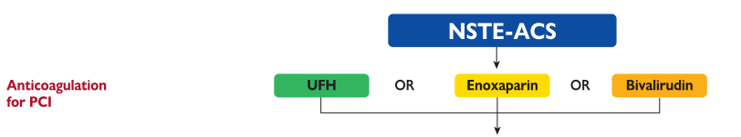
Antithrombotic therapy in NSTE-ACS
Bleeding risk
LOW
HIGH
VERY HIGH
A
P
A
C
Antithrombotic
drugs
1 months
OR
A
T
A
C
A
T
A
= Aspirin
Treatment
duration
3 months
OR
A
C
C
C
= Clopidogrel
6 months
P
= Prasugrel
12 months’
DAPT
T
A
12 months
R
= Rivaroxaban
A
R
A
T
T
= Ticagrelor
OR
A
P
A
C
DAT
>12 months
DAPT
>12 months
Ischaemic risk
DAPT, dual antiplatelet therapy; DAT, dual antithrombotic therapy; NSTE-ACS, non-ST-segment elevation acute coronary syndrome; UFH, unfractionated heparin
Collet J-P, et al. Eur Heart J. 2020. DOI: 10.1093/eurheartj/ehaa575

Slide 18
additional Pharmacological
Therapy for ACS

Slide 19
Other pharmacological therapies after STEMI
Recommendations | Classª | Level^{b}
Beta-blockers
Oral treatment with beta-blockers is indicated in patients with heart failure and/or LVEF ≤40% unless contraindicated. | I | A
Intravenous beta-blockers should be considered at the time of presentation in patients undergoing primary PCI without contraindications, with no signs of acute heart failure, and with an SBP >120 mmHg. | IIa | A
Routine oral treatment with beta-blockers should be considered during hospital stay and continued thereafter in all patients without contraindications. | IIa | B
Intravenous beta-blockers must be avoided in patients with hypotension, acute heart failure or AV block, or severe bradycardia. | III | B
Lipid-lowering therapies
It is recommended to start high-intensity statin therapy^{c} as early as possible, unless contraindicated, and maintain it long-term. | I | A
An LDL-C goal of <1.8 mmol/L (70 mg/dL) or a reduction of at least 50% if the baseline LDL-C is between 1.8-3.5 mmol/L (70-135 mg/dL) is recommended. | I | B
It is recommended to obtain a lipid profile in all STEMI patients as soon as possible after presentation | I | C
In patients with LDL-C ≥1.8 mmol/L (≥70 mg/dL) despite a maximally tolerated statin dose who remain at high risk, further therapy to reduce LDL-C should be considered. | IIa | A
Recommendations | Classª | Level^{b}
ACE inhibitors/ARBs
ACE inhibitors are recommended, starting within the first 24 h of STEMI in patients with evidence of heart failure, LV systolic dysfunction, diabetes, or an anterior infarct. | I | A
An ARB, preferably valsartan, is an alternative to ACE inhibitors in patients with heart failure and/or LV systolic dysfunction, particularly those who are intolerant of ACE inhibitors | I | B
ACE inhibitors should be considered in all patients in the absence of contraindications. | IIa | A
MRAs
MRAs are recommended in patients with an LVEF ≤40% and heart failure or diabetes, who are already receiving an ACE inhibitor and a beta-blocker, provided there is no renal failure or hyperkalaemia. | I | B
Other pharmacological therapies after STEMI
ª Class of recommendation; ^{b} Level of evidence; ^{c} High-intensity statin (atorvastatin 40-80 mg and rosuvastatin 20-40 mg)
ACE, angiotensin-converting enzyme; ARB, angiotensin II receptor blocker; AV, atrioventricular; LDL-C, low density lipoprotein cholesterol; LV, left ventricle; LVEF, left ventricular ejection fraction; MRA, mineral corticoid receptor antagonist; PCI, percutaneous coronary intervention; SBP, systolic blood pressure; STEMI; ST-segment elevation myocardial infarction
Ibanez B, et al. Eur Heart J. 2017;39:119-77

Slide 20
Other pharmacological therapies after NSTEMI
Recommendations | Classª | Level^{b}
Lipid-lowering drugs
Statins are recommended in all NSTE-ACS patients. The aim is to reduce LDL-C by ≥50% from baseline to achieve LDL-C <1.4 mmol/L (<55 mg/dL). | I | A
If the LDL-C goal^{c} is not achieved after 4-6 weeks with the maximally tolerated statin dose, combination with ezetimibe is recommended. | I | B
If the LDL-C goal^{c} is not achieved after 4-6 weeks despite maximally tolerated statin therapy and ezetimibe, the addition of a PCSK9 inhibitor is recommended. | I | B
If the current NSTE-ACS episode is a recurrence within less than 2 years of a first ACS, while taking maximally tolerated statin-based therapy, an LDL-C goal of <1.0 mmol/L (<40 mg/dL) may be considered. | IIb | B
ACE inhibitors or ARBs
ACE inhibitors (or ARBs in cases of intolerance to ACE inhibitors) are recommended in patients with heart failure with reduced LVEF (<40%), diabetes, or CKD unless contraindicated (e.g. severe renal impairment, hyperkalaemia, etc.) in order to reduce all-cause and cardiovascular mortality and cardiovascular morbidity. | I | A
Recommendations | Classª | Level^{b}
Beta-blockers
Beta-blockers are recommended in patients with systolic LV dysfunction or heart failure with reduced LVEF (<40%). | I | A
In patients with prior MI, long-term oral treatment with a beta-blocker should be considered in order to reduce all-cause and cardiovascular mortality and cardiovascular morbidity. | IIa | B
MRAs
MRAs are recommended in patients with heart failure with reduced LVEF (<40%) in order to reduce all-cause and cardiovascular mortality and cardiovascular morbidity. | I | A
Proton pump inhibitors
Concomitant use of a proton pump inhibitor is recommended in patients receiving aspirin monotherapy, DAPT, DAT, TAT, or OAC monotherapy who are at high risk of gastrointestinal bleeding in order to reduce the risk of gastric bleeds. | I | A
Other pharmacological therapies after NSTEMI
ª Class of recommendation; ^{b} Level of evidence; ^{c} For patients at very high risk (such as patients with ACS), an LDL-C reduction of at least 50% from baseline and an LDL-C goal
<1.4 mmol/L (<55 mg/dL) are recommended
ACE, angiotensin-converting enzyme; ACS, acute coronary syndrome; ARB, angiotensin II receptor blocker; CKD, chronic kidney disease; DAPT, dual antiplatelet therapy; DAT, dual antithrombotic therapy;
LDL-C, low density lipoprotein cholesterol; LV, left ventricle; LVEF, left ventricular ejection fraction; MI, myocardial infarction; MRA, mineral corticoid receptor antagonist; NSTE-ACS, non-ST-segment
elevation acute coronary syndrome; OAC, oral anticoagulation/anticoagulant; PCSK9, proprotein convertase subtilisin kexin 9; SBP, systolic blood pressure; TAT, triple antithrombotic therapy
Collet J-P, et al. Eur Heart J. 2020. DOI: 10.1093/eurheartj/ehaa575

Slide 21
Early treatment in NSTE-ACS:
The ongoing debate
Time of angio.
Time of
P2Y12
Time of anticoag.
Time
of GPI
Time of PCSK9i
Time of statins
Time of ezetimibe
Time of ACEi
ACEi, angiotensin-converting enzyme inhibitor; angio., angiography; anticoag., anticoagulant; GPI; glycoprotein IIb-IIIa inhibitor;
NSTE-ACS, non-ST-segment elevation acute coronary syndrome; PSCK9i, proprotein convertase subtilisin kexin 9 inhibitor

Slide 22
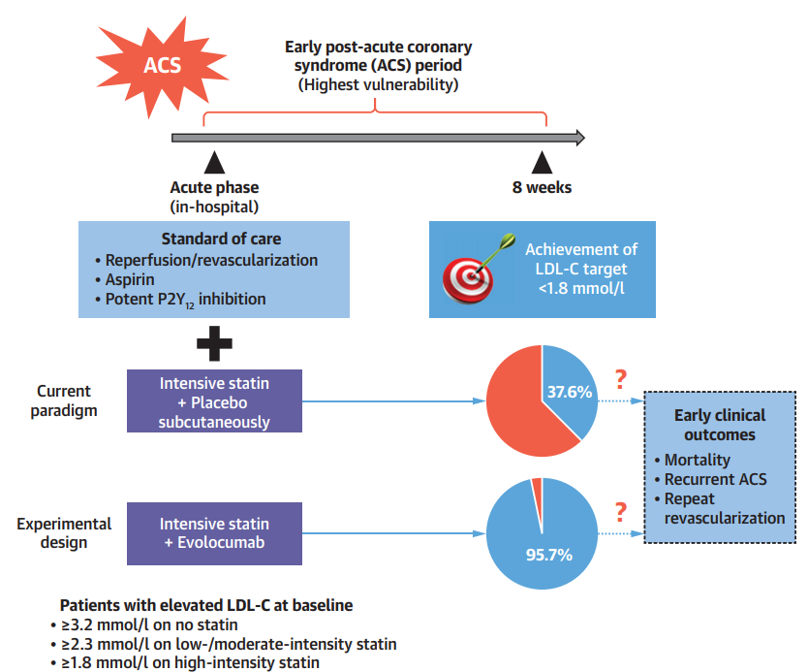
EVOPACS: greater LDL-C reduction with PCSK9 inhibitor initiated in-hospital
Evolocumab in Patients with ACS
EVOPACS: Evolocumab was associated with a substantially greater LDL-C reduction at 8 weeks as compared with placebo, given in addition to high-intensity statin therapy
  Over 95% of patients on evolocumab achieved the LDL-C target of
  <1.8 mmol/L at 8 weeks
Safety: percentage AEs, SAEs and AEs leading to study drug discontinuation were similar between groups
ACS, acute coronary syndrome; AE, adverse events; LDL-C, low density lipoprotein cholesterol; PCSK9, proprotein convertase subtilisin kexin 9; SAEs, serious adverse events
Koskinas K, et al. JACC 2019;74:2452-62

Slide 23
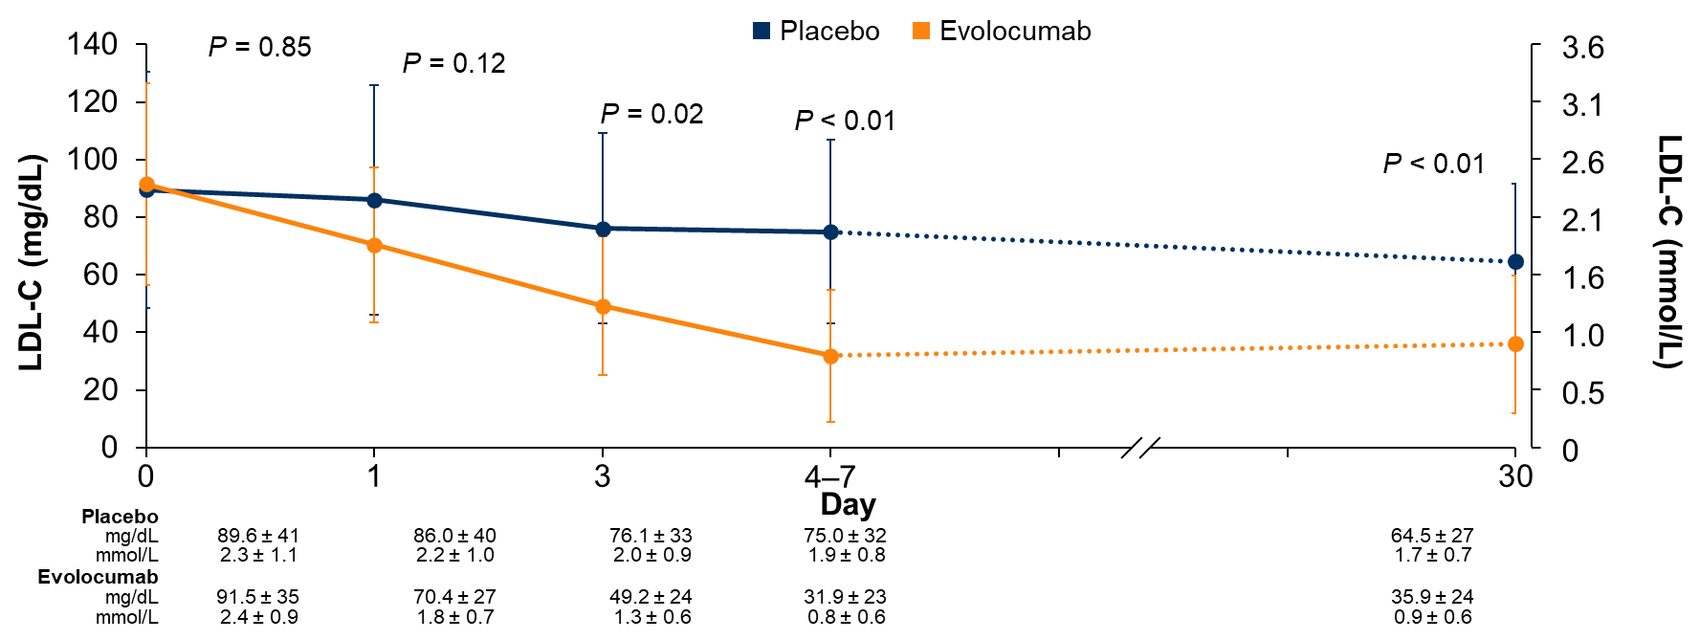
EVACS: PSCK9i initiated early after ACS rapidly reduces LDL-C in just 24 hours
PRIMARY ENDPOINT: Change in LDL-C at Day 30
At hospital discharge (~4 days) significantly more patients treated with evolocumab and a statin achieved AHA/ACC and ESC guideline LDL-C recommendations and were maintained at 30 days
Leucker TM, et al. Circulation. 2020;142:419-21

Slide 24
Benefit of early loading to PCI time for statins
30-day MACE
1
Time of study drug
administration
Overall (adjusted HR)
Up to 2 hours before PCI
Between 2 and 4 hours before PCI
Between 4 and 12 hours before PCI
More than 12 hours before PCI
Favours
atorvastatin
Favours
placebo
0.5
0
Log odds ratio
-0.5
-1
-1.5
0.5
0.75
1
1.33
2
3
4
5
 | SLOPE | INTERCEPT
p value | <0.0001 | <0.0001
HR (95% CI)
-2
-25
-5
15
35
55
75
Time between randomisation and PCI (hours)
Navarese EP, et al. Am J Cardiol. 2014;113:1753-64
Lopes RD, et al. JAMA Cardiol. 2018;3:1113-8
CI, confidence interval; HR, hazard ratio; MACE, major adverse cardiac events; PCI, percutaneous coronary intervention

Slide 25
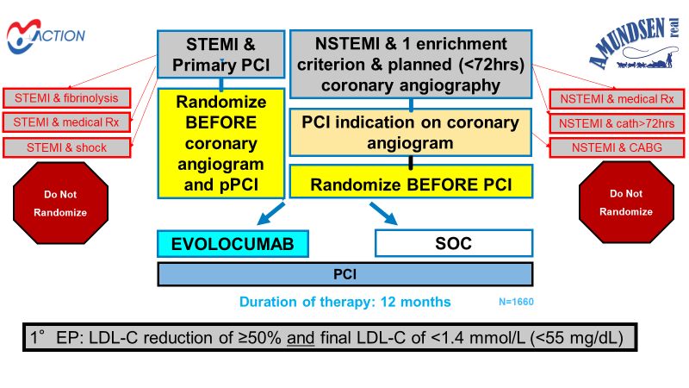
Benefit of early loading to PCI time for PCSK9 inhibition
STEMI and
primary PCI
NSTEMI, 1 enrichment
criterion, and planned (<72 hours)
coronary angiography
STEMI and fibrinolysis
NSTEMI and
medical treatment
Randomise
before
coronary
angiogram
and primary PCI
STEMI and medical Rx
PCI indication on coronary
angiogram
NSTEMI and catheterisation:
>72 hours
STEMI and shock
Randomise before PCI
NSTEMI and CABG
Do not
randomise
Do not
randomise
Evolocumab
Standard of care
PCI
Duration of therapy: 12 months
N=1,660
Primary endpoint: LDL-C reduction of ≥50% and final LDL-C of <1.4 mmol/L (<55 mg/dL)
CABG, coronary artery bypass graft; LDL-C, low density lipoprotein cholesterol; NSTEMI, non-ST-segment elevation myocardial infarction;
PCI, percutaneous coronary intervention; PCSK9, proprotein convertase subtilisin kexin 9
Montalescot, G. Personal communication

Slide 26
SUMMARY
Appropriate secondary prevention should be utilised in all ACS patients to decrease the risk of further cardiac events
Dual antiplatelet therapy (DAPT) including aspirin and a P2Y₁₂ inhibitor is the current gold standard for the treatment and secondary prevention of ACS
Treatment should also include intensive risk factor intervention, and guideline-directed medical management with high-intensity lipid lowering agents, ACE inhibitors or ARBs and beta-blockers
Further evidence is required to determine the optimum timing of some of these treatments in relation to the index event
ACE, angiotensin-converting enzyme; ARB, angiotensin-receptor blocker
Collet J-P, et al. Eur Heart J. 2020. DOI: 10.1093/eurheartj/ehaa575

Slide 27




REACH CORONARY CONNECT VIA
TWITTER, LINKEDIN, VIMEO & EMAIL
OR VISIT THE GROUP’S WEBSITE http://www.coronaryconnect.com/
Follow us on Twitter
@CoronaryConnect
Follow the
CORONARY CONNECT
Group on LinkedIn
Watch us on the
Vimeo Channel
CORONARY CONNECT
Email
carrie.brubaker
@cor2ed.com

