Slide 2
ACROCOVID II: an international survey on acromegaly management more than 1 year into the COVID-19 pandemic era
Sheila Khawaja¹ , Muriël Marks¹, Mark Gurnell², Maria Fleseriu³
¹World Alliance of Pituitary Organizations, Zeeland, Netherlands; ²Wellcome-MRC Institute of Metabolic Science, University of Cambridge & Addenbrooke’s Hospital, Cambridge, UK; ³Pituitary Center, Oregon Health and Science University, Portland, OR, USA
December 2021

Slide 3
acrocovid
BACKGROUND
Acromegaly is a rare chronic endocrine condition, which requires management by a multidisciplinary team^{1,2}
The real-world impact of COVID-19 on care for people with acromegaly has not been fully established^{3,4}
The 2020 ACROCOVID survey revealed substantial negative impacts on all aspects of care during the early stages of the global pandemic³
OBJECTIVES
The ACROCOVID II survey aimed to improve the understanding of the pandemic’s ongoing effect on care pathways, and the need for changes in delivery of, and access to, care
1. Giustina A, et al. Rev Endocr Metab Disord. 2020;21:667-78; 2. Frara S, et al. Prog Mol Biol Transl Sci. 2016;138:63-83; 3. Giustina A, et al. Endocrine. 71:273-280; 4. Fleseriu M. Front Endocrinol (Lausanne). 2021;12:656025.

Slide 4
Methods
Two surveys were created, targeting people with acromegaly and endocrinologists, respectively
Questions were drafted with input from patients, patient advocates, and endocrinologists
Surveys were available in six languages (English, German, Spanish, Portuguese, Russian, and Simplified Chinese)
The surveys were hosted on a commercial platform (4C Research Solutions) from April 26 to July 6, 2021
Dissemination was supported by a global social media campaign

Slide 5
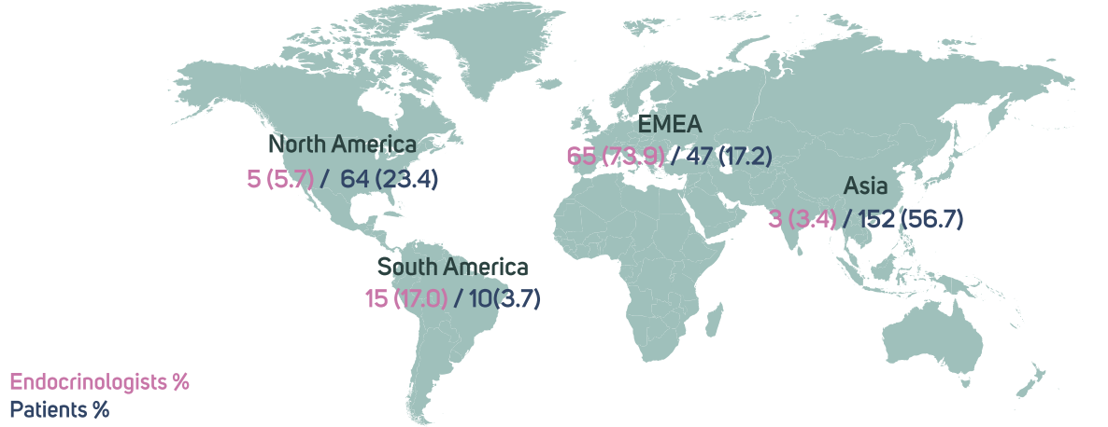
Regional distribution of respondents
Endocrinologists: N = 88; Patients: N = 273; EMEA: Europe, Middle East and Africa

Slide 6
demographics
Most respondents with acromegaly were female (68.9%) and were aged between 31 and 50 (79.1%), with a similar number aged ≤30 (9.9%) or ≥61 (11.0%)
Close to half of patients (46.2%) were diagnosed with acromegaly ≤5 years ago, 27.1% were diagnosed 6-10 years ago, 12.5% 11-15 years ago, and 14.3% >15 years ago
Most endocrinologists worked in a general endocrinology practice (53.4%), rather than a pituitary centre (46.6%)
A fifth of endocrinologists (20.5%) had ≥100 patients under their ongoing care, 40.9% cared for between 21 and 100 patients, and 38.6% ≤20 patients

Slide 7
Demographics and characteristics
Confirmed SARS-CoV-2 infection during the pandemic was uncommon amongst respondents with acromegaly (2.9%)
Close to half of respondents with acromegaly had been vaccinated (46.2%), though prioritization due to an acromegaly diagnosis was uncommon (7.0%)
Conversely, 26.1% of endocrinologists reported that acromegaly patients were part of vaccine priority groups in their country and 25.0% suggested early vaccination for all such patients

Slide 8
Effects on care
Most endocrinologists (62.5%) felt people with acromegaly were at high risk during the pandemic
Just over half of patients sought or were offered advice regarding care during the pandemic (53.5%) and the vast majority of endocrinologists received queries or provided advice (94.3%)
Close to half of respondents agreed that the pandemic had made it harder to live with acromegaly (47.3%)
A minority of both people with acromegaly (25.3%) and endocrinologists (13.6%) reported continuing their in-person care appointments as usual
However, only 41.4% of people with acromegaly and 46.6% of endocrinologists felt their relationship with their care team/patients was negatively affected
Reduced access to endocrinologists (39.2%) and primary care physicians (36.6%) were the most commonly reported barriers to care-team members

Slide 9
Aspects of care negatively affected during the pandemic
Endocrinologists were more likely than people with acromegaly to report issues related to specific aspects of care
HCP: healthcare professional

Slide 10
Remote methods of consultation used during the pandemic
Endocrinologists were more likely to have used most types of remote consultation than individuals with acromegaly (Figure)
49.5% of those with acromegaly and 42.4% of endocrinologists agreed that remote consultation had improved communication during the pandemic; 23.6% and 23.5%, respectively, disagreed
50.0% of those with acromegaly and 69.4% of endocrinologists agreed they would continue to use remote consultation post-pandemic; 19.8% and 11.8%, respectively, disagreed

Slide 11
Changes to treatment
28.9% of people with acromegaly and 25.0% of endocrinologists reported a treatment change was delayed during a period of poor biochemical control
Increases in intervals between somatostatin receptor ligand (SRL) injections and delayed medical treatment after surgery were reported by 16.1% and 15.0% of respondents with acromegaly, respectively
23.9% of endocrinologists recommended a change to self/partner injections of SRLs, and 26.1% could not change dose of medication in symptomatic patients due to an inability to assess IGF-1 levels
Surgery was delayed in 46.9% of people with acromegaly for whom it was scheduled, and 73.9% of endocrinologists had delayed surgery on at least one occasion

Slide 12
Effect of the pandemic on different aspects of day-to-day life
53.8% of respondents with acromegaly reported a negative effect on their financial situation due to the pandemic, and there were broad effects on other aspects of life (Figure)
1 (minimal impact)
2
3
4
5 (Significant negative impact)
100%
90%
80%
70%
60%
50%
40%
30%
20%
10%
0%
Accessing support from family and friends
Ability to perform important activities
How safe I feel at home
Ability to cope with symptoms
Ability to cope with
treatment side effects
Ability to work
My mood
My energy levels
Ability to cope with anxiety
People with acromegaly most commonly reported increased use of medical websites (41.8%), patient advocacy groups (36.3%) and Facebook communities (34.8%) for support or information

Slide 13
Strengths and limitations
This was an open online survey and there was no opportunity to check the veracity of answers nor the identity of those filling out the survey
The large contingent of Chinese respondents (N=142; 52%), herein, reported substantially more positive experiences in coping with their acromegaly than those of other regions, perhaps due to low levels of infection/restrictions following severe lock downs

Slide 14
Conclusions
Our data suggest the COVID-19 pandemic is substantially affecting the clinical care of acromegaly, despite few confirmed SARS-CoV-2 infections in respondents with acromegaly
Physicians appear to be embracing the ‘new normal’ by creating a novel continuum of care better suited to the presumed post-COVID-19 environment
Routine care, including screening for complications, biochemical and imaging monitoring, and medication adjustments, should continue during the pandemic to avoid a rise in non-COVID-19-related morbidity and mortality in chronic rare conditions such as acromegaly
The ability of respondents with acromegaly to maintain their relationships with their care team and the desire of to continue the use of remote communications post-pandemic suggest a potential positive shift in care patterns for this rare disease

Slide 15
Acknowledgments and Disclosures
This project was developed by COR2ED, funded by an independent medical educational grant from Ipsen.
Editorial and writing support was provided by Ewen Legg, PhD, of COR2ED.
MF Grants/scientific consultancy with Chiasma, Crinetics, Ionis, Ipsen, Pfizer, Recordati.
MG, MM & SK – none to declare

Slide 16
Connect on
LinkedIn @COR2ED
Watch on
Vimeo @COR2ED
Visit us at
cor2ed.com
Follow us on
Twitter @COR2EDMedEd

