Slide 1
Integrating patient preference into treatment decisions for advanced prostate cancer Dr. Alicia K. Morgans, MD, MPH Dana-Faber Cancer Institute, Boston, MA, USA DECEMBER 2021

Slide 2
Disclaimer and disclosures
Please note: The views expressed within this presentation are the personal opinions of the authors. They do not necessarily represent the views of the author’s academic institution or the rest of the GU CONNECT group.
This content is supported by an independent educational grant from Bayer.
Dr. Alicia K. Morgans has received financial support/sponsorship from the following companies:
Honoraria/consulting: Astellas, AstraZeneca, AAA, Bayer, Clovis, Dendreon, Janssen, Lantheus, Myriad, Merck, Myovant, Novartis, Pfizer, Sanofi, Seattle Genetics
Research collaborations/Grants: Astellas, Bayer, Myovant, Sanofi, Seattle Genetics

Slide 3
Clinical Disease-States Model of Prostate Cancer
What is advanced prostate cancer?
Castration-resistant prostate cancer (CRPC) is a form of advanced prostate cancer. CRPC means the prostate cancer is growing or spreading even though testosterone levels are low from hormone therapy
Clinical metastases: noncastrate
Clinically localised disease
Rising PSA Noncastrate
mCRPC: 1st line
mCRPC: 2nd line
mCRPC: line X
nmCRPC
Noncastrate
Castration-resistant
mCRPC: 3rd line, 4th line, etc.
(n)mCRPC, (non)metastatic castration-resistant prostate cancer; PSA, prostate-specific antigen
Scher HI, et al. J Clin Oncol. 2016;34:1402-18

Slide 4
Patient-centred care can improve outcomes
Patient-Centred Care
Patient satisfaction
Adherence to treatment plans
Clinical outcomes
Pain
Psychological distress
Quality of life
Disease-specific outcomes
Informed, activated, participatory patient and family
Accessible, well-organised, responsive health system
Patient-centred communicative clinician
Improved communication
Improved health outcomes
Schmittdiel J, et al. J Gen Intern Med. 2008;23:77-80; Epstein RM, et al. National Cancer Institute, NIH Publication No. 07-6225. Bethesda, MD, 2007; Meterko M, et al. Health Serv Res. 2010;45:1188-204; Glasgow RE, et al. Diabetes Care. 2005;28:2655-61; Kehl KL, et al. JAMA Oncol. 2015;1:50-8

Slide 5
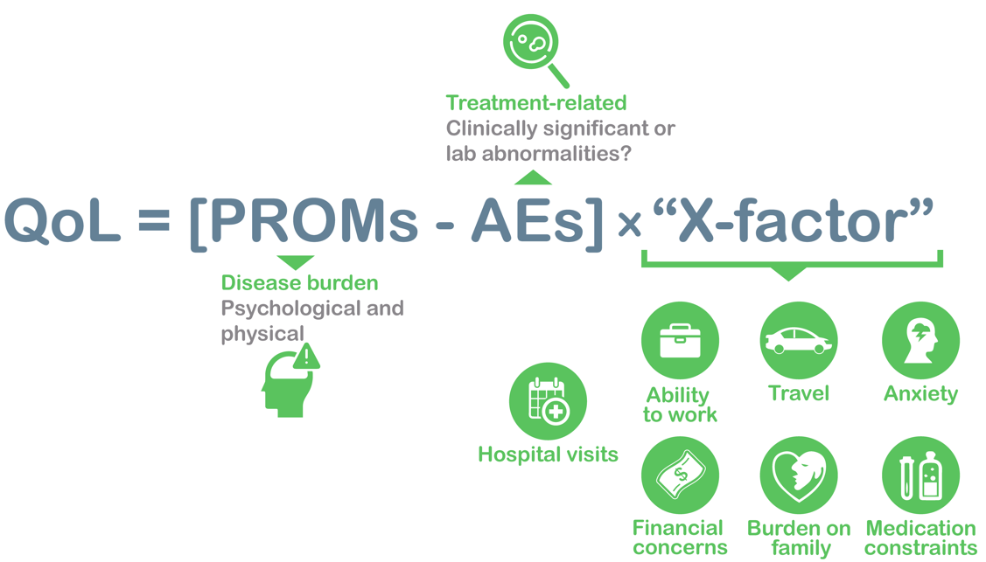
What contributes to QoL?
AE, adverse event; PROM, patient-reported outcome measure; QoL, quality of life

Slide 6
Treatment Is Associated With Maintenance of HRQoL
SGARIs prolonged survival while maintaining HRQoL. No treatment-induced deterioration in overall QoL as measured by FACT-P total score
Delay in time to deterioration was also observed in some items evaluated
Study/SGARI | QoL Instrument | Median time to deterioration, Mo (95% CI) |  | P-value
 |  | SGARI | Placebo | P-value
SPARTAN¹ (apalutamide) | FACT-P total score | 6.6 (5.6-8.3) | 8.4 (6.5-12.9) | 0.60
 | FACT-P PCS | 3.8 (3.7-4.7) | 3.8 (2.9-4.8) | 0.60
PROSPER² (enzalutamide) | FACT-P total score | 22.11 (18.63-25.86) | 18.43 (14.85-19.35) | 0.037
 | FACT-P PCS | 18.43 (14.85-18.66) | 14.69 (11.07-16.20) | 0.0042
 | EORTC QLQ-PR25 Urinary | 36.86 (33.35-NR) | 25.86 (18.53-29.47) | <0.0001
 | EORTC QLQ-PR25 Bowel | 33.15 (29.50-NR) | 25.89 (18.43-29.67) | 0.0018
ARAMIS³ (darolutamide) | FACT-P PCS | 11.07 (11.04-11.14) | 7.88 (7.46-11.07) | 0.0005
 | EORTC QLQ-PR25 Urinary | 25.8 (22.0-33.1) | 14.8 (11.2-15.1) | <0.0001
 | EORTC QLQ-PR25 Bowel | 18.4 (14.8-18.5) | 11.5 (11.1-14.8) | 0.0027
CI, confidence interval; EORTC QLQ-PR25, European Organisation for Research and Treatment of Cancer Quality of Life Questionnaire; FACT-P, Functional Assessment of Cancer Therapy–Prostate; HRQoL, health-related quality of life; Mo, month; NR, not reached; PCS, Prostate Cancer Subscale; QoL, quality of life; SGARIs, second-generation androgen receptor inhibitors
1. Oudard S, et al. Eur Urol. Focus 2021. DOI: 10.1016/j.euf.2021.08.005; 2. Tombal B, et al. Lancet Oncol. 2019;20:556-69; 3. Smith MR, et al. Eur J Cancer. 2021;154:138-46

Slide 7
Adverse Events in nmCRPC
Safety | SPARTAN^{1,2} |  | PROSPER³ |  | ARAMIS⁴
 | APA (N=803) | PBO (N=398) | ENZA (N=930) | PBO (N=465) | DARO (N=954) | PBO (N=554)
Any AE, n (%) | 781 (97) | 373 (94) | 876 (94) | 380 (82) | 818 (85.7) | 439 (79.2)
Any serious AE, n (%) | 290 (36) | 99 (25) | 372 (40) | 100 (22) | 249 (26.1) | 121 (21.8)
AE leading to discontinuation, % | 120 (15) | 29 (7.3) | 158 (17.0) | 41 (9.0) | 85 (8.9) | 48 (8.7)
AE leading to death, n (%) | 24 (3.0) | 2 (0.5) | 51 (5.0) | 3 (1.0) | 38 (4.0)^{c} | 19 (3.4)^{c}
AE (all grades), %
Fatigue | 33 | 21 | 37 | 16 | 13.2 | 8.3
Hypertension | 28 | 21 | 18 | 6 | 7.8 | 6.5
Rash | 26 | 6.3 | 4 | 3 | 3.1 | 1.1
Falls | 22 | 9.5 | 18 | 5 | 5.2 | 4.9
Fractures | 18 | 7.5 | 18 | 6 | 5.5 | 3.6
Mental impairment disorderª | 5.1^{b} | 3.0^{b} | 8 | 2 | 2.0 | 1.8
ª SPARTAN: disturbance in attention, memory impairment, cognitive disorder and amnesia; PROSPER: disturbance in attention, cognitive disorders, amnesia, alzheimer's disease, mental impairment, dementia, vascular dementia and senile dementia; ARAMIS trial: MedRA High Level Group Term; ^{b} Data taken from first interim analysis as not reported in final analysis¹; ^{c} reported as grade 5 adverse event
Presented for information, safety comparisons across trials should not be made
AE, adverse event; APA, apalutamide; DARO, darolutamide; ENZA, enzalutamide; nmCRPC, nonmetastatic castration-resistant prostate cancer; PBO, placebo
1. Smith MR, et al. N Engl J Med. 2018;378:1408-18; 2. Smith MR, et al. Eur Urol. 2021;79:150-8; 3. Sternberg CN, et al. N Engl J Med. 2020;382:2197-206; 4. Fizazi K, et al. N Engl J Med. 2020;383:1040-9

Slide 8
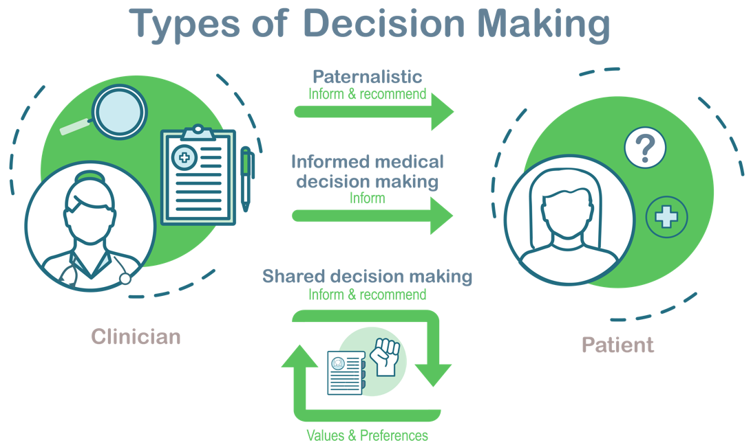
Other patient factors must also guide treatment choice
Patient preferences critical, especially in settings of multiple treatment options
Preferences may relate to obligations at home or work, past experiences, fears, cost of care, and others
Pain and other symptoms that could prompt palliative radiation or other specialty care should also be discussed
Van Stam M-A, et al. The Journal of Urology 2018; 200: 582-589;https://www.therapeuticassociates.com/shared-decision-making/

Slide 9
Drugs for cv indications and their metabolic pathways
Drug Class | Drugs | Indications | Metabolic Pathway | Management of Interaction
Anti-coagulant | rivaroxaban | Stroke; embolism prophylaxis; DVT | CYP3A4 and P-gp substrate | Avoid apalutamide; reduced rivaroxaban exposure
 | dabigatran | Stroke; embolism prophylaxis; DVT | P-gp substrate | Avoid apalutamide; reduced dabigatran exposure
 | apixaban | Stroke; embolism prophylaxis; DVT | CYP3A4 and P-gp substrate | Avoid apalutamide; reduced apixaban exposure; increased risk of stroke
 | heparin | DVT; arterial thromboembolism | RES | NA
 | warfarin | Prophylaxis of thromboembolism | CYP2C9 and CYP3A4 | Strong potential for apalutamide and enzalutamide to reduce warfarin exposure
Anti-platelet agent | clopidogrel | Arterial thromboembolism prophylaxis; MI; unstable angina; TIA | CYP2C8 inhibitor, CYP2C19 | Monitor for increased apalutamide-related AEs; avoid coadministration with enzalutamide due to increased prasugrel exposure
 | prasugrel | Arterial thromboembolism prophylaxis; MI; unstable angina | CYP3A4 and CYP2B6 substrate | None noted
 | ticagrelor | Arterial thromboembolism prophylaxis in patients with ACS | CYP3A4 substrate | Avoid apalutamide or enzalutamide coadministration due to decreased ticagrelor exposure
ACE inhibitor | captopril | HTN; heart failure | Hepatic, renal, P-gp inhibitor | NA
 | enalapril | HTN | Renal | NA
 | lisinopril | HTN; heart failure | Renal | NA
 | perindopril | HTN | Hepatic, renal | NA
Angiotensin receptor blocker | candesartan | HTN; heart failure | Renal, fecal | NA
 | losartan | HTN; stroke prophylaxis in patients with LVH; heart failure | CYP2C9, CYP3A4 substrate | NA
 | valsartan | HTN; heart failure; reduction of mortality in patients with LVD or LVH following MI | CYP2C9 substrate | NA
Beta-blocker | atenolol | HTN; angina; acute MI | Renal, faecal | NA
 | propranolol | HTN; angina; heart rate control | CYP2C19, CYP2D6, CYP1A2, P-gp substrate | Monitor for reduced effect if apalutamide or enzalutamide coadministered
 | sotalol | Maintenance of normal sinus rhythm; ventricular arrhythmias; AF prophylaxis | Renal | NA
 | metoprolol | Angina; HTN; heart failure; MI; heart rate control | CYP2D6 substrate | NA
 | carvedilol | HTN; heart failure; reduction of mortality in patients with LVD following MI, angina, heart rate control | CYP2D6 substrate; CYP2C9, CYP3A4, CYP2C19, CYP1A2, CYP2E1, P-gp substrate and inhibitor | Monitor for decreased efficacy if apalutamide coadministered
ACS, acute coronary syndrome; AEs, adverse events; AF, atrial fibrillation; CV, cardiovascular; CYP, cytochrome; DVT, deep vein thrombosis; HTN, hypertension; LVD, left ventricular dysfunction; LVH, left ventricular hypertrophy; MI, myocardial infarction; NA, not applicable; P-gp, P-glycoprotein; RES, reticuloendothelial system; TIA, transient ischaemic attack
Morgans AK, et al. Urol Oncol. 2021;39(1):52-62

Slide 10
Key phase 3/4 trials in mcrpc
Overall survival results
Study | Treatments | N | Population | HR | 95% CI; p value
TAX 327¹ | Docetaxelª/prednisone vs mitoxantrone/prednisone | 1,006 | mCRPC | 0.76 | 0.62-0.94; p=0.009
TROPIC² | Cabazitaxel/prednisone vs mitoxantrone/prednisone | 755 | mCRPC (post docetaxel) | 0.70 | 0.59-0.83; p<0.0001
COU-AA-301³ | Abiraterone/prednisone vs placebo/prednisone | 1,195 | mCRPC (post docetaxel) | 0.74 | 0.64-0.86; p<0.0001
COU-AA-302⁴ | Abiraterone/prednisone vs placebo/prednisone | 1,088 | mCRPC (chemotherapy naive) | 0.81 | 0.70-0.93; p=0.0033
PREVAIL⁵ | Enzalutamide vs placebo | 1,717 | mCRPC (pre chemotherapy) | 0.71 | 0.60-0.84; p<0.001
AFFIRM⁶ | Enzalutamide vs placebo | 1,199 | mCRPC (post docetaxel) | 0.63 | 0.53-0.75; p<0.001
ALSYMPCA⁷ | Radium-223 vs placebo | 921 | mCRPC | 0.70 | 0.58-0.83; p<0.001
IMPACT⁸ | Sipuleucel-T vs placebo | 512 | mCRPC (pre chemotherapy^{b}) | 0.78 | 0.61-0.98; p=0.03
CARD⁹ | Cabazitaxel/prednisone vs ASTI^{c} | 255 | mCRPC (post docetaxel and post abiraterone or enzalutamide) | 0.64 | 0.46-0.89; p=0.008
PROfound¹⁰ | Olaparib vs ASTI^{c} | 387 | mCRPC with HRR mutations (post abiraterone or enzalutamide or both. Previous taxane chemotherapy^{d} was allowed)) | 0.69e | 0.50-0.97; p=0.02
VISION¹¹ | ¹⁷⁷Lu-PSMA-617 + SOC vs SOC^{f} | 831 | PSMA-positive mCRPC previously treated with next-generation androgen receptor signaling inhibition and 1–2 taxane regimens | 0.62 | 0.52-0.74; p<0.001
ª 3-weekly docetaxel cycle; ^{b} 18.2% had received previous treatment with chemotherapy; ^{c} enzalutamide or abiraterone plus prednisone; ^{d} approximately 65% of patients had previously received taxanes; ^{e} Results for cohort A of study: patients with alterations in BRCA1, BRCA2, ATM; ^{f} SOC was investigator determined but excluded cytotoxic chemotherapy and radium-223
ASTI, androgen signaling targeted inhibitor; ATM, ataxia telangiectasia mutated; BRCA1/2, breast cancer 1/2; CI, confidence interval; HR, hazard ratio; HRR, homologous recombination repair; mCRPC, metastatic castration-resistant prostate cancer; PSMA, prostate-specific membrane antigen; SOC, standard of care
1. Tannock IF, et al. N Engl J Med. 2004;351:1502-12; 2. de Bono JS, et al. Lancet. 2010;376:1147-54; 3. Fizazi K, et al. Lancet Oncol. 2012;13;983-92; 4. Ryan CJ, et al. Lancet Oncol. 2015;16:152-60; 5. Beer TM, et al. N Engl J Med. 2014;371:424-33; 6. Scher HI, et al. N Engl J Med. 2012;367:1187-97; 7. Parker C, et al. N Engl J Med. 2013;369:213-23; 8. Kantoff PW, et al. N Engl J Med. 2010;363:411-22; 9. de Wit R, et al. N Engl J Med. 2019;381:2506-18; 10. Hussain M, et al. N Engl J Med. 2020;383:2345-57; 11. Morris MJ, et al. J Clin Oncol. 2021;39 suppl 18:LBA4

Slide 11
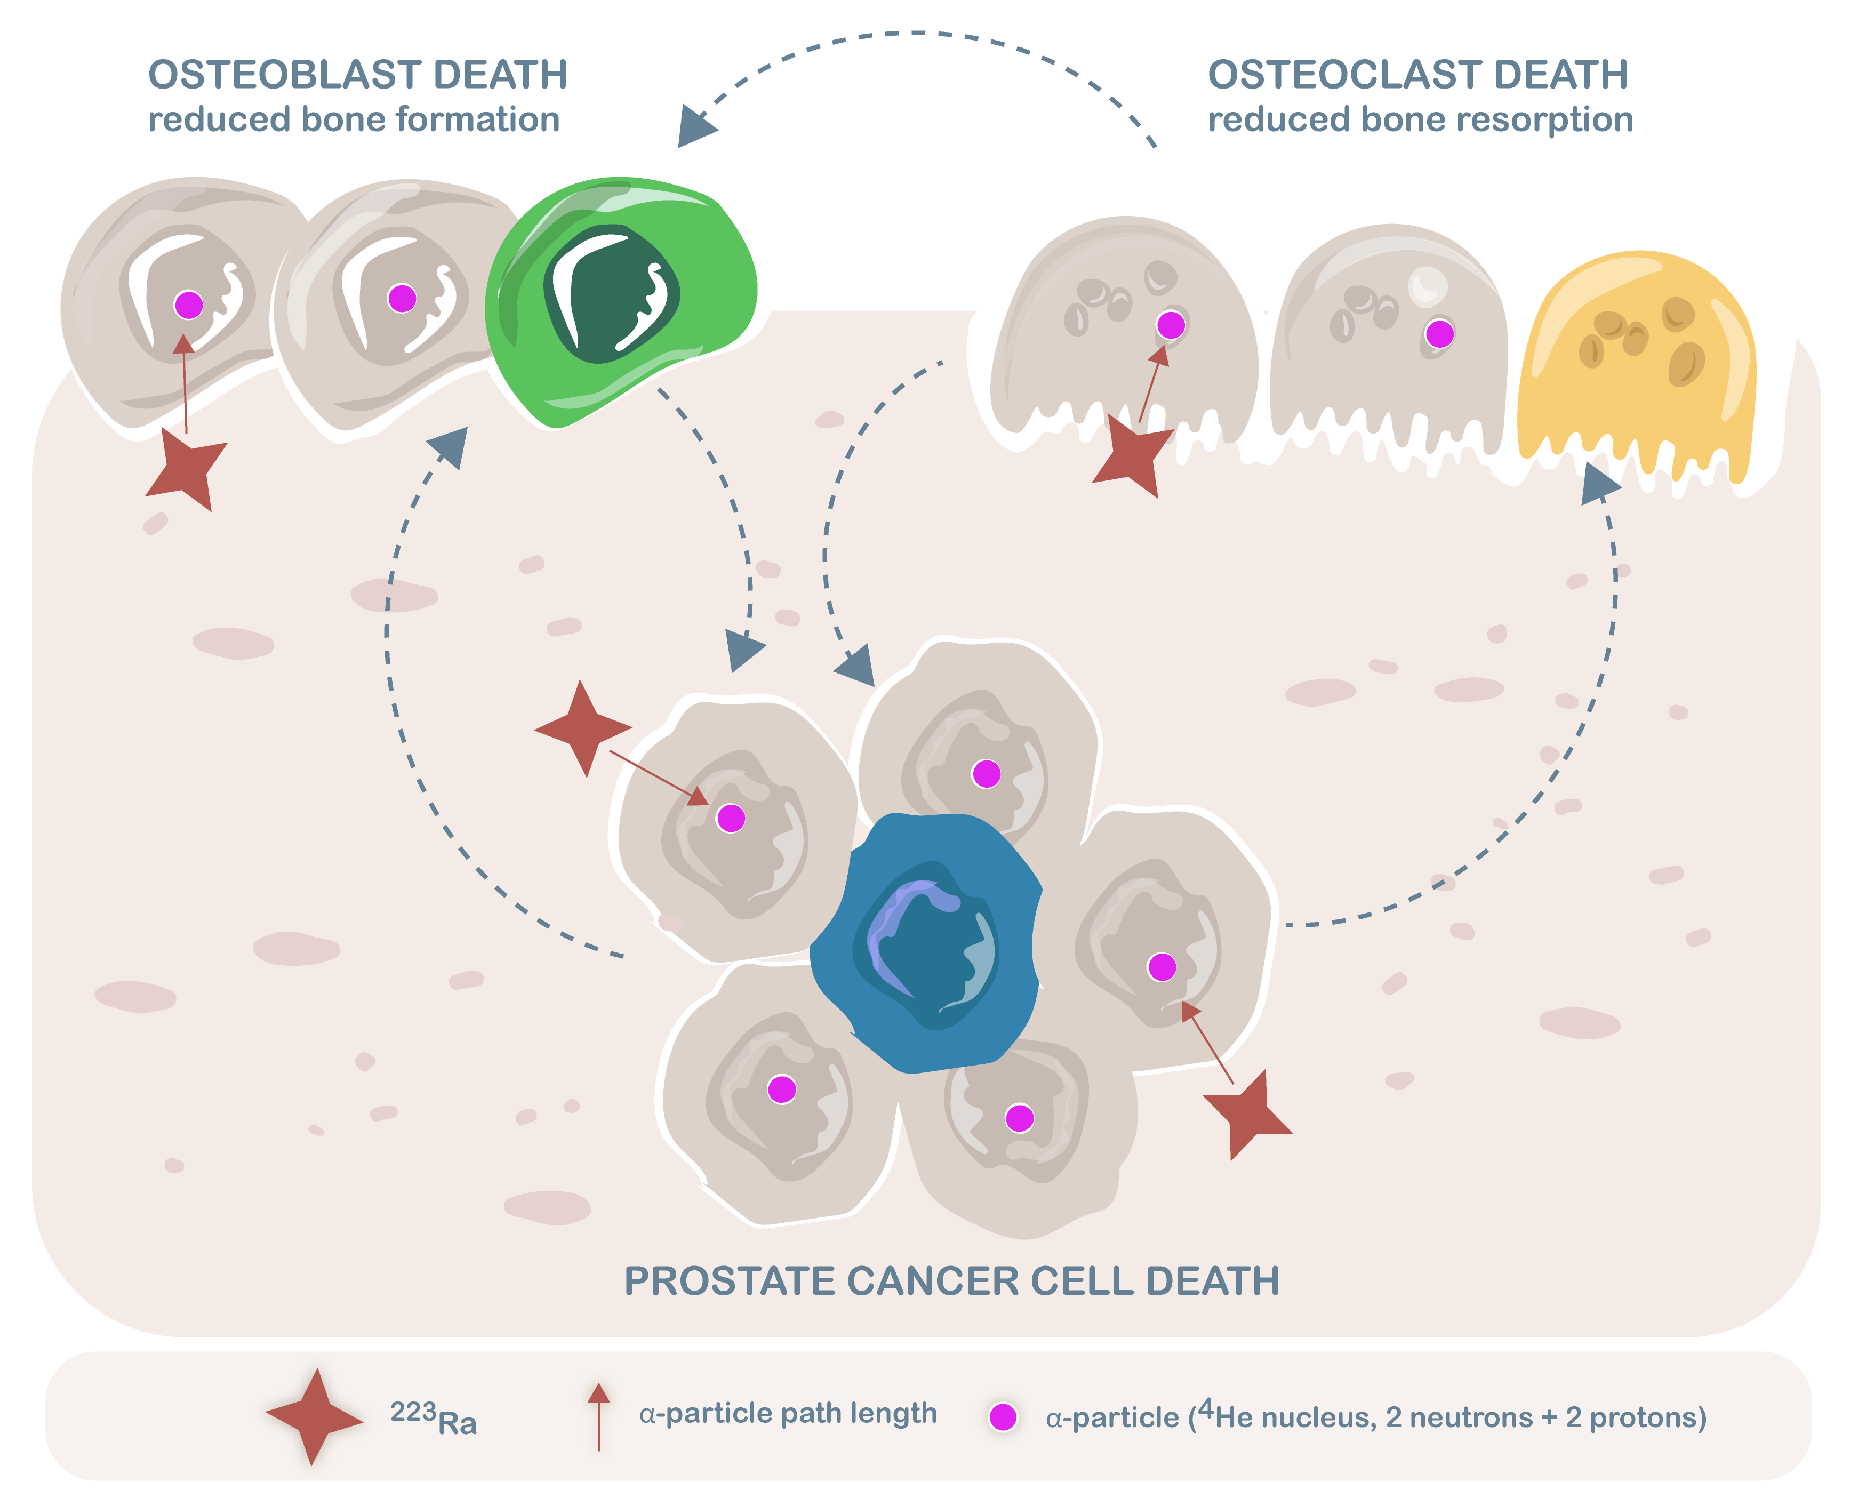
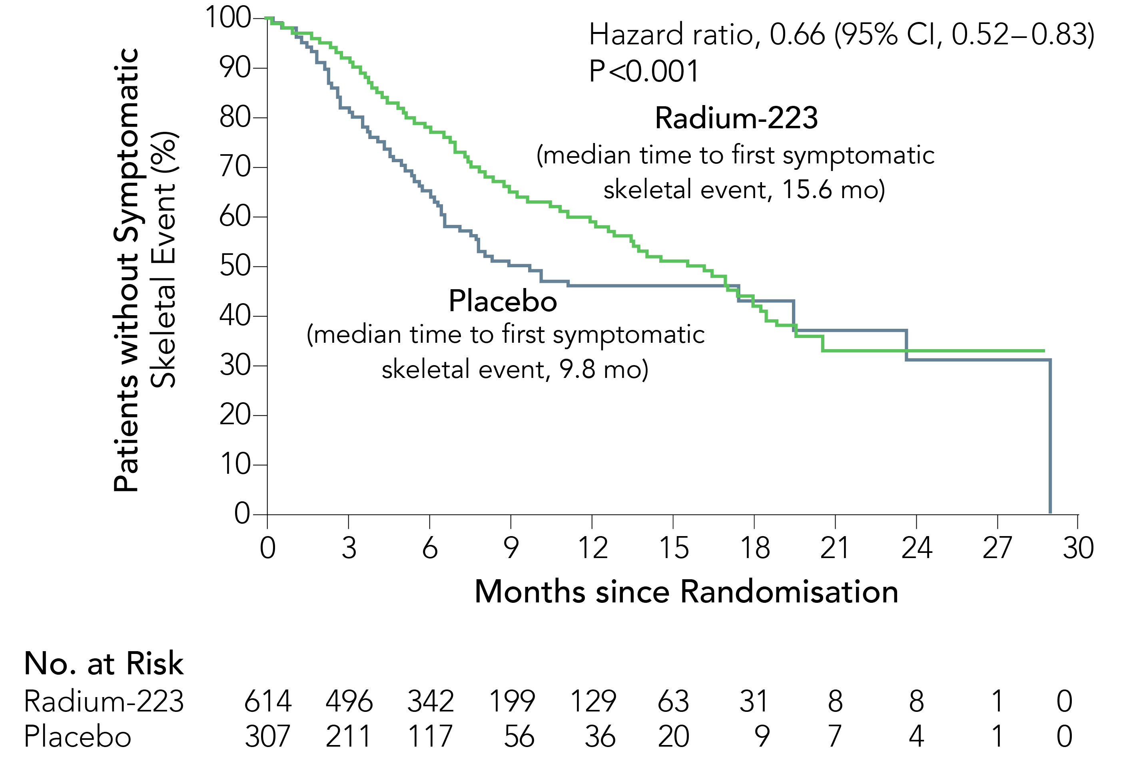
Symptom management: focus on pain
Mechanism of action of radium-223
TIME TO FIRST SKELETAL EVENT
⁴He, helium-4; ²²³Ra, radium-223; CI, confidence interval; mo, months
Morris MJ, et al. Nat Rev Urol. 2019;16:745-56; Parker C, et al. N Engl J Med. 2013;369:213-23

Slide 12
conclusions
Involving patients in shared decision making for treatment of advanced prostate cancer is critical
Patient preferences for quality-of-life outcomes and medication-related factors must be considered
Optimise comorbidity management via engagement with specialists and primary care teams, and remember drug-drug interactions
Pain is a top priority for patients and should be addressed via treatment of the cancer or use of other strategies (pain medications, palliative radiation, etc)

Slide 13
REACH GU CONNECT VIA TWITTER, LINKEDIN, VIMEO & EMAIL OR VISIT THE GROUP’S WEBSITE http://www.guconnect.cor2ed.com
Follow us on Twitter @guconnectinfo
Follow the GU CONNECT group on LinkedIn
Watch us on the Vimeo Channel GU CONNECT
Email sam.brightwell@cor2ed.com

