Slide 2
Disclaimer
Please note: The views expressed within this presentation are the personal opinion of the author. They do not necessarily represent the views of the author’s academic institution or the rest of the NTRK and SARCOMA CONNECT groups.
This content is supported by an Independent Educational Grant from Bayer.

Slide 3
introduction

Slide 4



An integrated approach to care is key in paediatric oncology
A multidisciplinary approach is key to long-term efficacy in paediatric oncology¹
Cancer does not respect age boundaries (child/adolescent/adult)²
  Increased translation of treatment approaches between paediatric and adult care is beginning²
1. Cantrell MA and Ruble K. J Multidiscip Healthc. 2011;4:171–81; 2. Mody RJ, et al. Pediatr Blood Cancer. 2017;64:26288.

Slide 5
From Ewing-like to Cic-Dux

Slide 6
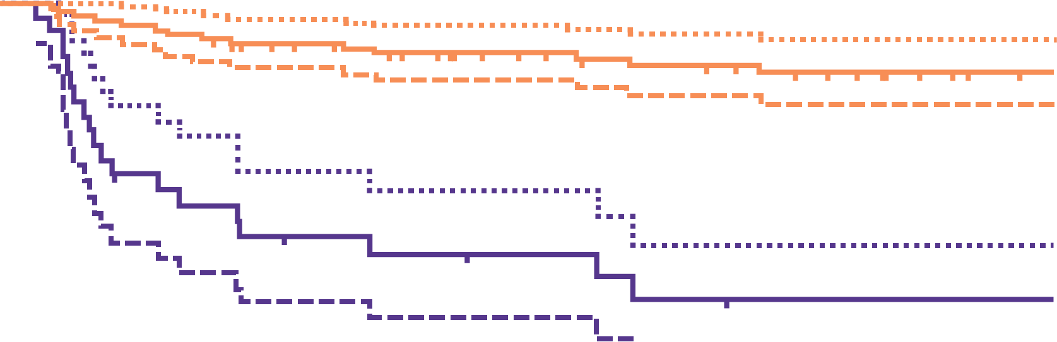
Long-term survival: ewing sarcoma
Long-term survival outcomes
are excellent for localised paediatric
Ewing sarcoma¹
Long-term survival in adults is
less favourable²
  HR for death based on 5-year overall
  survival (≥ 18 years vs < 18 years):
  2.02; 95% CI: 1.53–2.67, P < 0.001²
Long term OS in Paediatric
ewing sarcoma¹
100
Localised disease
80
60
Metastatic disease
Patient survival
40
P<0.0001
20
0
0
2
4
6
8
10
12
14
No. at risk
Localised
Metastatic
Years
77
24
72
11
63
6
53
5
47
3
44
1
38
1
34
1
Long term OS in Paediatric vs
adult ewing sarcoma²
CI, confidence interval; HR, hazard ratio; OS, overall survival
1. Hamilton SN, et al. Am J Clin Oncol 2017;40:423–8; 2. Davenport JR, et al. Pediatr Blood Cancer 2016;63:1091–5

Slide 7
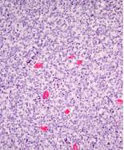
Molecular classification of small blue round cell tumours
A number of molecular subtypes of small-round blue cell tumour have been defined in recent years^{1–3}
CIC-DUX4 gene fusion is the most common mutation found in non‑Ewing (EWSR1-negative) small blue round cell tumours²
PREDOMINANT CIC-DUX PHENOTYPE SHOWING SOLID SHEETS OF ROUND TO OVOID CELLS³
Haematoxylin and eosin stain
CIC-DUX4, capicua–double homeobox 4; EWSR1, Ewing sarcoma RNA binding protein 1
1. Folpe AL, et al. Am J Surg Pathol 2005;29:1025–33; 2. Antonescu CR, et al. Am J Surg Pathol 2017;41:941–49;
3. Carter CS, Patel RM. Surg Pathol Clin. 2019;12:191-215.

Slide 8
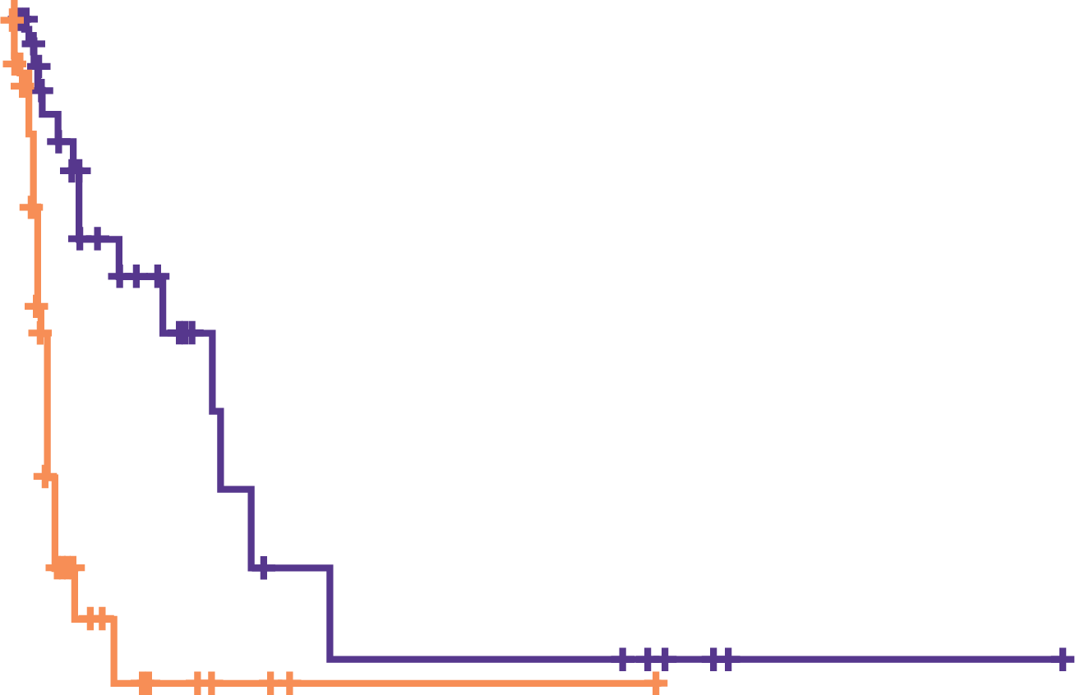
cic-dux tumours are a distinct clinical and molecular tumour subset
Tumours with CIC-DUX fusions appears in children, adolescents, and adults¹
  Dx range 6–81 years,
  mean 32 years¹
  22% were < 18 years of age¹
CIC-DUX tumours are aggressive with much less favourable outcomes that Ewing sarcoma¹
Global initiatives will be necessary to allow pooling of data to test therapies in these newly defined rare molecular subtypes²
Survival outcomes in CIC-DUX
vs ewing sarcoma¹
1.0
Genetic rearrangement
CIC
EWSR
CIC-censored
EWSR-censored
0.8
0.6
Cum. survival
0.4
0.2
P=0.002
0.0
0
100
200
300
400
500
Months
CIC-DUX, capicua–double homeobox; Cum., cumulative; Dx, diagnosis; EWSR, Ewing sarcoma RNA binding protein
1. Antonescu CR, et al. Am J Surg Pathol 2017;41:941–49;
2. Mathoulin-Pélissier S, Pritchard-Jones K. Eur J Surg Oncol. 2019;45:22-30.

Slide 9
NTRK gene Fusions in sarcoma

Slide 10
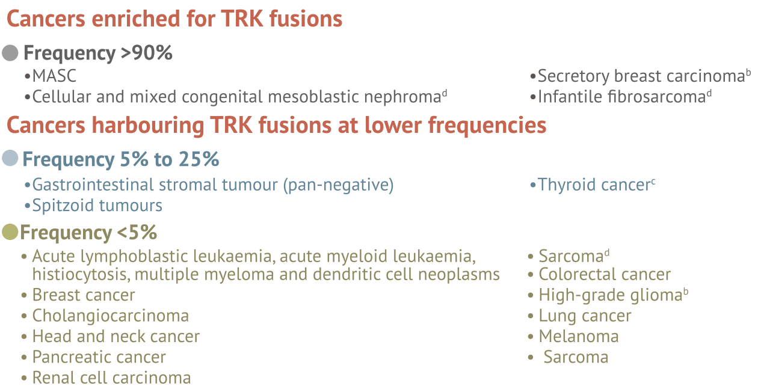
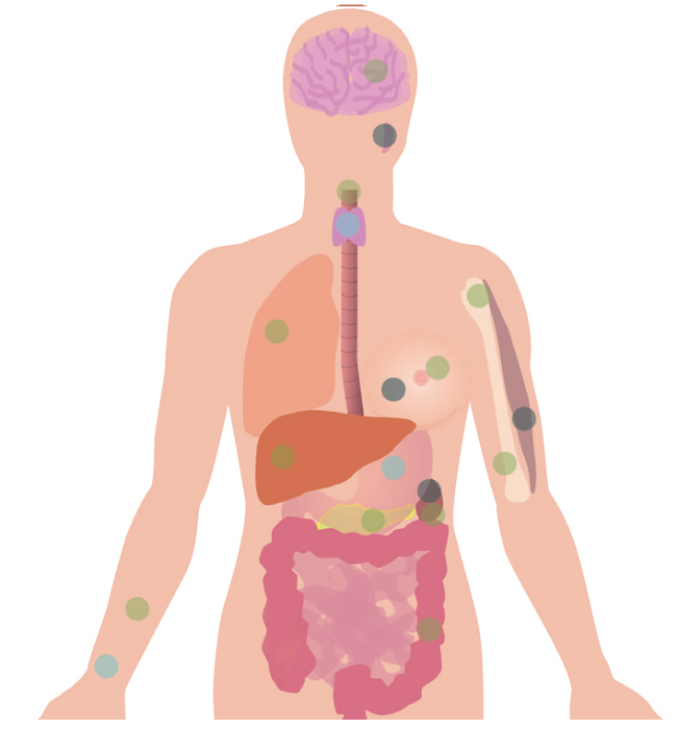
NTRK gene fusions have a high incidence in sarcoma
NTRK genes (NTRK1, NTRK2 or NTRK3) encode the TRK receptors (TRKA , TRKB and TRKC, respectively)^{1,2}
There is a high incidence of NTRK gene fusions in both paediatric and adult sarcomas^{1,3}
  Around ¼ of adult NTRK gene fusions positive tumours are sarcomas²
TUMOURS CLASSIFICATION BY NTRK GENE FUSIONS²
Incidence of NTRK gene fusions in sarcoma³
Gynaecological
4%
Neuroendocrine
6%
Cholangiocarcinoma
2%
Pancreatic
6%
Sarcoma NOS, n=7
Cervical
adenosarcoma, n=1
Dedifferentiated
chondrosarcoma, n=1
Endometrial stromal
sarcoma, n=1
Follicular dendritic cell
sarcoma, n=1
GIST, n=1
MPNST, n=1
Sarcoma
24%
CRC
7%
Thyroid
9%
NSCLC
19%
Breast
11%
MASC
13%
CRC, colorectal cancer; GIST, gastrointestinal stromal tumour; NOS, not otherwise specified; MASC, mammary analogue secretory carcinoma; MPNST, malignant peripheral nerve sheath tumour; NSCLC, non-small cell lung cancer; NTRK, neurotrophic tropomyosin-related kinase; TRK, tropomyosin receptor kinase
1. Cocco, et al. Nat Rev Clin Oncol 2018;15:731–47; 2. NTRK CONNECT BluePrint. Available from: https://ntrkconnect.info/ntrk-gene-fusions-trk-inhibitors-and-testing-approaches-blueprint/. Accessed March 2020; 3. Doebele, et al. Lancet Oncology 21:271-282; 21:271–82

Slide 11
TRK-inhibition provides robust responses in patients with NTRK gene fusion-positive sarcoma
EFFICACY OF LAROTRECTINIB IN SARCOMAS HARBOURING TRK FUSIONS: BEST CHANGE IN TARGET LESIONS
+93.2
%
50
40
30
20
10
0
-10
-20
Maximum change in tumour size (%)
-30
-40
-50
-60
-70
-80
-90
STS
IFS
GIST
Bone sarcoma
-100
Data cut-off: Feb 19, 2019
IFS, infantile fibrosarcoma; NTRK, neurotrophic tropomyosin receptor kinase; STS, soft tissue sarcoma; TRK, tropomyosin receptor kinase; GIST, gastrointestinal stromal tumour
Demetri GD, et al. CTOS 2019. Abstract #3254588

Slide 12
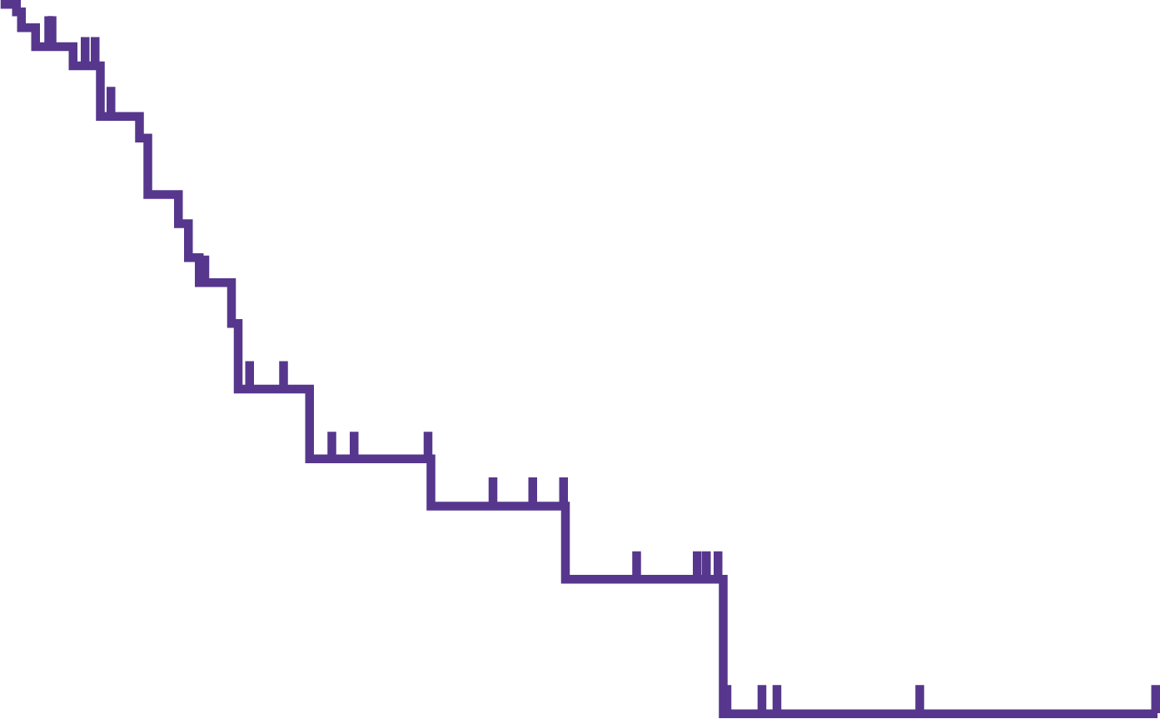
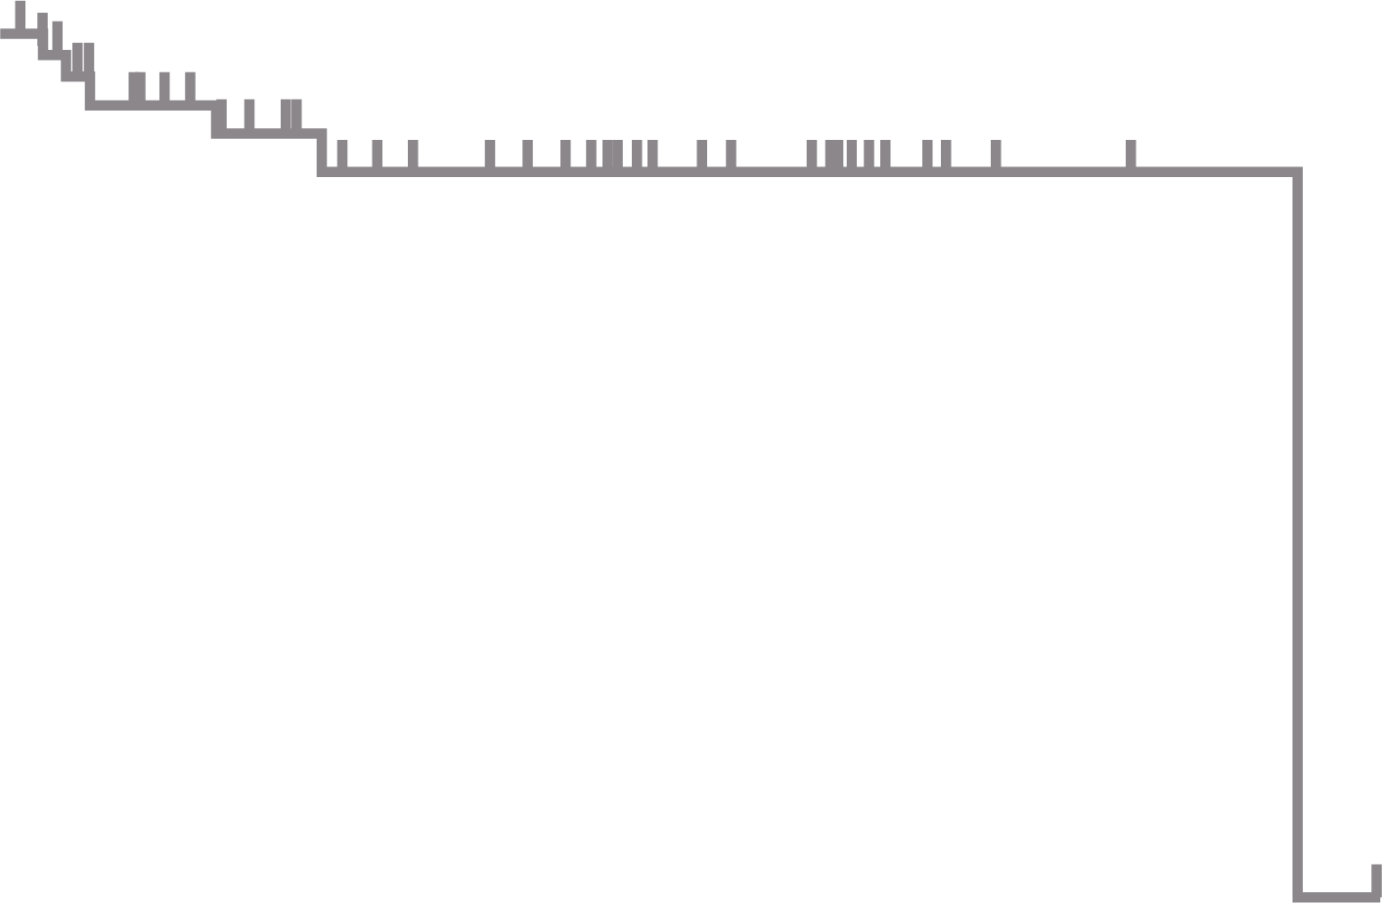
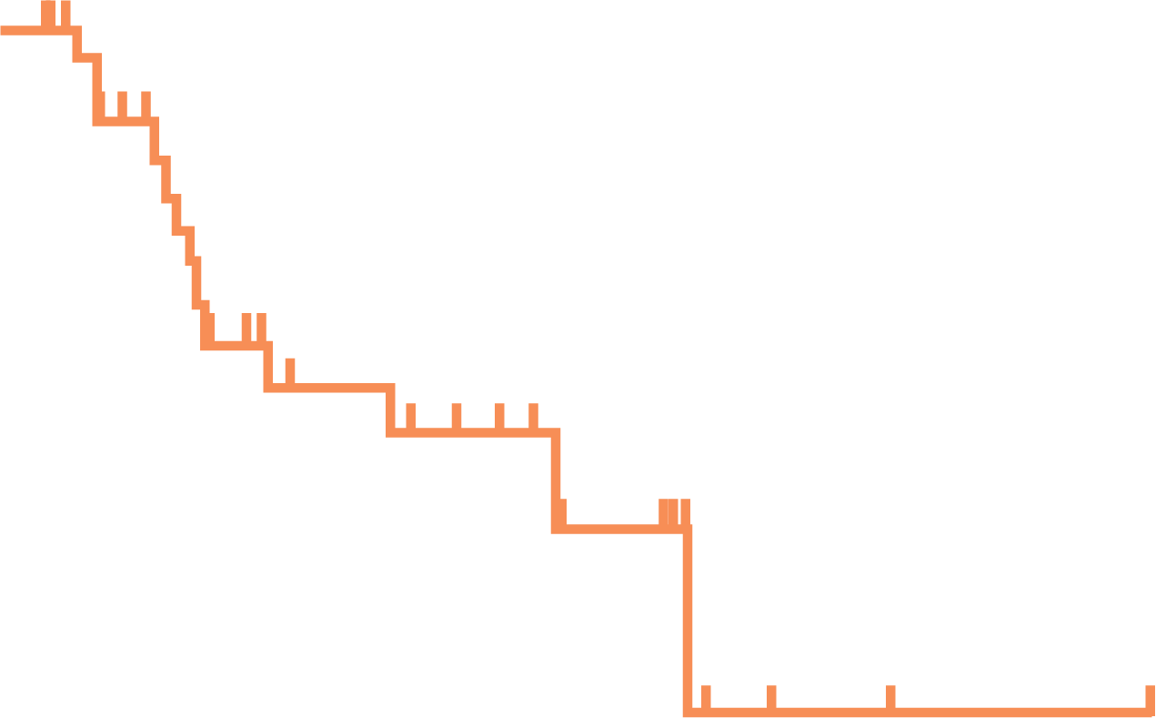
TRK-inhibition provides durable responses in patients with NTRK gene fusion-positive sarcoma
DURATION OF RESPONSE
PROGRESSION-FREE
SURVIVAL
OVERALL SURVIVAL
100
100
100
86%
91%
91%
75
75%
75
67%
75
Progression-free survival (%)
Duration of response (%)
50
Overall survival (%)
50
50
Median: NE
(range 1.6+ to 44.2+ months)
Median follow-up: 15.6 months
Median: 28.3 months
(95% CI 16.8–NE)
Median follow-up: 13.0 months
Median: 44.4 months
(95% CI 44.4–NE)
Median follow-up: 14.1 months
25
25
25
0
0
0
0
6
12
18
24
30
36
42
48
0
6
12
18
24
30
36
42
48
0
6
12
18
24
30
36
42
48
No.
at
risk
Months from start of response
Months from start of treatment
Months from start of treatment
54
37
22
14
9
2
1
1
0
71
41
25
20
10
3
1
1
0
71
53
36
29
17
8
3
2
0
Data cut-off: Feb 19, 2019
NE, not estimable; NTRK, neurotrophic tropomyosin receptor kinase; TRK, tropomyosin receptor kinase
Demetri GD, et al. CTOS 2019. Abstract #3254588

Slide 13
Where can we find ntrk gene Fusions in sarcoma?
Established tumour subtypes with ntrk gene Fusions
It is unclear which of the many sarcoma subtypes are likely to harbour NTRK gene fusions
Screening methods are expensive and must be targeted
Tumours with translocations of EWSR1 in Ewing sarcoma or KIT in GIST are unlikely to harbour NTRK gene fusions
  More research is required to confirm these observations
Infantile fibrosarcoma with ETV6‑NTRK3 gene Fusions¹
Wild-type GIST²
emerging tumour subtypes with ntrk gene Fusions
Spindle cell tumours with RAF1, BRAF & NTRK1/2 gene fusions³
Infantile fibrosarcoma-like with BRAF & NTRK1 gene fusions^{4,5}
Lipofibromatosis-like neural tumours with NTRK1 gene fusions⁶
NTRK3 gene fusions positive sarcomas⁵
ETV6, translocation-ETS-leukaemia; EWSR1, Ewing sarcoma RNA binding protein 1; GIST, gastrointestinal stromal tumour; KIT, proto-oncogene c-KIT; NTRK, neurotrophic tropomyosin receptor kinase
1. Fletcher CDM et al. WHO Classiﬁcation of Tumours of Soft Tissue and Bone. 4th ed. Lyon, France: IARC Press; 2013.; 2. Cocco E, et al. Nat Rev Clin Oncol 2018;15:731–47; 3. Suurmeijer AJH, et al. Genes Chromosomes Cancer 2018;57:611–21; 4. Kao Y-C, et al. Am J Surg Pathol 2018;42:28–38; 5. Agaram NP, et al. Am J Surg Pathol 2016;40:1407–16; 6. Suurmeijer AJH, et al. Genes Chromosomes Cancer 2019;58:100–10

Slide 14
Succinate-dehydrogenase deficient gist

Slide 15
sdh-deficient gist predominates in the under 20s
Kit/pdgfra genotypes predominate in gist overall^{1,2}
SDHB negative (sdh-deficient) gist by age group⁴
80–90% of GIST cases are positive for a KIT or PDGFRA mutation
  KIT positive approximately 65–75%
  PDGFRA positive approximately 10–20%
GIST in the paediatric and young adult population displays a different pattern of mutations³
250
Negative
Positive
200
150
Number of patients
100
50
0
0-19
20-29
30-39
40-49
50-59
60-69
70-79
80-89
90-99
Age (years)
Slide adapted from S. Bauer, ESMO Sarcoma and GIST 2020
BRAF, proto-oncogene B-Raf; FGFR3, Fibroblast Growth Factor Receptor 3; GIST, gastrointestinal stromal tumour; KIT, proto-oncogene c-KIT; PDGFRA, platelet-derived growth factor receptor alpha; PIK3CA, phosphatidylinositol-4,5-bisphosphate 3-kinase catalytic subunit alpha; SDH, succinate dehydrogenase; SDHB, succinate dehydrogenase complex iron sulphur subunit B. 1. Heinrich MC. ASCO 2010: educational session; 2. Mavroeidis L, et al. ESMO Open. 2018;3:e000335; 3. Rink L, Godwin AK. Curr Oncol Rep. 2009;11:314; 4. Miettinen M, et al. Am J Surg Pathol 2011;35:1712–21

Slide 16
Sunitinib has efficacy in KIT/PDGFRA WT paediatric gist
Baseline Characteristics and Response to
Treatment in Paediatric GIST Patients
Case | Age |  |  |  | Genotype |  | Responseª |  | Time to tumour progression
 | Dx | Study entry^{b} | Gender | Morphology | KIT | PDGFRA | IM | SU | IM | SU | SU versus IM
1 | 17 | 17 | F | Epithelioid | WT | WT | PD | SD | <1 | 7 | +6
2 | 8 | 10 | F | Epithelioid | WT | WT | Adjuvant | PR | 14 | >21 | +7
3 | 13 | 16 | F | Epithelioid | WT | WT | SD | SD | 12 | 8 | –4
4 | 15 | 16 | M | Epithelioid | WT | WT | SD | SD | 16 | 18 | +2
5 | 15 | 16 | F | Spindle | WT | WT | PD | SD | <1 | >18 | +17
6 | 16 | 16 | M | Mixed | NA | NA | PD | PD | <1 | <1 | 0
7 | NA | 14 | F | NA | NA | NA | SD | SD | 12 | 18 | +6
ªAssessed based on RECIST; ^{b}Age at time of enrolment
Slide adapted from S. Bauer, ESMO Sarcoma and GIST 2020
Dx, age at diagnosis; F, female; GIST, gastrointestinal stromal tumour; KIT, proto-oncogene c-KIT; IM, imatinib; M, male; NA, not available; PD, progressive disease; PDGFRA, platelet-derived growth factor receptor alpha; PR, partial response; RECIST, Response Evaluation Criteria in Solid Tumours; SD, stable disease; SU, sunitinib; WT, wild-type
Janeway KA, et al. Pediatr Blood Cancer 2009;52:767–71

Slide 17
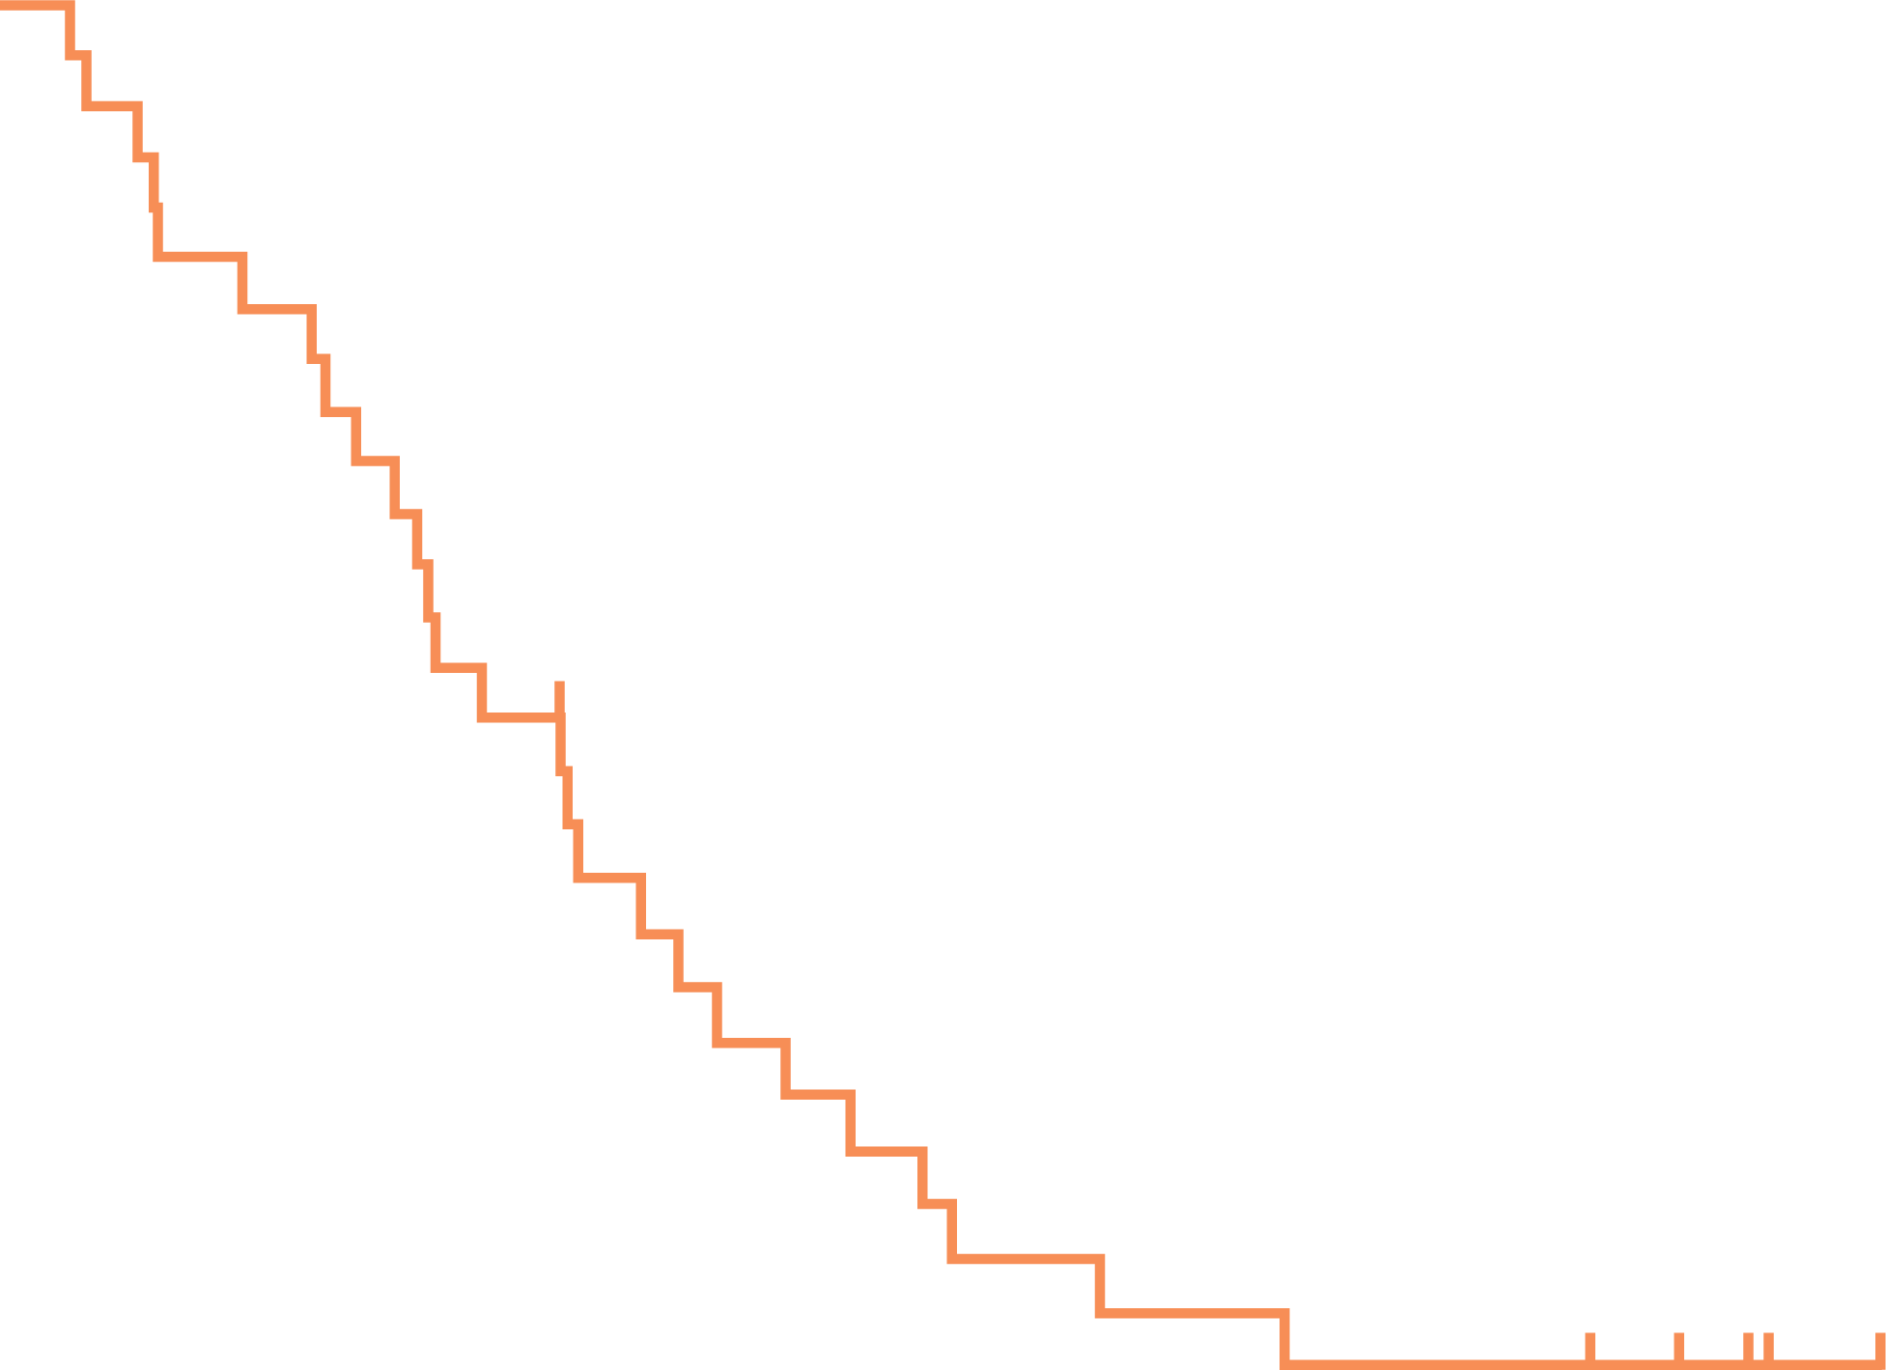
Regorafenib has demonstrated efficacy in metastatic sdh-deficient gist
PFS in full populationª
CBR and PFS by genotype
1.00
0.75
Proportion progression-free
Median PFS = 13.2 months
(95% CI: 9.2 to 18.3)
0.50
0.25
0
0
6
12
18
24
30
36
42
Time (months)
No. at risk
32
26
18
11
7
5
5
1
ªPatients with metastatic GIST refractory to standard TKI therapy (at least imatinib and sunitinib)
Slide adapted from Bauer S. ESMO Sarcoma and GIST 2020
CBR, clinical benefit rate; CI, confidence interval; ESMO, European Society for Medical Oncology; GIST, gastrointestinal stromal tumour; KIT, proto-oncogene c-KIT; PFS, progression-free survival; SDH, succinate dehydrogenase; TKI, tyrosine-kinase inhibitor
Ben-Ami E, et al. Ann Oncol 2016;27:1794–9

Slide 18
Regorafenib has demonstrated efficacy in metastatic sdh-deficient gist
PFS in full populationª
CBR and PFS by genotype
1.00
Genotype | Patients (%) | CBR % (95% CI) | Median PFS (months)
KIT Exon 11 | 19 (59) | 79 (54 to 94) | 13.4
KIT Exon 9 | 3 (9) | 67 (9 to 99) | 5.7
SDH deficient | 6 (18) | 100 (54 to 100) | 10
BRAF exon 15 | 1 (3) | 0 | N/A
SDH unknown, BRAF intact | 1 (3) | 0 | N/A
Unknown | 3 (9) | 67 (9 to 99) | N/A
Total | 33 (100) | 76 (58 to 89) | 13.2
0.75
Proportion progression-free
Median PFS = 13.2 months
(95% CI: 9.2 to 18.3)
0.50
0.25
0
0
6
12
18
24
30
36
42
Time (months)
No. at risk
32
26
18
11
7
5
5
1
ªPatients with metastatic GIST refractory to standard TKI therapy (at least imatinib and sunitinib)
Slide adapted from Bauer S. ESMO Sarcoma and GIST 2020
CBR, clinical benefit rate; ESMO, European Society for Medical Oncology; GIST, gastrointestinal stromal tumour; KIT, proto-oncogene c-KIT; PFS, progression-free survival; SDH, succinate dehydrogenase; TKI, tyrosine-kinase inhibitor
Ben-Ami E, et al. Ann Oncol 2016;27:1794–9

Slide 19
targeting of kit and fgfr may offer a new approach in sdh-deficient gist
Response of mouse PDX confirms dependence of
SDH-deficient GIST on FGF signalling
28-day treatment
Observation
No treatment
2,500
During treatment:ª
Vehicle control +672%
KIT inhibition +482%
FGFR inhibition –10%
Combination –36%
*
*
*
*
*
2,000
*
*
*
*
1,500
Tumour size (mm³)
During observation:ª
FGFR inhibition
Combination
1,000
*
*
*
500
0
0
10
20
30
40
50
ªP values reflect the difference in tumour growth between groups per two-way ANOVA (*P < 0.05, **P < 0.001, ***P < 0.0001)
Days
ANOVA, analysis of variance; FGF, fibroblast growth factor; FGFR, FGF receptor; GIST, gastrointestinal stromal tumour; KIT, proto-oncogene c-KIT; PDX, patient-derived xenograft; SDH, succinate dehydrogenase
Flavahan WA, et al. Nature 2019;575:229–33

Slide 20
summary
Cancer does not respect age boundaries, a multidisciplinary approach should bridge paediatric and adult cancer care
Pooling of global data will be a necessary approach in rare molecular tumour subtypes
CIC-DUX positive tumours are a distinct from Ewing sarcomas and have less favourable outcomes
Sarcomas represent around 25% of tumours with NTRK gene fusions
  TRK-inhibitors have demonstrated robust and durable responses
SDH-deficient GIST predominates in the under 20s
  Sunitinib and regorafenib have demonstrated efficacy in SDH-deficient GIST
CIC-DUX, capicua–double homeobox; GIST, gastrointestinal stromal tumour; SDH, succinate dehydrogenase; NTRK, neurotrophic tropomyosin receptor kinase; TRK, tropomyosin receptor kinase

Slide 21
REACH SARCOMA CONNECT VIA
TWITTER, LINKEDIN, VIMEO & EMAIL
OR VISIT THE GROUP’S WEBSITE http://www.sarcomaconnect.info
Follow us on Twitter
@sarcomaconnect
Follow the
Sarcoma CONNECT
group on LinkedIn
Watch us on the
Vimeo Channel
Sarcoma CONNECT
Email
Froukje.sosef1
@cor2ed.com

Slide 22
REACH NTRK CONNECT VIA
TWITTER, LINKEDIN, VIMEO & EMAIL
OR VISIT THE GROUP’S WEBSITE http://www.ntrkconnect.info
Follow us on Twitter
@ntrkconnectinfo
Follow the
NTRK CONNECT
group on LinkedIn
Watch us on the
Vimeo Channel
NTRK CONNECT
Email
froukje.sosef
@cor2ed.com

Slide 23
Dr. Antoine Lacombe
Pharm D, MBA
Phone: +41 79 529 42 79
antoine.lacombe@cor2ed.com
Dr. Froukje Sosef
MD
Phone: +31 6 2324 3636
froukje.sosef@cor2ed.com

