Slide 2
Recent developments in the treatment of DLBCL Prof. Georg Lenz, MD Department of Haematology, Oncology and Pneumology University Hospital Münster, Germany May 2020

Slide 3
DISCLAIMER and disclosures
LYMPHOMA CONNECT is supported by an Independent Educational Grant from Bayer
The views expressed within this presentation are the personal opinions of the author. They do not necessarily represent the views of the authors’ academic institutions or the rest of the LYMPHOMA CONNECT group
DISCLOSURES PROF. LENZ Celgene, Janssen, Roche, Gilead, Bayer, BMS, Hexal, AstraZeneca, MorphoSys, NanoString, Takeda, Abbvie

Slide 4
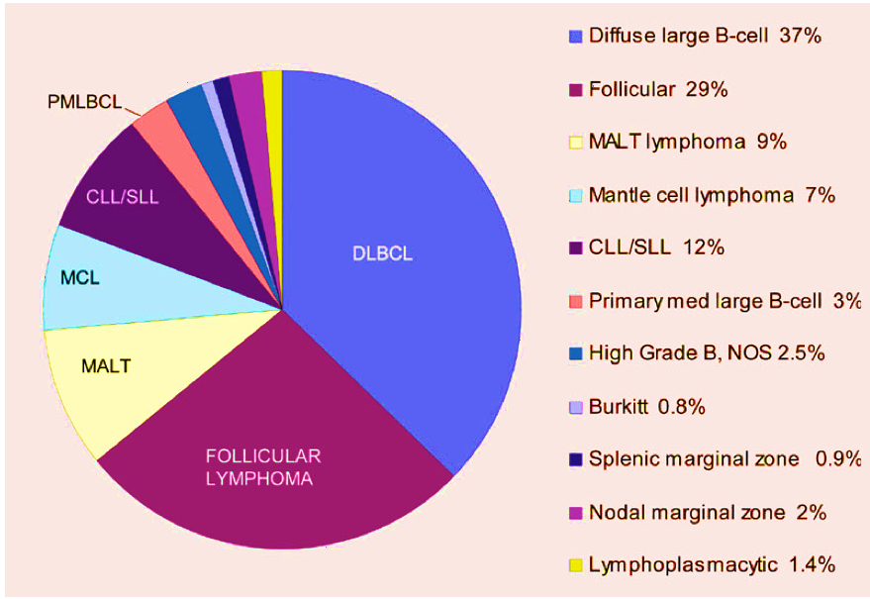
Diffuse large B-cell lymphoma (DLBCL) represents the most frequent lymphoma subtype
CLL, chronic lymphocytic leukaemia; DLBCL, diffuse large B-cell lymphoma; MALT, mucosa-associated lymphoid tissue; MCL, mantle-cell lymphoma; NOS, not otherwise specified; PMLBCL, primary mediastinal large B-cell lymphoma; SLL, small lymphocytic lymphoma
Swerdlow SH, et al. WHO Classification of Tumours of Haematopoietic and Lymphoid Tissues. Revised 4th Edition, volume 2. 2008.

Slide 5
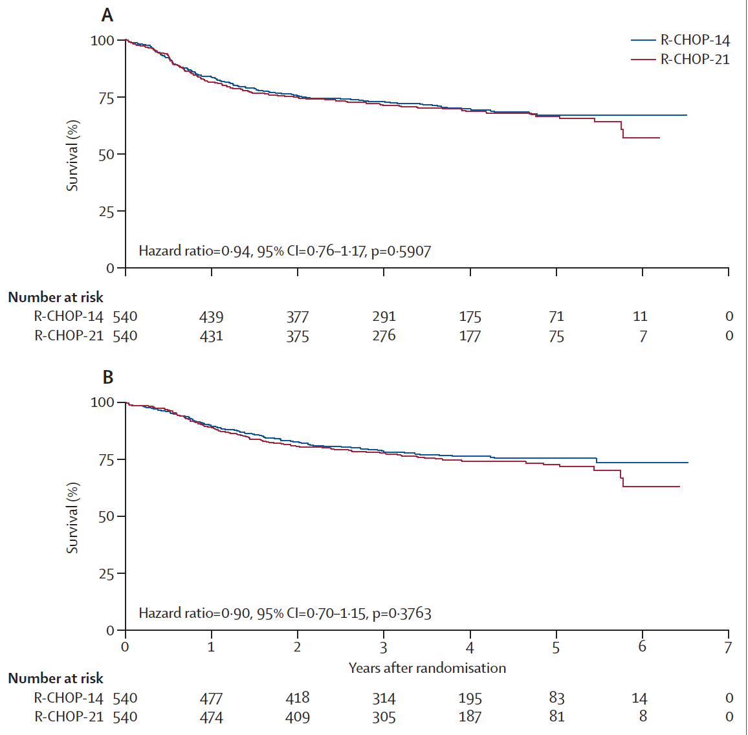
Roughly 70% of DLBCL patients can be cured with R-CHOP
Progression-free survival
Overall survival
CI, confidence interval; DLBCL, diffuse large B-cell lymphoma; R-CHOP, rituximab-cyclophosphamide-doxorubicin hydrochloride-vincristine-prednisolone
Cunningham D, et al. Lancet 2013; 381:1817-26

Slide 6
PHOENIX trial R-CHOP + ibrutinib vs R-CHOP + placebo in Previously Untreated non-GCB DLBCL

Slide 7
PHOENIX: double-blind, placebo-controlled phase 3 study¹ Study design
Key eligibility criteria
Untreated non-GCB DLBCL
Determined by Hans-based IHC at a central laboratory
Retrospectively analysed for ABC subtype using GEP
Stage II to IV measurable disease
R-IPI ≥1
ECOG performance status ≤2
End points
Primary end point: EFS† in ITT (non-GCB) and ABC subgroup
Secondary end points: PFS, CR rate, OS, safety
Response assessed per Revised Response Criteria for Malignant Lymphoma²
N=838
R-CHOP (6-8 cycles*) + placebo
Randomiseª
1:1
*As prespecified by site
R-CHOP (6-8 cycles*) + 560 mg ibrutinib
ªStratified by R-IPI, region, and number of prespecified treatment cycles (6 vs 8 cycles)
Prophylactic antibiotics and G-CSF were not mandated but were permitted at the investigator’s discretion per local or other standard guidelines
†EFS: time from randomization to PD, relapse from CR, initiation of subsequent disease-specific therapy for PET-positive or biopsy-proven residual disease after ≥6 cycles of R-CHOP, or any-cause death
ABC, activated B-cell; CR, complete response; DLBCL, diffuse large B-cell lymphoma; ECOG, Eastern Cooperative Oncology Group; EFS, event-free survival; GCB, germinal centre B cell-like; GEP, gene expression profiling; G-CSG, granulocyte colony stimulating factor; IHC, immunohistochemistry; ITT, intent-to-treat; OS, overall survival; PD, progressive disease; PET, positron emission tomography; PFS, progression-free survival; R-CHOP, rituximab-cyclophosphamide-doxorubicin hydrochloride-vincristine-prednisolone; R-IPI, revised International Prognostic Index
1. Younes A, et al. J Clin Oncol 2019; 37; 1285-95. 2. Cheson BD, et al. J Clin Oncol 2007;25:579-86

Slide 8
Phoenix Primary end point: EFS in the ITT and ABC population
Overall response (89.3% vs 93.1%) and CR rates (67.3% vs 68.0%) were similar in the ibrutinib + R-CHOP and placebo + R-CHOP arms in the ITT population
CNS progression was observed in 10 (2.4%) vs 16 (3.8%) patients in the ibrutinib + R‑CHOP and placebo + R-CHOP arms
ABC, activated B-cell; CI, confidence interval; CNS, central nervous system; CR, complete response; EFS, event-free survival; ITT, intent-to-treat; R-CHOP, rituximab-cyclophosphamide-doxorubicin hydrochloride-vincristine-prednisolone
Younes A, et al. J Clin Oncol 2019; 37; 1285-95

Slide 9
Phoenix Efs and os in patients <60 years (ITT population)
10.8%
Ibrutinib + R-CHOP improved EFS and OS vs placebo + R-CHOP in patients <60 years of age
Subgroup analyses showed that EFS benefit was consistent across most subgroups for baseline factors
A similar trend with age was seen in patients with the ABC subtype (HR [95% CI]: 0.532 [0.307-0.922] for EFS; HR [95% CI]: 0.345 [0.138-0.862] for OS)
More patients on the placebo + R-CHOP arm received subsequent antilymphoma therapy (16.2% vs 21.6%)
ABC, activated B-cell; CI, confidence interval; EFS, event-free survival; HR, hazard ratio; OS, overall survival; R-CHOP, rituximab-cyclophosphamide-doxorubicin hydrochloride-vincristine-prednisolone
Younes A, et al. J Clin Oncol 2019; 37; 1285-95

Slide 10



ROBUST trial R²-CHOP vs Placebo/R-CHOP in Previously Untreated ABC-Type DLBCL

Slide 11
ROBUST: Phase 3 study Study Design
Multicentre, randomised, double-blind, placebo-controlled, phase 3 study in 282 global sites^{1,2}
Primary endpoint: PFS by central review (per 2014 IWG)^{1,3}
Secondary endpoints: EFS (key secondary), OS, ORR, CR rate, DOR, and safety¹
Stratification by
IPI score (2 vs ≥3)
Bulky disease (< 7 vs ≥7 cm)
Age (<65 vs ≥65 years)
R²-CHOP (n=285)
Lenalidomide PO 15 mg, d1-14 + R-CHOP 21-day cycles × 6 cycles
ABC (N = 570)
1:1
Placebo/R-CHOP (n=285)
Placebo PO d1-14 + R-CHOP 21-day cycles × 6 cycles
Previously Untreated, Stage II-IV, CD20+
DLBCL
Select by GEP NanoString assay
Required neutropenia prophylaxis per local practice with G-CSF/GM-CSF
Non-ABC
Ineligible
ABC, activated B-cell; CR, complete response; d, day; DLBCL, diffuse large B-cell lymphoma; DOR, duration of response; EFS, event-free survival; GEP, gene expression profiling; HR, hazard ratio; IPI, International Prognostic Index; IWG, International Working Group; OS, overall survival; ORR, objective response rate; PFS, progression-free survival; PO, oral administration; R-CHOP, rituximab-cyclophosphamide-doxorubicin hydrochloride-vincristine-prednisolone; R²-CHOP, lenalidomide/R-CHOP
1. Vitolo U, et al. Hematol Oncol 2019;37(S2):36-7; 2. Clinicaltrials.gov NCT02285062 3. Cheson BD, et al. J Clin Oncol 2014;32:3059-68

Slide 12
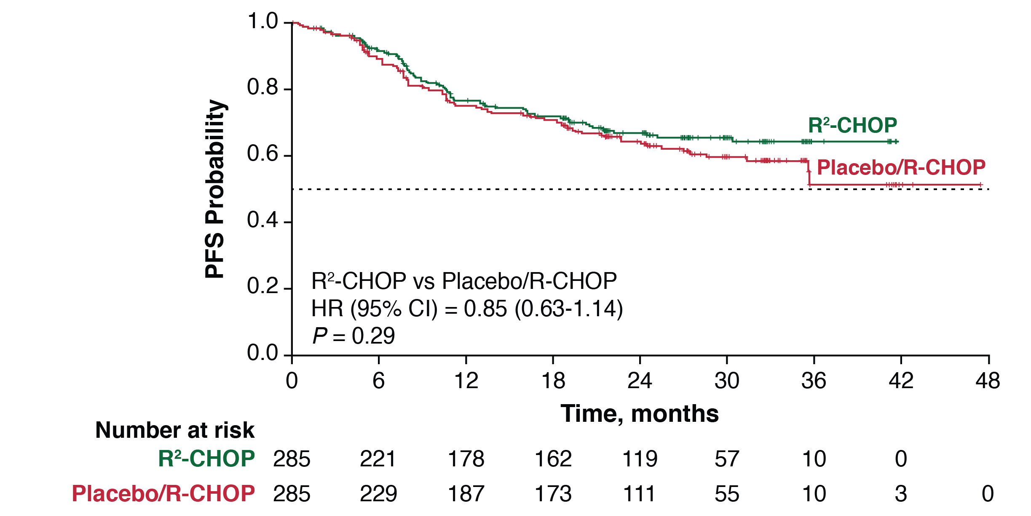
ROBUST Primary Endpoint Progression-Free Survival (ITT, IRAC)
PFS Rates | R²-CHOP (n = 285) | Placebo/ R-CHOP (n = 285)
1 year | 77% | 75%
2 year | 67% | 64%
At a median follow-up of 27.1 months (range 0–47), the primary endpoint of PFS was not met (medians not reached)
Median PFS improved from 24 months with R-CHOP to 38 months with R²-CHOP in ABC-DLBCL (192 events with 90% power; HR = 0.625)
CI, confidence interval; HR, hazard ratio; IRAC, independent response adjudication committee; ITT, intent-to-treat; PFS, progression-free survival; R‑CHOP, rituximab-cyclophosphamide-doxorubicin hydrochloride-vincristine-prednisolone; R²-CHOP, lenalidomide/R‑CHOP
Data cut-off 15 Mar 2019.
Vitolo U, et al. Hematol Oncol 2019;37(S2):36-7

Slide 13
ROBUST Response
R²-CHOP
Placebo/R-CHOP
ORR and CR rates were high in both arms
Median time from diagnosis to treatment was 31 days for each arm
CR, complete response; ORR, objective response rate; R‑CHOP, rituximab-cyclophosphamide-doxorubicin hydrochloride-vincristine-prednisolone; R²-CHOP, lenalidomide/R‑CHOP
Data cut-off 15 Mar 2019. CR was assessed by 2014 IWG criteria with CT-PET (Cheson BD, et al. J Clin Oncol. 2014;32:3059-3068)
Vitolo U, et al. Hematol Oncol 2019;37(S2):36-7

Slide 14
Polatuzumab

Slide 15
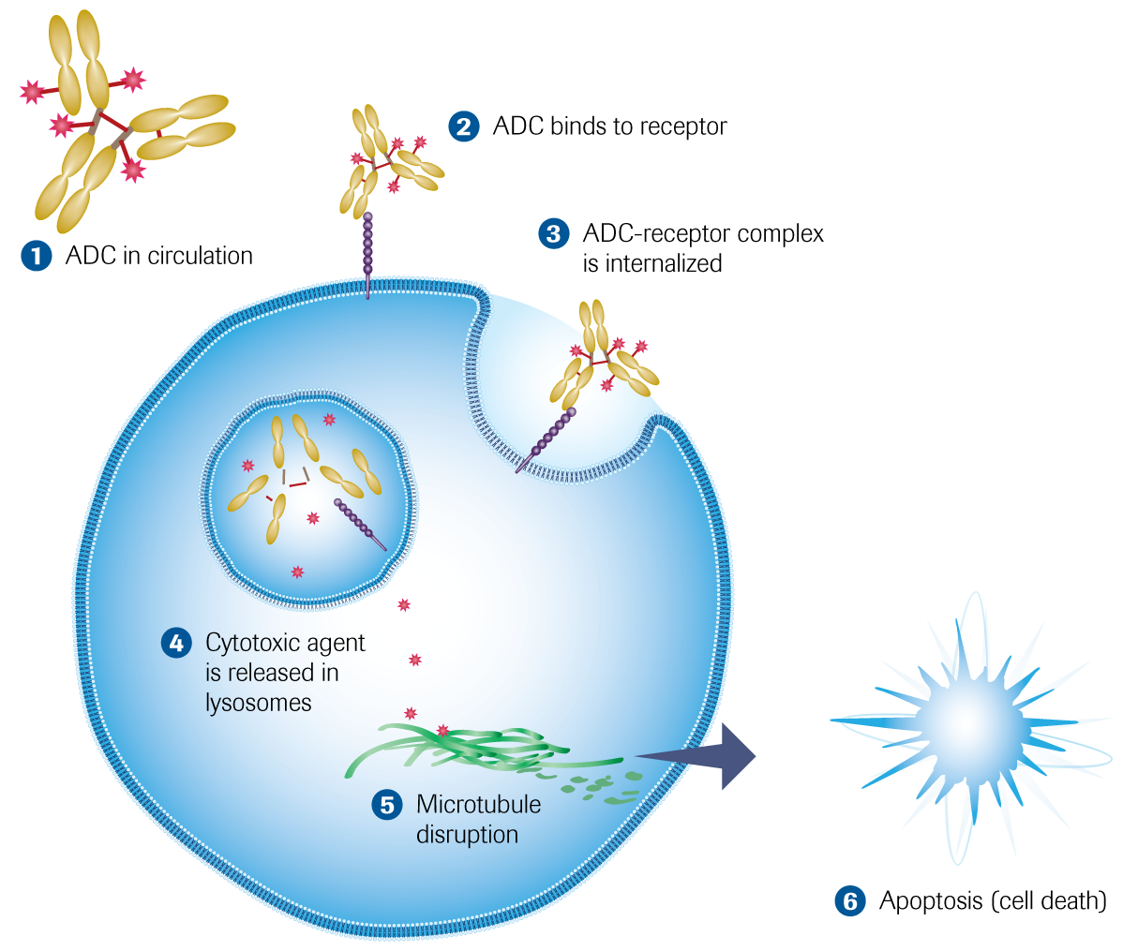
polatuzumab vedotin is an Antibody-drug conjugate (ADC) mechanism of action
ADC, antibody-drug conjugate
Sharman J, et al. EHA 2015

Slide 16
Polatuzumab Phase 1/2 study in DLBCL Study design
Phase 1b safety run-in: Pola-BR or BG¹
R/R
DLBCL
Pola-BR
(N=6)
Pola-BG
(N=6)
R/R
DLBCL
Pola-BG
(N=20)
Phase 2 expansion: Pola-BG¹
Pola-BR
(N=40)
1:1 randomisation Stratification: DoR ≤12mo, >12mo
Phase 2 randomisation: Pola-BR vs. BR
R/R
DLBCL
BR
(N=40)
Treatment administered every 21 days x 6 cycles:
Polatuzumab vedotin: 1.8 mg/kg, C1D2, then D1 for C2+
Bendamustine (B): 90 mg/m², C1D2/3, then D1/2 for C2+
Obinutuzumab (G): 1000 mg, C1D1/8/15, then D1 for C2+
Rituximab (R): 375 mg/m², D1 for C1+
B, bendamustine; C, cycle; D, day; DLBCL, diffuse large B-cell lymphoma; DoR, duration of response; G, obinutuzumab; mo, months; pola, polatuzumab; R, rituximab; R/R, relapsed/refractory
Sehn L, et al. J Clin Oncol. 2020;38:155-65; Clinicaltrials.gov NCT02257567

Slide 17
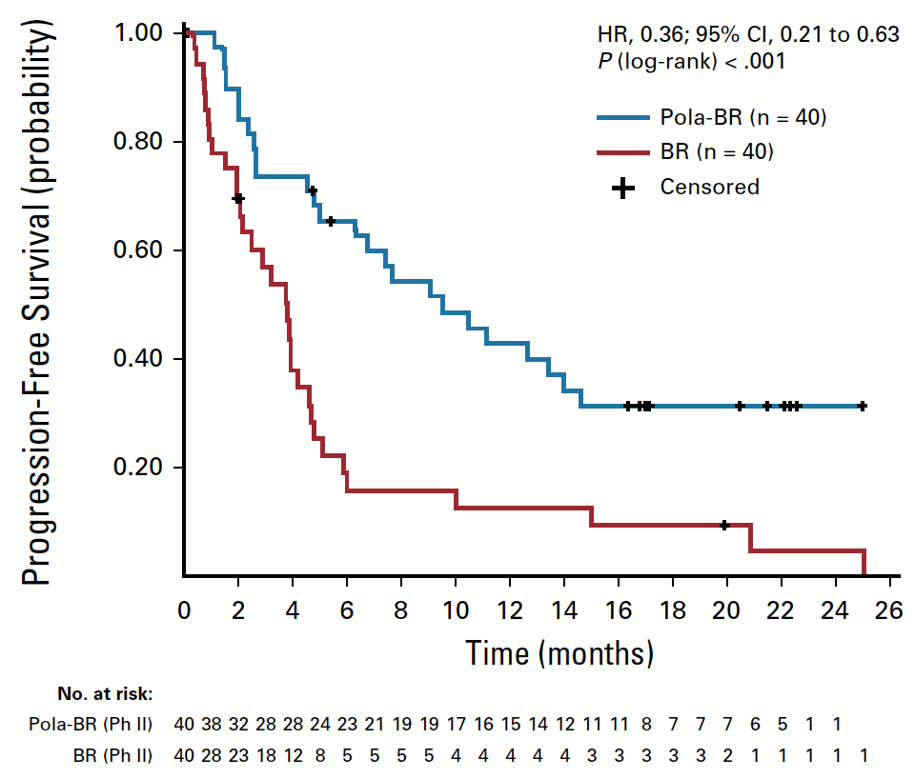
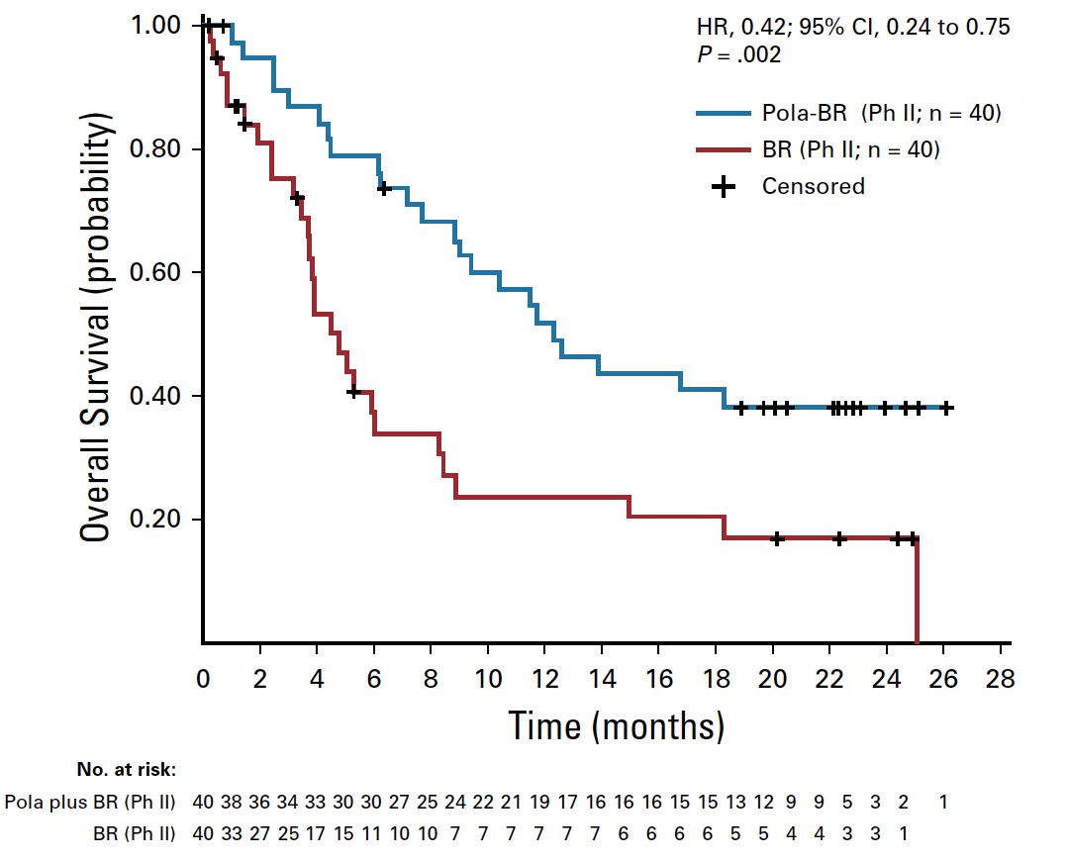
Polatuzumab is active in DLBCL
Progression-free Survival (IRC)
Overall Survival
B, bendamustine; CI, confidence interval; HR, hazard ratio; pola, polatuzumab; R, rituximab
Sehn L, et al. J Clin Oncol. 2020;38:155-65

Slide 18
Clinical implications
Standard of care
No benefit of adding ibrutinib or lenalidomide
However, the PHOENIX trial showed an interesting signal in patients <60 years, indicating that adding a BTK inhibitor might improve outcomes in this group
Promising novel agents
Antibody-drug conjugates, such as polatuzumab vedotin
CAR T-cells
CAR T-cells have been approved for use in the R/R setting
Bispecific antibodies
R-CHOP remains the first-line standard of care in DLBCL
The PHOENIX and ROBUST trials did not show clinically meaningful improvement of adding ibrutinib or lenalidomide to R-CHOP

Slide 19
REACH LYMPHOMA CONNECT VIA TWITTER, LINKEDIN, VIMEO & EMAIL OR VISIT THE GROUP’S WEBSITE http://www.lymphomaconnect.info
Follow us on Twitter
@lymphoma_connec
Follow the LYMPHOMA CONNECT group on LinkedIn
Watch us on the Vimeo Channel LYMPHOMA CONNECT
Email froukje.sosef @cor2ed.com

Slide 20
Dr. Antoine Lacombe
Pharm D, MBA Phone: +41 79 529 42 79 antoine.lacombe@cor2ed.com
Dr. Froukje Sosef
MD Phone: +31 6 2324 3636
froukje.sosef@cor2ed.com

