Slide 2
Meeting summary
ASCO GU 2020, San Francisco, USA
Assoc. Prof. Martin Pichler
Medical University of Graz, Austria
RENAL CELL CARCINOMA UPDATE

Slide 3
Disclaimer
Please note: The views expressed within this presentation are the personal opinions of the author. They do not necessarily represent the views of the author’s academic institution or the rest of the GU CONNECT group.
This content is supported by an Independent Educational Grant from Bayer.

Slide 4
Phase I/II study of the oral
HIF-2α inhibitor MK-6482 in patients with advanced clear cell renal cell carcinoma
Choueiri T, et al.
ASCO GU 2020. Abstract #611
Oral presentation

Slide 5
introduction
Hypoxia-inducible factor (HIF)-2α is a transcription factor that is a key oncogenic driver in RCC
90% of patients with sporadic ccRCC have defective pVHL^{1,2}
Loss of pVHL function results in constitutive activation of HIF-2α²
MK-6482 is a first-in-class small molecule HIF-2α inhibitor that blocks the heterodimerisation of HIF-2α with HIF-1β and induces regression in mouse xenograft RCC models
ccRCC, clear cell renal cell carcinoma; HIF, hypoxia-inducible factor; RCC, renal cell carcinoma; pVHL, von Hippel–Lindau protein
1. Shen C, et al. Semin Cancer Biol 2013;23:18-25; 2. Sato Y, et al. Nat Genet 2013;45:860-7;
3. Choueiri T, et al. ASCO GU 2020. Abstract #611 Oral presentation

Slide 6
study design
Tumour
evaluation
Tumour evaluation
Q8W
PK/PD
PK/PD
Screening
MK-6482 daily dosing
until progression or toxicity
Primary endpoint
Safety
Key secondary endpoints
ORR
DOR
PFS
Week
1
2
3
4
5
7
9
21-day DLT period
for dose escalation
Dose-escalation cohort for patients with advanced solid tumours
Dose-expansion cohort for patients with advanced ccRCC who previously received ≥1 therapy
  Key end points: Safety, ORR, duration of response, PFS
  Data cut-off: 15 May 2019
Dose of 120 mg QD selected for further clinical development from dose-escalation cohort
55 previously treated advanced ccRCC patients enrolled at 120 mg PO QD in dose expansion cohort
  39 (71%) discontinued
    Mainly due to disease progression (55%)
  16 (29%) treatment ongoing
Median (95% CI) follow-up: 13.0 (11.0-13.8) months
ccRCC, clear cell renal cell carcinoma; CI, confidence interval; DLT, dose limiting toxicity; DOR, duration of response; ORR, overall response rate; PFS, progression-free survival; PK/PD, pharmacokinetics/pharmacodynamics;
Choueiri T, et al. ASCO GU 2020. Abstract #611 Oral presentation

Slide 7
BASELINE CHARACTERISTICS
Characteristics | All patients N=55 | IMDC risk category
 |  | Favorable N=5 | Intermediate N=40 | Poor N=10
Age, median (range), years | 62 (39-75) | 61 (50-71) | 62 (39-75) | 59 (41-75)
Sex, n (%) Female Male | 11 (20) 44 (80) | 3 (60) 2 (40) | 7 (18) 33 (82) | 1 (10) 9 (90)
Prior systemic therapies, median (range), n | 3 (1-9) | 3 (1-5) | 3 (1-6) | 3 (2-9)
Prior systemic therapies, n (%) 1 2 ≥3 | 9 (16) 12 (22) 34 (62) | 1 (20) 1 (20) 3 (60) | 8 (20) 9 (23) 23 (58) | 0 (0) 2 (20) 8 (80)
Prior anticancer therapies, n (%) VEGF/VEGFR Immune checkpoint inhibitor Investigational/other mTOR inhibitor Cytokine | 51 (93) 40 (73) 15 (27) 12 (22) 7 (13) | 5 (100) 3 (60) 2 (40) 1 (20) 0 (0) | 36 (90) 29 (73) 10 (25) 8 (20) 4 (10) | 10 (100) 8 (80) 3 (30) 3 (30) 3 (30)
The majority of patients were male (80%)
Patients were heavily pre-treated with 62% having received ≥3 prior
systemic therapies
IMDC, International Metastatic RCC Database Consortium; VEGF, vascular endothelial growth factor; VEGFR, vascular endothelial growth factor receptor
Choueiri T, et al. ASCO GU 2020. Abstract #611 Oral presentation

Slide 8
RESULTS
Primary endpoint – safety
All-Cause adverse events ≥20%
AE, n (%) | MK-6482 N=55
 | Grade 1/2 | Grade 3 | Grade 4 | Grade 5 | All Grades
Anemia | 27 (49) | 14 (26) | 0 (0) | 0 (0) | 41 (75)
Fatigue | 34 (62) | 3 (6) | – | – | –
Dyspnea | 23 (42) | 3 (6) | – | – | 26 (47)
Nausea | 17 (31) | 1 (2) | – | – | 18 (33)
Cough | 17 (31) | 0 (0) | – | – | 17 (31)
Edema peripheral | 16 (29) | 0 (0) | – | – | 16 (29)
Vomiting | 16 (29) | 0 (0) | – | – | 16 (29)
Hypoxia | 6 (11) | 8 (15) | – | – | 14 (26)
Arthralgia | 13 (24) | 0 (0) | – | – | 13 (24)
Dizziness | 13 (24) | 0 (0) | – | – | 13 (24)
Blood creatinine increased | 11 (20) | 1 (2) | – | – | 12 (22)
Diarrhea | 12 (22) | 0 (0) | – | – | 12 (22)
Constipation | 11 (20) | 0 (0) | – | – | 11 (20)
Hyperkalemia | 10 (18) | 1 (2) | – | – | 11 (20)
Most common grade 3 AEs were anaemia (26%) and hypoxia (15%)
No grade 4 or 5 drug-related AEs were observed
2 patients (4%) experienced a total of four grade 4 AEs: hypercalcaemia, sepsis, cardiac arrest and respiratory failure
4 patients (7%) experienced grade 5 AEs secondary to PD:
  Acute kidney injury, disease progression, malignant neoplasm progression, ventricular fibrillation
No patient died of a TRAE
2 patients (4%) discontinued after the TRAE hypoxia
5 patients (9%) required dose reductions to manage TRAEs
AE, adverse event; PD, progressive disease; TRAE, treatment-related adverse event
Choueiri T, et al. ASCO GU 2020. Abstract #611 Oral presentation

Slide 9
results
Efficacy parameter, n (%) [95% CI] | All patients N=55 | IMDC risk category
 |  | Favorable N=5 | Intermediate N=40 | Poor N=10
ORR PR | 13 (24) [13-37] 13 (24) | 2 (40) 2 (40) | 10 (25) 10 (25) | 1 (10) 1 (10)
SD | 31 (56) | 3 (60) | 22 (55) | 6 (60)
Disease control rate (CR + PR + SD) | 44 (80) | 5 (100) | 32 (80) | 7 (70)
PD Nonevaluable | 9 (16) 2 (4) | 0 (0) 0 (0) | 7 (18) 1 (2) | 2 (20) 1 (10)
Best confirmed objective response by RECIST v1.1 per investigator assessment
69% of patients experienced a tumour shrinkage
Median DOR was not reached
81% of patients had a response ≥6 months per Kaplan-Meier estimate
16 patients (29%) continued treatment beyond 12 months
CR, complete response; DOR, suration of response; IMDC, International Metastatic RCC Database Consortium; RECIST, Response Evaluation Criteria In Solid Tumors; ORR, overall response rate; PD, progressive disease; PR, partial response; SD, stable disease
Choueiri T, et al. ASCO GU 2020. Abstract #611 Oral presentation

Slide 10
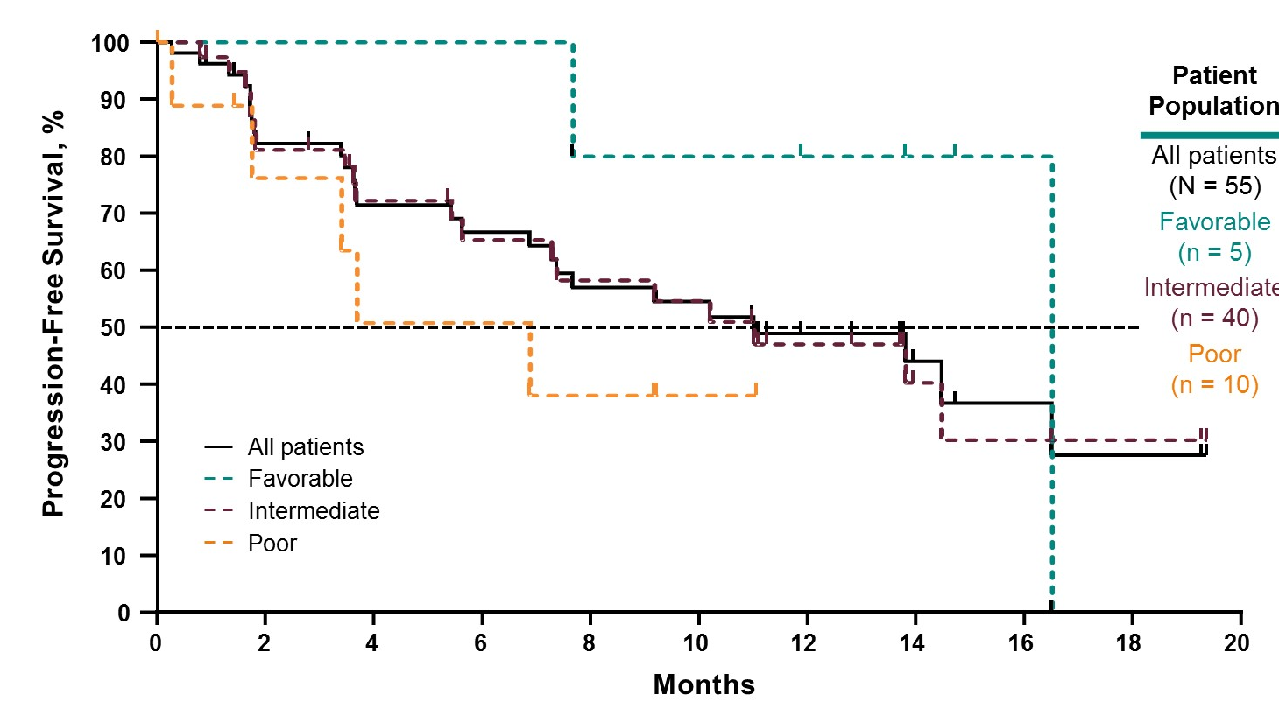
results
Progression free survival
Patient population | Median PFS, months | 12-month PFS Rate, %
All patients (N=55) | 11.0 | 49
Favourable (n=5) | 16.5 | 80
Intermediate (n=40) | 11.0 | 47
Poor (n=10) | 6.9 | NR
PFS, progression free survival
Choueiri T, et al. ASCO GU 2020. Abstract #611 Oral presentation

Slide 11
Conclusions
MK-6482 is well tolerated with a favourable safety profile
  Anaemia and hypoxia are on-target toxicities
After a median follow up of 13 months, promising clinical activity was observed in patients with heavily pre-treated advanced ccRCC
A phase 3 trial is ongoing to further investigate the effects of MK-6482 monotherapy in patients with advanced ccRCC
ccRCC, clear cell renal cell carcinoma
Choueiri T, et al. ASCO GU 2020. Abstract #611 Oral presentation

Slide 12
Overall survival and independent review of response in CheckMate-214 with 42-month follow-up: First-line nivolumab + ipilimumab versus sunitinib in patients with advanced renal cell carcinoma
Tannir N, et al.
ASCO GU 2020. Abstract #609
Oral presentation

Slide 13
introduction
Sunitinib, a small molecule that inhibits multiple receptor tyrosine kinases, is standard of care for first-line treatment of advanced renal-cell carcinoma
Approximately 75% of patients with advanced RCC have intermediate- or poor-risk disease and have worse outcomes than those with favourable-risk disease^{1,2}
Nivolumab (a PD-1 immune checkpoint inhibitor antibody) is approved for patients with intermediate or poor-risk, previously untreated advanced RCC, in combination with ipilimumab (an anti–cytotoxic T-lymphocyte–associated antigen 4 antibody) based on the results of the Checkmate-214 study³
In the Checkmate-214 study, nivolumab and ipilimumab demonstrated superior overall survival and objective response rate compared to sunitinib in patients with advanced RCC⁴
  This benefit was observed in the ITT population as well as patients with intermediate /poor-risk classification¹
This presentation reports OS and response outcomes per independent radiology review committee (IRRC) and safety with extended follow up (minimum of 42 months)
IDMC, International Metastatic Renal Cell Carcinoma Database Consortium; IRRC, independent radiology review committee; ITT, intention-to-treat; OS, overall survival; PD-1, Programmed cell death protein 1; RCC, renal cell carcinoma;
1. Heng DY, et al. J Clin Oncol 2009;27:5794-9; 2. Heng DY, et al. Lancet Oncol 2013;14:141-8; 3. Nivolumab prescribing information Sep 2019;
4. Motzer RJ, et al. NEJM 2018;378:1277-90; 5. Tannir N, et al. ASCO GU 2020 Abstract #609 Oral Presentation

Slide 14
CHECKMATE-214 study design
Patients
Treatment
Treatment-naïve advanced or metastatic clear-cell RCC
Measurable disease
KPS ≥70
Tumour tissue available for
PD-L1 testing
N=1096
Arm A
3 mg/kg nivolumab IV +
1 mg/kg ipilimumab IV Q3W
for four doses, then
3 mg/kg nivolumab IV Q2W
Treatment until
progression or
unacceptable
toxicity
Randomise 1:1
Stratified by
IMDC prognostic score (0 vs 1–2 vs 3–6)
Region (US vs Canada/Europe vs Rest of World)
Arm B
50 mg sunitinib orally once
daily for 4 weeks
(6-week cycles)
Co-primary endpoints
In IMDC intermediate and poor
risk patients:
  ORR
  PFS
  OS
Secondary endpoints
In ITT population:
  ORR
  PFS
  OS
Exploratory endpoints
ORR, PFS, OS in favourable-risk patients
IMDC, International Metastatic RCC Database Consortium; ITT, intent-to-treat; IV, intravenous; KPS, karnofsky performance status; ORR, overall response rate; OS, overall survival; PD-L1, programmed death-ligand 1; PFS, progression free survival; RCC; renal cell carcinoma; US, United States of America
Escudier, B. ESMO 2017, Abstract ~ LBA5, Oral presentation; Motzer RJ, et al. NEJM 2018;378:1277-90

Slide 15
results
Arm; n | ITT |  | IP
 | Niv+Ipi N=550 | Sun N=546 | Niv+ Ipi N= 425 | Sun N=422
OS, HR (95% CI) | 0.72 (0.61-0.86) |  | 0.66 (0.55-0.80)
OS, %
24 mo | 71 | 61 | 66 | 52
36 mo | 59 | 51 | 55 | 44
48 mo | 53 | 44 | 50 | 36
ORR per IRRC, % (95% CI) | 39 (35-43) | 33 (29-37) | 42 (37-47) | 26 (22-31)
CR, % | 11 | 2 | 10 | 1
PFS per IRRC, HR (95% CI) | 0.89 (0.76-1.05) |  | 0.76 (0.63-0.91)
PFS per IRRC, %
24 mo | 38 | 34 | 37 | 26
36 mo | 34 | 25 | 35 | 20
48 mo | 34 | 17 | 35 | 13
PFS per IRRC in responders, % | N=215 | N=178 | N=179 | N=111
24 mo | 70 | 63 | 68 | 55
36 mo | 66 | 44 | 65 | 40
48 mo | 66 | 34 | 65 | 33
CI, confidence interval; CR, complete response; IP, intermediate/poor risk; Ipi, ipilimumab; IRRC, independent radiology review committee ;
ITT, intention-to-treat; mo, months; Niv; nivolumab; ORR, overall response rate; OS, overall survival; PFS, progression free survival; Sun, sunitibib
Tannir N, et al. ASCO GU 2020. Abstract #609 Oral presentation

Slide 16
results
ORR per IRRC was higher and more responses were ongoing with Niv + Ipi vs Sun
  68% vs 53% (ITT) and 68% vs 52% (IP)
More patients achieved CR with Niv + Ipi and these were ongoing in 86% (ITT) and 84% (IP) of patients
PFS probability with Niv + Ipi stabilised after 24 months at ~35% in ITT and IP patients, whereas probabilities declined over time with Sun
Among FAV patients:
  ORR was 29% with Niv + Ipi vs 54% with Sun
  More patients achieved CR (13% vs 6%) and more responses were ongoing
  (69% vs 54%) with Niv + Ipi vs Sun
  94% of CRs were ongoing with Niv + Ipi
  OS benefits were similar across treatment arms and PFS probabilities are stabilising with Niv + Ipi and declining with Sun
Incidence of grade 3-4 TRAEs was consistent with previous reports
No new drug-related deaths occurred in either treatment arm
CR, complete response; FAV, favourable risk patients; IP, intermediate/poor risk; Ipi, ipilimumab; IRRC, independent radiology review committee ; ITT, intention-to-treat; mo, months; Niv; nivolumab; ORR, overall response rate; OS, overall survival; PFS, progression free survival; Sun, sunitibib; TRAE, treatment-related adverse event
Tannir N, et al. ASCO GU 2020. Abstract #609 Oral presentation

Slide 17
conclusions
Superior OS and ORR with Niv + Ipi vs Sun was maintained in ITT and IP patients
More patients treated with Niv + Ipi experienced CR compared with S, responses and CRs were durable
PFS probabilities stabilised with Niv + Ipi after extended follow up
No new safety signals emerged during extended follow-up
IP, intermediate/poor risk; Ipi, ipilumumab; ITT, intention-to-treat; Niv, nivolumab; ORR, overall response rate; OS, overall survival; PFS, progression-free survival; Sun, sunitinib
Tannir N, et al. ASCO GU 2020. Abstract #609 Oral presentation

Slide 18
Nivolumab in combination with stereotactic body radiotherapy in pretreated patients with metastatic renal cell carcinoma: First results of phase II NIVES study
Masini C, et al.
ASCO GU 2020. Abstract #613
Oral presentation

Slide 19
introduction
Despite advances in treatments for patients metastatic RCC (mRCC), the 5-year survival rate of these patients remains approximately 10%
Stereotactic body radiotherapy (SBRT) is a focussed radiation therapy, delivering high-dose radiation directly to the tumour resulting in more tumour cells being destroyed and less damage to adjacent healthy tissue
Several preclinical studies have documented an increase in peripheral anti-tumour immunity following radiation. SBRT may trigger increased tumour antigen release, promote T-cell infiltration, and result in increased anti-tumour immunity
Radiation has been shown to induce tumour PD-L1 expression
Inhibition of the PD-1/PD-L1 axis with nivolumab has been demonstrated to improve anti-tumour immunity by blocking the tumour-mediated suppression of cytotoxic T cells
Nivolumab is a monoclonal antibody directed against PD-1. Combining this drug with radiotherapy might have a synergistic effect. The combination of SBRT with nivolumab could potentially enhance the anti-tumour immune response and might improve clinical outcomes
This study attempted to ascertain whether the anti-tumour immunity of anti-PD1 therapy, in the form of nivolumab, can be enhanced by radiotherapy (SBRT)
mRCC, metastatic renal cell carcinoma; PD-1, programmed cell death protein 1; PD-L1, programmed death ligand-1; SBRT, stereotactic body radiotherapy
Masini C, et al. ASCO GU 2020. Abstract #613 Oral presentation; Masini C, et al. Journal of Clinical Oncology 2018;36.

Slide 20
study design
Phase 2, single-arm, multicentre study
Metastatic RCC
Patients with disease
progressed after ≤2 prior anti-angiogenic therapies
Nivolumab 240 mg Q2W
flat dose for 6 months
+
SBRT 10 Gy x 3 fractions
(start 7 days after the first
infusion of Nivolumab)*
In responding patients
(CR, PR, SD)
Nivolumab 480 mg Q4W
until RECIST 1.1 PD
or unacceptable toxicity
N=69
* First cycle = Nivolumab 240 mg + SBRT + Nivolumab 240 mg
One cycle = 4 weeks
Primary endpoints
ORR
Secondary endpoints
PFS
OS
ORR of irradiated and non-irradiated metastases
DOR
Safety profile
Exploratory endpoints
PD-L1 expression and analysis of genomic profile of tumour sample
cfDNA (analysis of genomic alterations)
cfDNA, Circulating cell-free DNA; CR, complete response; DOR, duration of response; ORR, overall response rate; OS, overall survival; PD-L1; programmed death ligand-1; PFS, progression free survival; PR, partial response; RECIST, Response Evaluation Criteria In Solid Tumors ; RCC, renal cell carcinoma; SBRT, stereotactic body radiotherapy; SD, stable disease
Masini C, et al. ASCO GU 2020. Abstract #613 Oral presentation

Slide 21
EFFICACY results
Patient characteristics:
  Clear cell histology: 79.7%
  Males: 82.6%
  IMDC intermediate/poor: 79.7%
  Median age: 67 (range 43-85)
  2 prior lines of therapy: 18.8%
  Non-nephrectomy: 21.7%
Most frequent sites of SBRT:
  Lung: 37.7%
  Lymph nodes: 11.6%
  Bone: 11.6%
 | N=69 (ITT) | N=63* (PP)
ORR, No (%) 95% CI | 12 (17.4) [9.3-28.4) | 12 (19.0) [10.25-30.9)
Best overall response No (%) CR PR SD PD Not evaluable | 1 (1.4) 11 (16.0) 28 (40.6) 23 (33.3) 6 (8.7) | 1 (1.6) 11 (17.4) 28 (44.5) 23 (36.5) –
Disease control rate No (%) | 40 (58.0) | 40 (63.5)
*2 patients didn’t receive SBRT; 4 pts didn’t receive 2nd dose of nivolumab
(first cycle not concluded)
Median number of nivolumab doses received was 12 (range 1-32)
There was no statistically significant difference between site of SBRT and ORR
Patients with clear cell histology achieved the greatest ORR benefit
CI, confidence interval; CR, complete response; IMDC, International Metastatic RCC Database Consortium; ITT, intention-to-treat; ORR, overall response rate; PD, progressive disease; PR, partial response; SBRT, stereotactic body radiotherapy; SD, stable disease
Masini C, et al. ASCO GU 2020 Abstract #613 Oral presentation

Slide 22
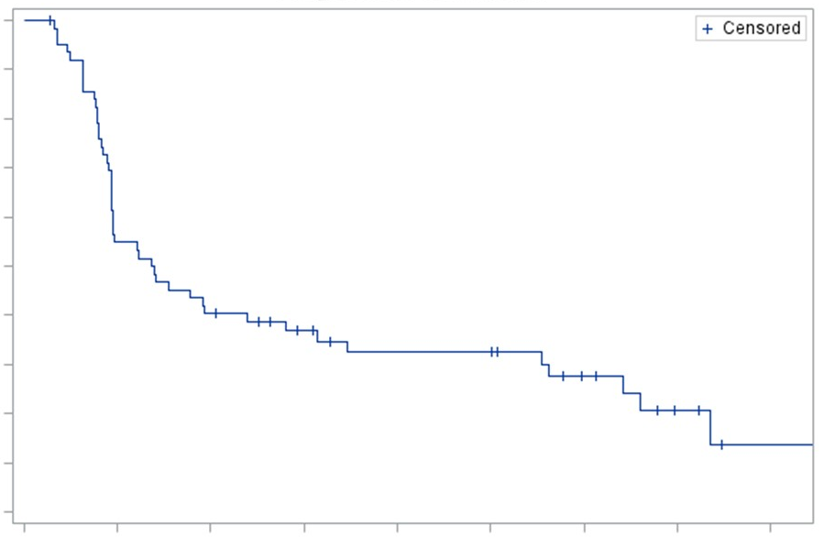
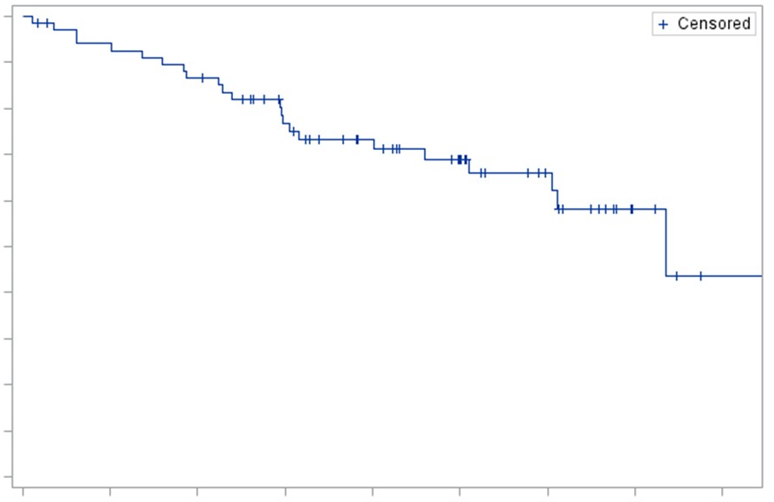
EFFICACY results
PROGRESSION FREE SURVIVAL
OVERALL SURVIVAL
1.0
+ Censored
1.0
+ Censored
0.9
0.9
0.8
0.8
0.7
0.7
0.6
0.6
Probability of PFS (%)
Probability of PFS (%)
0.5
0.5
0.4
0.4
0.3
0.3
0.2
Median PFS
4.1 months (95% CI: 2.8-7.1)
12-months PFS rate 32.6% (95% CI: 21.0-44.6)
0.2
Median OS
22.07 months (95% CI: 18.1 – NR)
12-months OS rate: 73.4% (95% CI: 60.6-82.6)
0.1
0.1
0.0
0.0
0
3
6
9
12
15
18
21
24
0
3
6
9
12
15
18
21
24
Months
Months
At risk
63
34
25
19
15
15
9
4
1
At risk
69
63
58
45
36
26
17
5
1
Median follow up of 15 months (range 0-25.6)
CI, confidence interval; NR, not reached; OS, overall survival; PFS, progression free survival;
Masini C, et al. ASCO GU 2020 Abstract #613 Oral Presentation

Slide 23
SAFETY
 | Grade 1-2 (%) | Grade 3-4 (%)
Dermatologic Rash Pruritus | 13 (18.8%) 6 (8.7%) | 2 (2.9%) –
Renal Elevated creatinine | 1 (1.4%) | –
Respiratory Pneumonia | 8 (11.6%) | –
GI Anorexia Diarrhoea Nausea-vomiting Colitis Bowel obstruction Gastric pain | 1 (1.4%) 1 (1.4%) 4 (5.8%) 1 (1.4%) – 2 (2.9%) | – 4 (5.8%) – 1 (1.4%) 1 (1.4%) –
Hyperamilasemia/hyperlipasemia | 3 (4.3%) | 3 (4.3%)
Hypertransaminasemia | 3 (4.3%) | –
Neurologic disorders | 0 | 1 (1.4%)
Endocrine immune disorders | 4 (5.8%) | –
Cardiologic disorders | 1 (1.4%) | –
Haematologic | – | 2 (2.9%)
Fatigue | 11 (15.9%) | 3 (4.3%)
Others | 7 (10.1%) | –
7 patients discontinued treatment due to AE
Treatment-related grade 3-4 toxicities were experienced in 17 patients (24.6%)
All grade 3-4 toxicities were outside of the irradiated area
6 patients (8.7%) were hospitalised due to treatment related SAEs
AE, adverse event; GI, gastrointestinal; SAEs, serious adverse events
Masini C, et al. ASCO GU 2020 Abstract #613 Oral Presentation

Slide 24
Conclusions
NIVES is the first prospective trial of nivolumab plus SBRT in
mRCC patients
The combination of nivolumab and SBRT had an acceptable safety profile in pre-treated mRCC patients
A high DCR and survival rate was observed with the combination
of nivolumab and SBRT but the primary endpoint of ORR was
not reached
The results of this study suggest that the combination of nivolumab and SBRT warrant further investigation in future studies
DCR, disease control rate; mRCC, metastatic renal cell carcinoma; ORR, overall response rate; SBRT, stereotactic body radiotherapy
Masini C, et al. ASCO GU 2020 Abstract #613 Oral Presentation

Slide 25

REACH GU CONNECT VIA
TWITTER, LINKEDIN, VIMEO & EMAIL
OR VISIT THE GROUP’S WEBSITE http://www.guconnect.info
Follow us on Twitter
@guconnectinfo
Follow the
GU CONNECT
group on LinkedIn
Watch us on the
Vimeo Channel
GU CONNECT
Email
elaine.wills@cor2ed.com

Slide 26
Dr. Antoine Lacombe
Pharm D, MBA
Phone: +41 79 529 42 79
antoine.lacombe@cor2ed.com
Dr. Froukje Sosef
MD
Phone: +31 6 2324 3636
froukje.sosef@cor2ed.com

