Slide 2
Strengthening shared decision making between nmCRPC patients and the healthcare team
GUIDE COMMUNICATION FRAMEWORK – Part 1
Veerle Lamotte
Antwerp University Hospital, Belgium
NOVEMBER 2021
nmCRPC, non-metastatic castration-resistant prostate cancer

Slide 3
Disclaimer and disclosure
Please note: The views expressed within this presentation are the personal opinions of the author. They do not necessarily represent the views of the author’s academic institution or the rest of the GU NURSES CONNECT group.
This content is supported by an Independent Educational Grant from Bayer.
Veerle Lamotte does not have any relevant financial relationships to disclose.

Slide 4
A REMINDER OF guide
GUIDE’S five letters each represent a crucial step in your conversations with patients with prostate cancer
G
Gain insight into the goals of treatment and care
Steps 3-5 of the GUIDE framework for ‘Strengthening shared decision making between nmCRPC patients and the healthcare team’ can be found on: GU Nurses CONNECT
U
Understand the gaps in the patient’s knowledge
I
G
Inform and educate
U
D
I
Direct to additional support
D
E
E
Empower the patient
nmCRPC, non-metastatic castration-resistant prostate cancer

Slide 5
Principles and use of the guide communication framework
PRINCIPLES OF GUIDE
GUIDE aims to support nurses in their role as a go-to figure for their patients
The ultimate goal is to improve patient outcomes through enhanced patient engagement, understanding and outlook
The framework may be delivered over several interactions and should be adapted to meet the patient’s needs
The role of the carer should also be considered, so they feel engaged appropriately
HOW COULD YOU USE GUIDE?
Include each step into your conversations with patients with nmCRPC
Consider the need to incorporate the framework over a series of consultations
Apply the principles to communication with family or carers
Use GUIDE in conversations with patients with other types of cancers
Encourage your team to complete this training and follow the steps consistently
G
U
I
D
E
nmCRPC, non-metastatic castration-resistant prostate cancer

Slide 6
THE GUIDE COMMUNICATION FRAMEWORK
StEP 1
G
GAIN INSIGHT INTO GOALS OF TREATMENT AND CARE
U
I
G
U
D
I
D
E
E

Slide 7
The right knowledge
Before engaging in a conversation with a patient, it is essential for the nurse to know
The goals of treatment and care for this patient
Which treatment is prescribed to this patient and the rationale for it
Adopting a proactive approach and being actively involved in the MDT is key to obtain the information you need
Being part of the team that makes the treatment decision will allow you to fully understand and support it
This will allow you to accurately inform the patient and provide patient-centred care
Despite a high-quality relationship between the patient and the oncologist, it is often the nurse who the patient will feel more comfortable with discussing their treatment, side effects, symptoms and wider issues
Practical tip:
Beyond the medical goal of treatment (e.g. disease control), it is often helpful for patients to have an achievable short-term goal, like attending a wedding or the birth of a grandchild.
G
U
I
D
E
MDT, multidisciplinary team

Slide 8
What needs to be explained to the patient
Initial engagement
Appreciating the patient’s understanding and wishes will set the course of the nurse-patient relationship
Some patients like to be informed in detail (including e.g. specific laboratory values, extent of tumour burden) to be able to actively participate in the treatment decision. Others can easily be overwhelmed by too many details
Find the right balance for each individual patient
G
U
Questions you may want to ask your patient at this stage:
What is your understanding where you are in your illness?
How much information about what may be ahead would you like?
I
D
E

Slide 9
The right way to deliver the messages
Reiterate the treatment decision is a shared decision, underlining that the patient has choices
Talk to the patient with reassurance and confidence
Being fully informed on the goals of treatment and care for this patient, the treatment plan and the rationale will allow you to do this
Allow room for the patient’s feelings and emotions
This approach will make the patient feel you are the knowledgeable go-to person they can rely on throughout the journey
G
Practical tip:
Repeat the patient’s personal treatment goal back to them, to demonstrate that you understand the theoretical as well as the personal treatment goal that they are aiming for.
U
Practical tip:
Actively advise patients that you can give them as much or as little information as they would like. For example: ”are you a person who likes everything explained in detail or would you prefer me to summarise for you?”
I
D
E

Slide 10
WHAT IS nmcrpc?
Non-metastatic castration-resistant prostate cancer (nmCRPC) is defined as:
a rising prostate-specific antigen concentration [25% increase from nadir (starting PSA ≥1.0 ng/mL; minimum increase of 2 ng/mL)]
castrate levels of testosterone with ongoing androgen-deprivation therapy or orchiectomy
no detectable metastases by conventional imaging
Patients with nmCRPC progress to metastatic disease and are at risk of developing cancer-related symptoms and morbidity, eventually dying of their disease
nmCRPC patients are generally asymptomatic from their disease, are often older and have chronic comorbidities requiring long-term concomitant medication
Therefore, careful consideration of the benefit–risk profile of potential treatments is required
Adverse events vs OS/PFS/MFS
MFS, metastasis-free survival; nmCRPC, non-metastatic castration-resistant prostate cancer; OS, overall survival; PFS, progression-free survival; PSA, prostate-specific antigen
Chung DY, et al. Biomedicines. 2021;9(6):661; Saad F, et al. Prostate Cancer Prostatic Dis. 2021;24(2):323-34

Slide 11
Goals of treatment
Patient perspective
Essential to understand what’s important for the patient
nmCRPC patients are usually relatively asymptomatic
Major objective is therefore maintaining QoL and having minimal side effects from treatment
Patient may be
Less focused on longevity due to their age
They may be more concerned about maintaining a good QoL
Rising PSA may cause anxiety and therefore patient may focus on treatment due to the rising PSA
Concerned about other comorbidities
Important to determine how well informed the patient is
nmCRPC, non-metastatic castration-resistant prostate cancer; PSA, prostate-specific antigen; QoL, quality of life

Slide 12
Patient and caregiver benefit-risk preferences for nmcrpc treatment
(Question 1 of 14) Imagine that your doctor told you that you need to start a new medicine for your prostate cancer treatment. If these are your only options available, which would you choose?
nmCRPC patients and caregivers preferred treatments with lower AE burdens and were willing to forego OS to reduce the risk and severity of AEs
Highlights the importance of carefully balancing risks and benefits when selecting treatments in this relatively asymptomatic population
 | Medicine A | Medicine B
Prolonging life | 4 years and an additional 12 months | 4 years and an additional 6 months
Delay in time until pain progresses (develops or worsens) | 3 years and an additional 3 months | 3 years and an additional 12 months
Fatigue (lack of energy) | None | Moderate (affects daily activities)
Skin rash | Mild (less than 10% of the body, does not affect daily activities) | None
Cognitive problems | Moderate (affects daily activities) | Mild (does not affect daily activities)
Chance of a serious fall | 5% (5 out of 100 people) | 8% (8 out of 100 people)
4 years
12 months
4 years
6 months
3 years
3 months
3 years
12 months
Online survey that included 14 treatment choice questions, each comparing 2 hypothetical treatment profiles
AE, adverse event; nmCRPC, non-metastatic castration-resistant prostate cancer; OS, overall survival
Srinivas S, et al. Cancer Med. 2020;9(18):6586-96

Slide 13
Goals of treatment
Physician perspective
Delay the developing of metastasis (progression-free month)
Preserve the quality of life
Increase the overall survival
Improve the time to initiation of cytotoxic chemotherapy and/or symptomatic progression
Therapeutic benefits
Adverse events

Slide 14
Physician preferences for nmcrpc treatment
(Question 2 of 14) If these are the only options available, which would you choose for the patient?
A 74-year-old man who has PSA doubling time ≤10 months and a PSA level ≥2 ng/mL. He is castration-resistant but has not developed distant metastases. He is continuing to receive androgen deprivation therapy for his prostate cancer. Besides the cancer, the patient’s health is otherwise good (asymptomatic and high-performance status) with no significant comorbidities.
Physicians were willing to trade substantial amounts of survival to avoid AEs between hypothetical treatments
Results emphasise the importance of carefully balancing therapies’ benefits and risks to ultimately optimise the overall quality of nmCRPC patients’ survival
 | Medicine A | Medicine B
Prolonging life | 4 years and an additional 3 months | 4 years and an additional 6 months
Delay in time until pain progresses (develops or worsens) | 3 years and an additional 12 months | 3 years and an additional 3 months
Fatigue (lack of energy) | Severe (affects self-care) | None
Skin rash | None | Severe (more than 30% of the body, require treatment and affects self-care)
Cognitive problems | Mild-to-moderate (may affect daily activities) | None
Chance of a serious fracture | None (0 out of 100 people) | 8% (8 out of 100 people)
I choose:
4 years
3 months
4 years
6 months
3 years
12 months
3 years
3 months
Online survey that included 14 treatment choice questions, each comparing 2 hypothetical treatment profiles
AE, adverse event; nmCRPC, non-metastatic castration-resistant prostate cancer; PSA, prostate-specific antigen
Srinivas S, et al. BMC Urol. 2020;20(1):73

Slide 15
Why Shared decision making?
Shared decision making is a collaborative process that involves a patient and his/her healthcare professional working together to reach a joint decision about care
A patient who can participate:
is better informed
copes better with side effects
is more satisfied
more compliant/adherent
Josfeld L, et al. J Cancer Res Clin Oncol. 2021;147:1725-32

Slide 16
THE GUIDE COMMUNICATION FRAMEWORK
StEP 2
G
U
UNDERSTAND THE GAPS IN THE PATIENT’S KNOWLEDGE
I
G
U
D
I
D
E
E

Slide 17
The right knowledge
The level of knowledge and understanding of the disease and its impact and treatment varies from patient to patient
By understanding misconceptions and gaps in the patient’s knowledge, you can efficiently educate the patient
This understanding is powerful in establishing a trusting relationship with the patient
The carer can play a key role in increasing understanding
The carer can help you reach the patient’s knowledge gaps more quickly. Carers can provide a different perspective and perhaps a truth that the patient does not want to admit to
Understanding and addressing the carer’s knowledge gaps as well, allows you to assist the patient’s understanding
G
U
I
D
E

Slide 18
What needs to be explained to the patient
It is important that the patient understands some of the fundamentals of the treatment
The treatment aim – Why this specific drug was prescribed
How the drug works – Potential side effects and how to manage them
The patient
The patient will probably have more questions later
The Nurse
The nurse is always there for the patient as a supporter, navigator and guide throughout the cancer journey
The carer
Carers are very important every step of the way
G
U
Practical tip:
Advise patients to write down their questions and call or bring them to the next appointment. Emphasise that all questions are good questions.
Practical tip:
Advise patients to always have ‘a second pair of ears’ with them. Two hear more than one.
I
D
E

Slide 19
Systemic Treatment for nmcrpc
WHAT?
Active surveillance or continued ADT with first-generation androgen receptor (AR) antagonists
+/-
Second‐generation androgen receptor inhibitors (SGARIs):
Apalatumide
Darolutamide
Enzalutamide
WHY?
nmCRPC patients:
46% will develop metastasis within 2 years
60% metastatic disease within the first 5 years
Metastatic disease in prostate cancer
predominantly targets bone
poor prognosis with worse 5-year OS rates
WHEN?
Guidelines recommend SGARIs:
in patients with nmCRPC
AND with a PSA doubling time (PSADT) of less than 10 months
TREATMENT AIM AND THERAPEUTIC BENEFITS
Delay of:
Pain progression, symptomatic progression, development skeletal-related events, initiation of chemotherapy and PSA progression
ADT, androgen deprivation therapy; AR, androgen receptor; nmCRPC, non-metastatic castration-resistant prostate cancer; OS, overall survival; PSA, prostate-specific antigen; PSADT, prostate-specific antigen doubling time; SGARIs, second-generation androgen receptor inhibitors
Smith MR, et al. N Engl J Med. 2018;378:1408-18; Moreira DM, et al. Clin Genitourin Cancer 2017;15:60-66.e2; Olivier KM, et al. Int J Urol Nurs. 2021;15:47-58; Moreira D, et al. Urology 2016; 96: 171-176; Smith M, et al. Cancer 2011; 117: 2077-2085

Slide 20
The right way to deliver the messages
Emphasise that by understanding the treatment fundamentals, the treatment journey will be smoother
Ask questions in a way that reinforces you are doing so in order to support the patient and not ‘test’ them
Discussing the gaps in the patient’s understanding with openness and empathy will allow you to inform and educate the patient with reassurance and confidence
This will make the patient feel you are the knowledgeable go-to person they can rely on throughout the journey
Encourage patients to bring someone with them to the next appointment
A carer can help increase understanding, but may also have his/her own questions and perspective
G
U
I
Practical tip:
It can be difficult for patients to say they do not understand, especially when they are already feeling vulnerable. Asking to explain the information given back to you in their own words is a nice way to work around this.
D
E

Slide 21
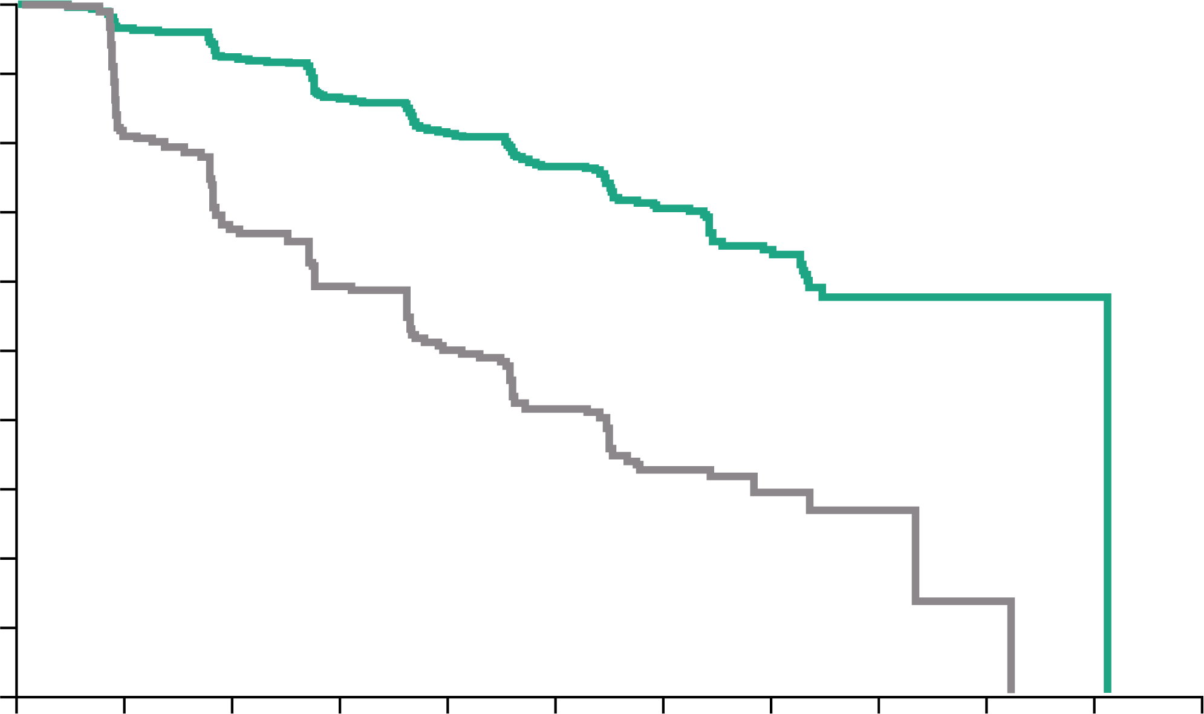
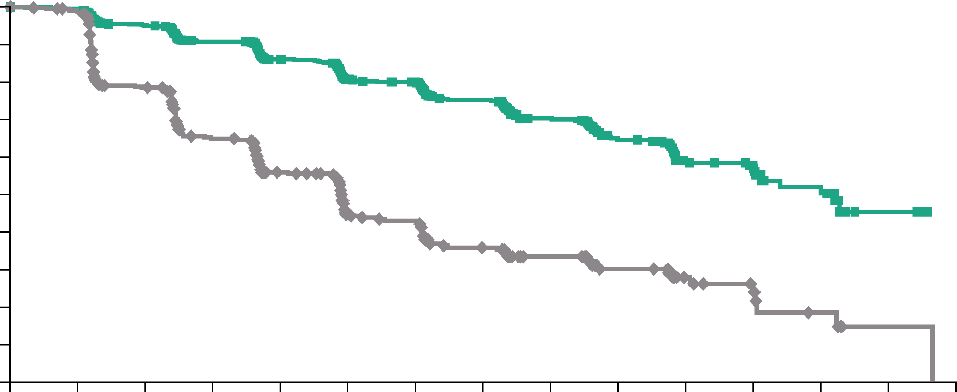
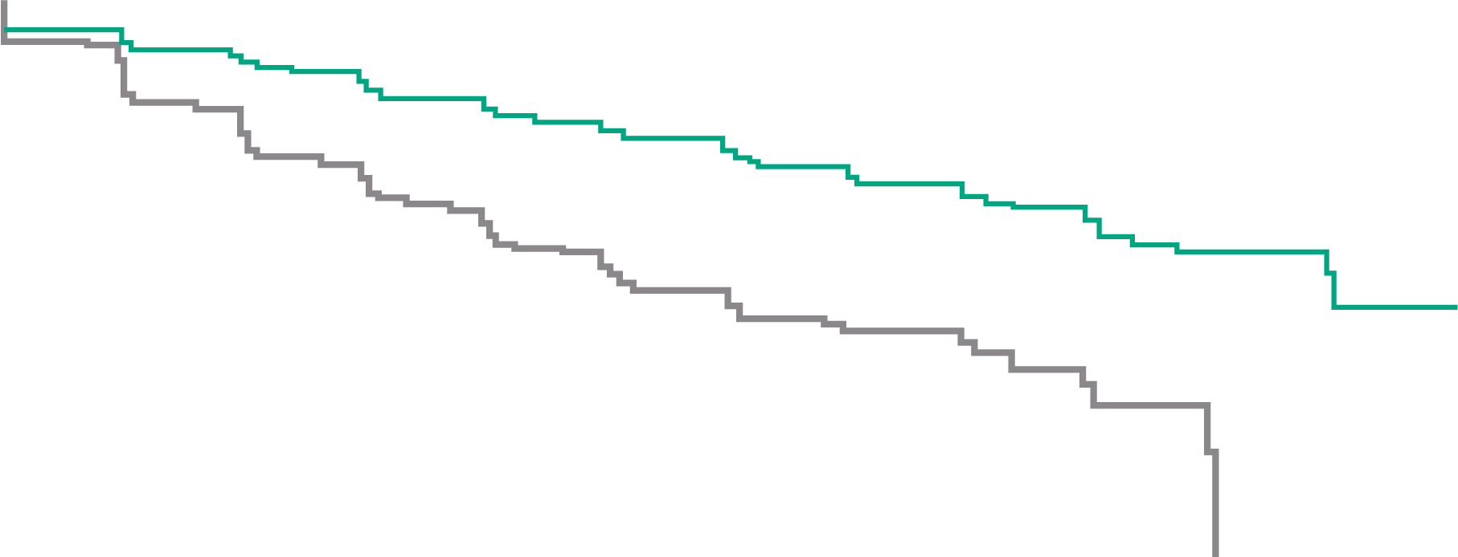
nmCRPC studies: Metastasis-Free Survival
SPARTAN:¹
apalutamide
PROSPER:²
enzalutamide
ARAMIS:³
darolutamide
100
Apalutamide
Placebo
100
Enzalutamide
Placebo
1.0
Darolutamide
Placebo
80
90
0.9
80
0.8
60
70
0.7
Patients alive without metastasis (%)
60
0.6
Patients without metastasis (%)
MFS probability
40
50
0.5
40
0.4
20
30
0.3
HR 0.28 (95% CI 0.23-0.35) p<0.001
20
HR 0.29 (95% CI 0.24-0.35) p<0.001
0.2
HR 0.41 (95% CI 0.34-0.50) p<0.001
10
0.1
0
0
4
8
12
16
20
24
28
32
36
40
44
0
0
3
6
9
12
15
18
21
24
27
30
33
36
39
42
0
0
4
8
12
16
20
24
28
32
36
40
44
48
No. at risk
Apalutamide Placebo
Time since randomisation (months)
No. at risk
Enzalutamide Placebo
Time (months)
No. at risk
Darolutamide Placebo
Time (months)
806
401
713
291
652
220
514
153
398
91
282
58
180
34
96
13
36
5
16
1
3
0
0
0
933
468
865
420
759
296
637
212
528
157
431
105
418
98
328
64
237
49
159
31
87
16
77
11
31
5
4
1
0
0
955
554
817
368
675
275
506
180
377
117
262
75
189
50
116
29
68
12
37
4
18
0
2
0
0
0
 | SPARTAN |  | PROSPER |  | ARAMIS
 | APA (n=806) | PBO (n=401) | ENZA (n=933) | PBO (n=468) | DARO (n=955) | PBO (n=554)
Median follow-up | 20.3 months |  | 18.5 months | 15.1 months | 17.9 months
Median MFS, months | 40.5 | 16.2 | 36.6 | 14.7 | 40.4 | 18.4
HR (95% CI) | 0.28 (0.23-0.35) |  | 0.29 (0.24-0.35) |  | 0.41 (0.34-0.50)
p value | <0.001 |  | <0.001 |  | <0.001
APA, apalutamide; CI, confidence interval; DARO, darolutamide; ENZA, enzalutamide; HR, hazard ratio; MFS, metastasis-free survival; nmCRPC, non-metastatic castration-resistant prostate cancer; No., number; PBO, placebo
1. Smith MR, et al. N Engl J Med. 2018;378:1408-18; 2. Hussain M, et al. N Engl J Med. 2018;378:2465-74; 3. Fizazi K, et al. N Engl J Med. 2019;380:1235-46

Slide 22
nmCRPC studies: Final Overall Survival
SPARTAN:¹
apalutamide
PROSPER:²
enzalutamide
ARAMIS:³
darolutamide
100
100
Enzalutamide
Placebo
100
Darolutamide
Placebo
80
90
90
Apalutamide Median 73.9 months
80
80
60
70
70
60
60
Patients alive (%)
Patients alive (%)
Patients alive (%)
40
Placebo Median 59.9 months
50
 | Enzalutamide (n=933) | Placebo (n=468)
Median (95% CI), months | 67.0 (64.0-NR) | 56.3 (54.4-63.0)
HR (95% CI) | 0.73 (0.61-0.89)
 | p=0.001
50
Apalutamide
Placebo
40
40
30
30
20
HR for death 0.78 (95% CI 0.64-0.96) p=0.016
20
20
HR 0.69 (95% CI 0.53-0.88) p=0.003
10
10
0
0
4
8
12
16
20
24
28
32
36
40
44
48
52
56
60
64
68
72
76
0
0
4
8
12
16
20
24
28
32
36
40
44
48
52
56
60
64
68
72
0
0
4
8
12
16
20
24
28
32
36
40
44
48
52
56
60
No. at risk
Apalutamide Placebo
Time since randomisation (months)
No. at risk
Enzalutamide Placebo
Time (months)
No. at risk
Darolutamide Placebo
Time since randomisation (months)
806
401
791
392
774
385
758
373
739
358
717
339
691
328
658
306
625
286
593
263
558
240
499
204
376
156
269
114
181
82
100
38
47
21
19
6
4
2
0
0
933
468
926
467
910
459
897
444
874
428
850
404
822
381
782
363
700
321
608 274
517
219
424
177
327
140
244
106
169
64
89
30
33
16
4
3
0
0
955
554
932
530
908
497
863
460
816
432
771
394
680
333
549
261
425
182
293
130
214
93
129
54
69
28
37
16
12
4
0
0
 | SPARTAN |  | PROSPER |  | ARAMIS
 | APA (n=806) | PBO (n=401) | ENZA (n=933) | PBO (n=468) | DARO (n=955) | PBO (n=554)
Median follow-up, months | 52.0 |  | 48.0 |  | 29.0
Median OS, months | 73.9 | 59.9 | 67.0 | 56.3 | NR | NR
HR (95% CI) | 0.78 (0.64-0.96) |  | 0.73 (0.61-0.89) |  | 0.69 (0.53-0.88)
p value | 0.016 |  | 0.001 |  | 0.003
APA, apalutamide; CI, confidence interval; DARO, darolutamide; ENZA, enzalutamide; HR, hazard ratio; ITT, intention to treat; nmCRPC, non-metastatic castration-resistant prostate cancer; NR, not reached; No., number; OS, overall survival; PBO, placebo
1. Smith MR, et al. Eur Urol. 2021;79:150-8; 2. Sternberg CN, et al. N Engl J Med. 2020;382:2197-206; 3. Fizazi K, et al. N Engl J Med. 2020;383:1040-9

Slide 23
The right way to deliver the messages
Phone conversations
Suggestions for questions to ask in phone conversations. Pick from this list the questions applying to the GUIDE step you are in
GENERAL WELL-BEING AND ADVERSE EVENTS (AEs)
How are things going with the treatment?
List the potential side effects and ask if the patient is experiencing any or all
Are you tired? And is it the same as before, better or worse?
Are you getting out? What are you doing during the day?
How is your appetite? Are you able to drink and stay hydrated?
Are you have any pain?
How is your mood?
ADHERENCE
Can you tell me the name of the medication you are using?
How often do you take your medication?
Do you take medication with or without food?
How do you store your medication?
Do you have trouble swallowing the medication?
Have you missed any doses or vomited after a dose?
Were you able to read and understand the prescribing information?
G
U
I
STAYING IN CONTACT
Do you know when to contact us? When is that?
Do you know how to contact us? How is that?
D
E
AE, adverse event

Slide 24
Adverse Events in nmCRPC
Safety | SPARTAN^{1,2} |  | PROSPER³ |  | ARAMIS⁴
 | APA (N=803) | PBO (N=398) | ENZA (N=930) | PBO (N=465) | DARO (N=954) | PBO (N=554)
Any AE, n (%) | 781 (97) | 373 (94) | 876 (94) | 380 (82) | 818 (85.7) | 439 (79.2)
Any serious AE, n (%) | 290 (36) | 99 (25) | 372 (40) | 100 (22) | 249 (26.1) | 121 (21.8)
AE leading to discontinuation, % | 120 (15.0) | 29 (7.3) | 158 (17.0) | 41 (9.0) | 85 (8.9) | 48 (8.7)
AE leading to death, n (%) | 24 (3.0) | 2 (0.5) | 51 (5.0) | 3 (1.0) | 38 (4.0)^{c} | 19 (3.4) ^{c}
AE (all grades), %
Fatigue | 33 | 21 | 37 | 16 | 13.2 | 8.3
Hypertension | 28 | 21 | 18 | 6 | 7.8 | 6.5
Rash | 26 | 6.3 | 4 | 3 | 3.1 | 1.1
Falls | 22 | 9.5 | 18 | 5 | 5.2 | 4.9
Fractures | 18 | 7.5 | 18 | 6 | 5.5 | 3.6
Mental impairment disorderª | 5.1^{b} | 3.0^{b} | 8 | 2 | 2.0 | 1.8
ª SPARTAN: disturbance in attention, memory impairment, cognitive disorder and amnesia; PROSPER: as per SPARTAN trial with the addition of Alzheimer's disease, mental impairment, vascular dementia and senile dementia; ARAMIS trial: MedRA High Level Group Term; ^{b} Data taken from first interim analysis as not reported in final analysis¹; ^{c} reported as grade 5 adverse event
Presented for information, safety comparisons across trials should not be made
AE, adverse event; APA, apalutamide; DARO, darolutamide; ENZA, enzalutamide; PBO, placebo
1. Smith MR, et al. N Engl J Med. 2018;378:1408-18; 2. Smith MR, et al. Eur Urol. 2021;79:150-8; 3. Sternberg CN, et al. N Engl J Med. 2020;382:2197-206; 4. Fizazi K, et al. N Engl J Med. 2020;383:1040-9

Slide 25
Summary
SGARIs for non-metastatic castration-resistant prostate cancer (nmCRPC) have similar efficacy but differ in safety profiles
Inform your patient about adverse events
Inform the patient about benefits
An involved and informed patient will cope better with side effects but also make more targeted choices in his/her treatment
nmCRPC, non-metastatic castration-resistant prostate cancer; SGARI, second-generation androgen receptor inhibitors

Slide 26
Summary The guide communication framework
WHAT THE GUIDE COMMUNICATION FRAMEWORK
Is a 5-step communication framework to improve the benefit of nurse-patient interactions
Supports nurses in their role as a knowledgeable go-to person for patients with nmCRPC strengthening shared decision making and delivering the best possible care
Includes a memory aid – GUIDE
May be delivered over several interactions and should be adapted depending on patient needs
WHY IS THE COMMUNICATION FRAMEWORK NEEDED
Nurses are to be regarded as a go-to person for their patients with nmCRPC and therefore must
empower patients through guidance and support throughout the treatment journey
be an active member of the MDT in delivering shared decision making
so they can provide patients with the greatest chance of success
nmCRPC
GUIDE, a communication framework that will help you have even better conversations with your patients, to educate and guide them throughout their cancer treatment journey. GUIDE’s five letters each represent a crucial step in your conversations with patients with nmCRPC.
nmCRPC, non-metastatic castration-resistant prostate cancer; MDT, multidisciplinary team

Slide 27
REACH GU NURSES CONNECT VIA TWITTER, LINKEDIN, VIMEO & EMAIL OR VISIT THE GROUP’S WEBSITE https://gunursesconnect.cor2ed.com/
Follow us on Twitter @gunursesconnect
Follow the GUNURSESCOR2ED
Group on LinkedIn
Watch us on the Vimeo Channel GUNURSES CONNECT
Email sam.brightwell @cor2ed.com

