Slide 2
Meeting summary asco 2020, virtual meeting
Brittni Prosdocimo, MSN, RN, BMTCN
University of Pittsburgh Medical Center,
Pittsburgh, Pennsylvania, USA
HIGHLIGHTS FROM GI NURSES CONNECT
May 2020

Slide 3
Disclaimer
Please note: Views expressed within this presentation are the personal opinions of the author. They do not necessarily represent the views of the author’s academic institution or the rest of the GI Nurses CONNECT group.
This content is supported by an Independent Educational Grant from Bayer.
Disclosures: Brittni Prosdocimo does not have any relevant financial relationships to disclose.

Slide 4
Using digital engagement to proactively manage symptoms in patients on capecitabine
Sohal M, et al.
ASCO 2020. Abstract #4605. Poster presentation

Slide 5
Background and methods
Background
Capecitabine may cause patients to experience AEs, in particular HFS and diarrhoea, which may lead to non-adherence^{1,2}
Digital patient engagement has been used in cancer care to monitor AEs and improve patient adherence³
Methods
Patients received messages and respondents who reported AEs were engaged by nurses via a secure platform¹
Nurses made pharmacologic or non-pharmacologic recommendations or referred to an oncologist¹
AE, adverse event; HFS, hand–foot syndrome
1. Sohal M, et al. J Clin Oncol 2020;38:(suppl; abstr 12079); 2. Walko CM, Lindley C. Clin Ther 2005;27:23-44;
3. Sawicki C, et al. JMCP 2019;25:11

Slide 6
Results
Demographics and outcomes
  Patients treated with capecitabine were sent 1,421 messages, receiving 658 (46.3%) replies
  105 (16%) of messages from 95 patients indicated experience of diarrhoea or HFS
  Referral to an oncologist was more common for HFS (66.7%) than for diarrhoea (33.3%)
Adherence (PDC) was significantly better in the intervention group (Figure 1)
Resolution of symptoms was more common in patients recommended self care than in those referred to an oncologist, loss to follow-up was more common in the self care group (Figure 2)
*
*Statistically significant at P=0.038
Symptoms
resolved
(n=17)
Medication
Change
(n=4)
Symptom
Treatment
prescribed
(n=2)
Loss to
follow-up
(n=31)
Patients (%)
HFS, hand–foot syndrome; PDC, proportion of days covered
Sohal M, et al. J Clin Oncol 2020;38:(suppl; abstr 12079)

Slide 7
ConclusionS
The SMS and nurse-led secure messaging system facilitated clinical interventions by nurse care managers
Adherence was improved in the intervention group
The authors suggested that nurse-led digital engagement is effective in increasing engagement of cancer patients treated with oral therapy who are suffering from AEs
AE, adverse event
Sohal M, et al. J Clin Oncol 2020;38:(suppl; abstr 12079)

Slide 8
Home-based management of cancer patients (CPs) experiencing toxicities while on anticancer treatment:
The impact of a nurse-led telephone triage (NTT)
Calvetti L, et al.
ASCO 2020. Abstract #2002. Oral presentation

Slide 9
Background and methods
Background
The cost of cancer care is increasing rapidly, and health care provision are not keeping pace¹
  Increased cost of therapies has a role to play¹
  Focusing on treatment-related AEs and hospitalizations can reduce costs²
Use of CTCAE in clinical practice may facilitate early intervention and reduce resource utilisation
and costs³
Methods
Assess a NTT to reduce hospitalisation³
  Assessment of AEs according to CTCAE v4.1 by trained oncology nurses
  Intervention over the phone for Grade 1-2, immediate referral for ≥3
AE, adverse event; CTCAE, Common Terminology Criteria for Adverse Events; NTT, Nurse-led Telephone Triage
1. Voda AI, Bostan I. Cancers (Basel). 2018;10:117; 2. Barkley R, et al. J Oncol Pract 2019;15:e91‐e97;
3. Calvetti L, et al. J Clin Oncol 2020,38:(suppl; abstr 2002)

Slide 10
Results
Demographics, primary, and secondary outcomes
  Breast, colorectal and lung were the main cancer types (Figure 1)
  Primary endpoint: hospitalisations were reduced from 2017-2018 to 2018-2019 (Figure 2)
Secondary endpoints:
  117 (27.3%) patients reported > 1 AE during NTT consultation
    AEs G1 237 (40.8%), G2 231 (39.8%), G3–G4 113 (19.4%)
  Lung cancer patients most frequent callers (22.4%)
  Lung, pancreatic and gastric patients had the highest rate of AEs
  Estimated annual cost saving for single Italian centre €380,160
P = 0.105
P = 0.847
P = 0.002
AE, adverse event; CP, cancer patients; G, grade; NTT, Nurse-led Telephone Triage; ENT, ear, nose and throat.
1. Calvetti L, et al. J Clin Oncol 2020,38:(suppl; abstr 2002)

Slide 11
ConclusionS
NTT successfully reduced the rate of hospitalisation for CP receiving treatment
A focus on lung cancer patients may be particularly effective due to their substantial use of the NTT and complex symptoms
Substantial cost savings were achieved (€380,160)
NTT implementation into a regional network is planned
CP, cancer patients; G, grade; NTT, Nurse-led Telephone Triage
1. Calvetti L, et al. J Clin Oncol 2020,38:(suppl; abstr 2002)

Slide 12
Intervention combining nurse navigators (NNs) and a mobile application versus standard of care (SOC) in cancer patients (pts) treated with oral anticancer agents (OAA): Results of CapRI, a single-center, randomized phase III trial
Mir O, et al.
ASCO 2020. Abstract #2000. Oral presentation

Slide 13
Background and methods
Background
Remote monitoring systems may improve follow-up and patient care^{1,2}
  There is a need for prospective data on these systems
Methods
Single-centre randomised phase 3 trial conducted in a tertiary-care setting
Standard of care
Adult cancer patients
Advanced disease
Approved oral treatment
Solid tumours
PS <3
R
1:1
Nurse navigator (NN)
→ Weekly calls for 1 month then every other week
→ Hotline Mon-Fri 09 AM – 05 PM
Dedicated website / mobile application
80 algorithms ≥ specific alerts
For
6 months
Excluded: treatment in a clinical trial or compassionate
use program, hormonal therapy alone
Web/mobile application:
→ Dashboard for NNs to manage patients’ records
→ Interface for other healthcare professionals
→ Patients can record tracking data, contact nurses via secure messaging, view therapy and side effect information or store documents
NN, nurse navigator; PS, performance status; R, randomisation
1. Denis F, et al. JAMA 2019;321:306-7; 2. Warrington L, et al. J Med Inernet Res 2019;21(1):e10875;
3. Mir O, et al. J Clin Oncol 2020;38:(suppl; abstr 2000)

Slide 14
Results
Demographics, primary, and secondary outcomes
The majority of the enrolled patients (N=559) were women (59.0%), with a substantial elderly population (>75 years: 14.0%), and use of targeted therapy (60.6%)
  All primary tumour sites were represented
Primary endpoint RDI
  Improvement in mean (SD) adherence-adjusted RDI (0.8417 [0.2632] vs 0.7998 [0.2090] for the intervention vs SoC groups, respectively; P=0.0451)
Secondary endpoints
Patients experiencing Grade ≥ 3 toxicities were reduced with the intervention vs SoC, respectively (Figure)
  Patient experience improved: mean (SD) PACIC global score: 2.94 (0.83) vs 2.67 (0.89); P=0.01
  Use of supportive care increased in the intervention group: 43.8% vs 35.2%, P=0.04
P=0.02
Intervention
SoC
P=0.04
P=0.04
PACIC, Patients Assessment Chronic Illness Care; RDI, relative dose-intensity; SD, standard deviation; SoC, standard of care
Mir O, et al. J Clin Oncol 2020;38:(suppl; abstr 2000)

Slide 15
Results and CONCLUSIONS
Results
Secondary endpoints (cont.)
  The proportion of patients hospitalised improved (Figure)
  Mean (SD) days of hospitalisation improved with the intervention
  vs SoC, respectively: 2.82 (6.96) vs 4.44 (9.60); P=0.02
CONCLUSIONS
The NN intervention improved:
  RDI
  Patient experience
  Number and duration of hospitalisations
  Treatment related Grade ≥3 toxicities
Future studies focussed on adherence,
specific tumours, and drug classes
should be carried out
NN, nurse navigator; RDI, relative dose-intensity; SoC, standard of care
Mir O, et al. J Clin Oncol 2020;38:(suppl; abstr 2000)

Slide 16
Donafenib versus sorafenib as first-line therapy in advanced hepatocellular carcinoma:
An open-label, randomized, multicenter phase II/III trial
Bi F et al.
ASCO 2020. Abstract #4605. Oral presentation

Slide 17
Background and methods
Background
HCC has a insidious and rapid onset, often resulting in late diagnosis¹
  >50% of global cases and deaths occur in China²
  Sorafenib is the standard first-line therapy, median OS is lower in China (6.5–11.4 months) than globally (10.7–14.7 months)³⁻¹²
Methods
Multi-centre phase 2/3 trial conducted at 37 Chinese sites¹
Study design
Patients with
unresectable or
metastatic HCC
(N=668)
Donafenib (0.2 g bid)
Until intolerable toxicity or disease progression (according to RECIST 1.1)
Primary endpoint:
OS
Secondary endpoints:
PFS, ORR, DCR, AEs
R
1:1
Sorafenib (0.4 g bid)
Key inclusion criteria:
18–75 years
≥1 measurable lesion
Unresectable or metastatic HCC
Child-Pugh score ≤7
No prior systemic treatment
ECOG 0-1
Stratified by:
AFP level: <400 µg/L vs ≥400 µg/L
Previous locoregional therapy: Yes vs no
BCLC staging: B vs C
Portal vein invasion and/or extrahepatic metastasis: present vs absent
AE, adverse event; AFP, alpha-fetoprotein; BCLC, Barcelona Clinic Liver Cancer; bid, twice daily; DCR, disease control rate; ECOG, Eastern Cooperative Oncology Group; HCC, hepatocellular carcinoma; ORR, objective response rate; OS, overall survival; PFS, progression-free survival; R, randomisation; RECIST, Response evaluation criteria in solid tumours.
1. Bi F, et al. Clin Oncol 38:2020 (suppl; abstr 4506); 2. Globocan 2018, Available from: https://gco.iarc.fr/today/data/factsheets/cancers/11-Liver-fact-sheet.pdf. Accessed June, 2020;
3. Llovet JM, et al. N Engl J Med 2008;359:378-90; 4. Cheng AL, et al. Lancet Oncol 2009;10:25‐34; 5. Cheng AL, et al. J Clin Oncol 2013;31:4067-75; 6. Johnson PJ, et al. J Clin Oncol 2013;31:3517-24;
7. Cainap C, et al. J Clin Oncol 2015;33:172-9; 8. Zhu AX, et al. S J Clin Oncol 2015;33:559-66; 9. Kudo M, et al. Lancet 2018;391:1163-73; 10. Yau T, et al. ESMO 2019 Abstract 6572;
11. Cheng AL, et al. ESMO Asia Abstract LBA3; 12. Qin SK, et al. EASL Liver Cancer Summit 2020;OP02-03.

Slide 18

Results
Demographics, primary, and secondary outcomes
  Patient characteristics were well balanced between groups (N=659)
  BCLC stage C (87.4%), PVI and/or EHS (73.4%), and HBV aetiology (90.1%)
  Primary endpoint: demonstrated superiority of donafenib vs sorafenib for OS in the FAS population (Figure)ª
Secondary endpoints
  Efficacy outcomes for donafenib and sorafenib were similar
    PFS (HR [95% CI]: 0.909 [0.763, 1.082]; P=0.2824), respectively
    ORR (4.6% vs 2.7%; P=0.2488) , respectively
    DCR (30.8% vs 28.7%; P=0.5532), respectively
OS with donafenib vs sorabenib
Median OS, months (95% CI)
Donafenib | 12.1 (10.3, 13.4)
Sorafenib | 10.3 (9.2, 12.0)
HR (95% CI): 0.831 (0.699, 0.988) P=0.0363
1.0
0.8
0.6
Overall survival (%)
0.4
0.2
0.0
mOS: 10.3 m
mOS: 12.1 m
0
5
10
15
20
25
30
35
40
45
Months
Donafenib | 328 | 262 | 188 | 134 | 95 | 54 | 25 | 10 | 2 | 0
Sorafenib | 331 | 258 | 170 | 124 | 75 | 39 | 15 | 2 | 1 | 0
ªITT results were similar
BCLC, Barcelona Clinic Liver Cancer; CI, confidence interval; DCR, disease control rate; EHS, extrahepatic spread; FAS, full analysis set; HBV, hepatitis B virus; HR, hazard ratio; mOS, median overall survival; ORR, objective response rate; OS, overall survival; PFS, progression-free survival; PVI, portal vein invasion
Bi F, et al. Clin Oncol 2020;38:(suppl; abstr 4506)

Slide 19
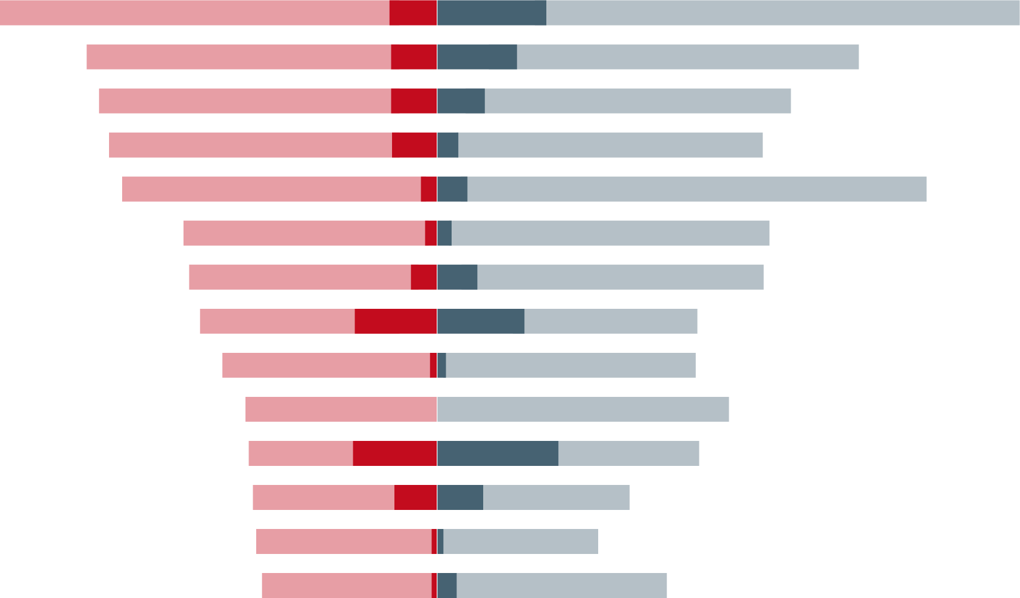
Results and Conclusion
Results
AE incidence with donafenib vs sorafenib
Donafenib (n=333)
Sorafenib (n=332)
AEs were less common with
donafenib than sorafenib (Figure)
  Grade ≥3 (57.4% vs 67.5%;
  P=0.0082);
  AEs leading to treatment interruption
  (30.3% vs 42.5%; P=0.0013)
Hand-foot skin reactions
AST increased
Blood billirubin increased
Platelet count decreased
Diarrhoea
Weight loss
ALT increased
Hypertension
Fatigue
Alopecia
𝜸-GT increased
Hypophosphatemia
Proteinuria
Rash
60%
40%
20%
0
20%
40%
60%
80%
Patients (%)
Donafenib grade ≥3
Donafenib any grade
Sorafenib grade ≥3
Sorafenib any grade
Conclusions
Donafenib demonstrated superiority over
sorafenib for OS in Chinese patients with HCC
Safety and tolerability were improved with donafenib
The authors suggested that donafenib should be considered as the first-line therapy for advanced HCC
AE, adverse event; HCC, hepatocellular carcinoma; OS, overall survival
Bi F, et al. Clin Oncol 2020;38:(suppl; abstr 4506)

Slide 20
summary

Slide 21
Summary
Closing thoughts from Brittni Prosdocimo
A well thought out and implemented approach to nurse-lead triage for
side-effect reduction is an important area to focus future research
Everyday technology like mobile applications can allow tracking of oral chemotherapy to improve patients outcomes
These data from ASCO back up practices being implemented empirically where by nurses proactively follow-up of patients using oral oncolytics in order to monitor their care and reduce adverse events

Slide 22
REACH GI NURSES CONNECT VIA
TWITTER, LINKEDIN, VIMEO & EMAIL
OR VISIT THE GROUP’S WEBSITE http://www.ginursesconnect.info
Follow us on Twitter
@ginursesconnect
Follow the
GINURSESCONNECT
Group on LinkedIn
Watch us on the
GINURSES CONNECT
Vimeo Channel
Email
antoine.lacombe
@cor2ed.com

