Slide 2
HIGHLIGHTS BY
Prof Andrea Sartore-Bianchi
Niguarda Cancer Center and University of Milano (La Statale)
Milano, Italy
JULY 2021

Slide 3
Disclosures
Please note: Views expressed within this presentation are the personal opinions of the author.
They do not necessarily represent the views of the author’s academic institution or the rest of
NTRK CONNECT group.
This content is supported by an independent educational grant from Bayer.
Disclosures: Prof. Andrea Sartore-Bianchi has received honoraria from the following:
Amgen, Bayer, Sanofi and Servier

Slide 4
Long-term efficacy and safety of larotrectinib in an integrated dataset of patients with TRK fusion cancer
Hong D.S, et al. ASCO 2021, #3108
TRK, tropomyosin receptor kinase

Slide 5
Long-term efficacy and safety follow-up for larotrectinib
Adult Phase 1
Advanced solid tumours
NCT02122913
Paediatric Phase 1/2
Advanced solid tumours
SCOUT: NCT02637687
Adult/adolescent Phase 2
Advanced solid tumours
NAVIGATE: NCT02576431
Data cutoff: 17 July 2017¹
Patients:
8
12
35
Primary analysis set: Total of 55 patients with TRK fusion solid tumours
Data cutoff: 20 July 2020
Patients:
5
67
91
Expanded dataset: Total of 218 patients with non primary CNS TRK fusion solid tumours
This analysis reports updated safety and efficacy data with longer follow-up in an expanded dataset of adult and paediatric patients with TRK fusion cancer treated with larotrectinib (N=218)
CNS, central nervous system; TRK, tropomyosin receptor kinase
1. Drilon A, et al. N Engl J Med. 2018;378:731-9

Slide 6
Baseline demographics and disease characteristics in TRK-positive non primary CNS tumours
Characteristics | N=218
Age, median (range), years Peadiatric (<18), n (%) Adult (≥18), n (%) | 38 (0.1-84) 78 (36) 140 (64)
Female, n (%) Male, n (%) | 106 (49) 112 (51)
ECOG or equivalent Lansky performance status, n (%) 0 1 2 3 | 114 (52) 78 (36) 23 (11) 3 (1)
Known CNS metastases at enrolment, n (%) | 19 (9)
Prior cancer treatments, median (range) | 1 (1-10)
Number of prior systemic therapies, n (%) 0 1 2 3 or more | 59 (27) 60 (28) 42 (19) 57 (26)
Main Primary tumour type (>2%) | N=218
Soft tissue sarcoma Infantile fibrosarcoma Thyroid Salivary gland Lung Colon Melanoma Breast GIST | 26% 20% 13% 11% 9% 4% 3% 3% 2%
NTRK gene fusions
NTRK1
44%
(n=97)
NTRK2
3%
(n=6)
NTRK3
53%
(n=115)
CNS, central nervous system; ECOG, Eastern Cooperative Oncology Group; GIST, gastrointestinal stromal tumour; NTRK, neurotrophic tyrosine receptor kinase;
TRK, tropomyosin receptor kinase

Slide 7
Efficacy of Larotrectinib in trk fusion cancer
 | All patients (N=218) | CNS metastases at baseline (N=19)
Evaluable patients, n | 206 | 15
ORR, % (95% CI) | 75 (68-81) | 73 (45-92)
Best overall response, n (%) Complete response Partial response Stable disease Progressive disease Not determined | 45 (22) 109 (53) 33 (16) 13 (6) 6 (3) | 0 11 (73) 2 (13) 2 (13) 0
Treatment duration ranged from 0.03+ to 60.4+ months
At the data-cut off date, 108 patients (50%) still on treatment and 48 patients (22%) continued treatment post-progression
Median time to response: 1.84 months (range 0.89-9.07)
CI, confidence interval; CNS, central nervous system; ORR; objective response rate; TRK, tropomyosin receptor kinase

Slide 8
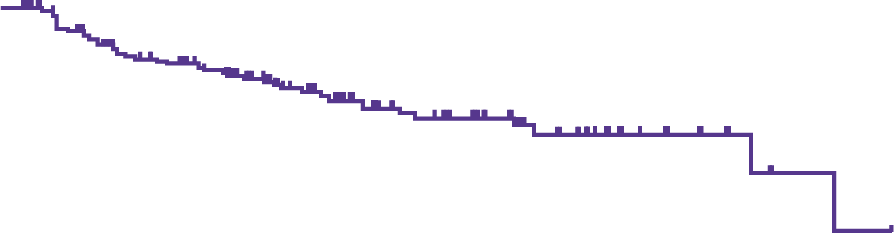
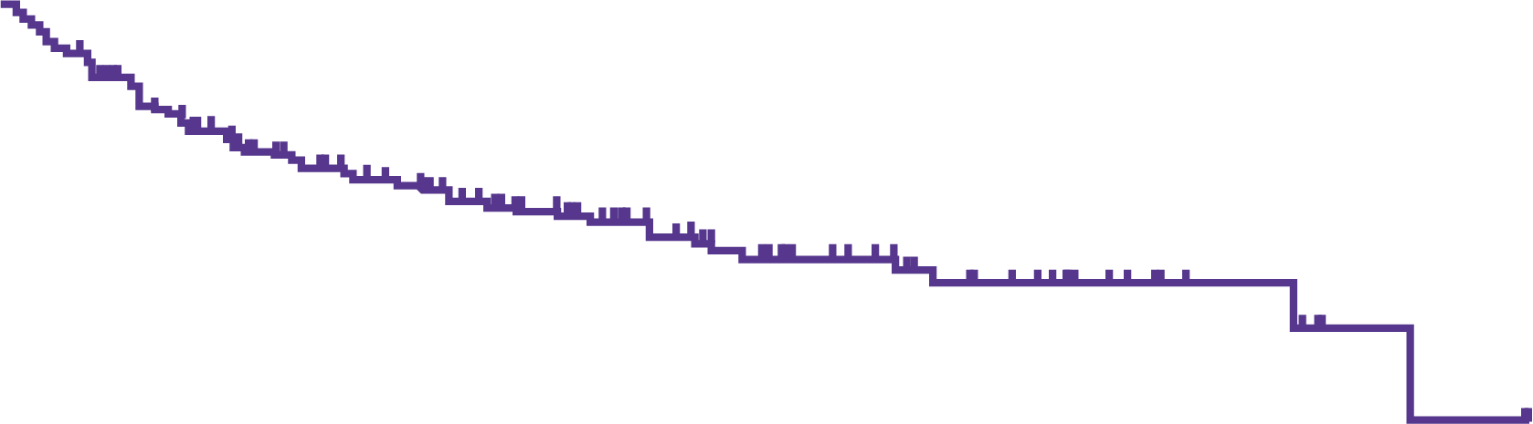

Dor, PFS and OS in patients with trk-positive tumours treated with larotrectinib
DoR
PFS
OS
100
80%
100
100
89%
81%
64%
69%
57%
77%
75
54%
75
48%
75
DoR (%)
50
PFS (%)
50
OS (%)
50
25
25
25
0
0
6
12
18
24
30
36
42
48
54
60
0
0
6
12
18
24
30
36
42
48
54
60
66
0
0
6
12
18
24
30
36
42
48
54
60
66
Time (months)
Time (months)
Time (months)
No. at risk
143
110
93
63
39
27
17
9
4
2
0
No. at risk
218
138
103
79
50
34
19
11
5
2
1
0
No. at risk
218
172
141
116
77
57
42
23
12
5
2
0
Integrated dataset (N=143)
Median DoR, (95% CI), months | 49.3 (27.3-NE)
Median follow-up, months | 22.3
Integrated dataset (N=218)
Median PFS, (95% CI), months | 35.4 (23.4-55.7)
Median follow-up, months | 20.3
Integrated dataset (N=218)
Median OS, (95% CI), months | Not reached
Median follow-up, months | 22.3
CNS metastases at baseline (N=19)
Median DoR, (95% CI), months | 17.4 (3.7-NE)
CNS metastases at baseline (N=19)
Median PFS, (95% CI), months | 9.9 (1.9-NE)
CNS metastases at baseline (N=19)
Median OS, (95% CI), months | 27.8 (8.5-NE)
CI, confidence interval; CNS, central nervous system; DoR, duration of response; NE; not estimable; OS, overall survival; PFS, progression-free survival; TRK, tropomyosin receptor kinase

Slide 9
Safety profile of Larotrectinib in trk-positive tumours
TRAEs: predominantly Grade 1 or 2
2% of patients discontinued treatment due to TRAEs
Grade 3 and 4 TRAEs were reported in 18% of patients
There were no new or unexpected safety signals, with a longer follow-up to the previous report and with 53 patients (24%) on larotrectinib treatment for ≥24 months
TRAE, treatment-related adverse event; TRK, tropomyosin receptor kinase

Slide 10
Efficacy and safety of larotrectinib in adult and pediatric patients with TRK fusion-positive primary CNS tumors
Perreault S, et al. ASCO 2021, Abstract #2002
CNS, central nervous system; TRK, tropomyosin receptor kinase

Slide 11
Study design on the investigation of trk fusion primary CNS tumours treated with larotrectinib
Paediatric Phase 1/2
Advanced solid tumours
SCOUT: NCT02637687
Adult/adolescent Phase 2
Advanced solid tumours
NAVIGATE: NCT02576431
Data cutoff: 20 July 2020
Patients:
24
9
Total of 33 patients with TRK fusion-positive primary CNS tumours
This analysis reports data in an expanded set of TRK fusion primary CNS tumors treated with larotrectinib (N=33)
CNS, central nervous system; TRK, tropomyosin receptor kinase

Slide 12
Baseline demographics and disease characteristics in TRK-positive primary CNS tumours
Characteristics | N=33
Age, median (range), years | 8.9 (1.3-79.0)
Female, n (%) Male, n (%) | 16 (48) 17 (52)
ECOG or equivalent Lansky performance statusª, n (%) 0 1 2 | 18 (55) 10 (30) 4 (12)
Prior therapies^{b}, n (%) Radiotherapy Surgery Systemic therapy | 18 (55) 22 (67) 28 (85)^{c}
Number of prior systemic therapies, n (%) 0 1 2 3 or more | 6 (18)^{c} 12 (36) 8 (24) 7 (21)
Primary tumour type, n (%) | N=33
Glioma High grade Low grade | 27 (82) 19 (58) 8 (24)
Other Glioneuronal tumour Neuroepithelial tumour CNS neuroblastoma Small round blue cell brain tumour | 6 (18) 2 (6) 2 (6) 1 (3) 1(3)
NTRK gene fusions
NTRK2
73%
(n=24)
NTRK1
15%
(n=5)
NTRK3
12%
(n=4)
ª ECOG PS not reported in one patient; ^{b} Patients may be counted in more than one category; ^{c} One patient who reported “yes” to prior systemic therapies had the number of prior systemic therapies reported as zero
CNS, central nervous system; ECOG, Eastern Cooperative Oncology Group; NTRK, neurotrophic tyrosine receptor kinase; PS, performance status; TRK, tropomyosin receptor kinase

Slide 13
Efficacy of Larotrectinib in trk-positive primary CNS tumours
 | Evaluable patients (N=33)
ORR, % (95% CI) Total High grade glioma Low grade glioma | 30 (16-49) 26 (9-51) 38 (9-76)
Median PFS, (95% CI), months 12-month PFS rate, % (95% CI) | 18.3 (6.7-NE) 56 (38-74)
Median OS, (95% CI), months 12-months OS rate, % (95% CI) | Not reached (16.9-NE) 85 (71-99)
Best change in tumour size for 28 patients with
baseline measurable disease
100
90
80
70
Paediatric HGG
Adult HGG
Paediatric LGG
Adult LGG
Other
60
50
40
30
20
10
*
Adult
HGG
Maximum change in tumour size (%)
0
-10
*
*
*
-20
-30
*
-40
-50
-60
-70
-80
Treatment duration ranged from 1.2 to 31.3+ months
At the data-cut off date, 18 patients still receiving treatment
Median time to best response: 1.87 months (range 0.99-3.75)
-90
-100
*Based on RECIST v1.1 sum of longest diameters
CI, confidence interval; CNS, central nervous system; HGG, high grade glioma; LGG, low grade glioma; NE, not estimable; ORR; objective response rate; OS, overall survival; PFS, progression-free survival; TRK, tropomyosin receptor kinase

Slide 14
Safety profile of Larotrectinib in trk-positive primary CNS tumours
TEAEs were mainly grade 1 and 2
39% (13/33) of patients had Grade 3 or 4 TEAE
9% (3/33) of patients had Grade 3 or 4 AEs related to Larotrectinib:
  Decrease neutrophil count (Grade 3)
  Increased gamma-glutamyltransferase (Grade 3)
  Hyperglycemia (Grade 3)
  Hypernatremia (Grade 3)
  Hyponatremia (Grade 4)
6% (2/33) required dose reductions due to a TEAE
33% (11/33) had doses skipped, missed or delayed due to a TEAE
No discontinuation due to TRAEs
Neurological AEs:
  Most common neurological TEAE = Headache at Grade 1 or 2 (6 patients) and Grade 3 (1 patient)
  6 patients had neurological AEs related to Larotrectinib (all Grade 1 or 2)
AE, adverse event; CNS, central nervous system; TEAE, treatment-emergent adverse event; TRAE, treatment-related adverse event; TRK, tropomyosin receptor kinase

Slide 15
Efficacy and safety of larotrectinib in patients with TRK fusion-positive GI cancer: an expanded dataset
Boni V, et al. WCGIC 2021, #SO-29
GI, gastrointestinal; TRK, tropomyosin receptor kinase

Slide 16
Study design on the investigation of trk fusion metastatic GI tumours treated with larotrectinib
Adult/adolescent Phase 2
Advanced solid tumours
NAVIGATE: NCT02576431
Data cutoff: 20 July 2020
Patients:
18
Total of 18 patients with TRK fusion-positive metastatic GI cancer
This analysis reports data in an expanded dataset of patients with TRK fusion-positive GI cancer (N=18)
GI, gastrointestinal; TRK, tropomyosin receptor kinase

Slide 17
Baseline demographics and disease characteristics in TRK-positive metastatic GI tumours
Characteristics | N=18
Age, median (range), years | 67.0 (32.0-84.0)
Female, n (%) Male, n (%) | 11 (61) 7 (39)
ECOG performance status, n (%) 0 1 2 3 | 3 (17) 11 (61) 3 (17) 1 (6)
Prior therapies, n (%) Surgery Systemic therapyª Radiotherapy | 14 (78) 17 (94) 2 (11)
Number of prior systemic therapies, n (%) 0 1 2 3 or more | 1 (6) 4 (22) 9 (50) 4 (22)
Primary tumour type, n (%) | N=18
Colorectal cancer: MSI-H MSS Unknown | 10 (56) 7 (70) 2 (20) 1 (10)
Cholangiocarcinoma Pancreas Appendix Oesophageal Hepatic | 3 (17) 2 (11) 1 (6) 1 (6) 1 (6)
NTRK gene fusions
NTRK3
17%
(n=3)
NTRK1
83%
(n=15)
ª 3 patients had received prior immunotherapy: one with colorectal cancer had progressive disease as best response after 2.8 months IO therapy, one with hepatic cancer had progressive disease and one with oesophageal cancer had unknown response.
ECOG, Eastern Cooperative Oncology Group; GI, gastrointestinal; IO, immuno-oncology; MSI-H, microsatellite instability high, MSS, microsatellite stable; NTRK, neurotrophic tyrosine receptor kinase; TRK, tropomyosin receptor kinase

Slide 18
Efficacy of Larotrectinib in trk-positive metastatic GI tumours
 | All patients (N=18) | CRC patients (N=10)
Evaluable patients | 17 | 10
ORR, % (95% CI) | 41 (18-67) | 50 (19-81)
Best overall response, n (%) Complete response Partial response Stable disease Progressive disease Not determined | 1 (6) 6 (35) 7 (41) 2 (12) 1 (6) | 1 (10) 4 (40) 5 (50) 0 0
Best change in tumour size for patients with
measurable disease at baseline
100
90
80
70
60
Cholangiocarcinoma
Appendix
Colorectal cancer
Pancreas
50
40
30
20
10
Maximum change in tumour size (%)
Pancreas
CRC
0
*
-10
-20
*
*
-30
*
-40
*
-50
-60
*
-70
-80
Treatment duration ranged from 0.26+ to 29.3 months
At the data cut-off, 10 patients had progressed, with 3 continuing treatment post-progression (range 2.7-5.5 months)
Median time to response: 1.86 months (range 1.68-4.96)
-90
-100
*
*MSI-high
CI, confidence interval; CRC, colorectal cancer; GI, gastrointestinal; MSI; microsatellite instability; ORR, objective response rate; TRK, tropomyosin receptor kinase

Slide 19
Treatment duration with larotrectinib in trk-positive metastatic GI tumours
Best overall
response
Treatment duration
CR
*
†
PR
*
‡
PR
§
SD
§
PR
§
PR
§
PR
*
§
Appendix
Cholangiocarcinoma
Colorectal cancer
Oesophageal
Hepatic
Pancreas
Component of treatment after
progression (months)
SD
‡
SD
§
SD
*
‡
SD
*
SD
*
§
SD
*
‡
Progression of disease
Treatment ongoing
Start of partial response
Start of complete response
PD
§
PR
‡
Not determined
†
PD
§
NE
0
5
10
15
20
25
30
35
Time (months)
*MSI-high; †Died without disease progression beforehand; ‡Alive without disease progression; §Stopped treatment due to progression
CR, complete response; GI, gastrointestinal; MSI, microsatellite instability; NE, not evaluable; PD, progressive disease; PR, partial response; SD, stable disease; TRK, tropomyosin receptor kinase

Slide 20
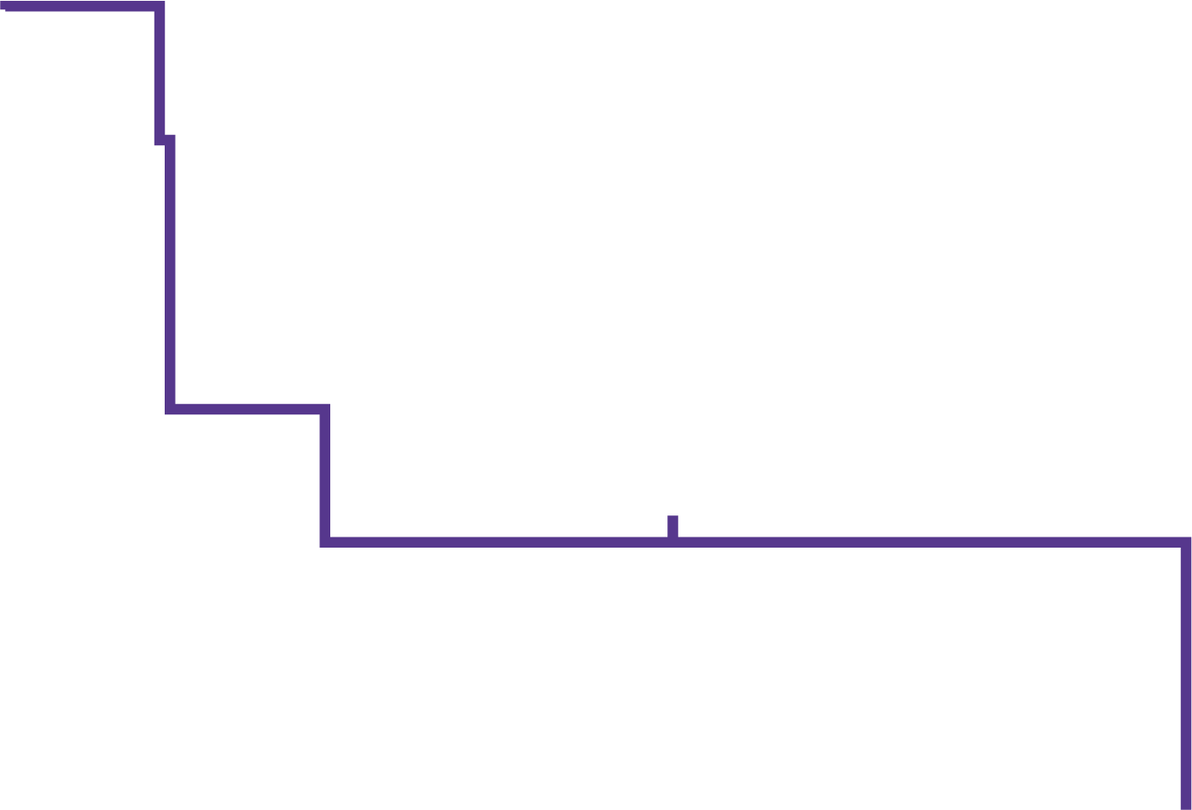
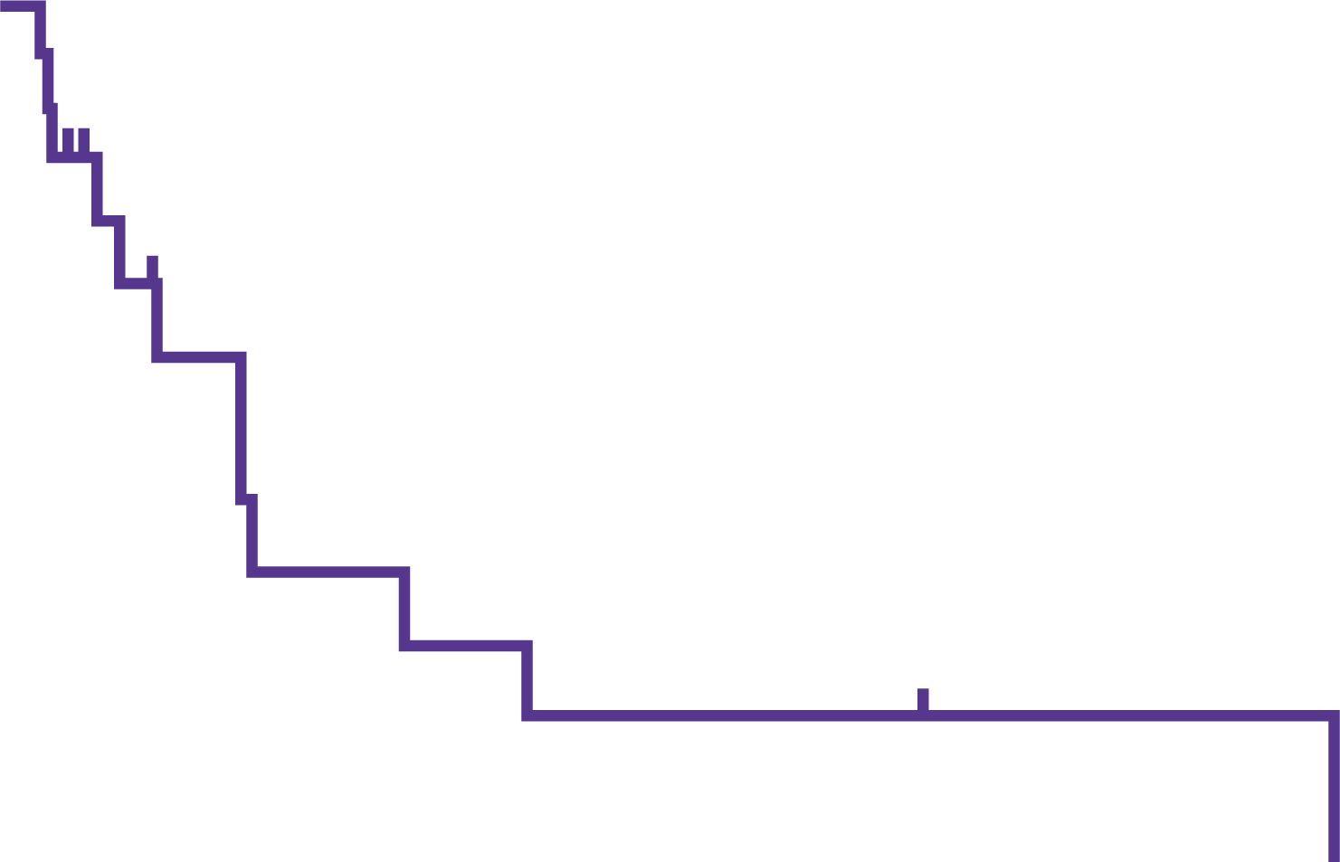
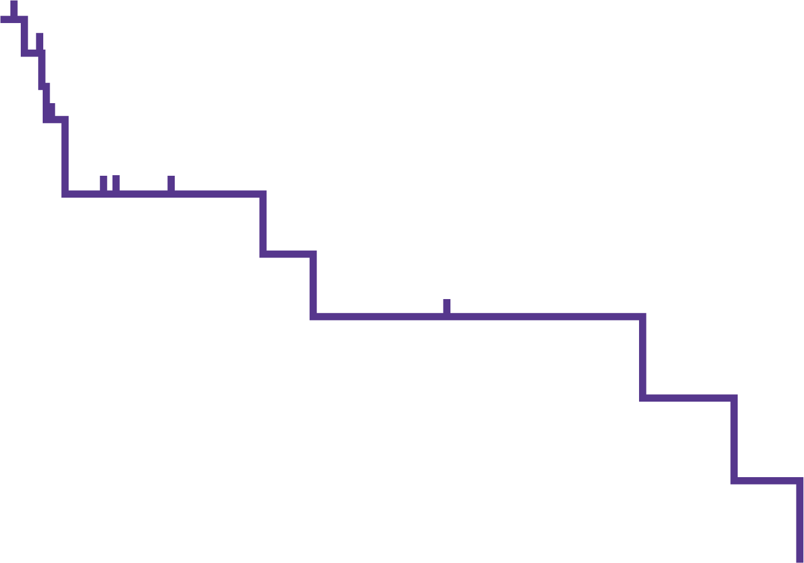
Dor, PFS and OS in patients with trk-positive metastatic GI tumours treated with larotrectinib
100
DoR
100
PFS
100
OS
75
75
75
50
50
50
Duration of response (%)
Progression-free survival (%)
Overall survival (%)
25
25
25
0
0
6
12
18
24
30
36
0
0
6
12
18
24
30
36
0
0
6
12
18
24
30
36
42
48
Time (months)
Time (months)
Time (months)
No. at risk
6
3
2
1
1
2
0
No. at risk
18
4
2
2
1
0
0
No. at risk
18
8
6
4
3
2
1
0
0
All patients (N=18)
Median DoR, (95% CI), months Median follow-up, months | 5.5 (3.5-27.3) Not reached
Patients with CRC (n=10)
Median DoR, (95% CI), months Median follow-up, months | 15.5 (3.7-27.3) Not reached
All patients (N=18)
Median PFS, (95% CI), months Median follow-up, months | 5.4 (2.2-11.6) 20.3
Patients with CRC (n=10)
Median PFS, (95% CI), months Median follow-up, months | 5.5 (2.2-29.4) 20.3
All patients (N=18)
Median OS, (95% CI), months Median follow-up, months | 14.1 (2.8-33.4) 7.8
Patients with CRC (n=10)
Median OS, (95% CI), months Median follow-up, months | 29.4 (2.8-36.5) 7.8
CI, confidence interval; CRC, colorectal cancer; DoR, duration of response; GI, gastrointestinal; OS, overall survival; PFS, progression-free survival; TRK, tropomyosin receptor kinase

Slide 21
Safety profile of Larotrectinib in trk-positive metastatic GI tumours
TEAEs were mainly Grade 1–2
56% (10/18) of patients had Grade 3 or 4 TEAEs
11% (2/18) of patients had Grade 3 or 4 AEs related to Larotrectinib:
  Nausea (Grade 3)
  Increased ALT and AST (Grade 4)
6% (1/18) required dose reductions due to a TEAE
No discontinuation due to TRAEs
AE, adverse event; ALT, alanine aminotransferase; AST, aspartate aminotransferase; GI, gastrointestinal; TEAE, treatment-emergent adverse event; TRAE, treatment-related adverse event; TRK, tropomyosin receptor kinase

Slide 22
Intra-patient comparison from larotrectinib clinical trials in
TRK fusion cancer:
An expanded dataset
Italiano A, et al. ASCO 2021, #3114
TRK, tropomyosin receptor kinase

Slide 23
GMI analysis in a long-term follow-up with larotrectinib
Adult Phase 1
Advanced solid tumours
NCT02122913
Paediatric Phase 1/2
Advanced solid tumours
SCOUT: NCT02637687
Adult/adolescent Phase 2
Advanced solid tumours
NAVIGATE: NCT02576431
Data cutoff: July 2019¹
PFS_{larotectinib}ª
GMI analysis reported in a cohort of 122 patients with TRK fusion cancer¹
GMI =
TTP_{prior line}^{b}
Data cutoff: July 2020
This analysis reports the GMI analysis in a long-term follow-up in an expanded cohort (N=140)
ª Defined as the time from the start of Larotrectinib treatment to radiological progression as determined by an independent review committee per RECIST v1.1, clinical progression or death by any cause
^{b} Defined as the time from the start of the last prior treatment to investigator-assessed radiological progression (RECIST v1.1), clinical progression or treatment end date
GMI, growth modulation index; PFS; progression-free survival; TRK, tropomyosin receptor kinase; TTP, time to progression or treatment failure
1. Italiano A. et al. Presented at the ESMO virtual Congress 2020, #542P

Slide 24
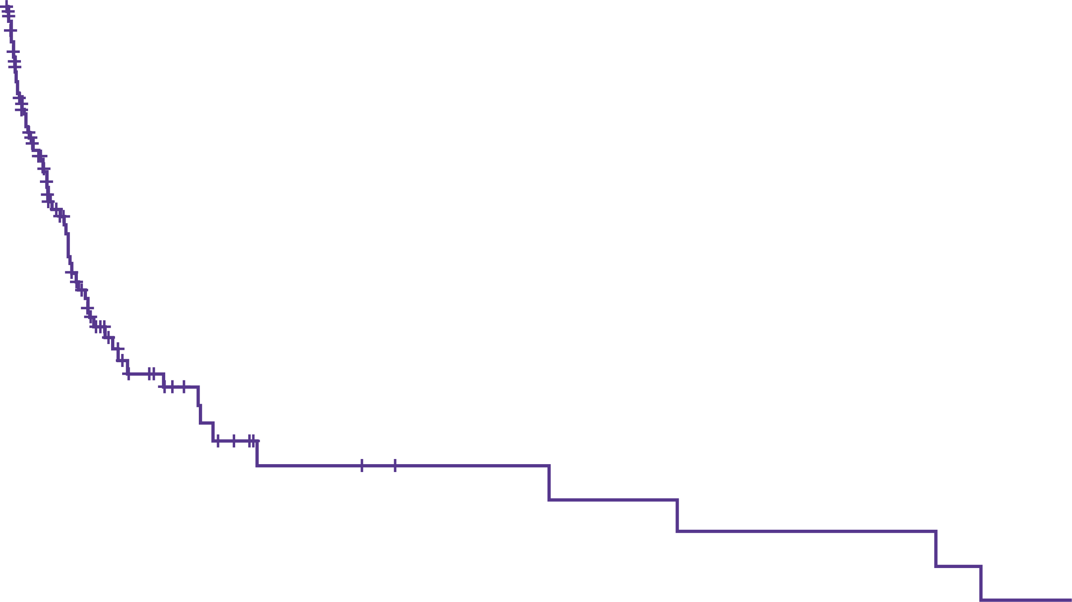
GMI analysis of 140 patients treated with larotrectinib
 | GMI <1 | GMI: 1 to <1.33 | GMI ≥1.33
Overall patients, n (%)ª | 30 (21) | 7 (5) | 103 (74)
Lines of prior therapy, n (%) 1 (N=53) 2 (N=37) ≥3 (N=50) | 10 (19) 10 (27) 10 (20) | 4 (8) 3 (8) 0 | 39 (74) 24 (65) 40 (80)
Tumour type, n (%)^{b} Soft tissue sarcoma (n=35) Infantile fibrosarcoma (n=27) Thyroid (n=21) Lung (n=14) Salivary gland (n=10) Colon (n=7) Melanoma (n=7) | 8 (23) 1 (4) 5 (24) 2 (14) 2 (20) 2 (29) 4 (57) | 1 (3) 2 (7) 2 (10) 0 0 2 (29) 0 | 26 (74) 24 (89) 14 (67) 12 (86) 8 (80) 3 (43) 3 (43)
ª A total of 78 patients (56%) had not progressed and were censored for progression-free survival as of data cut-off. Six of the 37 patients with a GMI <1.33 were censored and still receiving treatment ^{b} Only tumours reported in ≥7 patients are listed
Kaplan-Meier estimate of GMI in the July 2020 dataset (N=140)
100
Censored
90
80
70
60
Median GMI: 8.9 (95% CI 6.2-17.4)
Patients without progression for death (%)
50
40
30
20
10
NTRK1
44%
(n=97)
0
0
12
24
36
48
60
72
84
96
Growth modulation index
No. at risk
140
22
8
6
6
5
4
3
2
CI, confidence interval; GMI, growth modulation index

Slide 25
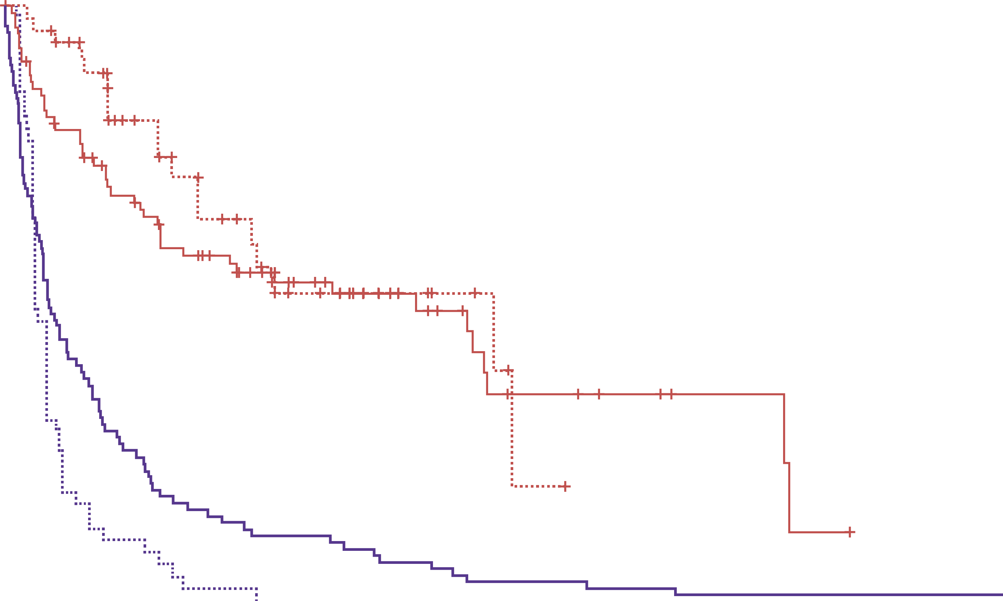
PFS and TTP in patients with trk-positive tumours treated with Larotrectinib by age group
100
1. Adult: TTP for prior therapy
2. Adult: PFS for larotrectinib
3. Paediatric: TTP for prior therapy
4. Paediatric: PFS for larotrectinib
Censored
90
 | Overall (N=140) | Adult (n=91) | Paediatric (n=49)
Median PFS on Larotrectinib, (95% CI), months | 33.0 (16.6-34.9) | 29.4 | 34.9
Median TTP on prior therapyª, (95% CI), months | 3.0 (2.1-3.5) | 3.1 | 2.0
Hazard ratio, (95% CI) | 0.22 (0.16-0.30) | 0.29 (0.20-0.41) | 0.10 (0.05-0.18)
80
70
60
Patients without treatment failure
or progression (%)
50
40
30
20
10
0
0
12
24
36
48
60
72
No. at risk
1
2
3
4
Months
91
91
49
49
15
46
2
21
9
25
0
8
3
8
0
2
2
3
0
0
1
1
0
0
1
0
0
0
ª Calculated as time from start of most recent prior therapy (regardless of metastatic setting) until progression. For the 85 patients with no data of progression, the end date of the last prior therapy was considered the date of progression. One pediatric patient progressed at 151 months
CI, confidence interval; PFS, progression-free survival; TRK, tropomyosin receptor kinase; TTP, time to progression or treatment failure

Slide 26
Tumor-agnostic precision immuno-oncology and somatic targeting rationale for you (TAPISTRY):
A novel platform umbrella trial
Drilon A.E. et al. ASCO 2021, #TPS3154

Slide 27
Tapistry Study design
TAPISTRY: Phase 2, open-label, multi-cohort study to evalute the efficacy and safety of targeted therapy or immunotherapy as single agents or in combination in patients with unresectable, locally advanced or metastatic solid tumours
Primary efficacy endpoint:
Confirmed ORR ≥28 days after intitial response determined by IRC per
RECIST v1.1
Key secondary endpoints for cohort B:
ORR DoR, CBR, PFS, Time to CNS PD per RECIST v1.1
OS
ORR, DoR, CBR, PFS per INRC
CNS-ORR, DoR, CBR, PFS per RANO
Intracranial ORR; DoR, CBR, PFF per
RECIST v1.1ª
Safety
PROs
PK
Main eligibility criteria:
PD on prior treatment
Advanced and unresectable or metastatic solid tumours
Adequate PS
≥18 years: ECOG PS 0-2
16-<18 years: Karnofsky
score ≥50%
<16 years: Lansky score ≥50%
Positive status per NGS for a cohort specified biomarker
10 cohorts
Cohort B: entrectinib NTRK1/2/3 fusion
Target enrollment: 200 adult patients
Dose in 28-day treatment cycles:
BSA ≥1.51 m²: 600mg QD
BSA <1.51 m²: 100-400mg QD
As of 19 April 2021, 21 patients have been recruited
ª In patients with CNS metastases at baseline
BSA, body surface area; CBR, clinical benefit rate; CNS, central nervous system; DoR, duration of response; ECOG, Eastern Cooperative Oncology Group; INRC, International Neuroblastoma Response Criteria; IRC, independent review committee; NGS, next-generation sequencing; NTRK, neurotrophic tyrosine receptor kinase; ORR, objective response rate; OS, overall survival; PD, progressive disease; PFS, progression-free survival; PK, pharmacokinetic; PROs, patient-reported outcomes; PS, performance status; QD, once daily; RANO, response assessment in neuro-oncology; RECISTv1.1, response evaluation criteria in solid tumours version 1.1

Slide 28
In summary
Larotectinib continues to demonstrate a robust and durable response rate and is well tolerated in patients with TRK fusion cancer:
  Confirmed in patients with TRK fusion primary CNS tumours
  Confirmed in patients with TRK fusion GI tumours (including CRC)
Three-quarters of patients with TRK fusion cancer treated with larotrectinib had a better than 33% increase in PFS compared to most recent prior therapy
  Suggest improved disease response over prior therapy
These data highlight the importance of identifying NTRK gene fusions in patients
with cancer → Testing is critical
TAPISTRY Phase 2 trial has been initiated and worth following up
CNS, central nervous system; CRC, colorectal cancer; NTRK, neurotrophic tyrosine receptor kinase; PFS; progression-free survival; TRK, tropomyosin receptor kinase

Slide 29
REACH NTRK CONNECT VIA
TWITTER, LINKEDIN, VIMEO & EMAIL
OR VISIT THE GROUP’S WEBSITE http://www.ntrkconnect.info
Follow us on Twitter
@ntrkconnectinfo
Follow the
NTRK CONNECT
group on LinkedIn
Watch us on the
Vimeo Channel
NTRK CONNECT
Email
froukje.sosef
@cor2ed.com

