Slide 2
NTRK CONNECT
MEETING SUMMARY:
TRK fusion-positive cancer
FROM WCLC, ECP and ESMO 2022
Dr Fernando Santini
Memorial Sloan Kettering Cancer Center, New York, USA
SEPTEMBER 2022

Slide 3
Disclosures
Please note: Views expressed within this presentation are the personal opinions of the author.
They do not necessarily represent the views of the author’s academic institution or the rest of
NTRK CONNECT group.
This content is supported by an independent educational grant from Bayer.
Disclosures: Dr Fernando Santini has received honoraria from Bayer

Slide 4
Selected abstrActs from WCLC, ECP AND ESMO 2022
Updated clinical efficacy and safety data from larotrectinib:
  463P - Efficacy and safety of larotrectinib in a pooled analysis of patients (pts) with tropomyosin receptor kinase (TRK) fusion cancer with an extended follow-up. Presented by R.S. McDermott (ESMO 2022)
  EP08.02-148 - Extended follow-up of efficacy and safety of larotrectinib in patients with TRK fusion lung cancer. Presented by V. Moreno (WCLC 2022)
Promising testing methods:
  OFP-12-007: Ultra-fast gene fusion assessment as a reflex testing in daily clinical practice for advanced non-small cell lung cancer patients. Presented by C. Bontoux (ECP 2022)
TRK, tropomyosin receptor kinase

Slide 5
Efficacy and Safety of Larotrectinib in a Pooled Analysis of PATIENTS With TRK Fusion Cancer With an Extended Follow-Up
McDermott RS, et al. ESMO 2022. Abstract #463P
TRK, tropomyosin receptor kinase

Slide 6
Background
larotrectinib = first-in-class, highly selective, CNS-active TRK inhibitor approved to
treat adult and paediatric patients with TRK fusion cancer
Adult in Phase 1
Advanced solid tumours
NCT02122913
Paediatric in Phase 1/2
Advanced solid tumours
SCOUT: NCT02637687
Adult/adolescent in Phase 2
Advanced solid tumours
NAVIGATE: NCT02576431
Data cut-off: 20 July 2021
Total of 164 patients with non-primary CNS TRK-fusion cancer treated with larotrectinib
McDermott RS, et al. ESMO 2022. Abstract #463P
CNS, central nervous system; TRK, tropomyosin receptor kinase

Slide 7
Integrated dataset: High ORR achieved with larotrectinib across various tumours
Patient population by
tumour type (N=164)
Efficacy assessments
 | Overall | Patients with CNS metastases
Evaluable patients, n | 164 | 14
ORR (95% CI), % | 74 (67-81) | 86 (57-98)
Best response, n (%)
Complete response | 40 (24) | 1 (7)
Pathological complete response | 10 (6) | 0
Partial response | 72 (44) | 11 (79)
Stable disease | 22 (13) | 1 (7)
Progressive disease | 13 (8) | 0
Not determinedª | 7 (4) | 1 (7)
ª Patients who discontinued study drug without evaluable post-baseline assessments
Each 1%: Cholangiocarcinoma,
Pancreas, Bone sarcoma
Each <1%: Congenital mesoblastic nephroma,
CUP, Prostate, Hepatic, Appendix
GIST 2%
Breast 3%
Soft tissue sarcoma
22%
Melanoma 4%
Colon 5%
Lung 8%
Infantile fibrosarcoma
20%
Salivary gland
13%
Thyroid
17%
McDermott RS, et al. ESMO 2022. Abstract #463P
CI, confidence interval; CNS, central nervous system; CUP, cancer of unknown primary; GIST, gastrointestinal stromal tumour; ORR, objective response rate

Slide 8
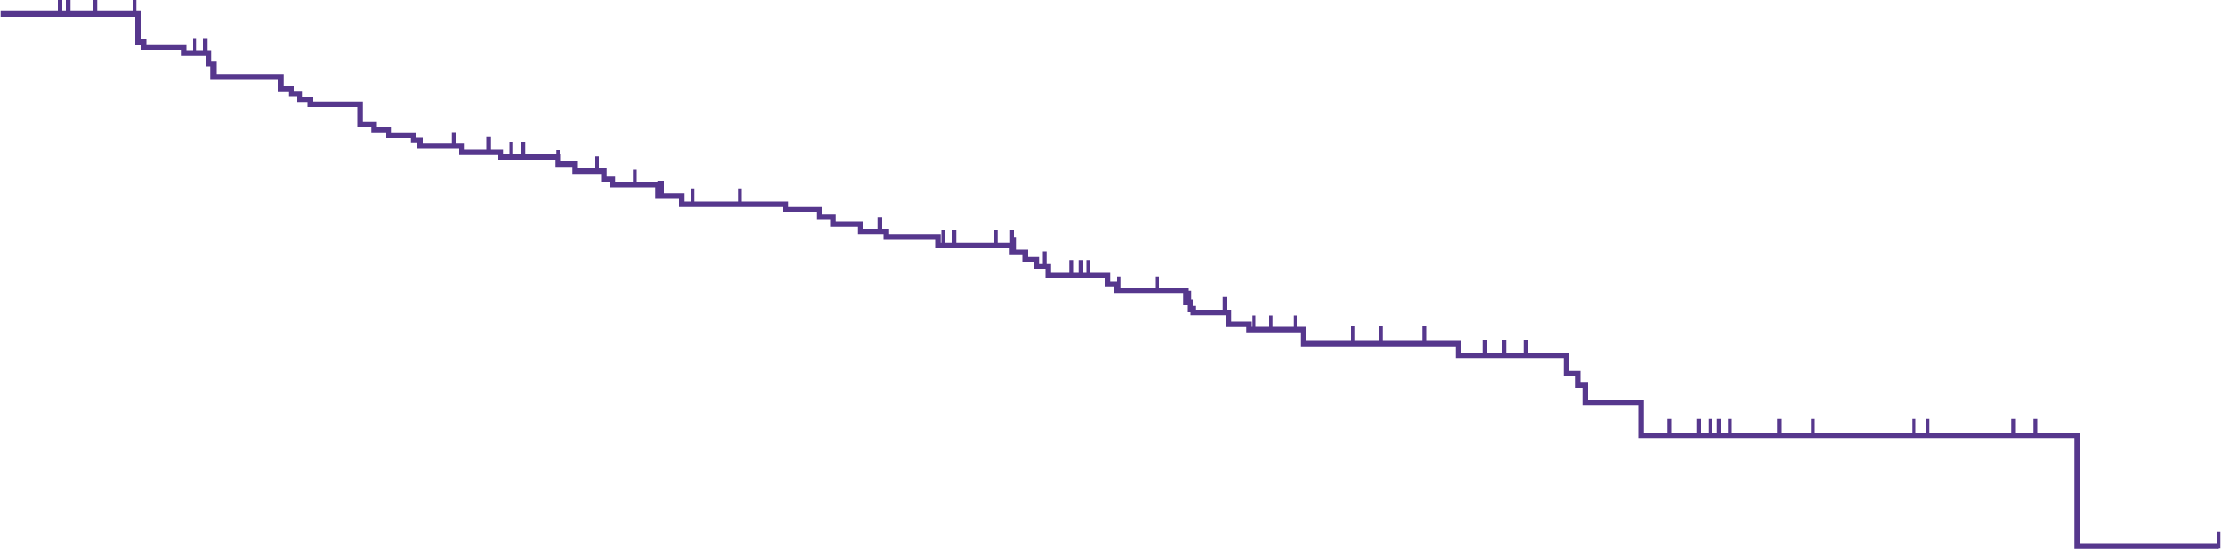
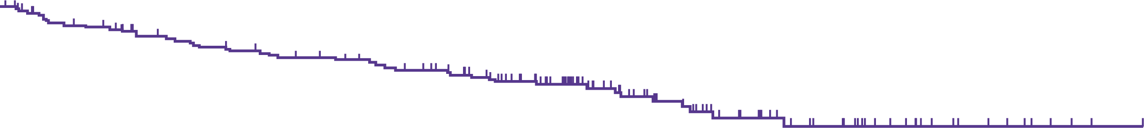
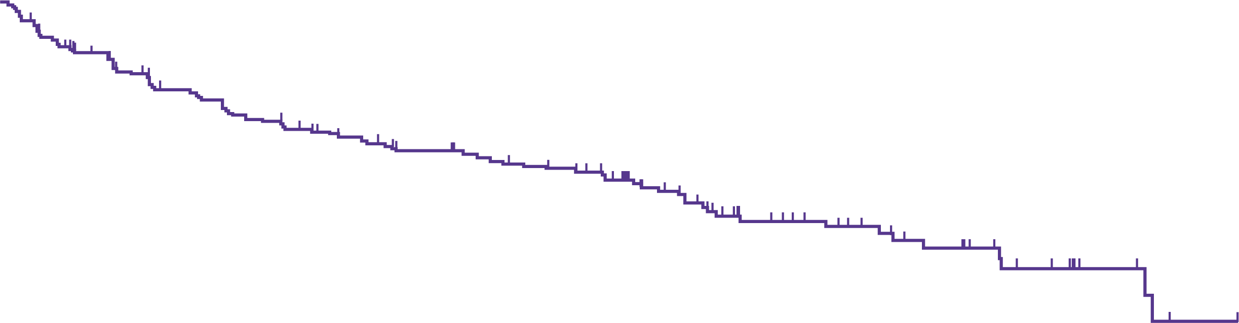
Efficacy: Dor, pfs, and os in patients with trk fusion cancer
DoR
Median DoR (95% CI), months | 34.5 (27.6-43.3)
Median follow-up, months | 34.1
24-month DoR (95% CI), % | 65 (56-75)
36-month DoR (95% CI), % | 49 (38-60)
100
75
65%
Duration of
response (%)
49%
Median OS (95% CI), months | Not reached (NE-NE)
Median follow-up, months | 38.0
36-month OS (95% CI), % | 76 (69-83)
48-month OS (95% CI), % | 66 (57-75)
50
OS
25
0
100
0
6
12
18
24
30
36
42
48
54
60
75
76%
66%
Months from start of response
No. at risk
122
100
87
69
60
40
26
16
6
2
0
50
Overall
survival (%)
25
PFS
Median PFS (95% CI), months | 32.0 (23.4-40.2)
Median follow-up, months | 35.8
24-month PFS (95% CI), % | 58 (50-66)
36-month PFS (95% CI), % | 43 (34-52)
0
0
6
12
18
24
30
36
42
48
54
60
66
72
100
Months from start of treatment
75
No. at risk
164
147
133
124
115
102
69
47
30
17
8
3
0
58%
Progression-free
survival (%)
43%
50
25
0
0
6
12
18
24
30
36
42
48
54
60
66
Months from start of treatment
No. at risk
164
121
98
84
71
58
31
22
14
5
1
0
McDermott RS, et al. ESMO 2022. Abstract #463P
CI, confidence interval; DoR, duration of response; NE, not estimable; No., number; OS, overall survival; PFS, progression-free survival;
TRK, tropomyosin receptor kinase

Slide 9
Safety: no new signal identified
AEs that occurred in ≥20% of patients (N=164)
All AEs
TRAEs
Cough
ALT increased
Vomiting
Constipation
Diarrhoea
Fatigue
Pyrexia
AST increased
Dizziness
Anaemia
Nausea
Arthralgia
Upper respiratory tract infection
Myalgia
Oedema peripheral
Headache
Back pain
Dyspnoea
Pain in extremity
42.1
1.2
1.2
37.8
4.9
3.6
31.1
36.0
0.6
7.9
35.4
14.0
35.4
3.0
9.1
34.1
1.2
17.7
34.1
3.6
1.8
33.5
3.6
2.4
29.3
32.9
1.2
0.6
21.3
31.1
10.4
1.2
9.8
31.1
0.6
0.6
15.2
25.6
0.6
0.6
4.9
24.4
0.6
23.8
1.2
0.6
13.4
23.2
1.2
6.7
22.0
0.6
0.6
6.1
20.1
1.2
1.2
20.1
3.0
1.8
Grade ≥3
Any grade
20.1
1.2
4.3
50
40
30
20
10
0
10
20
30
40
Patients (%)
McDermott RS, et al. ESMO 2022. Abstract #463P
AE, adverse event; ALT, alanine aminotransferase; AST, aspartate aminotransferase; TRAE, treatment-related adverse event

Slide 10
Extended Follow-up of
Efficacy and Safety of Larotrectinib in Patients With
TRK Fusion Lung Cancer
Moreno V, et al. WCLC 2022. Abstract #EP08.02-148
TRK, tropomyosin receptor kinase

Slide 11
Background
larotrectinib = first-in-class, highly selective, CNS-active TRK inhibitor approved to
treat adult and paediatric patients with TRK fusion cancer
Adult in Phase 1
Advanced solid tumours
NCT02122913
Paediatric in Phase 1/2
Advanced solid tumours
SCOUT: NCT02637687
Adult/adolescent in Phase 2
Advanced solid tumours
NAVIGATE: NCT02576431
Data cut-off: 20 July 2021
Group 1; n=15 ; 15 evaluable: refers to the patients who were enrolled and evaluable in the trials as of July 2020 and had an additional year of follow up
Group 2; n=26; 23 evaluable: refers to the expanded dataset of patients which includes all patients from Group 1 plus 11 additional patients identified by the time of data cut off
Moreno V, et al. WCLC 2022. Abstract #EP08.02-148
CNS, central nervous system; TRK, tropomyosin receptor kinase

Slide 12



key efficacy results in patients with TRK fusion lung cancer
Efficacy from the Group 1 and Group 2 datasets
 | Patients from the Group 1 dataset | Patients from the Group 2 dataset
IRC evaluable patients, n | 15 | 23
ORR (95% CI), % | 87 (60-98) | 83 (61-95)
Best overall response, n (%) Complete response Partial response Stable disease Progressive disease | 2 (13) 11 (73) 2 (13) 0 | 2 (9) 17 (74) 4 (17) 0
DoR, PFS and OS in patients with TRK fusion lung cancer from the Group 2 dataset (n=26)
100
100
100
90%
75
72%
72%
75
67%
67%
75
72%
Duration of
response (%)
Progression-free
survival (%)
Overall
survival (%)
50
50
50
25
25
25
0
0
0
0
6
12
18
24
30
36
42
48
0
6
12
18
24
30
36
42
48
0
6
12
18
24
30
36
42
48
54
60
66
Months from start of response
Months from start of treatment
Months from start of treatment
No. at risk
No. at risk
No. at risk
19
13
7
5
4
3
2
1
0
23
29
8
7
6
5
2
1
0
26
23
14
9
7
6
3
2
1
1
1
0
Median DoR (95% CI), months | Not reached
Median follow-up, months | 12.9
12-month DoR (95% CI), % | 72 (48-96)
24-month DoR (95% CI), % | 72 (48-96)
Median PFS (95% CI), months | Not reached
Median follow-up, months | 14.6
12-month PFS (95% CI), % | 67 (44-90)
24-month PFS (95% CI), % | 67 (44-90)
Median OS (95% CI), months | 40.7 (19.4-NE)
Median follow-up, months | 12.9
12-month OS (95% CI), % | 90 (78-100)
24-month OS (95% CI), % | 72 (48-97)
Moreno V, et al. WCLC 2022. Abstract #EP08.02-148
CI, confidence interval; DoR, duration of response; IRC, independent review committee; NE, not estimable; ORR, objective response rate; OS, overall survival; PFS, progression free survival; TRK, tropomyosin receptor kinase

Slide 13
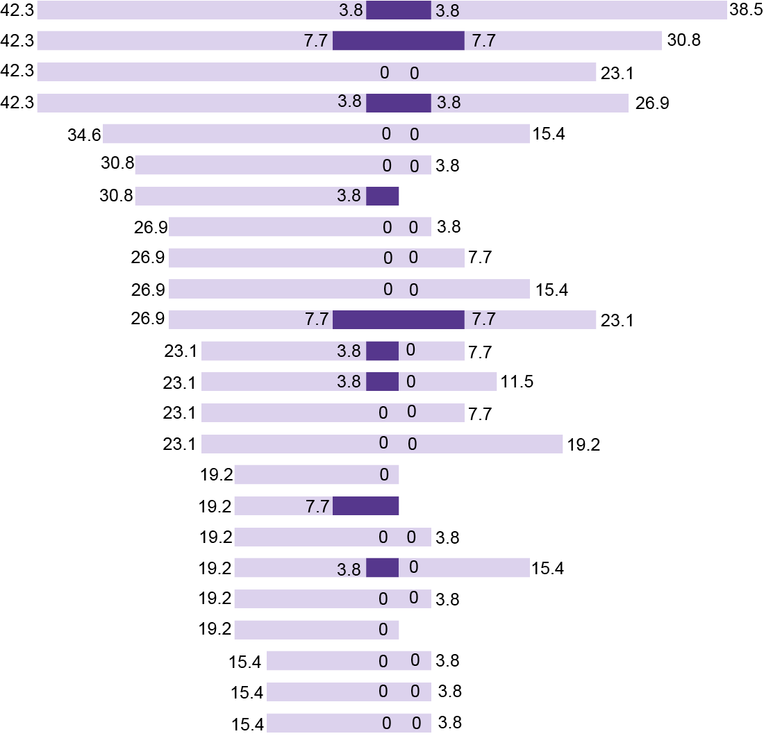
Safety: no new safety signals identified
AEs occurring in >/=15% of patients from Group 2 (n=26)
All AEs
AEs related to larotrectinib (TRAEs)
ALT increased
AST increased
Constipation
Myalgia
Dizziness
Arthralgia
Cough
Diarrhoea
Fatigue
Nausea
Weight increased
Anaemia
Oedema peripheral
Vomiting
WBC count decreased
Back pain
Dyspnoea
Muscular weakness
Neutrophil count decreased
Pyrexia
Upper respiratory tract infection
Insomnia
Pain in extremity
Pruritus
For the Group 1 dataset:
with an additional year of follow-up, there were no new safety signals identified
Grade ≥3
Any grade
50
40
30
20
10
0
10
20
30
40
50
Patients (%)
Moreno V, et al. WCLC 2022. Abstract #EP08.02-148
AE, adverse event; ALT, alanine aminotransferase; AST, aspartate aminotransferase; TRAE, treatment related adverse event; WBC, white blood cell

Slide 14
Ultra-fast gene fusion assessment as a reflex testing in daily clinical practice for advanced non-small cell lung cancer patients
Bontoux C, et al. ECP 2022. Abstract #OFP-12-007

Slide 15
Background & methods
Objectives:
  There is an urgent need to improve the broad molecular profiling (reflex testing) of advanced non-squamous non-small cell lung carcinoma patients, notably for a rapid assessment of multiple genomic alterations
Methods:
  We compared two ultra-fast gene fusion assessment assays, using a next generation sequencing (Genexus, Oncomine™ Precision Assay, Thermo-Fisher) or an RT-PCR (Idylla™, GeneFusion Assay, Biocartis) approach, for reflex testing at diagnosis
Bontoux C, et al. ECP 2022. Abstract #OFP-12-007
RT-PCR, reverse transcription polymerase chain reaction

Slide 16
Results and conclusion
250 NS-NSCLC patients (68 ALK, 26 ROS1, 15 RET, 6 NTRK, 11 MET positive and 125 wild type patients) from eight centres were included; 83% of patients were stage IIIB-IV
The sensitivity (98%) and specificity (99%) of the two approaches were analogous, when compared to gold standard methods, accredited according to the ISO 15189 norm
Conclusion: Ultra-fast gene fusion evaluation using NGS or RT-PCR approaches should be developed as a reflex testing for NS-NSCLC at diagnosis in order to treat these patients according to international recommendations and guidelines
Bontoux C, et al. ECP 2022. Abstract #OFP-12-007
ALK, anaplastic lymphoma kinase; ISO, International Organisation for Standardization; MET, MET proto-oncogene; NGS, next-generation sequencing; NS‑NSCLC, non-squamous non-small cell lung carcinoma; NTRK, neurotrophic receptor tyrosine kinase; RET, RET proto-oncogene; ROS1, ROS proto‑oncogene 1; RT-PCR, reverse transcription polymerase chain reaction

Slide 17
conclusions

Slide 18
COnclusions
First generation TRK inhibitor:
  larotrectinib continues to demonstrate a robust clinical efficacy with a manageable safety profile in various solid tumour types including in lung cancer
Testing for presence of NTRK fusions:
  Presence of NTRK fusions must be tested for in order to identify patients who can benefit from first-generation TRK inhibitors such as larotrectinib and entrectinib
  A reflex testing method is valuable for efficient and rapid identification (within 1 day) of patients with NTRK positive tumours
NTRK, neurotrophic receptor tyrosine kinase; TRK, tropomyosin receptor kinase

Slide 19
REACH NTRK CONNECT VIA
TWITTER, LINKEDIN, VIMEO & EMAIL
OR VISIT THE GROUP’S WEBSITE https://ntrkconnect.cor2ed.com/
Follow us on Twitter
@ntrkconnectinfo
Follow the
NTRK CONNECT
group on LinkedIn
Watch us on the
Vimeo Channel
NTRK CONNECT
Email
Iain.murdoch
@cor2ed.com

