Slide 2
GI CONNECT
MEETING SUMMARY
UPPER GI CANCER HIGHLIGHTS
FROM ASCO GI 2023
Dr. Efrat Dotan
Fox Chase Cancer Center, USA
Dr. Nataliya Uboha
University of Wisconsin, Madison, USA
JANUARY 2023

Slide 3

DEVELOPED BY GI CONNECT
This programme is developed by GI CONNECT,
an international group of experts in the field
of gastrointestinal oncology.
Acknowledgement and disclosures
This GI CONNECT programme is supported through an independent educational grant from Bayer. The programme is therefore independent, the content is not influenced by the supporter and is under the sole responsibility of the experts.
Please note: The views expressed within this programme are the personal opinions of the experts. They do not necessarily represent the views of the experts’ institutions, or the rest of the GI CONNECT group.
Expert Disclaimers:
Dr Efrat Dotan has received financial support/sponsorship for research support, consultation, or speaker fees from the following companies: : Eli Lilly, Gilead, Lutris, Zymworks, Relay, Ipsen, AstraZeneca, Medimmune, Incyte, Pfizer, Incyte, Helsinn, Taiho, G1 Therapeutics
Dr Nataliya Uboha has received financial support/sponsorship for research support, consultation, or speaker fees from the following companies: QED, Taiho Inc., Incyte, AstraZeneca, Pfizer, Boston Gene, Helsinn, Taiho Inc, Ipsen, EMD Serono, Natera, Exact Sciences

Slide 4


THIS PROGRAMME HAS BEEN DEVELOPED BY THE FOLLOWING EXPERTS
Dr. Efrat Dotan
Fox Chase Cancer center, USA
Dr. NatalIya Uboha
University of Wisconsin, USA

Slide 5
ZOLBETUXIMAB + mFOLFOX6 AS 1L TREATMENT FOR PTS WITH CLDN18.2+ / HER2− LOCALLY ADVANCED UNRESECTABLE OR METASTATIC GASTRIC OR GASTROESOPHAGEAL JUNCTION ADENOCARCINOMA: PRIMARY RESULTS FROM
PHASE 3 SPOTLIGHT STUDY
Shitara K, et al. ASCO GI 2023. Abstract #LBA292
1L, first line; CLDN, claudin; FOLFOX, folinic acid, fluorouracil and oxaliplatin; HER2, human epidermal growth factor receptor 2; mFOLFOX(6), modified FOLFOX(6); PT, patient

Slide 6
SPOTLIGHT: BACKGROUND AND STUDY DESIGN
Patients with unresectable or metastatic G/GEJ adenocarcinoma are often treated with standard of care chemotherapy like mFOLFOX¹⁻⁷
Targeted therapy prolongs survival in a limited number of patients (e.g. trastuzumab can benefit around 15% of patients with HER2+)²⁻⁹
Zolbetuximab is an IgG1 monoclonal antibody that targets CLDN18.2, a tight junction protein that is expressed on the surface of mucosal cells in G/GEJ¹⁰⁻¹⁷
SPOTLIGHT is a global, randomized, double-blind, placebo controlled phase 3 study¹⁸
Planned
(N=550)
N=283
Zolbetuximab 800/600 mg/m² IV Q3W +
mFOLFOX6 IV Q2W
Cycles 1-4 (42 days/cycle)
Zolbetuximab 600 mg/m² IV Q3W +
5-FU + folinic acid IV Q2W
Cycles 5+
R
1:1
Placebo IV Q3W +
mFOLFOX6 IV Q2W
Cycles 1-4 (42 days/cycle)
Placebo IV Q3W +
5-FU + folinic acid IV Q2W
Cycles 5+
N=282
Primary endpoint
PFS
Key secondary endpoints
OS
TTCD in GHS/QoL, PF and OG25-Pain
Secondary endpoints
ORR • Safety
DoR • PROs
5-FU, fluorouracil; CLDN, claudin; DoR, duration of response; FOLFOX, folinic acid, fluorouracil and oxaliplatin; G/GEJ, gastric or gastroesophageal junction; GHS, global health status; HER2, human epidermal growth factor receptor 2; IV, intravenous; mFOLFOX(6), modified FOLFOX(6); OG25, oesophageal module questionnaire; ORR, objective response rate; OS, overall survival; PF, physical function; PFS, progression-free survival; PRO, patient-reported outcome; Q2/3W, every 2/3 weeks; R, randomisation; TTCD, time to confirmed clinical deterioration
1. Van Cutsem et al. Lancet. 2016;388:2654-64; 2. Lordick F, et al. Ann Oncol. 2022;33:1005-20; 3. Obermannová R, et al. Ann Oncol. 2022;33:992-1004; 4. JGCA. Gastric Cancer 2021;24:1-21; 5. Kelly RJ, et al. New Engl J Med. 2021;384:1191-1203; 6. NHCPRC. Chin J Cancer Res. 2022;34:207-37; 7. Bang Y-J, et al. Lancet 2010;376:687-97; 8. Janjigian YY, et al. Lancet 2021;398:27‑40; 9. Shitara K, et al. Nature. 2022;603:942-8; 10. Nimi T, et al. Mol Cell Biol. 201;21:7380-90; 11. Sahin U, et al. Clin Cancer Res. 2008;14:7624-34; 12. Moran D, et al. Ann Oncol. 2018;29:viii13-viii57; 13. Sahin U, et al. Eur J Cancer. 2018;100:17-26; 14. Rohde C, et al. Jpn J Clin Oncol. 2019;49:870-76; 15. Türeci Ö, et al. Ann Oncol. 2019;30:1487-95. 16. Pellino A, et al. J Pers Med. 2021;11:1095; 17. Sahin U et al. Ann Oncol. 2021;32:609-19; 18. https://www.clinicaltrials.gov/ct2/show/NCT03504397 (last accessed: January 25, 2023)

Slide 7
SPOTLIGHT: RESULTS
Primary Endpoint: PFS was significantly longer in patients treated with zolbetuximab + mFOLFOX vs placebo + mFOLFOX
Secondary Endpoint: OS was significantly longer in patients treated with zolbetuximab + mFOLFOX vs placebo + mFOLFOX
Incidence of TEAEs were similar in both treatment arms
  GI toxicity was the most common
Primary endpoint: PFS
Key secondary endpoint: OS
 | mFOLFOX6 | mFOLFOX6
No. events/ no. patients | 146/283 | 167/282
Median PFS, months (95% CI) | 10.61 (8.90-12.48) | 8.67 (8.21-10.28)
HR (95% CI) p value | 0.751 (0.589-0.942) 0.0066
 | Zolbetuximab + mFOLFOX6 | Placebo + mFOLFOX6
No. events/ no. patients | 149/283 | 177/282
Median OS, months (95% CI) | 18.23 (16.43-22.90) | 15.54 (13.47-16.53)
HR (95% CI) p value | 0.750 (0.601-0.936) 0.0053
CI, confidence interval; FOLFOX, folinic acid, fluorouracil and oxaliplatin; GI, gastrointestinal; HR, hazard ratio; mFOLFOX(6), modified FOLFOX(6); OS, overall survival; PFS, progression-free survival; TEAE, treatment-emergent adverse event

Slide 8
SPOTLIGHT: RESULTS
ADVERSE EVENTS IN ALL TREATED PATIENTS
Event, n (%) | Zolbetuximab + mFOLFOX6 (N=279) |  | Placebo + mFOLFOX6 (N=278)
 | All Grade | Grade ≥3 | All Grade | Grade ≥3
All TEAEs | 278 (99.6) | 242 (86.7) | 277 (99.6) | 216 (77.7)
Serious TEAEs | 125 (44.8) | – | 121 (43.5) | –
TRAEs leading to discontinuation of any study drug | 106 (38.0) | – | 82 (29.5) | –
TRAEs leading to discontinuation of zolbetuximab or placebo | 38 (13.6) | – | 6 (2.2) | –
TRAEs leading to death | 5 (1.8) |  | 4 (1.4)
FOLFOX, folinic acid, fluorouracil and oxaliplatin; mFOLFOX(6), modified FOLFOX(6); TEAE, treatment-emergent adverse event; TRAE, treatment-related adverse event

Slide 9
SPOTLIGHT: SUMMARY
Treatment with zolbetuximab + mFOLFOX showed a statistically and clinically significant improvement for PFS and OS
  These benefits were also seen across most subgroups of patients
Zolbetuximab + mFOLFOX demonstrated a tolerable and manageable safety profile
Zolbetuximab + mFOLFOX is potentially a new standard of care treatment for unresectable or metastatic G/GEJ patients with CLDN18.2 +ve / HER2−ve biomarker profile
Clinical Takeaways:
SPOTLIGHT results indicate that patients expressing Claudin 18.2 could potentially benefit from this agent
Incorporation of this agent still remains a question and oncologists need to discuss patient selection methods
Tissue claudin 18.2 expression needs to be incorporated into lab testing
CLDN, claudin; FOLFOX, folinic acid, fluorouracil and oxaliplatin; G/GEJ, gastric or gastroesophageal junction; HER2, human epidermal growth factor receptor 2; mFOLFOX, modified FOLFOX; OS, overall survival; PFS, progression-free survival

Slide 10
RATIONALE 305: PHASE 3 STUDY OF TISLELIZUMAB PLUS CHEMOTHERAPY VS PLACEBO PLUS CHEMOTHERAPY AS 1L TREATMENT OF ADVANCED GASTRIC OR GASTROESOPHAGEAL JUNCTION ADENOCARCINOMA
Moehler M, et al. ASCO GI. Abstract #286
1L, first line

Slide 11
RATIONALE 305: BACKGROUND AND STUDY DESIGN
G/GEJ cancer has a poor prognosis¹. The addition of the anti-(PD-1) treatment, nivolumab, to standard of care has already been approved for first line treatment of G/GEJ cancer²⁻⁴
Tislelizumab is an anti-PD-1 monoclonal antibody engineered to minimize binding to FcyR on macrophages⁵
The Rationale 305 study is a randomised, double-blind, global phase 3 study⁶
Key eligibility criteria
Histologically confirmed GC/GEJC
Exclude patients with HER2-positive tumours
No previous therapy for unresectable, locally advanced or metastatic GC/GEJC
Tislelizumab 200 mg IV Q3W
+ chemo (XELOX or FP)
Primary endpoints
OS in PD-L1+ (PD-L1 score ≥5%) and ITT analysis set
Secondary endpoints
PFS, ORR, DoR, DCR, CBR, TTR, HRQoL, safety
R
1:1
Maintenance treatment until unacceptable
toxicity or disease progression
Stratification
Region of enrolment
Peritoneal metastasis
PD-L1 score (PD-L1 ≥5% vs <5%)
Investigator’s choice of chemo
Placebo IV Q3W
+ chemo (XELOX or FP)
CBR, clinical benefit rate; DCR, disease control rate; DoR, duration of response; FcyR, Fc gamma receptor; FP, 5-FU/cisplatin; G/GEJ, gastric or gastroesophageal junction; HER2, human epidermal growth factor receptor 2; HRQoL, health-related quality of life; ITT, intent to treat; IV, intravenous; ORR, objective response rate; OS, overall survival; PD-1, programmed cell death protein 1; PD-L1, programmed cell death ligand 1; PFS, progression-free survival; Q3W, every 3 weeks; TTR, time to recurrence; XELOX, oxaliplatin and oral capecitabine
1. Patel TH and Cecchini M. Curr Treat Options Oncol. 2020;21:70; 2. US Food and Drug Administration. Available at: http://www.fda.gov/drugs/resources-information-approved-drugs/fda-approves-nivolumab-combination-chemotherapy-metastatic-gastric-cancer-and-esophageal (last accessed: January 25, 2023); 3. PPF. Available at: https://www.ppf.eu/en/insights/biotech-market/september-2021-review-of-news-from-the-most-innovative-therapeutic-areas-and-the/opdivo-approved-as-first-immunotherapy-for-first-line-advanced-gastric-cancer-in (last accessed: January 25, 2023); 4. Bristol Myers Squibb press release. Available at: https://news.bms.com/news/corporate-financial/2021/Bristol-Myers-Squibb-Receives-European-Commission-Approval-for-Opdivo-nivolumab--Chemotherapy-for-Patients-with-HER2-Negative-Advanced-or-Metastatic-Gastric-Gastroesophageal-Junction-or-Esophageal-Adenocarcinoma-/default.aspx (last accessed: January 25, 2023); 5. Zhang T, et al. Cancer Immunol Immunother. 2018;67:1079-90; 6. https://clinicaltrials.gov/ct2/show/NCT03777657 (last accessed: January 25, 2023)

Slide 12
RATIONALE 305: RESULTS
Overall Survival (OS): TIS plus chemo demonstrated statistically significant improvement in OS vs placebo plus chemo
Progression free survival (PFS): TIS plus chemo demonstrated improvement in
PFS vs placebo plus chemo
Numerically higher ORR and more durable response for TIS plus chemo vs placebo + chemo
Overall survival
Progression-free survival
 | TIS + Chemo | Placebo + Chemo
Events, n (%) | 130 (47.4) | 161 (59.2)
Median OS, months (95% CI) | 17.2 (13.9, 21.3) | 12.6 (12.0, 14.4)
HR (95% CI) | 0.74 (0.59, 0.94)
p value | 0.0056
 | TIS + Chemo | Placebo + Chemo
Events, n (%) | 169 (61.7) | 206 (75.7)
Median PFS, months (95% CI) | 7.2 (5.8, 8.4) | 5.9 (5.6, 7.0)
HR (95% CI) | 0.67 (0.55, 0.83)
CI, confidence interval; HR, hazard ratio; ORR, objective response rate; TIS, tislelizumab

Slide 13
RATIONALE 305: SUMMARY
TIS plus chemo had a manageable safety profile in patients with unresectable, locally advanced or metastatic G/GEJ cancer
TIS plus chemo demonstrated statistically significant and clinically meaningful improvement in OS versus placebo plus chemo in patients with PD-L1-positive GC/GEJ cancer.
  Median OS: 17.2 vs 12.6 months; HR 0.74 (95% CI 0.59, 0.94); p=0.0056
RATIONALE-305 results provide tislelizumab plus chemotherapy as a new 1L treatment option for patients with PD-L1-positive unresectable, locally advanced or metastatic GC/GEJ cancer
Double blind treatment within the study is still ongoing and results of the final analysis for OS will be presented later this year
Clinical takeaway:
Towards the goal of developing an immunotherapy in PD-L1+ve patients, tislelizumab - like nivolumab - shows promising results
1L, first line; CI, confidence interval; G/GEJ, gastric or gastroesophageal junction; HR, hazard ratio; ITT, intent to treat; OS, overall survival; PD-L1, programmed death ligand 1; TIS, tislelizumab

Slide 14
NIVO PLUS CHEMO VS CHEMO AS 1L TREATMENT FOR ADVANCED GASTRIC CANCER/GASTROESOPHAGEAL JUNCTION CANCER/ESOPHAGEAL ADENOCARCINOMA:
3-YEAR FOLLOW-UP FROM CHECKMATE 649
Janjigian Y, et al. ASCO GI 2023. Abstract #291
1L, first line; chemo, chemotherapy; NIVO, nivolumab

Slide 15
CHECKMATE 649: BACKGROUND AND STUDY DESIGN
Randomised open-label, global phase 3 study
Patients enrolled from 175 hospital and cancer centres in 29 countries
At data cutoff (May 31st 2022) minimum follow up was 36.2 months
NIVO + chemo demonstrated superior OS and clinically meaningful PFS benefit vs chemo and an acceptable safety profile after 1 year of follow-up in previously untreated patients with advanced GC/GEJC/EAC in CheckMate 649
The combination is currently approved in more than 50 countries
The 3-year follow-up results from the NIVO+ chemo vs chemo arms of CheckMate 649
Key eligibility criteria
Previously untreated, unresectable, advanced or metastatic gastric/GEJ/oesophageal adenocarcinoma
No know HER2-positive status
ECOG PS 0-1
NIVO 360 mg +
XELOX Q3W or
NIVO 240 mg +
FOLFOX Q2W
Dual primary endpoints:
OS and PFS (PD-L1 CPS ≥5)
Secondary endpoints:
OS (PD-L1 CPS ≥1 randomised)
OS (PD-L1 CPS ≥10)
PFS (PD-L1 CPS ≥10, ≥1, all randomised)
ORR
Exploratory endpoints:
Safety
QoL
N=789
R
1:1:1
N=833
XELOX Q3W or
FOLFOX Q2W
Stratification factors
Tumour cell PD-L1 expression) ≥1% vs <1%)
Region (Asia vs United States/Canada vs ROW
ECOG PS (0 vs 1)
Chemo (XELOX vs FOLFOX)
N=2031
N=409
NIVO (1 mg/kg) +
IPI (3 mg/kg) Q3W × 4
then NIVO 240 mg Q2W

Slide 16
CHECKMATE 649: BACKGROUND AND STUDY DESIGN
NIVO + chemo demonstrated superior OS and clinically meaningful PFS benefit vs chemo and an acceptable safety profile after 1 year of follow-up in previously untreated patients with advanced GC/GEJC/EAC in CheckMate 649¹
The combination is currently approved in more than 50 countries²⁻⁵
3-year follow-up results from the NIVO + chemo vs chemo arms of CheckMate 649 are reported⁶
Key eligibility criteria
Previously untreated, unresectable, advanced or metastatic gastric/GEJ/oesophageal adenocarcinoma
No know HER2-positive status
ECOG PS 0-1
NIVO 360 mg +
XELOX Q3W or
NIVO 240 mg +
FOLFOX Q2W
Dual primary endpoints:
OS and PFS (PD-L1 CPS ≥5)
Secondary endpoints:
OS (PD-L1 CPS ≥1 randomised)
OS (PD-L1 CPS ≥10)
PFS (PD-L1 CPS ≥10, ≥1, all randomised)
ORR
Exploratory endpoints:
Safety
QoL
N=789
R
1:1:1
N=833
XELOX Q3W or
FOLFOX Q2W
Stratification factors
Tumour cell PD-L1 expression) ≥1% vs <1%)
Region (Asia vs United States/Canada vs RoW
ECOG PS (0 vs 1)
Chemo (XELOX vs FOLFOX)
N=2031
N=409
NIVO (1 mg/kg) +
IPI (3 mg/kg) Q3W × 4
then NIVO 240 mg Q2W
Randomised, open-label, global phase 3 study
Pts enrolled from 175 hospitals / cancer centres, 29 countries
At data-cut-off (May 31, 2022), minimum FU of 36.2 months
CPS, combined positive score; EAC, oesophageal cancer; ECOG PS, Eastern Cooperative Group Oncology Group performance status; FOLFOX, folinic acid, fluorouracil and oxaliplatin; FU, follow-up; GC, gastric cancer; GEJC, gastroesophageal junction cancer; HER2, human epidermal growth factor receptor 2; IPI, ipilimumab; NIVO, nivolumab; ORR, objective response rate; OS, overall survival; Q2/3W, every 2/3 weeks; PD-L1, programmed cell death ligand 1; PFS, progression-free survival; pt, patient; QoL, quality of life; R, randomisation; RoW, rest of world; XELOX, oxaliplatin and oral capecitabine
1. Janjigian YY, et al. Lancet. 2021;398:27:40; 2. OPDIVO® (nivolumab) [package insert]. Princeton, NJ: Bristol Myers Squibb, May 2022; 3. OPDIVO® (nivolumab) [package insert]. China: Bristol Myers Squibb, June 2022; 4. OPDIVO® (nivolumab) [SmPC]. Dublin, Ireland: Bristol Myers Squibb, January 2022; 5. OPDIVO® (nivolumab) [package insert]. Japan: Bristol Myers Squibb, July 2022; 6. https://clinicaltrials.gov/ct2/show/NCT02872116 (last accessed: January 25, 2023)

Slide 17
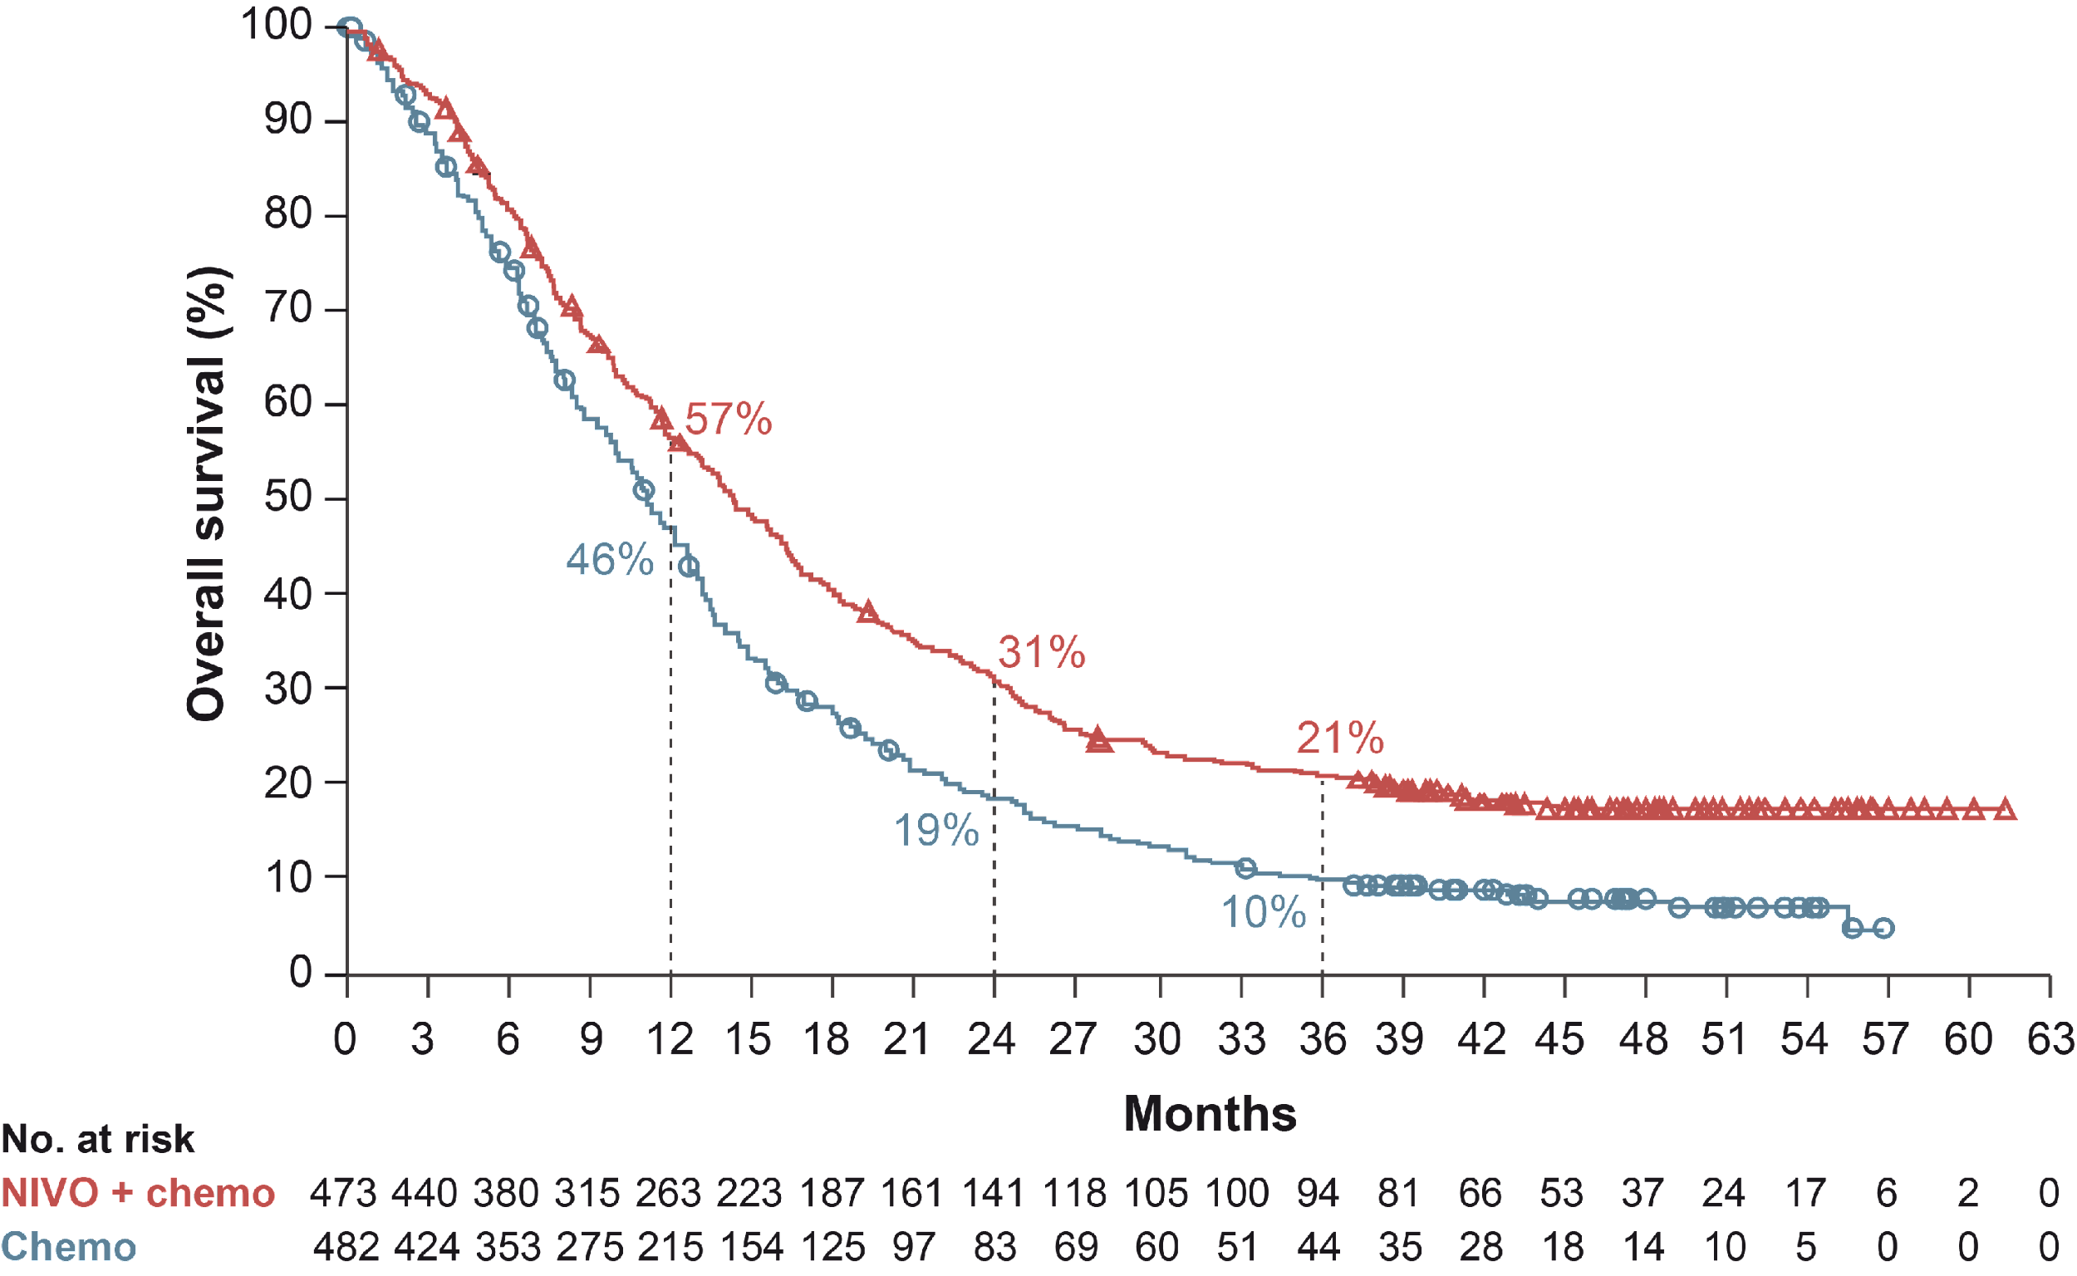
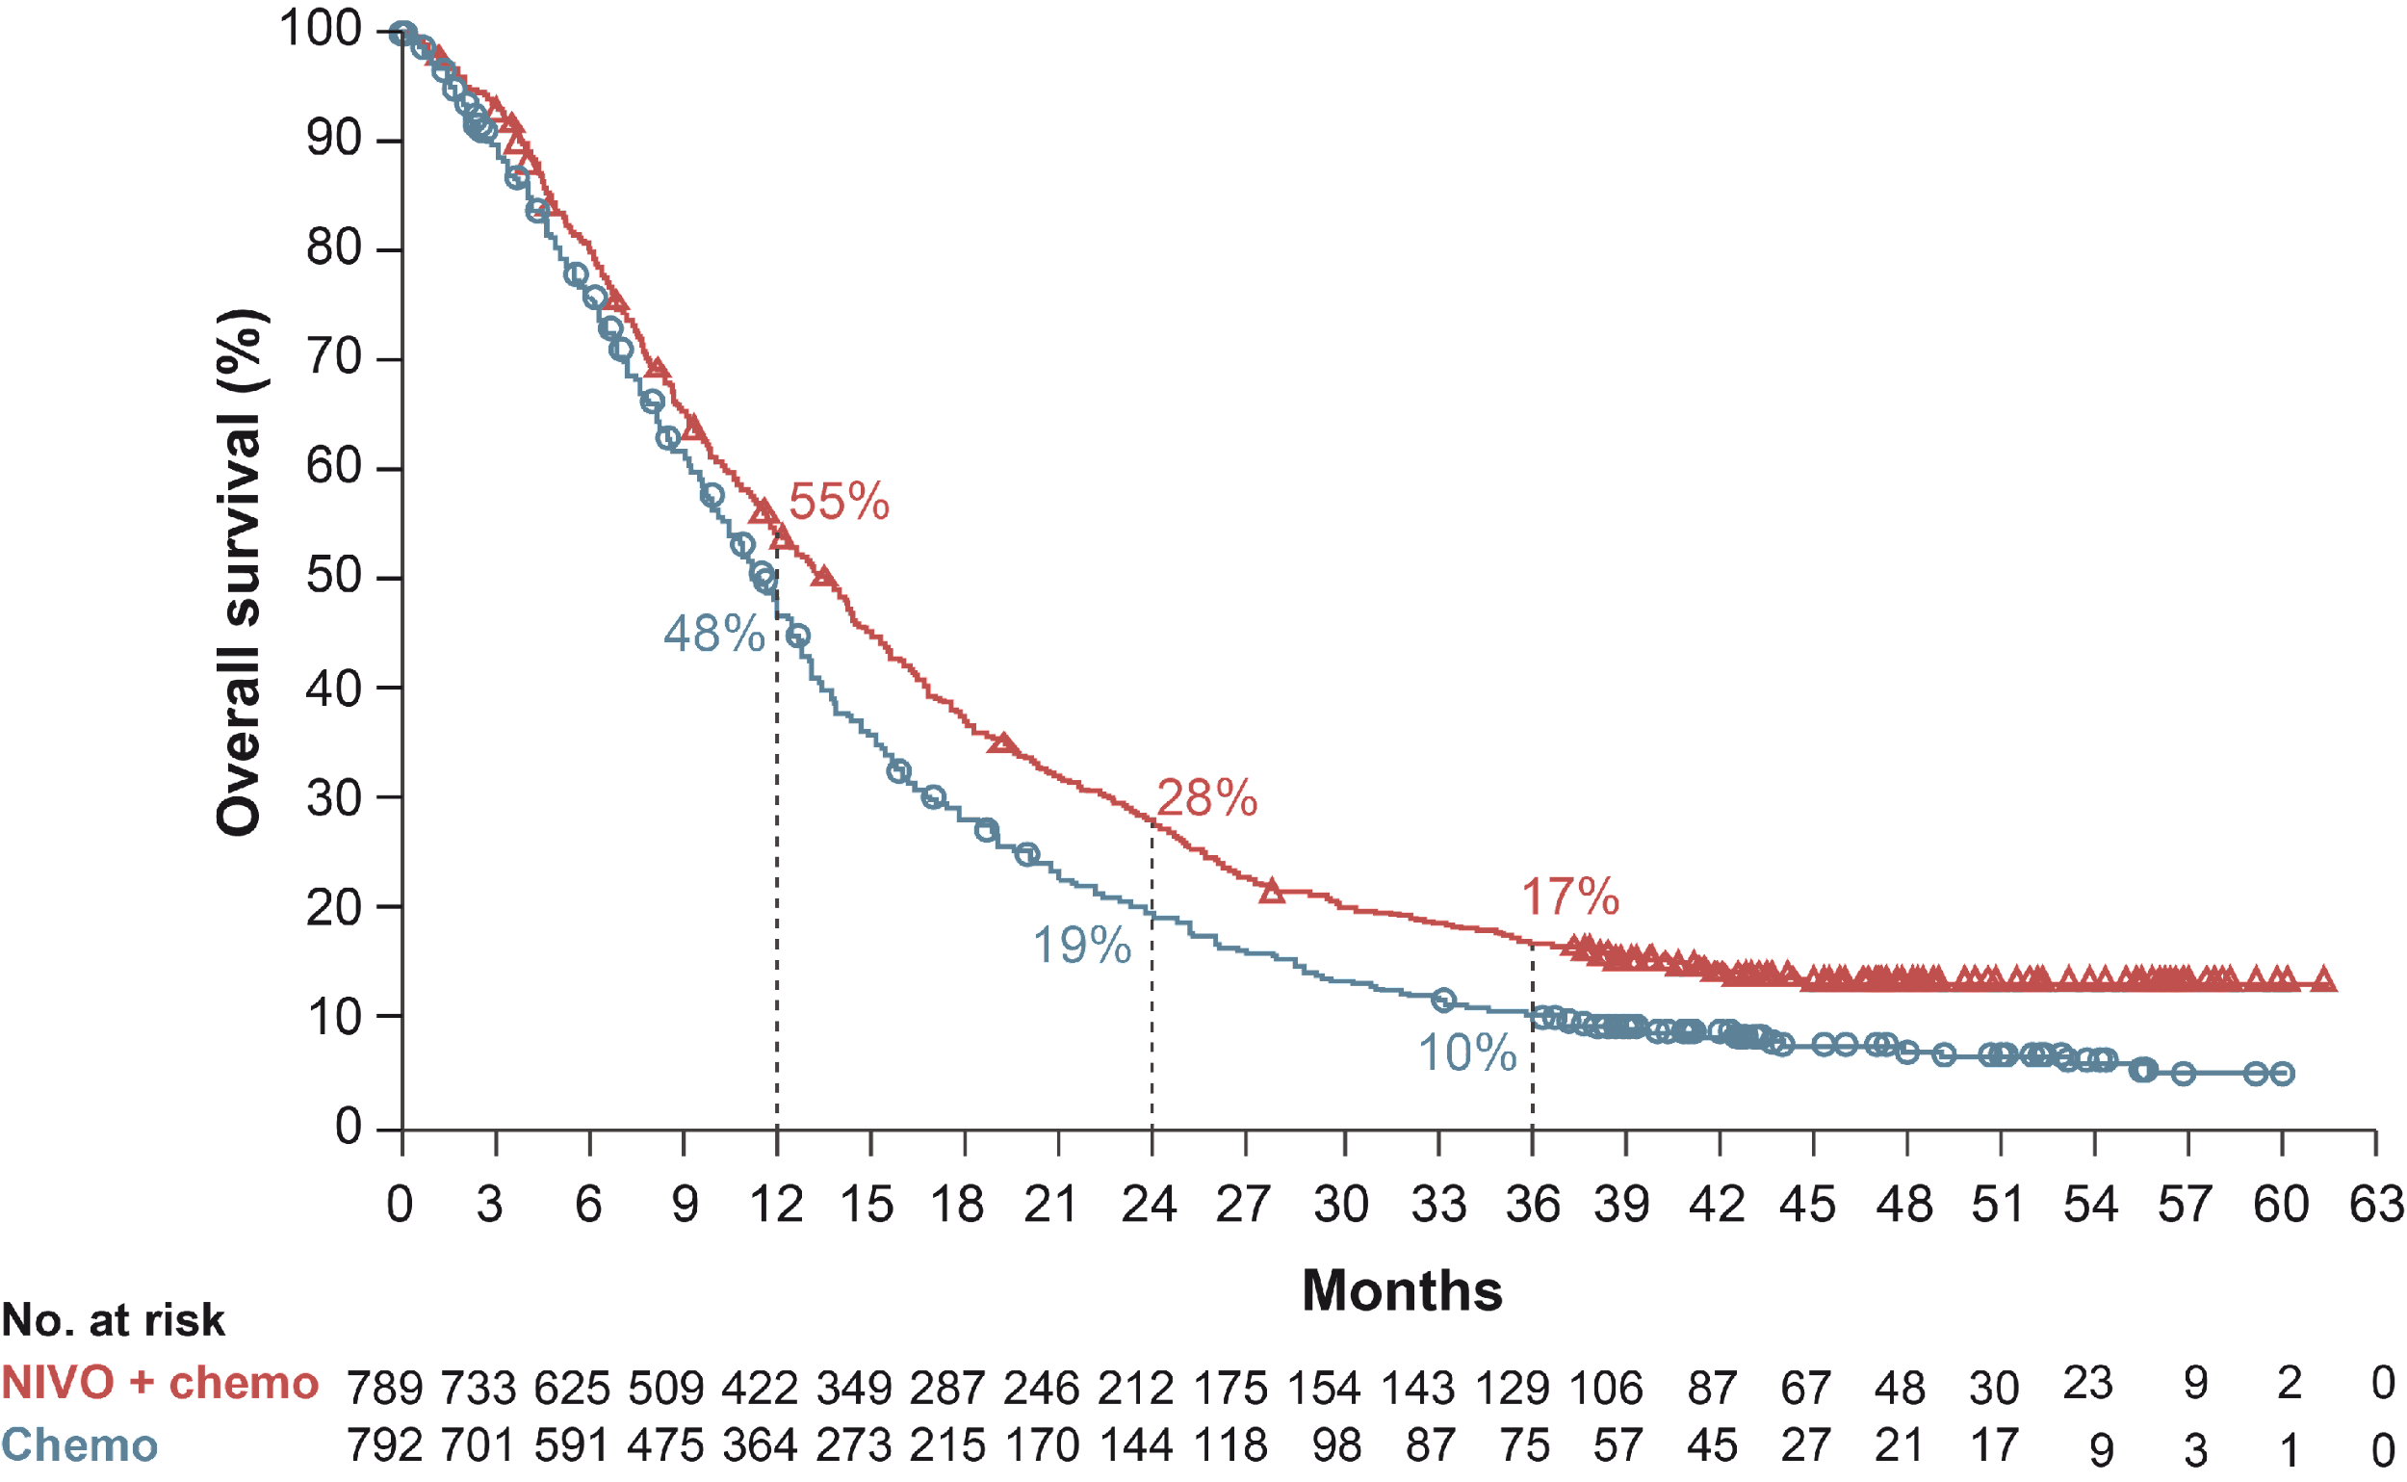
CHECKMATE 649: RESULTS
Overall survival
After 3 years of follow-up NIVO + chemo continues to show clinically meaningful impact
  Higher OS / PFS vs chemo at 36 months
OVERALL SURVIVAL: 36-MONTH FOLLOW-UP
PD-L1 CPS ≥5
All randomised
 | NIVO + chemo (N=473) | Chemo (N=482)
Median OS,ª mo | 14.4 | 11.1
95% CI | 13.1-16.2 | 10.0-12.1
HR (95% CI) | 0.70 (0.61-0.81)
 | NIVO + chemo (N=789) | Chemo (N=792)
Median OS,ª mo | 13.7 | 11.6
95% CI | 12.4-14.5 | 10.9-12.5
HR (95% CI) | 0.79 (0.71-0.88)
Minimum follow-up, 36.2 months
CI, confidence interval; CPS, combined positive score; HR, hazard ratio; mo, months; NIVO, nivolumab; OS, overall survival; PD-L1, programmed cell death ligand 1; PFS, progression-free survival

Slide 18
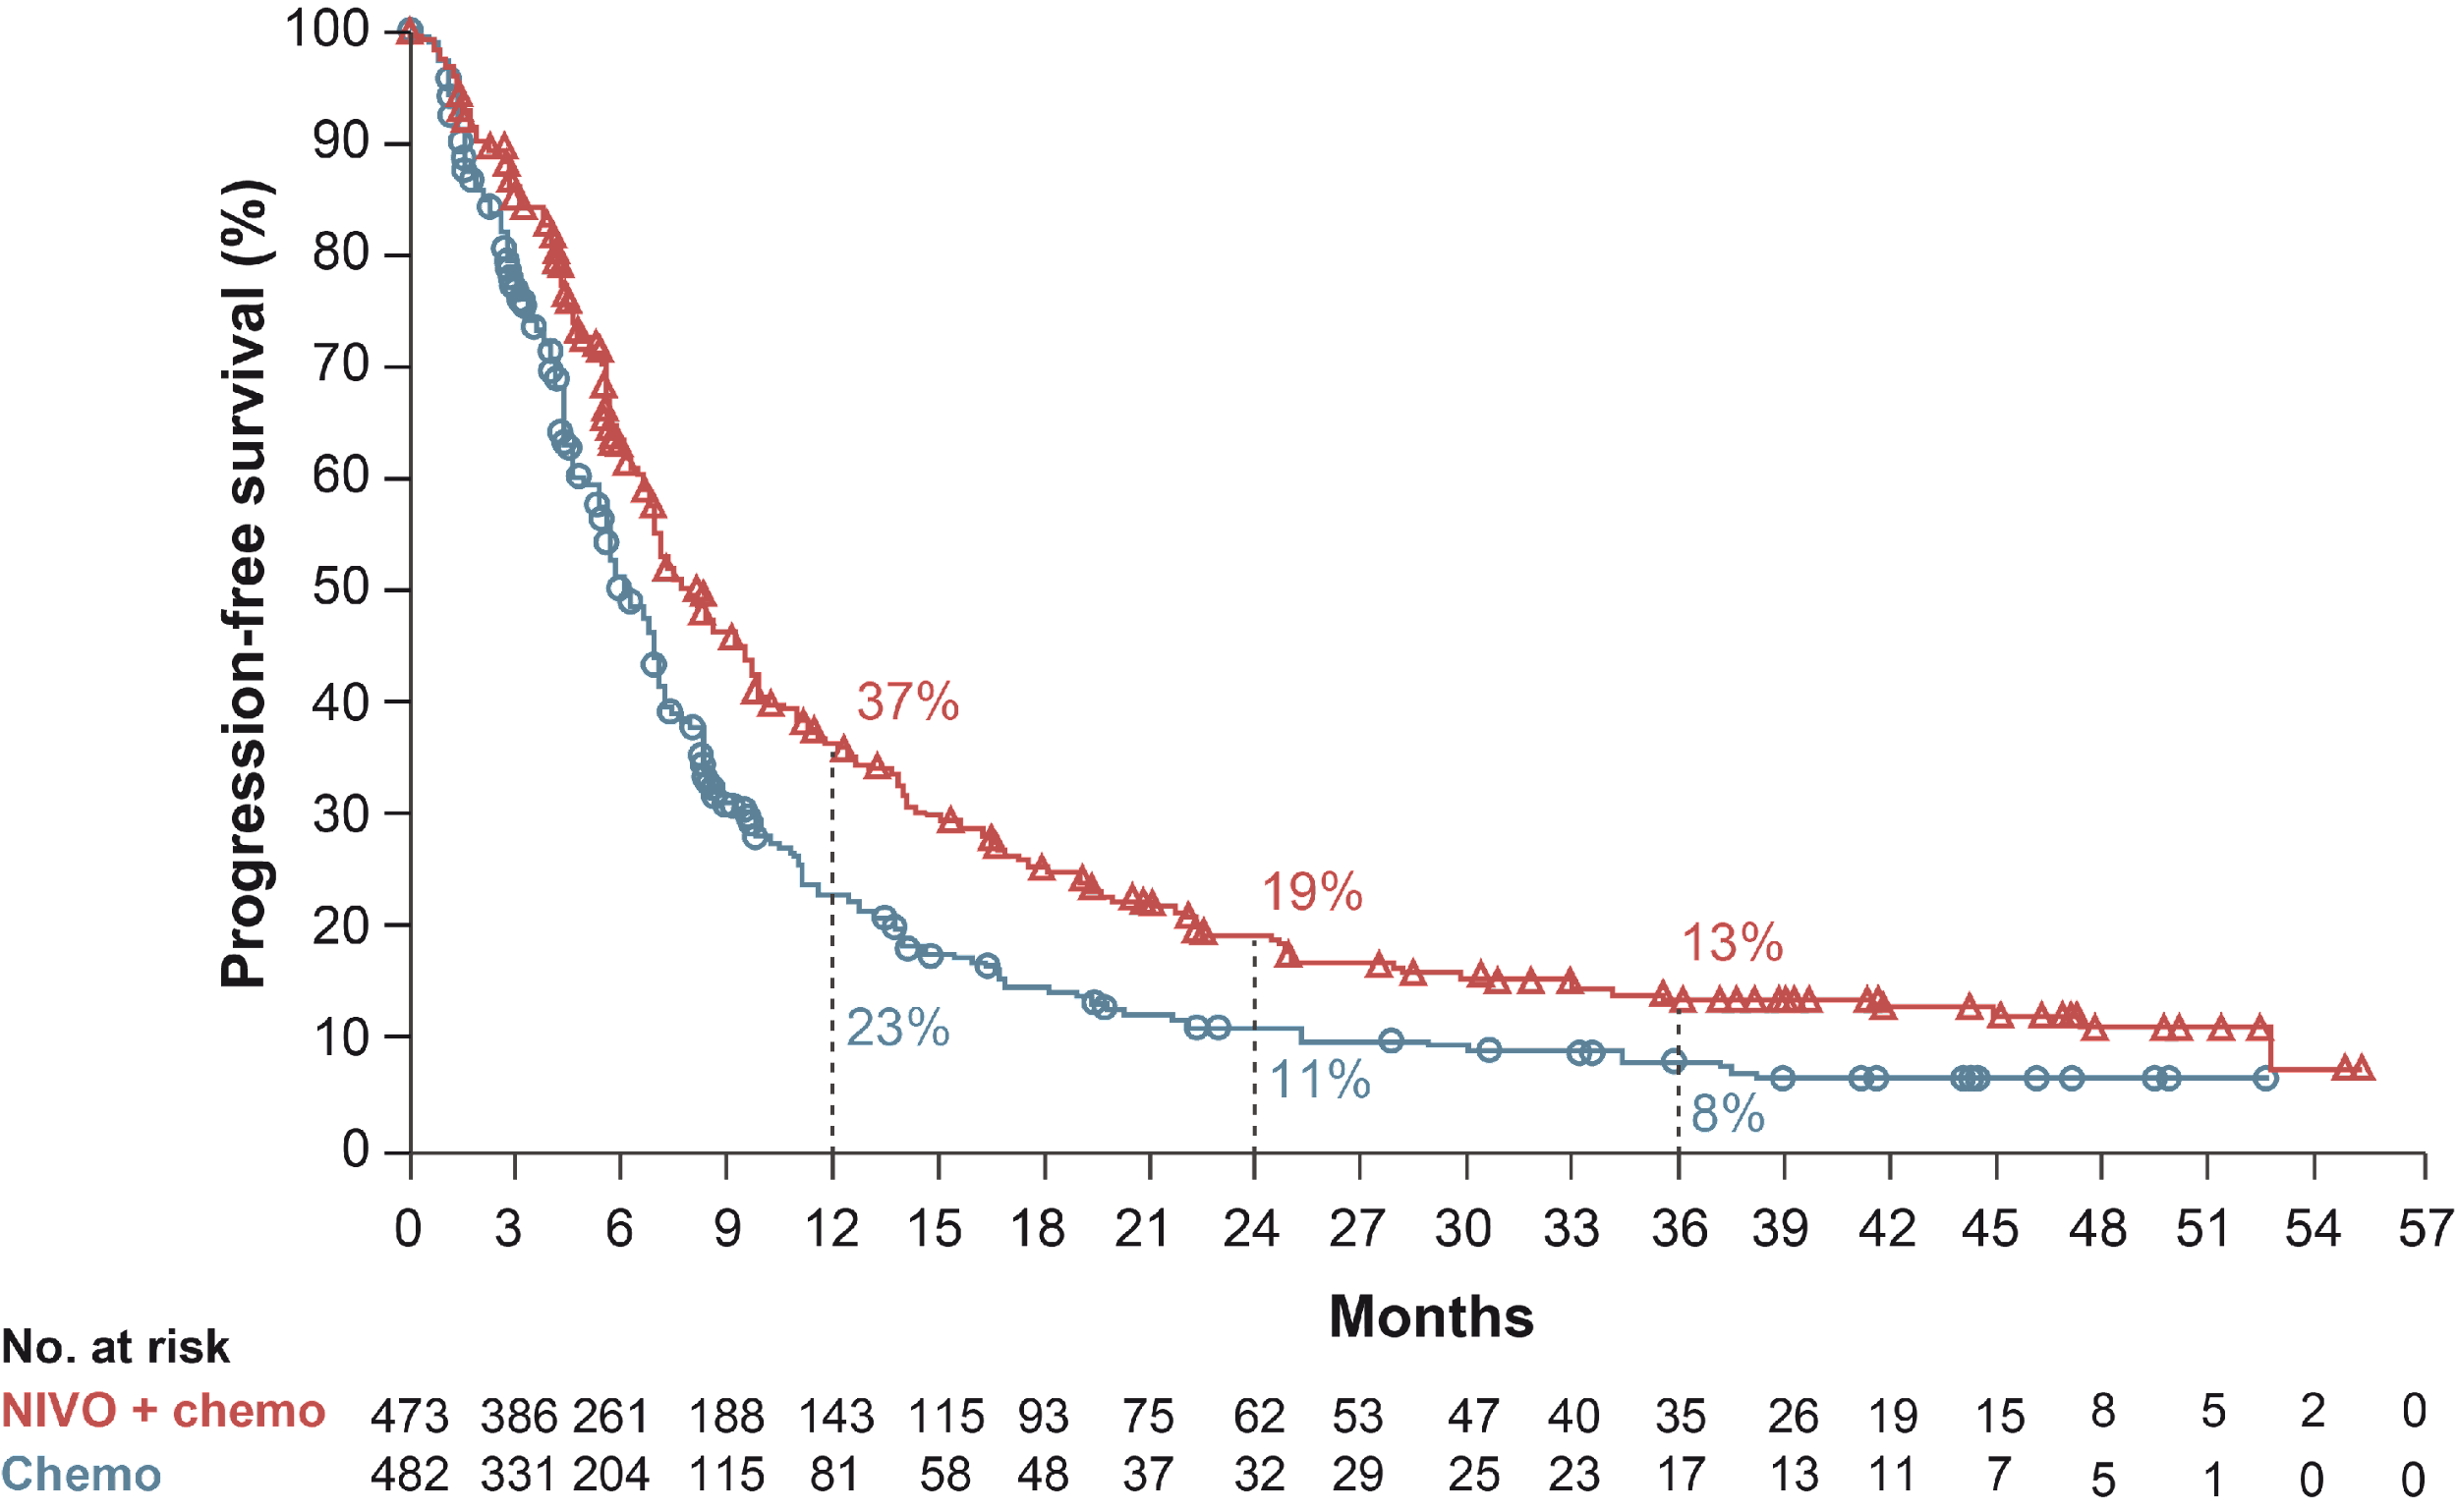
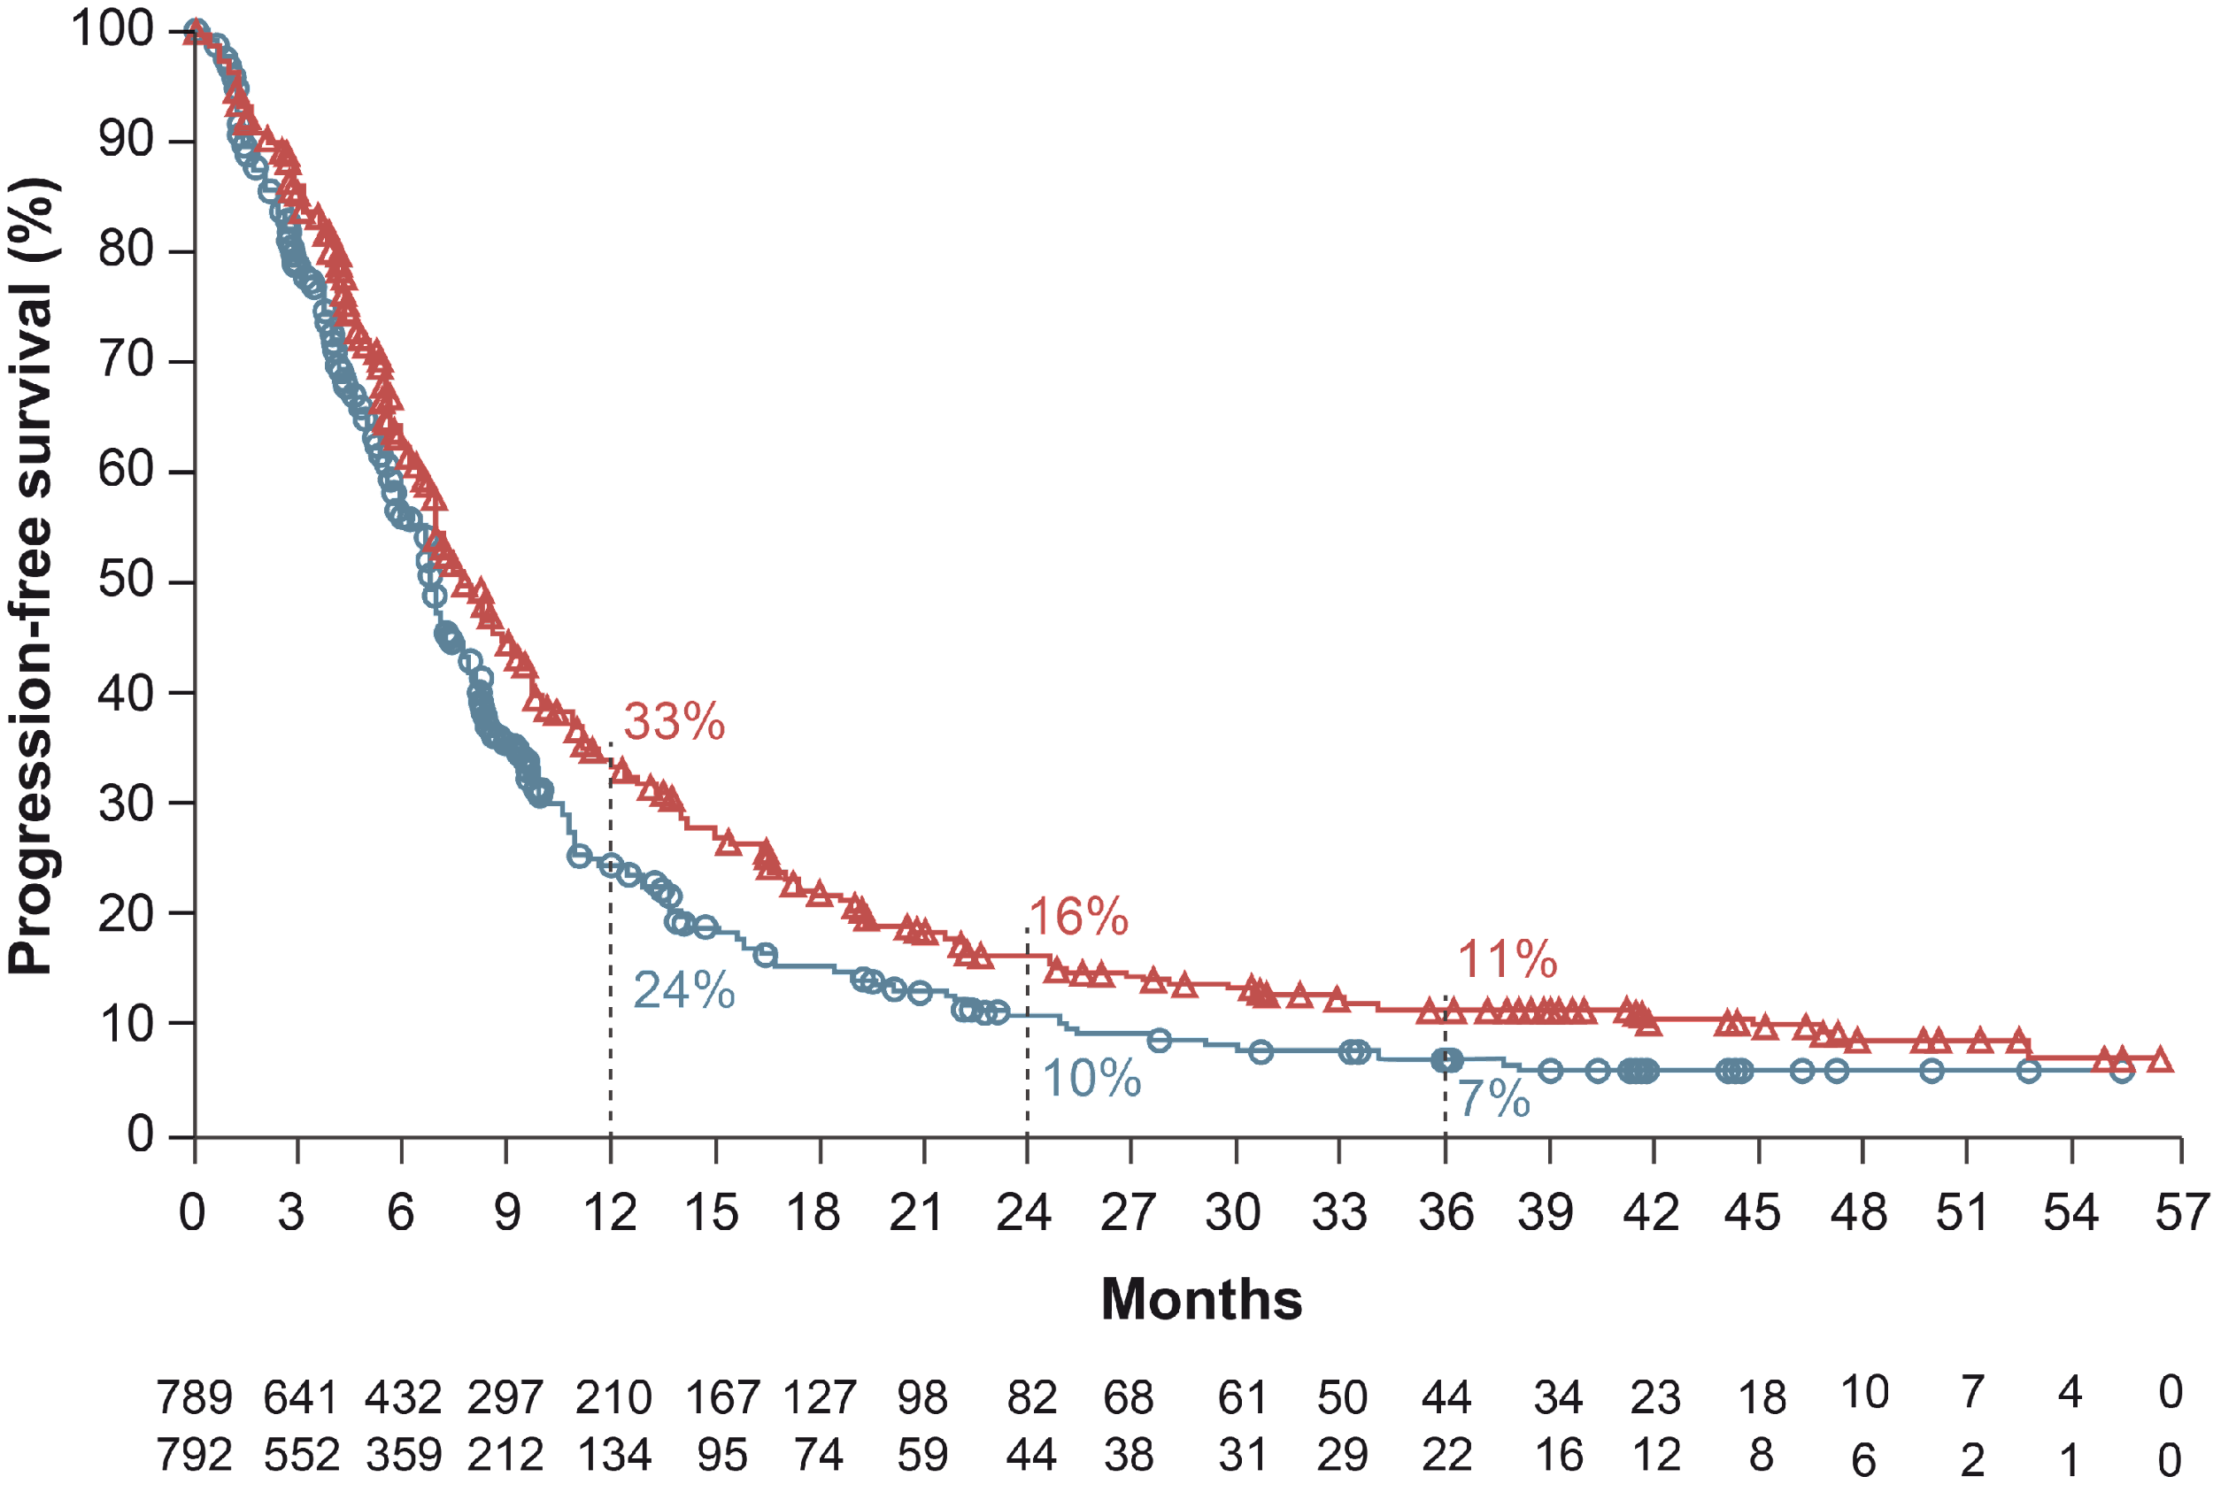
CHECKMATE 649: RESULTS
Progression-free survival
After 3 years of follow-up NIVO + chemo continues to show clinically meaningful impact
  Higher OS / PFS vs chemo at 36 months
PROGRESSION-FREE SURVIVAL: 36-MONTH FOLLOW-UP
PD-L1 CPS ≥5
All randomised
 | NIVO + chemo (N=473) | Chemo (N=482)
Median PFS,ª mo | 8.3 | 6.1
95% CI | 7.0-9.3 | 5.6-6.9
HR (95% CI) | 0.70 (0.60-0.81)
 | NIVO + chemo (N=789) | Chemo (N=792)
Median PFS,ª mo | 7.7 | 6.9
95% CI | 7.1-8.6 | 6.7-7.2
HR (95% CI) | 0.79 (0.71-0.89)
Minimum follow-up, 36.2 months
CI, confidence interval; CPS, combined positive score; HR, hazard ratio; mo, months; NIVO, nivolumab; OS, overall survival; PD-L1, programmed cell death ligand 1; PFS, progression-free survival

Slide 19
CHECKMATE 649: SUMMARY
NIVO + chemo has demonstrated higher ORR across all evaluated PD-L1 CPS subgroups
No new safety signals were shown with longer follow-up
Clinical takeaway:
Data further supports the use of NIVO + chemo in first-line setting for treatment of patients with advanced GC/GEJC/EAC
CPS, combined positive score; GC, gastric cancer; GEJC, gastroesophageal junction cancer; NIVO, nivolumab; ORR, objective response rate; PD-L1, programmed cell death ligand 1

Slide 20
INTEGRATE IIA: A RANDOMISED, DOUBLE‑BLIND, PHASE 3 STUDY OF REGORAFENIB VERSUS PLACEBO IN REFRACTORY ADVANCED
GASTRO-OESOPHAGEAL CANCER – A STUDY LED BY THE AUSTRALASIAN GASTROINTESTINAL TRIALS GROUP (AGITG)
Pavlakis N, et al. ASCO GI 2023. Abstract #LBA294

Slide 21
INTEGRATE IIA: BACKGROUND AND STUDY DESIGN
Refractory advanced gastric and oesophago-gastric junction cancer has limited treatment options¹
Regorafenib is a multi-targeted tyrosine kinase inhibitor (TKI)²
  Prolonged survival vs placebo in all regions and subgroups in the INTEGRATE phase 2 trial²
INTEGRATE IIa: an international, multicentre, randomised phase 3 study³
Regorafenib
160 mg (4 × 40 mg tablets) once daily on days 1 to 21 of each 28-day cycle
+ best supportive care until progression or prohibitive toxicity
Endpoints
Primary: OS
Secondary:
PFS, Objective Tumour Response Rate, QoL, EORTC QLQ-C30 and STO22), Safety (NCI-CTCAE v 4.03)
Tertiary:
Pharmacokinetics, Biomarkers
Stratification
Tumour location (gastro-oesophageal junction vs stomach)
Geographic region (Asia vs Rest of World)
Prior VEGF inhibitors (Yes vs No)
R
2:1
Placebo
+ best supportive care until
progression or prohibitive toxicity
Primary objective (INTEGRATE IIa): overall survival in ITT patient populations
EORTC, European Organisation for Research and Treatment of Cancer; G/GEJ, gastric or gastroesophageal junction; ITT, intent to treat; NCI-CTCAE, National Cancer Institute Common Terminology Criteria for Adverse Event; OS, overall survival; PFS, progression-free survival; QoL, quality of life; QLQ-C30, EORTC core quality of life questionnaire; QLQ-STO22, EORTC-QLQ-stomach module; R, randomisation; VEGF, vascular endothelial growth factor
1. Smyth EC, et al. Lancet. 2020;396:635-48; 2. Pavlakis N, et al. J Clin Oncol. 2016;34:2728-35; 3. https://clinicaltrials.gov/ct2/show/NCT02773524 (last accessed: January 25, 2023)

Slide 22
INTEGRATE IIA: RESULTS
Regorafenib improved OS and PFS
Regorafenib delayed deterioration in global QoL
Regorafenib toxicity profile was similar to that seen previously
OS, overall survival; PFS, progression-free survival; QoL, quality of life

Slide 23
INTEGRATE IIA: RESULTS
Regorafenib improved both overall survival and progression free survival
INTEGRATE IIa: regorafenib vs PBO
Regorafenib delayed deterioration in global QoL vs PBO (p=0.0043)
Regorafenib toxicity profile was similar to that seen previously
 | Hazard ratio | 95% CI | p value
Overall survival | 0.68 | 0.52-0.90 | 0.006
Progression-free survival | 0.53 | 0.40–0.70 | <0.0001
CI, confidence interval; PBO, placebo; QoL, quality of life

Slide 24
INTEGRATE IIA: SUMMARY
Regorafenib significantly improved survival vs placebo in patients with refractory advanced gastric and esophago-gastric junction cancer
This benefit is consistent across all pre-planned subgroups
This is a new treatment option for patients in this setting
INTEGRATE IIb is another ongoing phase 3 trial in pre-treated patients with refractory advanced gastric and esophago-gastric junction cancer
  Patients treated with regorafenib + nivolumab vs standard therapy
Clinical takeaway:
INTEGRATE IIa study had statistically significant results, although the absolute numbers were not as clinically relevant. Results of INTEGRATE IIb are eagerly awaited to further understand the utility of this agent in this disease setting

Slide 25
NEO-AEGIS (NEOADJUVANT TRIAL IN ADENOCARCINOMA OF THE ESOPHAGUS AND ESOPHAGO-GASTRIC JUNCTION
INTERNATIONAL STUDY):
FINAL PRIMARY OUTCOME ANALYSIS
John V. R, et al. ASCO GI 2023. Abstract #295

Slide 26
NEO-AEGIS: BACKGROUND AND STUDY DESIGN
Pathology: Adenocarcinoma, AEG I-III, <8 cm primary tumour length, cT2-3, N (any), AJCC 7th edition^{1,2}
Operative complications: strictly defined (i) as per the Esophageal Complications Consensus Group (ECCG), and (ii) Clavien-Dindo severity score^{1,2}
Neo-AEGIS (Arm A: 2013-18 MAGIC; 2018-20; FLOT or MAGIC)³
Primary endpoints:
Overall survival
Secondary endpoints:
Disease free survival
Time to treatment failure
Toxicity
Tumour Regression Grade (TRG)
R0 resection
Postoperative complications (ECCG defined, Clavien-Dindo)
Quality of life
ADENOCARCINOMA
Esophageal and AEG I-III
cT2-3N0-3M0
N=540 (planned)*
N=377 (enrolled)
EC(O)F(𝚾) × 3
or
FLOT × 4
Surgery
EC(O)F(𝚾) × 3
or
FLOT × 4
Arm A
R
Neo CRT (CROSS)
wCP-RT (41.4Gy) + Surgery
Arm B
*non-inferiority: powered as per first futility analysis (n=71 deaths)
AEG, adenocarcinoma of the esophagogastric junction; AJCC, American Joint Committee on Cancer; CROSS, Chemoradiotherapy for Oesophageal Cancer Followed by Surgery Study; CRT, chemoradiotherapy; cT, clinical T stage; FLOT, docetaxel, 5‑FU, leucovorin, oxaliplatin; MAGIC, epirubicin, cisplatin (oxaliplatin), 5-FU (capecitabine); M, evaluation of distant metastasis; N, evaluation of regional lymph nodes
1. Low D, et al. Ann Surg. 2015;262:286-94; 2. Dindo D, et al. Ann Surg. 2004;240:205-113; 3. https://clinicaltrials.gov/ct2/show/NCT01726452 (last accessed: January 25, 2023)

Slide 27
NEO-AEGIS: RESULTS AND SUMMARY
Peri-operative chemotherapy does not seem inferior to neoadjuvant chemoradiotherapy CROSS-regimen
The 3-year survival is 55% for peri-operative chemotherapy and 57% for CROSS regimen
However, markers of response including pathologic complete response, major pathologic response, R0 rate and nodal-down staging, were significantly better in CROSS arm
There was no significant difference between regimens in severity of complications
Data will support better clinical decision-making
Clinical takeaway:
Peri-operative chemotherapy and neoadjuvant chemoradiotherapy CROSS regimen have similar overall survival results. The data should make it easier for clinicians to decide between CROSS and peri-operative chemotherapy, particularly as CROSS is associated with lower toxicity
CROSS, Chemoradiotherapy for Oesophageal Cancer Followed by Surgery Study

Slide 28
INFINITY: A MULTICENTRE, SINGLE-ARM,
MULTI-COHORT, PHASE 2 TRIAL OF TREMELIMUMAB AND DURVALUMAB AS NEOADJUVANT TREATMENT
OF PATIENTS WITH MSI HIGH RESECTABLE GASTRIC
OR GASTROESOPHAGEAL JUNCTION ADENOCARCINOMA
Filippo P, et al. ASCO GI 2023. Abstract #358
MSI, microsatellite instability

Slide 29
INFINITY: BACKGROUND AND STUDY DESIGN
In resectable G/GEJ cancer, dMMR/MSI-H status is associated with better survival and a potential lack of benefit from chemotherapy¹
dMMR/MSI-H status is one of the strong predictors of the efficacy of immunotherapy²
INFINITY is a multicentre, single arm and phase 2 clinical study³
Trial design
Cohort 1
Surgery
Standard follow up
14
16
18
Resectable gastric
or GEJ cancer
Centrally
confirmed MSI-H
& dMMR, EBV -ve
cT≥2, any N, M0
IDMC APPROVAL
Cohort 2
Time
weeks
2
4
8
10
12
Incomplete
response
Surgery
Standard
follow up
Restaging:
CT & PET scan
EUS with multiple biopsies/
nodal FNA,
Liquid biopsy MRD
Tremelimumab
300 mg on day 1
14
Evidence of disease/tumour regrowth
Durvalumab
1500 mg on day 1, 29 and 57
Complete
response
Non-operative
management
Intensive
follow up*
*
Intensive follow-up
Every 12 weeks for 2 years: chest-abdomen-pelvis CT scan, EUS with
multiple biopsies/nodal FNA, liquid biopsy MRD
cT, clinical T stage; CT, computed tomography; dMMR, DNA mismatch repair deficiency; EBV, Epstein-Barr virus; EUS, endoscopic ultrasound; FNA, fine-needle aspiration; G/GEJ, gastric or gastroesophageal junction; IDMC, independent data monitoring committee; M, evaluation of distant metastasis; MRD, minimal residual disease; MSI-H, microsatellite instability-high; N, evaluation of regional lymph nodes; PET, positron emission tomography
1. Pietrantonio F, et al. J Clin Oncol. 2019;37:3392-400; 2. Leone AG, et al. ESMO Open. 2022;7:100380; 3. https://clinicaltrials.gov/ct2/show/NCT04817826 (last accessed: January 25, 2023)

Slide 30
INFINITY: RESULTS
Primary endpoint: pathological complete response (ypT0N0) and negative ctDNA status after neoadjuvant immunotherapy
Primary endpoint
0
TRG Becker | N=15 | %
1a | 9 | 60%
1b | 3 | 20%
3 | 2 | 13%
-20
-40
Pathologic tumour
regression (%)
-60
1 patient did not undergo surgery for PD
-80
Among evaluable patients, rate of pCR was 60% and rate of major to complete pathological response (<10% viable cells) was 80%
-100
01-007
01-009
01-021
04-002
04-004
04-006
05-001
10-001
13-002
01-001
01-012
04-003
04-005
04-009
Heterogeneous pMMR/dMMR status at surgery
ctDNA, circulating tumour DNA; dMMR, DNA mismatch repair deficiency; pCR, pathologic complete response; PD, progressive disease; pMMR, proficient mismatch repair; TRG, tumour regression grading

Slide 31
INFINITY: SUMMARY
Tremelimumab plus durvalumab (T300/D) for 3 months pre-operatively was safe and achieved promising eradicating activity in patients with resectable dMMR and MSI-H
Chemo free ICI-based strategies have the potential to become standard of care in this molecular subgroup
Enrolment in Cohort 2 is still ongoing after IDMC evaluation and protocol amendment to exclude cT4 tumours identified at baseline staging
Clinical takeaway:
Results from this study show potential of tremelimumab plus durvalumab as standard of care for patients with resectable MSI-H G/GEJ cancers
cT, clinical T stage; dMMR, DNA mismatch repair deficiency; G/GEJ, gastric or gastroesophageal junction; ICI, immune checkpoint inhibitor; IDMC, Independent Data Monitoring Committee; MSI-H, microsatellite instability-high

