Slide 2
GU CONNECT MICRO E-Learning
The use of PARP inhibitors in prostate cancer treatment and the rationale behind combination treatment module one
DECEMBER 2022
PARPi, poly-ADP ribose polymerase inhibitor

Slide 3
module one
PARPi IN advanced PROSTATE CANCER

Slide 4


This module has been developed by two international experts
Dr Pasquale Rescigno
Clinical Senior Lecturer,
Translational and Clinical Research Institute, Faculty of Medical Sciences, Newcastle University, UK
Assoc. Prof. Alicia Morgans
GU Medical Oncologist, Dana-Farber Cancer Institute, Boston, USA

Slide 5
Disclaimer and disclosures
Please note: The views expressed within this presentation are the personal opinions of the authors. They do not necessarily represent the views of the authors’ academic institutions, or the rest of the GU CONNECT group.
This content is supported by an Independent Educational Grant from AstraZeneca.
The experts have received financial support/sponsorship for research support, consultation, or speaker fees from the following companies:
Dr. Alicia Morgans: Astellas, AstraZeneca, AAA, Bayer, Exelixis, Janssen, Lantheus, Myovant, Novartis, Pfizer, Telix, Sanofi
Dr. Pasquale Rescigno: AstraZeneca, Janssen, MSD Italy, BMS and Gilead

Slide 6
Educational objectives
  Understand the mechanism of action of PARPi’s
  Understand the role of genetic testing
  Recognise the efficacy and safety profiles of PARP inhibitors
  Understand their differences across tumour types
  Understand the place of PARP inhibitors in the treatment landscape for patients with prostate cancer
PARP(i), poly-ADP ribose polymerase (inhibitors)

Slide 7
Clinical takeaways
PARP inhibitors are effective drugs as monotherapy in mCRPC patients with HRR alterations
Genetic testing is important to help with treatment decision making and for understanding inherited risk
BRCA mutations are associated with poor outcomes in mCRPC patients
Patients with tumours harbouring BRCA1/BRCA2 alteration appear to derive the greatest clinical benefit from PARPi, but patients with other HRR alterations might also derive benefit

Slide 8
PARPi mechanism of action
PARPi, poly-ADP ribose polymerase inhibitor

Slide 9





For patients with HRRm, PARPi’s are a treatment option as they trigger cell death in cancer cells with an HRR deficiency¹
PARPi mechanism of action
PARPi
PARP
Increase in double-strand breaks in replicating cells
Trapped PARP on single-strand breaks
PARP
PARPi
Double-strand break
HRR-deficient cancer cell
Normal cell

Repair of double-strand breaks via the HRR pathway and cell survival
Reliance on error-prone pathways leads to accumulation of genomic instability and cell death
✓
HRR(m), homologous recombination repair (mutation); PARP(i), poly-ADP ribose polymerase (inhibitor)
Adapted from: 1. O’Connor MJ. Mol Cell. 2015;60:547-60

Slide 10
DNA repair pathway aberrations: Homologous Recombination Repair (HRR) defects
88
72
120
123
109
55
31
20
49
91
43
137
113
32
118
140
42
46
48
66
57
65
145
50
67
21
41
17
132
150
148
149
BRCA2
ATM
BRCA1
FANCA
RAD51B
RAD51C
MLH1
MSH2
2 copy loss
1 copy loss
Copy neutral LOH
Splice
Frameshift
Nonsense
Missense
In-frame indel
Gene fusion
Amplification
Not detected
Germline allele
p.V484fs
p.I870fs
p.S884fs
p.D1575Y
p.Y2154fs
p.H2361fs
p.N2452fs
p.P3067fs
BRCA2
Above: Somatic events
Below: Germline events
~23% of mCRPC harbour DNA repair pathway aberrations
8% harbor germline findings
p.Q699fs
p.K1057fs
p.L1491fs
p.E1493fs
p.I1516fs
p.S1882*
p.S1955*
p.S1982fs
3418
p.V2969fs
Homozygous deletion
Missense mutation
Frameshift mutation (Indel)
Nonsense mutation
Splice acceptor mutation
One copy loss LOH
Copy neutral LOH
No copy loss
p.R23*
p.G301fs
p.L2490fs
p.Q2637*
p.Q2809fs
p.R3047*
ATM
p.V1268fs
Splice acceptor before p.L2544
3056
BRCA1
p.Q1756fs
1863
ATM, ataxia telangiectasia mutated; BRC, Brca repeat; BRCA1/2, breast cancer gene 1/2; CC, coiled coil; FAT, FRAP-ATM-TRRAP domain; HELC, helical domain; HRR, homologous recombination repair; LOH, loss of heterozygosity; mCRPC, metastatic castration-resistant prostate cancer; OB, oligonucleotide binding fold; PIK3c, phosphoinositide 3-kinase domain Robinson D, et al. Cell. 2015;161:1215-28

Slide 11
DNA Damage repair mutations and genetic testing

Slide 12




Tumours can develop in the context of germline or somatic gene alterations¹⁻⁷
BRCAª mutations provide a good example of this^{1,2}
Germline
Somatic
BRCAm inherited from parent
No inherited BRCAm
All cells have one mutated and one normal BRCAª copy
(monoallelic BRCA loss – cells are viable but predisposed to cancer)
All cells have two ‘normal’ copies of BRCA gene
Somatic mutation in cell causes monoallelic BRCA loss
Somatic mutation causes loss of normal BRCA copy in a cell
(biallelic BRCA loss is a
tumour driver event)
.
Cancer associated with BRCAm
Second somatic mutation results in biallelic BRCA loss
Non-tumour cells remain with monoallelic BRCA loss
Tumour cells have biallelic BRCA loss^{b}
Cancer associated with BRCAm
Non-tumour cells remain ‘normal’
Tumour cells have biallelic BRCA loss^{b}
ª Can be either BRCA1 or BRCA2. ^{b} Loss of function can also result from epigenetic and other non-genomic mechanisms
BRCA1/2, breast cancer gene 1/2; BRCAm, breast cancer gene 1/2 mutation
1. Wu H, et al. Gene Ther. 2017;24,601-9; 2. Castro E, et al. Asian J Androl. 2012;14:409-14; 3. Macedo GS, et al. Genet Mol Biol. 2019;42(1 suppl 1):215-31; 4. Ryland GL, et al. BMC Medical Genomics. 2015;8:45; 5. Stoppa-Lyonnet D. Eur J Human Genet. 2016;24:S3-9; 6. Tucker T, et al. J. Clin Genet. 2002;62:345-57; 7. Hunt JL. Cell & Tissue Based Mol Pathol. 2009;5:50-5

Slide 13

Family History Is the strongest known Risk Factor for prostate cancer
A father or brother with prostate cancer doubles a man’s risk of prostate cancer
A mother or sister with breast cancer diagnosed before age 50 significantly increases a woman’s risk of breast cancer
A mother or sister with breast cancer can affect a man’s risk of prostate cancer
Chen YC, et al. Prostate. 2008;68(14):1582-91; Colditz GA, et al. Breast Cancer Res Treat. 2012;133(3):1097-104

Slide 14





Cascading Impact
Tailored screening
and risk-reduction
Full family history should be collected:
  3 or 4 generation pedigree
  Ancestry and consanguinity information
  Any prior genetic testing
Family history:
  Guides choice of broad vs narrow gene panel
  Determines a patient's criteria for testing
  Identifies the most appropriate family members for testing
  Informs screening if test is negative
~50% chance of
inheriting same
DNA repair mutation
↑ risk of
PC, more aggressive
~23% of men with mCRPC have DNA pathway aberrations
Tailored
screening,
risk-reduction
~12% of men with
PC carry an inherited
DNA repair gene mutation – implications for cancer screening and for their relatives
Treatment opportunities
PARP inhibitors, platinum-based
chemotherapy, etc.
↑ risk of PC,
more aggressive
HR, homologous recombination; mCRPC, metastatic castration-resistant prostate cancer; PARP, poly-ADP ribose polymerase; PC, prostate cancer
Cheng HH, et al. J Natl Compr Canc Netw. 2019;17:515-21; Pritchard CC, et al. N Engl J Med. 2016;375:443-53; Szymaniak BM, et al. JCO Oncol Pract. 2020;16:811-9; Antonarakis ES, et al. Eur Urol. 2018;74:218-25
Figure adapted from Cheng H. https://www.ustoo.org/Pathways-Seattle-Webcast

Slide 15
Guideline recommendations for genetic testing
Guideline/consensus | Recommendations for genomic testing | Recommendations for specific genes to test | Recommendations for specimen to test (e.g. tissue, ctDNA) | Recommendations for germline testing
ESMO Clinical Practice Guidelines^{1,2} | ✓ | ✓ | ✓ | ✓
EAU-EANM-ESTRO-ESUR-ISUP-SIOG Guidelines³ | ✓ | ✗ | ✗ | ✓
NCCN Guidelines⁴ | ✓ | ✓ | ✓ | ✓
AUA/ASTRO/SUO Guidelines⁵ | ✓ | ✗ | ✗ | ✓
1. Parker C, et al. Ann Oncol. 2020;31(9):1119-34; 2. Mosele F, et al. Ann Oncol. 2020 Nov;31(11):1491-1505; 3. Mottet N, et al. EAU - EANM - ESTRO -ESUR - ISUP - SIOG Guidelines on Prostate Cancer. EAU-EANM-ESTRO-ESUR-ISUP_SIOG-Guidelines-on-Prostate-Cancer-2022_2022-04-25-063938_yfos.pdf (d56bochluxqnz.cloudfront.net) Accessed Dec 2022); 4. National Comprehensive Cancer Network. Prostate Cancer (Version 1.2023). https://www.nccn.org/professionals/physician_gls/pdf/prostate.pdf. Accessed Oct 2022; 5. Lowrance WT, et al. J Urol. 2021; 205(1):22-9

Slide 16
Guideline recommendations for genetic testing
INTERNATIONAL GUIDELINE RECOMMENDATIONS FOR GENETIC TESTING
ESMO¹ | EAU-EANM-ESTRO-ESUR-ISUP-SIOG² | NCCN³ | AUA/ASTRO/SUO⁴
Somatic testing for HRR and MMR defects (or MSI) in patients with mCRPC Germline testing for BRCA2 and other DDR genes associated with cancer predisposition syndromes is recommended in patients with a family history of cancer and should be considered in all patients with metastatic prostate cancer | Somatic testing for homologous repair and MMR defects should be offered to all metastatic patients should be offered somatic genomic testing Germline testing should be considered for men with a personal or family history of PCa or other cancer types arising from DNA repair gene mutations (strength rating “weak”): Men with mPCa Men with high-risk PCa and a family member diagnosed with PCa at age < 60 years Men with multiple family members diagnosed with clinically significant PCa at age < 60 years or a family member who died from PCa cancer Men with a family history of high-risk germline mutations or a family history of multiple cancers on the same side of the family | Somatic testing in mPCa patients to identify alterations in HRR genes. May be considered in patients with regional PCa. Germline testing recommended for patients with prostate cancer and any of the following: Very-high-risk localized or high-risk localised , very high-risk, regional, or mPCa Family history of certain cancers Ashkenazi Jewish ancestry A known family history of a familial cancer risk mutation Personal history of breast cancer | Germline and somatic tumour genetic testing should be offered to identify DNA repair deficiency mutations and MSI status that may inform prognosis in patients with mCRPC and counselling regarding family risk as well as potential targeted therapies
ASTRO, American Society for Radiation Oncology; AUA, American Urological Association; BRCA, breast cancer gene; EANM, European Association of Nuclear Medicine; EAU, European Association of Urology; ESMO, European Society for Medical Oncology; ESTRO, European Society for Radiotherapy and Oncology; ESUR, European Society of Urogenital Radiology; HRR, homologous recombination repair; mCRPC, metastatic castration-resistant prostate cancer; MMR, mismatch repair; mPCa, metastatic prostate cancer; MSI, microsatellite instability; NCCN, National Comprehensive Cancer Network; PARP, poly-ADP ribose polymerase; SIOG, International Society of Geriatric Oncology; SUO, Society of Urologic Oncology
1. Parker C, et al. Ann Oncol. 2020;31(9):1119-34; 2. Mottet N, et al. Guidelines on prostate cancer 2022: EAU-EANM-ESTRO-ESUR-ISUP-SIOG-Guidelines-on-Prostate-Cancer-2022_2022-04-25-063938_yfos.pdf (d56bochluxqnz.cloudfront.net); 3.National Comprehensive Cancer Network. Prostate Cancer (Version 1.2023). https://www.nccn.org/professionals/physician_gls/pdf/prostate.pdf. Accessed Oct 2022;
4. Lowrance WT, et al. J Urol. 2021; 205(1):22-9

Slide 17
BRCAm are associated with poor clinical outcomes
Tumour size (p<0.02)¹
Gleason score (p<0.001)¹
Nodal involvement (p=0.009)¹
HRRm is associated with an aggressive phenotype, with most data assessing BRCAm^{1–3}
gBRCA1/2m carrier (n=67)
Non-carrier (n=1,235)
6.0%
1.6%
Percent of patients
gBRCA1/2m carrier (n=67)
Non-carrier (n=1,235)
gBRCA2m tumours are also more likely to show a pattern of ultra-ductal carcinoma which correlates with poor prognosis²
Several large retrospective studies have found an association between BRCAm and aggressive disease and rapid progression to metastatic disease^{1–3}
BRCA2m tumours are also more likely to show a pattern of intraductal carcinoma which correlates with poor prognosis²
Stage at diagnosis (p=0.001)³
Patients who developed metastases within 5 years (based on 5-year MFS in localised PC patients)³
BRCA1/2 carrier (n=79)
Non-carrier (n=1,940)
p=0.0001
Proportion of patients (%)
Proportion of
patients (%)
BRCA1/2m
non-carrier
(n=1,940)
BRCA1/2m
carrier
(n=79)
BRCA1/2, breast cancer gene 1/2; BRCAm, BRCA mutated; (g)BRCA2m, (germline) BRCA2 mutation; (g)BRCA1/2m, (germline) breast cancer gene 1/2 mutation; HRRm, homologous recombination repair mutation; MFS, metastasis-free survival; PC, prostate cancer
1. Castro E, et al. Eur Urol. 2015;68:186-93; 2. Taylor RA, et al. Nat Commun. 2017;8:13671; 3. Castro E, et al. J Clin Oncol. 2013;31(14):1748-57

Slide 18
PARPi monotherapy in mCRPC: non-registrational studies
mCRPC, metastatic castration resistant prostate cancer; PARPi, poly-ADP ribose polymerase inhibitor

Slide 19
Phase 2/3 PARP inhibitor monotherapy trials in mCRPC
Q1 2017¹
PROfound
study initiated
Q2 2020²
PROfound
study published
Q2 2020³
FDA approval
of olaparib
Q4 2020⁴
EMA approval of olaparib
2015 | 2016 | 2017 | 2018 | 2019 | 2020 | 2021 | 2022
Q4 2015⁵
TOPARP-A
data published
Q4 2019⁶
TOPARP-B
data published
Q1 2022⁷
P3 rucaparib study primary completion (TRITON3)
Q1 2017⁸
P2 rucaparib study initiated (TRITON2)
Q2 2017⁷
P3 rucaparib study initiated (TRITON3)
Q2 2020⁹
FDA accelerated approval of rucaparib
Q3 2020¹⁰
P2 rucaparib study
published (TRITON2)
Q3 2016¹¹
P2 niraparib study initiated (GALAHAD)
Q3 2017¹²
P2 talazoparib study initiated (TALAPRO-1)
Q1 2021¹¹
P2 niraparib study
primary completion (GALAHAD)
Q3 2021¹³
P2 talazoparib study publication
(TALAPRO-1)
EMA, European Medicines Agency; FDA, United States Food and Drug Administration; HRR, homologous recombination repair; mCRPC, metastatic castration-resistant prostate cancer; P, phase;
PARP, poly-ADP ribose polymerase; Q, quarter
1. NCT02987543; 2. de Bono J, et al. N Engl J Med. 2020;382:2091-102; 3. FDA approves olaparib for HRR gene-mutated metastatic castration-resistant prostate cancer. www.fda.gov/drugs/drug-approvals-and-databases/fda-approves-olaparib-hrr-gene-mutated-metastatic-castration-resistant-prostate-cancer; 4. Lynparza SmPC; 5. Mateo J, et al. N Engl J Med. 2015;373:1697-708;
6. Mateo J, et al. Lancet Oncol. 2020;21:162-74; 7. NCT02975934; 8. NCT02952534; 9. FDA grants accelerated approval to rucaparib for BRCA-mutated metastatic castration-resistant prostate cancer. www.fda.gov/drugs/fda-grants-accelerated-approval-rucaparib-brca-mutated-metastatic-castration-resistant-prostate; 10. Abida W, et al. J Clin Oncol. 2020;38:3763-72; 11. NCT02854436;
12. NCT03148795; 13. de Bono JS, et al. Lancet Oncol. 2022;9:1250-64. All accessed August 2022.

Slide 20
Toparp trials: phase 2 trials of Olaparib in heavily pre-treated mCrpc patients
TOPARP A – UNSELECTED PTS
(TEST SET)¹
Olaparib 400 mg bid
33% response rate (n=16/49) (95% CI: 20-48%)
Genomic analysis of prospectively obtained tumour samples revealed:
  33% were biomarker positive (n=16/49)
    mutations in ATM, BRCA2 and others
    14 of these patients responded to treatment
  67% were biomarker negative (n=33/49)
    2 of these patients responded
TOPARP A: identified an association between somatic alterations in DDR genes and antitumour activity of olaparib in mCRPC patients
TOPARP B – BIOMARKER SELECTED PTS (VALIDATION SET)²
Olaparib 300 mg or 400 mg bid
First prospective clinical trial in a genomically defined population of patients with mPC
Distribution of DDR mutations in screened patients:
  32.7% BRCA1/2
  21.4% ATM
  21.4% CDK12
  7.1% PALB2
  21.4% Other
Study confirmed the antitumour activity of olaparib against mCRPC with germline or somatic alterations in DDR genes
ATM, ataxia telangiectasia mutated; BRCA1/2, breast cancer gene 1/2; CDK12, cyclin-dependent kinase 12; CI, confidence interval; DDR, DNA damage repair; mCRPC, metastatic castration-resistant prostate cancer; mPC, metastatic prostate cancer; PALB2, partner and localizer of BRCA2; Pts, patients
1. Mateo J, et al. N Engl J Med. 2015;373:1697-1708; 2. Mateo J, et al. Lancet Oncol. 2020;21:162-74

Slide 21
TOPARP-B results: Olaparib has antitumour activity against mcrpc with ddr gene alterations
DNA damage response gene aberration subgroup
Baseline characteristics | Total (N=98) | Dose group
 |  | 300 mg (n=49) | 400 mg (n=49)
BRCA1/2 | 32 (33%) | 15 (31%) | 17 (35%)
ATM | 21 (21%) | 10 (20%) | 11 (22%)
CDK12 | 21 (21%) | 15 (31%) | 6 (12%)
PALB2 | 7 (7%) | 3 (6%) | 4 (8%)
OTHER | 21 (21%) | 10 (20%) | 11 (22%)
Despite randomisation, CDK12 aberrations were imbalanced between the cohorts, which might explain the inferior response in the 300 mg cohort
 | Total (N=92ª) |  |  | Dose group
 |  |  |  | 300 mg (n=46) |  |  | 400 mg (n=46)
 | Resp/N | % | 95% CI | Resp/n | % | 95% CI | Resp/n | % | 95% CI
Composite response (confirmed) | 43/92 | 46.7% | 36.3-57.4 | 18/46 | 39.1% | 25.1-54.6 | 25/46 | 54.3% | 39.0-69.1
RECIST 1.1 objective response | 14/70 | 20.0% | 11.4-31.3 | 6/37 | 16.2% | 6.2-32.0 | 8/33 | 24.2% | 11.1-42.3
PSA response ≥50% | 30/89 | 33.7% | 24.0-44.5 | 13/43 | 30.2% | 17.2-46.1 | 17/46 | 37.0% | 23.2-52.5
CTC conversion | 28/55 | 50.9% | 37.1-64.6 | 13/27 | 48.1% | 28.7-68.1 | 15/28 | 53.6% | 33.9-72.5
RECIST or PSA response | 32/92 | 34.8% | 25.1-45.4 | 13/46 | 28.3% | 16.0-43.5 | 19/46 | 41.3% | 27.0-56.8
ª 98 randomised, 92 evaluable for primary endpoint analysis (6 found ineligible/not evaluable and excluded)
ATM, ataxia telangiectasia mutated; BRCA1/2, breast cancer gene 1/2; CI, confidence interval; CTC, circulating tumour counts; PSA, prostate-specific antigen; RECIST, Response Evaluation Criteria in Solid Tumours
Mateo J, et al. Lancet Oncol. 2020;21:162-74

Slide 22
Toparp-B: Olaparib side effects
TOPARP-B study: TEAEs incidence ≥10% (N=98)
N, (%) | 300 mg (N=49) |  |  | 400 mg (N=49)
 | Grade 1-2 | Grade 3 | Grade 4 | Grade 1-2 | Grade 3 | Grade 4
Anaemia | 16 (33) | 14 (29) | 1 (2) | 19 (39) | 18 (37) | 0
Fatigue | 19 (39) | 3 (6) | 0 | 27 (55) | 4 (8) | 0
Back pain | 13 (27) | 4 (8) | 0 | 11 (22) | 3 (6) | 0
Nausea | 17 (35) | 1 (2) | 0 | 13 (27) | 0 | 0
Platelet count decreased | 9 (18) | 2 (4) | 1 (2) | 12 (24) | 3 (6) | 0
Decreased appetite | 13 (27) | 2 (4) | 0 | 10 (20) | 0 | 0
Vomiting | 10 (20) | 0 | 0 | 15 (31) | 0 | 0
Weight decreased | 9 (18) | 1 (2) | 0 | 15 (31) | 0 | 0
Diarrhoea | 8 (16) | 1 (2) | 0 | 10 (20) | 1 (2) | 0
Arthralgia | 8 (16) | 1 (2) | 0 | 5 (10) | 4 (8) | 0
Hypertension | 9 (18) | 1 (2) | 0 | 4 (8) | 4 (8) | 0
Neutrophil count decreased | 9 (18) | 2 (4) | 0 | 4 (8) | 2 (4) | 1 (2)
Dyspnoea | 5 (10) | 1 (2) | 0 | 10 (20) | 1 (2) | 0
Abdominal pain | 4 (8) | 0 | 0 | 6 (12) | 5 (10) | 1 (2)
Blood creatinine increased | 9 (18) | 0 | 0 | 6 (12) | 0 | 0
Oedema peripheral | 6 (12) | 0 | 0 | 8 (16) | 1 (2) | 0
Urinary tract infection | 3 (6) | 3 (6) | 0 | 6 (12) | 3 (6) | 0
Constipation | 7 (14) | 0 | 0 | 7 (14) | 0 | 0
Cough | 3 (6) | 0 | 0 | 9 (18) | 0 | 0
Musculoskeletal chest pain | 3 (6) | 0 | 0 | 9 (18) | 0 | 0
Musculoskeletal pain | 5 (10) | 1 (2) | 0 | 5 (10) | 1 (2) | 0
Hypokalaemia | 3 (6) | 0 | 0 | 8 (16) | 0 | 0
Muscular weakness | 4 (8) | 0 | 0 | 5 (10) | 2 (4) | 0
White blood cell count decreased | 4 (8) | 0 | 0 | 6 (12) | 1 (2) | 0
Alkaline phosphatase increased | 3 (6) | 0 | 0 | 5 (10) | 1 (2) | 0
Dysgeusia | 6 (12) | 0 | 0 | 3 (6) | 0 | 0
Haematuria | 5 (10) | 0 | 0 | 2 (4) | 2 (4) | 0
Influenza like illness | 3 (6) | 0 | 0 | 6 (12) | 0 | 0
Muscle spasms | 3 (6) | 0 | 0 | 6 (12) | 0 | 0
Spinal cord compression | 0 | 1 (2) | 0 | 0 | 5 (10) | 0
TEAE, treatment emergent adverse event
Mateo J, et al. Lancet Oncol. 2020;21:162-74

Slide 23
Galahad: Phase 2 Study of Niraparib in pre-treated mCRPC patients with DDRm
Biomarker
evaluation
(pre-screening)
Screening
phase
(28 days)
Treatment phase
Niraparib 300 mg once daily
Follow-up
phase
28-day cycle until end of treatmentª
Every 3 months after
end of treatment
Key eligibility criteria
mCRPC
Biomarker positive for DRD
Progressed on ≥1 ARSI therapy and ≥1 taxane-based CTx
No prior PARP inhibitor or platinum-based CTx
No prior or current MDS/AML
Primary endpoint
Objective response rate (ORR) of soft tissue (visceral or nodal disease), as defined by RECIST 1.1^{b} with no evidence of bone progression according to the PCWG3 criteria in patients with biallelic BRCA
Secondary endpoints
ORR (per RECIST 1.1 / PCWG3 criteria) in patients with biallelic non-BRCA
CTC response: CTC=0 per 7.5 mL blood at 8 weeks post-baseline in patients with baseline CTC >0
OS: time from enrolment to death from any cause
rPFS: time from enrolment to radiographic progression or death from any cause, whichever occurs first
Duration of objective response: time from complete response (CR) or partial response (PR) to radiographic progression of disease, unequivocal clinical progression, or death, whichever occurs first
Safety: adverse events and laboratory tests
ª Treatment continued until disease progression, unacceptable toxicity or death; ^{b} Investigator assessed
Non-BRCA: ATM, FANCA, PALB2, CHEK2, BRIP1 or HDAC2
AML, acute myeloid leuameia; ARSI, androgen signalling receptor inhibitors; BRCA, breast cancer gene; CTC, circulating tumour cell; CTx, chemotherapy; DDRm, DNA damage repair mutations; DRD, DNA repair deficiency; mCRPC; metastatic castration resistant prostate cancer; MDS, myelodysplastic syndrome; OS, overall survival; PARP, poly adenosine diphosphate-ribose polymerase; PCWG3, Prostate Cancer Working Group 3; PSA50, ≥50% decline in prostate-specific antigen; RECIST, Response Evaluation Criteria in Solid Tumours; rPFS, radiographic progression-free survival
Smith M, et al. ESMO 2019, oral presentation

Slide 24
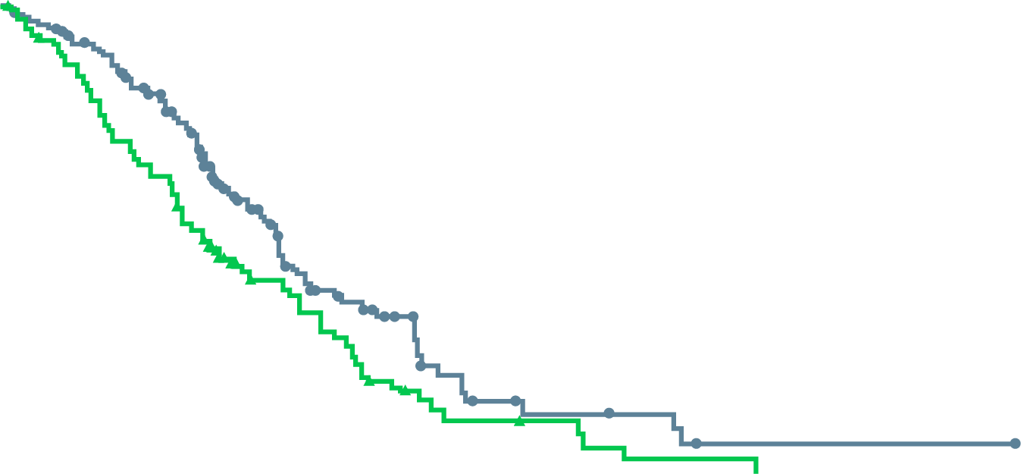
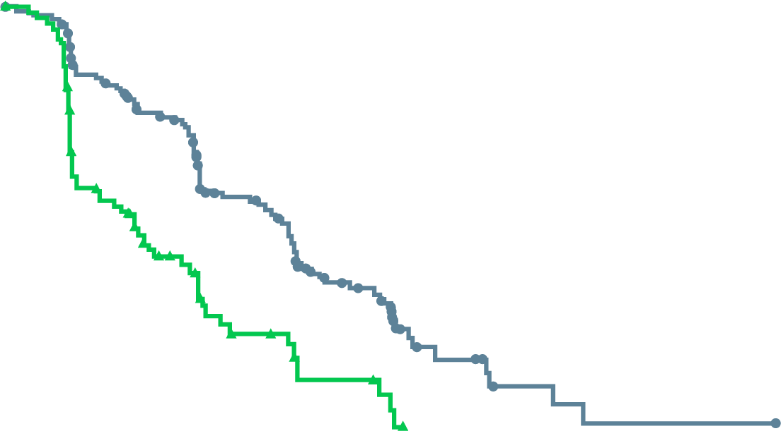
GALAHAD: niraparib shows anti-tumour activity In mcrpc patients with DDRm, particularly brca1/2
OBJECTIVE RESPONSE RATE | BRCA cohortª (N=76) | non-BRCA cohort^{b} (N=47)
Objective response rate | 26 (34.2%; 23.7-46.0) | 5 (10.6%; 3.5-23.1)
Complete response | 2 (3%) | 0
Partial response | 24 (32%) | 5 (11%)
RADIOGRAPHIC PROGRESSION-FREE SURVIVAL
OVERALL SURVIVAL
100
100
BRCA
Non-BRCA
90
BRCA
Non-BRCA
90
80
80
70
70
60
13.01 months
(95% CI: 11.04-14.29)
Overall survival (%)
60
50
Radiographic progression-
free survival (%)
50
8.08 months
(95% CI: 5.75-8.97)
40
40
30
30
20
9.63 months
(95% CI: 8.05-13.44)
20
10
3.71 months
(95% CI: 1.97-5.49)
0
10
0
4
8
12
16
20
24
28
32
36
40
44
48
0
No. at risk
(No. censored)
BRCA
Non-BRCA
Time since enrolment (months)
No. at risk
(No. censored)
BRCA
Non-BRCA
0
4
8
12
16
20
24
142 (0)
81 (0)
91 (19)
27 (15)
49 (33)
10 (21)
9 (51)
0 (24)
2 (54)
0 (24)
1 (54)
0 (24)
0 (55)
0 (24)
142
(0)
81
(0)
126
(5)
66
(2)
100
(11)
49
(2)
53
(33)
23
(13)
26
(43)
16
(13)
12
(49)
7
(15)
7
(50)
5
(15)
5
(51)
2
(16)
2
(52)
1
(16)
1
(53)
0
(16)
1
(53)
0
(16)
1
(53)
0
(16)
0
(54)
0
(16)
CI, confidence interval; DDRm, DNA damage repair mutations; mCRPC, metastatic castration resistant prostate cancer
Smith M, et al. Lancet Oncol. 2022;23:362-73

Slide 25
Galahad: Niraparib side effects
All-cause TEAEs (N=288)
 | Grade 1-2 | Grade 3 | Grade 4 | Grade 5
Nausea | 154 (53%) | 15 (5%) | 0 | 0
Vomiting | 101 (35%) | 10 (3%) | 0 | 0
Constipation | 95 (33%) | 5 (2%) | 1 (<1%) | 0
Fatigue | 87 (30%) | 19 (7%) | 0 | 0
Decreased appetite | 85 (29%) | 8 (3%) | 0 | 0
Anaemia | 61 (21%) | 92 (32%) | 2 (1%) | 1 (<1%)
Thrombocytopenia | 52 (18%) | 24 (8%) | 23 (8%) | 0
Back pain | 51 (18%) | 13 (4%) | 0 | 0
Arthralgia | 38 (13%) | 6 (2%) | 0 | 0
Asthenia | 37 (13%) | 11 (4%) | 0 | 0
Neutropenia | 27 (9%) | 17 (6%) | 11 (4%) | 0
Bone pain | 23 (8%) | 9 (3%) | 0 | 0
Hypertension | 22 (8%) | 12 (4%) | 0 | 0
Blood alkaline phosphatase increased | 15 (5%) | 11 (4%) | 0 | 0
Stomatitis | 15 (5%) | 6 (2%) | 0 | 0
Leukopenia | 14 (5%) | 11 (4%) | 3 (1%) | 0
γ-glutamyl transferase increased | 13 (4%) | 11 (4%) | 1 (<1%) | 0
Lymphopenia | 11 (4%) | 12 (4%) | 1 (<1%) | 0
Hypophosphataemia | 7 (2%) | 6 (2%) | 1 (<1%) | 0
Spinal cord compression | 1 (<1%) | 7 (2%) | 0 | 0
General physical health deterioration | 1 (<1%) | 7 (2%) | 1 (<1%) | 4 (1%)
Data are n (%). Data are presented for grade 1-2 treatment-emergent adverse events with a combined incidence of ≥20% or any higher-grade (grade 3-5) treatment-emergent adverse events with an incidence of ≥2%.
TEAEs, treatment emergent adverse events
Smith M, et al. Lancet Oncol. 2022;23:362-73

Slide 26
Talapro-1: talazoparib in pre-treated mcrpc patients with ddr mutations
International open label, phase 2 study
Primary endpoint: ORR
Secondary endpoints: TTR, DoR, PSA decrease ≥50%, CTC count conversion, time to PSA progression, rPFS, OS, safety, PROs, pharmacokinetics
Patients with mCRPC and a DDR alteration in 1 of the
following genes: ATM, ATR, BRCA1,
BRCA2, CHEK2, FANCA, MLH1,
MRE11A, NBN, PALB2, RAD51C;
1-2 previous CTx regimens and
progression on AA/enzalutamide
(N=128)
Talazoparib 1 mg/day
(0.75 mg for moderate
renal impairment)
Until radiographic
progression or
discontinuation for
other reason
AA, abiraterone acetate; BRCA1/2, breast cancer gene 1/2; CTx, chemotherapy; CTC, circulating tumour cells; DDR, DNA damage repair; DoR, duration of response; mCRPC, metastatic castration resistant prostate cancer; ORR, objective response rate; OS, overall survival; PROs, patient-reported outcomes; PSA, prostate specific antigen; rPFS, radiographic progression-free survival; TTR, time to response
de Bono JS, et al. Lancet Oncol. 2021;22:1250-64

Slide 27
Talapro-1: talazoparib shows anti-tumour activity In mcrpc patients with drds, particularly brca1/2
TUMOUR RESPONSE BY HRR GENE ALTERATION
rPFS BY HRR GENE ALTERATION
N (%) | BRCA1 or BRCA2 (n=61)* | BRCA2 (n=57)* | PALB2 (n=4) | ATM (n=17)† | Other (N=22)‡ | Total (N=104)
Best overall response§
Confirmed complete response | 6 (10) | 6 (11) | 0 (0) | 1 (6) | 0 (0) | 7 (7)
Confirmed partial response | 22 (36) | 20 (35) | 1 (25) | 1 (6) | 0 (0) | 24 (23)
Stable disease (any duration) | 21 (34) | 19 (33) | 2 (50) | 6 (35) | 8 (36) | 37 (36)
Stable disease for ≥6 months | 6 (10) | 6 (11) | 0 (0) | 2 (12) | 0 (0) | 8 (8)
Non-complete response or non-progressive disease | 4 (7) | 4 (7) | 0 (0) | 0 (0) | 0 (0) | 4 (4)
Progressive disease | 4 (7) | 4 (7) | 0 (0) | 8 (47) | 10 (46) | 22 (21)
Not evaluable | 4 (7) | 4 (7) | 1 (25) | 1 (6) | 4 (18) | 10 (10)
Objective response§ | 28 (46) | 26 (46) | 1 (25) | 2 (12) | 0 (0) | 31 (30)
*The BRCA1 or BRCA2 and BRCA2 groups included two patients with both BRCA2 and PALB2 alterations, one patient with both BRCA2 and ATM alterations, one patient with both BRCA2 and CHEK2 alterations, and one patient with both BRCA2 and MLH1 alterations. †The ATM group included one patient with both ATM and FANCA alterations and one patient with both ATM and RAD51C alterations. ‡The other group included patients with HRR gene alterations in ATR, CHEK2, FANCA, MLH1, MRE11A, NBN, or RAD51C. § Only includes patients with measurable disease per investigator assessment
Overall n=104, events=63, median progression-free survival=5.6 months
(95% CI 3.7-8.8)
BRCA1 or BRCA2 group n=61, events=31,
median progression-free survival=11.2 months (95% CI 7.5-19.2)
ATM group n=17, events=11, median progression-free survival=3.5 months
(95% CI 1.7-8.3)
100
90
80
70
Radiographic progression-
free survival (%)
60
50
40
30
20
10
0
3
6
9
12
15
18
21
Number at risk
(number censored)
Overall
BRCA1 or BRCA2 group
ATM group
Time since start of treatment (months)
104 (0)
61 (0)
17 (0)
72 (7)
52 (1)
8 (2)
38 (18)
31 (10)
5 (3)
26 (22)
23 (14)
3 (3)
16 (29)
15 (19)
1 (5)
10 (34)
9 (24)
1 (5)
4 (39)
4 (28)
0 (6)
1 (40)
1 (29)
0 (6)
ATM, ataxia telangiectasia mutated; BRCA1/2, breast cancer gene 1/2; CI, confidence interval; HRR, homologous recombination repair; rPFS, radiographic progression-free survival
de Bono JS, et al. Lancet Oncol. 2021;22:1250-64

Slide 28
Talapro-1: Talazoparib side effects
Talapro-1 study: All-cause TEAEs incidence ≥10% (N=127)
 | Grade 1-2 | Grade 3 | Grade 4
Any treatment-emergent adverse event | 50 (39%) | 57 (45%) | 4 (3%)
Non-haematological
Nausea | 39 (31%) | 3 (2%) | 0
Decreased appetite | 32 (25%) | 4 (3%) | 0
Asthenia | 25 (20%) | 5 (4%) | 0
Fatigue | 23 (18%) | 2 (2%) | 0
Constipation | 22 (17%) | 1 (1%) | 0
Diarrhoea | 21 (17%) | 0 | 0
Peripheral oedema | 20 (16%) | 1 (1%) | 0
Back pain | 16 (13%) | 1 (1%) | 0
Dyspnoea | 15 (12%) | 2 (2%) | 0
Vomiting | 15 (12%) | 2 (2%) | 0
Dizziness | 15 (12%) | 0 | 0
 | Grade 1-2 | Grade 3 | Grade 4
Haematological
Any | 22 (17%) | 41 (32%) | 5 (4%)
Anaemia | 23 (18%) | 39 (31%) | 0
Thrombocytopenia | 13 (10%) | 7 (6%) | 4 (3%)
Neutropenia | 11 (9%) | 10 (8%) | 0
Leukopenia | 12 (9%) | 1 (1%) | 0
Lymphopenia | 4 (3%) | 4 (3%) | 2 (2%)
Data are n (%). Data presented are for events reported in at least 10% of patients
de Bono JS, et al. Lancet Oncol. 2021;22:1250-64

Slide 29
parpi monotherapy in mCRPC: studies leading to registration
mCRPC, metastatic castration resistant prostate cancer; PARPi, poly-ADP ribose polymerase inhibitor

Slide 30
PROfound: Phase 3 of olaparib vs. second new hormonal agent in HRRm mCRPC
Olaparib 300 mg BID
(n=162)
Primary endpoint
rPFS in cohort A (RECIST 1.1 and PCWG3 by BICR)
Key eligibility criteria
mCRPC with disease progression on prior NHA (abiraterone acetate or enzalutamide)
Alterations in ≥1 of any qualifying gene with a direct or indirect role in HRR ª
Cohort A
BRCA1, BRCA2, or ATM alteration
(N=245)
Physician’s choice ^{b}
(n=83)
2:1 randomisation
(Open label)
Upon progression by BICR,
physician’s choice patients were
allowed to cross over to olaparib
Key secondary endpoints
rPFS in cohorts A and B (by BICR) Confirmed radiographic objective response rate in cohort A (by BICR) Time to pain progression in cohort A OS in cohort A
Cohort B
Other alterations
(N=142)
Olaparib 300 mg BID
(n=94)
Physician’s choice ^{b}
(n=48)
Stratification factors
Previous taxane
Measurable disease
ª An investigational clinical trial assay, based on the FoundationOne® CDx next-generation sequencing test, used to prospectively select patients with alteration of BRCA1, BRCA2, ATM, BARD1, BRIP1, CDK12, CHEK1, CHEK2, FANCL, PALB2, PPP2R2A, RAD51B, RAD51C, RAD51D, or RAD54L in their tumour tissue
^{b} Physician’s choice: enzalutamide 160 mg/day, or abiraterone 1,000 mg/day + prednisone 5 mg BID
ATM, ataxia telangiectasia mutated; BICR, blinded independent central review; BID, twice daily; BRCA1/2, breast cancer type 1/2 susceptibility protein; HRR, homologous recombination repair; mCRPC, metastatic castration resistant prostate cancer; NHA, new hormonal agent; OS, overall survival; PCWG3, Prostate Cancer Working Group 3; RECIST, Response Evaluation Criteria In Solid Tumours; rPFS, radiographic progression-free survival; QD, once daily
de Bono J, et al. N Engl J Med. 2020;382:2091-102; Hussain M, et al. N Engl J Med. 2020;383(24):2345-57

Slide 31
PROfound: OLAPARIB MONOTHERAPY IMPROVES rPFS COMPARED TO NHA RECHALLENGE
 | Olaparib (N=162) | Physician’s choice (N=83)
Events, n (%) | 106 (65.4) | 68 (81.9)
Median PFS, months (BICR) | 7.4 | 3.6
Median difference, months | +3.8
 | HR=0.34 95% CI (0.25, 0.47) p<0.001
COHORT A: BRCA1/2 or ATM
BRCA1 and/or BRCA2
rPFSª
HR, 0.22 (95% CI, 0.15-0.32)
Median rPFS, 9.8 vs 3.0 months
1.0
100
0.9
6-month rate
60%
23%
0.8
12-month rate
28%
9%
80
0.7
0.6
60
Probability of rPFS
Probability of rPFS (%)
0.5
0.4
40
0.3
0.2
20
0.1
0.0
0
0
1
2
3
4
5
6
7
8
9
10
11
12
13
14
15
16
17
18
19
20
21
0
1
2
3
4
5
6
7
8
9
10
11
12
13
14
15
16
17
18
19
20
21
Time from randomisation (months)
No. at risk
Time from randomisation (months)
No. at risk
Olaparib
Physician’s
choice
102
58
93
56
87
30
83
27
78
10
77
10
67
6
66
5
48
4
45
3
36
1
33
1
23
1
22
0
16
0
8
0
8
0
2
0
2
0
0
0
0
0
0
0
Olaparib
162
149
126
116
102
101
82
77
56
53
42
37
26
24
18
11
11
3
2
0
0
0
Physician’s
choice
83
79
47
44
22
20
13
12
7
6
3
3
3
2
2
1
1
1
1
0
0
0
COHORT A. PFS by BICR assessment, data maturity=71%. Data cut-off date: 4 June 2019
ª The study was not powered for gene-by-gene analysis.
ATM, ataxia telangiectasia mutated; BRCA1/2, breast cancer gene 1/2; BICR, blinded independent central review; CI, confidence interval; HR, hazard ratio; (r)PFS, radiographic progression-free survival
de Bono J, et al. N Engl J Med. 2020;382:2091-102

Slide 32
PROfound: 31% REDUCTION IN DEATH WITH OLAPARIB MONOTHERAPY COMPARED TO NHA RECHALLENGE
Cohort A: BRCA1/2 or ATM mutations
Cohort A with adjustment for crossoverª
100
100
HR (95% CI) 0.69 (0.50-0.97)
Median OS: 19.1 vs 14.7 months; p=0.02
HR (95% CI): 0.42 (0.19-0.91)
Crossover rate: 67% (56/83)
80
80
60
60
OS (%)
OS (%)
40
40
20
20
0
0
0
2
4
6
8
10
12
14
16
18
20
22
24
26
28
30
32
34
0
2
4
6
8
10
12
14
16
18
20
22
24
26
28
30
32
34
No. at risk
Time from randomisation (months)
No. at risk
Time from randomisation (months)
Olaparib
Physician’s
choice
155
79
44
15
Olaparib
Physician’s
choice
155
79
44
0
162
83
150
74
142
69
136
64
124
58
107
50
101
43
91
37
71
27
56
18
30
11
18
9
6
6
2
3
1
1
0
0
162
83
150
73
142
67
136
56
124
47
107
29
101
15
91
9
71
3
56
0
30
0
18
0
6
0
2
0
1
0
0
0
Median follow-up duration for censored patients: olaparib, 21.9 months; control, 21.0 months
ª Re-censored; conducted using rank-preserving structural failure time model to demonstrate the impact on OS of crossover of patients from the control arm to receive olaparib as a first subsequent anticancer therapy
CI, confidence interval; HR, hazard ratio; NHA, new hormonal agents; OS, overall survival
Adapted from: Hussain M, et al. N Engl J Med. 2020;383:2345-57

Slide 33
PROfound: greater activity with Olaparib in BRCAm BUT POSITIVE EFFECT SEEN WITH OTHER HRRm
Exploratory gene-level analyses | Exploratory gene-level analyses | BRCA1/2 or ATM |  | All HRRmª |  | BRCA1 and/or BRCA2 |  | ATM |  | CDK12
 |  | Olaparib (N=162) | pcNHA (N=83) | Olaparib (N=256) | pcNHA (N=131) | Olaparib (N=102) | pcNHA (N=58) | Olaparib (N=62) | pcNHA (N=24) | Olaparib (N=61) | pcNHA (N=28)
rPFS | Median, months | 7.4 | 3.6 | 5.8 | 3.5 | 9.8 | 3.0 | 5.4 | 4.7 | 5.1 | 2.2
 | HR (95% CI) | 0.34 (0.25–0.47) |  | 0.49 (0.38–0.63) |  | 0.22 (0.15–0.32) |  | 1.04 (0.61–1.87) |  | 0.74 (0.44–1.31)
OS | Median OS, months | 19.1 | 14.7 | 17.3 | 14.0 | 20.1 | 14.4 | 18.0 | 15.6 | 14.1 | 11.5
 | HR (95% CI) | 0.69 (0.50–0.97) |  | 0.79 (0.61–1.03) |  | 0.63 (0.42–0.95) |  | 0.93 (0.53–1.75) |  | 0.97 (0.57–1.71)
ORR | Evaluable patients, n | 84 | 43 | 138 | 67 | 57 | 33 | 30 | 10 | 34 | 12
 | (%) | 33.3 | 2.3 | 21.7 | 4.5 | 43.9 | 0 | 10.0 | 10.0 | 5.9 | 0
PSA | Evaluable patients, n | 153 | 77 | 243 | 123 | 94 | 54 | 61 | 22 | 58 | 27
 | Confirmed response, % | 43.1 | 7.8 | 30.0 | 9.8 | 61.7 | 0 | 13.1 | 22.7 | 5.2 | 3.7
CTC | Evaluable patients, n | 52 | 22 | 78 | 32 | 29 | 17 | 25 | 3 | 14 | 5
 | Conversion, % | 55.8 | 22.7 | 52.6 | 21.9 | 69.0 | 23.5 | 40.0 | 33.3 | 50.0 | 40.0
ªBRCA1, BRCA2, ATM, BARD1, BRIP1, CDK12, CHEK1, CHEK2, FANCL, PALB2, PPP2R2A, RAD51B, RAD51C, RAD51D, or RAD54L
ATM, ataxia telangiectasia mutated; BRCA1/2, breast cancer gene 1/2; BRCAm, breast cancer gene 1/2 mutation; CI, confidence interval, CTC, circulating tumour count; HR, hazard ratio; ORR, overall response rate; OS, overall survival; pcNHA, physician’s choice new hormonal agent; PSA, prostate-specific antigen; rPFS, radiographic progression-free survival
1. de Bono J, et al. N Engl J Med. 2020;382:2091-102; 2. Hussain M, et al. N Engl J Med. 2020;383(24):2345-57; 3. de Bono J, et al. J Clin Oncol. 2021;39 suppl 6:126
(ASCO GU 2021 presentation)

Slide 34
PROfound: most common AEs (≥10% any grade) in the overall population*
At the final OS DCO, median duration of treatment was 7.6 months in the olaparib arm and 3.9 months in the control arm
Olaparib (N=256)
Physician’s choice (N=130)†
Any
Anaemia
Nausea
Fatigue or asthenia‡
Decreased appetite
Diarrhoea
Vomiting
Constipation
5.0
3.0
Grade ≥3
Any grade
2.0
<1.0
Grade ≥3
Any grade
<1.0
2.0
Proportion of patients (%)
* Most common AEs associated with treatment with PARP inhibitors. Patients had alterations in BRCA1, BRCA2, ATM, BARD1, BRIP1, CDK12, CHEK1, CHEK2, FANCL, PALB2, PPP2R2A, RAD51B, RAD51C, RAD51D, and / or RAD54L. Note, there were no cases of myelodysplastic syndromes or AML. There has since been one fatal case of AML 54 days after discontinuation of olaparib. † One patient in the control group did not receive treatment. ‡ Grouped term.
AE, adverse event; AML, acute myeloid leukemia; DCO, data cut-off; OS, overall survival.
1. Hussain M, et al. N Engl J Med. 2020;383(24):2345-2357

Slide 35
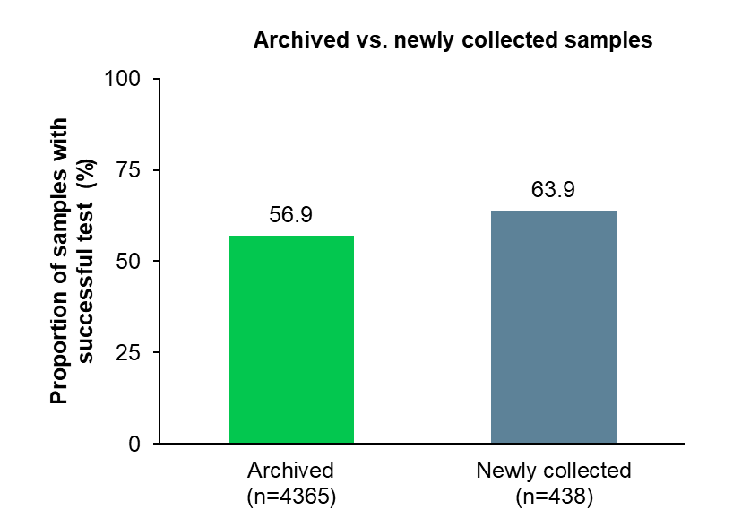
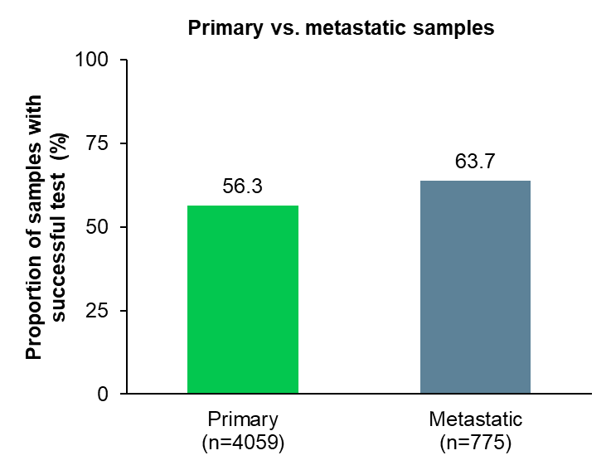
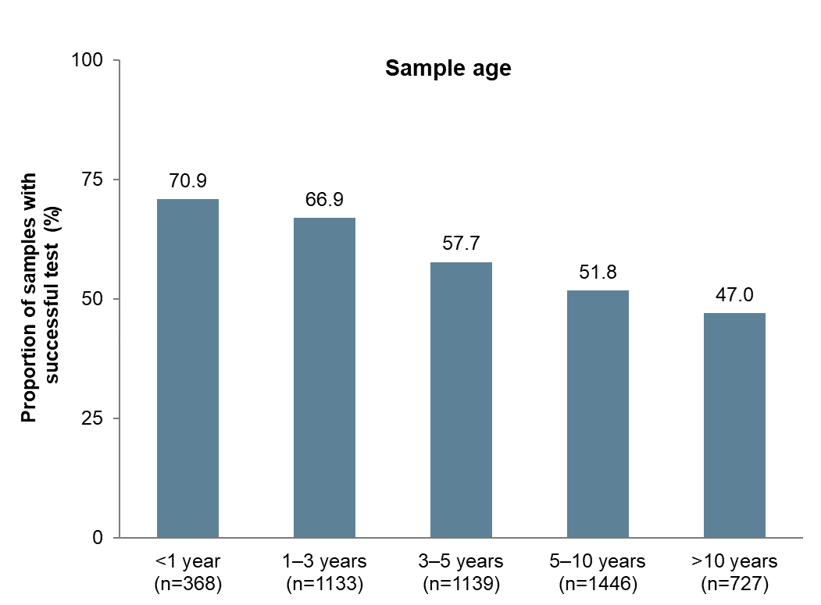
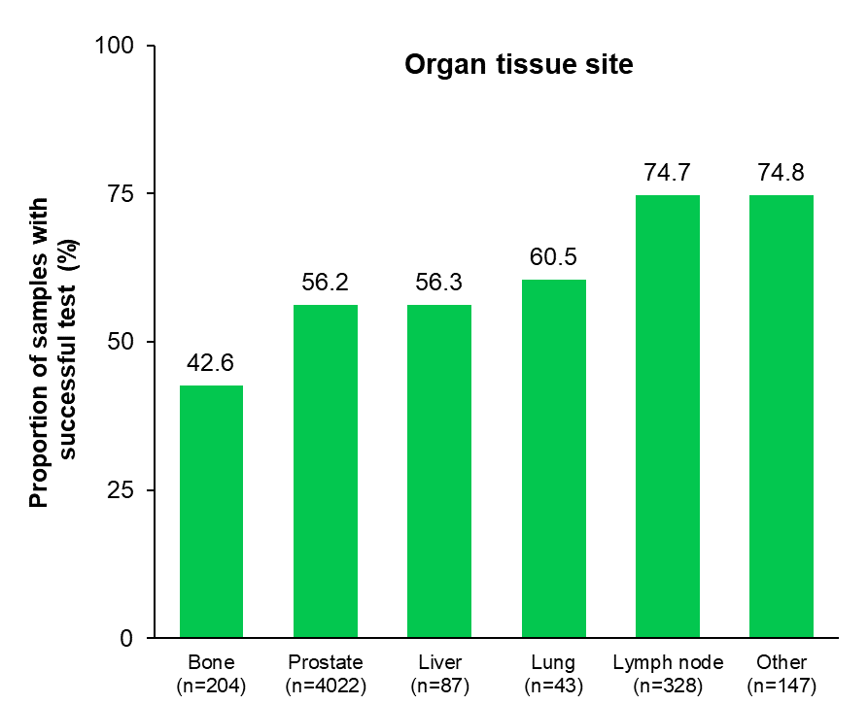
PROfound: tumour tissue used to prospectively identify patients with hrrm
A total of 4,858 samples were tested and reported by FMI during screening
Majority of samples were derived from archived tissue (N=4,365) and from the primary tumour (N=4,059)
Success rates higher with newly collected vs. archived samples and metastatic sites vs.
primary tumour
FMI, Foundation Medicine, Inc
Hussain M, et al. J Clin Oncol. 2020;38 suppl 6:195 (ASCO GU 2020)

Slide 36
Profound: ~ 30% of screened patients were identified with a qualifying HRRm
A similar proportion of patients were identified with HRRm, irrespective of whether the tissue was derived from the primary tumour or metastatic deposits
BRCA2, ATM and CDK12 were the most prevalent HRRm identified
HRR gene alteration prevalence in primary and metastatic tumour samples from screened patients¹
Overview of HRR gene profile in patients screened for the PROfound study with a reported biomarker (n=2792)^{1a}
 | HRR gene alteration prevalence (%)
All patients | 27.9
All primary tumours | 27.2
Archived primary | 27.1
Newly collected primary | 28.9
All metastatic tumours | 31.8
Archived metastatic | 33.2
Newly collected metastatic | 29.5
PPP2RA only 1.0%
CHEK2 only 1.2%
Low-prevalence genes 1.7%
Co-occurring genes 2.1%
CDK12 23% of HRR
CDK12 only 6.3%
ATM 21% of HRR
ATM only 5.9%
BRCA1 only 1.0%
BRCA2 only 8.7%
BRCA2 31% of HRR
No HRR alteration detected 72.1%
ª Patients with multiple genes are included across more than one gene
ATM, ataxia telangiectasia mutated; BRCA1/2, breast cancer gene 1/2; HRR(m), homologous recombination repair (mutation)
1. de Bono J, et al. Ann Oncol. 2019;30 suppl 5:v328-9 (ESMO 2019, 847PD)

Slide 37
TRITON2: open label, single-arm, phase 2 study of rucaparib in mCRPC patients
Screening
Key eligibility criteria
Treatment
28-day cycles
Identification of a deleterious somatic or germline alteration in HRR gene*
mCRPC
Deleterious somatic or germline alteration in HRR gene
Disease progression on AR-directed therapy (eg, abiraterone, enzalutamide, or apalutamide) for PC and 1 prior taxane-based chemotherapy for CRPC
ECOG PS 0 or 1
No prior PARP inhibitor, mitoxantrone, cyclophosphamide, or platinum-based chemotherapy
Rucaparib 600 mg BID
HRR genes
BRCA1 BRCA2 ATM | BARD1 BRIP1 CDK12 CHEK2 | FANCA NBN PALB2 RAD51 | RAD51B RAD51C RAD51D RAD54L
Tumour assessments every 8 weeks for 24 weeks, then every 12 weeks
PSA assessments every 4 weeks
Treatment until radiographic progression or discontinuation for other reason
Primary endpoints†
Patients with measurable disease at baseline: confirmed ORR per modified RECIST/PCWG3 by central assessment
Patients with no measurable disease at baseline: confirmed PSA response (≥50% decrease) rate§
*Alterations detected by local testing or central testing of blood or tumour samples. † Efficacy analyses in TRITON2 will be conducted separately based on HRR gene with alteration and presence/absence of measurable disease. ‡ RECIST modified to include up to 10 target lesions, maximum 5 per site, not including prostatic bed or bone lesions; MRI allowed. § The proportion of patients with a ≥50% decrease from baseline confirmed by a second consecutive measurement; PSA measurements performed by local laboratory.
AR, androgen receptor; BID, twice daily; CRPC, castration-resistant prostate cancer; ECOG PS, Eastern Cooperative Oncology Group Performance Status; HRR, homologous recombination repair, mCRPC, metastatic castration-resistant prostate cancer; MRI, magnetic resonance imaging; ORR, objective response rate; PARP, poly (ADP-ribose) polymerase; PC, prostate cancer; PCWG3, prostate cancer working group 3; PSA, prostate specific antigen; RECIST, Response Evaluation Criteria in Solid Tumours version 1.1
Abida W, et al. J Clin Oncol 2020;38:3763-72

Slide 38
TRITON2: Rucaparib has anti-tumour activity in mCRPC patients with BRCA1/2 alterations¹
Response | Investigator-evaluable population (N=65) | IRR-evaluable population (N=62)
Confirmed ORR, n (% [95% CI])ª | 33 (50.8 [38.1-63.4]) | 27 (43.5 [31.0-56.7])
Complete response, n (%) | 4 (6.2) | 7 (11.3)
Partial response, n (%) | 29 (44.6) | 20 (32.3)
Stable disease, n (%) | 25 (38.5) | 28 (45.2)
Progressive disease, n (%) | 6 (9.2) | 6 (9.7)
Not evaluable, n (%) | 1 (1.5) | 1 (1.6)
 | Overall efficacy population (N=115)
Confirmed PSA, n (% [95% CI]) | 63 (54.8 [45.2-64.1])
Visit cutoff date: December 23, 2019.
ª Per modified RECIST/Prostate Cancer Clinical Trials Working Group 3 criteria.
Patients harbouring an ATM or CDK12 alteration did not receive significant benefit²
ATM, ataxia telangiectasia mutated; BRCA1/2, breast cancer gene 1/2; CDK12, cyclin-dependent kinase 12; CI, confidence interval; IRR, independent radiology review; mCRPC, metastatic castration-resistant prostate cancer; ORR, objective response rate; PSA, prostate-specific antigen
1. Abida W, et al. J Clin Oncol 2020;38:3763-72; 2. Abida W, et al. Clin Cancer Res. 2020;26:2487-96

Slide 39
TRITON2: Rucaparib achieved a median rpfs of 9 months in mCRPC patients with BRCA alterations
FDA granted accelerated approval based on data from TRITON2
100
90
Median, months | 95% CI | Range
9.0 | 8.3 to 13.5 | 0.0-27.6+
80
70
60
Radiographic progression-free survival (%)
50
40
30
20
10
0
0
4
8
12
16
20
24
28
Time (months)
No. at risk:
(events)
115 (0)
80
(21)
53
(34)
17
(50)
9
(53)
4
(53)
3
(53)
0
(53)
rPFS by blinded independent radiology review assessment. Visit cutoff date: December 23, 2019.
Progression was assessed per modified RECIST/PWCG3 criteria.
BRCA, breast cancer gene; CI, confidence interval; FDA, Food and Drug Administration; IRR, independent radiology review; mCRPC, metastatic castration‑resistant prostate cancer; PCWG3, Prostate Cancer Clinical Trials Working Group 3; RECIST, Response Evaluation Criteria In Solid Tumors version 1.1; rPFS, radiographic progression-free survival
Abida W, et al. J Clin Oncol 2020;38:3763-72

Slide 40
TRITON2: Rucaparib side effects
Individual TEAE (preferred terms) occurring in ≥15% of patients | Any grade | Grade ≥3
Asthenia/fatigue | 71 (61.7) | 10 (8.7)
Nausea | 60 (52.2) | 3 (2.6)
Anaemia/decreased hemoglobin | 50 (43.5) | 29 (25.2)
ALT/AST increased | 38 (33.0) | 6 (5.2)
Decreased appetite | 32 (27.8) | 2 (1.7)
Constipation | 31 (27.0) | 1 (0.9)
Thrombocytopenia/decreased platelets | 29 (25.2) | 11 (9.6)
Vomiting | 25 (21.7) | 1 (0.9)
Diarrhoea | 23 (20.0) | 0
Dizziness | 21 (18.3) | 0
Blood creatinine increased | 18 (15.7) | 1 (0.9)
ALT, alanine aminotransferase; AST, aspartate aminotransferase; TEAE, treatment-emergent adverse event
Abida W, et al. J Clin Oncol. 2020;38:3763-72

Slide 41
TRITON2: hrrm identified via tissue or ctdna
genomic testing by assay type
TRITON2
BRCA⁺ patients
N=115
Enrolled by central
plasma testing
N=34
Enrolled by central
tissue testing
N=37
Enrolled by local
testing
N=44
Enrolled by
central plasma testing
n=34
Enrolled by
central tissue testing
n=37
Enrolled by
local testing
n=44
n=21
Pts with
plasma
test
 | Pts enrolled by | Pts BRCA⁺ by
Plasma test | 34 | 61
Tissue test | 37 | 59
Local test | 44 | 44
n=6
n=28
n=10
Pts
with
local
test
n=22
n=6
n=22
Pts
with
tissue
test
Homozygous loss
Frameshift mutation
Nonsense mutation
Missense mutation
Splice site mutation
Rearrangement
BRCA, breast cancer gene; ctDNA, circulating tumour DNA; HRRm, homologous recombination repair mutations; mCRPC, metastatic castration-resistant prostate cancer; NHA, new hormonal agent; Pts, patients
Loehr A, et al. Clin Cancer Res. 2021;27:6677-86

Slide 42
TRITON2: Concordance between tissue and ctDNA testing
Concordance between tumour tissue and ctDNA testing determined by
positive and negative percentage agreements
There is high concordance between liquid and tissue biopsy
 | Tissue BRCA/ ATM mutation detected (T⁺) | Tissue BRCA/ ATM mutation not detected (T⁻) | Total
Plasma (ctDNA) BRCA/ATM mutation detected (P⁺) | 143 (81%; T⁺/P⁺) | 24 (8%; T⁻/P⁺) | 167
Plasma (ctDNA) BRCA/ATM mutation not detected (P⁻) | 33 (19%; T⁺/P⁻) | 291 (92%; T⁻/P⁻) | 324
Total | 176 | 315 | 491
 | T⁺/P⁺: 81% (95% CI, 75-87) | T⁻/P⁻: 92% (95% CI, 89-95) | PPV = 0.68 NPV = 0.96
BRCA/ATM variant subtype detection sensitivity in ctDNA and tissue
 | Sensitivity of detection in tumour tissue |  |  | Sensitivity of detection in ctDNA
 | Detected in tumour tissue | Detected in tumour tissue and ctDNA | Detected in tumour tissue only | Detected in ctDNA | Detected in tumour tissue and ctDNA | Detected in ctDNA only
Frameshift/indel | 96 | 83 (86%) | 13 (14%) | 110 | 83 (75%) | 27 (25%)
Homozygous loss | 30 | 8 (27%) | 22 (73%) | 7 | 7 (100%) | 0
Large rearrangement | 24 | 15 (63%) | 9 (37%) | 23 | 16 (70%) | 7 (30%)
Nonsense | 28 | 26 (93%) | 2 (7%) | 32 | 26 (81%) | 6 (19%)
Splice | 15 | 13 (87%) | 2 (13%) | 26 | 13 (50%) | 13 (50%)
Missense | 4 | 1 (25%) | 3 (75%) | 9 | 1 (11%) | 8 (89%)
Total | 197 | 146 (74%) | 51 (26%) | 207 | 146 (71%) | 61 (29%)
However, sequencing on ctDNA might miss a significant proportion of BRCA2 homologous loss
ATM, ataxia telangiectasia mutated; BRCA, breast cancer gene; CI, confidence interval; ctDNA, circulating tumour DNA; NPV, negative predictive value; P, plasma; PPV, positive predictive value; T, tissue
Chi KN, et al. Clin Cancer Res. 2022. DOI: 10.1158/1078-0432.CCR-22-0931

Slide 43
TRITON3 study design
Confirmatory study for accelerated approval of rucaparib
Rucaparib 600 mg BID
Key eligibility criteria
Randomisation 2:1
Endpoints^{d}
Chemotherapy-naïve mCRPC
BRCA or ATM alterationª
1 prior second-generation API in any setting^{b}
Stratification:
ECOG PS 0 vs 1
Hepatic metastases
yes vs no
BRCA1 vs BRCA2
vs ATM
Physician’s choice of^{c}:
Docetaxel
75 mg/m² Q21D; 10 cycles max
or
Abiraterone acetate
1000 mg QD
or
Enzalutamide
160 mg QD
Primary:
rPFS by IRR
Key secondary:
OS
ORR by IRR
Prior docetaxel or other
taxane chemotherapy for
castration-sensitive disease
was permitted
Patients who progress on physician’s choice of
treatment may be considered for crossover to rucaparib
Visit cutoff date: 25 August 2022. ª Determined by Foundation Medicine testing of tissue or plasma. ^{b} Protocol amendment June 19, 2018: patients’ qualifying second-generation API could be in any setting. ^{c} If chosen, patients received whichever second-generation API had not yet been received. ^{d} Tumour assessments were conducted at baseline and every 8 weeks for 24 weeks, then every 12 weeks, via CT/MRI and technetium-bone scans.
API, androgen pathway inhibitor; ATM, ataxia telangiectasia mutated; BID, twice daily; BRCA, breast cancer gene; CT, computed tomography; ECOG PS, Eastern Cooperative Oncology Group performance status; IRR, independent radiology review; mCRPC, metastatic castration-resistant prostate cancer; MRI, magnetic resonance imaging; ORR, objective response rate; OS, overall survival; Q21D, every 21 days; QD, daily; rPFS, radiographic progression-free survival
Bryce AL, et al. Prostate Cancer Foundation Retreat 2022

Slide 44
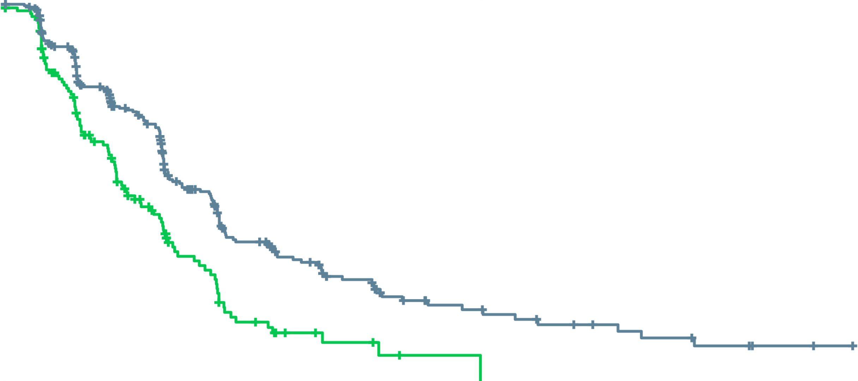
Triton3: rucaparib improves rPFS vs physician’s choice in itt population
100
90
80
70
60
50
40
30
20
10
0
 | Median, mo | 95% CI
Rucaparib | 10.2 | 8.3-11.2
Physician’s choice | 6.4 | 5.6-8.2
Log-rank p=0.0003 HR (95% CI): 0.61 (0.47-0.80)
rPFS by IRR (%)
Rucaparib
Physician’s choice
0
3
6
9
12
15
18
21
24
27
30
33
36
39
42
45
Months
Patients at risk (events)
Rucaparib | 270 (0) | 220 (29) | 155 (68) | 99 (108) | 61 (135) | 46 (142) | 31 (150) | 19 (156) | 15 (158) | 12 (160) | 9 (161) | 7 (162) | 4 (164) | 2 (164) | 2 (164) | 0 (164)
Physician’s choice | 135 (0) | 97 (25) | 58 (56) | 28 (74) | 13 (88) | 6 (91) | 4 (92) | 1 (93) | 1 (93) | 0 (94)
Data maturity: 64% (258/405). The ATM subgroup completed enrolment in December 2019
ATM, ataxia telangiectasia mutated; CI, confidence interval; HR, hazard ratio; IRR, independent radiology review; ITT, intention-to-treat; mo, months; rPFS, radiographic progression-free survival
Bryce AL, et al. Prostate Cancer Foundation Retreat 2022

Slide 45
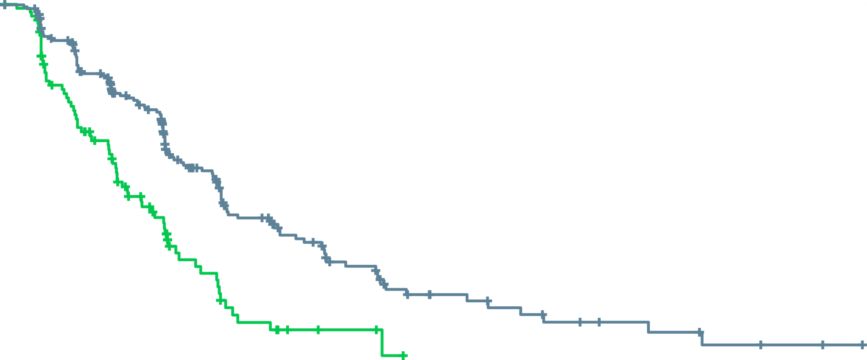
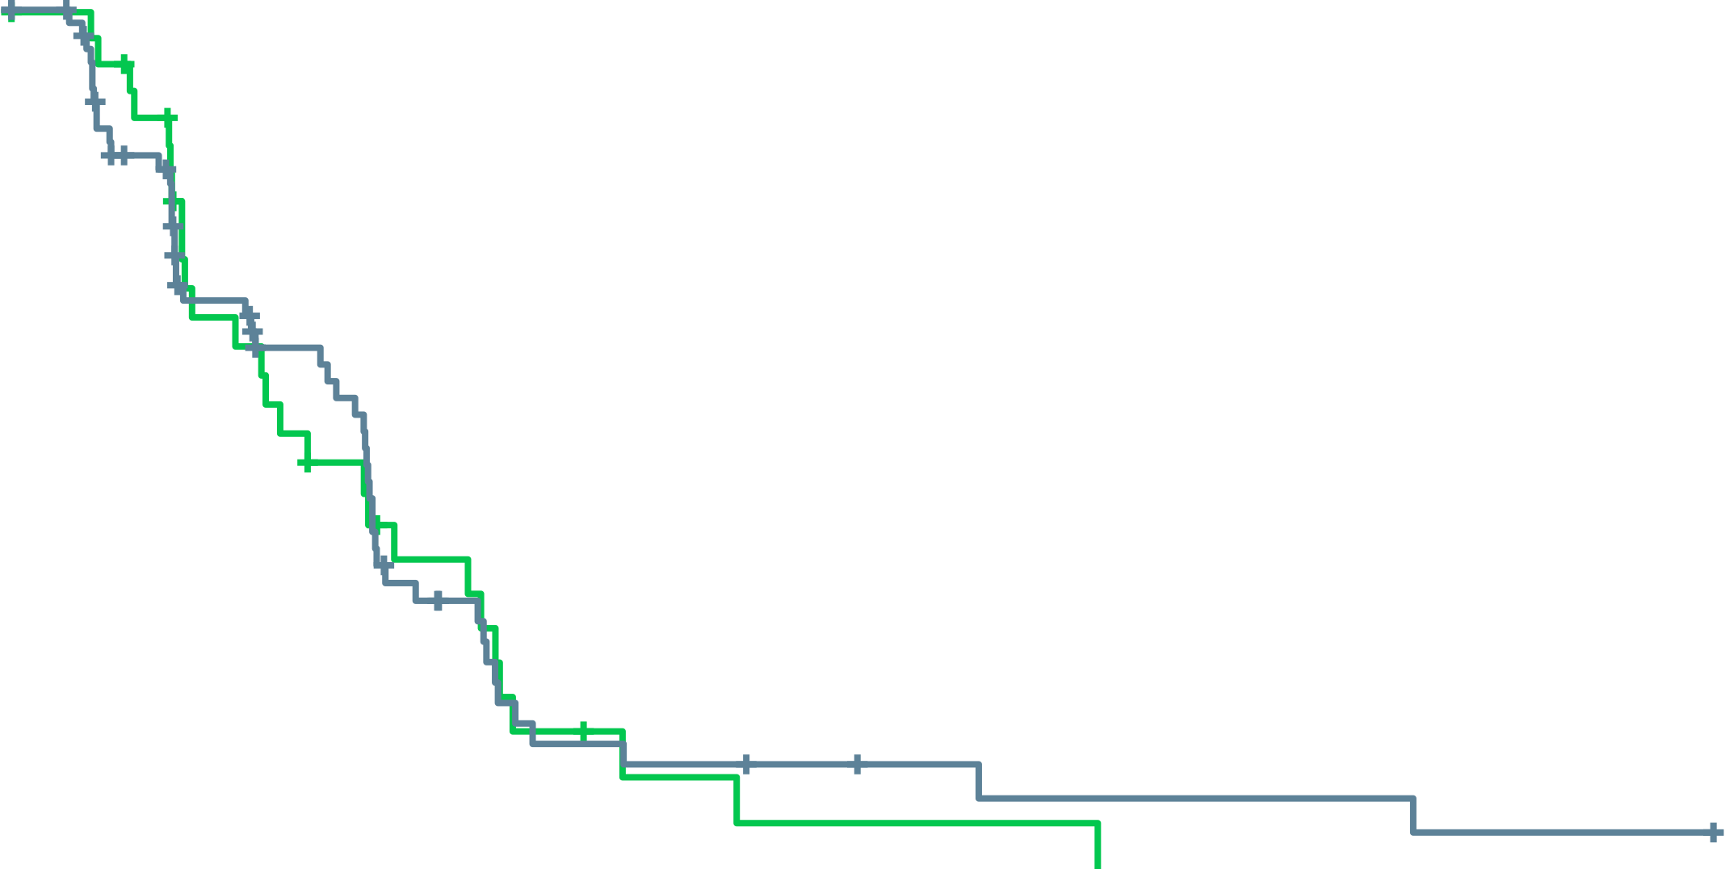
Triton3: rucaparib improves rPFS vs physician’s choice in BRCA subgroup
rPFS by IRR in the BRCA subgroup
rPFS by IRR in the ATM subgroup
100
90
80
70
60
50
40
30
20
10
0
 | Median, mo | 95% CI
Rucaparib | 11.2 | 9.2-13.8
Physician’s choice | 6.4 | 5.4-8.3
Log-rank p<0.0001 HR (95% CI): 0.50 (0.36-0.69)
100
90
80
70
60
50
40
30
20
10
0
 | Median, mo | 95% CI
Rucaparib | 8.1 | 5.5-8.3
Physician’s choice | 6.8 | 4.0-10.4
Log-rank p=0.84 HR (95% CI): 0.95 (0.59-1.52)
rPFS by IRR (%)
rPFS by IRR (%)
Rucaparib
Physician’s choice
Rucaparib
Physician’s choice
0
3
6
9
12
15
18
21
24
27
30
33
36
39
42
45
0
3
6
9
12
15
18
21
24
27
30
33
36
39
42
45
Months
Months
Patients at risk (events)
Rucaparib | 201 (0) | 169 (18) | 124 (44) | 83 (70) | 55 (89) | 41 (95) | 27 (103) | 16 (109) | 13 (110) | 10 (112) | 7 (113) | 6 (113) | 3 (115) | 2 (115) | 2 (115) | 0 (115)
Physician’s choice | 101 (0) | 69 (21) | 42 (42) | 19 (55) | 9 (64) | 4 (66) | 3 (66) | 0 (67)
Patients at risk (events)
Rucaparib | 69 (0) | 51 (11) | 31 (24) | 16 (38) | 6 (46) | 5 (47) | 4 (47) | 3 (47) | 2 (48) | 2 (48) | 2 (48) | 1 (49) | 1 (49) | 0 (49)
Physician’s choice | 34 (0) | 28 (4) | 16 (14) | 9 (19) | 4 (24) | 2 (25) | 1 (26) | 1 (26) | 1 (26) | 0 (27)
Data maturity: 60% (182/302). BRCA subgroup, BRCA1 and BRCA2
Data maturity: 74% (76/103). The ATM subgroup completed enrollment in December 2019
ATM, ataxia telangiectasia mutated; BRCA, breast cancer gene; CI, confidence interval; HR, hazard ratio; IRR, independent radiology review; ITT, intention-to-treat; mo, months; rPFS, radiographic progression-free survival
Bryce AL, et al. Prostate Cancer Foundation Retreat 2022

Slide 46
Triton3: MOST COMMON TEAEs
(≥20% ANY GRADE)
Rucaparib (n=270ª)
Physician’s choice (n=130ª)
100
99.2
1.5
Grade ≥3
Any grade
Grade ≥3
Any grade
3.3
3.1
Proportion of patients (%)
ª Safety population (all patients who received ≥1 dose of protocol-specified treatment). ^{b} Grade ≥3, 0.8%
Neuropathy includes neurotoxicity, paraesthesia, peripheral motor neuropathy, peripheral neuropathy, peripheral sensory neuropathy, and polyneuropathy.
ALT, alanine aminotransferase; AST, aspartate aminotransferase; TEAE, treatment-emergent adverse event
Bryce AL, et al. Prostate Cancer Foundation Retreat 2022

Slide 47
Where do parpi’s fit in the mcrpc treatment landscape?
mCRPC, metastatic castration resistant prostate cancer; PARPi, poly-ADP ribose polymerase inhibitor

Slide 48


PARP inhibitors are approved in prostate cancer^{1,2}
Olaparib FDA-approved indication¹
Olaparib EMA-approved indication²
Indicated as monotherapy for the treatment of adult patients with mCRPC and HRRm, who have progressed on enzalutamide or abiraterone acetate, selected using an FDA-approved Lynparza companion diagnostic
Indicated as monotherapy for the treatment of adult patients with mCRPC and a BRCAm, who have progressed on an NHA. Determine BRCAm status with a validated test method^{b}
Rucaparib FDA-approved indication³
Indicated as monotherapy for the treatment of adult patients with BRCAm mCRPC who have progressed on AR-directed therapy and a taxaneª
Treatment should continue until progression or unacceptable toxicity. An LHRH analogue should be continued in patients who are not surgically castrated^{1,2}
Talazoparib and niraparib are not currently approved in prostate cancer
ªRucaparib is FDA-approved for the treatment of adult patients with a deleterious BRCAm-associated mCRPC who have been treated with androgen receptor-directed therapy and a taxane-based chemotherapy (no current approval in prostate cancer in Europe)^{3; b}olaparib has received a positive recommendation from the EMA CHMP to be used in combination with abiraterone and prednisone or prednisolone for the treatment of adult patients with mCRPC in whom chemotherapy is not clinically indicated
AR, androgen receptor; BRCAm, breast cancer gene mutation; EMA, European Medicines Agency; FDA, US Food and Drug Administration; HRRm, homologous recombination repair mutation; LHRH, luteinising hormone-releasing hormone; mCRPC, metastatic castration-resistant prostate cancer; NHA, new hormonal agent; PARP, poly-ADP ribose polymerase
1. Lynparza (olaparib) US prescribing information (Aug-2022); 2. Lynparza (olaparib) summary of product characteristics (Sep 2022); 3. Rubraca (rucaparib) US prescribing information; 4. Lynparza: Pending EC decision | European Medicines Agency (europa.eu);

Slide 49
There are multiple trials investigating the use of PARP inhibitors in prostate cancer¹⁻¹¹
Primary
Adjuvant
Biochemical Recurrence (BCR)
mHSPC
(incl de novo)
1L mCRPC
2L mCRPC
3L mCRPC
nmCRPC
PROpel¹
P3 Olaparib + abi vs abi
Primary endpoint: rPFS unselected pts
PROfound²*
P3 Olaparib vs abi/enza, HRRm, post-NHA Primary endpoint: rPFS BRCA/ATMm
TALAPRO-3³
P3 Talazoparib + enza
Primary endpoint: rPFS HRRm
TALAPRO-2⁴
P3 Talazoparib + enza vs. enza
Primary endpoint: rPFS unselected pts/HRRm
TALAPRO-1⁵
P2 Talazoparib
HRRm
Post-NHA, post-taxane
Primary endpoint: ORR HRRm
AMPLITUDE⁶
P3 Niraparib + abi
Primary endpoint: rPFS HRRm
MAGNITUDE⁷
P3 Niraparib + abi vs abi
Primary endpoint: rPFS BRCAm/HRRm
GALAHAD⁸
P2 Niraparib, HRRm
Post-NHA, post-taxane
Primary endpoint: ORR BRCAm
Prostate Specific Antigen
TRITON-3⁹
P3 Rucaparib vs abi/enza/docetaxel
BRCAm / ATM, post-NHA
TRITON-2¹⁰
P2 Rucaparib HRRm/BRCAm†
Post-NHA, post-taxane
Primary endpoint: ORR and PSA HRRm
Met
CASPAR¹¹
P3 Rucaparib + enza vs. enza
Primary endpoint rPFS & OS
Unselected patients
Time
Non-metastatic
Metastatic
Hormone-sensitive
Castration-resistant
Asymptomatic
Symptomatic
Please see slide notes for references. ª As a result of the data from PROfound, olaparib monotherapy was approved for treatment of mCRPC in patients with HRR mutations (FDA approval) or for patients with mutations in only BRCA1/2 (EMA approval) after progression on a NHA^{12,13; b} As a result of the data from TRITON2, rucaparib monotherapy was approved by the FDA only for the treatment of mCRPC in patients with a BRCA1/2m who have disease progression after treatment with prior AR-directed therapy and prior taxane¹⁴
Abi, abiraterone; BCR, biochemical recurrence; Enza, enzalutamide; FDA, US Food and Drug Administration; HRR, homologous recombination repair; mCRPC, metastatic castration-resistant prostate cancer;
mHSPC, metastatic hormone-sensitive prostate cancer; NHA, new hormonal agent; nmCRPC, non-metastatic castration-resistant prostate cancer; Ola, olaparib; P, phase; PSA, prostate-specific antigen
Notes:
References:
1. Study NCT03732820. Available at ClinicalTrials.gov; 2. Study NCT02987543. Available at ClinicalTrials.gov; 3. Study NCT04821622. Available at ClinicalTrials.gov; 4. Agarwal N, et al. Presented at ASCO Annual Meeting 3–7th June 2022. Chicago, IL. Abstract TPS5096; 5. Study NCT03395197. Available at ClinicalTrials.gov; 6. Study NCT03148795. Available at ClinicalTrials.gov; 7. Study NCT04497844. Available at ClinicalTrials.gov; 8. Study NCT03748641. Available at ClinicalTrials.gov; 9. Study NCT02854436. Available at ClinicalTrials.gov; 10. Study NCT02975934. Available at ClinicalTrials.gov; 11. Study NCT02952534. Available at ClinicalTrials.gov; 12. Study NCT04455750. Available at ClinicalTrials.gov

Slide 50
parpi’s BEYOND PROSTATE CANCER
PARPi, poly-ADP ribose polymerase inhibitor

Slide 51
Available PARP inhibitors and their current tumour indications
 | Olaparib | Rucaparib | Niraparib | Talazoparib
Single-agent dose (approved for olaparib, rucaparib, niraparib, and talazoparib) | 300 mg BID | 600 mg BID | 200/300^{d} mg QD | 1 mg QD
Tumour indications | Ovarian cancer, breast cancer, pancreatic cancer, prostate cancer^{1,2,3,a,b} | Ovarian cancer,^{4,5} prostate cancer^{5,c} | Ovarian cancer^{6,7} | Breast cancer^{8,9}
ª Olaparib is FDA-approved for the treatment of adult patients with deleterious or suspected deleterious germline or somatic HRR mutation-positive mCRPC who have progressed following prior treatment with enzalutamide or abiraterone¹
^{b} Olaparib is EMA-approved as monotherapy for the treatment of adult patients with mCRPC and BRCA1/2 mutations (germline and/or somatic) who have progressed following prior therapy that included an NHA² and has received a positive recommendation from the EMA CHMP to be used in combination with abiraterone and prednisone or prednisolone for the treatment of adult patients with mCRPC in whom chemotherapy is not clinically indicated³
^{c} Rucaparib is FDA-approved for the treatment of adult patients with a deleterious BRCA mutation-associated mCRPC who have been treated with AR-directed therapy and a taxane-based chemotherapy
(no current approval in prostate cancer in Europe)⁴
^{d} Niraparib FDA-approved dose is 300 mg QD and EMA approved dose is either 200 or 300 mg QD depending on weight and other factors
AR, androgen receptor; BID, twice daily; CHMP, Committee for Medicinal Products for Human Use; EMA, European Medicines Agency; QD, once daily; EMA, European Medicines Agency; FDA, Food and Drug Administration; HRR, homologous recombination repair; mCRPC, metastatic castration-resistant prostate cancer; NHA, new hormonal agent; PARP, poly-ADP ribose polymerase
1. Olaparib PI; 2. Olaparib SmPC; 3. Lynparza: Pending EC decision | European Medicines Agency (europa.eu); 4. Rucaparib SmPC; 5. Rucaparib PI; 6. Niraparib PI; 7. Niraparib SmPC; 8. Talazoparib SmPC; Talazoparib PI. All accessed November 2022.

Slide 52
AE profiles of PARPi from monotherapy trials across different tumour types
Frequency of AEs in prostate cancer trials – All Grade (Grade ≥3) | Olaparib (PROfound)¹ | Rucaparib (TRITON2)² | Niraparib (GALAHAD)³ | Talazoparib (TALAPRO-1)⁴
Hypertension % | NR | NR | 11.8 (4.2) | 5.5 (3.1)
Increased ALT/AST % | NR | 33.0 (5.2) | 12.8 (2.8) | 11.8 (2.4)
Insomnia % | NR | NR | 8.3 (0.3) | NR
Alopecia % | NR | NR | NR | NR
Frequency of AEs in ovarian and breast cancer trials – All Grade (Grade ≥3) | Olaparib (SOLO-2)⁵ | Rucaparib (ARIEL3)⁶ | Niraparib (NOVA)⁷ | Talazoparib (EMBRACA)⁸
Hypertension % | NR | 9.7 (2.4) | 19.3 (8.2) | NR
Increased transaminases % | NR | 34.7 (10.2) | NR | NR
Insomnia % | NR | 14.5 (0.0) | 24.3 (0.3) | NR
Alopecia % | NR | NR | NR | 25.2 (0.0)
Please note that head-to-head studies were not conducted between these products. This data is for information purposes only, and no comparative claims of non-inferiority or superiority in terms of efficacy or safety are implied or intended. AEs highlighted in red if value ≥10%
AE, adverse event; ALT, alanine aminotransferase; AST, aspartate aminotransferase; NR, not reported; PARPi, poly-ADP ribose polymerase inhibitor
1. Hussain M, et al. New Engl J Med. 2020;383:2345-57; 2. Abida W, et al. J Clin Oncol. 2020;38(32):3763-72; 3. Smith MR, et al. Lancet Oncol. 2022;23(3):362-73;
4. de Bono JS, et al. Lancet Oncol. 2021;22(9):1250-64; 5. Poveda A, et al. Lancet Oncol. 2021;22(5):620-31; 6. Ledermann A, et al. Lancet Oncol. 2020;21:710-22;
7. Mirza MR, et al. New Engl J Med. 2016;375:2154-64; 8. Litton JK, et al. New Engl J Med. 2018;379:753-63 (supplementary appendix)

Slide 53
Haematological AE profiles of PARPi from monotherapy trials across different tumour types
Frequency and grade of cytopenias in prostate cancer trials | Olaparib (PROfound)¹ | Rucaparib (TRITON2)² | Niraparib (GALAHAD)³ | Talazoparib (TALAPRO-1)⁴
Anaemia Grade ≥3 (%) | 23 | 25 | 33 | 31
Neutropenia Grade ≥3 (%) | NRª | 7 | 10 | 8
Thrombocytopenia Grade ≥3 (%) | NRª | 10 | 16 | 9
Frequency and grade of cytopenias in ovarian and breast cancer trials | Olaparib (SOLO-2)⁵ | Rucaparib (ARIEL3)⁶ | Niraparib (NOVA)⁷ | Talazoparib (EMBRACA)⁸
Anaemia Grade ≥3 (%) | 21 | 22 | 25 | 39
Neutropenia Grade ≥3 (%) | 7 | 8 | 20 | 21
Thrombocytopenia Grade ≥3 (%) | 2 | 5 | 34 | 15
Please note that head-to-head studies were not conducted between these products. This data is for information purposes only, and no comparative claims of non-inferiority or superiority in terms of efficacy or safety are implied or intended. AEs highlighted in red if value ≥10%
ªFrequency of grade 3 AEs not reported but 1% of patients experienced TEAE leading to treatment discontinuation
AE, adverse event; NR, not reported; PARPi, poly-ADP ribose polymerase inhibitor; TEAE, treatment-emergent adverse event
1. Hussain M, et al. New Engl J Med. 2020;383:2345-57; 2. Abida W, et al. J Clin Oncol. 2020;38(32):3763-72 (supplementary appendix); 3. Smith MR, et al. Lancet Oncol. 2022;23(3):362-73;
4. de Bono JS, et al. Lancet Oncol. 2021;22(9):1250-64; 5. Poveda A, et al. Lancet Oncol. 2021;22(5):620-31; 6. Ledermann A, et al. Lancet Oncol. 2020;21:710-22;
7. Mirza MR, et al. New Engl J Med. 2016;375:2154-64; 8. Litton JK, et al. New Engl J Med. 2018;379:753-63 (supplementary appendix)

Slide 54
In Conclusion
PARP inhibitors are effective drugs as monotherapy in mCRPC patients with HRR alterations
Genetic testing is important to help with treatment decision making and for understanding inherited risk
BRCA mutations are associated with poor outcomes in mCRPC patients
Patients with tumours harbouring BRCA1/BRCA2 alteration (especially HomDel) appear to derive the greatest clinical benefit from PARPi, but patients with other HRR alterations might also derive benefit
Further work needed to understand predictive phenotypes (mutational signatures, HRD scores)
HomDel, homologous deletions; HRD, homologous repair deficiency; HRR, homologous recombination repair; mCRPC, metastatic castration-resistant prostate cancer; PARPi, poly-ADP ribose polymerase inhibitors

Slide 55

REACH GU CONNECT VIA
TWITTER, LINKEDIN, VIMEO & EMAIL
OR VISIT THE GROUP’S WEBSITE https://guconnect.cor2ed.com/
Follow us on Twitter
@guconnectinfo
Follow the
GU CONNECT
group on LinkedIn
Watch us on the
Vimeo Channel
GU CONNECT
Email
sam.brightwell
@cor2ed.com

