Slide 2
WELCOME TO EXPERTS
KNOWLEDGE SHARE
Prevention and Management of Heart Disease in T2D Patients:
Cardiologist and Diabetologist Perspective

Slide 3
Contents
DISCLAIMER AND DISCLOSURES | COR2ED
The Prevention & Management of Cardiovascular Disease in Diabetes– A Diabetologist Perspective | Prof Peter Grant
Coronary Risk Prevention in Patients with T2 Diabetes | Prof. Gaetano Maria De Ferrari

Slide 4
DISCLAIMER AND DISCLOSURES
Please note: The views expressed within this presentation are the personal opinions of the authors. They do not necessarily represent the views of the authors academic institutions, or COR2ED.
This programme is supported by an Independent Educational Grant from Amgen.
The experts have received financial support/sponsorship for research support, consultation, or speaker fees from the following companies:
Prof. Gilles Montalescot: Abbott, Amgen, AstraZeneca, Ascendia, Bayer, BMS, Boehringer-Ingelheim, Boston-Scientific, Celecor, CSLBehring, Idorsia, Lilly, Novartis, Novo, Opalia, Pfizer, Quantum Genomics, Sanofi, Terumo.
Prof. Peter Grant: Speaker and advisory board member for BMS, Takeda, Astra Zeneca, Lilly, Novo Nordisk, Novartis, Bayer Diabetes adviser to Synexus. Speaker for the Medicines Company. Editor-in-Chief, Diabetes and Vascular Disease Research. Co-Chair 2013 and 2020 ESC/EASD guidelines on prevention and management of CV disease in pre-diabetes and diabetes
Prof. Gaetano Maria De Ferrari: Steering Committee Member : Amgen, Merck Advisory Board & Speaker’s Fee: Amgen, Lilly, Sanofi, Sigma Tau, UCB

Slide 5
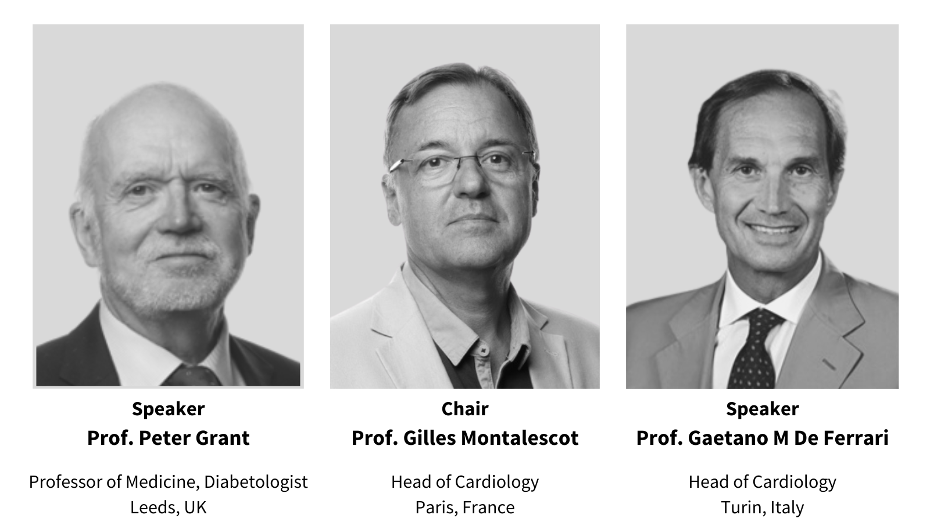
INTRODUCING THE EXPERT PANEL

Slide 6
The Prevention and Management of Cardiovascular Disease in Diabetes:
A Diabetologists Perspective
Peter J. Grant
Faculty of Medicine and Health, University of Leeds, UK

Slide 7
Effects of Hypoglycaemic Agents on Vascular Complications in Patients with Adult Onset Diabetes
‘The results from the UDGP have given little hope thus far that the degenerative complications of diabetes are preventable by simple control of blood sugar…..
…..neither insulin nor hypoglycaemic agents gave greater protection….than diet alone’
Goldner MG, JAMA. 1971;218:1400-10

Slide 8
DCCT/EDIC: glycemic control reduces risk of
CVD in type 1 diabetes
9
Conventional treatment
HbA_{1C} (%)
8
Intensive treatment
7
0
1
2
3
4
5
6
7
8
9
10
11
12
13
14
15
16
17
Years
0.06
0.04
0.02
0.00
DCCT (intervention period)¹ EDIC (observational follow-up)²
57% risk reductionª
(P=0.02; 95% CI: 12 to 79%)
Cumulative incidence:
non-fatal MI, stroke or
death from CVD
Conventional
treatment
*Intensive vs conventional treatment
Intensive
treatment
0
1
2
3
4
5
6
7
8
9
10
11
12
13
14
15
16
17
18
19
20
21
Years
DCCT (intervention period)³ EDIC (observational follow-up)³
ª Intensive vs conventional treatment
CVD, cardiovascular disease; DCCT, Diabetes Control and Complications Trial; EDIC, Epidemiology of Diabetes Interventions and Complications; MI, myocardial infarction; T1D, type 1 diabetes
Adapted from: 1. DCCT Research Group, et al. N Engl J Med. 1993;329:977-86. 2. Writing Team for the DCCT/EDIC Research Group. JAMA. 2002;287:2563-9. 3. Nathan DM, et al. N Engl J Med. 2005;353:2643-53
Notes:
8
In DCCT (Diabetes Control and Complications Trial), 1,441 patients with type 1 diabetes were randomized to intensive (≥3 daily insulin injections or insulin pump) or conventional treatment (1–2 daily insulin injections) for a mean follow-up period of 6.5 years. At the end of DCCT, participants receiving conventional treatment were offered intensive treatment. All patients returned to their own healthcare provider for diabetes care.¹
In total, 1,397 patients (96%) from the DCCT were followed in the observational EDIC (Epidemiology of Diabetes Interventions and Complications) study for a mean 17 years of follow-up.¹
As shown in the upper graph, in DCCT the absolute difference in mean HbA_{1c} between the intensive and conventional groups was ~2% (7.4% vs 9.1%; p<0.01) at 6.5 years, which was sustained during the intervention period. During EDIC, differences in HbA_{1c} narrowed in these groups (8.0% vs 8.2%, respectively; p=0.03) at 11 years.^{1,2}
As shown in the lower graph, changes in HbA_{1c} associated with intensive treatment were accompanied by a reduction in risk of non-fatal MI, stroke or death. Differences between the conventional treatment group and the intensive treatment group started to appear from Year 9 onwards. The intensive treatment line stops at Year 17 as this was the time of the last recorded event.¹
In EDIC, patients with type 1 diabetes who had received intensive treatment in DCCT had a 57% reduction in risk of non-fatal MI, stroke or death from CVD (95% CI, 12 to 79%; p=0.02). Intensive treatment also reduced the risk of any CVD event by 42% (95% CI, 9 to 63%; p=0.02).¹
There are a number of potential mechanisms by which intensive glycemic control may reduce CVD risk, including a reduction in HbA_{1c}.¹
DCCT/EDIC. N Engl J Med 2005;353:2643–2653.
DCCT/EDIC. JAMA 2002;287:2563–2569.

Slide 9
T2DM Glucose-lowering Studies, Micro- and
Macro-vascular outcomes
Study¹ | Baseline HbA_{1c} Control vs intensive | Mean duration of diabetes at baseline (years) | Microvascular | CVD | Mortality
UKPDS | 9%→ 7.9% vs 7% | Newly diagnosed | ↓ | ↔ | ↔
ACCORD^{1–3} | 8.3%→ 7.5% vs 6.4% | 10.0 | ↓* | ↔ | ↑
ADVANCE | 7.5 %→ 7.3% vs 6.5% | 8.0 | ↓ | ↔ | ↔
VADT | 9.4 %→ 8.4% vs 6.9% | 11.5 | ↓ | ↔ | ↔
↓ | ↓ | ↔ | ↓ | ↔ | ↓
↓ | ↔** | ↔ | ↔ | ↔ | ↔
↓ | ? | ↔ | ↓ | ↔ | ↔
Long-term follow-up^{1,4,5}
* No change in primary microvascular composite but significant decreases in micro/macroalbuminuria^{2,3}
** No change in major clinical microvascular events but significant reduction in end-stage renal disease (p = 0.007)⁵
↑, increased rate; ↓, decreased rate
CVD, cardiovascular disease; HbA1c, glycated haemoglobin A1C; T2D, type 2 diabetes
Adapted from: 1. Bergenstal RM, et al. Am J Med. 2010;123:374.e9-18. 2. Genuth S, Ismail-Beigi F. Clin Endocrinol Metab. 2012;97:41-8. 3. Ismail-Beigi F, et al. Lancet. 2010;376:419-30.
4. Hayward RA, et al. N Engl J Med. 2015;372:2197-206. 5. Zoungas et al. N Engl J Med. 2014;371:1392-406
Notes:
Notes
Available data suggests that intensive glucose lowering has beneficial effects on microvascular risk (as indicated by the results from UKPDS, ADVANCE and VADT). IN ACCORD, there were beneficial effects on surrogate secondary microvascular outcomes with intensive versus standard treatment but not for the primary microvascular composite endpoint, which was the same between the two groups.
However, for macrovascular outcomes and mortality, the evidence is mixed.
Long-term follow-up was 20 years for UKPDS, 10 years for VADT and 6 years for ADVANCE-ON.
Long-term follow-up of both UKPDS and VADT reveals a reduction in CV events with intensive glucose therapy versus standard – the reasons behinds this are not yet clear.
Abbreviations
ACCORD, Action to Control Cardiovascular Risk in Diabetes; ADVANCE, Action in Diabetes and Vascular Disease: Preterax and Diamicron Modified Release Controlled Evaluation; CVD, cardiovascular disease; HbA1c, glycosylated haemoglobin; T2D, type 2 diabetes; UKPDS, UK Prospective Diabetes Study; VADT, Veterans Affairs Diabetes Trial.
Copyright
Bergenstal et al. Am J Med 2010;123:374.e9–e18. Table2. Page e12

Slide 10
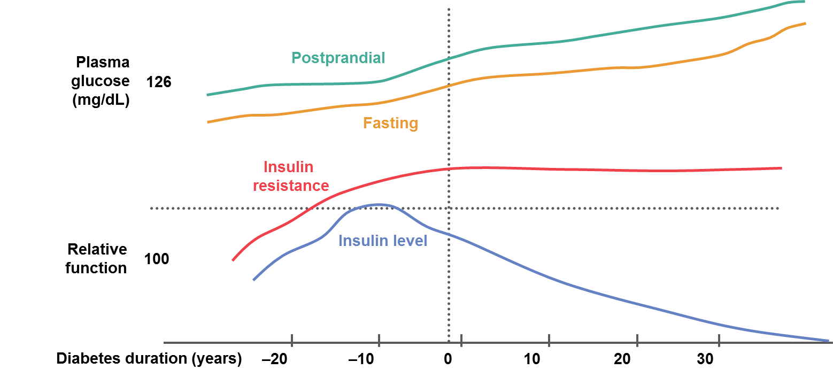
Insulin Resistance and Type 2 Diabetes
Obesity
IGT
Diabetes
(Uncontrolled)
Prediabetes
T2DM
Macrovascular complications
Microvascular complications
IGT, impaired glucose tolerance; T2D, type 2 diabetes
Adapted from Bergenstal RM, et al. Diabetes mellitus, carbohydrate metabolism and lipid disorders. In Endocrinology. 4th ed. 2001
Diabetes duration (years)
-20
-10
0
10
20
30
Notes:
There is a temporal relationship between insulin resistance, insulin secretion and the development of diabetes.
Obesity – particularly central obesity – is a known risk factor for type 2 diabetes^{1,2} and the risk of developing type 2 diabetes increases with increasing body mass index.
Insulin resistance is increased in obesity and is characterized by impaired glucose tolerance (IGT) and increased insulin secretion.³
In the early stages as insulin resistance increases, there is a compensatory increase in insulin secretion and the individual remains normoglycemic.⁴
The β-cells then begin to fail, insulin secretion falls, IGT and hyperglycaemia become apparent and frank type 2 diabetes develops.
Management strategies that target the underlying pathophysiology may be of particular benefit in the treatment of type 2 diabetes.
Therapies should afford long-term reduction of postprandial and fasting glucose levels.
Therapies should be included that reduce insulin resistance and improve β-cell function, thereby increasing insulin secretion.
1. Hu FB, et al. N Engl J Med 2001; 345:790–797.
2. Chan JM, et al. Diabetes Care 1994; 17:961–969.
3. Must A, et al. JAMA 1999; 282:1523–1529.
4. Reaven GM. Diabetes 1988; 37:1595–1607.

Slide 11

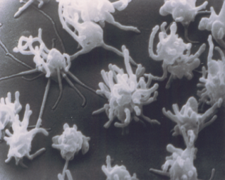
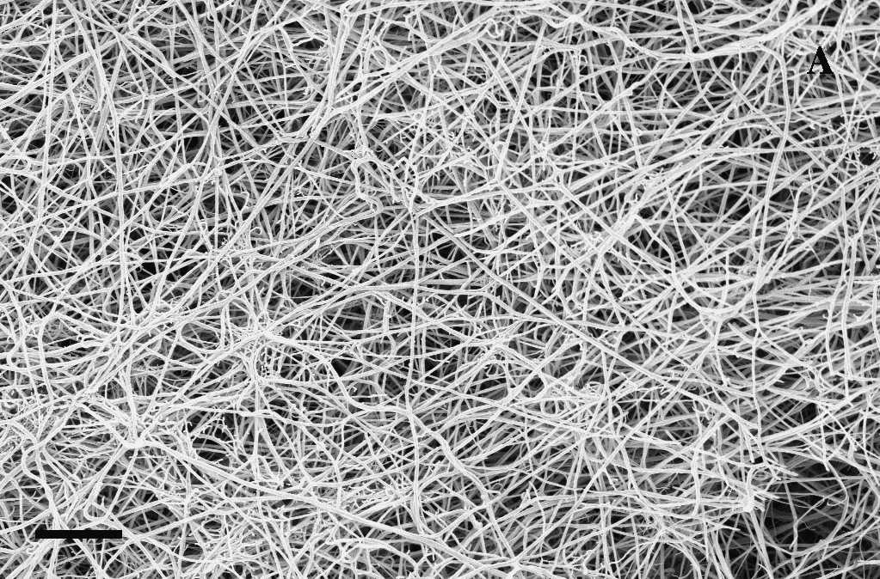
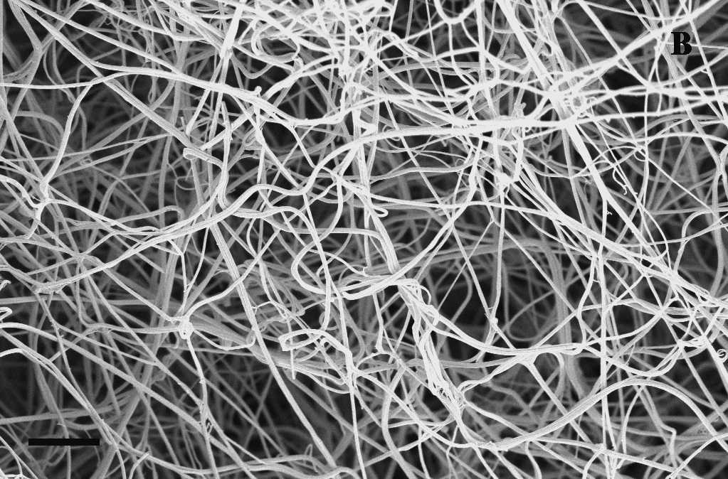
Insulin Resistance: An Inflammatory Athero-thrombotic Syndrome
Hyperinsulinaemia
Hyperglycaemia
Triglyceride
Insulin Resistance
INSULIN RESISTANCE
Cholesterol
PAI-1 tPA
Hypertension
Factor VII Factor XII
CRP
Monocytes
Cytokines
Adhesion Molecules
Smoking
Fibrinogen
CRP, C-reactive protein; PAI-1, plasminogen activator inhibitor‑1; tPA, tissue-type plasminogen activator

Slide 12
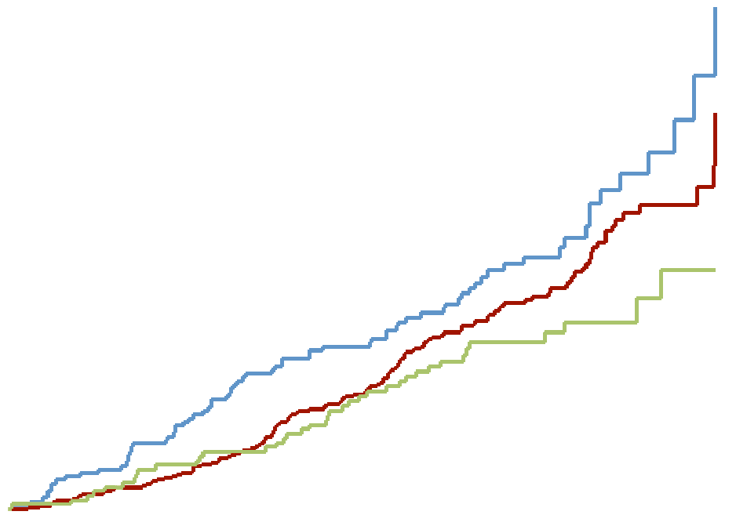
Evidence for Beneficial CV Effects of Metformin in Overweight Patients
Risk of MI is 39% lower with metformin vs conventional therapy in obese patients^{1,2}
Significant reduction in MI maintained over 10 years’ follow-up³
Myocardial infarction
Overall values at study end in 1997
30
Conventional (n = 411; events = 73)
Annual values during 10-year post-trial monitoring period
Intensive (n = 951; events = 139)
1.4
Metformin (n = 342; events = 39)
RR 0.61¹
p=0.01
RR 0.67
p=0.005
20
1.2
Proportion of patients
with events (%)
Metformin vs conventional
p=0.01
1.0
HR (95% CI)
0.8
10
0.6
0.4
0.0
 | 1997 | 1999 | 2001 | 2003 | 2005 | 2007
No. of events:
Conventional therapy | 73 | 83 | 92 | 106 | 118 | 126
Metformin | 39 | 45 | 55 | 64 | 68 | 81
0
3
6
9
12
15
Time from randomisation (years)
CI, confidence interval; CV, cardiovascular; HR, hazard ratio; MI, myocardial infarction; RR, risk ratio
Adapted from: 1. No authors listed. Lancet. 1998;352:854-65. 2. Metformin SmPC. Available from: http://www.medicines.org.uk/emc/medicine/23244/SPC. 3. Holman RR, et al. N Engl J Med. 2008;359:1577-89
Notes:
Notes
UKPDS provides evidence for the beneficial CV effects of metformin.
In UKPDS 34, the metformin group had a 39% lower risk of MI than the conventional treatment group (p = 0.01).¹
The significant reduction in MI risk was maintained over 10 years,² as shown in the right-hand figure where all the upper CI limits are below the HR = 1.0 line.
Metformin added to SU vs SU alone was associated with increased risk of diabetes-related death (RR of 1.96, p=0.039) and all-cause mortality (RR of 1.60 p=0.041).¹
Abbreviations
CV, cardiovascular; HR, hazard ratio; MI, myocardial infarction; RR, relative risk
(in original study¹); risk ratio (in follow-up study²); SU, sulphonylurea; UKPDS,
United Kingdom Prospective Diabetes Study.
References
Metformin 500 mg tablets. Summary of Product Characteristics. Aurobindo Pharma Milpharm Ltd. Available at: http://www.medicines.org.uk/emc/medicine/23244/SPC. Accessed 26 Jun 2015
Copyright
Holman et al. N Engl J Med 2008;359:1577–89. Figure 3D. Page 1585
UKPDS 34. Lancet 1998;352:854–65. Figure7. Page 847.

Slide 13
Steno-2: Benefits of a Multifactorial Approach in Reducing CV Events and Mortality over 13 Years
Active trial
Post-trial follow-up
80
HR 0.41 (p<0.001; 95% CI 0.25-0.67) at 13.3 years
70
60
50
Conventional therapy
Cumulative incidence
of any CV event (%)
40
30
Intensive therapy
20
10
0
0
1
2
3
4
5
6
7
8
9
10
11
12
13
Years
CI, confidence interval; CV, cardiovascular; HR, hazard ratio
Adapted from: Gaede P, et al. N Engl J Med. 2008;358:580-91
Notes:
13
In the Steno-2 study, patients with type 2 diabetes and microalbuminuria (n=160) were randomised to conventional treatment, based on national guidelines, or intensive treatment: reduced-fat diet, regular exercise, smoking-cessation counselling, vitamin supplementation, aspirin, stepwise antiglycaemic medication, angiotensin-converting enzyme inhibitor or angiotensin II-receptor blocker (all patients), additional stepwise antihypertension intervention (hypertensive patients) and lipid-modifying therapy (with statin and/or fibrate).¹
The mean treatment period was 7.8 years. Patients were then followed for a mean observational period of 5.5 years (for a total of 13.3 years) during which, structured treatment in the intensive group stopped and all patients were informed of the benefits of intensive, multifactorial treatment.^{1,2}
At 7.8 years, intensive intervention was associated with a significantly lower risk of cardiovascular disease (CVD) than conventional treatment (hazard ratio 0.47, 95% CI, 0.24 to 0.73; p=0.008)¹ and was sustained at 13.3 years (hazard ratio 0.41, 95% CI, 0.25 to 0.67; p<0.001).² A CVD event could include death from CV causes, non-fatal stroke, non-fatal myocardial infarction, coronary-artery bypass grafting, percutaneous coronary intervention or revascularisation for peripheral atherosclerotic artery disease and amputation due to ischaemia.^{1,2}
Gæde P, et al. N Engl J Med 2003;348:383–393.
Gæde P, et al. N Engl J Med 2008;358:580–591.

Slide 14
Achievement of guideline targets for blood pressure, lipid, and glycaemic control in type 2 diabetes: A meta-analysis
~ 370,000 individual’s data from 24 studies in 20 countries
ADA targets for HBA1C, BP, LDL-C, HDL-C
43% achieved HBA1C target
29% attained the BP target
49% had LDL-C to goal
58% achieved HDL-C goal
No change by year
ADA, American Diabetes Association; BP, blood pressure; HbA1c, glycated haemoglobin A1C, HDL-C, high-density lipoprotein cholesterol; LDL-C, low-density lipoprotein cholesterol
Khunti K, et al. Diabetes Res Clin Pract. 2018;137:137-48

Slide 15
Impact of kidney disease in T2D
Mortality excess is largely confined to those with CKD
15.7×
Patients with healthy kidneys do very well despite diabetes
Age-standardised
mortality ratio
8×
6×
2.8×
1.3×
Population
All diabetes
No kidney problems
Albuminuria
eGFR
Both
----------Chronic kidney disease ----------
CKD, chronic kidney disease; eGFR, estimated glomerular filtration rate
Adapted from: Afkarian et al. J Am Soc Nephrol. 2013;24:302-8

Slide 16

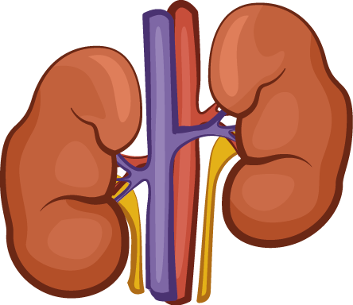
Diabetes, CVD and Renal Disease: The Deadly Triad
T2D/hyperglycaemia
Glucose, AGEs, lipids,
BP, ROS, inflammation, fibrosis, RAAR, SNS
Acute or chronic disorder of one…
SGLT2i +++
SGLT2i +++
…can induce dysfunction in the other
Renal and cardiac systems are inextricably linked and should be considered together
AGE, advanced glycation end-product; BP, blood pressure; CVD, cardiovascular disease; RAAS, renin-angiotensin-aldosterone system; ROS, reactive oxygen species; SGLT2, sodium-glucose cotransporter-2;
SNS, sympathetic nervous system; T2D, type 2 diabetes
Adapted from: 1. Maqbool M, et al. Semin Nephrol. 2016;38:217-32. 2. Ronco C, et al. J Am Coll Cardiol. 2008;52:1527-39

Slide 17

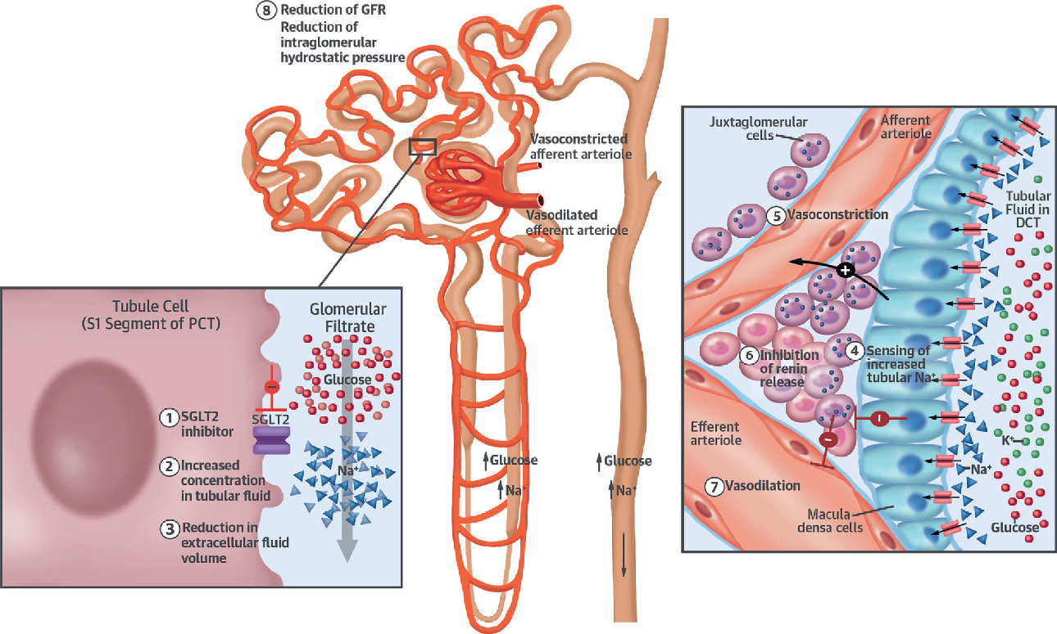
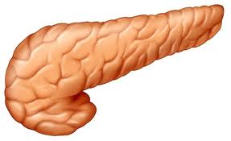

The New Diabetes Therapies
The Incretin System
Renal SGLT2 system
Satiety
DPPIV
Insulin
secretion
GLP-1
Satiety
DCT, distal convoluted tubule; DPPIV, dipeptidyl peptidase-4; GFR, glomerular filtration rate; GLP-1, glucagon-like peptide 1; PCT, proximal convoluted tubule; SGLT2, sodium-glucose cotransporter-2

Slide 18
Summary of Earlier CVOTS for Newer T2DM Agents
SAVOR-TIMI 53¹
Primary endpoint Hazard ratio
CVD or CRFs
HbA_{1c} 6.5–12.0%
n=16,492
Saxagliptin
2.1 year median follow-up
3P-MACE
1.00
(95% CI 0.89–1.12)
p=0.99
Placebo
EXAMINE²
ACS
HbA_{1c} 6.5–11.0%
n=5380
Alogliptin
1.5 year median follow-up
3P-MACE
0.96
(upper CI* 1.16)
p=0.315
Placebo
TECOS³
3.0 year median follow-up
CVD
HbA_{1c} 6.5–8.0%
n=14,735
Sitagliptin
4P-MACE
0.98
(95% CI 0.88–1.09)
p=0.645 (superiority)
Placebo
ELIXA⁴
ACS
HbA_{1c} 5.5–11%
n=6068
Lixisenatide
2.1 year median follow-up
4P-MACE
1.02
(95% CI 0.89–1.17)
Placebo
Randomisation
1
2
3 years of median follow-up
ª Upper boundary of 1-sided repeated CI
3/4P-MACE, 3/4-point major adverse cardiovascular events; ACS, acute coronary syndromes; CI, confidence interval; CRF, chronic renal failure; CVD, cardiovascular disease; CVOT, cardiovascular outcomes trial; HbA1c, glycated haemoglobin A1C; HR, hazard ratio
Adapted from: 1. Scirica BM, et al. N Engl J Med. 2013;369:1317-26. 2. White WB, et al. N Engl J Med. 2013;369:1327-35. 3. Green JB, et al. N Engl J Med 2015 373:232-42.
4. Pfeffer MA, et al. Presented at ADA 2022 (oral presentation)
Notes:
Abbreviations
ACS, acute coronary syndrome; CI, confidence interval; CRF, chronic renal failure; CVD, cardiovascular disease; CVOT, cardiovascular outcomes trial; DPP4, dipeptidyl peptidase 4; ELIXA, Evaluation of Lixisenatide in Acute Coronary Syndrome; EXAMINE, Examination of Cardiovascular Outcomes with Alogliptin Versus usual care; HbA_{1C}, glycosylated haemoglobin; 3P-MACE, 3-point major adverse CV events (CV death, non-fatal myocardial infarction or non-fatal stroke); 4P-MACE, 4-point major adverse cardiovascular events (CV death, non-fatal myocardial infarction, non-fatal stroke or unstable angina requiring hospitalisation); SAVOR-TIMI 53, Saxagliptin Assessment of Vascular Outcomes Recorded in Patients with Diabetes Mellitus – Thrombolysis in Myocardial Infarction 53; T2D, Type 2 Diabetes; TECOS, Trial Evaluating Cardiovascular Outcomes with Sitagliptin.

Slide 19
Effects of GLP-1 RA on Weight and Glycaemia
A)
Short-acting
Long-acting
D)
0.0
-0.6
y=0.611 × -0.102
r²=0.890
p=0.0004
-0.2
-0.8
-0.4
-0.6
-1.0
-0.8
HbA_{1c} reduction
vs baseline (%)
HbA_{1c} reduction
vs baseline (%)
-1.0
-1.2
-1.2
-1.4
-1.4
-1.6
-1.6
-1.8
-1.8
-2.0
-2.0
B)
Short-acting
Long-acting
Exenatide b.i.d
Lixisenatide
Liraglutide
Exenatide o.w.
Dulaglutide
Albiglutide
Semaglutide s.c.
Oral semglutide
-3.0
-2.5
-2.0
-1.5
-1.0
Exenatide b.i.d
Lixisenatide
Liraglutide
Exenatide o.w.
Dulaglutide
Albiglutide
Semaglutide s.c.
Oral semaglutide
0.0
Fasting plasma glucose reduction
vs baseline (mmol/l)
-0.5
-1.0
Fasting plasma glucose
reduction vs baseline (%)
p=0.016
-1.5
E)
-2.0
1200
-2.5
1000
-3.0
800
600
400
C)
Short-acting
Long-acting
200
0
180
-1
160
-2
140
120
Body weight reduction
vs baseline (kg)
HbA_{1c} reduction
vs baseline (%)
-3
100
-4
80
-5
60
-6
40
-7
20
0
HbA_{1c}
reduction
Body weight
reduction
b.i.d., twice daily; GLP-1 RA, glucagon-like peptide 1 receptor agonist; o.w./q.w., once weekly; s.c. subcutaneous
Nauck MA, et al. Mol Metab. 2021;46:101102

Slide 20
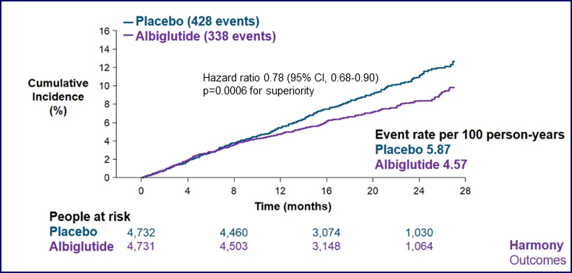
CVOTs with GLP-1 receptor agonists
(3P-MACE endpoint
LEADER¹
SUSTAIN-6²
HARMONY³
REWIND⁴
PIONEER-6⁵
3P-MACE, 3-point major adverse cardiovascular events; CI, confidence interval; CVOT, cardiovascular outcomes trial; GLP-1 RA, glucagon-like peptide 1 receptor agonist; HR, hazard ratio
1. Marso SP, et al. N Engl J Med. 2016;375:311-22. 2. Marso P, et al. N Engl J Med. 2016;375:1834-44. 3. Hernandez AF, et al. Lancet. 2018;392:151-29. 4. Gerstein HC, et al. Lancet. 2019;394:121-30.
5. Husain M, et al. N Engl J Med. 2019;381:841-51

Slide 21
GLP-1RA and Cardiorenal outcomes in T2DM:
A Metanalysis of eight CVOTs
MACE
Study | Favours GLP-1RA | HR with 95% CI | Weight (%)
1: History of CVD
LEADER |  | 0.83 (0.74-0.93) | 20.87
SUSTAIN-6 |  | 0.72 (0.55-0.94) | 5.78
EXSCEL |  | 0.90 (0.81-0.99) | 24.07
REWIND |  | 0.87 (0.74-1.02) | 13.34
PIONEER 6 |  | 0.83 (0.58-1.18) | 3.54
AMPLITUDE-O |  | 0.71 (0.57-0.89) | 7.62
Heterogeneity: T² = 0.00, I² = 6.12%, H² = 1.07 Test of 𝚹_{i} = 𝚹_{j}: Q(5) = 5.35, p=0.37 |  | 0.84 (0.79-0.90)
2: No history of CVD
LEADER |  | 1.20 (0.86-1.67) | 3.93
SUSTAIN-6 |  | 1.00 (0.41-2.44) | 0.58
EXSCEL |  | 0.99 (0.77-1.28) | 6.34
REWIND |  | 0.87 (0.74-1.02) | 13.34
PIONEER 6 |  | 0.51 (0.15-1.71) | 0.32
AMPLITUDE-O |  | 1.71 (0.48-6.08) | 0.29
Heterogeneity: T² = 0.00, I² = 0.00%, H² = 1.00 Test of 𝚹_{i} = 𝚹_{j}: Q(5) = 4.99, p=0.42 |  | 0.94 (0.83-1.06)
Test of group differences: Q(1) = 2.33, p=0.13
Random-effects empirical Bayes model
0.25
0.50
0.75
1.00
1.50
2.00
CI, confidence interval; CVD, cardiovascular disease; CVOT, cardiovascular outcomes trial; GLP-1 RA, glucagon-like peptide 1 receptor agonist; HR, hazard ratio; MACE, major adverse cardiovascular events;
T2D, type 2 diabetes
Giugliano D, et al. Cardiovasc Diabetol. 2021;20:189

Slide 22
GLP-1RA and Cardiorenal outcomes in T2DM:
A Metanalysis of eight CVOTs
CV MORTALITY
NON-FATAL STROKE
Study | Favours GLP-1RA | HR with 95% CI | Weight (%)
ELIXA |  | 0.98 (0.78-1.23) | 12.30
LEADER |  | 0.78 (0.66-0.93) | 19.08
SUSTAIN-6 |  | 0.98 (0.65-1.48) | 4.31
EXSCEL |  | 0.88 (0.76-1.02) | 23.57
HARMONY |  | 0.93 (0.73-1.19) | 10.95
REWIND |  | 0.91 (0.78-1.06) | 22.30
PIONEER 6 |  | 0.49 (0.27-0.90) | 2.01
AMPLITUDE-O |  | 0.72 (0.50-1.03) | 5.48
Overall Heterogeneity: T² = 0.00, I² = 18.69%, H² = 1.23 Test of 𝚹_{i} = 𝚹_{j}: Q(7) = 7.99, p=0.33 |  | 0.87 (0.78-0.96)
Study | Favours GLP-1RA | HR with 95% CI | Weight (%)
ELIXA |  | 1.12 (0.79-1.58) | 8.31
LEADER |  | 0.89 (0.72-1.11) | 21.32
SUSTAIN-6 |  | 0.61 (0.38-0.98) | 4.45
EXSCEL |  | 0.85 (0.70-1.03) | 26.77
HARMONY |  | 0.86 (0.65-1.13) | 13.06
REWIND |  | 0.76 (0.61-0.95) | 20.35
PIONEER 6 |  | 0.74 (0.35-1.57) | 1.77
AMPLITUDE-O |  | 0.80 (0.48-1.32) | 3.96
Overall Heterogeneity: T² = 0.00, I² = 0.00%, H² = 1.00 Test of 𝚹_{i} = 𝚹_{j}: Q(7) = 5.64, p=0.58 |  | 0.84 (0.76-0.94)
0.50
0.75
1.00
1.25
1.50
0.50
0.75
1.00
1.25
1.50
Random-effects empirical Bayes model
Knapp-Hartung standard errors
Random-effects empirical Bayes model
Knapp-Hartung standard errors
CI, confidence interval; CV, cardiovascular; CVOT, cardiovascular outcomes trial; GLP-1 RA, glucagon-like peptide 1 receptor agonist; HR, hazard ratio; MACE, major adverse cardiovascular events;
T2D, type 2 diabetes
Giugliano D, et al. Cardiovasc Diabetol. 2021;20:189

Slide 23
GLP-1RA and Cardiorenal outcomes in T2DM:
A Metanalysis of eight CVOTs
RENAL ENDPOINTS
MACROALBUMINURIA
Study | Favours GLP-1RA | HR with 95% CI | Weight (%)
ELIXA |  | 1.16 (0.74-1.82) | 4.23
LEADER |  | 0.78 (0.67-0.91) | 21.32
SUSTAIN-6 |  | 0.64 (0.46-0.89) | 7.55
EXSCEL |  | 0.88 (0.76-1.01) | 24.02
REWIND |  | 0.85 (0.77-0.93) | 33.84
AMPLITUDE-O |  | 0.77 (0.58-1.03) | 9.05
Overall Heterogeneity: T² = 0.00, I² = 36.52%, H² = 1.58 Test of 𝚹_{i} = 𝚹_{j}: Q(5) = 6.30, p=0.28 |  | 0.83 (0.73-0.94)
Study | Favours GLP-1RA | HR with 95% CI | Weight (%)
ELIXA |  | 0.81 (0.66-0.99) | 14.16
LEADER |  | 0.74 (0.60-0.91) | 13.48
SUSTAIN-7 |  | 0.54 (0.37-0.78) | 4.64
EXSCEL |  | 0.79 (0.64-0.97) | 13.52
REWIND |  | 0.77 (0.68-0.87) | 32.90
AMPLITUDE-O |  | 0.68 (0.58-0.80) | 21.29
Overall Heterogeneity: T² = 0.00, I² = 11.05%, H² = 1.12 Test of 𝚹_{i} = 𝚹_{j}: Q(5) = 5.44, p=0.37 |  | 0.74 (0.67-0.82)
0.50
0.75
1.00
1.25
1.50
0.50
0.75
1.00
1.25
1.50
Random-effects empirical Bayes model
Knapp-Hartung standard errors
Random-effects empirical Bayes model
Knapp-Hartung standard errors
CI, confidence interval; CVOT, cardiovascular outcomes trial; GLP-1 RA, glucagon-like peptide 1 receptor agonist; HR, hazard ratio; MACE, major adverse cardiovascular events; T2D, type 2 diabetes
Giugliano D, et al. Cardiovasc Diabetol. 2021;20:189

Slide 24
Effects of Empagliflozin on Cardiovascular Outcomes
HR: 0.86
(0.74-0.99)
(p<0.04)
HR: 0.68
(0.57-0.82)
(p<0.001)
HR: 0.62
(0.49-0.77)
(p<0.001)
HR: 0.65
(0.50-0.85)
(p=0.002)
HR: 0.66
(0.55-0.79)
(p<0.001)
-1.6% ARR
-2.6% ARR
-2.8% ARR
-2.2% ARR
Incidence (%)
-1.4% ARR
HR indicated with 95% CIs; HR for 3P-MACE indicated with 95.02% CIs
3P-MACE, 3-point major adverse cardiovascular events; ARR, absolute risk reduction; CV, cardiovascular; HR, hazard ratio
Adapted from: Zinman B, et al. N Engl J Med. 2015;373:2117-28

Slide 25
CVOTs with SGLT2 inhibitors (3P-MACE endpoint)
EMPA-REG OUTCOME
CANVAS PROGRAM²
DECLARE³
20
20
HR: 0.86 (95% CI, 0.75-0.97)
p<0.0001 for noninferiority
p=0.0158 for superiority
Placebo
100
10
HR: 0.93 (95% CI, 0.84-1.03)
p=0.17 for superiority
Placebo
18
90
9
16
80
8
Placebo
15
14
70
7
HR: 0.86 (95% CI, 0.74-0.99)
p=0.04 for superiority
12
Canagliflozin
60
6
Dapagliflozin
Patients with an event (%)
Patients with an event (%)
5
Cumulative incidence (%)
10
Empagliflozin
10
50
4
8
40
3
6
30
2
5
1
4
20
0
0
180
360
540
720
900
1080
1260
1440
2
10
0
0
0
0
6
12
18
24
30
36
42
48
0
1
2
3
4
5
6
0
180
360
540
720
900
1080
1260
1440
Months
Years since randomisation
Days
3P-MACE, 3-points major adverse cardiovascular events; CVOT, cardiovascular outcomes trial; SGLT2, sodium-glucose cotransporter-2
1. Zinman B, et al. N Engl J Med. 2015;373:2117-28. 2. Neal B, et al. N Engl J Med. 2017;377:644-57. 3. Wiviott SD, et al. N Engl J Med. 2018;380:347-57

Slide 26
CVOTs with SGLT2 inhibitors (HF hospitaliSation and CV death)
EMPA-REG OUTCOME¹
CANVAS PROGRAM²
15
HR: 0.66 (95% CI, 0.55-0.79)
p<0.001
20
Placebo
18
HR: 0.78 (95% CI, 0.67-0.91)
16
10
14
Placebo
Patients with
an event (%)
12
Empagliflozin
Patients with
an event (%)
10
5
8
6
Canagliflozin
4
0
2
0
0
6
12
18
24
30
36
42
48
0
1
2
3
4
5
6
No. of patients
Empagliflozin
Placebo
Months
No. of patients
Placebo
Canagliflozin
Years since randomisation
4687
2333
4614
2271
4523
2226
4427
2173
3988
1932
2950
1424
2487
1202
1634
775
395
168
5795
4347
5655
4202
4442
3015
2647
1281
2577
1242
2503
1184
1782
831
DECLARE³
100
6
HR: 0.83 (95% CI, 0.73-0.95)
p=0.005 for superiority
90
5
Placebo
80
4
70
60
Cumulative incidence (%)
3
Dapagliflozin
50
2
40
1
30
20
0
0
180
360
540
720
900
1080
1260
1440
10
0
0
180
360
540
720
900
1080
1260
No. of patients
Placebo
Dapagliflozin
Days
8578
8582
8485
8517
8387
8415
8259
8322
8127
8224
8003
8110
7880
7970
7367
7497
5362
5445
CI, confidence interval; CV, cardiovascular; CVOT, cardiovascular outcomes trial; HF, heart failure; HR, hazard ratio; SGLT2, sodium-glucose cotransporter-2
1. Zinman B, et al. N Engl J Med. 2015;373:2117-28. 2. Neal B, et al. N Engl J Med. 2017;377:644-57. 3. Wiviott SD, et al. N Engl J Med. 2018;380:347-57

Slide 27
Effects of Empagliflozin on eGFR over 4 years
78
76
74
Empagliflozin, 10 mg
Adjusted mean eGFR (ml/min/1.73 m²)
72
Empagliflozin, 25 mg
70
Placebo
68
66
Baseline
4
12
28
52
66
80
94
108
122
136
150
164
178
192
Week
No. at risk
Placebo
Empagliflozin, 10 mg
Empagliflozin, 25 mg
2323 | 2295 | 2267 | 2205 | 2121 | 2064 | 1927 | 1981 | 1763 | 1479 | 1262 | 1123 | 977 | 731 | 448
2322 | 2290 | 2264 | 2235 | 2162 | 2114 | 2012 | 2064 | 1839 | 1540 | 1314 | 1180 | 1024 | 785 | 513
2322 | 2288 | 2269 | 2216 | 2156 | 2111 | 2006 | 2067 | 1871 | 1563 | 1340 | 1207 | 1063 | 838 | 524
eGFR, estimated glomerular filtration rate
Kraus, B. et al. Kidney International. 2020;99:750 - 762

Slide 28
CREDENCE: Canagliflozin and Renal Outcomes in Type Diabetes and Nephropathy
Primary Outcome ESKD, Doubling of Serum Creatinine, or Renal
or CV Death
Hazard ratio, 0.70 (95% CI, 0.59-0.82)
P=0.00001
340 participants
4401 patients with T2D and CKD
(eGFR 30 to <90 mL/min/1.73 m²)
Follow up: 2.6 years
245 participants
Participants with an event (%)
Placebo
Canagliflozin
Weeks since randomization
No. at risk
Placebo | 2199 | 2178 | 2132 | 2047 | 1725 | 1129 | 621 | 170
Canagliflozin | 2202 | 2181 | 2145 | 2081 | 1786 | 1211 | 646 | 196
CI, confidence interval; CKD, chronic kidney disease; eGFR, estimated glomerular filtration rate; ESKD, end-stage kidney disease; HR, hazard ratio; T2D, type 2 diabetes
Adapted from: Perkovic V, et al. N Engl J Med. 2019;380:2295-306

Slide 29
Cardiovascular and Renal Outcomes with Empagliflozin in Heart Failure
PRIMARY OUTCOME
100
35
Hazard ratio, 0.75 (95% CI, 0.65-0.86)
p<0.001
Placebo
90
30
Empagliflozin
80
25
70
20
60
15
Estimated cumulative
incidence (%)
10
0
50
5
40
0
0
90
180
270
360
450
540
630
720
810
-1
Placebo
30
Empagliflozin
-2
20
10
-3
0
Adjusted mean change from baseline in eGFR (ml/min/1.73 m²)
Empagliflozin
0
90
180
270
360
450
540
630
720
810
-4
No. at risk
Placebo
Empagliflozin
Days since randomisation
-5
1867
1863
1715
1763
1612
1677
1345
1423
1108
1172
854
909
611
645
410
423
224
231
109
101
-6
FIRST AND RECURRENT HOSPITALISATIONS FOR HEART FAILURE
-7
Between group difference in slope,
1.73 ml per min per 1.73 m² per yr;
p<0.001
0.6
Hazard ratio, 0.70 (95% CI, 0.58-0.85)
p<0.001
0.5
-8
Placebo
-9
0.4
Empagliflozin
Baseline
4
12
32
52
76
100
124
Mean number of events
per patient
Days since randomisation
0.3
No. at risk
Placebo
Empagliflozin
0.2
1792
1799
1765
1782
1683
1720
1500
1554
1146
1166
745
753
342
356
76
80
0.1
0.0
0
90
180
270
360
450
540
630
720
810
No. at risk
Placebo
Empagliflozin
Days since randomisation
1867
1863
1820
1826
1762
1768
1526
1532
1285
1283
1017
1008
732
732
497
495
175
272
135
118
Packer M, et al. New Engl J Med. 2020;383:1413-24

Slide 30
Meta-analysis of Cardiovascular and Renal Outcomes in EMPA-REG, CANVAS and DECLARE
34,322 T2DM (60% with ASCD), 3342 MACE, 2028 CV deaths/HHF and 776 renal composite endpoints.
MACE reduced by 11% (p=0.0014)
MACE benefit only seen in those with established ASCD
CV death/HHF reduced by 23% (p<0.0001)
CV death/HHF benefit seen in those with and without CVD/HF
Renal disease progression reduced by 45% (p<0.0001)
Renal effects greater in those with less severe impairment
ASCD, atherosclerotic coronary disease; CV, cardiovascular; CVD, cardiovascular disease; HF, heart failure; HHF, hospitalisation for heart failure; MACE, major cardiovascular adverse events
Zelniker TA, et al. Lancet. 2019;393:31-9

Slide 31
Risk of cardiovascular outcomes in T2DM following addition of SGLT2 inhibitors versus sulfonylureas to baseline GLP-IRA therapy
0.05
P-value for log-rank test = <0.001
0.04
Sulfonylureas
0.03
Cumulative incidence for HF
hospitalisations
0.02
SGLT2 inhibitors
0.01
0
0
3
6
9
12
15
18
21
Months since cohort entry
GLP-1 RA, glucagon-like peptide 1 receptor agonist; SGLT2, sodium-glucose cotransporter-2; T2D, type 2 diabetes
Dave CV, et al. Circulation. 2021;143:770-9

Slide 32
A Systematic Review and Network Meta-Analysis of Pharmacological Treatment of Heart Failure With Reduced Ejection Fraction
B)
Treatment | Mortality or HF hospitalisation | HR (95% CI)
ARNI + BB + MRA + SGLT2 ARNI + BB + MRA + Vericiguat ARNI + BB + MRA + Omecamtiv ACEI + BB + MRA + IVA ACEI + BB + MRA + Vericiguat ACEI + ARB + BB + Dig ARNI + BB + MRA ACEI + BB + MRA ARB + BB ARNI + BB ACEI + BB ACEI + BB + Dig ACEI + Dig BB |  | 0.36 (0.29-0.46) 0.43 (0.34-0.55) 0.44 (0.35-0.56) 0.49 (0.39-0.61) 0.54 (0.43-0.67) 0.73 (0.62-0.85) 0.47 (0.38-0.58) 0.58 (0.47-0.71) 0.65 (0.55-0.77) 0.68 (0.58-0.79) 0.84 (0.73-0.96) 0.84 (0.73-0.96) 1.00 0.75 (0.65-0.87)
RELATIVE RISK REDUCTION OF DIFFERENT
PHARMACOLOGICAL TREATMENT COMBINATIONS
FOR HEART FAILURE
A)
Treatment | All-cause mortality | HR (95% CI)
ARNI + BB + MRA + SGLT2 ARNI + BB + MRA + Vericiguat ARNI + BB + MRA + Omecamtiv ACEI + BB + Dig + ISDN ACEI + BB + MRA + IVA ACEI + BB + MRA + Vericiguat ACEI + BB + MRA + Omecamtiv ARNI + ARB + BB + Dig ARNI + BB + MRA ACEI + BB + MRA ACEI + MRA + Dig ACEI + BB + Dig ARB + BB + Dig ACEI + ARB + Dig Dig + H-ISDN ARNI + BB ACEI + BB ARB + BB ACEI + Dig ARB + Dig BB ACEI ARB Dig PLBO |  | 0.39 (0.31-0.49) 0.41 (0.32-0.53) 0.44 (0.36-0.55) 0.46 (0.35-0.61) 0.48 (0.39-0.58) 0.49 (0.39-0.62) 0.52 (0.43-0.63) 0.65 (0.55-0.76) 0.44 (0.37-0.54) 0.52 (0.44-0.61) 0.66 (0.56-0.78) 0.68 (0.59-0.78) 0.73 (0.64-0.83) 0.83 (0.72-0.96) 0.67 (0.53-0.86) 0.58 (0.50-0.68) 0.69 (0.61-0.77) 0.74 (0.66-0.82) 0.87 (0.78-0.98) 0.94 (0.84-1.05) 0.78 (0.72-0.84) 0.89 (0.82-0.96) 0.95 (0.88-1.02) 0.99 (0.91-1.07) 1.00
0.25
0.5
1
2
C)
Treatment | CV mortality | HR (95% CI)
ARNI + BB + MRA + SGLT2 ARNI + BB + MRA + Vericiguat ARNI + BB + MRA + Omecamtiv ACEI + BB + MRA + IVA ACEI + BB + MRA + Vericiguat ACEI + BB + MRA + Omecamtiv ACEI + BB + Dig + H-ISDN ARNI + BB + MRA ACEI + BB + MRA ACEI + ARB + BB + Dig ACEI + MRA + Dig ACEI + BB + Dig ACEI + BB ARB + BB ACEI + Dig Dig + H-ISDN ARA + Dig BB ACEI ARB PLBO Dig |  | 0.33 (0.26-0.43) 0.35 (0.26-0.47) 0.36 (0.27-0.46) 0.43 (0.35-054) 0.44 (0.33-0.57) 0.44 (0.35-0.56) 0.57 (0.37-0.88) 0.38 (0.31-0.47) 0.47 (0.39-0.57) 0.57 (0.47-0.70) 0.62 (0.52-0.74) 0.65 (0.56-0.76) 0.64 (0.56-0.73) 0.68 (0.59-0.78) 0.84 (0.75-0.96) 0.88 (0.58-1.34) 0.89 (0.78-1.02) 0.77 (0.70-0.85) 0.83 (0.76-0.91) 0.88 (0.80-0.98) 1.00 1.10 (0.93-1.10)
0.25
0.5
1
2
Tromp J, et al. J Am Coll Cardiol HF. 2022;10(2):73-84
0.2
0.5
1
2

Slide 33
Empagliflozin reduces risk of CV outcomes irrespective of baseline glucose-lowering therapy
EMPA-REG OUTCOME
CV death
HHF
 | Empagliflozin | Placebo | Empagliflozin vs placebo events per 100 pt-years | HR (95% CI) | HR (95% CI) | Treatment by subgroup interaction
 | N with events/N (%)
CV death
All patients | 172/4,687 (3.7) | 137/2,333 (5.9) |  | 0.62 (0.49-0.77)
Metformin at baseline
Yes | 118/3,459 (3.4) | 84/1,734 (4.8) | 11.5 vs 16.4 | 0.71 (0.54-0.94) |  | P=0.07
No | 54/1,228 (4.4) | 53/599 (8.8) | 15.2 vs 31.5 | 0.46 (0.32-0.68)
SU at baseline
Yes | 67/2,014 (3.3) | 51/992 (5.1) | 11.1 vs 17.4 | 0.64 (0.44-0.92) |  | P=0.85
No | 105/2,673 (3.9) | 86/1,341 (6.4) | 13.4 vs 22.2 | 0.61 (0.46-0.81)
Insulin at baseline
Yes | 93/2,252 (4.1) | 74/1,135 (6.5) | 14.2 vs 22.8 | 0.63 (0.46-0.85) |  | P=0.92
No | 79/2,435 (3.2) | 63/1,198 (5.3) | 10.8 vs 17.7 | 0.61 (0.44-0.85)
 | Empagliflozin | Placebo | Empagliflozin vs placebo events per 100 pt-years | HR (95% CI) | HR (95% CI) | Treatment by subgroup interaction
 | N with events/N (%)
Hospitalisation for heart failure
All patients | 126/4,687 (2.7) | 95/2,333 (4.1) |  | 0.65 (0.5-0.85)
Metformin at baseline
Yes | 79/3,459 (2.3) | 59/1,734 (3.4) | 7.9 vs 11.9 | 0.68 (0.49-0.95) |  | P=0.61
No | 47/1,228 (3.8) | 36/599 (6.0) | 13.6 vs 22.6 | 0.59 (0.38-0.91)
SU at baseline
Yes | 40/2,014 (2.0) | 30/992 (3.0) | 6.8 vs 10.5 | 0.65 (0.40-1.04) |  | P=0.95
No | 86/2,673 (3.2) | 65/1,341 (4.8) | 11.4 vs 17.5 | 0.66 (0.48-0.91)
Insulin at baseline
Yes | 84/2,252 (3.7) | 61/1,135 (5.4) | 13.2 vs 19.6 | 0.68 (0.49-0.94) |  | P=0.72
No | 42/2,435 (1.7) | 34/1,198 (2.8) | 5.9 vs 9.8 | 0.61 (0.39-0.96)
B)
0.25
0.5
1
2
0.25
0.5
1
2
Favours empagliflozin
Favours placebo
Favours empagliflozin
Favours placebo
 | EMPA REG OUTCOME | CANVAS program | DECLARE | CREDENCE
Metformin use (%) | 74 | 77 | 82 | 58
CV, cardiovascular; HHF, hospitalization for heart failure
Inzucchi SE, et al. Diabetes Obes Metab. 2020;105:3025-35

Slide 34
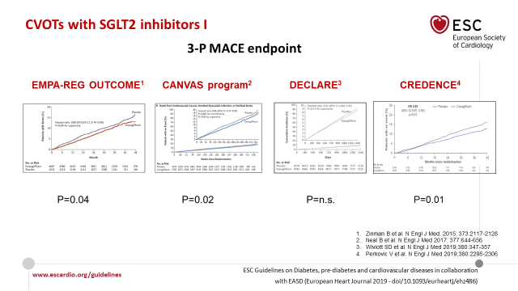
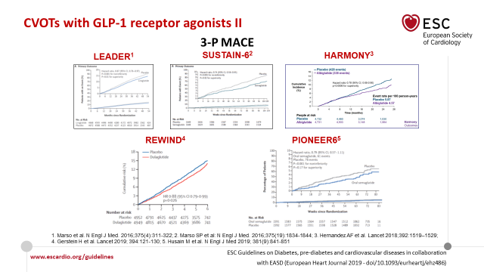
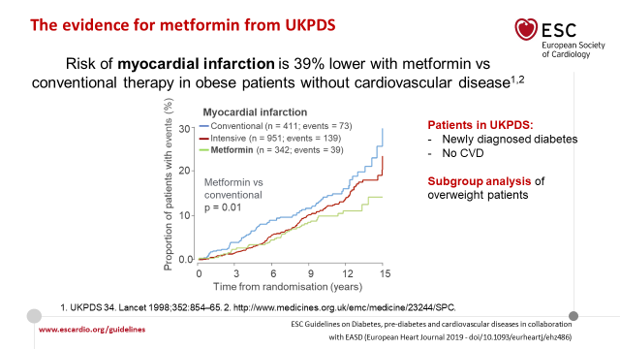
Treatment algorithm in drug-naïve patients with Type 2 Diabetes
+
ASCVD, or high/very high
CV risk (target organ damage or multiple risk factors)
-
SGLT2i or GLP-1 RA
monotherapy
Metformin monotherapy
ASCVD, or high/very high
CV risk (target organ damage
or multiple risk factors)
If HbA_{Ic} above target
If HbA_{Ic} above target
+
-
Add metformin
DPP-4i
GLP-I RA
SGLT2i
if eGFR
adequate
TZD
SGLT2i or GLP-1 RA
monotherapy
Metformin monotherapy
SGLT2i or GLP-1 RA
Monotherapy
If HbA_{Ic} above target
If HbA_{Ic} above target
Consider the adding the other class (GLP-I RA or SGLT2i with proven CVD benefit
DPP-4i if not on
GLP-I RA
Basal insulin
TZD (not in HF pat)
SU
SGLT2i
or
TZD
SGLT2i
or
TZD
GLP-I RA
or DPP-4i
or TZD
SGLT2i or
DPP-4i or
GLP-I RA
If HbA_{Ic} above target
Continue with addition of other agents as outlined above
If HbA_{Ic} above target
Consider the addition of sulphonylureas OR basal insulin:
Choose later generation SU with lower risk of hypoglycaemia
Consider basal insulin with lower risk of hypoglycaemia
3P-MACE, 3-point major adverse cardiovascular events; ASCVD, atherosclerotic cardiovascular disease; CV, cardiovascular; GLP-1 RA, glucagon-like peptide 1 receptor agonist;
SGLT2, sodium-glucose cotransporter-2; T2D, type 2 diabetes
Cosentino F, et al. Eur Heart J. 2020;41:255-323

Slide 35



Diabetes and cardiovascular disease: it’s time to apply the evidence
Cardiovascular disease
Diabetes mellitus
CLINICAL
PRESENTATION
Diabetes mellitus?
CVD?
SCREENING
CVD + Diabetes mellitus
Elevated risk:
3P-MACE
Heart failure mortality
PROGNOSIS
Therapy
Antiplatelet
therapy
LDL
lowering
Blood
pressure
lowering
SGLT2i
GLP-1RA
3P-MACE, 3-point major adverse cardiovascular events; CVD, cardiovascular disease; GLP-1 RA, glucagon-like peptide 1 receptor agonist; LDL, low-density lipoprotein (cholesterol);
SGLT2i, sodium-glucose cotransporter-2 inhibitor
Grant PJ, Marx N. Eur Heart J Acute Cardiovasc Care. 2020;9:586-8

Slide 36
Coronary Risk Prevention in Patients with T2 Diabetes
Gaetano Maria De Ferrari
Division of Cardiology, Department of Medical Science
Città della Salute e della Scienza, University of Turin

Slide 37
Survival Free of Death from CHD
100
80
60
Survival (%)
40
Nondiabetic subjects without prior MI
Diabetic subjects without prior MI
Nondiabetic subjects with prior MI
Diabetic subjects with prior MI
20
0
0
1
2
3
4
5
6
7
8
Year
CHD, coronary heart disease; MI, myocardial infarction
Haffner SM, et al. N Engl J Med. 1998;339:229-34

Slide 38
Incidence of Cardiovascular Death
Nondiabetic subjects
Subjects with type 2 diabetes
Events/100 person-year
Prior MI
No Prior MI
Prior MI
No Prior MI
CV, cardiovascular; MI, myocardial infarction; T2D, type 2 diabetes
Adapted from Haffner SM, et al. N Engl J Med. 1998;339:229-34

Slide 39
Incidence of Fatal and Nonfatal MI
Nondiabetic subjects
Subjects with type 2 diabetes
Events/100 person-year
Prior MI
No Prior MI
Prior MI
No Prior MI
CV, cardiovascular; MI, myocardial infarction; T2D, type 2 diabetes
Adapted from Haffner SM, et al. N Engl J Med. 1998;339:229-34

Slide 40
Type 2 diabetes as a ‘coronary heart disease equivalent’
An 18-year prospective population-based study in finnish subjects
1.0
0.8
DM+ MI+
0.6
CHD death
DM+ MI-
0.4
DM- MI+
0.2
DM- MI-
0.0
0
5
10
6
20
Year
CHD, coronary heart disease; DM, diabetes mellitus; MI, myocardial infarction
Juutilainen A, et al. Diabetes Care. 2005;28:2901-7

Slide 41
ATP, Adult Treatment Panel; CHD, coronary heart disease; LDL, low-density lipoprotein
National Cholesterol Education Program (NCEP) Expert Panel on Detection, Evaluation, and Treatment of High Blood Cholesterol in Adults
(Adult Treatment Panel III). Circulation. 2002;106:3143-421

Slide 42
T2DM vs. Prior MI on Odds of Fatal or Non-fatal MI
Study | Diabetes alone (No. of MI/ No. of subjects) | Prior MI alone (No. of MI/ No. of subjects) | Odds ratio (95% CI) | Odds ratio (95% CI) | Year
Lee et al. | 141/1460 | 59/283 |  | 0.41 (0.30-0.57) | 2004
Evans et al. | 113/1155 | 274/1347 |  | 0.42 (0.33-0.54) | 2002
Haffner et al. | 180/890 | 13/69 |  | 1.09 (0.58-2.04) | 1998
Hu FB, et al. | 161/3705 | 61/1302 |  | 0.92 (0.68-1.25) | 2001
Lotufo et al. | 89/2317 | 445/5906 |  | 0.49 (0.39-0.62) | 2001
Eberly et al. | 171/1122 | 177/658 |  | 0.49 (0.39-0.62) | 2003
Hu G, et al. | 159/962 | 373/1308 |  | 0.50 (0.40-0.61) | 2005
Cho et al. | 113/1285 | 364/2038 |  | 0.44 (0.35-0.55) | 2002
Wannamathee et al. | 36/202 | 140/517 |  | 0.58 (0.58-0.59) | 2004
Natarajan et al. | 35/178 | 92/300 |  | 0.55 (0.36-0.86) | 2003
Vaccaro et al. | 1087/4809 | 1468/4625 |  | 0.61 (0.56-0.67) | 2004
Pajunen et al. | 191/525 | 254/559 |  | 0.69 (0.54-0.88) | 2005
Natarajan et al. | 127/462 | 207/594 |  | 0.71 (0.54-0.92) | 2005
Total | 2603/19072 | 3927/19506 |  | 0.56 (0.53-0.60)
Random effects model Fixed effects model Test for heterogeneity | Odds ratio = 0.56 (0.53-0.60) odds ratio = 0.56 (0.53-0.60) I² = 75.0%
0.2
0.5
1
1.5
2
Favours diabetes as
not a CHD risk equivalent
Favours diabetes as
a CHD risk equivalent
CHD, coronary heart disease; CI, confidence interval; MI, myocardial infarction; T2DM, type 2 diabetes mellitus
Bulugahapitiya U, et al. Diabet Med. 2009:26:142-8

Slide 43
Adjusted HRs at 10 years for non CAD DM Patients vs. nondiabetic survivor of first MI
 |  |  | HR (95% CI)
 | Type 2 diabetes | AMI | All participants | Men | Women
N | 2,260 | 2,154
All-cause death | 289 (12.8) | 482 (22.4)* | 0.39 (0.32-0.46) | 0.44 (0.36-0.54) | 0.28 (0.20-0.39)
Coronary death | 41 (1.8) | 206 (9.6)* | 0.12 (0.08-0.18) | 0.16 (0.10-0.25) | 0.09 (0.05-0.17)
Stroke death | 24 (1.1) | 27 (1.3) | 0.66 (0.34-1.27) | 0.64 (0.32-1.31) | 0.82 (0.09-7.33)
Cardiovascular mortality | 99 (4.4) | 280 (13.0)* | 0.22 (0.17-0.28) | 0.26 (0.19-0.36) | 0.16 (0.10-0.26)
Unstable angina | 184 (8.1) | 145 (6.7) | 0.95 (0.74-1.23) | 1.24 (0.93-1.66) | 0.46 (0.29-0.72)
Nonfatal myocardial infarction | 126 (5.6) | 175 (8.1)* | 0.59 (0.45-0.77) | 0.72 (0.53-0.98) | 0.38 (0.24-0.61)
Fatal or nonfatal myocardial infarction | 161 (7.1) | 349 (16.2)* | 0.33 (0.27-0.41) | 0.41 (0.32-0.53) | 0.22 (0.16-0.32)
Coronary heart disease incidence | 296 (13.1) | 475 (22.1)* | 0.43 (0.36-0.51) | 0.54 (0.45-0.66) | 0.28 (0.21-0.37)
* p≤0.001; † Unstable angina or fatal or non-fatal AMI.
AMI, acute myocardial infarction; CAD, coronary artery disease; CI, confidence interval; DM, diabetes mellitus; HR, hazard ratio; MI, myocardial infarction
Cano JF, et al. Diabetes Care. 2010;33:2004-9

Slide 44
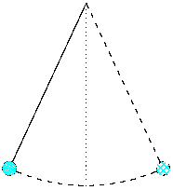
Relative to your coronary risk, better T2DM or previous MI?
Diabetes
Previous MI
MI, myocardial infarction; T2DM, type 2 diabetes mellitus

Slide 45

# 2
ESC 2019 Guidelines indicate a very high risk
and LDL-C goal of 55 mg/dL for which patients?
DM with major risk factor such as smoking
DM with organ damage such as proteinuria
DM with 3 major risk factors
B+C
CV, cardiovascular; DM, diabetes mellitus; ESC/EAS, European Society of Cardiology/European Atherosclerosis Society; MI, myocardial infarction
Mach F, et al. Eur Heart J. 2020;44:111-88

Slide 46
DM & CV Risk – ESC 2016 guidelines
Very-high-risk | Subjects with any of the following: Documented CVD, clinical or unequivocal on imaging. Documented clinical CVD includes previous AMI, ACS, coronary revascularisation and other arterial revascularisation procedures, stroke and TIA, aortic aneurysm and PAD. Unequivocally documented CVD on imaging includes significant plaque on coronary angiography or carotid ultrasound. It does NOT include some increase in continuous imaging parameters such as intima–media thickness of the carotid artery DM with target organ damage such as proteinuria or with a major risk factor such as smoking or marked hypercholesterolaemia or marked hypertension Severe CKD (GFR <30 mL/min/1.73 m²) A calculated SCORE ≥10%
High-risk | Subjects with: Markedly elevated single risk factors, in particular cholesterol >8 mmol/L (>310 mg/dL) (e.g. in familial hypercholesterolaemia) or BP ≥180/110 mmHg Most other people with DM (with the exception of young people with type 1 DM and without major risk factors that may be at low or moderate risk Moderate CKD (GFR 30-59 mL/min/1.73 m2) A calculated SCORE ≥5% and <10%
Moderate-risk | SCORE is ≥1% and <5% at 10 years. Many middle-aged subjects belong to this category
Low-risk | SCORE <1%
ACS, acute coronary syndromes; AMI, acute myocardial infarction; BP, blood pressure; CKD, chronic kidney disease; CV, cardiovascular; CVD, cardiovascular disease; DM, diabetes mellitus;
ESC, European Society of Cardiology; GFR, glomerular filtration rate; PAD, peripheral artery disease; SCORE, Systematic Coronary Risk Estimation; TIA, transient ischaemic attack
Piepoli M, et al. Eur Heart J. 2016;37:2315-81

Slide 47
DM & CV Risk – ESC 2016 Guidelines
Very-high-risk | DM with target organ damage such as proteinuria or with a major risk factor such as smoking or marked hypercholesterolaemia or marked hypertension Severe CKD (GFR <30 mL/min/1.73 m²) A calculated SCORE ≥10%
High-risk | Subjects with: Markedly elevated single risk factors, in particular cholesterol >8 mmol/L (>310 mg/dL) (e.g. in familial hypercholesterolaemia) or BP ≥180/110 mmHg Most other people with DM (with the exception of young people with type 1 DM and without major risk factors that my be at low or moderate risk
BP, blood pressure; CKD, chronic kidney disease; CV, cardiovascular; CVD, cardiovascular disease; DM, diabetes mellitus; ESC, European Society of Cardiology; GFR, glomerular filtration rate; SCORE, Systematic Coronary Risk Estimation
Piepoli M, et al. Eur Heart J. 2016;37:2315-81

Slide 48
CV Risk Categories 2019 – 1
Very-high-risk | People with any of the following: Documented ASCVD, either clinical or unequivocal on imaging Documented ASCVD includes previous ACS (MI or unstable angina), stable angina, coronary revascularisation (PCI, CABG and other arterial revascularisation procedures), stroke and TIA, and peripheral arterial disease. Unequivocally documented ASCVD on imaging incudes those findings that are known to be predictive of clinical events, such as significant plaque on coronary angiography or CT scan (multivessel coronary disease with two major epicardial arteries having >50% stenosis) or on carotid ultrasound DM with target organ damage, or at least three major risk factors, or early onset of T1DM of long durations (>20 years) (>20 years). Severed CKD (eGFR <30 mL/min/1.73 m²) A calculated SCORE ≥10% for 10-year risk of fatal CVD
ASCVD, atherosclerotic cardiovascular disease; ACS, acute coronary syndrome; CABG, coronary artery bypass graft; CKD, chronic kidney disease; CT, computed tomography; CVD, cardiovascular disease;
DM, diabetes mellitus; eGFR, estimated glomerular filtration rate; FH, familial hypercholesterolaemia; MI, myocardial infarction; PCI, percutaneous coronary intervention; SCORE, Systematic Coronary Risk Estimation; T1DM, type 1 diabetes mellitus; TIA, transient ischaemic attack
Mach F, et al. Eur Heart J. 2020;44:111-88

Slide 49
CV Risk Categories 2019 – 2
High-risk | People with: Markedly elevated single risk factors, in particular in particular TC >8 mmol/L (>310 mg/dL), LDL-C >4.9 mmol/L (>190 mg/dL, or BP ≥180/110 mmHg Patients with FH without other major risk factors Patients with DM without target organ damage*, with DM duration ≥10 years or another additional risk factors Moderate CKD (eGFR 30-59 mL/min/1.73 m²) A calculated SCORE ≥5% and <10% for 10-year risk of fatal CVD
Moderate-risk | Young patients (T1DM <35 years; T2DM <50 years) with DM duration <10 years, without other risk factors. Calculated SCORE ≥1% and <5% for 10-year risk of fatal CVD
Low-risk | Calculated SCORE <1% for 10-year risk of fatal CVD
* Target organ damage is defined as microalbuminuria, retinopathy, or neuropathy
CKD, chronic kidney disease; CV, cardiovascular; CVD, cardiovascular disease; DM, diabetes mellitus; eGFR, estimated glomerular filtration rate; FH, familial hypercholesterolaemia; LDL-C, low-density lipoprotein cholesterol; SCORE, Systematic Coronary Risk Estimation; TC, total cholesterol; T1DM, type 1 diabetes mellitus; T2DM, type 2 diabetes mellitus
Mach F, et al. Eur Heart J. 2020;44:111-88

Slide 50
Prevalence of CV complications based on duration of disease
MI, stroke, coronary, cerebral and peripheral revascularizations
CV, cardiovascular; MI, myocardial infarction
Penno G, et al. J Intern Med. 2013;274:176-91

Slide 51
Rates of MI on the basis of T2DM & Risk Factors
Incidence of MI/1000 pts
MI, myocardial infarction; T2DM, type 2 diabetes mellitus
Assmann G, Schulte H. Am Heart J. 1988;116:1713-24
Notes:
The Prospective Cardiovascular Münster Study (PROCAM) showed that rates of myocardial infarction (MI) over a 4-year follow-up period in a group of middle-aged men were increased nearly three times in people with diabetes compared with no diabetes. When diabetes mellitus and hypertension occurred together, the incidence of MI was eight-fold greater than in subjects without any risk factors. If dyslipidaemia was also present, a further two-fold increase in risk was observed. These data confirm both the independent risk associated with diabetes mellitus and the synergistic interaction that diabetes has with other common risk factors for coronary heart disease.¹
Reference
1. Assmann G, Schulte H. Am Heart J 1988;116:1713-1724.

Slide 52
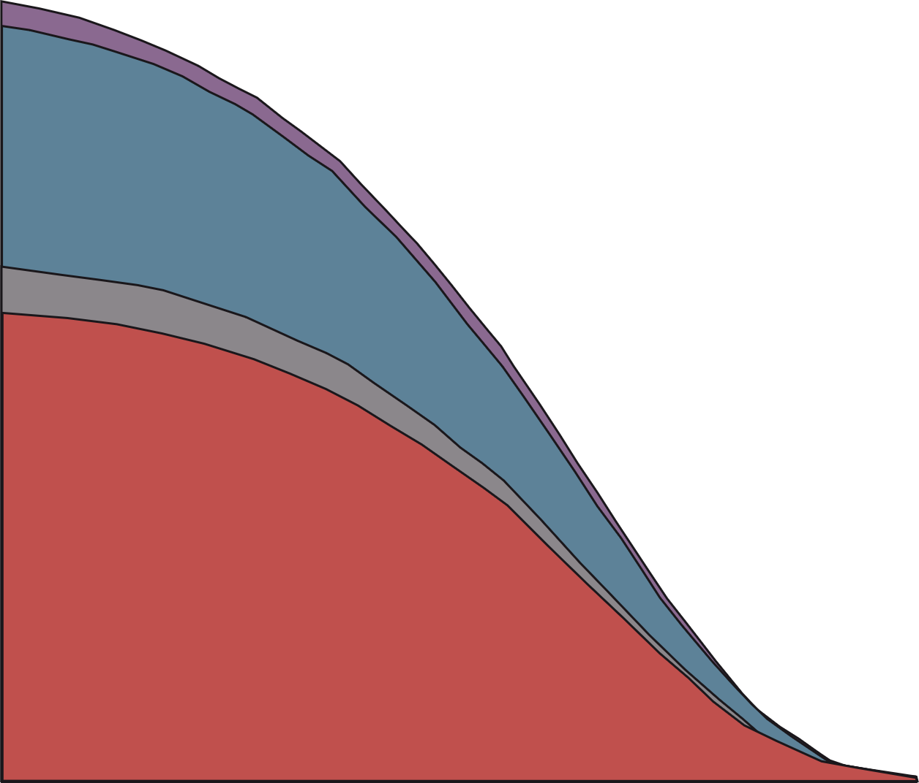
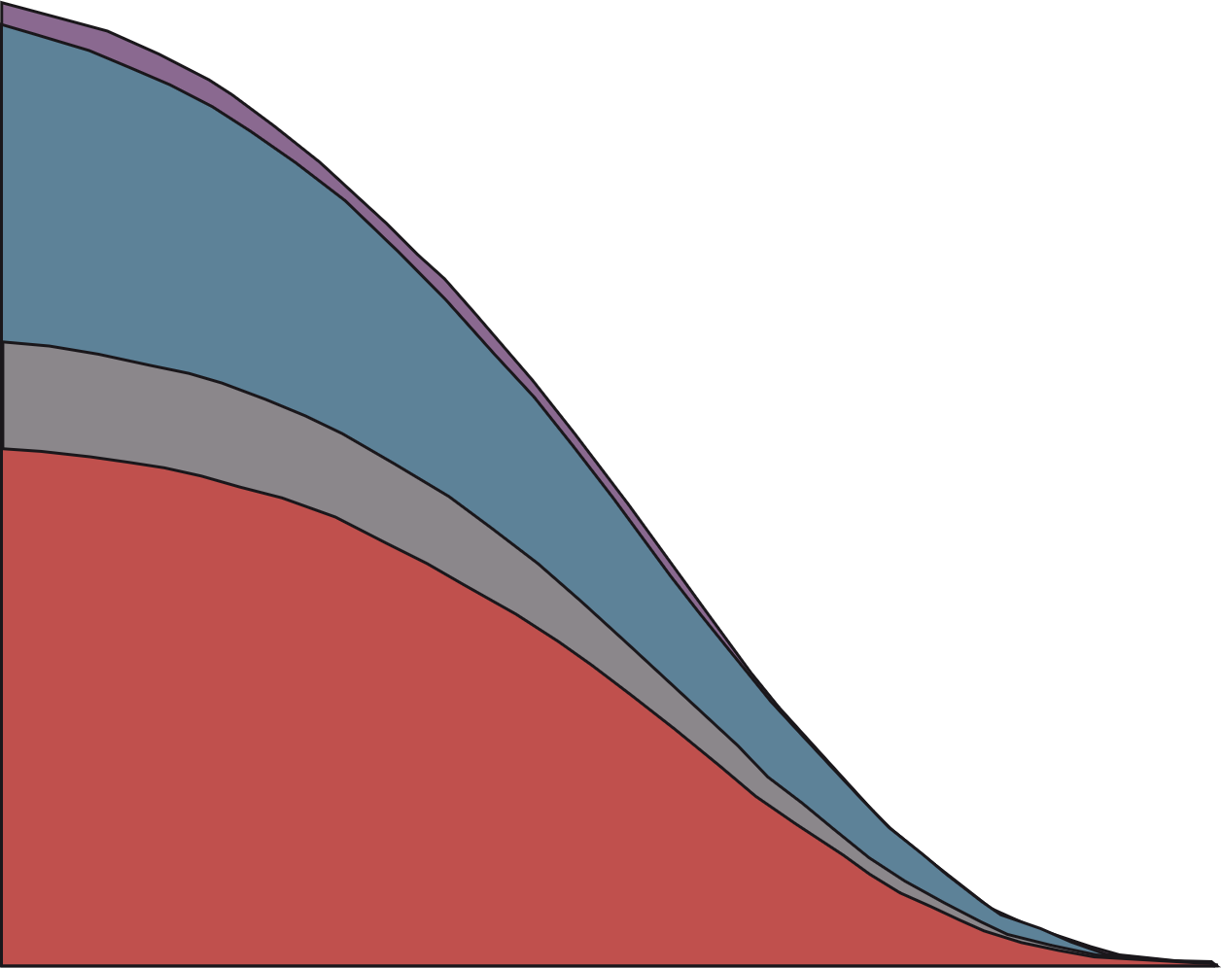
Years of life lost due to T2DM on the basis of age at diagnosis
Estimated future years of life lost owing to diabetes
Men
Women
7
7
6
Death from unknown causes
Non cancer, nonvascular deaths
Cancer deaths
Vascular deaths
6
5
5
4
4
Years of life lost
3
3
2
2
1
1
0
0
0
40
50
60
70
80
90
0
40
50
60
70
80
90
Age (year)
Age (year)
T2DM, type 2 diabetes mellitus; yr, years
Rao Kondapally Seshasai S, et al. N Engl J Med. 2011;36:829-41
Notes:
Una proposta ragionevole

Slide 53
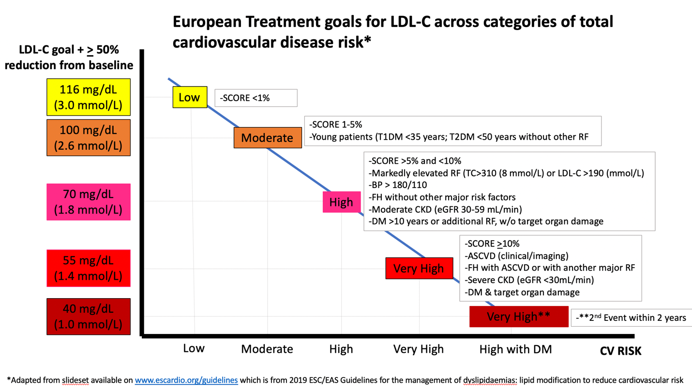
European treatment goals for ldl-c across categories of total cardiovascular disease risk*
ASCVD, atherosclerotic cardiovascular disease; BP, blood pressure; CKD, chronic kidney disease; CV, cardiovascular; DM, diabetes mellitus; eGFR, estimated glomerular filtration rate; ESC/EAS, European Society of Cardiology/European Atherosclerosis Society; FH, familial hypercholesterolaemia; LDL-C, low-density lipoprotein cholesterol; PCSK9, proprotein convertase subtilisin/kexin type 9; RF, rheumatoid factor; SCORE, Systematic COronary Risk Estimation; T1DM, type 1 diabetes mellitus; T2DM, type 2 diabetes mellitus; TC, total cholesterol
Adapted from Mach F, et al. Eur Heart J. 2020;41:111-88

Slide 54
Pathways of CV Risk in T2DM
Dyslipidemia
Hypercoagulation
platelet activation
Metabolic
dysfunction
Environmental
pollutants
Physical
inactivity
Poor diet
Type 2 diabetes mellitus
CVD
Smoking
Obesity
Endothelial
dysfunction
Arterial
stiffness
Inflammation
Oxidative
stress
CVD, cardiovascular disease; T2DM, type 2 diabetes mellitus
Newman JD, et al. J Am Coll Cardiol. 2017;70:883-93

Slide 55
DM Have a Very High Risk Despite Statin Treatment
 | Event rate (No diabetes) |  | Event rate (Diabetes)
 | On statin | On placebo | On statin | On placebo
HPS¹* (CHD patients) | 19.8% | 25.7% | 33.4% | 37.8%
CARE^{2†} | 19.4% | 24.6% | 28.7% | 36.8%
LIPID^{3‡} | 11.7% | 15.2% | 19.2% | 22.8%
PROSPER^{4§} | 13.1% | 16.0% | 23.1% | 18.4%
ASCOT-LLA^{5‡} | 4.9% | 8.7% | 9.6% | 11.4%
TNT^{6|} | 7.8% | 9.7% | 13.8% | 17.9%
* CHD death, non-fatal MI, stroke, revascularisation; † CHD death, non-fatal MI, CABG, PTCA; ‡ CHD death, non-fatal MI; §, stroke; | CHD death, non-fatal MI, resuscitated cardiac arrest, stroke (80 mg vs 10 mg atorvastatin)
CABG, coronary artery bypass graft; CHD, coronary heart disease; DM, diabetes mellitus; MI, myocardial infarction; PTCA, percutaneous transluminal coronary angioplasty
1. Collins R, et al. Lancet. 2003;361:2005-16. 2. Sacks FM, et al. N Engl J Med. 1996;335:1001-9. 3. Long-Term Intervention with Pravastatin in Ischaemic Disease (LIPID) Study Group. N Engl J Med. 1998;339:1349-57. 4. Shepherd J, et al. N Engl J Med. 2002;360:1623-30. 5. Sever PS, et al. Lancet. 2003;361:1149-58.
6. Shepherd J, et al. Diabetes Care. 2006;29:1220-6

Slide 56
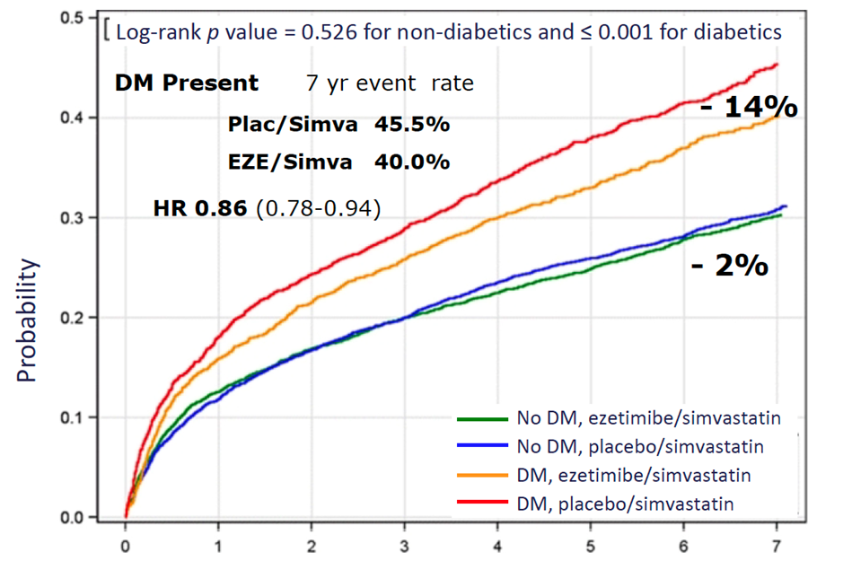
Effect of Ezetimibe in DM Patients in Improve-It
Primary endpoint a composite of cardiovascular death, major coronary event, or nonfatal stroke. DM, diabetes mellitus
Adapted from Giugliano RP, et al. Circulation. 2018;137:1571-82

Slide 57
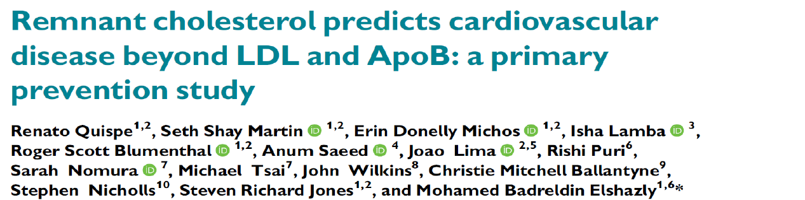

TG Rich Lipoprotein Remnants are associated with high CVD risk in diabetic patients
Remnant cholesterol predicts cardiovascular
disease beyond LDL and ApoB: primary
prevention study¹
Higher postprandial TG levels in T2D patients²
Diabetes
No diabetes
2.2
P<0.001
P<0.001
Patients with T2DM
show high and
problonged postprandial
lipemia after meals
2.0
LDL-C ≥130 mg/dL
RC ≥24 mg/dL
1.8
P<0.001
N=3378
1.6
Plasma remnants
Triglycerides (mmol/L)
1.4
1.2
1.0
N=2859
LDL-C ≥130 mg/dL
RC <24 mg/dL
0.8
0
2
4
6
Time (hours)
Epidemiological data
suggest that high
plasma TG levels, both
in the fasting state
and post-prandially,
are associated with
cardiovascular diseases
in patients with
diabetes
1.4
P<0.001
P<0.001
N=2767
LDL-C <130 mg/dL
RC ≥24 mg/dL
1.2
1.0
P<0.001
Plasma remnants
Triglycerides (mmol/L)
0.8
LDL-C <130 mg/dL
RC <24 mg/dL
(Reference)
0.6
(Reference group)
N=8528
0.4
0.2
0.5
1
1.5
2
0
Hazard Ratio
0
2
4
6
Adjusted for age + gender + race + smoking status + systolic blood pressure +
treatment for hypertension + lipi-lowering medication use + apoB + apoA1
Time (hours)
Remnants: Chylomicrons and VLDL remnants
ApoA1, apolipoprotein A1; ApoB, apolipoprotein B; CVD, cardiovascular disease; RC, triglyceride-rich lipoprotein remnant; T2DM, type 2 diabetes mellitus;
TG, triglyceride; LDL-C, low-density lipoprotein cholesterol; VLDL, very-low-density lipoprotein
1. Quispe R, et al. Eur Heart J. 2021;42:4324-32. 2. Tentolouris N, et al. J Lipid Res. 2007;48:218-25

Slide 58
Ezetimibe improves postprandial hyperlipemia and its induced endothelial dysfunction
A)
Serum TG levels (before –––, after 4 weeks –––)
C)
Serum Apo B-48 levels (before –––, after 4 weeks –––)
(mg/dl)
Ezetimibe group
(mg/dl)
Control group
(mg ∙
hour/dl)
AUC
(mg/dl)
Ezetimibe group
(mg/dl)
Control group
(mg ∙
hour/dl)
AUC
300
300
2500
P=0.15
12
12
100
P<0.05
250
250
2000
P<0.05
P=0.58
10
10
80
P<0.05
P=0.20
200
200
8
8
1500
6
6
60
150
150
1000
4
*
*
4
40
100
*
*
100
500
2
*
2
20
*
*
*
50
BL
2 hour
4 hour
6 hour
8 hour
50
BL
2 hour
4 hour
6 hour
8 hour
0
Before 4 weeks
Ezetimibe
Before 4 weeks
Control
0
BL
2 hour
4 hour
6 hour
8 hour
0
BL
2 hour
4 hour
6 hour
8 hour
0
Before 4 weeks
Ezetimibe
Before 4 weeks
Control
B)
Serum RLP-C levels (before –––, after 4 weeks –––)
D)
% FMD levels (before –––, after 4 weeks –––)
(mg/dl)
Ezetimibe group
(mg/dl)
Control group
(mg ∙
hour/dl)
AUC
(%)
Ezetimibe group
(%)
Control group
(%)
Max 𝚫FMD
P<0.05
16
16
125
P=0.08
12
12
P<0.05
P=0.14
14
14
P<0.01
P=0.14
0
12
12
100
10
*
*
*
10
-1
10
10
75
*
-2
8
8
8
8
6
6
50
-3
4
*
*
*
4
25
6
6
-4
2
*
*
2
0
BL
2 hour
4 hour
6 hour
8 hour
0
BL
2 hour
4 hour
6 hour
8 hour
0
Before 4 weeks
Ezetimibe
Before 4 weeks
Control
4
BL
2 hour
4 hour
6 hour
8 hour
4
BL
2 hour
4 hour
6 hour
8 hour
-5
Before 4 weeks
Ezetimibe
Before 4 weeks
Control
Apo B, apolipoprotein B; AUC, area under the curve; FMD, low-mediated dilation; RLP-C, remnant lipoprotein cholesterol; TG, triglyceride
Yunoki K, et al. Atherosclerosis. 2011;217:486-91

Slide 59
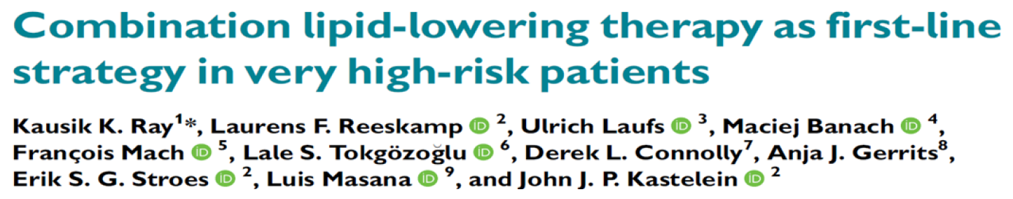
Combination lipid-lowering therapy as first line strategy
in very high-risk patients
Cardiovascular risk assessment
In patients with diabetes at HIGH/VERY HIGH
CV RISK, COMBINATION THERAPY STATIN-
EZETIMIBE leads to: 1) a robust LDL-C reduction
and, 2) improvement in the post-prandial lipemia,
key players in the atherothrombotic process
and SHOULD BE CONSIDERED THE BASIC
STANDARD OF CARE
Very high
CVD risk
Extremely high
risk patient†
Start statin +
ezetimibe*
Start statin +
ezetimibe* + PCSK9
targeted therapy‡
Reduction <50%
OR
LDL-C >1.4 mmol/L
Reduction >50%
&
LDL-C <1.4 mmol/L
* In statin-intolerant patients consider ezetimibe + bempedoic acid or PCSK9 targeted therapy
† Extremely high risk = post ACS + history of other vascular event/peripheral artery disease/ polyvascular disease/multivessel coronary artery disease/familial hypercholesterolemia
‡ Monoclonal antibodies directed against PCSK9 or PCSK9 siRNA therapy
Add PCSK9
targeted therapy‡ or
bempedoic acid
No further action
needed
ACS, acute coronary syndromes; CV, cardiovascular; CVD, cardiovascular disease; LDL-C, low-density lipoprotein cholesterol; PCSK9(i), proprotein convertase
subtilisin/kexin type 9 (inhibitor); siRNA, small interfering RNA
Ray KK, et al. Eur Heart J. 2022;43:830-3

Slide 60
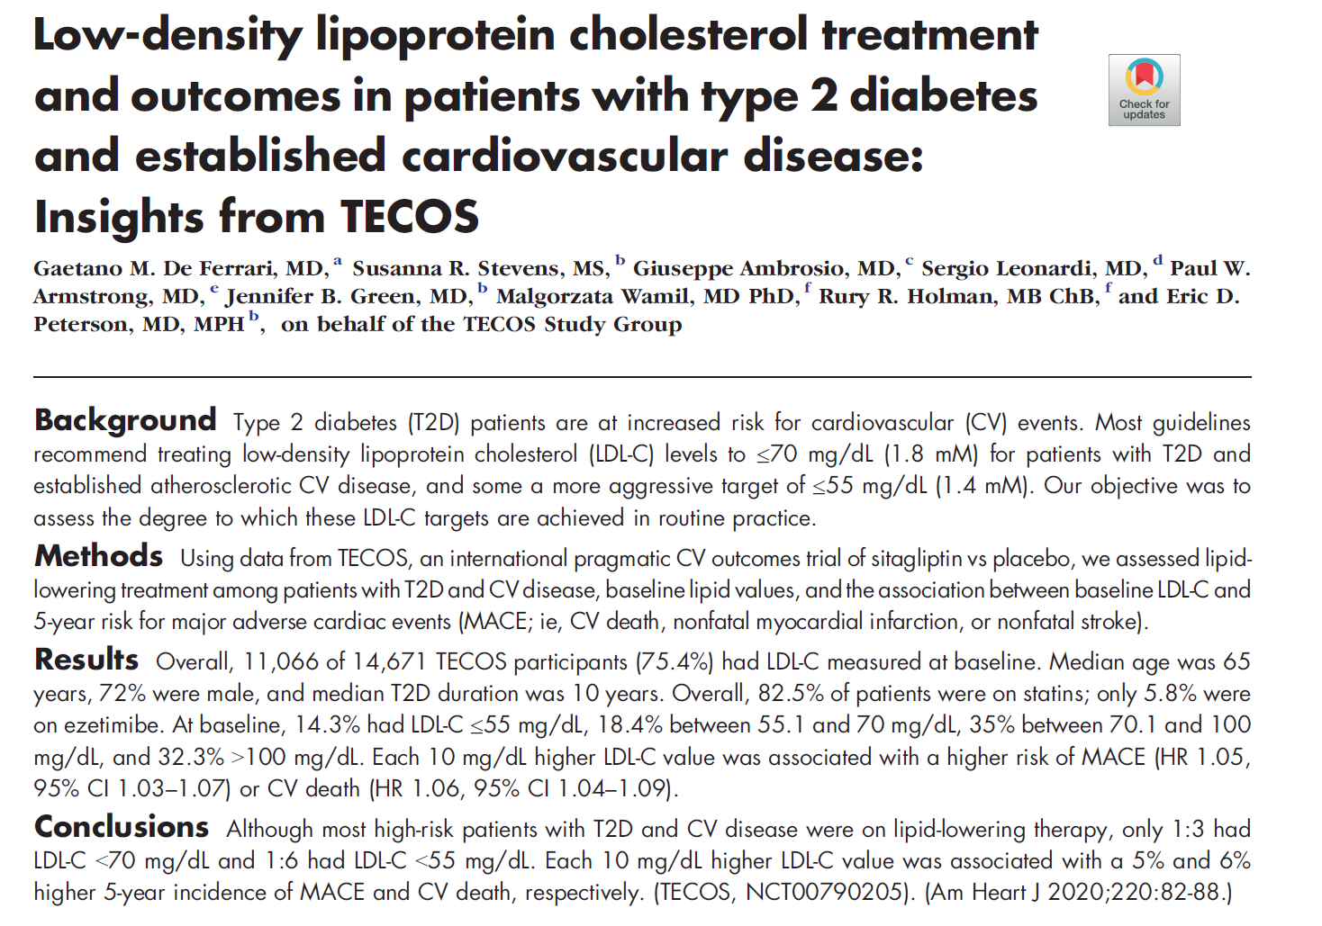
De Ferrari GM, et al. Am Heart J. 2020;220:82-8

Slide 61
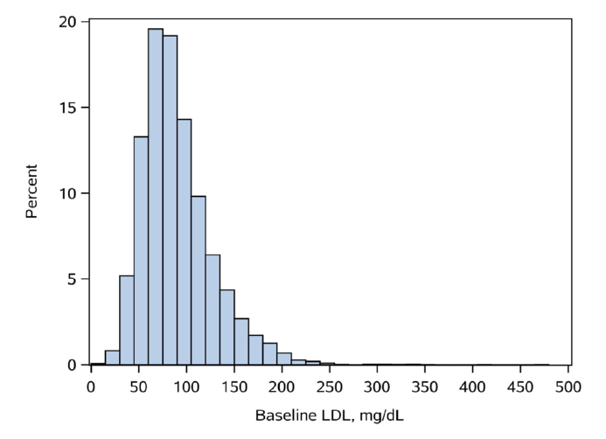
LDL-C Values in T2DM in the TECOS trial
LDL(-C), low-density lipoprotein (cholesterol); T2DM, type 2 diabetes mellitus
De Ferrari GM, et al. Am Heart J. 2020;220:82-8

Slide 62
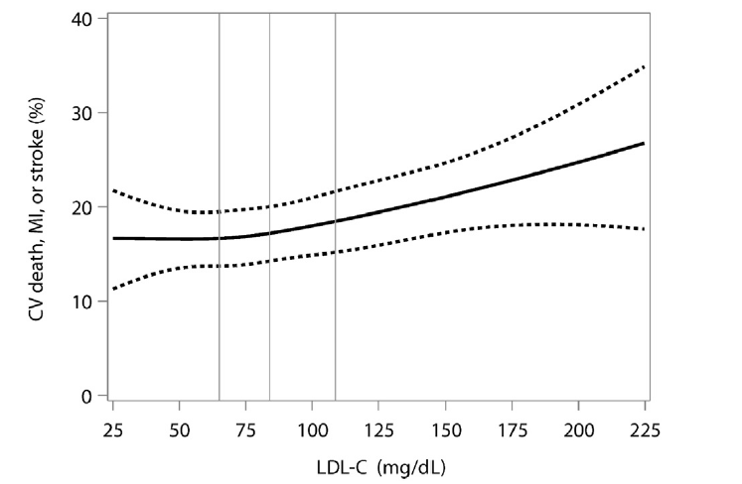
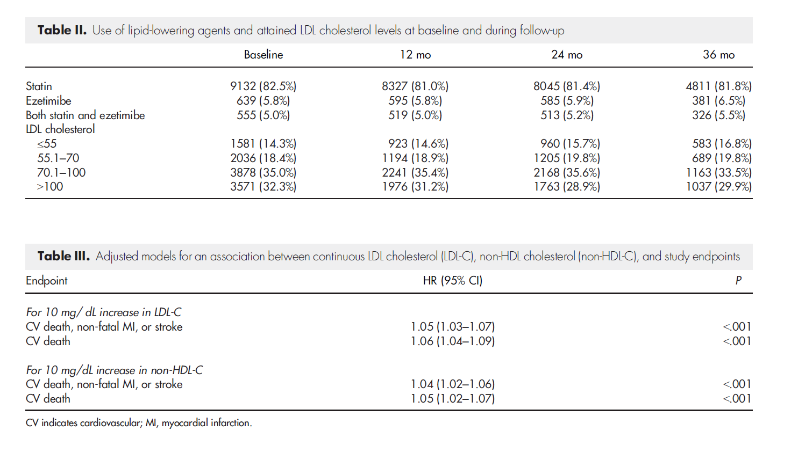
LDL-C Values in T2DM and Triple CV Endpoint
CV, cardiovascular; LDL(-C), low-density lipoprotein (cholesterol); MI, myocardial infarction; T2DM, type 2 diabetes mellitus
De Ferrari GM, et al. Am Heart J. 2020;220:82-8

Slide 63
Clinical Case: F.P. 38-year-old man
CV risk factors:
Young-onset T2DM
Previous smoker
Dyslipidaemia
Obesity
Medical history:
CKD (eGFR 59 mL/min)
Personality disorder
(negative thinking about future and death)
Seizures
Left ICA stenosis: 50%
Therapy:
Pantoprazole 20 mg
Acetylsalicylic acid 100 mg
Bisoprolol 2.5 mg
Rosuvastatin 20 mg
Insulin (30 + 15 + 20 IU + slow 34 IU)
Neurological drugs
Clinical presentation:
CCS (effort angina; CCS II)
Progressive worsening angina
LVEF: 55%
Hypokinesia inferior septum
mid-basal inferior wall
Negative TnI
Glycaemia: 292 mg/dL
Hb1Ac: 7.8%
Haemoglobin: 15.5 g/L
LDL-C: 96 mg/dL
ECG:
  SR: 77 bpm
  PQ interval: 160 msec
  QRS: 110 msec (incomplete RBBB)
  Aspecific repolarization
bpm, beats per minute; CCS, chronic coronary syndrome; CKD, chronic kidney disease; CV, cardiovascular; ECG, electrocardiogram; eGFR, estimated glomerular filtration rate; HbA1c, glycated haemoglobin A1C, ICA, internal carotid artery; IU, international units; LDL-C, low-density lipoprotein cholesterol;
LVEF, left ventricular ejection fraction; msec, milliseconds; RBBB, right bundle branch block; SR, sinus rhythm; TnI, troponin I

Slide 64
Fourier Study: single vessel vs multivessel disease
Multivessel disease
No multivessel disease
14%
30% RRR
HR 0.70
(95% CI 0.58-0.84)
P<0.001
14%
11% RRR
HR 0.89
(95% CI 0.79-1.00)
P=0.055
12.6%
12%
Δ 3.4%
NNT 29
12%
10%
9.2%
10%
8.9%
CV death, MI, stroke
Placebo
CV death, MI, stroke
8%
8%
7.6%
Placebo
6%
6%
Δ 1.3%
NNT 78
Evolocumab
4%
4%
Evolocumab
2%
P_{interaction}=0.03
2%
0%
0%
0
6
12
18
24
30
36
0
6
12
18
24
30
36
Months after randomisation
CV, cardiovascular; HR, hazard ratio; MI. myocardial infarction; NNT, number needed to treat; RRR, relative risk reduction
Adapted from Sabatine MS, et al. Circulation. 2018;138:756-66
Notes:
Global Review
QC/Data review performed
GDL (Ransi Somaratne) and GMAL (Cesar CerezoOlmos approved
Regional Review
Deck will need regional review (i.e. MAC)
Distribution
This slide set may NOT be left behind
Annotations
Available in deck as “Notes Page” view

Slide 65
ODYSSEY OUTCOME – MACE by diabetes Status
MACE incidence
Relative risk reduction
P_{interaction}=0.98
Hazard ratio
(95% CI)
Absolute risk reduction
P_{interaction}=0.0019
Absolute risk reduction
(95% CI)
Alirocumab
n/N (%)
Placebo
n/N (%)
Overall | 903/9462 (9.5%) | 1052/9462 (11.1%) |  | 0.85 (0.78-0.93) |  | 1.6% (0.7 to 2.4)
Normoglycaemia | 192/2639 (7.3%) | 220/2595 (8.5%) |  | 0.85 (0.70-1.03) |  | 1.2% (-0.3 to 2.7)
Prediabetes | 331/4130 (8.0%) | 380/4116 (9.2%) |  | 0.86 (0.74-1.00) |  | 1.2% (0.0 to 2.4)
Diabetes | 380/2693 (14.1%) | 452/2751 (16.4%) |  | 0.84 (0.74-0.97) |  | 2.3 (0.4 to 4.2)
0.75
0.85
1.0
3.2
1.6
0.0
Favours
alirocumab
Favours
placebo
Favours
alirocumab
Favours
placebo
CI, confidence interval; MACE, major adverse cardiovascular events
Ray KK, et al. Lancet Diabetol. 2019;7:618-28

Slide 66
LDL-C Reduction with Evolocumab
Patients w/ MetS at baseline
Patients w/o MetS at baseline
2.3 mmol/L
Placebo
2.3 mmol/L
58% mean reduction
P<0.00001
61% mean reduction
P<0.00001
0.8 mmol/L
Evolocumab
0.8 mmol/L
CV, cardiovascular; HR, hazard ratio; MI, myocardial infarction; NNT, number needed to treat
Sabatine MS et al. N Engl J Med. 2017;376;1713-1722

Slide 67
Risk of Primary Endpoint with Diabetes
Diabetes at baseline
17.1%
Adj Hazard Ratio 1.26
(95% CI 1.13-1.40)
P<0.0001
13.0%
No diabetes at baseline
CV Death, MI, Stroke,
Hosp for UA, or Cor Revasc
0
6
12
18
24
30
36
Months after Randomization
Analyses in placebo arm and adjusted for age, sex, BMI, race, region, history of MI, stroke, PAD, hypertension, smoking, heart failure, eGFR, lipids, statin
BMI, body mass index; CV, cardiovascular; eGFR, estimated glomerular filtration rate; HR, hazard ratio; MI, myocardial infarction; PAD, peripheral artery disease; UA, unstable angina
Sabatine Marc S, Lancet Diabetes Endocrinol. 2017 Dec;5(12):941-50

Slide 68
Effect of Evolocumab on Primary Endpoint
Patients with diabetes at baseline
Patients without diabetes at baseline
17.1%
Hazard Ratio 0.83
(95% CI 0.75-0.93)
P=0.0008
Hazard Ratio 0.87
(95% CI 0.79-0.96)
P=0.005
14.4%
13.0%
D 2.7%
NNT 37
11.4%
CV death, MI, stroke,
hosp for UA, or Cor Revasc
D 1.6%
NNT 62
Placebo
Evolocumab
P_{interaction}=0.60
0
6
12
18
24
30
36
0
6
12
18
24
30
36
Months after randomisation
CV, cardiovascular; HR, hazard ratio; MI, myocardial infarction; NNT, number needed to treat
Sabatine MS, et al. Lancet Diabetes Endocrinol. 2017;5:941-50

Slide 69
CV Death, MI, or Stroke based on attained LDL in Fourier
0.16
LDL-C (mM) | Adj HR (95% CI)
<0.5 | 0.69 (0.56-0.85)
0.5-1.3 | 0.75 (0.64-0.86)
1.3-1.8 | 0.87 (0.73-1.04)
1.8-2.6 | 0.90 (0.78-1.04)
≥ 2.6 | referent
P=0.0001
0.14
0.12
Adjusted event rate (probability)
0.10
0.08
0.06
0
0.5
1.0
1.5
2.0
2.5
3.0
3.5
4.0
4.5
LDL-C (mmol/L) at 1 month
CI, confidence interval; CV, cardiovascular; HR, hazard ratio; LDL, low-density lipoprotein; MI, myocardial infarction
Giugliano RP, et al. Presented at ESC Congress 2017; Clinical Trial Update I

Slide 70
Evolocumab: Evidence of Lag Effect for MACE
8%
8%
16% RRR
HR 0.84 (95% CI 0.74-0.96)
P=0.008
25% RRR
HR 0.75 (95% CI 0.66-0.85)
P=0.00001
6%
6%
CV death, MI, stroke
CV death, MI, stroke
4%
4%
Placebo
Placebo
2%
2%
Evolocumab
Evolocumab
0%
0%
0
3
6
9
12
12
18
24
30
36
Months from Randomisation
CI, confidence interval; CV, cardiovascular; HR, hazard ratio; MACE, major adverse cardiovascular events; MI, myocardial infarction; RRR, relative risk reduction
Adapted from Sabatine MS, et al. N Engl J Med. 2017;376:1713-22

Slide 71
Long-Term Extension – Effect on LDL-C
Placebo transition to evolocumab
Parent FOURIER
Evolocumab vs placebo
FOURIER-OLE
Open-label Evolocumab
2.5
2.0
Randomized to placebo
Randomized to evolocumab
Median LDL cholesterol (95% CI, mmol/L)
1.5
1.0
0.5
0
12
48
144
12
48
96
144
192
240
Weeks
CI, confidence interval; IQR, interquartile range; LDL-C, low-density lipoprotein (cholesterol); OLE open-label extension
O'Donoghue ML, et al. Circulation. 2022;146:1109-19 (Primary results presented at ESC 2022)

Slide 72
Long-Term Extension – Effect on LDL-C
Placebo transition to evolocumab
Parent FOURIER
Evolocumab vs placebo
FOURIER-OLE
Open-label Evolocumab
2.5
2.0
Randomized to placebo
Randomized to evolocumab
Median LDL cholesterol (95% CI, mmol/L)
1.5
Median LDL-C at Week 260:
0.75 mmol/L (IQR 0.44-1.29)
29 mg/dl (IQR 17-50)
1.0
0.5
0
12
48
144
12
48
96
144
192
240
Weeks
CI, confidence interval; IQR, interquartile range; LDL-C, low-density lipoprotein (cholesterol); OLE open-label extension
O'Donoghue ML, et al. Circulation. 2022;146:1109-19 (Primary results presented at ESC 2022)

Slide 73
Long-term Safety
Serious adverse events
Injection site reactions
Drug-related allergic rxn
Annualised IR
Annualised IR
Annualised IR
Muscle-related event
New onset diabetes
Hemorrhagic stroke
Annualised IR
Annualised IR
Annualised IR
Placebo Phase FOURIER
Evolocumab Phase FOURIER
Evolocumab Phase FOURIER & OLE
IR, incidence rate; RXN, reaction

Slide 74
Efficacy During FOURIER-OLE
15%
Key Secondary Endpoint:
CV death, MI or stroke
11.9%
HR 0.80
(95% CI 0.68-0.93)
P=0.003
20% reduction
10%
9.7%
5%
Placebo Evolocumab
Evolocumab Evolocumab
0%
0
1
2
3
4
5
Years in OLE
Number at risk:
Placebo-Evolocumab
3280
3128
2987
2857
2729
1809
Evolocumab-Evolocumab
3355
3247
3123
3012
2870
1862
CI, confidence interval; CV, cardiovascular; HR, hazard ratio; MI, myocardial infarction; OLE open-label extension
O'Donoghue ML, et al. Circulation. 2022;146:1109-19 (Primary results presented at ESC 2022)

Slide 75
Efficacy During FOURIER-OLE
5%
CV death
4.45%
HR 0.77
(95% CI 0.60-0.99)
P=0.04
23% reduction
4%
3.32%
3%
2%
1%
Placebo Evolocumab
Evolocumab Evolocumab
0%
0
1
2
3
4
5
Years in OLE
Number at risk:
Placebo-Evolocumab
3280
3223
3155
3081
2991
2049
Evolocumab-Evolocumab
3355
3314
3244
3173
3080
2069
CV, cardiovascular; OLE open-label extension
O'Donoghue ML, et al. Circulation. 2022;146:1109-19 (Primary results presented at ESC 2022)

Slide 76
Efficacy During FOURIER & FOURIER-OLE
Parent FOURIER
Median 2.2 yrs
FOURIER-OLE
Median 5 yrs
CV Death
7%
6%
5%
4%
CV death (%)
3%
2%
Placebo Evolocumab
1%
Evolocumab Evolocumab
0%
0
1
2
3
4
5
6
7
8
Years
Number at risk:
Placebo-Evolocumab
13780
13590
9399
3753
3167
3098
2996
1965
268
Evolocumab-Evolocumab
13784
13598
9464
3826
3270
3204
3109
1988
237
CV, cardiovascular; OLE open-label extension
O'Donoghue ML, et al. Circulation. 2022;146:1109-19 (Primary results presented at ESC 2022)

Slide 77
New-Onset Diabetes
In all patients w/o diabetes at baseline (1294 incident cases in 16,510 patients):
HR 1.05 (95% CI 0.94-1.17)
In patients w/ prediabetes at baseline (1163 incident cases in 10,338 patients):
HR 1.00 (95% CI 0.89-1.13)
Sabatine Marc S. Lancet Diabetes Endocrinol. 2017;Dec;5(12):941-50

Slide 78
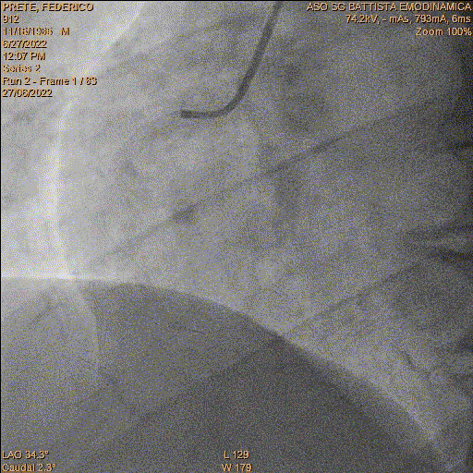
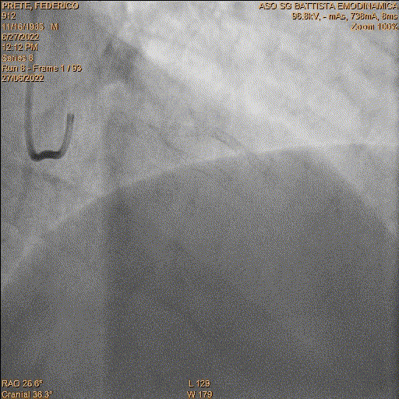
Therapy at discharge: pantoprazole 20 mg, bisoprolol 2.5 mg, rosuvastatin/ezetimibe 20/10 mg, insulin; dapaglifozin 10 mg; evolocumab 140 mg
2 × month; aspirin 100 mg; clopidogrel 75 mg
11 months later…
ER referral for chest pain
Coronary CT: good result of RCA PCI. Slow run-off distal to LAD PCI
LDL 34 mg/dl; HBl1Ac 6.8%. Negative TnI.
Minimal restenosis of mid LAD
CT, computed tomography; ER, emergency room; HbA1c, glycated haemoglobin A1C; LAD, left anterior descending; LDL, low-density lipoprotein;
PCI, percutaneous coronary intervention; RCA right carotid artery; TnI, troponin I

