Slide 2

Developed by GI COnnect
This programme is developed by GI CONNECT,
an international group of experts in the field
of gastrointestinal oncology
Acknowledgement and disclosures
This GI CONNECT programme is supported through an independent educational grant from Bayer. The programme is therefore independent, the content is not influenced by the supporter and is under the sole responsibility of the experts.
Please note: The views expressed within this programme are the personal opinions of the experts. They do not necessarily represent the views of the experts’ institutions, or the rest of the GI CONNECT group.
Expert Disclaimers:
Dr Cheng Ean Chee has received financial support/sponsorship for research support, consultation, or speaker fees from the following companies: AstraZeneca (Advisory Board)
Dr Hisato Kawakami has received financial support/sponsorship for research support, consultation, or speaker fees from the following companies: Consulting fees from Bristol Myers Squibb Co. Ltd., Eli Lilly Japan K.K., MSD K.K., Ono Pharmaceutical Co. Ltd.,
Daiichi-Sankyo Co. Ltd., and Taiho Pharmaceutical Co. Ltd; honoraria from Bristol Myers Squibb Co. Ltd., Bayer Yakuhin Ltd., Eli Lilly Japan K.K., MSD K.K., Ono Pharmaceutical Co. Ltd., Chugai Pharmaceutical Co. Ltd., Daiichi Sankyo Co. Ltd., Merck Biopharma Co. Ltd., Takeda Pharmaceutical Co. Ltd., Yakult Pharmaceutical Industry, Teijin Pharma Ltd., and Taiho Pharmaceutical Co. Ltd.; lecture fees from GlaxoSmithKline K.K., and Otsuka Pharmaceutical Co. Ltd.; and research funding from Chugai Pharmaceutical Co. Ltd., Taiho Pharmaceutical Co. Ltd, Kobayashi Pharmaceutical. Co. Ltd., and Eisai Co. Ltd.

Slide 3


This programme has been developed by the following experts
Asst. Prof. Cheng Ean Chee
Medical Oncologist,
National University Cancer Institute, Singapore
Dr Hisato Kawakami
Medical Oncologist
Kindai University,
Japan

Slide 4
Educational objectives
To discuss the gastric and gastroesophageal treatment landscape and disease prevalence
in Asia
To understand the current treatment options for 2L and 3L gastric and gastroesophageal cancers plus treatment selection strategies
To learn about the latest research and clinical trials in 2L and 3L treatments for gastric and gastroesophageal cancers
2L, second line; 3L, third line

Slide 5
Clinical takeawayS
Overall survival in patients with advanced gastric and GE cancers has improved with more effective systemic therapy
Current therapies in the second line and beyond setting may not be reflective of the changing landscape of first-line therapy in advanced disease but trials are ongoing.
Factors to consider when evaluating a patient for the second line and beyond therapy include prior lines of therapy and residual toxicities, performance status and competing comorbidities
PTX+RAM is the standard of care for second-line treatment, but there are multiple candidates for third-line treatment, which is not clearly defined
For HER2-positive gastric cancer, T-DXd was shown to be effective after trastsuzumab failure. Currently, the development of second-line therapy after trastsuzumab failure is the focus of attention

Slide 6
Advanced Gastric and Gastroesophageal Cancers in ASia: Beyond First-Line Treatment

Slide 7
Gastric Cancer Japanese recommended treatment guidelines
Advanced GC
First line
Second line
Third line
HER2-
HER2+
MSI-H
Non MSI-H
HER2-
HER2+
SOX/ CapeOX/ +/- Nivolumab
S-1/Cape + CDDP
Cape/CDDP + T-mab
CapeOX/SOX + Tmab
Pembrolizumab
PTX + RAM
PTX + RAM
Trifluridine/
tipiracil
Nivolumab
Trastuzumab-deruxtecan
Irinotecan
5-FU, fluorouracil; Cape, capecitabine; CapeOX, capecitabine and oxaliplatin; CDDP, Oxaliplatin; CPS, combined positive score; GC, gastric cancer; HER2, human epidermal growth factor receptor 2; MSI-H, microsatellite instability High; PD-1, programmed cell death protein 1; PD-L1, programmed death-ligand 1; PTX, paclitaxel; RAM, ramucirumab; SOX, S-1 and oxaliplatin; T-mab, trastuzumab
Japanese Gastric Cancer Association. Gastric Cancer. 2023;26:1-25

Slide 8
Second line treatment options IN asia
2L, second line

Slide 9

Trials of SECOND line Chemotherapy for Gastric Cancer in Japan
WJOG 4007: Study Design¹
RAINBOW: Study Design²
Phase 3
Phase 3
AGC Refractory to prior FP confirmed by imaging
Age 20-75 years, ECOG PS 0-2, No history of CPT-11 or taxanes
Ramucirumab 8 mg/kg day 1 &
15 + paclitaxel 80 mg/m² day 1,
8 & 15 of a 28 day cycle
N=330
Randomisation
Stratified by
Institution, PS 0-1/2, measurable lesion -/+
Treat until disease progression
or intolerable toxicity
SCREEN
R
1:1
Survival and
safety
follow-up
Placebo day 1 & 15
+ paclitaxel 80 mg/m²
day 1, 8 & 15
N=335
Weekly paclitaxel
80 mg/m² day 1, 8 & 15 q4w
CPT-11
150 mg/m² day 1, 15 q4w
Overall survival
/months
9.5
9.6
3.6
4.4
PFS
Intervention
AGC, advanced gastric cancer; CPT-11, irinotecan; ECOG PS, Eastern Cooperative Oncology Group performance status; FP, fluoropyrimidine + platinum; q4w, every 4 weeks; R, randomisation; RAM, ramucirumab; WJOG, West Japan Oncology Group
1.Hironaka S, et al. J Clin Oncol. 2013;31:4438-44; 2.Wilke H, et al. Lancet Oncol. 2014;15:1224-35

Slide 10
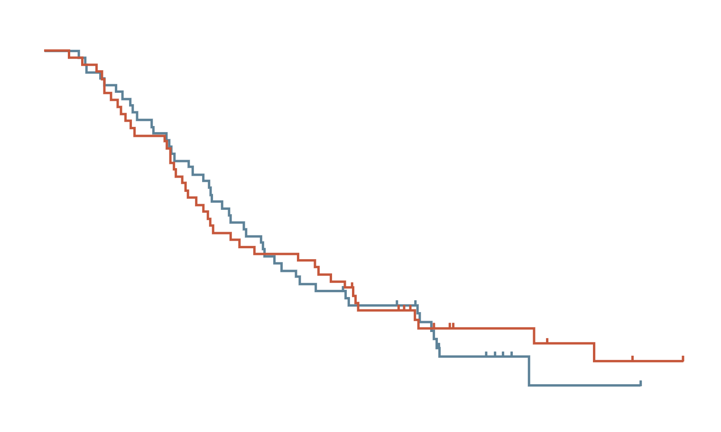
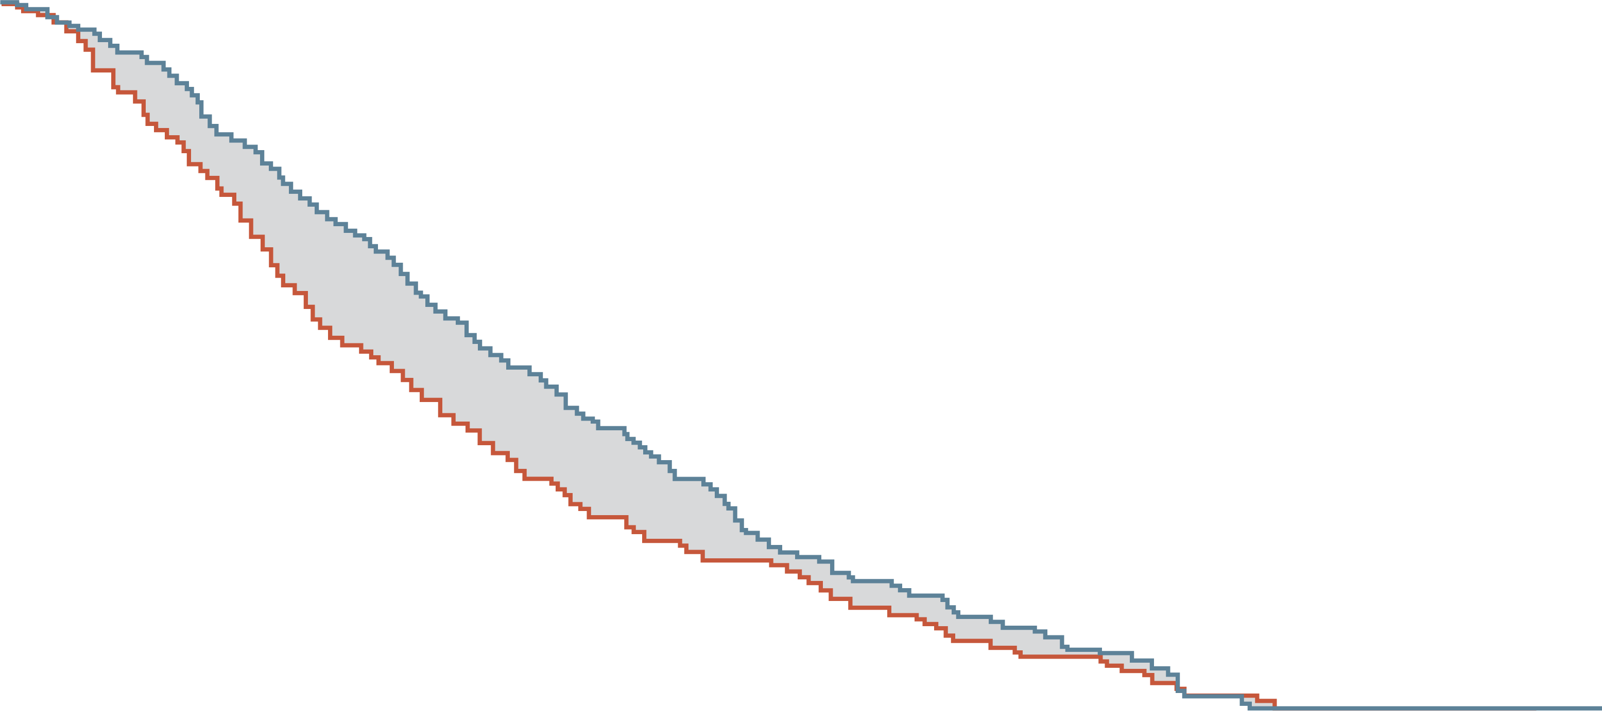
WJog Study¹
Second-line chemotherapy trials’ result in ASIA
RAINbow²
No difference was demonstrated between nab-paclitaxel + ramucirumab and weekly paclitaxel + ramucirumab in 2L setting
Demonstrated improved OS in ramucirumab + paclitaxel vs paclitaxel alone
Overall survival
Overall survival
100
 | Paclitaxel + ramucirumab (n=53) | Nab-paclitaxel + ramucirumab (n=52)
Number of events | 44 | 41
OS (95% CI) | 8.1 m (6.4-10.3) | 7.2 m (5.6-11.5)
100
Ramucirumab
+ paclitaxel
(n=330)
9.6
months
(8.5-10.8)
90
30% INCREASE
IN MEDIAN OS
80
80
70
60
HR (95% CI) = 0.96 (0.62-1.48)
Stratified log-rank p=0.63
60
HR (95% CI) = 0.81 (0.68-0.96)
P=0.017
50
Overall survival (%)
Overall survival (%)
Ramucirumab + paclitaxel
Placebo + paclitaxel
40
40
30
20
20
7.4
months
(6.3-8.4)
Placebo
+ paclitaxel
(n=335)
Paclitaxel + ramucirumab
Nab-paclitaxel + ramucirumab
10
0
0
0
3
6
9
12
15
18
21
24
27
0
2
4
6
8
10
12
14
16
18
20
22
24
26
28
Time from randomisation (months)
Time from randomisation (months)
No. at risk
RAM+ PTX
Nab-paclitaxel
+ ramucirumab
No. at risk
RAM +PTX
Placebo + paclitaxel
53
52
47
44
35
31
23
23
18
19
13
10
5
6
1
4
0
1
0
0
330
335
308
294
267
241
228
180
185
143
148
109
116
81
78
64
60
47
41
30
24
22
13
13
6
5
1
2
0
0
2L, second line; CI, confidence interval; HR, hazard ratio; m, months; OS, overall survival; PTX, paclitaxel; RAM, ramucirumab; WJOG, West Japan Oncology Group
1. Hirata K, et al. J Clin Oncol. 40, no. 4_suppl 280-280. ASCO GI Cancer Symposium presentation. Abstract #280; 2.Wilke H, et al. Lancet Oncol. 2014;15:1224-35

Slide 11
KEYNOTE-061: Pembrolizumab vs paclitaxel for previously treated gastric cancer
Os, orr, and dor for msi-h tumours
 | Events/Pts | HR (95% CI)
Pembrolizumab | 6/15 | 0.42
Paclitaxel | 10/12 | (0.13-1.31)
100
100
CR
PR
90
90
80
MSI-H = 27/512 = 5.3%
80
46.7%
70
70
60
60
16.7%
Overall survival, %
ORR, % (95% CI)
50
50
40
Median (95% CI)
NR (5.6-NR)
8.1 mo (2.0-16.7)
40
30
30
20
20
10
10
0
0
0
6
12
18
24
30
0
Pembrolizumab
Paclitaxel
Number at risk
Pembrolizumab
Paclitaxel
Months
DoR mo
median (range)
NR
(5.5 to 26.0+)
NR
(2.2 to 12.2+)
15
12
12
8
11
3
6
1
3
0
0
0
High efficacy of pembrolizumab in MSI-H gastric cancer was demonstrated.
Paclitaxel efficacy was not different between MSI-H vs. MSS
A post-hoc subgroup analysis. Data cut-off date: Oct 26, 2017
CI, confidence interval; CR, complete response; DoR, duration of response; HR, hazard ratio; mo, months; MSI-H, microsatellite instability High; MSS, microsatellite stable; NR, not reached; ORR, objective response rate; OS, overall survival; PR, partial response; pt, patient
Shitara K, et al. Lancet. 2018;392:123-33

Slide 12
SECOND Line Ongoing trials
2L, second line

Slide 13
Second line for HEr2+ metastatic Gastric Cancer
DESTINY-GC04
n=490
T-DXd
Failure to
Tmab
Fluoropyrimidine
Platinum
HER2 + per IHC/ISH required
Biopsy→
R
1:1
Paclitaxel + RAM
Primary endpoint, Overall survival
MOUNTAINEER-02
Multi-cohort, Open-label Phase 2
Cohort 2A
N=24-30
TUC + Tras + Ram + Pac
Failure to
Tmab
Fluoropyrimidine
Platinum
Paclitaxel Dose Optimisation
N=6-12
Pac 60 or 80 mg/m2 +
TUC + Tras + Ram
HER2+ by ctDNA
HER2+ by
NGS of ctDNA or
IHC/ISH of tissue
Pac RD
identified
HER2- by ctDNA
HER2+ by tissue
Cohort 2A (Exploratory)
N=24-30
TUC + Tras + Ram + Pac
Double blind, placebo-controlled Phase 3
Arm 3A (Test, N=235)
TUC + Tmab + RAM + PAC
HER2+ by ctDNA
R
8:8:1
Arm 3B (Control, N=235)
TUC placebo + Tmab placebo + RAM + PAC
Formal statistical comparisons to be made
between Arms 3A and 3B
Randomisation stratified by Asia vs Rest of
World, time to progression, prior gastrectomy
Arm 3C (Control, N=30)
TUC + Tmab placebo + RAM + PAC
ctDNA, circulating tumour DNA; HER2, human epidermal growth factor receptor 2; IHC, immunohistochemistry; ISH, in-situ hybridisation; NGS, next-generation sequencing; PAC, paclitaxel; R, randomisation; RAM, ramucirumab; T-DXd, trastuzumab deruxtecan; Tmab, trastuzumab; TUC, tucatinib
https://clinicaltrials.gov/ct2/show/NCT04704934; https://clinicaltrials.gov/ct2/show/NCT04499924; Strickler, J.H., et al. Clin Oncol. 2021. DOI: 10.1200/JCO.2021.39.3_suppl.TPS252

Slide 14
Third line treatments in japan
3L, third line

Slide 15
THIRD line systemic therapy trials for gastric cancer in Japan
ATTRACTION-2¹
TAGS²
FTD/TPI (TAS-102) + BSC (n=337)
35 mg/m² BID orally on days 1-5 and 8-12 of each
28-day cycle
Eligibility
Age ≥20 years
Unresectable advanced or recurrent G/GEJ cancer
Histologically confirmed adenocarcinoma
Prior treatment with ≥2 regimens and refractory to/intolerant of standard therapy
ECOG PS of 0 or 1
Nivolumab
3 mg/kg IV q2w
Primary endpoint:
OS
Secondary endpoints:
Efficacy
(PFS, BOR, ORR, TTR, DoR, DCR)
Safety
Patients with mGC (including GEJ cancer)
≥2 prior regimens:
  Fluoropyrimidine
  Platinum
  Taxane and/or irinotecan
  HER2 inhibitor, if available, for HER2+ disease
  Refractory to/intolerant of last prior therapy
ECOG PS of 0 or 1
Age ≥18 y (≥20 y in Japan)
Target sample size: 500
Primary endpoint:
OS
Key Secondary:
PFS, safety
Other secondary:
ORR, DCR, QoL
Time to ECOG PS ≥2
Stratification based on:
Country (Japan vs
Korea vs Taiwan)
ECOG PS (0 vs 1)
Number of organs with metastases (<2 vs ≥2)
R
2:1
R
2:1
Stratification: ECOG PS (0 vs 1), region (Japan vs RoW), prior ramucirumab (yes vs no)
Sites: 17 countries, 110 sites; enrolment: February 2016 – January 2018
Placebo
Placebo
No prospective
data
available
Overall survival
(months)
5.7
5.3
1.61
2.0
Intervention
BID, twice a day; BOR, best overall response; BSC, best supportive care; DCR, disease control rate; DoR, duration of response; ECOG PS, Eastern Cooperative Oncology Group performance status; FTD/TPI, trifluridine/tipiracil; G/GEJ, gastric or gastroesophageal junction; HER2, human epidermal growth factor receptor 2; IV, intravenous; mGC, metastatic gastric cancer; ORR, objective response rate; OS, overall survival; PFS, progression-free survival; q2w, every 2 weeks; QoL, quality of life; R, randomisation; RoW, rest of world; TTR, time to response; y, years
1. Kang Y-K, et al. Lancet. 2017;390:2461-71; 2. Shitara K, et al. Lancet Oncol. 2018;19:1437-48

Slide 16
Third line Ongoing trials
3L, third line

Slide 17
THIRD line and beyond: RINDberg study in japan
Phase 3 study: ramucirumab + irinotecan vs irinotecan alone
STUDY SCHEMA N=400
Ramucirumab + Irinotecan
Ramucirumab: 8 mg/kg, day 1, q2w
Irinotecan: 150 mg/m², day 1, q2w
Patients:
With advanced GC
and EGJC
Refractory with ramucirumab
ECOG PS 0-1
Primary endpoint:
OS
R
Irinotecan alone
Irinotecan: 150 mg/m², day 1, q2w
1:1
Stratified factors:
PS: 0 vs 1
Duration of prior chemotherapy containing ramucirumab
Peritoneal metastasis
The results will be presented at ESMO 2023!!
ECOG PS, Eastern Cooperative Oncology performance status; EGJC, esophagogastric Junction Cancer; ESMO, European Society for Medical Oncology; GC, gastric cancer; OS, overall survival; q2w, every 2 weeks
Daisuke S, et al. J Clin Oncol. 2018. DOI: 10.1200/JCO.2018.36.15_suppl.TPS4138

Slide 18

Beyond Ram with FTD/TPI in the THIRD or later line:
Phase 2 study (WJOG15822G)
FTD/TPI monotherapy n=55
FTD/TPI, 35mg/m² BID d1-5,
d8-12, q28d
Primary endpoint:
PFS
Secondary endpoints:
OS, ORR, DCR, AEs
Gastric Cancer
refractory to two previous lines
n=110
R
FTD/TPI + Ramucirumab n=55
FTD/TPI, 35mg/m² bid d1-5,
d8-12, q28d
Ramucirumab, 8 mg/kg on d1 and 15, q28d
Inclusion criteria:
Age: 20 years. or older
Histologically confirmed unresectable/metastatic/recurrent gastric cancer
ECOG PS: 0-1
Refractory or intolerant to pyrimidine fluoride, taxanes, irinotecan, or ramucirumab
AE, adverse event; BID, twice a day; d, day; DCR, disease control rate; ECOG PS, Eastern Oncology Cooperative Group performance status; FTD/TPI, trifluridine/tipiracil; ORR, overall response rate; OS, overall survival; PFS, progression-free survival; q28d, every 28 days; RAM, ramucirumab; WJOG, West Japan Oncology Group
Takahashi N, et al. 2023. DOI: 10.21203/rs.3.rs-2796191/v1 (pre-print)

Slide 19
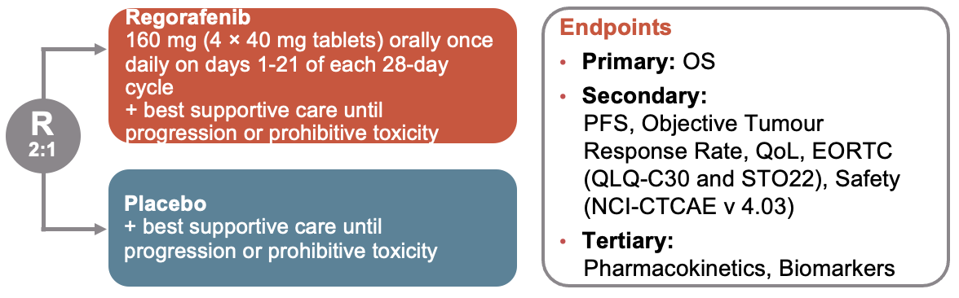
THIRD line and beyond: INTEGRATE studies
INTEGRATE IIa: regorafenib vs best supportive care
INTEGRATE IIb: regorafenib + nivolumab vs investigator’s choice chemotherapy
Regorafenib improved OS:
  After 238 events in INTEGRATE IIa, OS HR 0.68 with 12-month survival of 19% vs 6%
  No statistically significant regional difference (Asia vs non-Asia), with benefit seen in all pre-specified sub-groups
Regorafenib improved PFS: HR=0.53; 95% CI: 0.40-0.70; p<0.0001)
Regorafenib toxicity profile was similar to that seen in previous reports
INTEGRATE IIb is an ongoing international Phase 3 study in pre-treated patients with advanced gastric or gastroesophageal junction cancer comparing regorafenib + nivolumab to standard chemotherapy (NCT04879368)
Eligibility
Metastatic or locally advanced gastroesophageal cancer
Adenocarcinoma or undifferentiated carcinoma
Failed or intolerant to at least: two lines of prior anti-cancer therapy, which must include at least a platinum agent and a fluoropyrimidine analogue as single agents or in combination
REGONIVO
Regorafenib 90 mg orally once daily, days 1-21 of 28 day cycle
Nivolumab 240 mg IV every
2 weeks
R
2:1
Endpoints:
Overall survival (primary)
CONTROL
Investigator choice chemotherapy:
Paclitaxel, docetaxel, irinotecan or oral trifluridine/tipiracil (TAS-102)
Stratification:
Geographic region (Asia vs rest of world)
Prior VEGF inhibitors (Y vs N)
Prior immunotherapy (Y vs N)
CI, confidence interval; EORTC, European Organisation for Research and Treatment of Cancer; HR, hazard ratio; IV, intravenous; NCI-CTCAE, National Cancer Institute Common Terminology Criteria for Adverse Events; OS, overall survival; PFS, progression-free survival; QoL, quality of life; QLQ‑C30, EORTC core quality of life questionnaire; QLQ-STO22, EORTC-QLQ-stomach module; R, randomisation; VEGF, vascular endothelial growth factor; TAS‑102, trifluridine/tipiracil
Pavlakis N, et al. J Clin Oncol. 41, no. 4_suppl:LBA294-LBA294. ASCO GI Cancers Symposium presentation. Abstract #LBA294; https://clinicaltrials.gov/ct2/show/NCT02773524; https://clinicaltrials.gov/ct2/show/NCT04879368

Slide 20
summary

Slide 21
Summary
Improved overall survival: Patients with advanced gastric and GE cancers now have better survival rates due to more effective systemic therapy
Evolving landscape of first-line therapy: Current second-line and beyond therapies may not reflect the advancements in first-line treatment for advanced disease. Ongoing trials are addressing this issue
Factors for considering second-line and beyond therapy: Prior lines of therapy, residual toxicities, performance status, and comorbidities should be considered when evaluating patients
Standard second-line treatment and targeted therapy: PTX+RAM is the established standard of care for second-line treatment in advanced gastric and GEJ cancers. Additionally, T-DXd has shown effectiveness as a targeted therapy after trastuzumab failure in HER2-positive populations
Multiple options for third-line treatment: Third-line treatment for gastric and GEJ cancers lacks a clearly defined standard, with several candidates being explored

