Slide 2
HCC Connect virtual experts knowledge share Treatment options for HCC patients who are not eligible for or progressed on IO: Clinical considerations and when to switch Tuesday 23rd May 2023

Slide 3
Today you will
EXPLORE the outcomes of patients with HCC receiving IO 1st line and determine the right time to switch to 2nd line
KNOW the treatment options for patients with advanced HCC not eligible for IO in 1st line
UNDERSTAND the data supporting 2nd line treatment options for patients with advanced HCC, to enable optimal sequencing
IO, immunotherapy; HCC, hepatocellular carcinoma

Slide 4
AGENDA Treatment options for HCC patients who are not eligible for or progressed on IO: Clinical considerations and when to switch
Topic | Facilitator | Duration
Welcome and Introductions | COR2ED/ Prof. Michel Ducreux | 5 mins
Reviewing the outcomes in HCC with 1st line IO: when is the right time to switch? | Dr Timon Vandamme | 15 mins
Q&A | All | 5 mins
What are the treatment options for patients with advanced HCC not eligible for IO in 1st line? | Prof. Michel Ducreux | 15 mins
Q&A | All | 5 mins
Overview of 2nd line treatment options in advanced HCC: How to achieve optimal sequencing? | Assoc. Prof. Changhoon Yoo | 15 mins
Q&A | All | 5 mins
Discussion and Q&A | All | 15 mins
Future perspectives and summary | Prof. Michel Ducreux | 5 mins
Closing remarks | COR2ED | 5 mins
HCC, hepatocellular carcinoma; IO, immunotherapy

Slide 5
Developed by HCC COnnect
This programme is developed by HCC CONNECT, an international group of experts in the field of hepatocellular carcinoma.
Acknowledgement and disclosures
This HCC CONNECT programme is supported through an independent educational grant from Bayer. The programme is therefore independent, the content is not influenced by the supporter and is under the sole responsibility of the experts.
Expert Disclaimers:
Prof. Ducreux has received financial support/sponsorship from Roche, Servier, Pierre Fabre, Amgen, Daiichi Sankyo, MSD, Bayer, Merck Serono, AstraZeneca for advisory boards and from Roche, MSD, BeiGene, Bayer, Merck Serono, Pierre Fabre, Servier for symposium participation
Dr Vandamme has received financial support for consultation from Omnigen BV, Roche, Ipsen, Eisai, ElmediX BV, Bayer and institutional grants from Ipsen and Novartis
Assoc. Prof. Yoo has received financial support/sponsorship from Servier, Bayer, AstraZeneca, MSD, Eisai, Celgene, Bristol Myers Squibb, Debiopharm, Ipsen, Kyowa Kirin, Novartis, Boryung Pharmaceuticals, Merck Serono, Mundipharma, Roche and Janssen

Slide 6
Introducing the scientific committee
Prof. Michel Ducreux
Head of GI Oncology Unit, Department of Medical Oncology, Gustave Roussy France
Dr Timon Vandamme
Medical Oncologist, Digestive and Neuroendocrine Oncology at the University Hospital Antwerp, Belgium
Assoc. Prof. Changhoon Yoo
Medical Oncologist, Department of Oncology,
ASAN Medical Center, Seoul, South Korea

Slide 7
Key Clinical takeaways
A substantial part of the advanced HCC patient population is not eligible for IO 1st line, such as:
Post-liver transplant patients with recurrent HCC
Most patients with an active autoimmune disease
TKIs, such as lenvatinib and sorafenib, are recommended treatments for these patient groups
Switching to 2nd line after IO 1st line should be considered in case of toxicity or disease progression
Measuring disease progression can be challenging, as there are several methods with different evaluation criteria
mRECIST criteria have a powerful ability to discriminate between responders and non-responders
Multiple 2nd line treatment options have been approved in advanced HCC patients
There is lack of solid evidence for optimal 2nd line regimens after progression on new standard 1st line IO-based combination therapy
HCC, hepatocellular carcinoma; IO, immunotherapy; mRECIST, modified Response Evaluation Criteria in Solid Tumors; TKI, tyrosine kinase inhibitor
7

Slide 8
Reviewing the outcomes in HCC with 1st line immunotherapy: when is the right time to switch?
Dr Timon Vandamme

Slide 9
Liver cancer is the sixth most common cancer worldwide It represented 4.7% of all 18.1 million new cancer cases in 2018¹
Incidence of the 10 most common cancers in 2018, %¹
HCC is responsible for 90%
of all liver cancers²
HCC, hepatocellular carcinoma
1. Bray F, et al. CA Cancer J Clin. 2018;68:394-424; 2. Llovet JM, et al. Nat Rev Dis Primers. 2016;2:16018
Notes:
REF 1: Bray, Freddie, et al. "Global cancer statistics 2018: GLOBOCAN estimates of incidence and mortality worldwide for 36 cancers in 185 countries." CA: a cancer journal for clinicians 68.6 (2018): 394-424.
REF 2: Llovet, J. M., Zucman-Rossi, J., Pikarsky, E., Sangro, B., Schwartz, M., Sherman, M., & Gores, G. (2016). Hepatocellular carcinoma Nat Rev Dis Primers 2: 16018.

Slide 10
Worldwide incidence of liver cancer¹ highest incidence in low- and middle-income countries
75% of the patients are from low- and middle-income countries
Liver cancer is the 5th and 9th most common cancer in men and women, respectively
Men have a 3-fold higher risk of developing liver cancer than women
40
30
20
10
0
10
20
30
40
ASR (World) per 100,000
Figure adapted from WHO, Globocan 2020¹
ASR, age standardised rate
1. WHO, Globocan 2020, online: https://gco.iarc.fr/today/data/factsheets/cancers/11-Liver-fact-sheet.pdf accessed April 2023; 2. Bray F, et al. CA Cancer J Clin. 2018;68:394-424
Notes:
REF 1: WHO, Globocan 2020
REF 2: Bray, Freddie, et al. "Global cancer statistics 2018: GLOBOCAN estimates of incidence and mortality worldwide for 36 cancers in 185 countries." CA: a cancer journal for clinicians 68.6 (2018): 394-424.

Slide 11
CIRRhOSIS IS a PREDISPOSING FACTOR FOR hcc ~85% of HCC is caused by Cirrhosis¹
Development of HCC
Cirrhosis is the terminal stage of fibrosis: the wound healing response to chronic liver injury
Cirrhosis
Healthy liver
Chronic liver damage
HCC
Cirrhosis is a consequence of chronic liver inflammation, followed by diffuse hepatic fibrosis²
Normal hepatic architecture is replaced by regenerative hepatic nodules, leading to liver failure
The estimated incidence of cirrhosis per 100,000 people ranges from 8.50 in Oceania, 24.45 in Western Europe, to 59.06 in Central Asia 2019³
Liver cirrhosis contributed to nearly 1.5 million (1.4-1.6) deaths in 2019³
Risk factors for cirrhosis include heavy alcohol consumption – 15-20% of heavy alcohol drinkers will develop cirrhosis ⁴
HCC, hepatocellular carcinoma
1. Asafo-Agyei KO, Samant H. Hepatocellular Carcinoma. 2023 Feb 12. In: StatPearls [Internet]. Treasure Island (FL): StatPearls Publishing; 2023 Jan–. PMID: 32644603; 2. Ginès P, et al. Lancet. 2021;398(10308):1359-76; 3. Lan Y, et al. Hepatol Commun. 2023;7(2):e0026.
4. Åberg F, et al. Hepatology. 67(6):2141-9;

Slide 12
Polling question What are recommended treatment options for advanced hcc patients 1st line by BCLC guidelines?
Sorafenib and lenvatinib
Sorafenib, lenvatinib and durvalumab
Atezolizumab + bevacizumab, or durvalumab + tremelimumab
Atezolizumab + bevacizumab, or durvalumab + tremelimumab, if not feasible sorafenib, lenvatinib and durvalumab ✅
All of the above without specific order
I am not sure
BCLC, Barcelona Clinic Liver Cancer; HCC, hepatocellular carcinoma

Slide 13
BCLC UpdATED treatment algorithm Multidisciplinary Care for patients with hepatobiliary Cancer
HCC
Based on tumour burden, liver function and physical status
Refined by AFP, ALBI score, Child-Pugh, MELD
Very early stage (0)
Single ≤2 cm
Preserved liver functionª, PS 0
Early stage (A)
Single, or ≤3 nodules each ≤3 cm
Preserved liver functionª, PS 0
Intermediate stage (B)
Multinodular
Preserved liver functionª, PS 0
Advanced stage (C)
Portal invasion and/or extrahepatic spread
Preserved liver function, PS 1-2
Terminal stage (D)
Any tumour burden
End stage liver function, PS 3-4
Prognosis
To decide individualised treatment approach
Potential candidate for liver transplantation
Single
≤3 nodules, each ≤3 cm
Extended liver transplant criteria (size, AFP)
Well defined nodules, preserved portal flow, selective access
Diffuse, infiltrative, extensive bilobar liver involvement
Portal pressure, bilirubin
Patient characterisation
No
Yes
Normal
Increased^{b}
Contraindications to LT
Yes^{b}
No
1st treatment option
Ablation
Resection
Ablation
Transplant
TACE
Systemic treatment
BSC
Expected survival
>5 years
>2.5 years
>2 years
3 months
Treatment stage migration
Primes lower priority options due to non-liver related clinical profile
(Age, comorbidities, patient values and availability)
1st Line
Not feasible or failure
Successful downstaging
Atezolizumab-bevacizumab/durvalumab-tremelimumab If not feasible sorafenib or lenvatinib or durvalumab
2nd Line
regorafenib
(sorafenib-tolerant)
cabozantinib
ramucirumab
(AFP ≥400 ng/mL)
Clinical trials
Not feasible or failure
Not feasible
Clinical decision-making
TACE Radioembolisation (only for single lesion ≤8 cm)
Post sorafenib
Post atezolizumab-bevacizumab
Post durvalumab-tremelimumab
Post lenvatinib or durvalumab
Not feasible
Alternative sequences may be considered but they have not been proved
3rd Line
Cabozantinib
Not feasible
ª Except for those with tumour burden acceptable for transplant
^{b} Resection may be considered for single peripheral HCC with adequate remnant liver volume
AFP, alpha-fetoprotein; ALBI, albumin-bilirubin; BCLC, Barcelona Clinic Liver Cancer; BSC, best supportive care; HCC, hepatocellular carcinoma; LT, liver transplantation; MELD, model of end-stage liver disease; PS, performance status; TACE, transarterial chemoembolisation
Reig M, et al. J Hepatol. 2022;76:681-93
Notes:
REF: Reig, Maria, et al. "BCLC strategy for prognosis prediction and treatment recommendation: The 2022 update." Journal of hepatology 76.3 (2022): 681-693.

Slide 14
BCLC UpdATED treatment algorithm Multidisciplinary Care for patients with hepatobiliary Cancer
HCC
Based on tumour burden, liver function and physical status
Refined by AFP, ALBI score, Child-Pugh, MELD
Very early stage (0)
Single ≤2 cm
Preserved liver functionª, PS 0
Early stage (A)
Single, or ≤3 nodules each ≤3 cm
Preserved liver functionª, PS 0
Intermediate stage (B)
Multinodular
Preserved liver functionª, PS 0
Advanced stage (C)
Portal invasion and/or extrahepatic spread
Preserved liver function, PS 1-2
Terminal stage (D)
Any tumour burden
End stage liver function, PS 3-4
1st Line
Prognosis
Atezolizumab-bevacizumab/durvalumab-tremelimumab If not feasible sorafenib or lenvatinib or durvalumab
To decide individualised treatment approach
Potential candidate for liver transplantation
Single
≤3 nodules, each ≤3 cm
Extended liver transplant criteria (size, AFP)
Well defined nodules, preserved portal flow, selective access
Diffuse, infiltrative, extensive bilobar liver involvement
2nd Line
regorafenib
(sorafenib-tolerant)
cabozantinib
ramucirumab
(AFP ≥400 ng/ml)
Clinical trials
Portal pressure, bilirubin
Not feasible
Patient characterisation
No
Yes
Post sorafenib
Not feasible
Normal
Increased^
Contraindications to LT
Post atezolizumab-bevacizumab
Post durvalumab-tremelimumab
Post lenvatinib or durvalumab
Yes^{b}
No
Not feasible
1st treatment option
Ablation
Resection
Ablation
Transplant
TACE
Systemic treatment
BSC
Expected survival
>5 years
>2.5 years
>2 years
3 months
Treatment stage migration
Primes lower priority options due to non-liver related clinical profile
(Age, comorbidities, patient values and availability)
3rd Line
Not feasible
Cabozantinib
Successful downstaging
1st Line
Atezolizumab-bevacizumab/durvalumab-tremelimumab If not feasible sorafenib or lenvatinib or durvalumab
Not feasible or failure
2nd Line
regorafenib
(sorafenib-tolerant)
cabozantinib
ramucirumab
(AFP ≥400 ng/ml)
Clinical trials
Not feasible or failure
Not feasible
Clinical decision-making
TACE Radioembolisation (only for single lesion ≤8 cm)
Post sorafenib
Post atezolizumab-bevacizumab
Post durvalumab-tremelimumab
Post lenvatinib or durvalumab
Not feasible
Alternative sequences may be considered but they have not been proved
3rd Line
Cabozantinib
Not feasible
ª Except for those with tumour burden acceptable for transplant
^{b} Resection may be considered for single peripheral HCC with adequate remnant liver volume
AFP, alpha-fetoprotein; ALBI, albumin-bilirubin; BCLC, Barcelona Clinic Liver Cancer; BSC, best supportive care; HCC, hepatocellular carcinoma; LT, liver transplantation; MELD, model of end-stage liver disease; PS, performance status; TACE, transarterial chemoembolisation
Reig M, et al. J Hepatol. 2022;76:681-93
Notes:
REF: Reig, Maria, et al. "BCLC strategy for prognosis prediction and treatment recommendation: The 2022 update." Journal of hepatology 76.3 (2022): 681-693.

Slide 15
Atezolizumab + bevacizumab COMBINATION anti-pd-l1 + vegfi: imbrave150
Study design
Primary endpoints: overall survival and progression free survival
Key eligibility criteria:
Locally advanced or metastatic and/or unresectable HCC
No prior systemic therapy for HCC
≥1 measurable untreated lesion
ECOG PS 0 or 1
Adequate hematologic and end-organ function
Child–Pugh class A
Exclusion criteria:
Moderate-severe ascites
History of hepatic encephalopathy
Autoimmune disease or transplant
Incompletely treated high-risk varices
Prior bleeding varices within 6 months
Chronic daily treatment with NSAIDs
Atezolizumab + bevacizumab
Atezolizumab + bevacizumab
R
Sorafenib
ECOG PS, Eastern Cooperative Oncology Group performance status; HCC, hepatocellular carcinoma; NSAID, nonsteroidal anti-inflammatory drug; PD‑L1, programmed death-ligand 1; VEGFi, vascular endothelial growth factor inhibitor
Finn RS, et al. N Engl J Med. 2020;382(20):1894-905. Finn RS, et al. J Clin Oncol. 2021;39(3_suppl):267-267. Source: https://clinicaltrials.gov/ct2/show/NCT03434379
Notes:
REF: Kudo, M., Finn, R., & Qin, S. (2021, September). IMbrave150: albumin-bilirubin grade analyses in phase III study of atezolizumab+ bevacizumab vs sorafenib in patients with unresectable hepatocellular carcinoma. In 2021 international liver cancer association conference, virtual (pp. 2-5).

Slide 16
Atezolizumab + bevacizumab COMBINATION Median os was 5.8 months longer than sorafenib¹
Updated analysis 12 months after the primary analysis of IMbrave150
1.0
 | Atezo + bev (N=336) | Sorafenib (N=165)
Median OS, months (95% CI) | 19.2 (17.0-23.7) | 13.4 (11.4-16.9)
Stratified* HR (95% CI) | 0.66 (0.52–0.85)
p value | P<0.001‡
0.8
0.6
OS estimate
0.4
0.2
13.4
19.2
0
0
1
2
3
4
5
6
7
8
9
10
11
12
13
14
15
16
17
18
19
20
21
22
23
24
25
26
27
28
29
Time (months)
*Stratification factors included are geographic region (Asia excluding Japan vs RoW), AFP level (<400ng/mL vs ≥400ng/mL) at baseline and MVI and/or EHS (yes vs no) per IxRS ‡p value for descriptive purposes only
AFP, alpha fetoprotein; atezo, atezolizumab; bev, bevacizumab; CI, confidence interval; EHS, extrahepatic spread; HR, hazard ratio; IxRS, interactive voice/web response system; MVI, microvascular invasion; OS, overall survival; RoW, rest of world
1. Cheng A-L, et al. J Hepatology. 2022;76(4):862-73
Notes:
REF: Cheng, Ann-Lii, et al. "Updated efficacy and safety data from IMbrave150: Atezolizumab plus bevacizumab vs. sorafenib for unresectable hepatocellular carcinoma." Journal of hepatology 76.4 (2022): 862-873.

Slide 17
Durvalumab + tremelimumab COMBINATION anti-pd-l1 + anti-ctla4: himalaya
Study design
Unresectable HCC
No prior systemic therapy
BCLC stage B (not eligible for LRT) or C
Child–Pugh class A
ECOG PS 0/1
(N ~ 1,504)
Durvalumab
Durvalumab + tremelimumab (regimen 1)
R
1:1:1:1
Durvalumab + tremelimumab (regimen 2)
Sorafenib
Primary endpoint: OS
Key secondary endpoints: TTP, PFS, ORR, DCR, DoR, safety and tolerability
BCLC, Barcelona Clinic Liver Cancer; CTLA4, cytotoxic T-lymphocyte associated protein 4; DCR, disease control rate; DoR, duration of response; ECOG PS, Eastern Cooperative Oncology Group performance status; HCC, hepatocellular carcinoma; LRT, local regional treatment; ORR, objective response rate; OS, overall survival; PD‑L1, programmed death‑ligand 1; PFS, progression-free survival; TTP, time to progression
Source: https://clinicaltrials.gov/ct2/show/NCT03298451
Notes:
REF:

Slide 18
Durvalumab + tremelimumab COMBINATION Primary endpoint: significant benefit in overall survival vs sorafenib
 | T300+D (N=393) | Sorafenib (N=389)
OS events, n (%) | 262 (66.7) | 293 (75.3)
Median OS (95% CI), months | 16.4 (14.2-19.6) | 13.8 (12.3-16.1)
HR (96.02% CI) | 0.78 (0.65–0.93)
p-value (2-sided) | 0.0035
1.0
0.9
0.8
0.7
18-mo OS:
48.7%
41.5%
0.6
24-mo OS:
40.5%
32.6%
Probability of overall survival
36-mo OS:
30.7%
20.2%
0.5
0.4
0.3
0.2
0.1
T300+D
Sorafenib
0.0
0
6
12
18
24
30
36
42
48
Time from randomisation (months)
No.at risk
T300+D
Sorafenib
393 | 308 | 235 | 190 | 158 | 98 | 32 | 1 | 0
389 | 283 | 211 | 155 | 121 | 62 | 21 | 1 | 0
Data cut-off: August 27, 2021. Median duration of follow-up was 33.18 (95% CI, 31.7-34.5) months for T300+D and 32.23 (95% CI, 30.4-33.7) months for sorafenib.
CI, confidence interval; HR, hazard ratio; OS, overall survival; Q4W, every 4 weeks; T300+D, tremelimumab 300 mg × 1 dose + durvalumab 1500 mg Q4W
1Abou-Alfa GK, et al. NEJM Evid. 2022;1.8
Notes:
REF 1 Abou-Alfa, Ghassan K., et al. "Phase 3 randomized, open-label, multicenter study of tremelimumab (T) and durvalumab (D) as first-line therapy in patients (pts) with unresectable hepatocellular carcinoma (uHCC): HIMALAYA." (2022): 379-379.

Slide 19
safety time to switch to 2nd line therapy & re-challenging

Slide 20
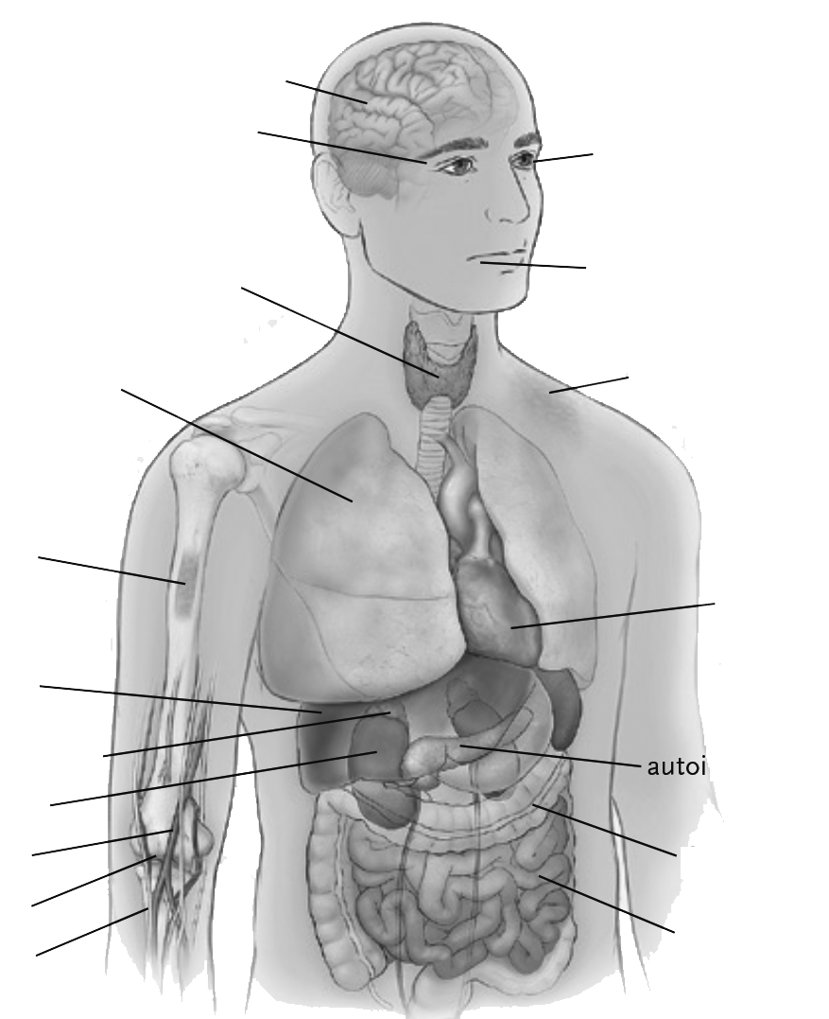
Immune-Related Adverse Events Associated with Immune Checkpoint Blockade 10 questions relevant to the management of immune related adverse events¹
Encephalitis, aseptic meningitis
Why do they occur?
How are they generally treated?
When do they occur?
Why do they occur in some patients and not others?
Are they associated with the efficacy of immune checkpoint blockade?
Does immunosuppression to treat such adverse events reduce the antitumor efficacy of treatment?
Are there unintended effects of immunosuppression to treat adverse events?
Is it safe to restart treatment after a major adverse event?
Is it necessary to restart treatment after resolution of an adverse event?
Is it safe to treat patients at potentially increased risk for such adverse events?
Hypophysitis
Uveitis
Thyroiditis, hypothyroidism, hyperthyroidism
Dry mouth, mucositis
Pneumonitis
Rash, vitiligo
Thrombocytopenia, anaemia
Myocarditis
Hepatitis
Adrenal insufficiency
Pancreatitis, autoimmune diabetes
Nephritis
Colitis
Enteritis
Neuropathy
Figure adapted from Postow et al. 2018¹
1. Postow MA, et al. N Engl J Med. 2018;378(2):158-68
Notes:
REF: Postow, M. A., Sidlow, R., & Hellmann, M. D. (2018). Immune-related adverse events associated with immune checkpoint blockade. New England Journal of Medicine, 378(2), 158-168.

Slide 21
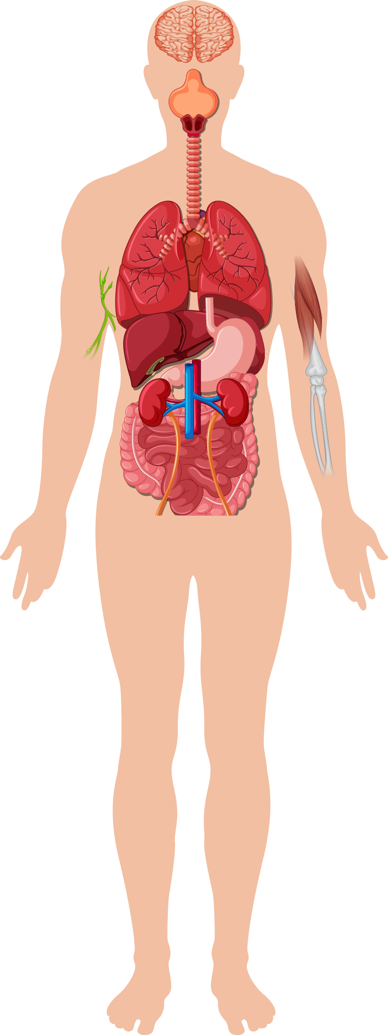
Immune-Related Adverse Events affected organs and manifestations
Timing of occurrence of immune-related events following ipilimumab treatment
Neurologic system
Neuropathy
Myelopathy
Guillain-Barré syndrome
Myasthenia gravis-like syndrome
Encephalitis, meningitis
Eyes
Conjunctivitis
Uveitis, iritis, retinitis
Scleritis, episcleritis
Blepharitis
Endocrine system
Hypo- or hyperthyroidism
Hypophysitis, hypopituitarism
Adrenal insufficiency
Type 1 diabetes
6-8 weeks
Cardiovascular system
Myocarditis
Pericarditis
Vasculitis
Rash, pruritis
Diarrhoea, colitis
Hypophysitis
Liver toxicity
Lungs
Pneumonitis
Pleuritis
Interstitial lung disease
Liver
Hepatitis
Kidneys
Nephritis
Lupus-like glomerulonephritis
Gastrointestinal tract
Colitis
Ileitis
Pancreatitis
Gastritis
Perforation
Toxicity grade
Musculoskeletal system
Arthralgias, arthritis
Myalgias, myositis
Enthesitis
Skin
Dermatitis, erythroderma
Erythema multiforme
Stevens-Johnson syndrome
Toxic epidermal necrolysis
Psoriasis
Vitiligo
Alopecia
0
2
4
6
8
10
12
14
Time (weeks)
Figure adapted from Esfahani et al. 2019¹
Figure adapted from Haanen et al. 2017²
1. Esfahani KH, et al. CMAJ. 2019;191:E40-E46; 2. Haanen JBAG, et al. Ann Oncol. 2017;28:iv119-iv142
Notes:
REF: Haanen, J. B. A. G., Carbonnel, F., Robert, C., Kerr, K. M., Peters, S., Larkin, J., & Jordan, K. (2017). Management of toxicities from immunotherapy: ESMO Clinical Practice Guidelines for diagnosis, treatment and follow-up. Annals of oncology, 28, iv119-iv142.

Slide 22
Atezolizumab + bevacizumab (IMbrave150): Varices and bleeding risk
All-causality adverse events of special interest by medical concept | Atezolizumab plus bevacizumab (N=329) |  | Sorafenib (N=156)
 | All grade | Grade 3 or 4 | All grade | Grade 3 or 4
Bevacizumab related, n(%)
Patients with at least one event | 190 (57.8) | 76 (23.1) | 76 (48.7) | 29 (18.6)
Hypertension | 102 (31.0) | 50 (15.2) | 40 (25.6) | 19 (12.2)
Bleeding/hemorrhage | 83 (25.2) | 21 (6.4) | 27 (17.3) | 9 (5.8)
Proteinuria | 70 (21.3) | 10 (3.0) | 13 (8.3) | 1 (0.6)
Thromboembolic event–venous | 10 (3.0) | 5 (1.5) | 5 (3.2) | 2 (1.3)
Thromboembolic event–arterial | 9 (2.7) | 4 (1.2) | 2 (1.3) | 1 (0.6)
Congestive heart failure | 1 (0.3) | 0 | 2 (1.3) | 0
Finn R, et al. N Engl J Med. 2020;382(20):1894-905 and supplement;
Notes:
REF 1: Finn, R. S., Qin, S., Ikeda, M., Galle, P. R., Ducreux, M., Kim, T. Y., ... & Cheng, A. L. (2020). Atezolizumab plus bevacizumab in unresectable hepatocellular carcinoma. New England Journal of Medicine, 382(20), 1894-1905.
In patients with cirrhosis, the actuarial risk of variceal bleeding is up to 15% after variceal ligation105 and is largely dependent on clinical parameters
pertaining to liver function, but not coagulation disorders.106 In this context, antiangiogenic agents may confer an increased risk, which has long been
acknowledged,107 given the interplay with concomitant cirrhosis (Table 1). Besides variceal bleeding, bleeding events that occur relatively frequently with antiangiogenics include epistaxis and gingival bleeding, which have been reported in patients with HCC108 as well as in non-HCC contexts.109,110 Such minor bleeding events do not require medical attention and their impact can be minimised with adequate patient education.
Among the key exclusion criteria were a history of autoimmune disease, coinfection with hepatitis B or hepatitis C virus, and untreated or incompletely treated esophageal or gastric varices (assessed with esophagogastroduodenoscopy and treated according to local clinical practice) with bleeding or high risk of bleeding.
(uHCC): HIMALAYA." (2022): 379-379.

Slide 23
Polling question What is the most common immune related adverse event in hcc patients?
Diarrhoea and colitis ✅
Infusion-related reactions
Hepatic toxicity
Other
HCC, hepatocellular carcinoma

Slide 24
Gastro intestinal and hepatic Immune-Related Adverse Events Steroids can be used for most immune-related adverse events
Different drugs and regimens¹
Use of steroids for immune related adverse events in
advanced HCC patients in randomised controlled trials
DRUG | Diarrhoea, %* | Colitis, %* | Hepatic, %*
Ipilimumab | 34.0 (7.2) | 11.6 (6.8) | 14.1 (5.5)
Nivolumab | 12.0 (1.0) | 1.0 (0.4) | 7.1 (1.5)
Pembrolizumab | 10.7 (0.6) | 1.9 (1.1) | 1.0 (0.6)
IPI + NIVO High IPI Low IPI | 45.0 (9.0) 21.7 (2.8) | 13.0 (8.0) 1.0 (0.5) | 33.0 (20.0) 3.5 (3.0)
Avelumab | 8.5 (0) | / | 4.2 (1.6)
Atezolizumab | 15.4 (0.7) | 0.3 (0) | 0.3 (0.3)
Durvalumab** | 0.7 (0.2) | 0.4 (0) | 0.7 (0.7)
DRUG | Trial | % use of steroids
Nivolumab | Checkmate459 | 11
Atezolizumab | IMbrave150 | 12
Durvalumab | HIMALAYA | 9.5
STRIDE | HIMALAYA | 20
Pembrolizumab/ lenvatinib | LEAP-002 | 9.6
*Any-grade adverse events (grade ≥3 adverse events)
**percentages reported for durvalumab probably do not reflect the true rate
All data have been averaged
HCC, hepatocellular carcinoma; IPI, ipilimumab; NIVO, nivolumab; STRIDE, Single Tremelimumab Regular Interval Durvalumab
1. Martins F, et al. Nat Rev Clin Oncol. 2019;16(9):563-80
Notes:
REF: Martins, F., Sofiya, L., Sykiotis, G. P., Lamine, F., Maillard, M., Fraga, M., ... & Obeid, M. (2019). Adverse effects of immune-checkpoint inhibitors: epidemiology, management and surveillance. Nature reviews Clinical oncology, 16(9), 563-580.
ISO 690

Slide 25
Atezolizumab + bevacizumab COMBINATION SUMMARY OF ADVERSE EVENTS ≥10% frequency of AEs in either arm and >5% difference between arms
Atezolizumab + bevacizumab
Sorafenib
Diarrhoea
PPE
Decreased appetite
Hypertension
Abdominal pain
Alopecia
Asthenia
Pyrexia
ALT increased
Proteinuria
All-Grade AEs
All-Grade AEs
Infusion-related reaction
Grade 3 or 4 AEs
Grade 3 or 4 AEs
60%
50%
40%
30%
20%
10%
0
10%
20%
30%
40%
50%
60%
AE, adverse event; ALT, alanine aminotransferase; PPE, palmar-plantar erythrodysaesthesia
Finn RS, et al. N Engl J Med. 2020;382(20):1894-905
Notes:
REF: Finn, Richard S., et al. "Atezolizumab plus bevacizumab in unresectable hepatocellular carcinoma." New England Journal of Medicine 382.20 (2020): 1894-1905.
First systemic treatment option to show a statisticallly significant improvement in overall survival compared with single agent Sorafenib

Slide 26
Re-challenging with Immune checkpoint inhibitor after toxicity
ICI-INDUCED ENTERO-COLITIS¹
Grade 2-4 response to CSs:
Initiate 4-8-weekly CSs tapering programme
Upon remission, discuss resuming ICI therapy, weighing oncological benefit against risk of GI irAE recurrence
In the case of relapse, consider infliximab or vedolizumab as below
Grade 2-4 refractory to CSs:
Infliximab 5 mg/kg IV in the more severe forms or vedolizumab 300 mg in the more moderate forms and rapid CS tapering
If no response, consider switching to the other biologic, higher-dose infliximab, faecal microbiota transplantation, ustekinumab, tofacitinib, extracorporeal photopheresis, colectomy and repeat testing for infections
IMMUNE RELATED HEPATOTOXICITY²
ICI-related toxicity: Management of hepatitis
Steroid wean:
Grade 2: Once grade 1, wean over 2 weeks; re-escalate if worsening; treatment may be resumed once prednisolone ≤10 mg
Grade 3 or 4: Once improved to grade 2, can change to oral prednisolone and wean over 4 weeks; for grade 3, re‑challenge only at consultant discretion
Worsening despite steroids:
If on oral change to IV (methyl)prednisolone
If on IV add MMF 500-1000 mg bid
If worse on MMF, consider addition of tacrolimus
A case report has described the use of anti-thymocyte globulin in steroid + MMF-refractory fulminant hepatitis
CS, corticosteroid; GI, gastrointestinal; ICI, immune checkpoint inhibitor; irAE, immune related adverse event; IV, intravenous; MMF, mycophenolate mofetil
1. Haanen J, et al. Ann Oncol. 2022;33(12)1217-38; 2. Haanen JBAG., et al. Ann Oncol. 2017;28, iv119-iv142.
Notes:
REF: Haanen, J. B. A. G., et al. (2017). Annals of oncology, 28, iv119-iv142 + ESMO guideline Slides

Slide 27
Progression Time to switch to 2nd line therapy

Slide 28
Polling question how would you measure progression in hcc patients?
Choi
EASL
RECIST
mRECIST ✅
I am not sure
EASL, European Association for the Study of the Liver (clinical practice guidelines); mRECIST, modified RECIST; RECIST, Response Evaluation Criteria in Solid Tumors

Slide 29
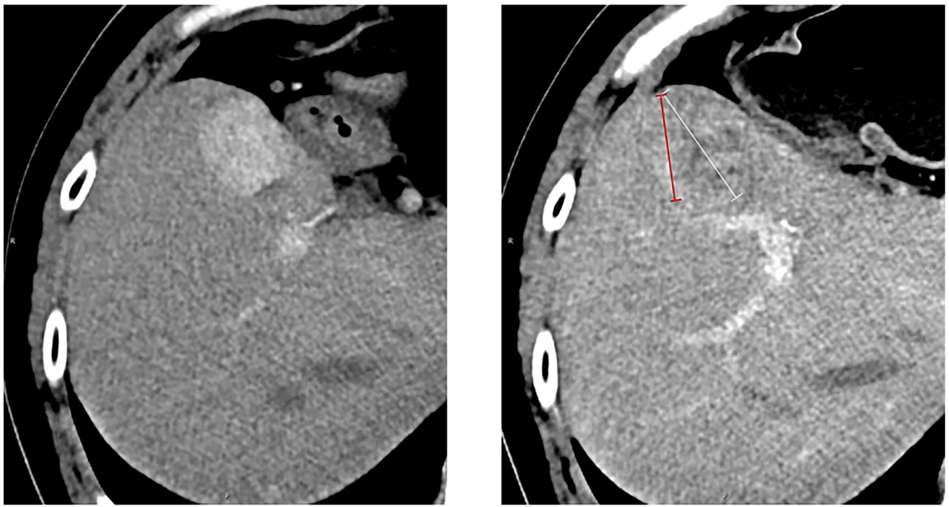
How to measure progression in hcc?
Before start treatment
After immunotherapy
Figure adapted from Zhou et al. 2021¹
HCC, hepatocellular carcinoma
Zhou, et al. Front Oncol. 2021;11:764189
Notes:
REF: Zhou et al. Front Oncol. 2021; 11: 764189

Slide 30
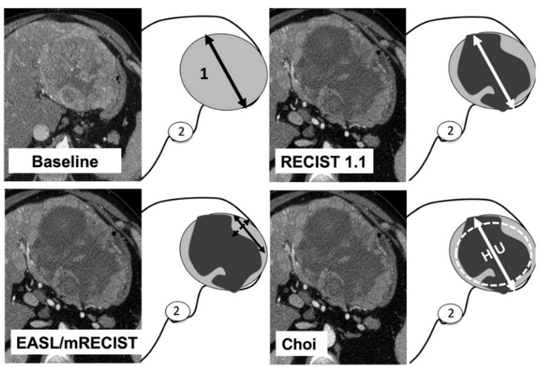
How to measure progression in hcc? mrecist criteria have a powerful ability to discriminate between responders and non responders
Proportions of patients with OR, SD and PD using alternative response criteria
Baseline and post-treatment evaluation
PD N=1
PD N=2
SD N=11
SD N=26
SD N=28
SD N=43
OR N=31
OR N=15
OR N=15
1 = tumour light/dark gray = viable tumour/necrosis
2 = inferior vena cava
RECIST
Choi
EASL
mRECIST
Figures adapted from Ronot et al. 2014
EASL, European Association for the Study of the Liver; HCC, hepatocellular carcinoma; mRECIST, modified RECIST; OR, objective response; PD, progressive disease; RECIST, Response Evaluation Criteria in Solid Tumors; SD, stable disease
Ronot M, et al. Oncologist. 2014;19:394-402
Notes:
REF: Ronot et al. The Oncologist 2014;19:394–402.

Slide 31
Conclusion Reviewing the outcomes in HCC with 1st line IO: when is the right time to switch?
HCC is an increasing global health care challenge
IO is an effective standard-of-care 1st line treatment in advanced HCC with rare but potentially dangerous side-effects
Switching to 2nd line after IO 1st line should be considered in case of toxicity or disease progression
Measuring disease-progression in HCC can be challenging as there are several methods with different evaluation criteria
mRECIST criteria have a powerful ability to discriminate between responders and non-responders
HCC, hepatocellular carcinoma; IO, immunotherapy; mRECIST, modified Response Evaluation Criteria in Solid Tumors

Slide 32
discussion

Slide 33
Patients with advanced hcc not eligible for IO in 1st line the role of tkis as the primary treatment option
Prof. Michel Ducreux
HCC, hepatocellular carcinoma; IO, immunotherapy; TKI, tyrosine kinase inhibitor

Slide 34
Polling question Which patient group is eligible for IO 1st line?
Patients with active or uncontrolled auto-immune disease
HCC recurrent patients after liver transplantation
Patients with a significant bleeding history ✅
*These patients are now eligible for durvalumab + tremelimumab
None of those
All of those
I am not sure
HCC, hepatocellular carcinoma; IO, immunotherapy

Slide 35
Polling question How would you treat a post-liver transplant patient with advanced recurrent hcc in 1st line?
With single agent immunotherapy
With immunotherapy based combination treatment, such as durvalumab + tremelimumab or atezolizumab + bevacizumab
With TKIs, such as lenvatinib or sorafenib ✅
With chemotherapy
I am not sure
HCC, hepatocellular carcinoma; TKI, tyrosine kinase inhibitor

Slide 36
The HCC systemic treatment landscape has rapidly evolved since 2017
First-line therapies
Nov 2007
Aug 2018
May/Nov 2020
Oct 2022
Sorafenib approved for patients with uHCC
Lenvatinib approved by the FDA and EMA for patients with uHCC based on the REFLECT study results^{4,5}
Atezolizumab + bevacizumab approved by the FDA, EMA, and others for patients with uHCC based on the IMbrave150¹²
Durvalumab + tremelimumab approved by the FDA and EMA for patients with uHCC based on the HIMALAYA^{14,15}
Apr 2017
Sep 2017
Nov 2018
Jan 2019
May 2019
Mar 2020
Mar 2020
Regorafenib approved for patients with HCC previously treated with sorafenib²
Accelerated FDA approval of nivolumab* for patients with HCC previously treated with sorafenib³
Pembrolizumab‡ granted FDA accelerated approval for patients with HCC previously treated with sorafenib based on KEYNOTE-224⁶
Cabozantinib approved by both the EMA (Nov 2018) and FDA (Jan 2019) for patients with HCC previously treated with sorafenib based on CELESTIAL^{7,8}
Ramucirumab approved by both the FDA (May 2019) and EMA (July 2019) for patients with HCC previously treated with sorafenib, with AFP levels ≥400 ng/mL based on REACH-2^{9,10}
Nivolumab + ipilimumab received accelerated approval by the FDA for patients with HCC previously treated with sorafenib based on CheckMate-040¹¹
Camrelizumab
received NMPA approval for patients with HCC previously treated with sorafenib and/or oxaliplatin systemic chemotherapies based on a phase 2 study (NCT02989922)¹³
Second-line therapies
Negative phase 3 trials
AFP, alpha-fetoprotein; EMA, European Medicines Agency; FDA, Food and Drug Administration; HCC, hepatocellular carcinoma; NMPA, National Medical Products Administration; OS, overall survival; PFS, progression-free survival; uHCC, unresectable HCC
1. Nexavar (sorafenib) Full Prescribing Information. Bayer HealthCare Pharmaceuticals, Whippany, NJ. 2020 (accessed May 2020); 2. FDA regorafenib in HCC press release. Available from: https://www.fda.gov/NewsEvents/Newsroom/PressAnnouncements/ucm555608.htm (accessed May 2020); 3. FDA press release. Available from: https://www.fda.gov/Drugs/InformationOnDrugs/ApprovedDrugs/ucm577166.htm (accessed May 2020); 4. FDA press release. Available from: https://www.fda.gov/Drugs/InformationOnDrugs/ApprovedDrugs/ucm617185.htm (accessed May 2020); 5. Merck press release. Available from: https://investors.merck.com/news/press-release-details/2018/Eisai-and-Merck-Announce-European-Commission-Grants-Marketing-Authorization-for-LENVIMA-lenvatinib-as-First-Line-Treatment-in-Adults-with-Advanced-or-Unresectable-Hepatocellular-Carcinoma/default.aspx (accessed May 2020); 6. FDA press release. Available from: https://www.fda.gov/drugs/fda-grants-accelerated-approval-pembrolizumab-hepatocellular-carcinoma (accessed May 2020): 7. Ipsen press release. Available from: https://www.ipsen.com/media/press-relases/post_custom_datacustom_datapost_custom_datacustom_dataeuropean-commission-approves-ipsens-cabometyx-cabozantinib-for-the-treatment-of-hepatocellular-carcinoma-in/ (accessed May 2020); 8. FDA press release. Available from: https://www.fda.gov/Drugs/InformationOnDrugs/ApprovedDrugs/ucm629512.htm (accessed May 2020): 9. FDA press release https://www.fda.gov/drugs/resources-information-approved-drugs/fda-approves-ramucirumab-hepatocellular-carcinoma (accessed May 2020); 10. Cyramza (ramucirumab) EMA approval. EMA summary of opinion. Available from: https://www.ema.europa.eu/en/documents/smop/chmp-post-authorisation-summary-positive-opinion-cyramza-ii-27_en.pdf (accessed May 2020); 11. FDA press release. Available from: https://www.fda.gov/drugs/resources-information-approved-drugs/fda-grants-accelerated-approval-nivolumab-and-ipilimumab-combination-hepatocellular-carcinoma (accessed May 2020); 12. ASCO Post press release. Available from: https://www.ascopost.com/news/may-2020/fda-approves-atezolizumab-plus-bevacizumab-for-patients-with-unresectable-or-metastatic-hcc/ (accessed May 2020); 13. Qin S. et al, Lancet Oncol. 2020;21(4):571-580; 14. Food and Drug Administration. (2022). Available from: https://www.fda.gov/drugs/resources-information-approved-drugs/fda-approves-tremelimumab-combination-durvalumab-unresectable-hepatocellular-carcinoma (accessed March 2023). 15. European Medicines Agency. (2022). Available from: https://www.ema.europa.eu/en/documents/smop-initial/chmp-summary-positive-opinion-imjudo_en.pdf (accessed March 2023)
Notes:
References
Nexavar (sorafenib) Full Prescribing Information. Bayer HealthCare Pharmaceuticals, Whippany, NJ. 2020 (accessed May 2020)
FDA regorafenib in HCC press release. Available from: https://www.fda.gov/NewsEvents/Newsroom/PressAnnouncements/ucm555608.htm (accessed May 2020)
Cheng A-L, et al. J Clin Oncol 2017;35(suppl 15):Abstract 4001
FDA press release. Available from: https://www.fda.gov/Drugs/InformationOnDrugs/ApprovedDrugs/ucm577166.htm (accessed May 2020)
Abou-Alfa GK, et al. N Engl J Med 2018;379:54–63
Eisai press release. Available from: https://www.eisai.com/news/2018/news201823.html (accessed May 2020)
Zhu AX, et al. Lancet Oncol 2019;20:282–296
Roche press release. Available from: https://www.roche.com/media/releases/med-cor-2018-07-18.htm (accessed May 2020)
FDA press release. Available from: https://www.fda.gov/Drugs/InformationOnDrugs/ApprovedDrugs/ucm617185.htm (accessed May 2020)
Merck press release. Available from: https://investors.merck.com/news/press-release-details/2018/Eisai-and-Merck-Announce-European-Commission-Grants-Marketing-Authorization-for-LENVIMA-lenvatinib-as-First-Line-Treatment-in-Adults-with-Advanced-or-Unresectable-Hepatocellular-Carcinoma/default.aspx (accessed May 2020)
FDA press release. Available from: https://www.fda.gov/drugs/fda-grants-accelerated-approval-pembrolizumab-hepatocellular-carcinoma (accessed May 2020)
Ipsen press release. Available from: https://www.ipsen.com/media/press-relases/post_custom_datacustom_datapost_custom_datacustom_dataeuropean-commission-approves-ipsens-cabometyx-cabozantinib-for-the-treatment-of-hepatocellular-carcinoma-in/ (accessed May 2020)
FDA press release. Available from: https://www.fda.gov/Drugs/InformationOnDrugs/ApprovedDrugs/ucm629512.htm (accessed May 2020)
FDA press releasehttps://www.fda.gov/drugs/resources-information-approved-drugs/fda-approves-ramucirumab-hepatocellular-carcinoma (accessed May 2020)
Cyramza (ramucirumab) EMA approval. EMA summary of opinion. Available from: https://www.ema.europa.eu/en/documents/smop/chmp-post-authorisation-summary-positive-opinion-cyramza-ii-27_en.pdf (accessed May 2020)
Roche press release. Available from: https://www.roche.com/media/releases/med-cor-2019-10-21.htm (accessed May 2020)
17. FDA press release. Available from: https://www.fda.gov/drugs/resources-information-approved-drugs/fda-grants-accelerated-approval-nivolumab-and-ipilimumab-combination-hepatocellular-carcinoma (accessed May 2020)
18. ASCO Post press release. Available from: https://www.ascopost.com/news/may-2020/fda-approves-atezolizumab-plus-bevacizumab-for-patients-with-unresectable-or-metastatic-hcc/ (accessed May 2020)
19. BMS press release. Available from: https://news.bms.com/press-release/bmy/bristol-myers-squibb-announces-results-checkmate-459-study-evaluating-opdivo-nivol (accessed May 2020)
20. Finn RS, et al. Oral Presentation 4004 at ASCO 2019: J Clin Oncol 2019;37(suppl):Abstract 4004
21. Merck press release. Available from: https://investors.merck.com/news/press-release-details/2019/Merck-Provides-Update-on-KEYNOTE-240-a-Phase-3-Study-of-KEYTRUDA-pembrolizumab-in-Previously-Treated-Patients-with-Advanced-Hepatocellular-Carcinoma/default.aspx (accessed May 2020)
22.
Durvalumab + Tremelimumab:
Food and Drug Administration. (2022). Available from: https://www.fda.gov/drugs/resources-information-approved-drugs/fda-approves-tremelimumab-combination-durvalumab-unresectable-hepatocellular-carcinoma (accessed March 2023).
European Medicines Agency. (2022). Available from: https://www.ema.europa.eu/en/documents/smop-initial/chmp-summary-positive-opinion-imjudo_en.pdf (accessed March 2023)

Slide 37
ESMO HCC guidelines e-update (March 2021) optional systemic treatment 1st line: Lenvatinib and sorafenib
BCLC 0-A
BCLC B
BCLC C
BCLC D
Resection LTX
(III, A)
Ablation (III, A) TACE (I, B)
LTX Resection
(III, A)
TACE
(I, A)
Standard: Atezolizumab + bevacizumab (I, A; MCBS 5)^{b}
Option:
Sorafenib (I, A; MCBS 4)^{b} Lenvatinib (I, A)^{c}
BSC
(III, A)
SBRTª Brachytherapyª SIRTª
(III, C)
SIRTª
(III, C)
Not suitable for local therapies
Systemic therapy
(I, A)
Standard after sorafenib Cabozantinib (I, A; MCBS 3)^{b}
Regorafenib^{d} (I, A; MCBS 4)^{b} Ramucirumab^{e} (I, A; MCBS 1)^{b}
Option after Atezolizumab +
Bevacizumab/lenvatinib Sorafenib (V, C)
Lenvatinib (V, C)
Cabozantinib (V, C)
Regorafenib^{d} (V, C)
Ramucirumab^{e} (V, C)
ª Non-standard, alternative treatment
^{b} ESMO-MCBS v1.1 score for new therapy/indication approved by the EMA since 1 January 2016. The score has been calculated by the ESMO-MCBS Working Group and validated by the ESMO Guidelines Committee
^{c} Non-inferiority to sorafenib established; no evaluable benefit
^{d} Regorafenib is not recommended in TKI-naive patients
^{e} Ramucirumab is only recommended in patients with an AFP level ≥ 400 ng/mL
AFP, alpha fetoprotein; BCLC, Barcelona Clinic Liver Cancer; BSC, best supportive care; EMA, European Medicines Agency; ESMO. European Society for Medical Oncology; HCC, hepatocellular carcinoma; LTx, liver transplantation; MCBS, magnitude of clinical benefit scale; SBRT, stereotactic body radiation therapy; SIRT, selective internal radiation therapy; TACE, transarterial chemoembolisation; TKI, tyrosine kinase inhibitor
1. Vogel A, et al. Ann Oncol. 32(6):801-5
Notes:
REF: Vogel, A., Martinelli, E., Cervantes, A., Chau, I., Daniele, B., Llovet, J. M., ... & Arnold, D. (2021). Updated treatment recommendations for hepatocellular carcinoma (HCC) from the ESMO Clinical Practice Guidelines. Annals of Oncology, 32(6), 801-805.

Slide 38
1st-line treatment options for patients not eligible for IO Tkis Sorafenib and lenvatinib
Overall survival in the SHARP trial¹
Overall survival in the REFLECT* trial²
Median OS: 10.7 months sorafenib vs 7.9 months placebo HR 0.69 (95% CI 0.55-0.87), p<0.001¹
Median OS: 13.6 months lenvatinib vs 12.3 months sorafenib HR 0.92 (95% CI 0.79-1.06)²
1.00
1.00
Sorafenib
Placebo
Sorafenib
Lenvatinib
0.75
0.75
Probability of survival
Probability of survival
0.50
0.50
0.25
0.25
0.00
0.00
0
2
4
6
8
10
12
14
16
0
3
6
9
12
15
18
21
24
27
30
33
36
39
42
Months since randomisation
Months since randomisation
*REFLECT is a randomised phase 3 non-inferiority trial
CI, confidence interval; HR, hazard ratio; IO, immunotherapy; OS, overall survival; TKI, tyrosine kinase inhibitor
1. Llovet JM, et al. N Engl J Med. 2008;359(4):378-90; 2. Kudo M, et al. Lancet. 2018;391(10126):1163-73

Slide 39
ESMO HCC guidelines e-update (March 2021) optional systemic treatment 1st line: Lenvatinib and sorafenib
BCLC 0-A
BCLC B
BCLC C
BCLC D
Resection LTX
(III, A)
Ablation (III, A) TACE (I, B)
LTX Resection
(III, A)
TACE
(I, A)
Standard: Atezolizumab + bevacizumab (I, A; MCBS 5)^{b}
Option:
Sorafenib (I, A; MCBS 4)^{b} Lenvatinib (I, A)^{c}
BSC
(III, A)
SBRTª Brachytherapyª SIRTª
(III, C)
SIRTª
(III, C)
Not suitable for local therapies
Systemic therapy
(I, A)
Standard after sorafenib Cabozantinib (I, A; MCBS 3)^{b}
Regorafenib^{d} (I, A; MCBS 4)^{b} Ramucirumab^{e} (I, A; MCBS 1)^{b}
Option after Atezolizumab +
Bevacizumab/lenvatinib Sorafenib (V, C)
Lenvatinib (V, C)
Cabozantinib (V, C)
Regorafenib^{d} (V, C)
Ramucirumab^{e} (V, C)
Who are these patients?
ª Non-standard, alternative treatment
^{b} ESMO-MCBS v1.1 score for new therapy/indication approved by the EMA since 1 January 2016. The score has been calculated by the ESMO-MCBS Working Group and validated by the ESMO Guidelines Committee
^{c} Non-inferiority to sorafenib established; no evaluable benefit
^{d} Regorafenib is not recommended in TKI-naive patients
^{e} Ramucirumab is only recommended in patients with an AFP level ≥ 400 ng/mL
AFP, alpha fetoprotein; BCLC, Barcelona Clinic Liver Cancer; BSC, best supportive care; EMA, European Medicines Agency; ESMO. European Society for Medical Oncology; HCC, hepatocellular carcinoma; LTx, liver transplantation; MCBS, magnitude of clinical benefit scale; SBRT, stereotactic body radiation therapy; SIRT, selective internal radiation therapy; TACE, transarterial chemoembolisation; TKI, tyrosine kinase inhibitor
1. Vogel A, et al. Ann Oncol. 32(6):801-5

Slide 40
patients with liver transplantation

Slide 41
Patients with liver transplantation Liver transplantation can be curative, but HCC recurs in 10-16% of patients¹
Retrospective study with 121 HCC recurrent patients²
Median time to recurrence: 14 months
41% early recurrence (<1 year)
31% treated with curative intent
42% palliative treatment
26% supportive care only
100
80
p<0.001
60
Actuarial survival
40
Curative-intent treatments
N=38
20
Not amenable to
curative treatments
N=83
0
0
12
24
36
48
60
Months after HCC recurrence diagnosis
Figure adapted from Saposochin et al. 2015²
HCC, hepatocellular carcinoma
1. Rimassa L, et al. J Hepatol. 2021:74;P931-43; 2. Sapisochin G, et al. Ann Surg Oncol. 2015;22:2286-94

Slide 42
Patients with liver transplantation type of recurrence (n=121)
Lung 43%
Bone metastases 26%
Adrenal 9%
Lymph nodes 11%
Peritoneal carcinomatosis 11%
Sapisochin G, et al. Ann Surg Oncol. 2015;22:2286-94

Slide 43
Patients with liver transplantation Role of immuno-suppression in the incidence of recurrence
219 patients, Milan criteria
HCC recurrence rates: 17.6% at 5 years
Not influenced by use of corticosteroids and antimetabolites
Similar with cyclosporine and tacrolimus
But: higher exposure to calcineurin inhibitors within the first month after liver transplantation associated with higher risk of recurrence: 27.7% versus 14.7 at 5 years
Within MILAN criteria
High CNI exposure
Reduced CNI exposure
1.0
0.8
Cumulative disease‑free survival
0.6
0.4
p=0.004
0.0
0
30
60
90
120
150
Follow-up (months)
HCC recurrence % (No. at risk) | 1 year | 3 years | 5 years
High CNI exposure (n=36) | 5.7 (32) | 14.7 (27) | 22 (21)
Reduced CNI exposure (n=106) | 1 (99) | 5.5 (79) | 7 (48)
Figure adapted from Rodiguez-Peralvarez et al. 2013
Little information is available on the safety of IO therapy in patients with liver or other solid organ transplants since they were excluded from trials
CNI, calcineurin inhibitor; HCC, hepatocelular carcinoma; IO, immunotherapy
Rodriguez-Peralvarez M, et al. J Hepatol. 2013;59:1193-9

Slide 44
Patients with liver transplantation High rejection risk with immunotherapy
Prior organ transplantation | Checkpoint inhibitor | Allograft rejection, no./reported cases (%) | Median time to rejection, days (range)
Hepatic | Ipilimumab | 1/3 (33) | 13
 | Nivolumab | 2/4 (50) | 12.5 (7-18)
 | Pembrolizumab | 1/3 (33) | 7
 | Ipilimumab followed by pembrolizumab | 0/1 (0)
 | All | 4/11 (36) | 10 (7-18)
Table adapted from Abdel-Wahab et al. 2019
Abdel-Wahab N, et al. J Immunother Cancer. 2019;7:106

Slide 45
patients with liver transplantation Sorafenib and Lenvatinib for recurrent hcc patients
HCC, hepatocelular carcinoma

Slide 46
Patients with liver transplantation sorafenib provides clinical benefit to patients with recurrent HCC
Retrospective study: OS by prior transplantation status of
patients treated with sorafenib⁵
Sorafenib has demonstrated improvements in OS vs BSC in the post-transplant setting¹⁻³
Patients with liver transplantation are typically excluded from RCTs⁴
Patient outcomes with liver transplantation may be better than without due to preserved liver function
1.0
Non-LT group
LT group
0.8
0.6
Med.: 16.8
Survival probability
0.4
0.2
p<0.001
Med.: 7.1
0.0
0
12
24
36
48
60
Time (months)
Numbers at risk
Non-LT group
LT group
790
42
186
20
80
8
27
6
13
3
9
1
Figure adapted from Lee et al. ⁵
BSC, best supportive care; HCC, hepatocellular carcinoma; LT, liver transplantation; Med., median; OS, overall survival; RCT, randomised controlled trial
1. Kang SH, et al. J Korean Med Sci. 2018;33:e283; 2. Sposito C, et al. J Hepatol. 2013;59:59-66; 3. de’Angelis N, et al. Prog Transplant. 2016;26:348-355; 4. Masi G, et al. Poster P-024; presented at EASL Digital Liver Cancer Summit 2021. Abstract P-024; 5. Lee SK, et al. Hepatol Int. 2021;15:137-45

Slide 47
The sorafenib-regorafenib sequence extending survival in HCC recurrence after liver transplantation
Survival according to treatment after sorafenib discontinuation in liver transplants
The median OS was:
14 months (95% CI, 9-19) sorafenib-regorafenib 4.5 months (95% CI, 0-15) sorafenib-BSC P<0.005
100
Retrospective, multicenter, international study of
32 patients who discontinued sorafenib due to progression
REGO
BSC
80
60
Survival probability (%)
58% (95% CI, 38-78)
Median OS from the start of sorafenib was:
32.6 months (95% CI, 18-46) sorafenib-regorafenib
14.3 months (95% CI, 7-21) sorafenib-BSC
P=0.001 (secondary endpoint)
41% (95% CI, 19-63)
40
37% (95% CI, 13-61)
P<0.005
20
0
Patients still at risk | Months | 0 | 3 | 6 | 9 | 12 | 15 | 18 | 21 | 24
 | REG | 28 | 26 | 23 | 17 | 11 | 8 | 5 | 2 | 2
 | BSC | 19 | 10 | 7 | 6 | 5 | 4 | 3 | 1 | 1
BSC, best supportive care; CI, confidence interval; HCC, hepatocellular carcinoma; OS, overall survival; REGO, regorafenib;
Iavarone M, et al. Liver Transpl. 2021;27(12):1767-78
Notes:
REF Iavarone, M., Invernizzi, F., Ivanics, T., Mazza, S., Zavaglia, C., Sanduzzi‐Zamparelli, M., ... & Reig, M. (2021). Regorafenib efficacy after sorafenib in patients with recurrent hepatocellular carcinoma after liver transplantation: a retrospective study. Liver Transplantation, 27(12), 1767-1778.

Slide 48
Patients with liver transplantation Meta-analysis shows 1-year survival rate of 63% for patients taking sorafenib for HCC recurrence post-Liver Transplantation
1-year survival rates of patients treated with sorafenib for HCC recurrence after LT in eight studies using a random-effects model (n=113)
Zavaglia
Waghray
Sposito
Vitale
Stoufer
Gomez
Yoon
Tan
1-year survival rate
63% (95% CI: 47, 78)
Summary
0
20
40
60
80
100
1-year survival rate
CI, confidence interval; HCC, hepatocellular carcinoma; LT, liver transplantation
Mancuso A, et al. Dig and Liv Dis. 2015;47:324-30
Notes:
REF Iavarone, M., Invernizzi, F., Ivanics, T., Mazza, S., Zavaglia, C., Sanduzzi‐Zamparelli, M., ... & Reig, M. (2021). Regorafenib efficacy after sorafenib in patients with recurrent hepatocellular carcinoma after liver transplantation: a retrospective study. Liver Transplantation, 27(12), 1767-1778.

Slide 49
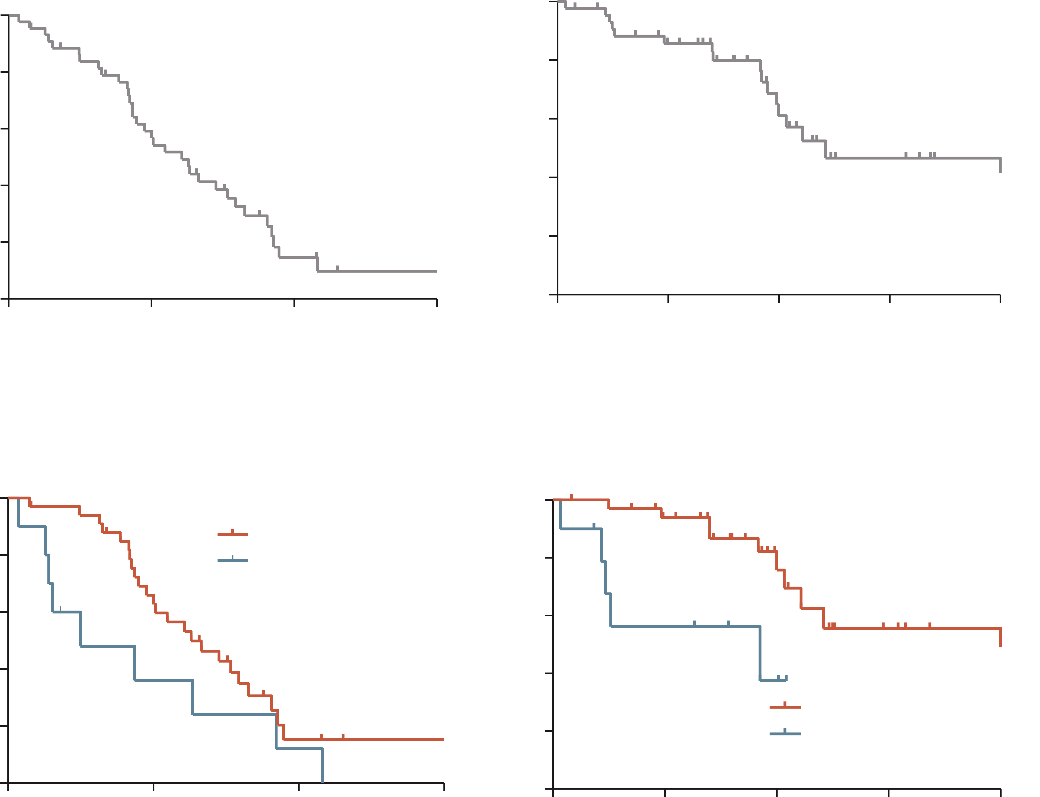
Patients with liver transplantation few data on lenvatinib in patients with recurrent HCC
PFS
OS
45 patients
43 Child-Pugh A
78% ALBI 1
22% ALBI 2
ORR: 20%
Median PFS: 7.6 months
Median OS: 14.5 months
100
100
80
80
60
60
Progression-free survival (%)
Overall survival (%)
40
40
20
Median PFS 7.6 months
(95% CI, 5.3-9.8 months)
20
Median OS 14.5 months
(95% CI, 0.8-28.2 months)
0
0
0
6
Months
12
18
0
6
12
18
24
Months
According to ALBI score
100
100
80
ALBI Grade 1 (N=35)
ALBI Grade 2 (N=10)
80
60
p=0.078
60
Progression-free survival (%)
Overall survival (%)
40
40
20
20
ALBI Grade 1 (N=35)
ALBI Grade 2 (N=10)
0
p=0.003
0
6
12
18
0
0
6
12
18
24
Months
Months
ALBI, Albumin-Bilirubin; CI, confidence interval; HCC, hepatocellular carcinoma; PFS, progression free survival; ORR, objective response rate; OS, overall survival
Bang K, et al. Cancer Med. 2023;12(3):2572-9

Slide 50
Before liver transplantation
The role of neoadjuvant treatment including immunotherapy is less clear
Immunotherapy pre liver transplantation may facilitate down staging of unresectable HCC bridging to liver transplantation eligibility
However, higher risk of donor graft rejection
Limited data in the literature¹
10 patients
80% objective response rate
100% disease control rate
Biopsy-proven acute rejection incidence: 30%
2 patients died from rejection
HCC, hepatocellular carcinoma
1. Qiao Z-Y, et al. Front Immunol. 2021;12:653437

Slide 51
patients with auto-immune disease (AID)

Slide 52
Patients with auto-immune disease have routinely been excluded from clinical trials
Patients with HCC may suffer from:
Hepatobiliary auto-immune diseases
Primary biliary cholangitis
Primary sclerosing cholangitis
Auto-immune hepatitis
Other auto-immune diseases
Rheumatoid arthritis
Type 1 diabetes
Psoriasis
Hypothyroidism
Data on the safety of immunotherapy in individuals with pre-existing AID are limited and restricted to case reports and retrospective cohorts
45 – 85 patients
Studies including a large variety of AIDs, which makes impossible to draw firm conclusions
AID, auto-immune disease; HCC, hepatocellular carcinoma
Pinter M, et al. Gut. 2021;70:204-14

Slide 53
Patients with auto-immune disease Immunotherapy can lead to adverse effects
In a multicenter retrospective cohort study¹ of patients with pre-existing autoimmune disease receiving ICI as cancer treatment (n=112) over a median follow up of 8 months:
71% of patients had a flare of a pre-existing autoimmune disease and/or another immune-related adverse effects related to ICI treatment
47% of patients had flares of pre-existing autoimmune disease
30% had severe flares
42% of patients had other immune-related adverse effects
40% had severe effects
AIDs with a potential high mortality on reactivation, such as neurological disorders or hepatobiliary disorders are underrepresented in such studies
AID, auto-immune disease; ICI, immune checkpoint inhibitor
Tison A, et al. Arthritis Rheumatol. 2019;71:2100-11

Slide 54
Patients with auto-immune disease contraindication for immunotherapy
Recent recommendations suggest:
“Immunotherapy should be avoided when reactivation of autoimmune disease may be life-threatening, in those with neurological or neuromuscular disease or in those on high doses of immunosuppression”
Pinter M, et al. Gut 2021;70:204-14

Slide 55
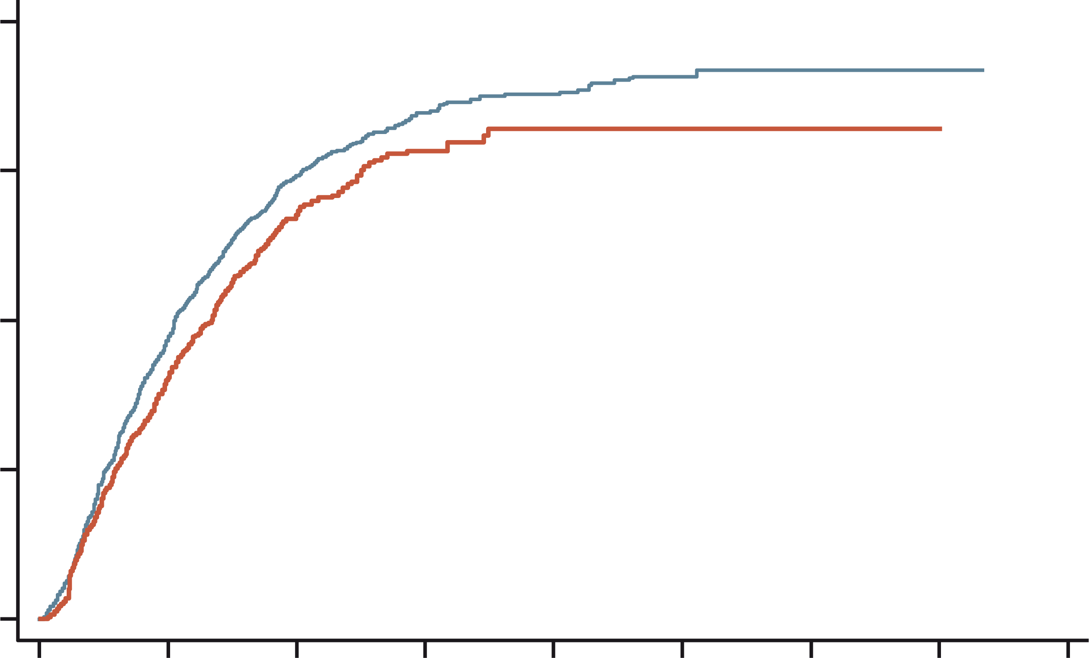
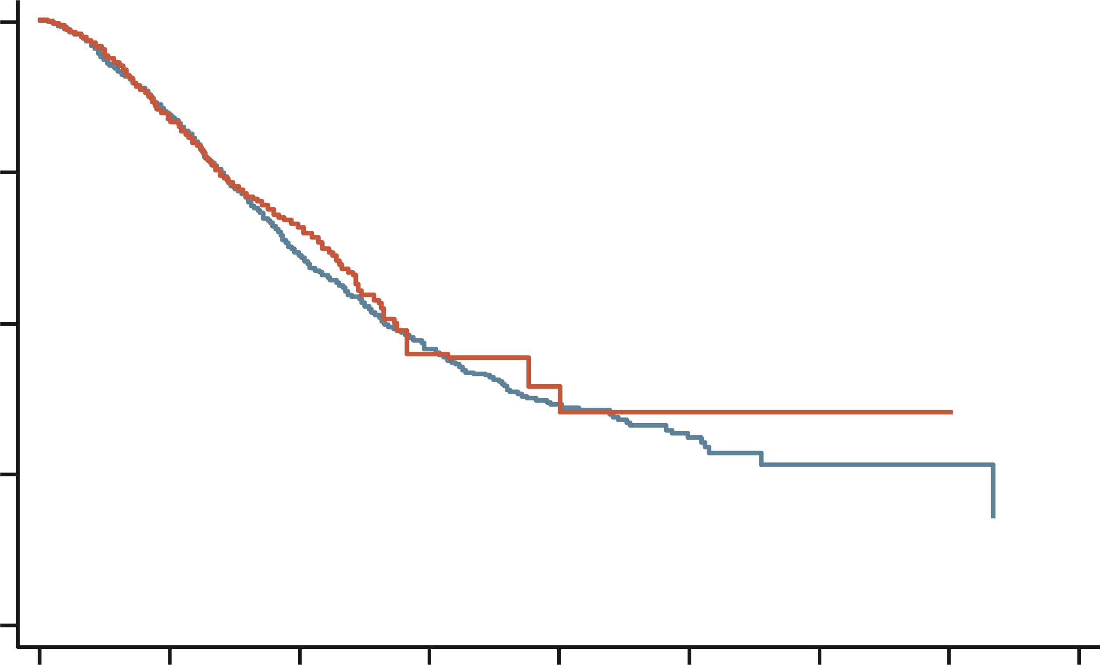
lenvatinib vs atezolizumab + bevacizumab in real life No meaningful difference in Overall survival
1341 patients treated with lenvatinib
864 with atezolizumab + bevacizumab
1.00
Lenvatinib
1.00
0.75
Atezolizumab + Bevacizumab
0.75
Time-to-progression
Overall survival
Atezolizumab + Bevacizumab
0.50
0.50
0.25
0.25
Lenvatinib
0.00
0.00
0
6
12
18
24
30
36
42
48
0
6
12
18
24
30
36
42
48
Time (months)
Time (months)
Weighted #at risk
Atezo + Bev
Lenvatinib
Weighted #at risk
Atezo + Bev
Lenvatinib
864
1343
399
582
114
196
22
64
4
33
4
11
4
1
2
1
0
0
864
1343
581
918
255
476
43
220
9
110
5
36
5
5
2
4
0
2
atezo, atezolizumab; bev, bevacizumab
Casadei-Gardini A, et al. Eur J Cancer. 2023;180:9-20
Notes:
showing in the real word that a choice with TKI is not a “low cost choice”

Slide 56
patients with a significant bleeding history

Slide 57
Polling question what would be the preferred 1st line treatment for patients with a significant bleeding history?
Durvalumab
Lenvatinib
Sorafenib
Durvalumab + tremelimumab ✅
Atezolizumab + bevacizumab
I am not sure

Slide 58
Patients with a significant bleeding history no longer a concern
When patients are not good candidates for atezolizumab + bevacizumab¹
When to consider patients for treatment with durvalumab + tremelimumab²
 | Atezo + bev (N=336) | Sorafenib (N=165)
Median OS, months (95% CI) | 19.2 (17.0-23.7) | 13.4 (11.4-16.9)
Stratified* HR (95% CI) | 0.66 (0.52-0.85)
p value | p=0.0009‡
 | T300+D (N=393) | Sorafenib (N=389)
OS events, n (%) | 262 (66.7) | 293 (75.3)
Median OS (95% CI), months | 16.4 (14.2-19.6) | 13.8 (12.3-16.1)
HR (96.02% CI) | 0.78 (0.65–0.92)
p-value (2-sided) | 0.0035
1.0
0.9
0.8
18-mo OS:
48.7%
41.5%
1.0
0.7
24-mo OS:
40.5%
32.6%
0.6
36-mo OS:
30.7%
20.2%
Probability of overall survival
0.8
0.5
0.4
0.6
0.3
OS estimate
0.2
T300+D
0.1
Sorafenib
0.4
0.0
0
6
12
18
24
30
36
42
48
0.2
No.at risk
T300+D
Sorafenib
Time from randomisation (months)
393 | 308 | 235 | 190 | 158 | 98 | 32 | 1 | 0
389 | 283 | 211 | 155 | 121 | 62 | 21 | 1 | 0
0.0
13.4
19.2
0
1
2
3
4
5
6
7
8
9
10
11
12
13
14
15
16
17
18
19
20
21
22
23
24
25
26
27
28
29
Data cut-off: August 27, 2021. Median duration of follow-up was 33.18 (95% CI, 31.74-34.53) months for T300+D and 32.23 (95% CI, 30.42-33.71) months for sorafenib.
Time (months)
*Stratification factors included are geographic region (Asia excluding Japan vs RoW), AFP level (<400ng/mL vs ≥400ng/mL) at baseline and MVI and/or EHS (yes vs no) per IxRS; ‡p value for descriptive purposes only
AFP, alpha fetoprotein; CI, confidence interval; EHS, extrahepatic spread; HR, hazard ratio; IxRS, interactive voice/web response system; MVI, microvascular invasion; OS, overall survival; Q4W, every 4 weeks; RoW, rest of world; T300+D, tremelimumab 300 mg × 1 dose + durvalumab 1500 mg Q4W
1. Cheng AL, et al. J Hepatol. 2022;76(4):862-73 ; 2. Abou-Alfa GK, et al. NEJM Evid. 2022;1.8

Slide 59
etiology of the liver disease

Slide 60
The impact of underlying liver disease on treatment efficacy viral vs. non-viral etiology
The atezolizumab + bevacizumab combination seems to be less effective in non-viral HCC
Characteristic (n) | Atezo + Bev mOS, mo | Sorafenib mOS, mo |  | HR (95% CI)
All patients (501) | 19.2 | 13.4 |  | 0.66 (0.52-0.85)
Hepatitis B virus HCC (240) | 19.0 | 12.4 |  | 0.58 (0.40, 0.83)
Hepatitis C virus HCC (108) | 24.6 | 12.6 |  | 0.43 (0.25, 0.73)
Non-viral HCC (153) | 17.0 | 18.1 |  | 1.05 (0.68, 1.63)
0.2
1.0
2.0
Favours atezo + bev
Favours sorafenib
Limitations :
Small sample size
Study not powered for subgroup analysis
Clinical cut-off date: 31 August 2020; median follow-up: 15.6 months *HRs are from unstratified analyses
atezo, atezolizumab; bev, bevacizumab; CI, confidence interval; HCC, hepatocellular carcinoma; HR, hazard ratio; mo, months; mOS, median OS; mPFS, median PFS; OS, overall survival; PFS, progression-free survival
Cheng AL, et al. J Hepatol. 2022;76(4):862-73

Slide 61
discussion

Slide 62
Overview of 2nd line treatment options in advanced hcc how to achieve optimal sequencing?
Assoc. Prof. Changhoon Yoo
HCC, hepatocellular carcinoma

Slide 63
Polling question What are recommended 2nd line options post sorafenib according to the BCLC guideline?
Atezolizumab + bevacizumab
Regorafenib, cabozantinib, and ramucirumab ✅
Durvalumab + tremelimumab
Durvalumab
Lenvatinib
I am not sure

Slide 64
Polling question How would you treat an advanced hcc patient who progressed on IO-based combination treatments?
Clinical trial ✅
Sorafenib
Lenvatinib
Regorafenib
Cabozantinib
Atezolizumab + bevacizumab (if not used previously)
Durvalumab + tremelimumab (if not used previously)
IO, immunotherapy

Slide 65
The BCLC guideline recommends clinical trials after progression in daily practice, most physicians need to choose one of approved agents
HCC
Based on tumour burden, liver function and physical status
Refined by AFP, ALBI score, Child-Pugh, MELD
Very early stage (0)
Single ≤2 cm
Preserved liver functionª, PS 0
Early stage (A)
Single, or ≤3 nodules each ≤3 cm
Preserved liver functionª, PS 0
Intermediate stage (B)
Multinodular
Preserved liver functionª, PS 0
Advanced stage (C)
Portal invasion and/or extrahepatic spread
Preserved liver function, PS 1-2
Terminal stage (D)
Any tumour burden
End stage liver function, PS 3-4
1st Line
Prognosis
Atezolizumab-bevacizumab/durvalumab-tremelimumab If not feasible sorafenib or lenvatinib or durvalumab
To decide individualised treatment approach
Potential candidate for liver transplantation
Single
≤3 nodules, each ≤3 cm
Extended liver transplant criteria (size, AFP)
Well defined nodules, preserved portal flow, selective access
Diffuse, infiltrative, extensive bilobar liver involvement
2nd Line
regorafenib
(sorafenib-tolerant)
cabozantinib
ramucirumab
(AFP ≥400 ng/mL)
Clinical trials
Portal pressure, bilirubin
Not feasible
Patient characterisation
No
Yes
Post sorafenib
Not feasible
Normal
Increased^
Contraindications to LT
Post atezolizumab-bevacizumab
Post durvalumab-tremelimumab
Post lenvatinib or durvalumab
Yes^{b}
No
Not feasible
1st treatment option
Ablation
Resection
Ablation
Transplant
TACE
Systemic treatment
BSC
Expected survival
>5 years
>2.5 years
>2 years
3 months
Treatment stage migration
Primes lower priority options due to non-liver related clinical profile
(Age, comorbidities, patient values and availability)
3rd Line
Not feasible
Cabozantinib
Successful downstaging
1st Line
Atezolizumab-bevacizumab/durvalumab-tremelimumab If not feasible sorafenib or lenvatinib or durvalumab
Not feasible or failure
2nd Line
regorafenib
(sorafenib-tolerant)
cabozantinib
ramucirumab
(AFP ≥400 ng/ml)
Clinical trials
Not feasible or failure
Not feasible
Clinical decision-making
TACE Radioembolisation (only for single lesion ≤8 cm)
Post sorafenib
Post atezolizumab-bevacizumab
Post durvalumab-tremelimumab
Post lenvatinib or durvalumab
Not feasible
Alternative sequences may be considered but they have not been proved
3rd Line
Cabozantinib
Not feasible
ª Except for those with tumour burden acceptable for transplant
^{b} Resection may be considered for single peripheral HCC with adequate remnant liver volume
AFP, alpha-fetoprotein; ALBI, albumin-bilirubin; BCLC, Barcelona Clinic Liver Cancer; BSC, best supportive care; HCC, hepatocellular carcinoma; LT, liver transplantation; MELD, model of end-stage liver disease; PS, performance status; TACE, transarterial chemoembolisation
Reig M, et al. J Hepatol. 2022;76:681-93
Notes:
REF: Reig, Maria, et al. "BCLC strategy for prognosis prediction and treatment recommendation: The 2022 update." Journal of hepatology 76.3 (2022): 681-693.

Slide 66
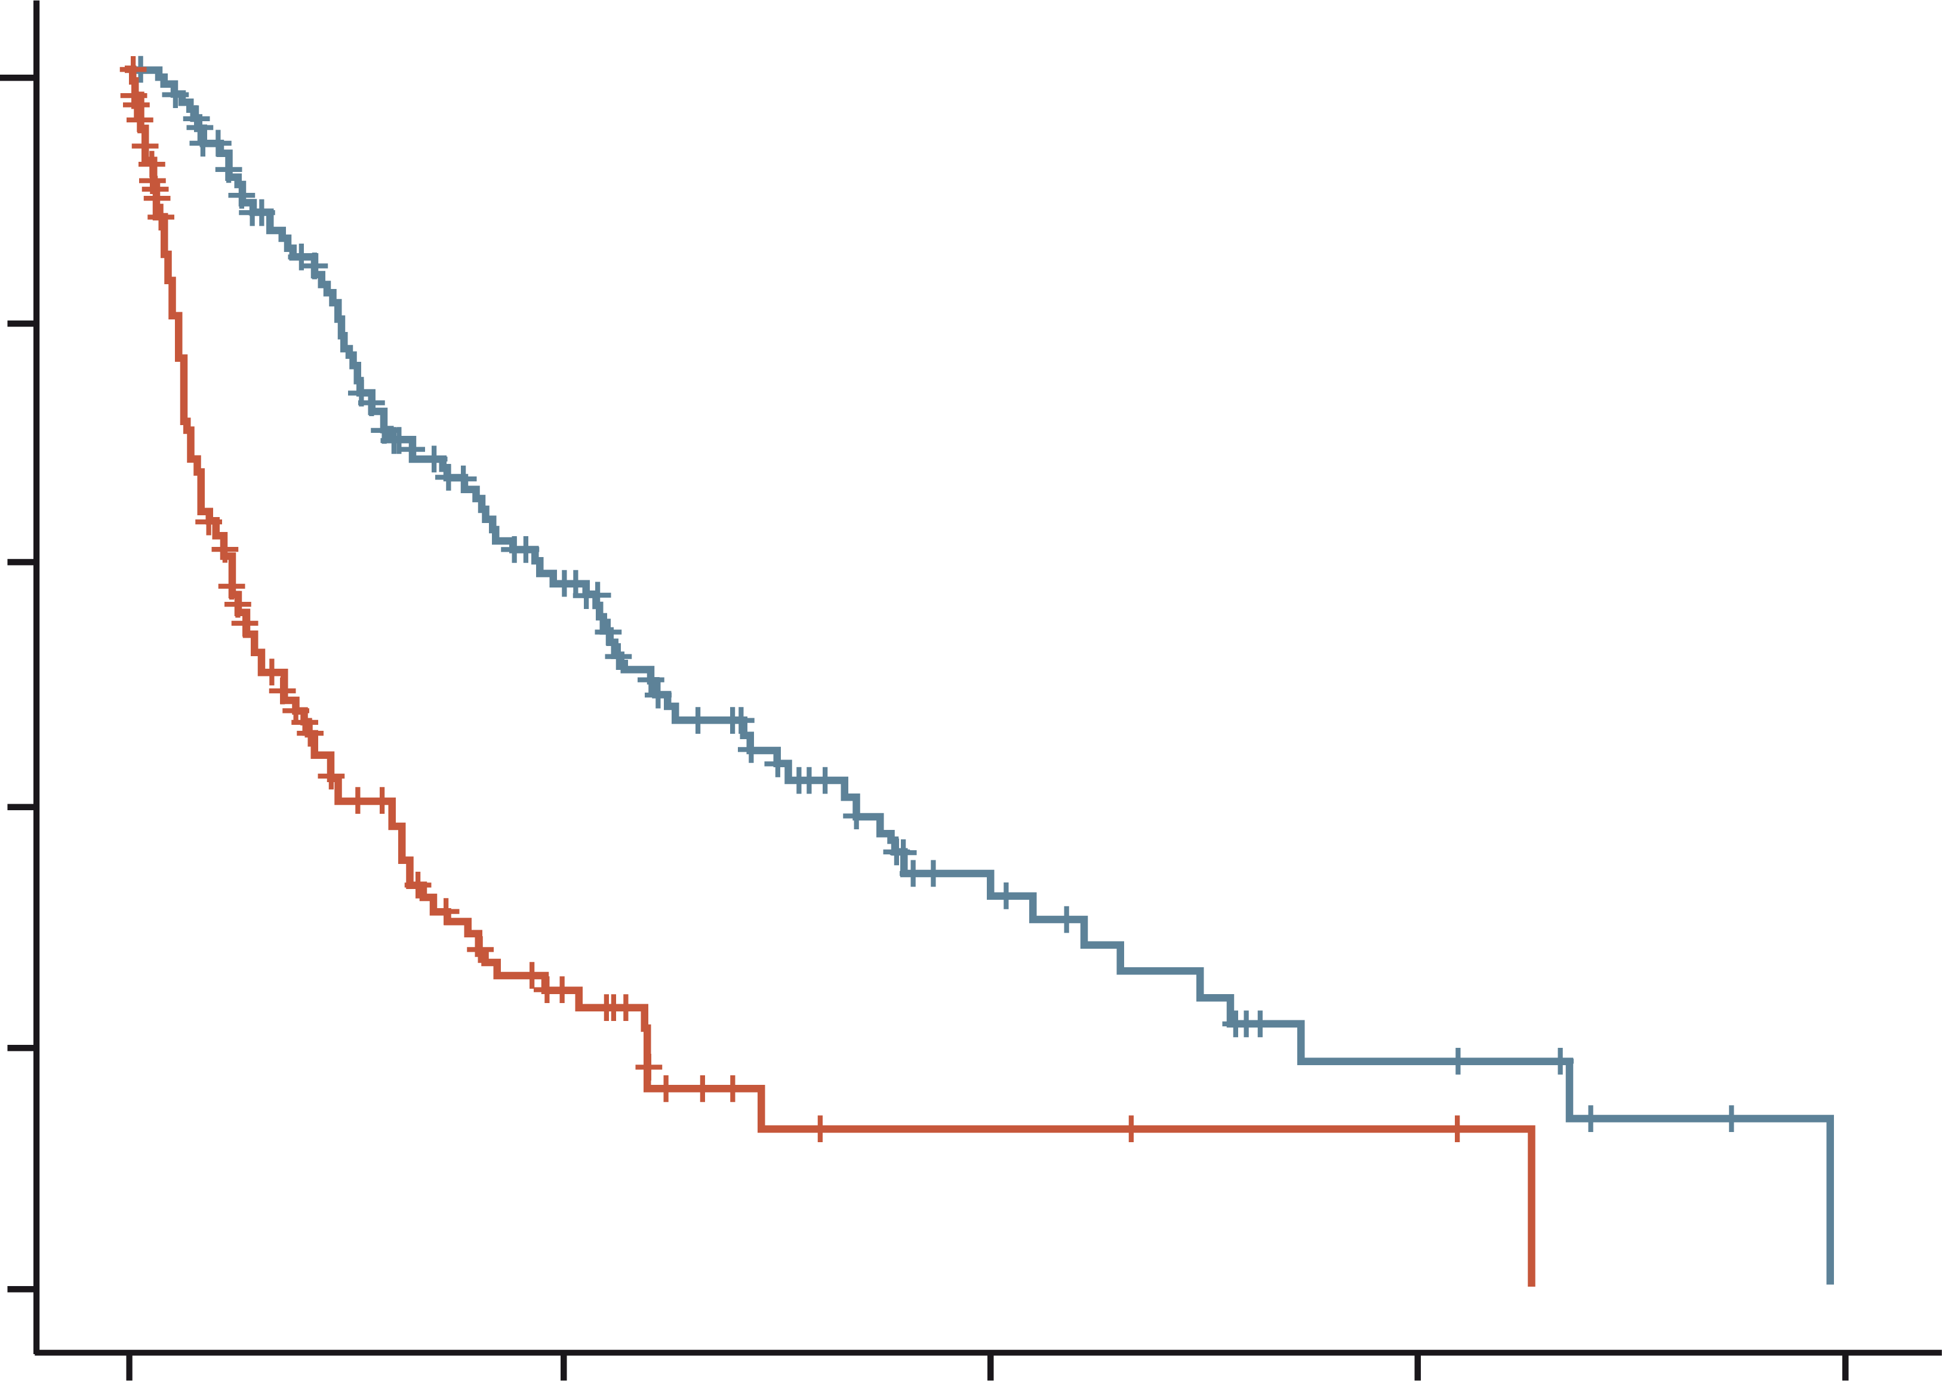
Retrospective analysis of HCC patients treated with immunotherapy Post-Immunotherapy treatment was associated with prolonged OS post-tki treatment suggested preserved efficacy in terms of OS
Details of subsequent therapies received during survival follow-up following immunotherapy (N=165)
420 patients
From USA, Europe and Asia
Number of subsequent lines received | N (%)
1 | 115 (67.9)
2 | 32 (19.4)
>3 | 13 (7.9)
Treatments received
TKI sorafenib lenvatinib regorafenib cabozantinib ramucirumab | 109 (66.1) 49 (44.9) 31 (28.4) 33 (30.3) 13 (11.9) 6 (5.5)
Radiotherapy | 28 (16.9)
Immunotherapy | 21 (12.7)
Transarterial chemoembolization/Y90 | 19 (11.5)
Chemotherapy | 9 (5.5)
Surgery | 6 (3.6)
Radiofrequency/microwave ablation | 4 (2.4)
Other | 23 (13.9)
1.0
Post ICI therapy
No
Yes
censored
0.8
0.6
Surviving proportion
0.4
0.2
0.0
0
10
20
30
40
Overall survival time (months)
HCC, hepatocellular carcinoma; ICI, immune checkpoint inhibitor; OS, overall survival; TKI, tyrosine kinase inhibitor; Y90, Yttrium-90
Sharma R, et al. Hepatol Commun. 2022;6(7):1776-1785
Notes:
REF:

Slide 67
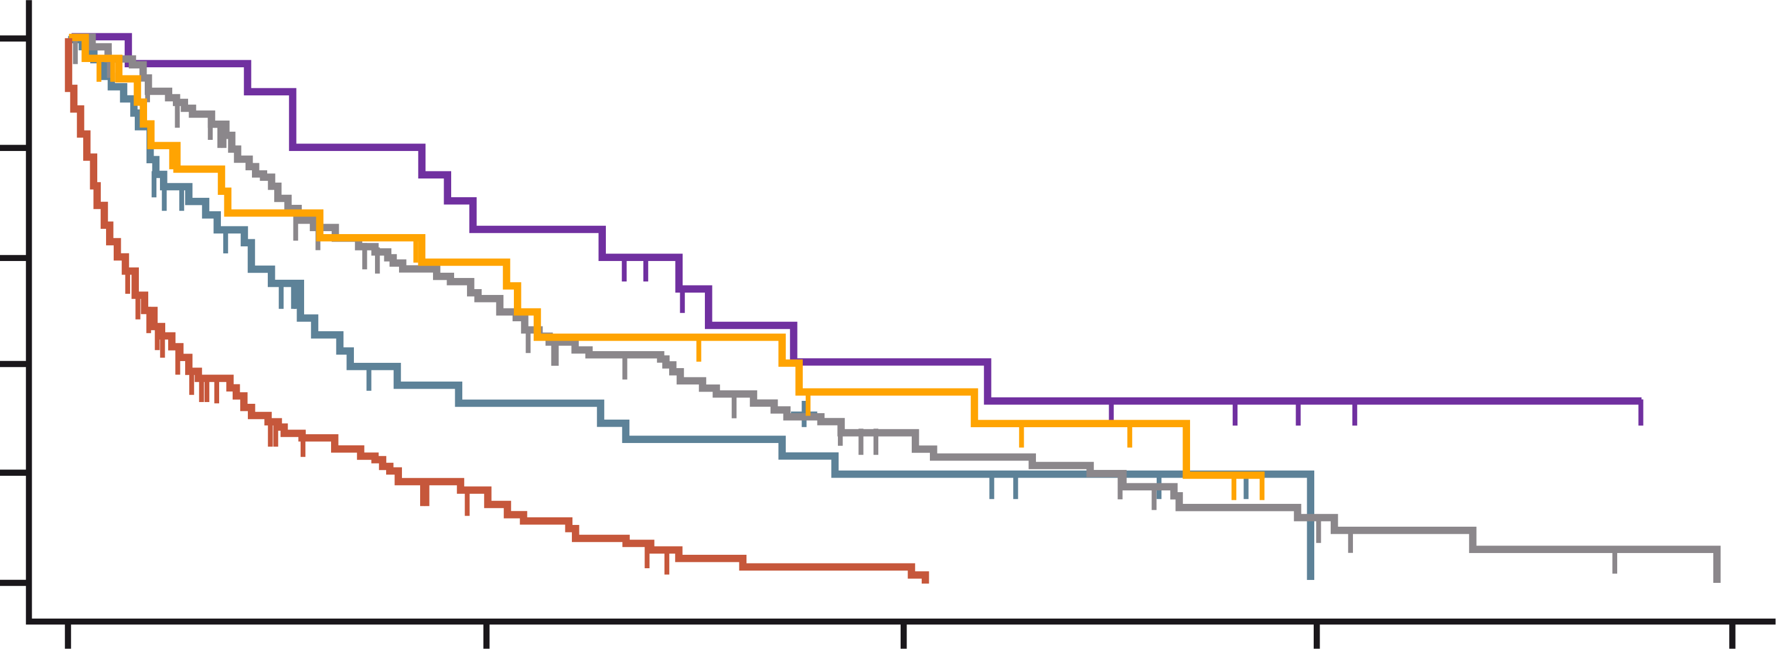
Patterns of progression after immunotherapy Continuation of IO and switching to TKIs were both associated with improved PPS
The median OS of these 271 patients from the initial diagnosis of HCC was 32.7 months (IQR 17.1–56.8)
No post-progression anticancer therapy
1.9 months (95% CI: 1.3-2.7)
ICIs beyond PD only
5.6 months (95% CI: 3.5-9.4)
Post-PD tyrosine kinase inhibitors (TKIs)
10.4 months (95% CI: 7.7-14.4)
ICIs beyond PD followed by TKIs
15.3 months (95% CI: 8.5-22.0)
Other post-PD anticancer therapies
10.8 months (95% CI: 3.7-21.7)
Post-progression survival in HCC patients treated with ICI
No ACT
ICI beyond PD
TKI
ICI beyond PD + TKI
Other
100
Log-rank p<0.0001
80
60
Survival probability (%)
40
20
0
0
10
20
30
40
Months
No. at risk
No ACT
ICI beyond PD
TKI
ICI beyond PD + TKI
Other
165
44
108
20
27
16
10
47
13
13
2
6
19
6
6
0
0
5
2
0
0
0
0
0
0
ACT, anticancer therapy; CI, confidence interval; ICI, immune checkpoint inhibitor; IO, immunotherapy; PD, progressive disease; PPS, post-progression survival
Talbot T, et al. Liver Int. 2023;43:695-707
Notes:
REF: Talbot, T., D’Alessio, A., Pinter, M., Balcar, L., Scheiner, B., Marron, T. U., ... & Pinato, D. J. (2022). Progression pattern and therapeutic sequencing following immune checkpoint inhibition for HCC: An international observational study. Liver International 2023;43:695–707

Slide 68
Optimal sequencing after progression on IO
IO, immunotherapy

Slide 69
Polling question is there any optimal sequencing after progressing on IO?
Yes
No
Not yet ✅
I am not sure
IO, immunotherapy

Slide 70
Is there any optimal sequencing after progression on IO? Not enough evidence either from prospective or retrospective studies
Is efficacy shown in prior registration phase 3 studies reproduced after progression on IO?
Prior 1st line
Lenvatinib
Sorafenib
Prior ≥ 2nd line
Regorafenib
Cabozantinib
Ramucirumab
Ipilimumab + nivolumab
IO, immunotherapy

Slide 71
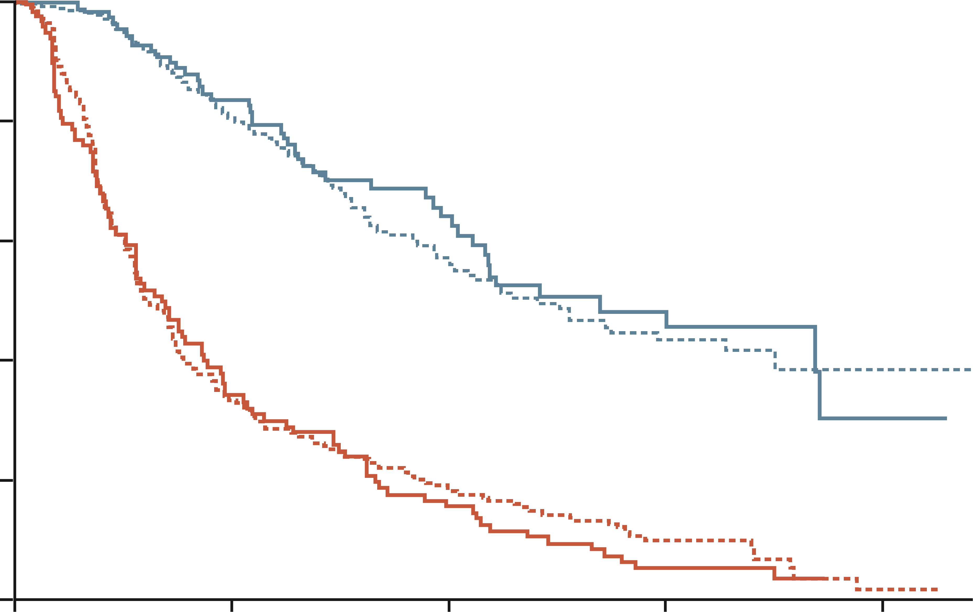
Subsequent mki after ici: Regorafenib no significant difference in PFS or OS according to the treatment lines, and prior exposure to immune checkpoint inhibitors
KCSG (Korean Cancer Study Group) multicenter retrospective study
440 patients from nine Korean centers
100
OS: no prior exposure to ICIs
OS: prior exposure to ICIs
PFS: no prior exposure to ICIs
PFS: prior exposure to ICIs
80
60
Surviving proportion (%)
40
p=0.63
20
p=0.61
0
0
5
10
15
20
Time (months)
The real-life clinical outcomes of regorafenib for patients who progressed on prior systemic therapy including ICIs were consistent with the phase 3 trial results
ICI, immune checkpoint inhibitor; MKI, multi-targeted kinase inhibitor; OS, overall survival; PFS, progression free survival
Yoo C, et al. Liver Int. 2020;40(9):2263-71.
Notes:
In one of largest retrospective study performed by KCSG including 440 patients, there was no significant difference in PFS or OS according to the treatment lines, and prior exposure to immune checkpoint inhibitors.

Slide 72
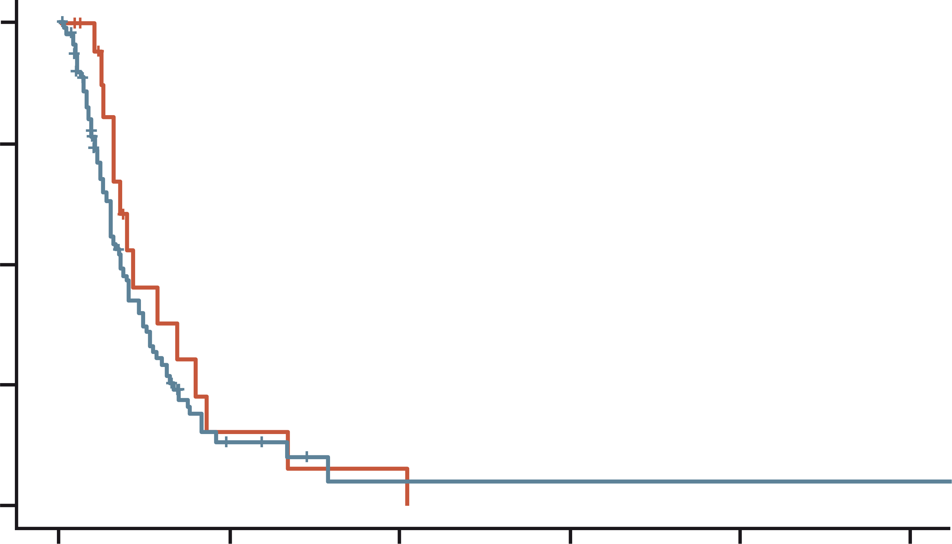
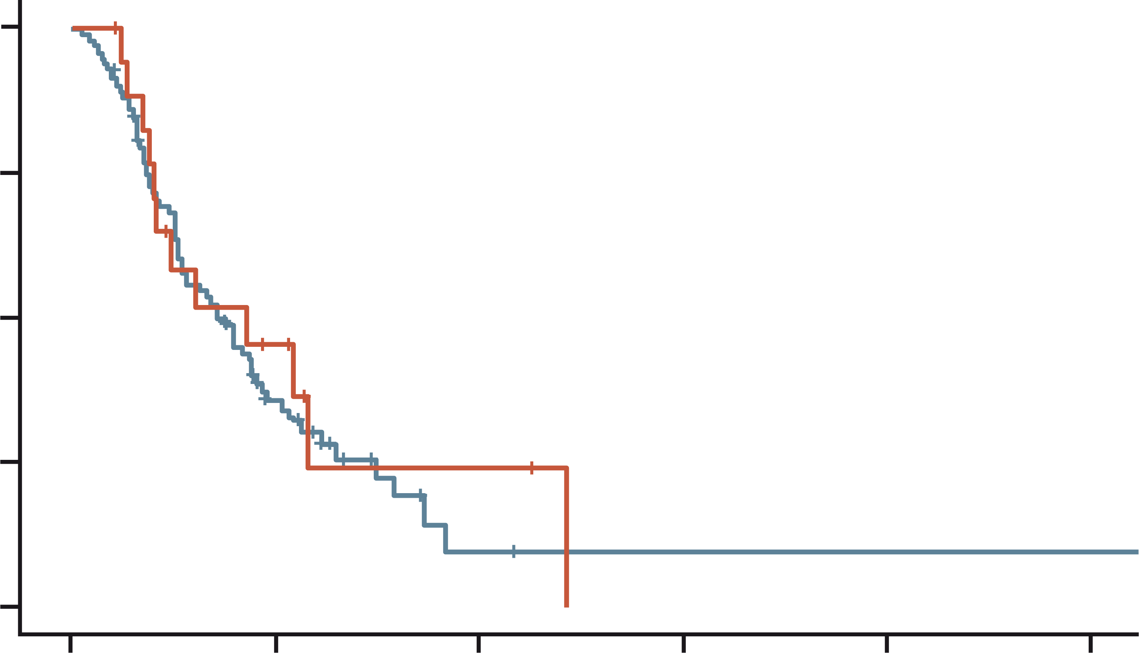
Subsequent mki after ici: cabozantinib no difference in terms of PFS and OS with cabozantinib according to the prior exposure to immune checkpoint inhibitors
Korean multicenter retrospective study
Multicenter (n=3) study for 110 patients: 82% of patients received cabozantinib as ≥4th line therapy
85% of patients received immune checkpoint inhibitors previously
100
Without prior history of ICI
With prior history of ICI
100
Without prior history of ICI
With prior history of ICI
75
75
Progression-free survival (%)
Overall survival (%)
50
50
p=0.43
p=0.64
25
25
0
0
0
10
20
30
40
50
0
10
20
30
40
50
Time (months)
Time (months)
Limitations of prior data for post-IO treatment:
Mostly ICI monotherapy, not atezolizumab + bevacizumab or durvalumab + tremelimumab
ICI, immune checkpoint inhibitor; IO, immunotherapy; MKI, multi-targeted kinase inhibitor; OS, overall survival; PFS, progression free survival
Bang YH, et al. Ther Adv Med Oncol. 2022;14:1-12
Notes:
Korean multicenter real-world study of cabozantinib showed 82% of patients received cabozantinib as 4th or 5th line of therapy and 85% of patients received immune checkpoint inhibitors previously. In this very heavily pretreated patient population, median PFS and OS were 4.3 and 9.0 months, respectively and there was no difference in terms of PFS and OS with cabozantinib according to the prior exposure to immune checkpoint inhibitors.
MKI efficacy is not affected by the prior ICI use.

Slide 73
Clinical outcomes with TKIs after progression on atezolizumab + Bevacizumab Sorafenib vs Lenvatinib in retrospective study
49 pts from Korea, HK and Singapore who received TKI after progression on 1st line atezolizumab + bevacizumab*
100
Sorafenib (N=29)
Lenvatinib (N=19)
100
90
90
80
mPFS 2.5 vs 6.1 months p=0.004
80
mOS 11.2 vs 16.6 months p=0.347
70
70
60
60
Progression-free survival (%)
Overall survival (%)
50
50
40
40
30
30
20
20
10
10
0
0
0
2
4
6
8
10
0
5
10
15
20
25
30
Time (months)
Time (months)
*One patient received cabozantinib – data not shown
Limitation:
Small sample size
Lenvatinib showed better PFS than sorafenib
No statistical difference in OS between lenvatinib and sorafenib
atezo, atezolizumab; bev, bevacizumab; HK, Hong Kong; mOS, median OS; mPFS, median PFS; OS, overall survival; PFS, progression free survival; TKI, tyrosine kinase inhibitor
Yoo C, et al. Liver Cancer. 2021;10(2):107-114
Notes:
Lenvatinib showed better PFS compared to sorafenib, but there was no statistical difference in OS between sorafenib and lenvatinib. But, this analysis is conducted based on very small sample size. Further studies based on large patient number is necessary.

Slide 74
Japanese real-world registry study of systemic treatment of HCC demonstrating the efficacy of various treatment sequences
Chronological trends of regimens
Sorafenib
Lenvatinib
Atezolizumab + Bevacizumab
100
1st line
80
Patient numbers (n)
60
40
20
0
Treatment efficacy of 2nd line therapy
1st line | 2nd line | N | RR/DCR (%/%) | Tx duration (days)
Atezolizumab + Bevacizumab | Ongoing | 148
 | Sorafenib | 8 | 0/40 (n=5) | 25 (11-ND)
 | Regorafenib | 0
 | Lenvatinib | 72 | 14.9/80.9 (n=47) | 87 (64-141)
 | Ramucirumab | 6 | 0/100 (n=2) | 28 (28-ND)
 | Cabozantinib | 3 | 0/50 (n=2) | 18 (9-ND)
DCR, disease control rate; HCC, hepatocellular carcinoma; ND, not determined; RR, response rate; Tx, treatment
Asaoka Y, J Clin Oncol. 2023. 41(no. 4_suppl):510-510 (presented at ASCO; poster #510)
Notes:
Prior first-line therapy (LEN and SOR) is mainly used as second-line therapy after Atezo+Bev in Japanese Real world.

Slide 75
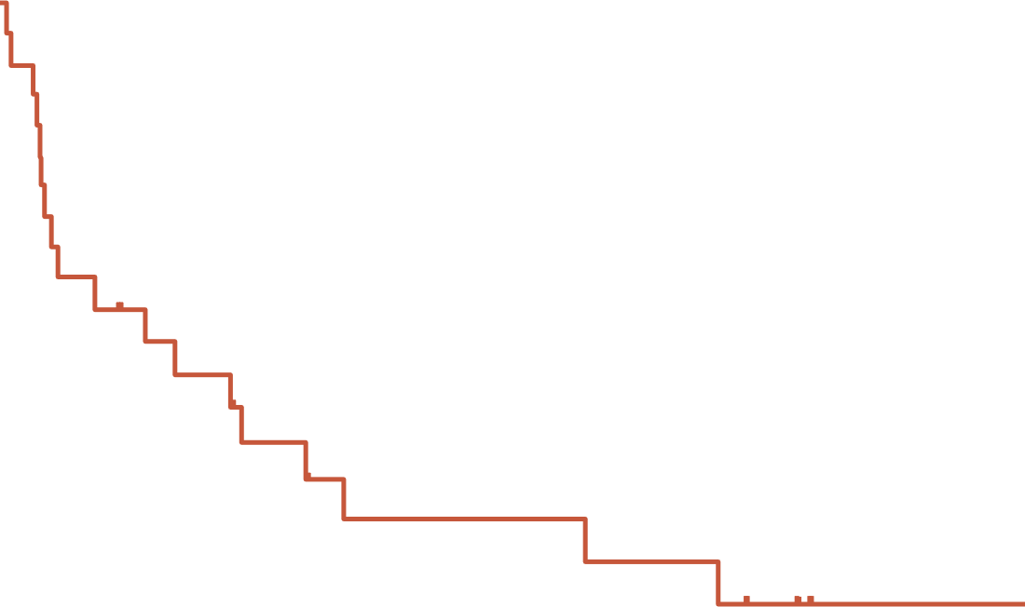
Any role of ICI rechallenge (anti-CTLA-4) in post-IO setting? Ipilimumab + Nivolumab or Pembrolizumab after progression on primarily Nivolumab or Pembrolizumab monotherapy*
42.4%
32.3%
21.6%
25 patients were included
Objective response rate of patients with primary resistance to prior ICI: 16.7%
100
90
80
70
60
Overall survival (%)
50
40
Median OS: 10.9 months (3.99-17.8)
?
Would there be a potential role of durvalumab + tremelimumab or ipilimumab + nivolumab after progression on atezolizumab + bevacizumab?
30
20
10
0
3
6
9
12
15
18
21
24
27
30
33
36
39
42
45
48
Time (months)
Ipilimumab + nivolumab or pembrolizumab can achieve durable antitumor activity and encouraging survival outcomes in HCC patients who had prior treatment with ICIs
Limitation:
Small retrospective study
*4% progressed on atezolizumab + bevacizumab
CTLA-4, cytotoxic T-lymphocyte associated protein-4; HCC, hepatocellular carcinoma; ICI, immune checkpoint inhibitor; IO, immunotherapy; OS, overall survival
Wong JSL, et al. J Immunother Cancer. 2021;9(2):e001945

Slide 76
IMbrave251: 2nd line atezolizumab + TKI vs TKI alone after progression on atezolizumab + bevacizumab
Site selects the choice of TKI:
lenvatinib or sorafenib
Unresectable HCC
Progressed following prior atezolizumab + bevacizumab treatment*
(N=554)
Atezolizumab + lenvatinib or sorafenib
Treatment until loss of clinical benefit or unacceptable toxicity
R
Survival follow-up
Lenvatinib or sorafenib
Efficacy objectives
Primary: OS
Secondary: PFS,* ORR,* DoR,* TTP,* TTD in PROs
Safety objective
Percentage of patients with AEs
Exploratory
Number of patients with anti-drug antibodies to atezolizumab
Serum concentration of atezolizumab
*INV-assessed per RECIST v1.1
AE, adverse event; AFP, alpha fetoprotein; ALBI, albumin-bilirubin; DoR, duration of response; HBV/HCV, hepatitis B/C virus; HCC, hepatocellular carcinoma; OS, overall survival; PFS, progression free survival; ORR, objective response rate; PRO, patient-reported outcome; TKI, tyrosine kinase inhibitor; TTD, time to deterioration; TTP, time to progression
ClinicalTrials.gov.Identifier: NCT04770896 https://clinicaltrials.gov/ct2/show/NCT04770896 accessed April 2023
Notes:
Imbrave 251 study is ongoing randomized trial to investigate the role of maintaining atezolizumab in combination with TKIs. This trial compares the atezolizumab in combination with lenvatinib or sorafenib and lenvatinib or sorafenib monotherapy. This study will let us know whether maintaining immunotherapy even after progression is effective or not.

Slide 77
Conclusion Overview of 2nd line treatment options in advanced HCC – how to achieve optimal sequencing?
There is lack of solid evidence for optimal second-line regimens after progression on new standard 1st line IO-based combination therapy
Previously approved drugs as 1st line or subsequent-line therapy may be used for these patients, if there are no adequate clinical trials
Multiple small retrospective studies suggest that the efficacy outcomes of post-IO TKIs are comparable to those in registration studies
Multiple prospective studies are ongoing for regorafenib, cabozantinib, and lenvatinib
HCC, hepatocellular carcinoma; IO, immunotherapy; TKI, tyrosine kinase inhibitor

Slide 78
discussion

Slide 79
Key Clinical takeaways
A substantial part of the advanced HCC patient population is not eligible for IO 1st line, such as:
Post-liver transplant patients with recurrent HCC
Most patients with an active autoimmune disease
TKIs, such as lenvatinib and sorafenib, are recommended treatments for these patient groups
Switching to 2nd line after IO 1st line should be considered in case of toxicity or disease progression
Measuring disease progression can be challenging, as there are several methods with different evaluation criteria
mRECIST criteria have a powerful ability to discriminate between responders and non-responders
Multiple 2nd line treatment options have been approved in advanced HCC patients
There is lack of solid evidence for optimal 2nd line regimens after progression on new standard 1st line IO-based combination therapy
HCC, hepatocellular carcinoma; IO, immunotherapy; mRECIST, modified Response Evaluation Criteria in Solid Tumors; TKI, tyrosine kinase inhibitor
79

Slide 80
ANY QUESTIONS? PANEL DISCUSSION

Slide 81
Future perspectives
As IO-based combination regimens are globally established as 1st line treatments, there is a need to study optimal sequencing after progression on these regimens
Multiple prospective trials and registry studies are ongoing
Novel methods for response evaluation such as circulating tumoral DNA could facilitate treatment decision-making in the future
The role of liver transplantation after IO needs further studies
IO, immunotherapy
81

