Slide 2
GU CONNECT animated video
Clinical implementation of testing and PARPis IN COMBINATION WITH NHAs, and the patient journey for prostate cancer patients
Dr Andrew Armstrong, MD SCM FACP
Duke Cancer Institute Center for Prostate and Urologic Cancers, USA
AUGUST 2023
NHA, novel hormonal agents; PARPi, poly-ADP ribose polymerase inhibitor

Slide 3
Educational objectives
Recognise the efficacy and safety profiles of PARP inhibitors, know their differences and understand their place in the treatment landscape for patients with mCRPC
Understand the data of combination studies with PARP inhibitors and novel hormonal agents (NHAs) in mCRPC, the rationale & MoA of the combination, its appropriate implementation and impact on clinical practice
Understand the role of testing for assessment of HRRm status and subsequent decision making for treatment with PARP inhibitors in combination with NHAs
HRRm, homologous recombination repair mutation; mCRPC, metastatic castration-resistant prostate cancer; MoA, mechanism of action;
PARP, poly-ADP ribose polymerase

Slide 4
Clinical takeaways
PARP inhibitors are effective drugs as monotherapy in mCRPC patients with HRR alterations
Genetic testing is important to inform on prognosis, help with treatment decision making and for understanding inherited risk
BRCA mutations are associated with poor outcomes in mCRPC patients
Patients with tumours harbouring BRCA1/BRCA2 alteration appear to derive the greatest clinical benefit from PARP inhibitor monotherapy, but patients with other HRR alterations also derive benefit
PARP inhibitors combined with novel hormonal agents are also effective as a first line treatment option for mCRPC patients with a HRR mutation. Certain combinations such as olaparib plus abiraterone have also shown benefit in patients regardless of their HRR status
BRCA1/2, breast cancer gene 1/2; HRR, homologous recombination repair; mCRPC, metastatic castration-resistant prostate cancer; PARP, poly-ADP ribose polymerase

Slide 5

Developed by GU COnnect
This programme is developed by GU CONNECT,
an international group of experts in the field of
genitourinary oncology.
Acknowledgement and disclosures:
This GU CONNECT programme is supported through an independent Educational Grant from AstraZeneca.
The programme is therefore independent, the content is not influenced by the supporter and is under the sole responsibility of the experts.
Please note: The views expressed within this presentation are the personal opinions of the authors. They do not necessarily represent the views of the authors academic institutions, or the rest of the GU CONNECT group. The patient case used in this resource is based on constructed cases with representative data for learning purposes.
Expert Disclaimers:
Dr Andrew Armstrong has received financial support/sponsorship for research support, consultation, or speaker fees from the following companies:
Amgen, Astellas, AstraZeneca, Bayer, BMS, Celgene, Clovis, Dendreon, Epic Sciences, Exact Sciences, Exelixis, Forma, GoodRx, Janssen, Merck, Myovant, Novartis, Pfizer

Slide 6
Introducing the Patient case and treatment options

Slide 7

Patient case: de Novo High Volume mHSPC
Patient: 66 year old
Presents with: mild fatigue
Medical history:
Well-controlled hypertension and hyperlipidaemia
+FH of breast cancer in sister, age 56
12 months
18 months
24 months
ADT/docetaxel x 6 → ADT
PSA 110
PSA nadir 0.2
PSA 1.6
PSA 14.4
Initial Presentation
Biopsy: 9 / 12 cores; Adenocarcinoma Gleason 4+4
Staging: T3 by DRE and mpMRI, N1 M1b, high volume mHSPC
Imaging: bone and CT scan
Metastases in hip, lumbar spine and ribs (five)
Multiple pelvic & retroperitoneal lymph nodes between 2-4 cm
Current situation
Slight discomfort in lumbar spine
Imaging:
Progression of bone and lymph node metastases
Haemoglobin: 11 g/dL
ADT, androgen deprivation therapy; CT, computed tomography; DRE, digital rectal exam; FH, family history; mHSPC, metastatic hormone sensitive prostate cancer; mpMRI, multi-parametric magnetic resonance imaging; PSA, prostate-specific antigen; T, N, M, tumour, nodes, metastasis

Slide 8
Timing and Selection of Secondary AR-Directed Therapies
Choice of abiraterone vs. enzalutamide cannot be dictated based on differences in efficacy
  Similar OS, PFS from cross-trial comparisons
  Enzalutamide has been evaluated in men with visceral metastases in the chemo-naïve setting
  Both considered level 1 evidence in NCCN guidelines based on improved PFS and overall survival
Therefore, choice is based on differential toxicity, costs, drug interactions, and other patient factors
  Abiraterone acetate in men who are seizure-prone, frail/elderly (>75 yrs) at high risk for falls, men for who drug-drug interactions is a potential issue
  Enzalutamide for men with significant CV risk factors, contraindications to prednisone, brittle diabetes and metabolic syndrome, contraindications to prednisone
AR, androgen receptor; CV, cardiovascular; NCCN, National Comprehensive Cancer Network; OS, overall survival; PFS, progression-free survival; yrs, years

Slide 9
Selecting abiraterone vs enzalutamide
Consider abirateroneª
(avoid enzalutamide)
Consider enzalutamide
(avoid abiraterone)
Falls/gait, neurologic issues
Baseline CHF
Significant baseline fatigue
Baseline oedema
Mild baseline pain
Renal impairment
Polypharmacy
Diabetes
ªKeep in mind that the steroids used with abiraterone are not supra-physiologic
CHF, congestive heart failure

Slide 10
The relevance of genetic testing

Slide 11
Precision medicine testing: Why?
Inform treatment decisions to improve survival, clinical benefit, and chance of remission
  DNA: HRR mutation→PARPi,
  MSI-high mCRPC→pembrolizumab
  RNA: AR-V7 and AR therapy resistance
  Histology/Phenotype:
    small cell transformation→ platinums;
    PSMA expression→Lu¹⁷⁷
Inform hereditary cancer risk, family counselling and risk reduction
  DNA/RNA: BRCA2, ATM, Lynch Syndrome, HOXB13, other DNA repair enzymes
Assess for clinical trial eligibility (research)
  PTEN loss, PI3K/Akt mutations, CDK12 mutation, PSMA expression, TP53/RB1 loss
Standard of care
Clinical trials
Olaparib or rucaparib^{c}
Pembrolizumab^{c}
DDR alteration, MSI-H,
CTC AR-V7
Actionable
alterations
present
Liquid biopsy^{b}
Germline testing and genetic counselling
High disease burdenª
or progressive disease
No
actionable
alterations
mCRPC
Progression
Standard of care
Clinical trials
Low disease burdenª
or progressive disease
Standard of
care
ª High disease burden based on the presence of known adverse prognostic factors in men with mCRPC, such as visceral metastases, high volume of bone metastases, anaemia, rapid PSA kinetics, high circulating tumour cell count, high LDH or alkaline phosphatase, pain, and progression despite multiple prior therapies. ^{b} If tumour biopsy is not available/inadequate or remote. Liquid biopsy can include ctDNA and/or CTC biomarkers such as AR-V7 testing. ^{C}Timing of these treatments dependent on product labels
AR(-V7), androgen receptor variant 7; ARSi, androgen receptor signalling inhibitor; ATM, ataxia-telangiectasia gene; BRCA2, breast cancer gene 2; CDK12, cyclin dependent kinase 12; CTC, circulating tumour cell; ctDNA, circulating tumour DNA; DDR, DNA damage response; LDH, lactate dehydrogenase; Lu, lutetium; mCRPC, metastatic castration resistant prostate cancer; MSI, microsatellite instability; PARPi, poly-ADP ribose polymerase inhibitor; PI3K, phosphoinositide 3-kinase; PSA, prostate specific antigen; PSMA, prostate specific membrane antigen; PTEN, phosphatase and tensin homolog; RB1, retinoblastoma tumour suppressor gene
Adapted from: Hawkey N, Armstrong A. Clin Cancer Res. 2021;27(11):2961-3

Slide 12
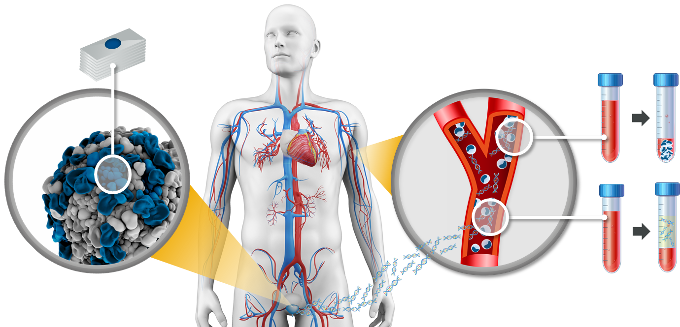
There are several ways to identify BRCA / HRR mutations in prostate cancer
Tissue testing
(Whole) blood testing
Somatic + germline
Germline
Somatic + germline
Plasma (ctDNA) testingª
ªTumour cells shed DNA into the circulation through necrosis or apoptosis. ctDNA can be isolated from a plasma sample
BRCA, breast cancer gene; ctDNA, circulating tumour DNA; HRR, homologous recombination repair
1. Cheng HH, et al. J Natl Compr Canc Netw. 2019;17:515-21; 2. Haber DA, Velculescu VE. Cancer Discov. 2014;4:650-61

Slide 13
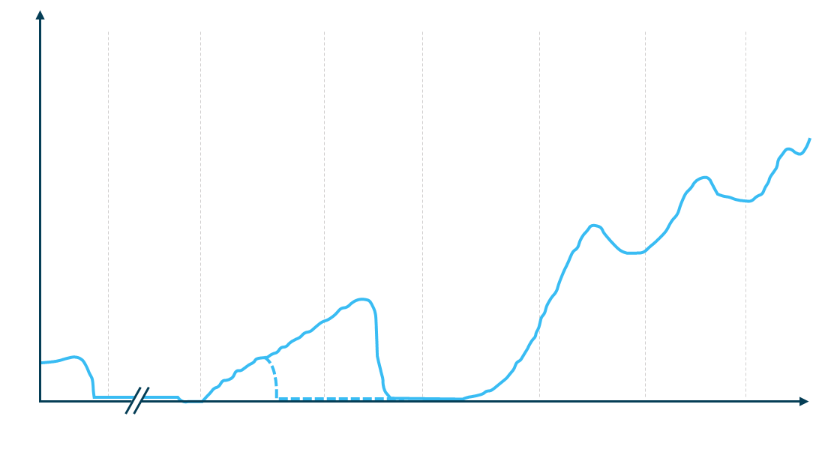
Considerations for when to test for HRRm are included in international guidelines
ESMO^{1,2}
Recommended for BRCA2 and other DDR genes associated with cancer predisposition in patients with family history of cancer
Should be considered in all patients with metastatic prostate cancer
Primary
Adjuvant
Biochemical recurrence
mHSPC
(inc. de novo)
1L
mCRPC
2L
mCRPC
3L
mCRPC
Consider HRRm and MSI dMRR testing in patients with mCRPC
EAU/EANM/ESTRO/ESUR/ISUP/SIOG³
Non-metastatic CRPC
Men with metastatic PCa;
Men with high-risk PCa and a family member diagnosed with PCa at age <60 years;
Men with multiple family members diagnosed with csPCa at age <60 years or a family member who died from PCa cancer;
Men with a family history of high-risk germline mutations or a family history of multiple cancers on the same side of the family.
Tumour testing
PSA
Consider HRRm and dMRR testing in all patients with mPC
Germline testing
NCCN⁴
Metastatic, regional (node positive), very-high-risk localised, or high-risk localised PCa
Family history of certain cancers
Known family history of familial cancer risk mutation
Personal history of breast cancer
Consider HRRm testing in patients with mPC
AUA/SUO⁵
Time
Testing for DDR, MSI dMMR, TMB and other potential mutations in mCRPC patients
Consider for mHSPC patients
Based on Scher et al, 2016
Testing for DDR, MSI dMMR, TMB and other potential mutations in mCRPC patients
Consider for mHSPC patients
1L/2L/3L, first/second/third line; BRCA2, breast cancer gene 2; CRPC, castration-resistant prostate cancer; csPCa, clinically significant PCa; DDR, DNA damage repair; dMMR, mismatch repair damage; HRRm, homologous recombination repair mutation; mCRPC, metastatic CRPC; mHSPC, metastatic hormone-sensitive prostate cancer; mPC, metastatic prostate cancer; MSI, microsatellite; PCa, prostate cancer; PSA, prostate-specific antigen; TMB, tumour mutational burden
1. Parker C, et al. Annals of Oncology 2020; 31(9): 1119-34; 2. Fizazi K, et al. Annals of Oncology 2023 https://doi.org/10.1016/j.annonc.2023.02.015 ; 3. Mottet N, et al. EAU - EANM - ESTRO - ESUR - ISUP - SIOG Guidelines on Prostate Cancer. EAU-EANM-ESTRO-ESUR-ISUP-SIOG-Guidelines-on-Prostate-Cancer-2023_2023-03-27-131655_pdvy.pdf (d56bochluxqnz.cloudfront.net) Accessed May 2023); 4. National Comprehensive Cancer Network. Prostate Cancer (Version 1.2023). https://www.nccn.org/professionals/physician_gls/pdf/prostate.pdf. Accessed May 2023; 5. Lowrance W, et al. J Urol. 2023; 209(6):10.1097/JU.0000000000003452; 6. Scher HI, et al. J Clin Oncol 2016; 34 (12): 1402-1418

Slide 14
Patient case
Patient: 66 year old
Presents with: mild fatigue
Medical history:
Well-controlled hypertension and hyperlipidaemia
+FH of breast cancer in sister, age 56
Germline BRCA2 mutation detection which is pathogenic.
Consider patient for treatment with a PARPi
12 months
18 months
24 months
ADT/docetaxel x 6 → ADT
PSA 110
PSA nadir 0.2
PSA 1.6
PSA 14.4
Initial Presentation
Biopsy: 9 / 12 cores; Adenocarcinoma Gleason 4+4
Staging: T3 by DRE and mpMRI, N1 M1b, high volume mHSPC
Imaging: bone and CT scan
Metastases in hip, lumbar spine and ribs (five)
Multiple pelvic & retroperitoneal lymph nodes between 1-3 cm
Current situation
Slight discomfort in lumbar spine
Imaging:
Progression of bone and lymph node metastases
Haemoglobin: 11 g/dL
ADT, androgen deprivation therapy; CT, computed tomography; DRE, digital rectal exam; FH, family history; mHSPC, metastatic hormone sensitive prostate cancer; mpMRI, multi-parametric magnetic resonance imaging; PSA, prostate-specific antigen; T, N, M, tumour, nodes, metastasis

Slide 15
Rationale for combining PARP and AR inhibitors

Slide 16
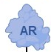
Preclinical rationale for a combined effect of PARP and AR inhibition
PARP and AR are important for DNA repair in prostate cancer
PARP
PARP activity facilitates repair
of DNA single-strand breaks
DNA damage
(single- and double-strand breaks)
AR
AR binds DNA and facilitates
repair through multiple pathways
three non-redundant DNA repair mechanisms that involve AR and PARP
PARP
DNA repair
AR
PARP enables AR binding to damaged DNA
Inhibition of PARP and AR in combination results in more DNA damage in AR-driven cancer cells
PARPi
AR
NHA
e.g. abiraterone
PARPi
PARP
PARPi
PARP trapping
PARP
accumulation of DNA double-strand breaks
Increased DNA damage and anti-prostate cancer efficacy
DNA single-strand breaks
Inhibition of AR DNA binding and repair
AR, androgen receptor; DNA, deoxyribonucleic acid; NHA, novel hormonal agent; PARP, poly(ADP-ribose) polymerase
1. Chaudhuri AR, et al. Nat Rev Mol Cell Biol. 2017;18:610-21; 2. Polkinghorn WR, et al. Cancer Discov. 2013;3:1245-53; 3. Lord CJ, et al. Science 2017;355:1152-8; 4. Pommier Y, et al. Sci Transl Med 2016;8:p362ps17; 5. Schiewer MJ, et al. Cancer Discov. 2012;2:1134-49; 6. Asim M, et al. Nat Commun. 2017;8:374;
7. Li L, et al. Sci Transl Med. 2017;10:10.1126/scisignal.aam7479

Slide 17
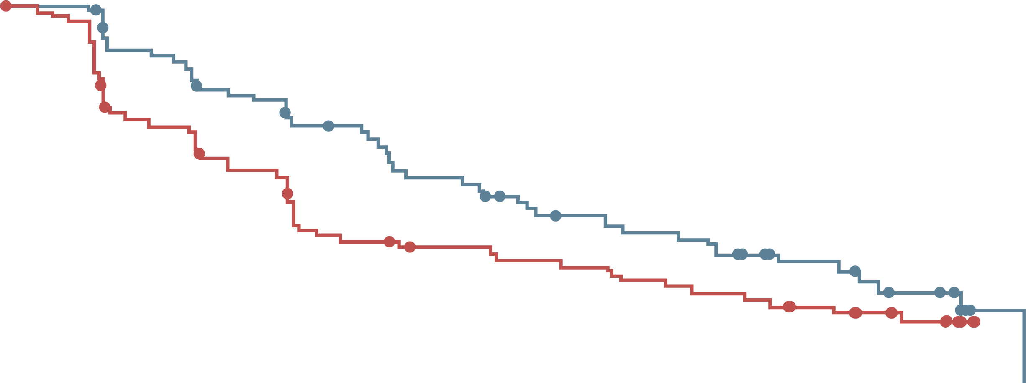
PROpel: clinical rationale for combination of Olaparib with abiraterone
In a phase 2 trial (NCT01972217), abiraterone + olaparib prolonged rPFS vs abiraterone + placebo in biomarker-unselected patients with mCRPC, who had received docetaxel^{1,2}
Investigator-assessed rpfs
1.0
 | Ola + Abi (N=71) | Pbo + Abi (N=71)
Events, n (%) | 46 (65) | 54 (76)
 | HR 0.65 95% CI, 0.44-0.97; p=0.034
0.8
0.6
8.2
13.8
Proportion of patients event-free
0.4
0.2
∆=5.6
0.0
0
3
6
9
12
15
18
21
24
27
30
Time from randomisation (months)
Abi, abiraterone; CI, confidence interval; HR, hazard ratio; mCRPC, metastatic castration-resistant prostate cancer; Ola, olaparib; Pbo, placebo; rPFS, radiographic progression-free survival
1. Clarke N, et al. Lancet Oncol. 2018;19:975-86; 2. Carr TH, et al. Cancers. 2021;13:5830

Slide 18
Key trial data

Slide 19
PROpel: Study Design
a global, randomised, double-blind phase 3 trial
Key eligibility criteria
First-line mCRPC
  Docetaxel allowed at mCSPC stage
  No prior abiraterone
  Other NHAs allowed if stopped
  ≥12 months prior to enrolment
  Ongoing ADT
  ECOG PS 0 or 1
Stratification Factors
Site of distant metastases: bone only vs visceral vs other
Prior taxane at mCSPC: yes vs no
Olaparib
300 mg BID +
abiraterone 1,000 mg QDª
(n=399)
Full dose of abiraterone
and olaparib used
Primary endpoint:
rPFS by investigator assessment (sensitivity analysis by BICR)
Key secondary endpoint:
OS (alpha control)
Additional endpoints:
TFST, ORR, PFS2
HRR gene mutation^{b} status (by tissue and ctDNA testing)
Health-related quality of life
Safety and tolerability
Randomise
1:1
Placebo +
abiraterone 1,000 mg QDª
(n=397)
Full dose of abiraterone
used
DCO1: 30 July 21
rPFS (primary)
DCO2: 14 March 22
OS (interim)
DCO3: 12 October 22
OS (final pre-planned OS)
NCT03732820
Analysis timeline:
First patient randomized: Nov 2018​; last patient randomised: Mar 2020
Multiple testing procedure is used in this study: 1-sided alpha of 0.025 fully allocated to rPFS; if the rPFS result is statistically significant, OS to be tested in a hierarchical fashion with alpha passed on to OS
ª abiraterone used in combination with prednisone or prednisolone 5 mg BID; ^{b} HRR mutation, including 14-gene panel, using the FoundationOne®CDx test and FoundationOne®Liquid CDx test
ADT, androgen-deprivation therapy; BID, twice daily; ctDNA, circulating tumour DNA; DCO, data cut-off; ECOG PS, Eastern Cooperative Oncology Group performance status; HRR, homologous recombination repair; mCRPC, metastatic castration-resistant prostate cancer; mCSPC, metastatic castration-sensitive prostate cancer; NHA, novel hormonal agent; ORR, objective response rate; OS, overall survival;
PFS2, time to second progression; QD, per day; rPFS, radiographic progression-free survival; TFST, time to first subsequent therapy or death
1. Clarke NW, et al. J Clin Oncol. 2019;37 Suppl: TPS340; 2. https://clinicaltrials.gov/ct2/show/NCT03732820; 3. Clarke N, et al. J Clin Oncol 41, 2023 (suppl 6; abstr LBA16) (ASCO GU 2023 oral presentation)

Slide 20
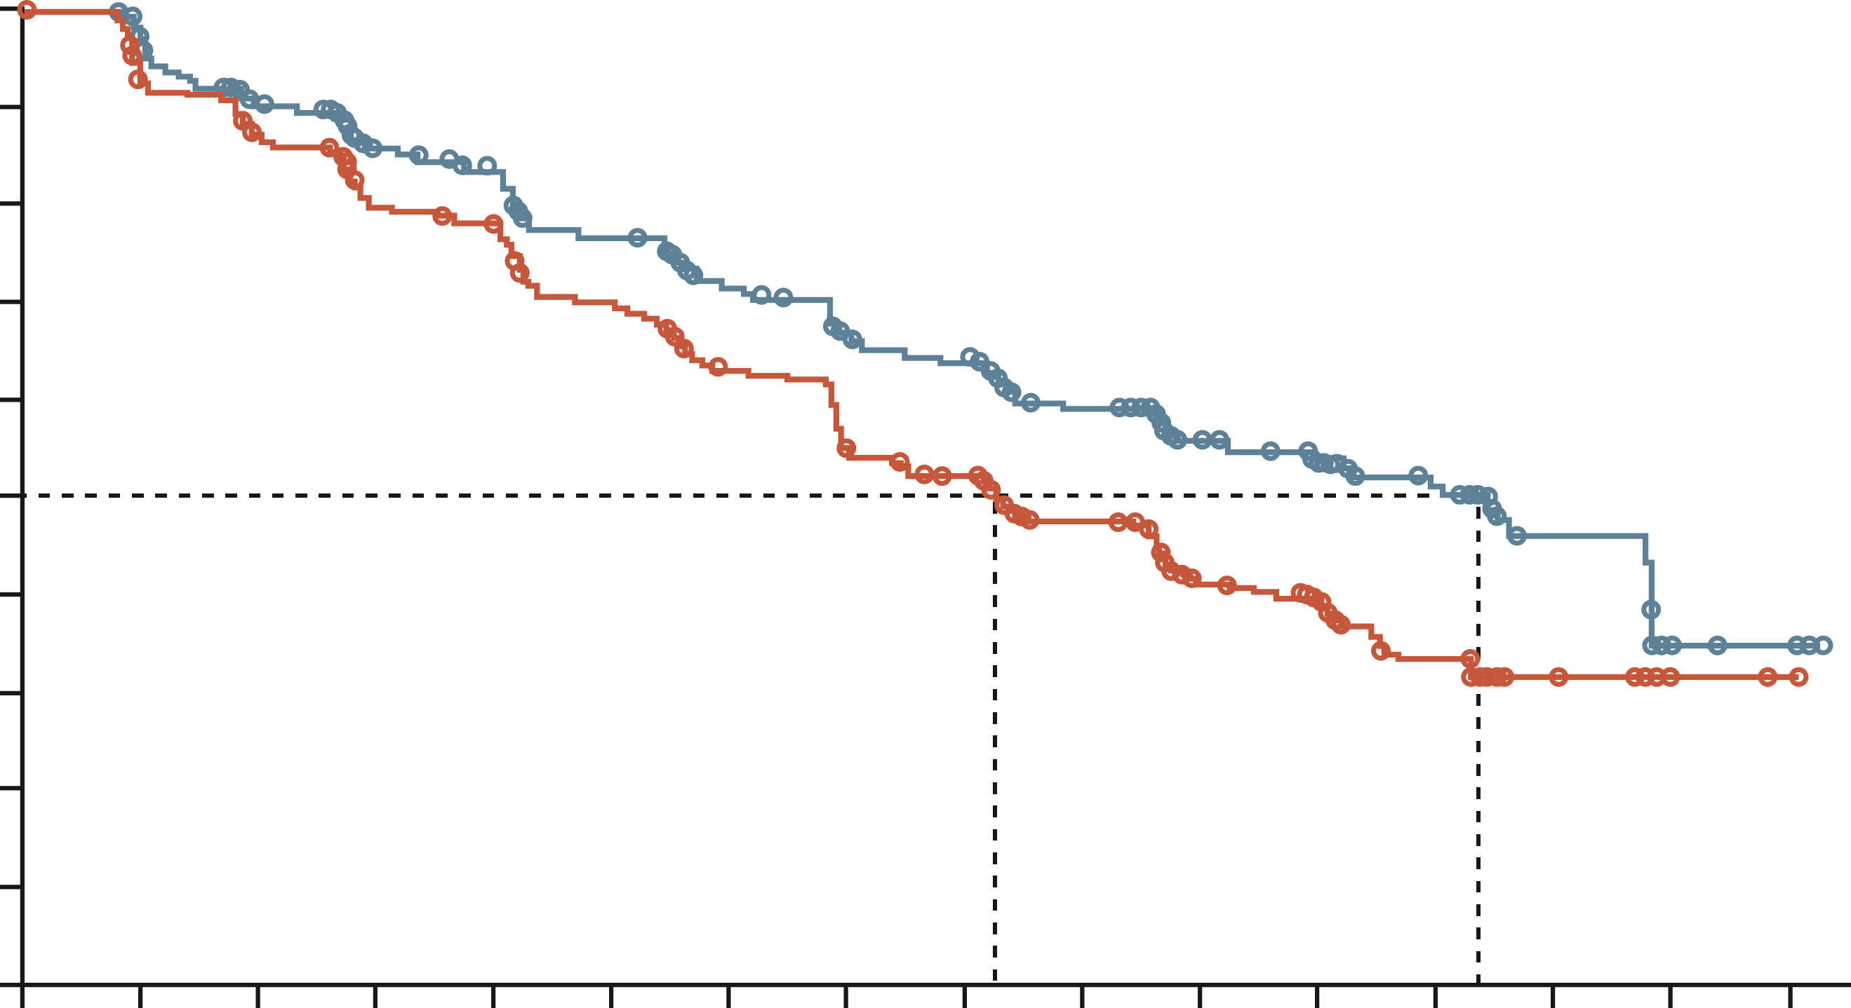
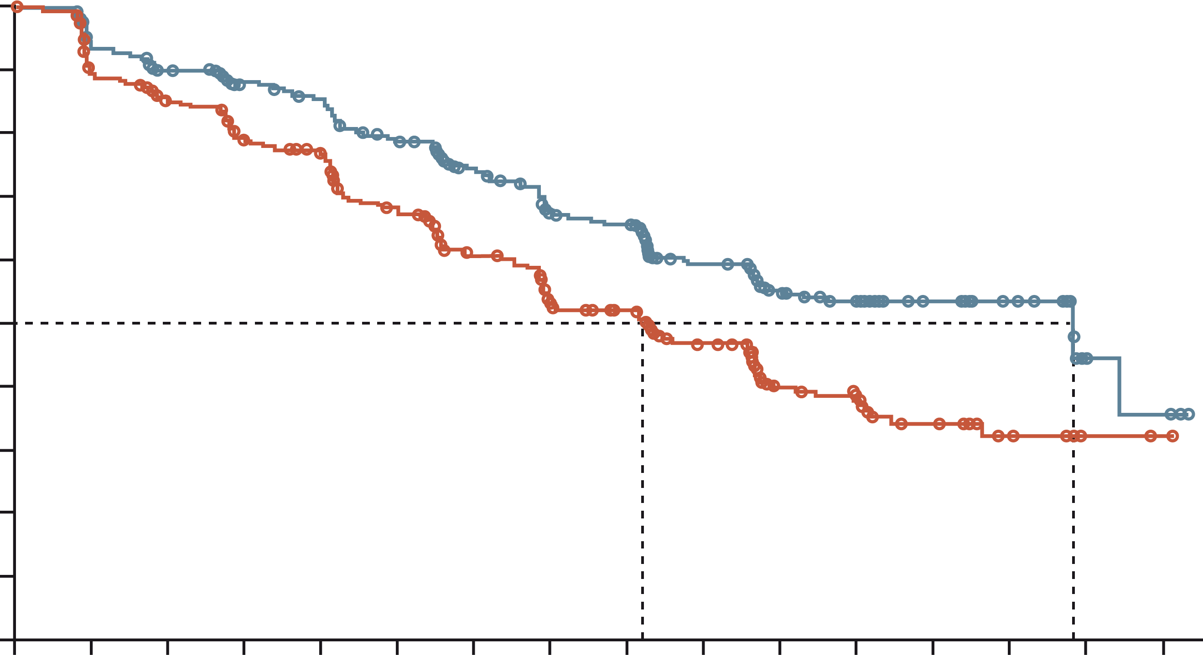
PROpel: primary rPFS results (DCO1)¹
Abiraterone + Olaparib significantly prolonged rpfs vs abiraterone + placebo in the itt population
rPFS by investigator assessment (INV)
rPFS by blinded independent central review (BICR)
 | Abi + Ola (N=399) | Abi + placebo (N=397)
Events, n (%) | 168 (42.1) | 226 (56.9)
Median, months | 24.8 | 16.6
 | HR 0.66 95% CI, 0.54-0.81; P<0.001
 | 2-sided boundary for significance 0.0324
 | Abi + Ola (N=399) | Abi + placebo (N=397)
Events, n (%) | 157 (39.3) | 218 (54.9)
Median, months | 27.6 | 16.4
 | HR 0.61 95% CI, 0.49-0.74; P<0.0001 (nominal)
1.0
1.0
0.9
0.9
0.8
0.8
0.7
0.7
0.6
0.6
0.5
0.5
Probability of rPFS
Probability of rPFS
0.4
0.4
0.3
0.3
0.2
0.2
0.1
∆=8.2 months
0.1
∆=11.2 months
0.0
0
2
4
6
8
10
12
14
16
18
20
22
24
26
28
30
0.0
0
2
4
6
8
10
12
14
16
18
20
22
24
26
28
30
Time from randomisation (months)
Time from randomisation (months)
Number of patients at risk:
Abi + Ola
Abi + placebo
Number of patients at risk:
Abi + Ola
Abi + placebo
399
397
367
359
340
338
313
306
301
297
274
264
251
232
227
198
219
186
167
141
104
87
87
73
57
43
26
17
5
2
4
1
399
397
353
345
332
322
314
294
303
282
275
245
249
209
221
177
215
168
161
126
96
73
80
62
53
38
28
16
5
2
4
1
DCO1: 30 July 2021
Median duration of follow-up for investigator-assessed rPFS for censored patients was 19.3 months in the abiraterone and olaparib arm, and 19.4 months in the abiraterone and placebo arm (19.3 and 19.2 months,
respectively, for BICR)
Abi, abiraterone; CI, confidence interval; DCO1, first data cut-off; HR, hazard ratio; ITT, intention-to-treat; Ola, olaparib; rPFS, radiographic progression-free survival
Clarke N, et al. NEJM Evidence 2022;1(9): doi: https://doi.org/10.1056/EVIDoa2200043; Clarke N, et al. J Clin Oncol 41, 2023 (suppl 6; abstr LBA16) (ASCO GU 2023 oral presentation)

Slide 21
PROpel: subgroup analysis of rPFS
An rPFS benefit was observed across all patient subgroups, including patients with and without HRRm (DCO1)
 | Number of patients, n | Median rPFS, months |  |  |  | HR (95% CI)
All patients | 796 | 24.8 | 16.6 |  |  | 0.66 (0.54-0.81)
Age at randomisation, years
<65 | 227 | NR | 16.4 |  |  | 0.51 (0.35-0.75)
≥65 | 569 | 22.0 | 16.7 |  |  | 0.78 (0.62-0.98)
Site of distant metastases
Bone only | 434 | 27.6 | 22.2 |  |  | 0.73 (0.54-0.98)
Visceral | 105 | 13.7 | 10.9 |  |  | 0.62 (0.39-0.99)
Other | 257 | 20.5 | 13.7 |  |  | 0.62 (0.44-0.85)
Docetaxel treatment at mHSPC stage
Yes | 189 | 27.6 | 13.8 |  |  | 0.61 (0.40-0.92)
No | 607 | 24.8 | 16.8 |  |  | 0.71 (0.56-0.89)
HRRm statusª
HRRm | 226 | NR | 13.9 |  |  | 0.50 (0.34-0.73)
Non-HRRm | 552 | 24.1 | 19.0 |  |  | 0.76 (0.60-0.97)
BRCAm statusª
BRCAm | 85 | NR | 8.4 |  |  | 0.23 (0.12-0.43)
Non-BRCAm | 693 | 24.1 | 19.0 |  |  | 0.76 (0.61-0.94)
0.1
Abiraterone + olaparib better
1
10
Abiraterone + placebo better
ª The HRRm and BRCAm status of patients in PROpel was determined after randomisation and before primary analysis using aggregated results from tumour tissue and/or plasma ctDNA HRRm tests. Aggregate HRRm and BRCAm subgroup analyses are post-hoc exploratory analyses. Results shown are by investigator assessment
BRCAm, breast cancer gene mutation; CI, confidence interval; ctDNA, circulating tumour DNA; DCO1, first data cut-off; HR, hazard ratio; HRRm, homologous recombination repair mutation; mHSPC, metastatic hormone-sensitive prostate cancer; NR, not reached; rPFS, radiographic progression-free survival
Saad F, et al. Ann Oncol. 2022;33 (suppl_7): S616-S652 (ESMO 2022 oral presentation); Clarke N, et al. NEJM Evidence 2022;1(9): doi: https://doi.org/10.1056/EVIDoa2200043

Slide 22
PROpel: OS at final analysis (DCO3)
In the ITT population, median OS was >7 months longer in the abiraterone + olaparib arm
1.0
 | Abiraterone + olaparib (N=399) | Abiraterone + placebo (N=397)
Events, n (%) | 176 (44.1) | 205 (51.6)
Median, months | 42.1 | 34.7
 | HR 0.81 95% CI, 0.67-1.00; P=0.0544
 | 2-sided boundary for significance 0.0377
 | 47.9% maturity
0.9
0.8
0.7
0.6
Probability of OS
0.5
0.4
0.3
0.2
∆ 7.4
months
0.1
0.0
0
2
4
6
8
10
12
14
16
18
20
22
24
26
28
30
32
34
36
38
40
42
44
46
48
Number of patients at risk:
Time from randomisation (months)
Abiraterone + olaparib
Abiraterone + placebo
399
397
399
395
391
388
385
383
374
376
364
370
349
355
334
337
318
316
312
305
298
301
283
282
273
254
258
241
253
225
246
213
226
201
192
157
135
119
96
84
63
53
29
25
10
7
2
0
0
0
DCO3: 12 October 2022.
Median (range) duration of follow-up for censored patients at DCO3 was 36.6 months (8.3–47.0) in the abiraterone + olaparib arm and 36.5 months (2.9–45.3) in the abiraterone + placebo arm.
CI, confidence interval; DCO3, third data cut-off; HR, hazard ratio; ITT, intention-to-treat; OS, overall survival
Clarke N, et al. J Clin Oncol 41, 2023 (suppl 6; abstr LBA16) (ASCO GU 2023 oral presentation)

Slide 23
PROpel: OS in subgroups (DCO3)
Results across subgroups were generally consistent with the ITT population
 | Events/ Number of patients, n | Median OS, months |  |  |  | HR (95% CI)
All patients | 381/796 | 42.1 | 34.7 |  |  | 0.81 (0.67-1.00)
Age at randomization, years
<65 | 93/227 | NR | 33.9 |  |  | 0.60 (0.40-0.90)
≥65 | 288/569 | 35.9 | 36.2 |  |  | 0.95 (0.75-1.19)
Site of distant metastases
Bone only | 198/434 | NR | 38.3 |  |  | 0.85 (0.64-1.13)
Visceral | 56/105 | 34.0 | 26.1 |  |  | 0.89 (0.53-1.51)
Other | 127/257 | 40.4 | 31.9 |  |  | 0.74 (0.52-1.05)
Docetaxel treatment at mHSPC stage
Yes | 107/189 | 38.8 | 27.2 |  |  | 0.76 (0.52-1.11)
No | 274/607 | NR | 38.3 |  |  | 0.85 (0.67-1.07)
HRRm statusª
HRRm | 117/226 | NR | 28.5 |  |  | 0.66 (0.45-0.95)
Non-HRRm | 255/552 | 42.1 | 38.9 |  |  | 0.89 (0.70-1.14)
BRCAm statusª
BRCAm | 38/85 | NR | 23.0 |  |  | 0.29 (0.14-0.56)
Non-BRCAm | 334/693 | 39.6 | 38.0 |  |  | 0.91 (0.73-1.13)
0.1
Abiraterone + olaparib better
1
10
Abiraterone + placebo better
DCO3: 12 October 2022.
a HRRm and BRCAm status was determined after randomisation and before primary analysis using aggregated results from tumour tissue and plasma ctDNA tests. Aggregate subgroup analyses are post hoc and exploratory.
BRCAm, breast cancer gene mutation; CI, confidence interval; ctDNA, circulating tumour DNA; DCO3, third data cut-off; HR, hazard ratio; HRRm, homologous recombination repair mutation; ITT, intention-to-treat; mHSPC, metastatic hormone sensitive prostate cancer; NR, not reached; OS, overall survival
Clarke N, et al. J Clin Oncol 41, 2023 (suppl 6; abstr LBA16) (ASCO GU 2023 oral presentation)

Slide 24
PROpel: most common AEs (>10% patients; DCO3)
Consistent with the known safety profiles of abiraterone and olaparib
Abiraterone + olaparib (N=398)
Abiraterone + placebo (N=396)
*
Professor Noel Clarke
Grade ≥3
0.3
All grade
3.8
Grade ≥3
0.5
All grade
2.5
Proportion of patients (%)
Pulmonary embolism (7.3% vs 2.3%) and cardiac failure events (1.8% vs 1.8%) were similar to earlier data cut-offs
DCO3: 12 October 2022. Safety was assessed through the reporting of AEs according to NCI CTCAE v4.03 and laboratory assessments. *Grouped term anaemia category includes anaemia, decreased haemoglobin level, decreased red-cell count, decreased haematocrit level, erythropenia, macrocytic anaemia, normochromic anaemia, normochromic normocytic anaemia and normocytic anaemia.
AEs, adverse events; DCO3, third data cut-off
Clarke N, et al. J Clin Oncol 41, 2023 (suppl 6; abstr LBA16) (ASCO GU 2023 oral presentation)

Slide 25
TALAPRO-2: A Randomised, Double-blind, Placebo‑Controlled Study
Patient population:
First-line mCRPC
ECOG performance status (PS)
0 or 1
Stratification factors:
Prior abirateroneª or docetaxel in castration-sensitive setting (yes vs no)
HRR gene alteration status (deficient vs nondeficient or unknown)
Talazoparib 0.5 mg* + enzalutamide 160 mg,
once daily
(n=402)
(*0.35 mg daily if moderate renal impairment)
Primary endpoint:
Radiographic progression-free survival (rPFS)
by blinded independent central review (BICR)
Key secondary endpoint:
Overall survival (alpha protected)
Other secondary endpoints:
Time to cytotoxic chemotherapy
PFS2 by investigator assessment^{b}
Objective response rate (ORR)
Patient-reported outcomes
Safety
(Data cut-off: August 16, 2022)
R
1:1
(N=805)
Placebo +
enzalutamide 160 mg,
once daily
(n=403)
All comers (Cohort 1), N=805
Nondeficient
or unknown
N=636
HRRm
N=169
HRRm
N=230
Samples prospectively assessed for HRR gene alterations (BRCA1, BRCA2, PALB2, ATM, ATR,
CHEK2, FANCA, RAD51C, NBN, MOH1, MRE11A, CDK12) using FoundationOne®CDx and/or
FoundationOne®Liquid CDx
HRRm only (Cohort 2), N=399
Results are repoprted only from the all-comers cohort of men unselected for HRR gene alterations
To maintain the overall type I error at or below 1-sided 0.025, alpha for rPFS by BICR was split equally between the all-comers and forthcoming molecularly selected cohort (1-sided alpha of 0.0125
for each). If the rPFS showed statistically significant improvement, overall survival was tested in the hierarchical stepwise procedure to preserve the overall type I error
ª Two patients in each treatment arm received prior orteronel
^{b} Time from randomisation to the date of documented progression on the first subsequent antineoplastic therapy or death from any cause, whichever occurred first
ATM, ataxia-telangiectasia gene; ATR, ataxia telangiectasia and Rad3 related; BICR, blinded independent central review; BRCA, breast cancer gene; CDK12, cyclin dependent kinase 12; CHEK2, checkpoint kinase 2; ECOG, Eastern Cooperative Oncology Group; HRR, homologous recombination repair; HRRm, HRR mutation; NBN, nibrin; ORR, objective response rate; PALB2, partner and localizer of BRCA2; PFS2, time to second progression; rPFS, radiographic progression-free survival
Agarwal N, et al. J Clin Oncol 41, 2023 (suppl 6; abstr LBA17) (ASCO GU 2023 oral presentation)

Slide 26
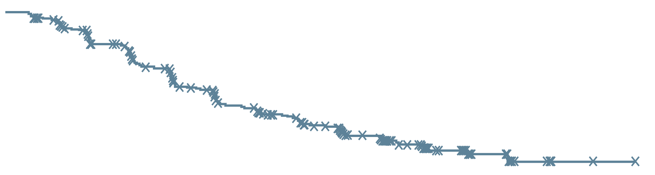
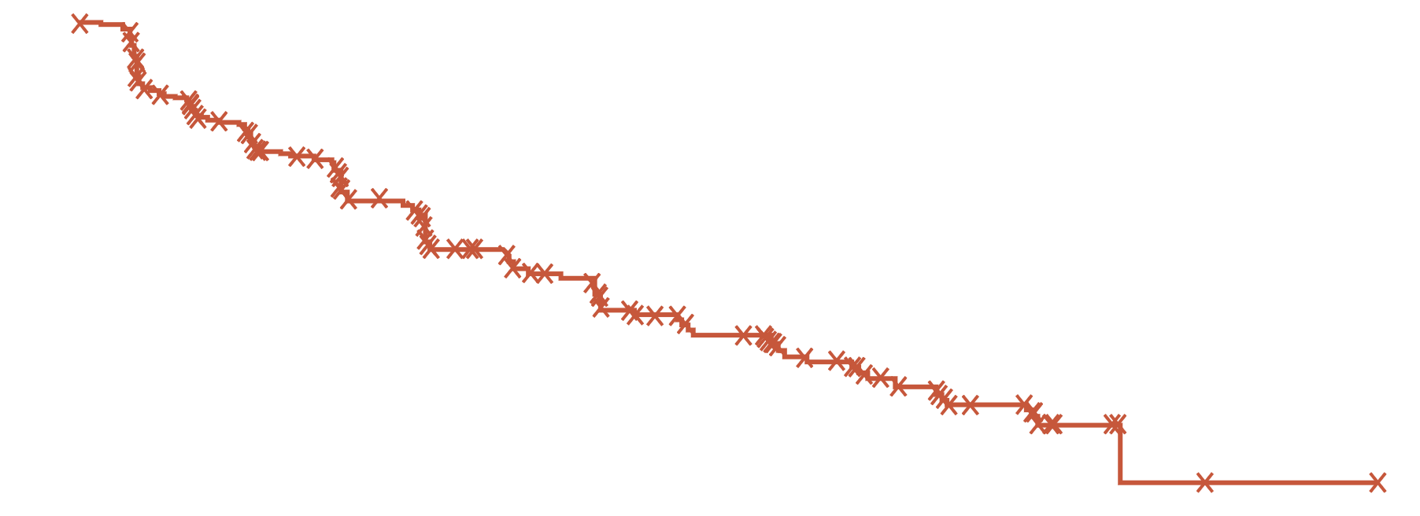
TALAPRO-2 Primary Endpoint: rPFS by BICR
Treatment with talazoparib plus enzalutamide resulted in a 37% reduced risk of progression or death
1.0
0.8
 | TALA + ENZA (N=402) | PBO + ENZA (N=403)
Events, n | 151 | 191
Median (95% CI), months | NR (27.5-NR) | 21.9 (16.6-25.1)
 | HR 0.63 95% CI, 0.51-0.78; P<0.001
0.6
Talazoparib + Enzalutamide
Probability of rPFS
0.4
0.4
Placebo + Enzalutamide
Median follow-up for rPFS was
24.9 and 24.6 months, respectively
0.0
0
2
4
6
8
10
12
14
16
18
20
22
24
26
28
30
32
34
36
38
40
42
Months
No. at risk
TALA + ENZA
PBO + ENZA
402
403
379
346
353
311
326
279
318
272
285
237
256
200
234
185
226
179
209
154
193
140
175
124
136
96
97
68
67
43
61
42
29
14
13
3
2
1
2
1
1
1
0
0
A consistent treatment effect was seen for investigator-assessed rPFS: HR 0.64 (95% CI, 0.50-0.81); P<0.001
Stratified hazard ratios (HRs) and 2-sided p values are reported throughout this presentation unless otherwise stated
BICR, blinded independent central review; CI, confidence interval; ENZA, enzalutamide; HR, hazard ratio; NR, not reached; PBO, placebo; rPFS, radiographic progression-free survival; TALA, talazoparib
Agarwal A, et al. J Clin Oncol 41, 2023 (suppl 6; abstr LBA17) (ASCO GU 2023 oral presentation)

Slide 27
TALAPRO-2: Subgroup Analysis of rPFS by BICR
A consistent treatment effect with talazoparib plus enzalutamide was seen in prespecified subgroups
 |  | Talazoparib + Enzalutamide | Placebo + Enzalutamide |  | HR (95% CI) | 2-sided p value
Subgroup |  | Events/N
Overall |  | 151/402 | 191/403 |  | 0.63 (0.51-0.78) | <0.001
Age, years | ≥70 | 93/240 | 109/240 |  | 0.67 (0.51-0.89) | 0.005
 | <70 | 58/162 | 82/163 |  | 0.61 (0.44-0.86) | 0.004
ECOG PS | 0 | 100/259 | 130/271 |  | 0.67 (0.51-0.86) | 0.002
 | 1 | 51/143 | 61/132 |  | 0.62 (0.43-0.90) | 0.01
Gleason score | <8 | 34/117 | 49/113 |  | 0.60 (0.39-0.93) | 0.02
 | ≥8 | 115/281 | 137/283 |  | 0.67 (0.52-0.86) | 0.001
Stage at diagnosis | M0 | 64/172 | 92/185 |  | 0.61 (0.44-0.84) | 0.002
 | M1 | 86/226 | 98/215 |  | 0.69 (0.51-0.92) | 0.01
Site of metastasis | Bone only | 52/169 | 63/154 |  | 0.59 (0.41-0.86) | 0.005
 | Soft tissue only | 15/48 | 29/57 |  | 0.57 (0.30-1.07) | 0.07
 | Bone and soft tissue | 82/180 | 98/188 |  | 0.71 (0.53-0.95) | 0.02
HRR status | Deficient | 37/85 | 49/84 |  | 0.48 (0.31-0.74) | <0.001
 | Non-deficient/unknown | 114/317 | 142/319 |  | 0.69 (0.54-0.89) | 0.004
Prior abirateroneª or docetaxel | Yes | 42/109 | 58/110 |  | 0.56 (0.38-0.83) | 0.004
 | No | 109/293 | 133/293 |  | 0.68 (0.53-0.88) | 0.003
0.25
0. 5
1
1.25
Talazoparib + Enzalutamide better
Placebo + Enzalutamide better
The HR for all patients was based on a Cox model stratified by the randomisation stratification factors. For all subgroups, the HR was based on an unstratified Cox model with treatment as the only covariate
ª Includes two patients in each treatment arm who received prior orteronel
BICR, blinded independent central review; CI, confidence interval; ECOG PS, Eastern Cooperative Oncology Group performance status; HR, hazard ratio; HRR, homologous recombination repair; rPFS, radiographic progression-free survival
Agarwal A, et al. J Clin Oncol 41, 2023 (suppl 6; abstr LBA17) (ASCO GU 2023 oral presentation)

Slide 28
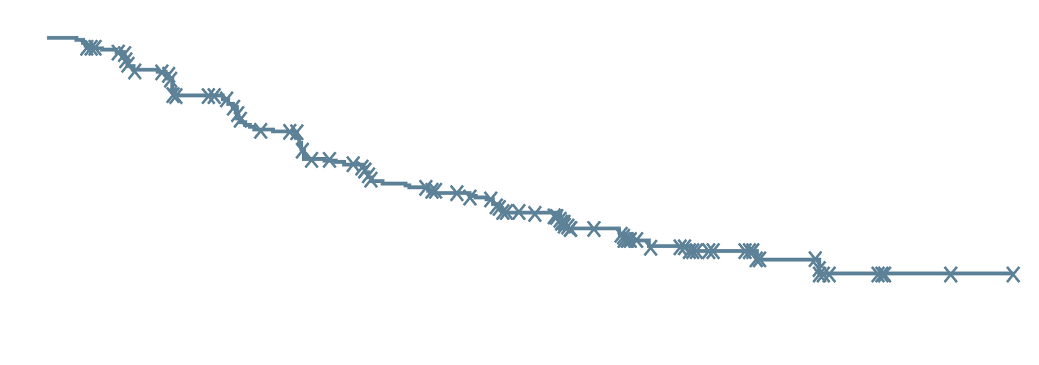
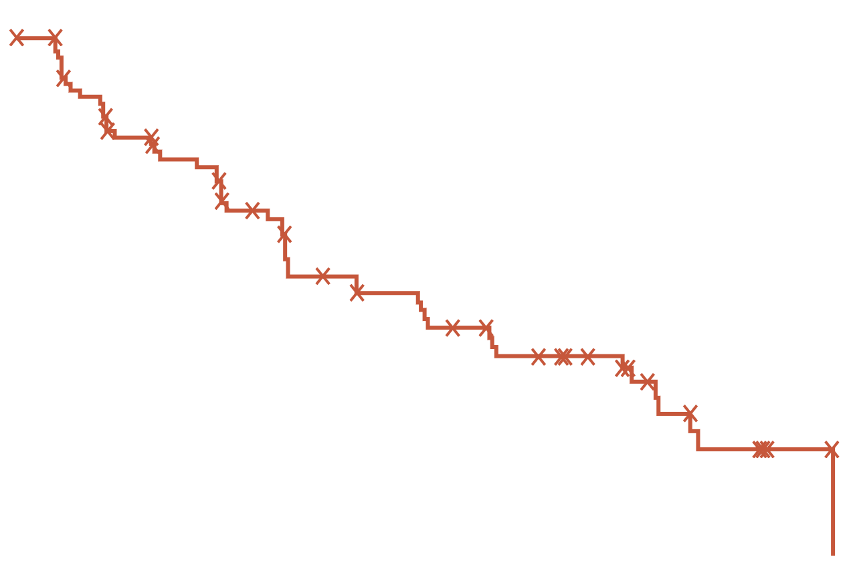
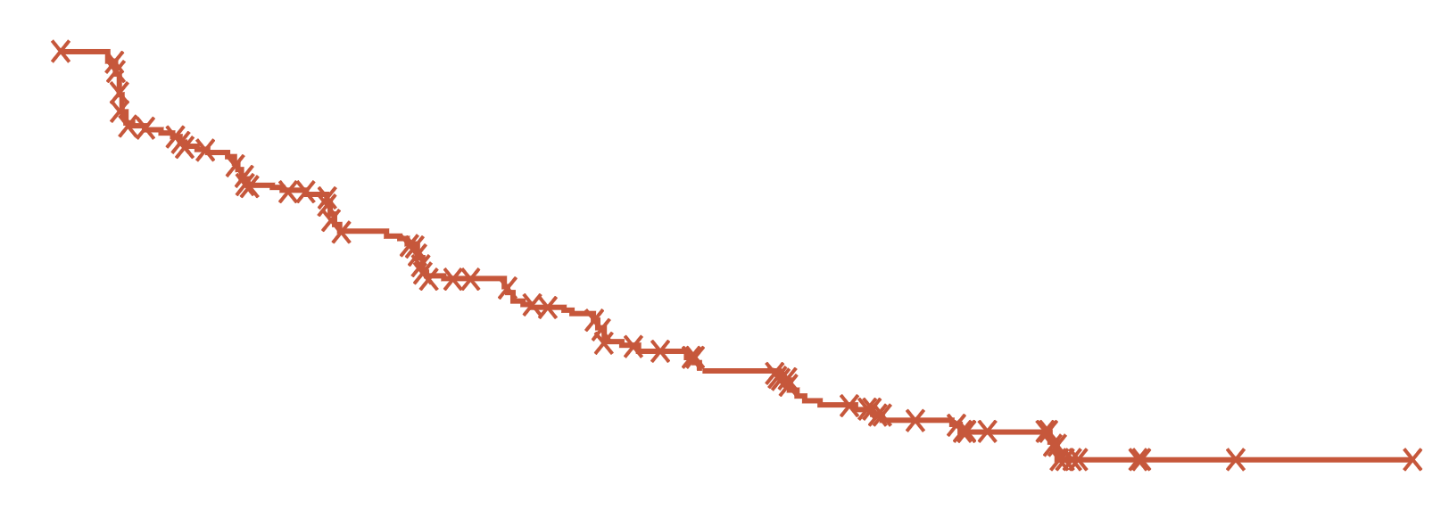
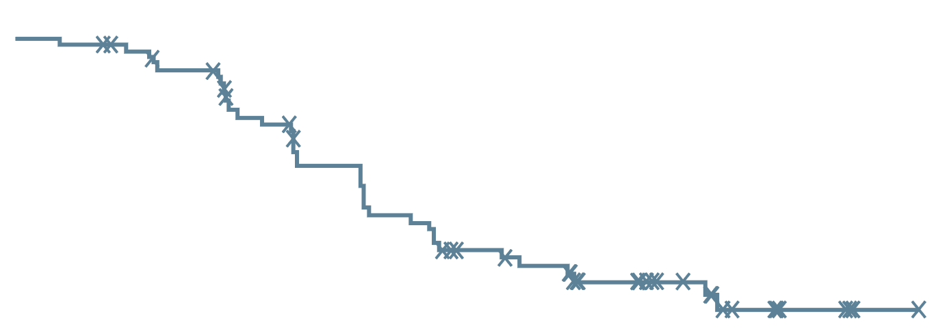
TALAPRO-2: rPFS by BICR by HRR Status
A clinically meaningful reduction in risk of progression or death was seen regardless of HRR status
HRR-deficient
HRR-nondeficient or unknown
1.0
 | TALA + ENZA (N=85) | PBO + ENZA (N=84)
Events, n | 37 | 49
Median (95% CI), months | 27.9 (16.6-NR) | 16.4 (10.9-24.6)
 | HR 0.46 95% CI, 0.30-0.70; P<0.001
1.0
0.8
0.8
Talazoparib + Enzalutamide
0.6
0.6
Probability of rPFS
Probability of rPFS
0.4
Talazoparib +
Enzalutamide
0.4
 | TALA + ENZA (N=317) | PBO + ENZA (N=319)
Events, n | 114 | 142
Median (95% CI), months | NR (27.5-NR) | 22.5 (19.1-30.5)
 | HR 0.70 95% CI, 0.54-0.89; P=0.004
Placebo + Enzalutamide
0.2
0.2
Placebo +
Enzalutamide
0.0
0.0
0
2
4
6
8
10
12
14
16
18
20
22
24
26
28
30
32
34
36
38
40
42
0
2
4
6
8
10
12
14
16
18
20
22
24
26
28
30
32
34
36
38
40
42
Months
Months
No. at risk
TALA + ENZA
PBO + ENZA
85
84
83
72
81
61
76
55
75
54
65
43
57
34
51
30
49
30
42
25
40
21
37
20
30
17
23
11
17
6
15
6
6
2
3
0
0
0
0
0
0
0
0
0
No. at risk
TALA + ENZA
PBO + ENZA
317
319
296
274
272
250
250
224
243
218
220
194
199
166
183
155
177
149
167
129
153
119
138
104
106
79
74
57
50
37
46
36
23
12
10
3
2
1
2
1
1
1
0
0
HRR gene alteration status (deficient vs nondeficient or unknown) as a stratification factor
BICR, blinded independent central review; CI, confidence interval; ENZA, enzalutamide; HR, hazard ratio; HRR, homologous recombination repair; NR, not reached;
PBO, placebo; rPFS, radiographic progression-free survival; TALA, talazoparib
Agarwal A, et al. J Clin Oncol 41, 2023 (suppl 6; abstr LBA17) (ASCO GU 2023 oral presentation)

Slide 29
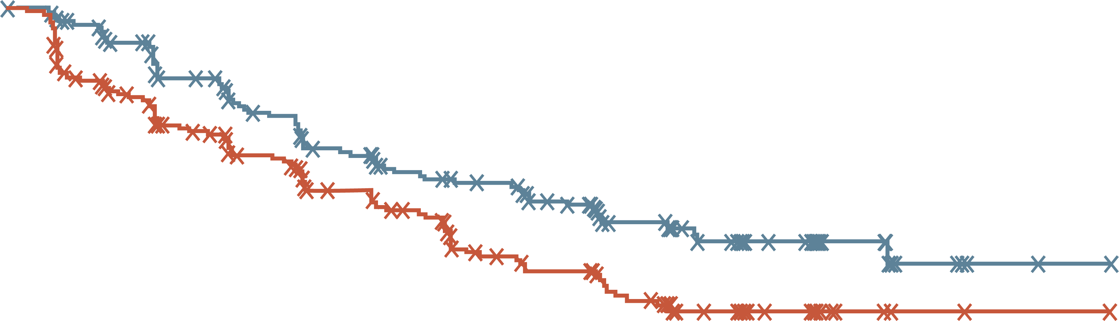
TALAPRO-2: rPFS by BICR in HRR-nondeficient by Prospective TumoUr Tissue Testing
34% risk reduction in patients without HRR gene alterations detected by prospective tumoUr tissue testing
1.0
0.8
 | TALA + ENZA (N=198) | PBO + ENZA (N=214)
Events, n | 70 | 96
Median (95% CI), months | NR (25.8-NR) | 22.1 (16.6-NR)
 | HR 0.66 95% CI, 0.49-0.91; P=0.009
Talazoparib + Enzalutamide
0.6
Probability of rPFS
0.4
Placebo + Enzalutamide
0.4
0.0
0
2
4
6
8
10
12
14
16
18
20
22
24
26
28
30
32
34
36
38
40
42
Months
No. at risk
TALA + ENZA
PBO + ENZA
198
214
184
179
170
162
152
143
148
138
132
123
119
107
109
100
104
95
100
78
91
71
83
65
63
50
43
34
31
23
28
22
18
8
7
2
2
1
2
1
1
1
0
0
Exploratory endpoint analysis based on HRR gene alteration status derived from the clinical database (unstratified analysis)
BICR, blinded independent central review; CI, confidence interval; ENZA, enzalutamide; HR, hazard ratio; HRR, homologous recombination repair; NR, not reached; PBO, placebo; rPFS, radiographic progression-free survival; TALA, talazoparib
Agarwal A, et al. J Clin Oncol 41, 2023 (suppl 6; abstr LBA17) (ASCO GU 2023 oral presentation)

Slide 30
Talapro-2: Most common all-cause teaes
Talazoparib + Enzalutamide
(N=398)
Placebo + Enzalutamide
(N=401)
In the talazoparib arm:
Most common TEAEs leading to a dose reduction of talazoparib were:
  Anaemia (43.2%)
  Neutropenia (15.1%)
  Thrombocytopenia (5.5%)
49.0% had grade 1-2 anaemia at baseline
Grade 3-4 anaemia
  Median time to onset was 3.3 months
  Reported in 46.5% of men
8.3% discontinued talazoparib due to anaemia
The median relative dose intensity of talazoparib remained >80%
Anaemia
65.8
17.5
Neutropenia
35.7
1.3
7.0
(0.5/1.0/5.5)
Fatigue
33.7
29.4
Thrombocytopenia
24.6
2.3
3.5
(0.2/0.7/2.5)
Leukopenia
22.1
4.5
Back pain
22.1
18.0
Decreased
appetite
Grade 4
Grade 4
Grade 3
21.6
15.7
Grade 3
Nausea
Grade 1-2
20.6
12.5
Grade 1-2
Proportion of patients (%)
TEAEs, treatment emergent adverse events
Agarwal A, et al. J Clin Oncol 41, 2023 (suppl 6; abstr LBA17) (ASCO GU 2023 oral presentation)

Slide 31
MAGNITUDE: Randomised, Double-Blind, Placebo-Controlled Study
biomarker cohorts selected prior to randomisation designed to test HRR BM⁺ and HRR BM–
Study start:
February 2019
Prescreening for
BM statusª
Allocation
to cohort
1:1
randomisation
Patient eligibility
First-line mCRPC
  ≤4 months prior AAP allowed for mCRPC
ECOG PS 0 or 1
BPI-SF worst pain score ≤3
Stratifications
Prior taxane-based chemotherapy for mCSPC
Prior AR inhibitor for nmCRPC or mCSPC
Prior AAP for first-line mCRPC
BRCA1/2 vs other HRR alterations (HRR BM⁺ cohort)
Niraparib 200 mg^{b} + abiraterone 1000 mg^{c}
Primary endpoint
rPFS by central review
HRR BM⁺
Planned N=400
HRR BM⁺ panel:
ATM
BRCA1
BRCA2 BRIP1 CDK12 CHEK2 FANCA HDAC2 PALB2
Secondary endpoints
Time to cytotoxic chemotherapy
Time to symptomatic progression
OS
Placebo + abiraterone 1000 mg^{c}
Other prespecified endpoints
Time to PSA progression
ORR
PFS2
Time to pain progression
Patient-reported outcomes
Niraparib 200 mg^{b} + abiraterone 1000 mg^{c}
HRR BM⁻
Planned N=600
Placebo + abiraterone 1000 mg^{c}
Note: Patients could request to be unblinded by the study steering
committee and go on to subsequent
therapy of the investigator's choice
Clinical data cut-off was October 8, 2021 for the final rPFS analysis.
ª Tissue and plasma assays: FoundationOne tissue test (FoundationOne®CDx), Resolution Bioscience liquid test (ctDNA), AmoyDx blood and tissue assays, Invitae germline testing (blood/saliva), local lab biomarker test results demonstrating a pathogenic germline or somatic alteration listed in the study biomarker gene panel
^{b} Dose of niraparib used was lower than the usual monotherapy dose as a result of data obtained from the BEDIVERE trial
^{c} Abiraterone given in combination with prednisone or prednisolone 5 mg BID
AAP, abiraterone acetate and prednisone/prednisolone; AR, androgen receptor; ATM, ataxia-telangiectasia gene; BID, twice daily; BM, biomarker; BPI-SF, Brief Pain Inventory–Short Form; BRCA1/2, breast cancer gene 1/2; CDK12, cyclin-dependent kinase 12; CHEK2, checkpoint kinase 2; CRPC, castration-resistant prostate cancer; ECOG PS, Eastern Cooperative Oncology Group performance status; HDAC2, histone deacetylase 2; HRR, homologous recombination repair; mCRPC, metastatic CRPC; mCSPC, metastatic castration-sensitive prostate cancer; nmCRPC, non-metastatic CRPC; ORR, overall response rate; OS, overall survival; PALB2, partner and localiser of BRCA2; PFS2, progression-free survival on first subsequent therapy; PSA, prostate-specific antigen; rPFS, radiographic progression-free survival
Chi K, et al. J Clin Oncol. 2022;40 Suppl: Abstract 12 (ASCO GU 2022 oral presentation); https://clinicaltrials.gov/ct2/show/NCT03748641

Slide 32
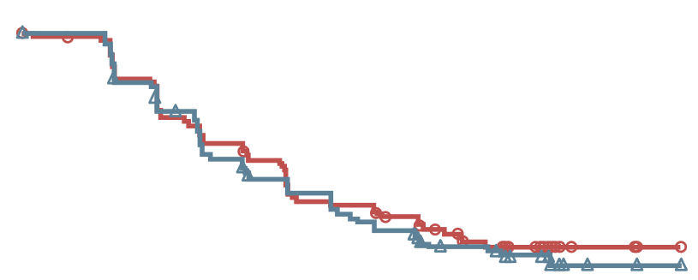
MAGNITUDE HRR BM⁻: Prespecified Early Futility Analysis
No Benefit of NIRA + AAP in HRR BM⁻ Patients
Composite progression endpointª
100
Additional grade 3/4 toxicity was observed
using NIRA + APP vs PBO + AAP
With added toxicity and no added efficacy in patients with HRR BM⁻ mCRPC, the IDMC recommend stopping enrolment in this cohort
80
60
PBO + AAP
Patients without events (%)
40
NIRA + AAP
20
HR = 1.09^{b} (95% CI 0.75-1.59)
0
0
3
6
9
12
15
Time from randomisation (months)
No. at risk
NIRA + AAP | 117 | 92 | 68 | 51 | 4 | 0
PBO + AAP | 116 | 91 | 68 | 56 | 8 | 0
ª Composite endpoint: rPFS or PSA progression, whichever occurred first
^{b} Breakdown of composite endpoint events: 83 PSA events (HR = 1.03, 95% CI 0.67-1.59); 65 rPFS events (HR = 1.03, 95% CI 0.63-1.67)
AAP, abiraterone acetate + prednisone/prednisolone; BM, biomarker; CI, confidence interval; HR, hazard ratio; HRR, homologous recombination repair; IDMC, independent data monitoring committee; mCRPC, metastatic castration-resistant prostate cancer; NIRA, niraparib; PBO, placebo; PSA, prostate antigen; rPFS, radiographic progression free survival
Chi K, et al. J Clin Oncol 2022; 40, (suppl 6; abstr 12) (ASCO GU 2022 oral presentation)

Slide 33
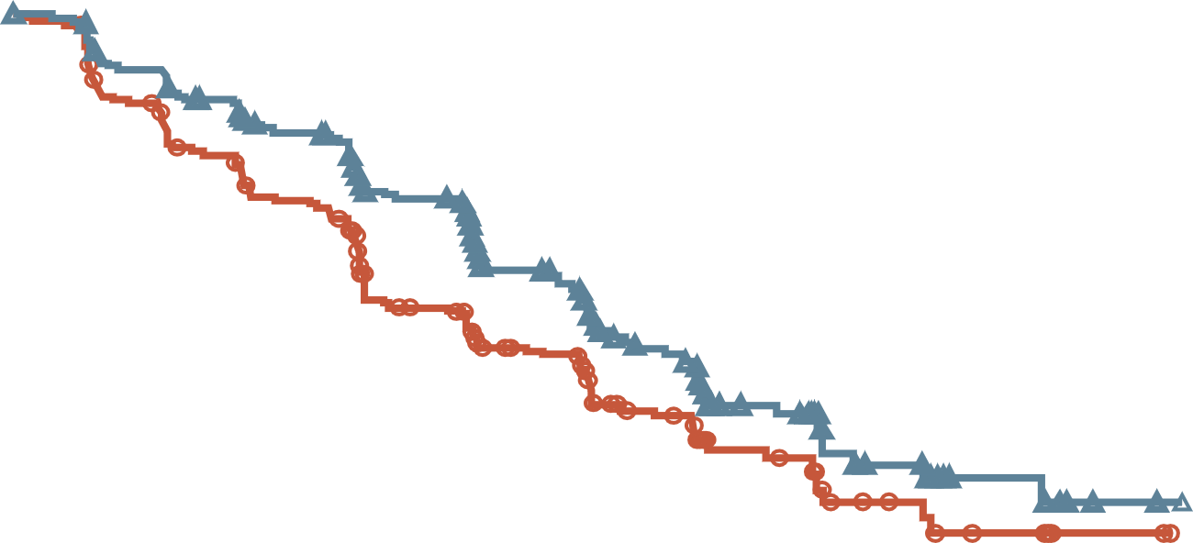
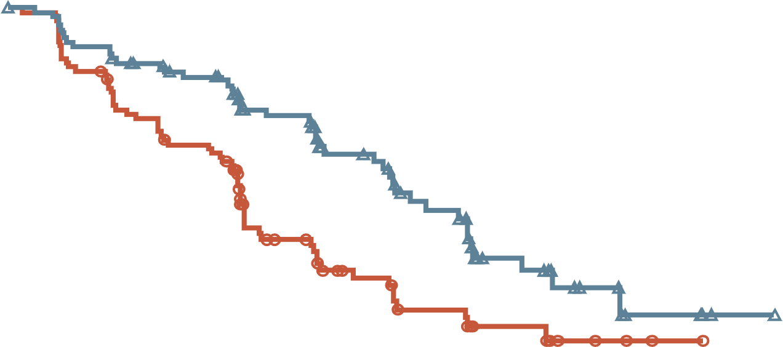
MAGNITUDE: Primary Endpoint rPFS (BICR)
rPFS WAS 2.8 MONTHS GREATER FOR ABIRATERONE + NIRAPARIB VERSUS ABIRATERONE + PLACEBO in HRR BM+ PATIENTS
All HRR BM+ patients
BRCA1/2-Mutated patients
NIRA + AAP: 16.6 mo
NIRA + AAP: 16.5 mo
PBO + AAP: 13.7 mo
PBO + AAP: 10.9 mo
HR: 0.73 (95% CI, 0.56-0.96)
P=0.0217
HR: 0.53 (95% CI, 0.36-0.79)
P=0.0014
No. at risk
NIRA + AAP | 212 | 192 | 167 | 129 | 96 | 64 | 45 | 21 | 10 | 2 | 0
PBO + AAP | 211 | 182 | 149 | 102 | 78 | 53 | 35 | 15 | 9 | 2 | 0
No. at risk
NIRA + AAP | 113 | 103 | 90 | 65 | 45 | 31 | 18 | 9 | 4 | 1 | 0
PBO + AAP | 112 | 97 | 77 | 43 | 28 | 20 | 11 | 5 | 2 | 0 | 0
Median follow-up 18.6 months
Median follow-up 16.7 months
AAP, abiraterone acetate + prednisone/prednisolone; BICR, blinded independent central review; BM, biomarker; BRCA1/2, breast cancer gene 1/2; CI, confidence interval; HR, hazard ratio; HRR, homologous recombination repair; NIRA, niraparib; PBO, placebo; rPFS, radiographic progression-free survival
Chi K, et al. J Clin Oncol. 2022;40 (suppl 6; abstr 12) (ASCO GU 2022 oral presentation)

Slide 34
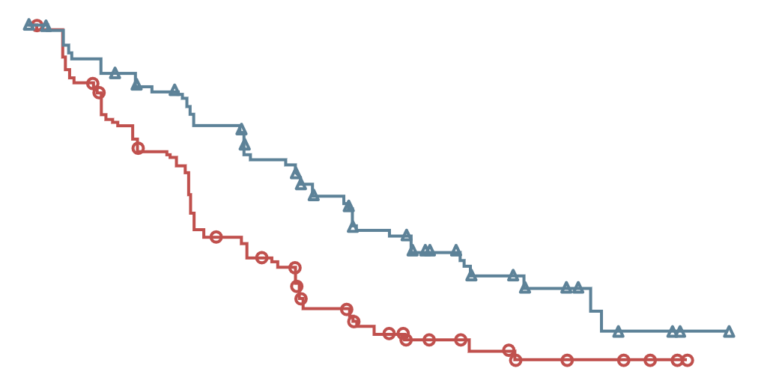
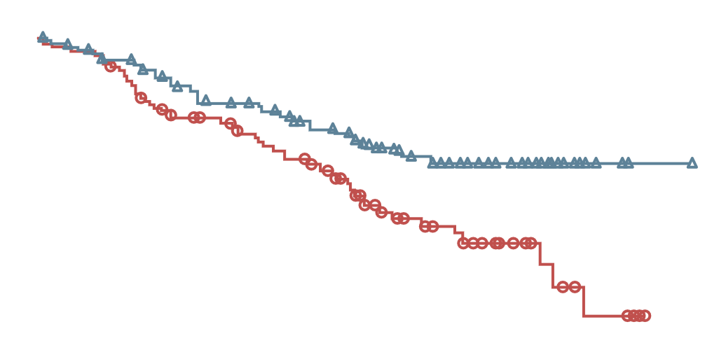
MAGNITUDE BRCA Patients: NIRA + AAP improved rPFS and Time to Symptomatic Progression in the BRCA Subgroup
With additional 8 months follow-up
rPFS by central review in the BRCA subgroup
Time to symptomatic progression in the
BRCA subgroup
100
100
80
80
NIRA + AAP: NE
NIRA + AAP: median 19.5 mo
60
60
Patients without
event (%)
Patients without
event (%)
40
40
20
PBO + AAP: median 10.9 mo
20
PBO + AAP: median 23.6 mo
HR 0.55 (95% CI, 0.39-0.78)
p=0.0007ª
HR 0.54 (95% CI, 0.35-0.85)
p=0.0071ª
0
0
0
3
6
9
12
15
18
21
24
27
30
33
36
0
3
6
9
12
15
18
21
24
27
30
33
36
39
No. of patients
NIRA + AAP
PBO + AAP
Months from randomisation
No. of patients
NIRA + AAP
PBO + AAP
Months from randomisation
113
103
91
80
69
55
40
26
19
12
6
2
0
113
112
107
107
100
91
91
84
85
74
72
68
58
48
42
28
33
20
21
14
8
6
3
4
1
0
0
0
rPFS by central review demonstrated a consistent and clinically meaningful treatment effect favouring niraparib + AAP, with a median rPFS of 19.5 months at IA2 compared with 10.9 months for placebo + AAP
Investigator Assessed HR (95% CI) 0.46 (0.32-0.67)
A strong improvement in time to symptomatic progression (TSP) was observed in patients who received niraparib + AAP compared with placebo + AAP
NIRA + AAP reduced the risk of progression or death by 45% in patients with BRCA mutations, extending rPFS by >8 months
Results are descriptive. No formal statistical testing was performed. Consistent results were observed for rPFS assessed by investigator for both the BRCA subgroup and HRR+ population
ª Nominal P value
AAP, abiraterone acetate with prednisone; BRCA, breast cancer gene; CI, confidence interval; HR, hazard ratio; HRR+, homologous recombination repair positive; IA2, second interim analysis; mo, months; NE, not estimable; NIRA, niraparib; PBO, placebo; rPFS, radiographic progression-free survival
Efstathiou E, et al. J Clin Oncol 41, 2023 (suppl 6; abstr 170) (ASCO GU 2023 oral presentation)

Slide 35
MAGNITUDE All HRR BM+: Subgroup Analysis of rPFS
rPFS benefit was similar across all patient subgroups
Median (months)
Events/N
Median (months)
Events/N
Variable
Subgroup
niraparib
control
HR (95% CI)
niraparib
control
Variable
Subgroup
niraparib
control
HR (95% CI)
niraparib
control
All HRR+ patients
All
16.5
13.7
0.74 (0.57–0.97)
100/212
117/211
Past taxane–based chemotherapy
Yes
13.4
10.9
0.89 (0.48–1.66)
20/40
21/41
Age group
<65
13.9
13.9
1.01 (0.61–1.66)
32/61
30/62
No
16.6
13.8
0.71 (0.53–0.96)
80/172
96/170
≥65-74
19.4
13.6
0.58 (0.38–0.89)
34/88
57/100
Past androgen receptor-targeted
therapyª
Yes
NE
4.3
0.19 (0.03–1.23)
2/8
3/4
≥75
16.4
10.9
0.76 (0.46–1.24)
34/63
30/49
No
16.5
13.8
0.76 (0.58-1.00)
98/204
114/207
Race group
Asian
22.0
10.9
0.48 (0.22–1.05)
9/29
22/41
Prior AAP use^{b}
Yes
13.9
14.6
0.95 (0.54–1.67)
23/47
26/45
White
14.4
13.8
0.83 (0.61–1.13)
82/160
83/153
No
16.7
12.7
0.71 (0.52–0.96)
77/165
91/166
Other
18.4
9.0
0.47 (0.20–1.14)
9/23
12/17
Presence of visceral metastases
Yes
11.0
8.1
1.03 (0.60–1.77)
34/51
22/39
Baseline ECOG performance
status
0
19.5
13.9
0.65 (0.46–0.92)
53/130
76/146
No
19.4
13.8
0.64 (0.47–0.87)
66/161
95/172
1
13.1
10.5
0.84 (0.55–1.28)
47/82
41/65
Bone only metastasis at entry
Yes
19.4
15.4
0.72 (0.45–1.14)
32/78
41/85
Baseline BPI-SF#3 Score
0
16.7
16.8
0.75 (0.51–1.12)
47/108
53/103
No
14.8
10.9
0.73 (0.53–1.02)
68/134
76/126
1 to 3
13.9
10.5
0.78 (0.52–1.17)
46/88
50/86
Number of bone lesions at baseline
≤10
19.4
15.4
0.76 (0.53–1.10)
54/127
65/128
>3
13.7
13.7
0.68 (0.26–1.79)
6/14
14/22
>10
13.8
8.4
0.69 (0.47–1.04)
46/85
52/83
Region
Asia Pacific
19.5
13.8
0.64 (0.35–1.17)
17/43
27/52
Baseline PSA above median
Yes
15.7
8.3
0.58 (0.40–0.82)
56/110
66/101
Europe
14.4
13.7
0.82 (0.58–1.14)
68/128
71/120
No
16.7
18.2
0.93 (0.62–1.40)
44/102
51/110
North and South America
16.6
16.4
0.60 (0.30–1.18)
15/41
19/39
Gene mutation type
BRCA
16.6
10.9
0.55 (0.38–0.81)
45/113
64/112
Other HRR
14.8
16.4
0.99 (0.68–1.45)
55/99
53/99
0.1
1
0.1
1
Favouring Niraparib
Favouring Control
Favouring Niraparib
Favouring Control
ª Past AR-targeted therapy was considered prior novel anti-androgen therapy, such as enzalutamide, apalutamide, or darolutamide
^{b} Prior AAP use was up to 4 months prior to study start
AAP, abiraterone acetate + prednisone/prednisolone; AR, androgen receptor; BM, biomarker; BPI-SF, Brief Pain Inventory–Short Form; BRCA, breast cancer gene; CI, confidence interval; ECOG, Eastern Cooperative Oncology Group; HR, hazard ratio; HRR, homologous recombination repair; NE, not estimable; PSA, prostate-specific antigen; rPFS, radiographic progression-free survival
Chi K, et al. J Clin Oncol. 2022;40 (suppl 6; abstr 12) (ASCO GU 2022 oral presentation)

Slide 36
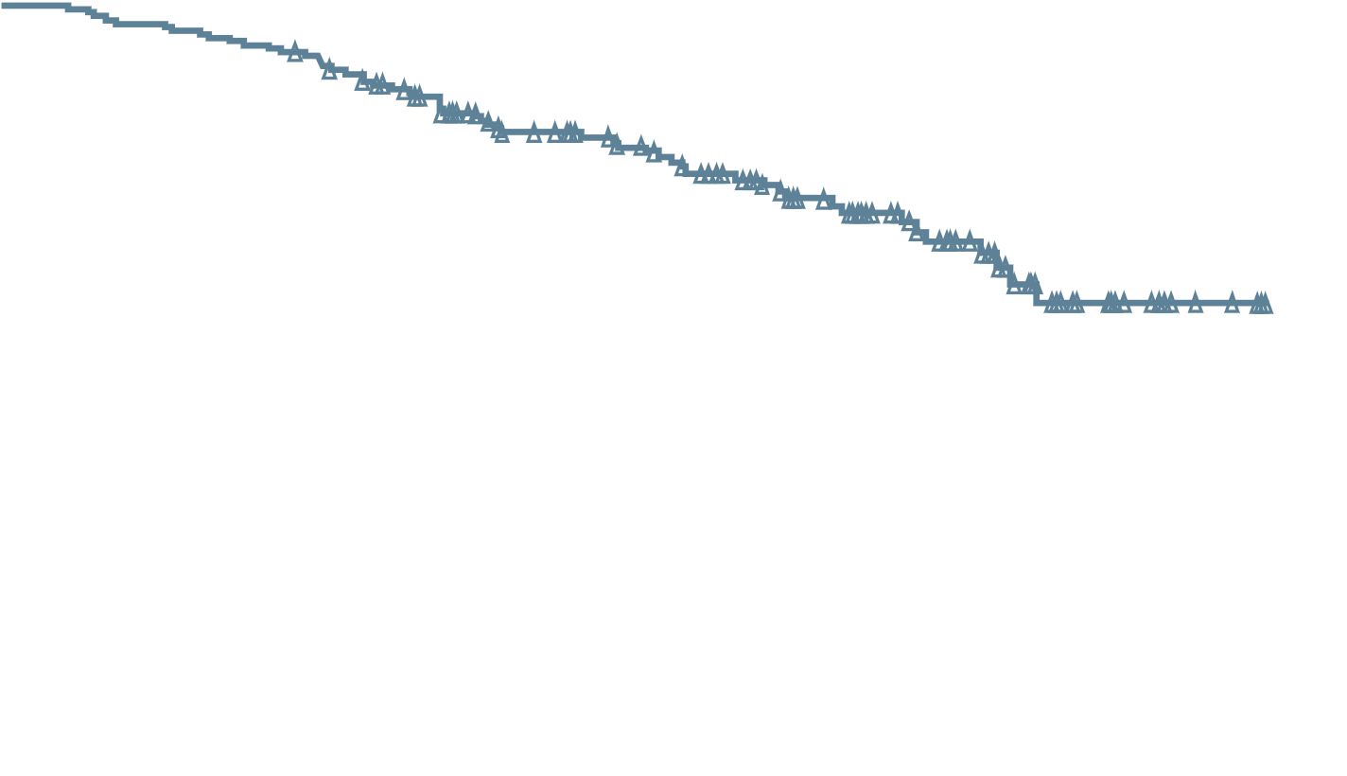
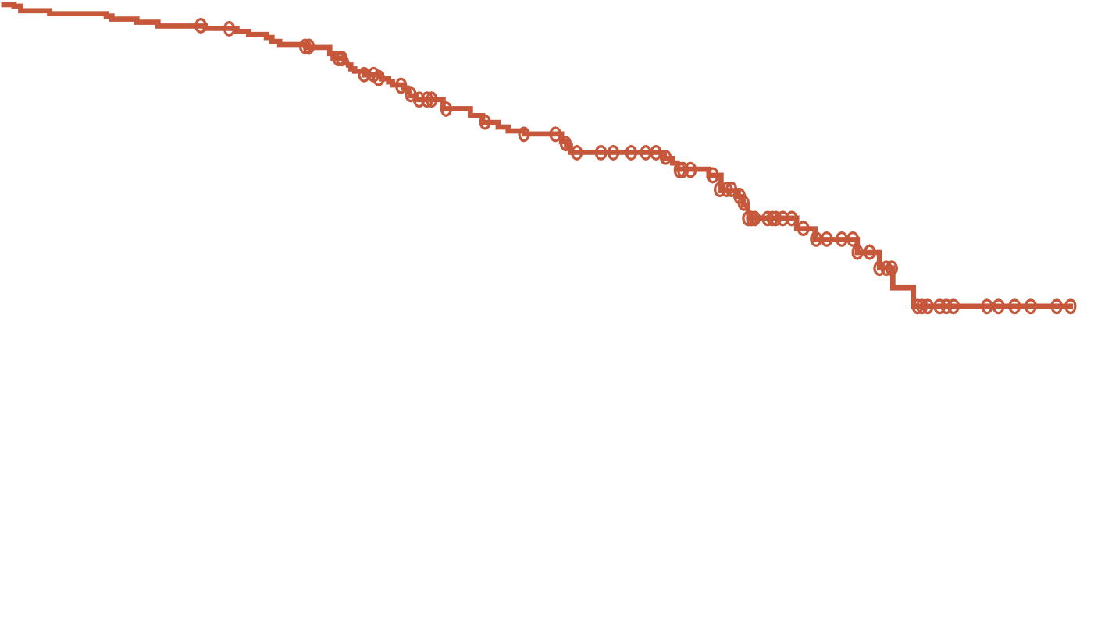
MAGNITUDE All HRR BM+: Overall Survival
NO STATISTICALLY SIGNIFICANT IMPROVEMENT IN OS AT THE TIME OF THIS ANALYSIS
NIRA + AAP: NE
(55 death events)
PBO + AAP: NE
(59 death events)
HR: 0.94 (95% CI, 0.65-1.36)
p=0.733 (boundary for significance, 0.0005)
No. at risk
NIRA + AAP | 212 | 207 | 200 | 180 | 146 | 110 | 84 | 52 | 20 | 4 | 0
PBO + AAP | 211 | 206 | 202 | 187 | 141 | 113 | 82 | 47 | 22 | 5 | 0
46.3% of the required death events for the final analysis observed and thus overall survival data are immature
AAP, abiraterone acetate + prednisone/prednisolone; BM, biomarker; CI, confidence interval; HR, hazard ratio; HRR, homologous recombination repair;
NE, not estimable; NIRA, niraparib; OS, overall survival; PBO, placebo
Chi K, et al. J Clin Oncol. 2022;40 (suppl 6; abstr 12) (ASCO GU 2022 oral presentation); Chi K, et al. J Clin Oncol. 2023; DOI: 10.1200/JCO.22.01649

Slide 37
MAGNITUDE: HRR BM+ TEAEs occurring at >20% in NIRA arm or of clinical interest
TEAEs consistent with the known safety profile for each therapy
NIRA + AAP, n=212
PBO + AAP, n=211
Grade ≥3
All grade
Grade ≥3
All grade
0.0
Proportion of patients (%)
ª Includes one Grade 5 event; ^{b} Includes three Grade 5 events
AAP, abiraterone acetate + prednisone / prednisolone; AML, acute myeloid leukaemia; BM, biomarker; HRR, homologous recombination repair; MDS, myelodysplastic syndrome; NIRA, niraparib; PBO, placebo; TEAE, treatment-emergent adverse event
Chi K, et al. J Clin Oncol. 2022;40 (suppl 6; abstr 12) (ASCO GU 2022 oral presentation); Chi K, et al. J Clin Oncol. 2023; DOI: 10.1200/JCO.22.01649

Slide 38
Considerations for treatment selection

Slide 39
Patient case
Patient: 66 year old
Presents with: mild fatigue
Medical history:
Well-controlled hypertension and hyperlipidaemia
+FH of breast cancer in sister, age 56
Germline BRCA2 mutation detection which is pathogenic.
Consider patient for treatment with a PARPi
12 months
18 months
24 months
ADT/docetaxel x 6 → ADT
PSA 110
PSA nadir 0.2
PSA 1.6
PSA 14.4
Initial Presentation
Biopsy: 9 / 12 cores; Adenocarcinoma Gleason 4+4
Staging: T3 by DRE and mpMRI, N1 M1b, high volume mHSPC
Imaging: bone and CT scan
Metastases in hip, lumbar spine and ribs (five)
Multiple pelvic & retroperitoneal lymph nodes between 1-3 cm
Current situation
Slight discomfort in lumbar spine
Imaging:
Progression of bone and lymph node metastases
Haemoglobin: 11 g/dL
ADT, androgen deprivation therapy; CT, computed tomography; DRE, digital rectal exam; FH, family history; mHSPC, metastatic hormone sensitive prostate cancer; mpMRI, multi-parametric magnetic resonance imaging; PSA, prostate-specific antigen; T, N, M, tumour, nodes, metastasis

Slide 40
rPFS across AR-PARP Inhibitor Combination trials (Primary Endpoint)
*
 | Primary endpoint analysis | TALAPRO-2 (BICR)¹ |  |  | PROpel (invest. review)^{2,3} |  | Magnitude (BICR)⁴
 |  | TALA+ ENZA | Placebo+ ENZA |  | OLA+ ABI | Placebo+ ABI | NIRA+ ABI | Placebo+ ABI
All comers/unselected | n | 402 | 403 |  | 399 | 397 | Not applicable
 | Median rPFS, mo | Not reached | 21.9 |  | 24.8 | 16.6
 | HR | 0.63 |  |  | 0.66
HRR deficient | n | 85 | 84 |  | 111 | 115 | 212 | 211
 | Median rPFS, mo | 27.9 | 16.4 |  | Not reached | 13.9 | 16.5 | 13.7
 | HR | 0.46 |  |  | 0.50 |  | 0.73
HRR non-deficientª | n | 198 | 214 |  | 279 | 273 | 117 | 116
 | Median rPFS, mo | Not reached | 22.1 |  | 24.1 | 19.0 | NA | NA
 | HR | 0.66 |  |  | 0.76 |  | (1.09)
BRCAm | n | 27 | 32 | 32 | 47 | 38 | 113 |  | 112
 | Median rPFS, mo | Not reported | Not reported | Not reported | Not reached | 8.4 | 16.6 |  | 10.9
 | HR | 0.23 |  |  | 0.23 |  | 0.53
Non-BRCAm | n | 58 |  | 52 | 343 | 350 | 99 |  | 99
 | Median rPFS, mo | Not reported |  | Not reported | 24.1 | 19.0 | 14.8 |  | 16.4
 | HR | 0.66 |  |  | 0.76 |  | 0.99
ªin TALAPRO-2 determined by prospective tumour tissue testing. Please note that these studies cannot be directly compared. The data are presented for information purposes only
ABI, abiraterone acetate; AR, androgen receptor; BICR, blinded independent central review; BRCAm, breast cancer gene mutation; CI, confidence interval; ENZA, enzalutamide; HR, hazard ratio; HRR, homologous recombination repair; mo, months; NIRA, niraparib; OLA, olaparib; PARP, poly-ADP ribose polymerase; rPFS, radiographic progression-free survival; TALA, talazoparib
1. Agarwal A, et al. The Lancet 2023: https://doi.org/10.1016/S0140-6736(23)01055-3; 2. Clarke N, et al. NEJM Evidence 2022; 1(9): DOI: 10.1056/EVIDoa2200043; 3. Clarke N, et al. J Clin Oncol 41, 2023 (suppl 6; abstr LBA16) (ASCO GU 2023 oral presentation); 4. Chi K, et al. J Clin Oncol 2023: DOI: 10.1200/JCO.22.01649

Slide 41
rPFS across AR-PARP Inhibitor Combination trials (by BICR)
 |  | TALAPRO-2 (BICR)¹ |  | PROpel (BICR)^{2,3,a} |  | Magnitude (BICR)⁴
 |  | TALA+ ENZA | Placebo+ ENZA | OLA+ ABI | Placebo+ ABI | NIRA+ ABI | Placebo+ ABI
All comers/unselected | n | 402 | 403 | 399 | 397 | Not applicable
 | Median rPFS, mo | Not reached | 21.9 | 27.6 | 16.4
 | HR | 0.63 |  | 0.61
HRR deficient | n | 85 | 84 | 111 | 115 | 212 | 211
 | Median rPFS, mo | 27.9 | 16.4 | 28.8 | 13.8 | 16.5 | 13.7
 | HR | 0.46 |  | 0.45 |  | 0.73
HRR non-deficient^{b} | n | 198 | 214 | 279 | 273 | 117 | 116
 | Median rPFS, mo | Not reached | 22.1 | 27.6 | 19.1 | NA | NA
 | HR | 0.66 |  | 0.72 |  | (1.09)
BRCAm | n | Not reported | 32 | 47 | 38 | 113 |  | 112
 | Median rPFS, mo | Not reported | Not reported | NR | 8.4 | 16.6 |  | 10.9
 | HR | 0.23 |  | 0.18 |  | 0.53
Non-BRCAm | n | Not reported |  | 343 | 350 | 99 |  | 99
 | Median rPFS, mo |  |  | 27.6 | 16.6 | 14.8 |  | 16.4
 | HR |  |  | 0.72 |  | 0.99
ªBICR is sensitivity analysis of PROpel primary endpoint ^{b}Determined by prospective tumour tissue testing in TALAPRO-2 Please note that these studies cannot be directly compared. The data are presented for information purposes only
ABI, abiraterone acetate; AR, androgen receptor; BICR, blinded independent central review; BRCAm, breast cancer gene mutation; ENZA, enzalutamide; HR, hazard ratio; HRR, homologous recombination repair; mo, months; NIRA, niraparib; OLA, olaparib; PARP, poly-ADP ribose polymerase; rPFS, radiographic progression-free survival; TALA, talazoparib
1. Agarwal A, et al. J Clin Oncol 41, 2023 (suppl 6; abstr LBA17) (ASCO GU 2023 oral presentation); 2. Clarke N, et al. NEJM Evidence 2022; 1(9): DOI: 10.1056/EVIDoa2200043 (supplementary appendix); 3. Clarke N, et al. J Clin Oncol 41, 2023 (suppl 6; abstr LBA16) (ASCO GU 2023 oral presentation, data supplement); 4. Chi K, et al. J Clin Oncol. 2023; 41 (18): 3339-3351

Slide 42
MAGNITUDE HRR BM⁻: Prespecified Early Futility Analysis
No Benefit of NIRA + AAP in HRR BM⁻ Patients
Composite progression endpointª
100
Additional grade 3/4 toxicity was observed
using NIRA + APP vs PBO + AAP
With added toxicity and no added efficacy in patients with HRR BM⁻ mCRPC, the IDMC recommend stopping enrolment in this cohort
80
60
PBO + AAP
Patients without events (%)
40
NIRA + AAP
20
HR = 1.09^{b} (95% CI 0.75-1.59)
0
0
3
6
9
12
15
Time from randomisation (months)
No. at risk
NIRA + AAP | 117 | 92 | 68 | 51 | 4 | 0
PBO + AAP | 116 | 91 | 68 | 56 | 8 | 0
ª Composite endpoint: rPFS or PSA progression, whichever occurred first
^{b} Breakdown of composite endpoint events: 83 PSA events (HR = 1.03, 95% CI 0.67-1.59); 65 rPFS events (HR = 1.03, 95% CI 0.63-1.67)
AAP, abiraterone acetate + prednisone/prednisolone; BM, biomarker; CI, confidence interval; HR, hazard ratio; HRR, homologous recombination repair; IDMC, independent data monitoring committee; mCRPC, metastatic castration-resistant prostate cancer; NIRA, niraparib; PBO, placebo; PSA, prostate antigen; rPFS, radiographic progression free survival
Chi K, et al. J Clin Oncol 2022; 40, (suppl 6; abstr 12) (ASCO GU 2022 oral presentation)

Slide 43
rpfs in an all-comer population (primary endpoint)
PROpel^{1,2}
TALAPRO-2³
rPFS by investigator assessment (INV)
rPFS by blinded independent central review (BICR)
 | ABI + OLA (N=399) | ABI + PBO (N=397)
Events, n (%) | 168 (42.1) | 226 (56.9)
Median, months | 24.8 | 16.6
 | HR 0.66ª 95% CI, 0.54-0.81; P<0.001
 | 2-sided boundary for significance 0.0324
1.0
1.0
0.9
0.8
0.8
0.7
Talazoparib + Enzalutamide
0.6
0.6
0.5
Probability of rPFS
Probability of rPFS
0.4
0.4
 | TALA + ENZA (N=402) | PBO + ENZA (N=403)
Events, n | 151 | 191
Median (95% CI), months | NR (27.5-NR) | 21.9 (16.6-25.1)
 | HR 0.63 95% CI, 0.51-0.78; P<0.001
0.3
0.2
0.2
Placebo + Enzalutamide
0.1
0.0
0.0
0
2
4
6
8
10
12
14
16
18
20
22
24
26
28
30
0
2
4
6
8
10
12
14
16
18
20
22
24
26
28
30
32
34
36
38
40
42
Time from randomisation (months)
Months
Number of patients at risk:
ABI + OLA
ABI + PBO
No. at risk
TALA + ENZA
PBO + ENZA
399
397
367
359
340
338
313
306
301
297
274
264
251
232
227
198
219
186
167
141
104
87
87
73
57
43
26
17
5
2
4
1
402
403
379
346
353
311
326
279
318
272
285
237
256
200
234
185
226
179
209
154
193
140
175
124
136
96
97
68
67
43
61
42
29
14
13
3
2
1
2
1
1
1
0
0
ªHR for rPFS by BICR in pre-defined sensitivity analysis is 0.61
Please note that these studies cannot be directly compared. The data are presented for information purposes only
Abi, abiraterone acetate; CI, confidence interval; ENZA, enzalutamide; HR, hazard ratio; NR, not reached; Ola, Olaparib; rPFS, radiographic progression-free survival; TALA, talazoparib
1. Clarke N, et al. NEJM Evidence 2022;1(9): doi: https://doi.org/10.1056/EVIDoa2200043; 2. Clarke N, et al. J Clin Oncol 41, 2023 (suppl 6; abstr LBA16) (ASCO GU 2023 oral presentation); 3. Agarwal A, et al. J Clin Oncol 41, 2023 (suppl 6; abstr LBA17) (ASCO GU 2023 oral presentation)

Slide 44
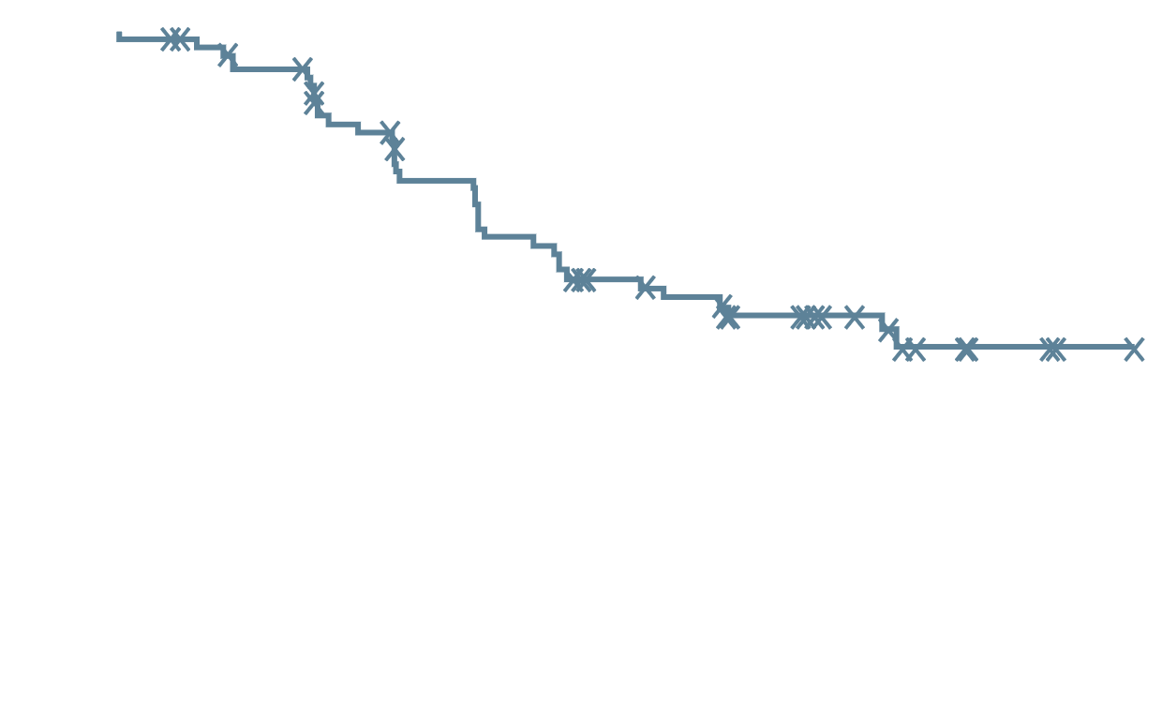
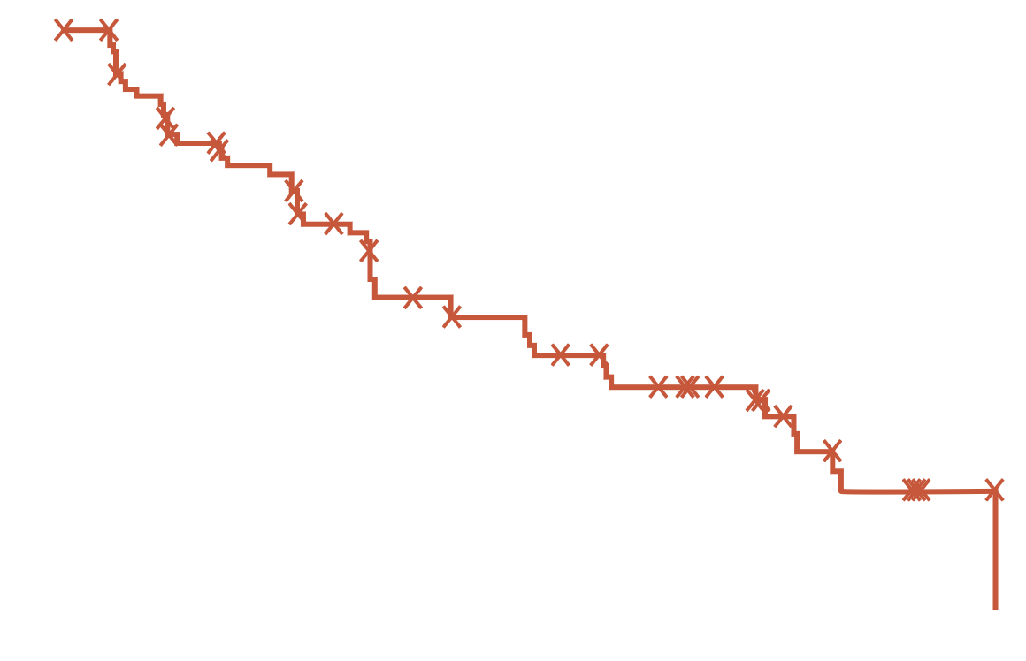
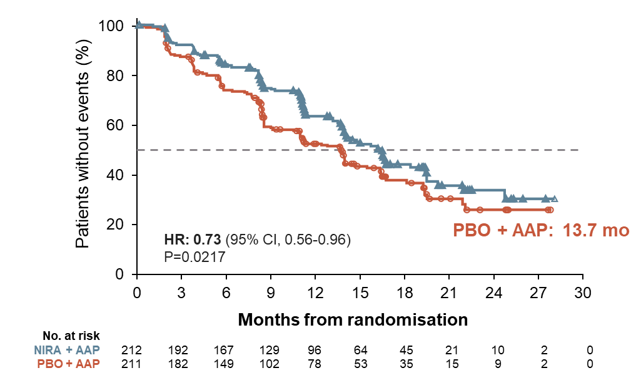
rpfsª in HRRm patients
1.0
TALAPRO-2¹
1.0
PROpel²
0.8
0.8
0.6
0.6
Probability of rPFS
Probability of rPFS
Abiraterone + Olaparib: NR
0.4
Talazoparib +
Enzalutamide:
27.9 months
0.4
0.2
HR: 0.46 (95% CI, 0.30-0.70)
P<0.001
Placebo +
Enzalutamide:
16.4 months
0.2
Abiraterone + Placebo:
13.9 months
HR: 0.50 (95% CI, 0.34-0.73)^{b}
0.0
0.0
0
2
4
6
8
10
12
14
16
18
20
22
24
26
28
30
32
34
36
38
40
42
0
2
4
6
8
10
12
14
16
18
20
22
24
26
28
30
No. at risk
TALA + ENZA
PBO + ENZA
Months
No. at risk
ABI + OLA
ABI + PBO
Time from randomisation (months)
85
84
83
72
81
61
76
55
75
54
65
43
57
34
51
30
49
30
42
25
40
21
37
20
30
17
23
11
17
6
15
6
6
2
3
0
0
0
0
0
0
0
0
0
111
115
103
103
94
94
90
81
87
78
78
68
72
58
66
51
64
49
52
39
34
22
28
20
14
11
8
2
2
0
1
0
100
MAGNITUDE³
80
Please note that these studies cannot be directly compared. The data are presented for information purposes only
ªrPFS by BICR for TALAPRO-2 and MAGNITUDE studies and by investigator assessment in PROpel; ^{b}post hoc exploratory analysis
AAP, abiraterone acetate + prednisone/prednisolone;
Abi, abiraterone acetate; CI, confidence interval; ENZA, enzalutamide; HR, hazard ratio; NIRA, niraparib; NR, not reached; Ola, Olaparib; rPFS, radiographic progression-free survival; TALA, talazoparib
Patients without events (%)
60
40
NIRA + AAP: 16.5 months
20
HR: 0.73 (95% CI, 0.56-0.96)
P=0.0217
PBO + AAP: 13.7 months
0
0
3
6
9
12
15
18
21
24
27
30
No. at risk
NIRA + AAP
PBO + AAP
Time from randomisation (months)
212
211
192
182
167
149
129
102
96
78
64
53
45
35
21
15
10
9
2
2
0
0
1. Agarwal A, et al. J Clin Oncol 41, 2023 (suppl 6; abstr LBA17) (ASCO GU 2023 oral presentation); 2. Clarke N, et al. NEJM Evidence 2022;1(9): doi: https://doi.org/10.1056/EVIDoa2200043; 3. Chi K, et al. J Clin Oncol. 2022;40 (suppl 6; abstr 12) (ASCO GU 2022 oral presentation)

Slide 45
mOS across AR-PARP Inhibitor Combination trials
*
 |  | TALAPRO-2 (BICR)¹ |  | PROpel (invest. review)² |  | Magnitude (BICR)^{3,4}
 |  | TALA+ ENZA | Placebo+ ENZA | OLA+ ABI | Placebo+ ABI | NIRA+ ABI | Placebo+ ABI
All comers/unselected | n | 402 | 403 | 399 | 397 | Not applicable
 | Median OS, mo | 36.4 | Not reached | 42.1 | 34.7
 | HR | 0.89 (31% mature) |  | 0.81 (47.9% mature)
HRR deficient | N | Not reported |  | 111 | 115 | 212 | 211
 | Median OS, mo |  |  | Not reached | 28.5 | Not reached | Not reached
 | HR |  |  | 0.66 |  | 0.94 (46.3% mature)
HRR non-deficient | n | Not reported |  | 279 | 273 | Not reported
 | Median OS, mo |  |  | 42.1 | 38.9
 | HR |  |  | 0.89
BRCAm | n | Not reported |  | 47 | 38 | 113 |  | 112
 | Median OS, mo |  |  | Not reached | 23.0 | 29.3 |  | 28.6
 | HR |  |  | 0.29 |  | 0.88
Non-BRCAm | n | Not reported |  | 343 | 350 | Not reported
 | Median OS, mo |  |  | 39.6 | 38.0
 | HR |  |  | 0.91
Please note that these studies cannot be directly compared. The data are presented for information purposes only
ABI, abiraterone acetate; AR, androgen receptor; BICR, blinded independent central review; BRCAm, breast cancer gene mutation; CI, confidence interval; ENZA, enzalutamide; HR, hazard ratio; HRR, homologous recombination repair; mo, months; NA, not applicable (not reported); NIRA, niraparib; OLA, olaparib; PARP, poly-ADP ribose polymerase; rPFS, radiographic progression-free survival; TALA, talazoparib
1. Agarwal A, et al. The Lancet 2023: https://doi.org/10.1016/S0140-6736(23)01055-3 (Data supplement); 2. Clarke N, et al. J Clin Oncol 41, 2023 (suppl 6; abstr LBA16) (ASCO GU 2023 oral presentation); 3. Chi K, et al. J Clin Oncol 2023: DOI: 10.1200/JCO.22.01649; 4. Efstathiou E, et al. J Clin Oncol 41, 2023 (suppl 6; abstr 170) (ASCO GU 2023 oral presentation);

Slide 46
Cytopenias (≥10% of pts) across AR-PARP Inhibitor Combination trials
Frequency of cytopenias – All grade (Grade ≥3), % | TALAPRO-2¹ |  | PROpel² |  | Magnitude^{3, a}
Frequency of AEs – All grade (Grade ≥3) | TALA+ ENZA | Placebo+ ENZA | OLA+ ABI | Placebo+ ABI | NIRA+ ABI | Placebo+ ABI
Anaemia^{b} | 66 (46) | 17 (4) | 46.0 (15.1) | 16.4 (3.3) | 46.2 (29.7) | 20.4 (7.6)
Thrombocytopenia | 25 (7) | 3 (1) | NR | NR | 21.2 (6.6) | 8.5 (2.4)
Neutropenia | 36 (18) | 7 (1) | NR | NR | 13.7 (6.6) | 5.7 (1.4)
Leukopenia | 22 (6) | 4 (0) | NR | NR | 10.4 (1.9) | 2.4 (0.5)
Lymphopenia | 11 (5) | 5 (1) | NR | NR | NR | NR
Please note that these studies cannot be directly compared. The data are presented for information purposes only. AEs reported if > 10% in TALAPRO-2 and MAGNITUDE and ≥ 10% in PROpel in combination arms AEs highlighted in blue if value ≥20%; ª safety presented for HRR+ cohort; ^{b} In PROpel: grouped term anaemia category includes anaemia, decreased haemoglobin level, decreased red-cell count, decreased haematocrit level, erythropenia, macrocytic anaemia, normochromic anaemia, normochromic normocytic anaemia and normocytic anaemia
ABI, abiraterone acetate; AE, adverse event; AR, androgen receptor; ENZA, enzalutamide; HRR, homologous recombination repair; NIRA, niraparib; NR, not reported; OLA, olaparib; PARP, poly-ADP ribose polymerase; TALA, talazoparib
1. Agarwal A, et al. The Lancet 2023: https://doi.org/10.1016/S0140-6736(23)01055-3; 2. Clarke N, et al. NEJM Evid 2022;1(9): DOI: 10.1056/EVIDoa2200043; 3. Chi K, et al. J Clin Oncol. 2023; 41 (18): 3339-3351

Slide 47
Most common teaes (≥10% of pts) across AR-PARP Inhibitor Combination trials
 | TALAPRO-2¹ |  | PROpel² |  | Magnitude (HRR+)³
Frequency of AEs – All grade (Grade ≥3) | TALA+ ENZA | Placebo+ ENZA | OLA+ ABI | Placebo+ ABI | NIRA+ ABI | Placebo+ ABI
Fatigue | 34 (4) | 29 (2) | 37.2 (2.3)ª | 28.3 (1.5)ª | 26.4 (3.3) | 16.6 (4.3)
Nausea | 21 (<1) | 12 (<1) | 28.1 (0.3) | 12.6 (0.3) | 23.6 (0.5) | 13.7 (0)
Constipation | 18 (<1) | 17 (<1) | 17.3 (0) | 13.9 (0.3) | 30.7 (0) | 13.7 (0)
Diarrhoea | 14 (<1) | 14 (0) | 17.3 (0.8) | 9.3 (0.3) | NR | NR
Decreased appetite | 22 (1) | 16 (1) | 14.6 (1.0) | 5.8 (0) | 14.2 (0.5) | 6.2 (0.5)
Back pain | 22 (3) | 18 (1) | 17.1 (0.8) | 18.4 (1.0) | 14.6 (2.4) | 20.9 (0.9)
Hypertension | 14 (5) | 15 (7) | 12.6 (3.5) | 16.4 (3.3) | 31.1 (14.6) | 20.9 (12.3)
Fall | 18 (2) | 15 (2) | NR | NR | 5.2 (0.9) | 12.3 (2.8)
Arthralgia | 15 (<1) | 20 (<1) | 12.8 (0) | 17.7 (0.5) | 13.2 (0.5) | 9.5 (0.5)
Asthenia | 14 (3) | 9 (<1) | NR | NR | 15.6 (1.0) | 9.0 (0.5)
Dizziness | 12 (1) | 6 (<1) | 10.8 (0) | 6.3 (0) | 11.3 (0.5) | 5.7 (0)
Hot flush | 12 (0) | 13 (0) | NR | NR | NR | NR
Oedema peripheral | 11 (0) | 6 (0) | 10.3 (0) | 11.4 (0.3) | NR | NR
Dyspnoea | 10 (<1) | 6 (<1) | NR | NR | 16.0 (1.9) | 5.7 (0.9)
Decreased weight | 10 (<1) | 8 (<1) | NR | NR | NR | NR
Hypokalemia | NR | NR | NR | NR | 13.7 (2.8) | 9.5 (2.8)
Vomiting | NR | NR | 13.1 (1.0) | 9.1 (0.3) | 13.2 (0.5) | 6.6 (0.5)
Insomnia | NR | NR | NR | NR | 10.4 (0) | 3.8 (0)
Bone pain | NR | NR | NR | NR | 9.9 (1.4) | 11.4 (0.5)
Urinary tract infection | NR | NR | 10.3 (2.0) | 7.8 (1.0) | NR | NR
Please note that these studies cannot be directly compared. The data are presented for information purposes only. AEs highlighted in blue if value ≥20%; ªFatigue and asthenia as grouped term
ABI, abiraterone acetate; AE, adverse event; AR, androgen receptor; ENZA, enzalutamide; HRR, homologous recombination repair; NIRA, niraparib; NR, not reported; OLA, olaparib; PARP, poly-ADP ribose polymerase; TALA, talazoparib
1. Agarwal A, et al. The Lancet 2023: https://doi.org/10.1016/S0140-6736(23)01055-3; 2. Clarke N, et al. NEJM Evid 2022;1(9): DOI: 10.1056/EVIDoa2200043; 3. Chi K, et al. J Clin Oncol. 2023; 41 (18): 3339-3351

Slide 48
Selecting abiraterone vs enzalutamide
Consider abirateroneª
(avoid enzalutamide)
Consider enzalutamide
(avoid abiraterone)
Falls/gait, neurologic issues
Baseline CHF
Significant baseline fatigue
Baseline oedema
Mild baseline pain
Renal impairment
Polypharmacy
Diabetes
ªKeep in mind that the steroids used with abiraterone are not supra-physiologic
CHF, congestive heart failure

Slide 49
Considerations for selection of parp inhibitor
Both talazoparib and olaparib have demonstrated efficacy in men with mCRPC in the first line setting, no prior ARSi use, and irrespective of HRR mutation detection
  Improvements in rPFS similar, with greater benefits seen in HRRm and BRCAm populations
Differences in discontinuation rates, severe anaemia, dosing, and AR inhibitor partner may better inform on choice
With either choice, patients should be followed regularly for adverse events, particularly anaemia requiring transfusion, GI intolerance, fatigue
  Dose holds and reductions are not uncommon and may be needed for optimal individualised care
  CBC every 2-4 weeks especially in first 3-4 months is reasonable
Niraparib and abiraterone is also associated with longer rPFS than abiraterone alone in first line mCRPC. However, this occurred in patients with BRCA mutations only
AR, androgen receptor; ARSi, androgen receptor signalling inhibitor; BRCAm, breast cancer gene mutation; CBC, complete blood count; GI, gastrointestinal; HRR, homologous recombination repair; HRRm, HRR mutation; mCRPC, metastatic castration resistant prostate cancer; OS, overall survival; PARP, poly-ADP ribose polymerase; rPFS, radiographic progression-free survival

Slide 50


PARP inhibitors are approved in prostate cancer
Olaparib FDA-approved indication¹
Olaparib EMA-approved indication²
Indicated as monotherapy for the treatment of adult patients with mCRPC and HRRm, who have progressed on enzalutamide or abiraterone acetate, selected using an FDA-approved Lynparza companion diagnostic
Indicated as monotherapy for the treatment of adult patients with mCRPC and a BRCAm, who have progressed on prior therapy, including an NHA. Determine BRCAm status with a validated test method
In combination with abiraterone and prednisone or prednisolone for the treatment of adult patients with mCRPC in whom chemotherapy is not clinically indicated
Rucaparib FDA-approved indication³
Indicated as monotherapy for the treatment of adult patients with BRCAm mCRPC who have progressed on AR-directed therapy and a taxaneª
ªRucaparib has no current approval in prostate cancer in Europe⁴
Niraparib EMA-approved indication⁵
Treatment should continue until progression or unacceptable toxicity. An LHRH analogue should be continued in patients who are not surgically castrated^{1,2}
Talazoparib is not currently approved in prostate cancer
Indicated as a fixed-dose combination of niraparib/abiraterone acetate with prednisone or prednisolone for the treatment of adult patients with mCRPC and BRCA1/2 gene mutations (germline and/or somatic) in whom chemotherapy is not clinically indicated
AR, androgen receptor; BRCAm, breast cancer gene mutation; EMA, European Medicines Agency; FDA, US Food and Drug Administration; HRRm, homologous recombination repair mutation; LHRH, luteinising hormone-releasing hormone; mCRPC, metastatic castration-resistant prostate cancer; NHA, new hormonal agent; PARP, poly-ADP ribose polymerase
1. Lynparza (olaparib) US prescribing information (Aug-2022); 2. Lynparza (olaparib) summary of product characteristics (Mar 2023); 3. Rubraca (rucaparib) US prescribing information (Jun 2022); 4. Rubraca (rucaparib) summary of product characteristics (Dec 2022); 5. https://www.esmo.org/oncology-news/ema-recommends-granting-a-marketing-authorisation-for-akeega-fixed-dose-combinations-of-niraparib-abiraterone-acetate

