Slide 2
Summary of the video on the Mechanism of action (mOA) of PARP inhibitors and Targeting DNA Damage Response (DDR) Created by Robert L. Coleman, MD Simon Boulton, PhD To view and download chapters or the full video, please visit: MoA of PARP inhibitors and targeting DDR
This video is an educational resource created by COR2ED and supported by a sponsorship grant from AstraZeneca

Slide 3
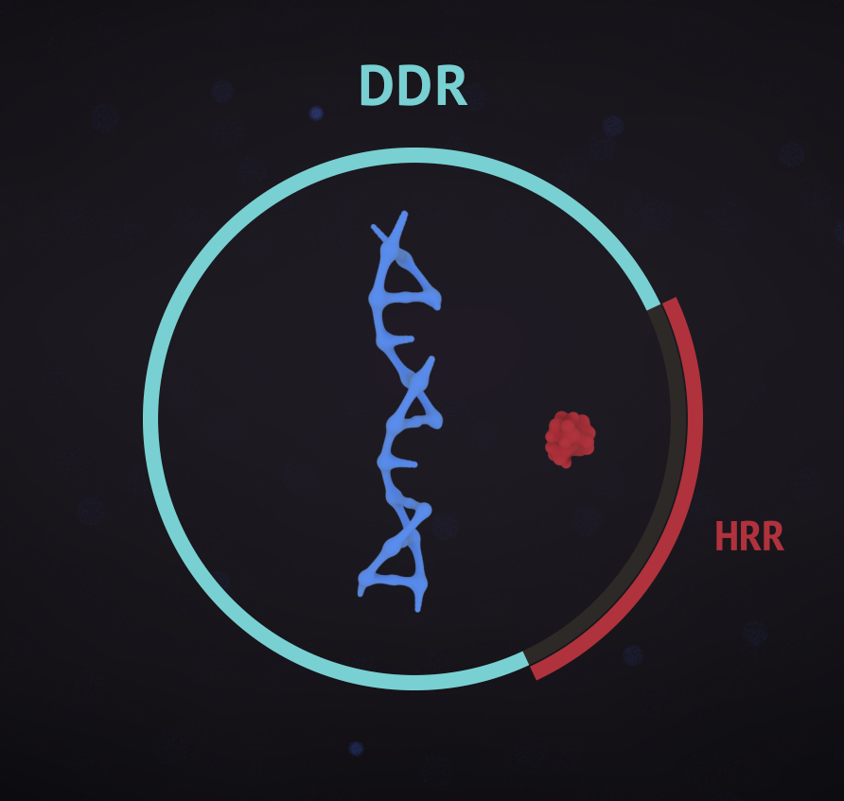
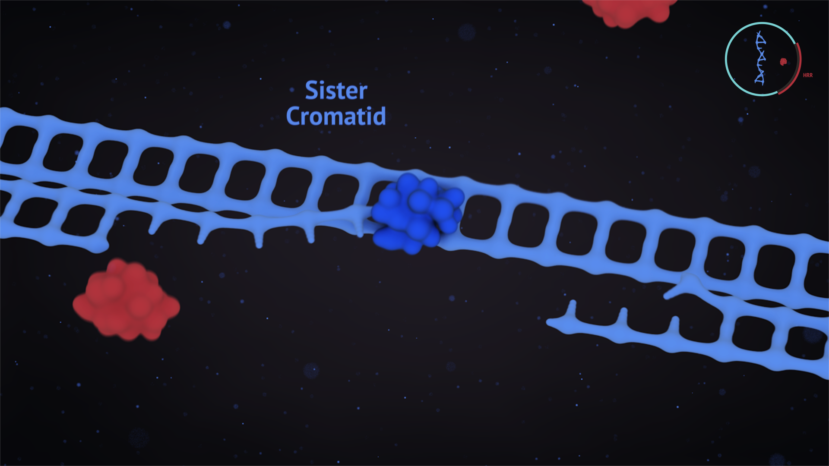
DNA Damage response repairs DNA damage
DNA is under constant risk of damage by endogenous and exogenous factors. Multiple repair systems, collectively referred to as DNA damage response (DDR), can repair this damage.
Homologous recombination repair (HRR) repairs double-strand breaks:
The broken DNA is trimmed back
One of the broken strands invades a sister chromatid
The missing information is copied
The break is repaired
DDR, DNA damage response; HRR, homologous recombination repair Gourley C, et al. J Clin Oncol 2019 May 3:JCO1802050

Slide 4
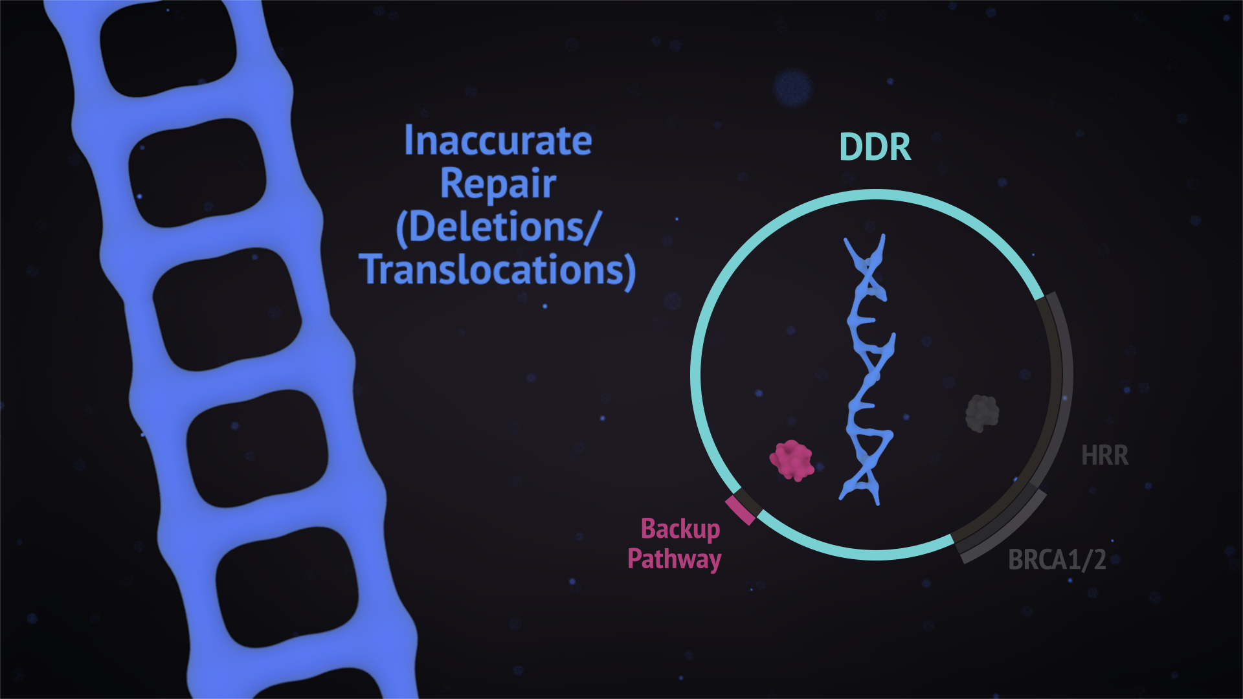
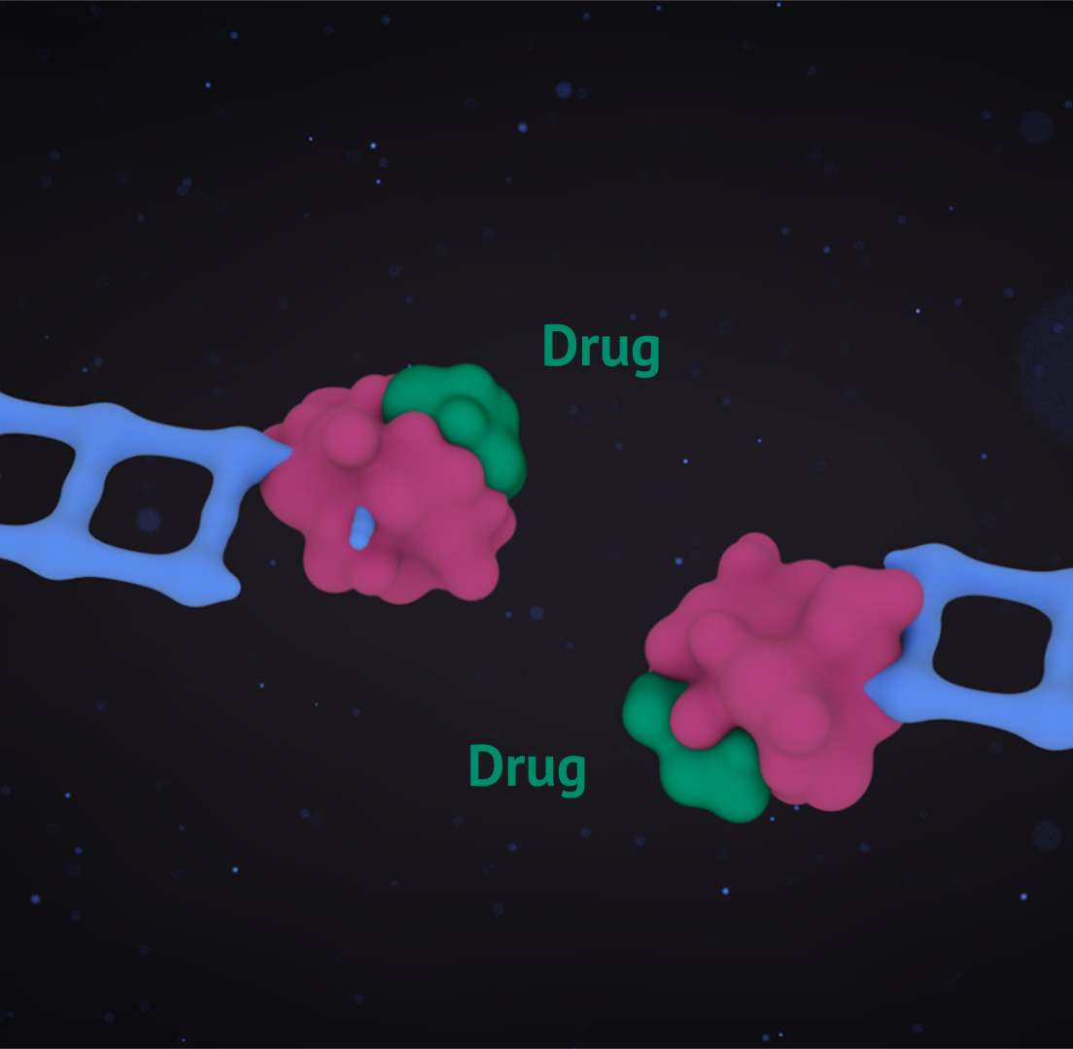
HRR deficiency leads to inaccurate DNA repair
In HRR deficient cells, DNA damage is repaired inaccurately by a backup pathway. Persistent damage leads to genome instability, so defects in DDR pathways drive cancer progression.
BRCA1 and BRCA2 mutations are the most well-known HRR mutations.
Targeting DDR is an approach that can be applied in cancer treatment.
DDR, DNA damage response; HRR, homologous recombination repair Gourley C, et al. J Clin Oncol 2019 May 3:JCO1802050

Slide 5
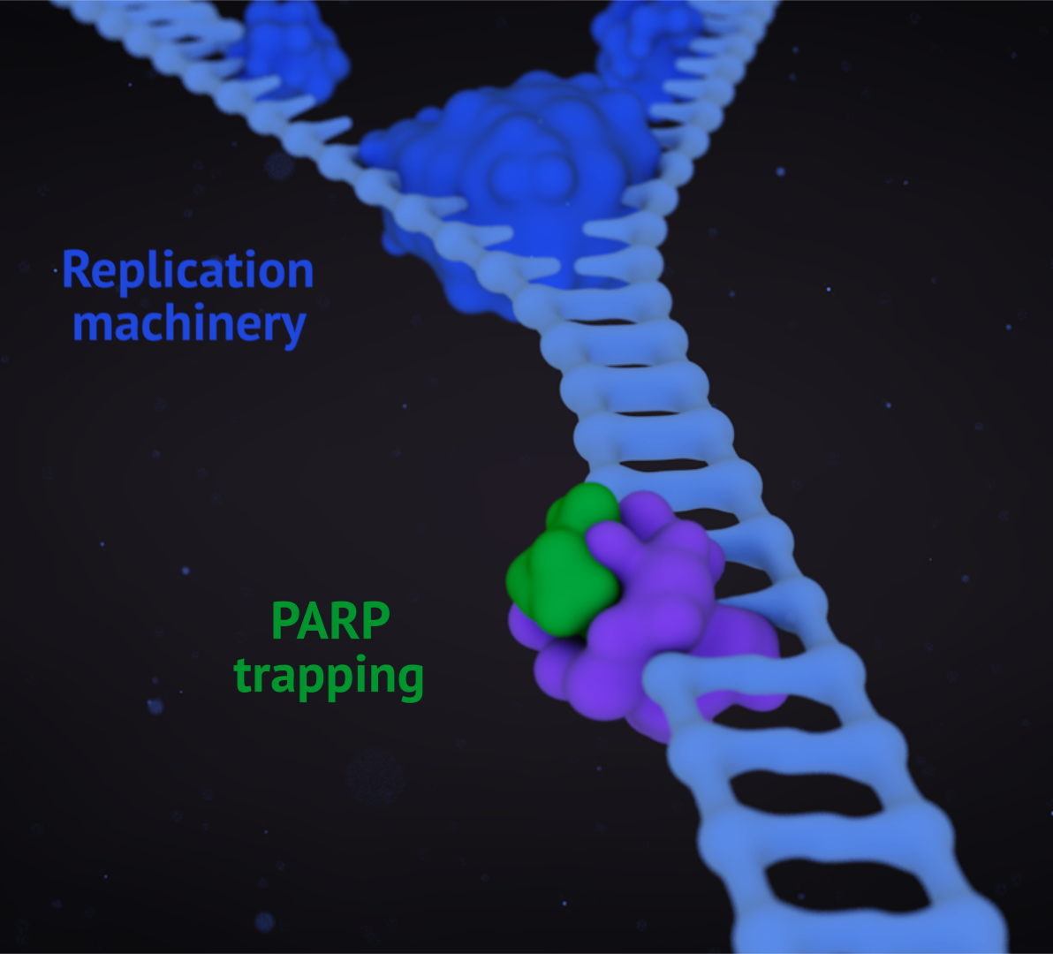
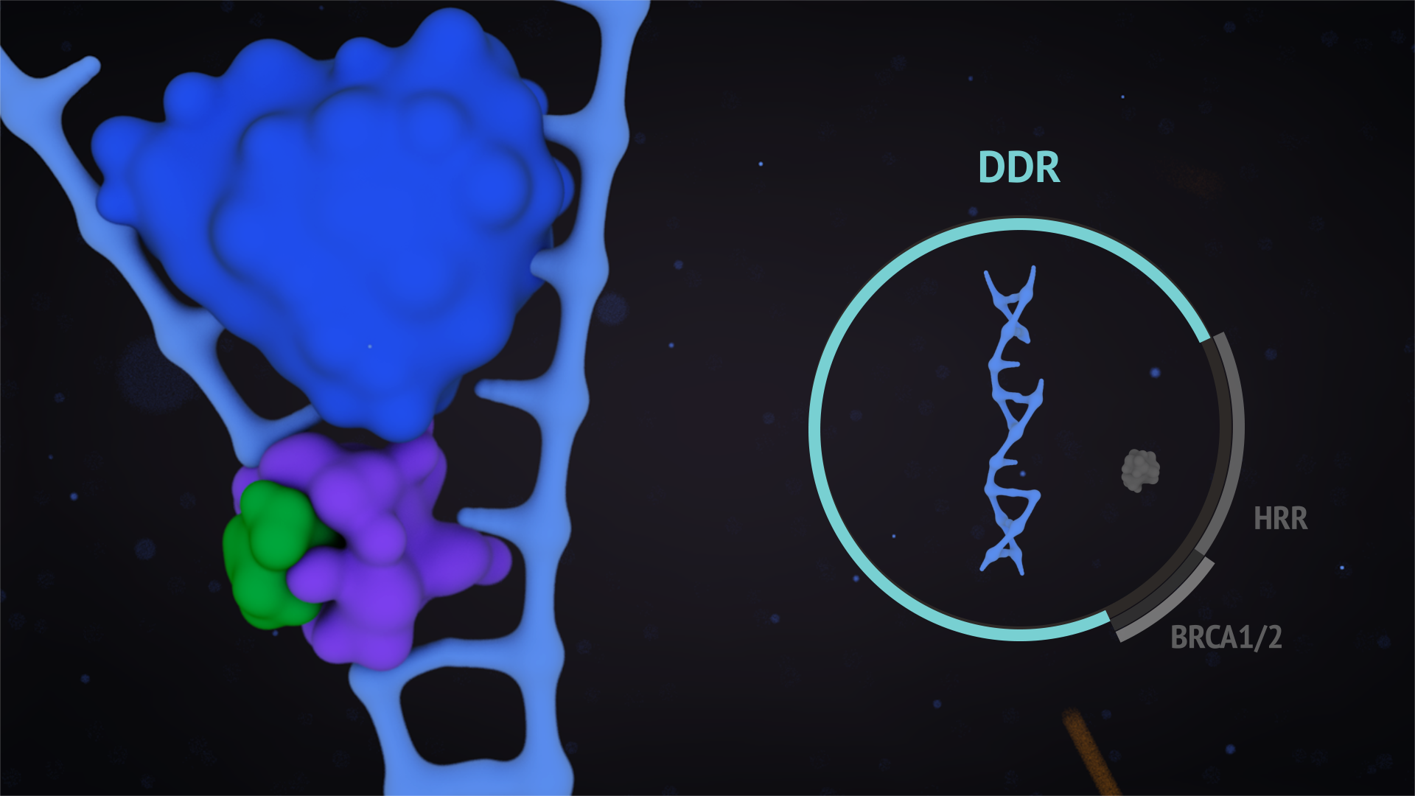
PARP inhibitors are the proof of concept of targeting DDR
PARP inhibitors trap PARP on the DNA, where the complex then presents a physical obstacle to the DNA replication machinery, resulting in a double-strand break. The HRR pathway is essential for repairing this type of DNA damage.
In HRR deficient cancer cells, PARP trapping by a PARP inhibitor results in:
Replication-fork collapse
Accumulation of double-strand breaks
Cell death
DDR, DNA damage response; HRR, homologous recombination repair; PARP, poly (ADP-ribose) polymerase Gourley C, et al. J Clin Oncol 2019 May 3:JCO1802050

Slide 6
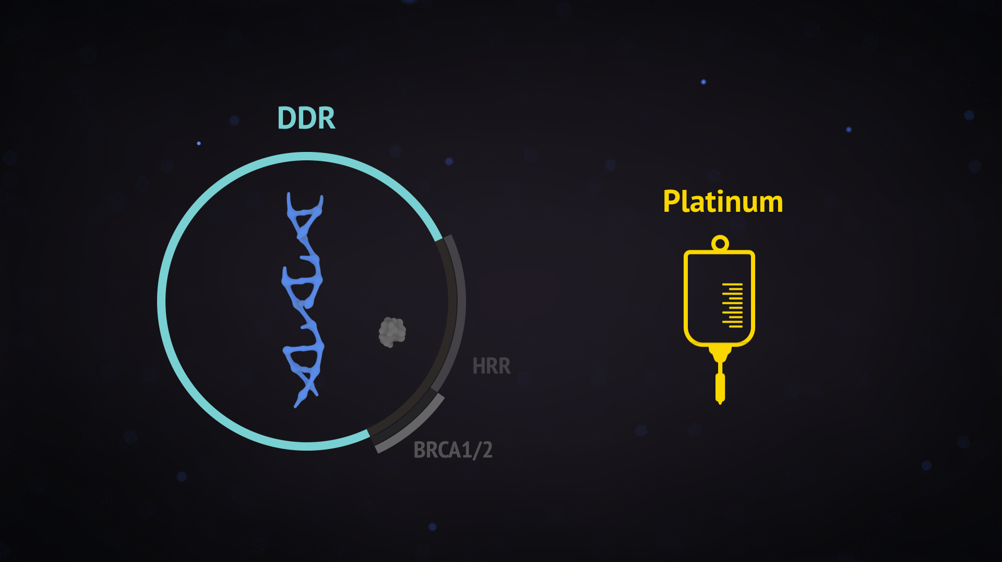
PARP inhibitors in clinical practice
PARP inhibitors have shown clinical benefit in ovarian and breast cancer, with clinical data supporting the use of PARP inhibitors in patients with an HRR deficiency.
Platinum also exploits HRR defects, so platinum sensitivity serves as a surrogate for HRR deficiency.
HRR, homologous recombination repair; PARP, poly (ADP-ribose) polymerase Gourley C, et al. J Clin Oncol 2019 May 3:JCO1802050

Slide 7
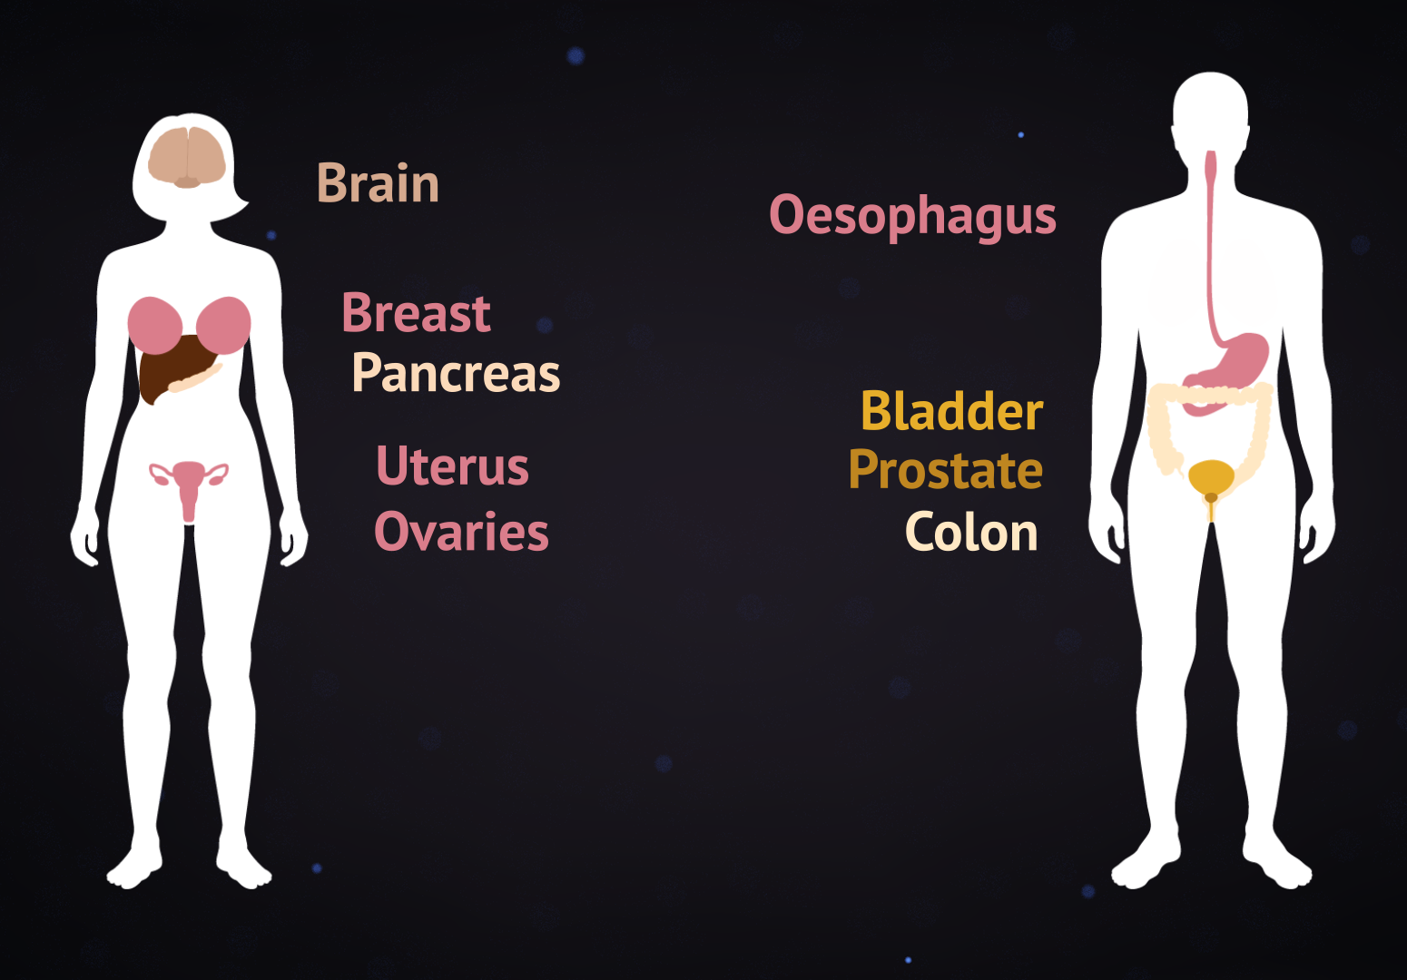
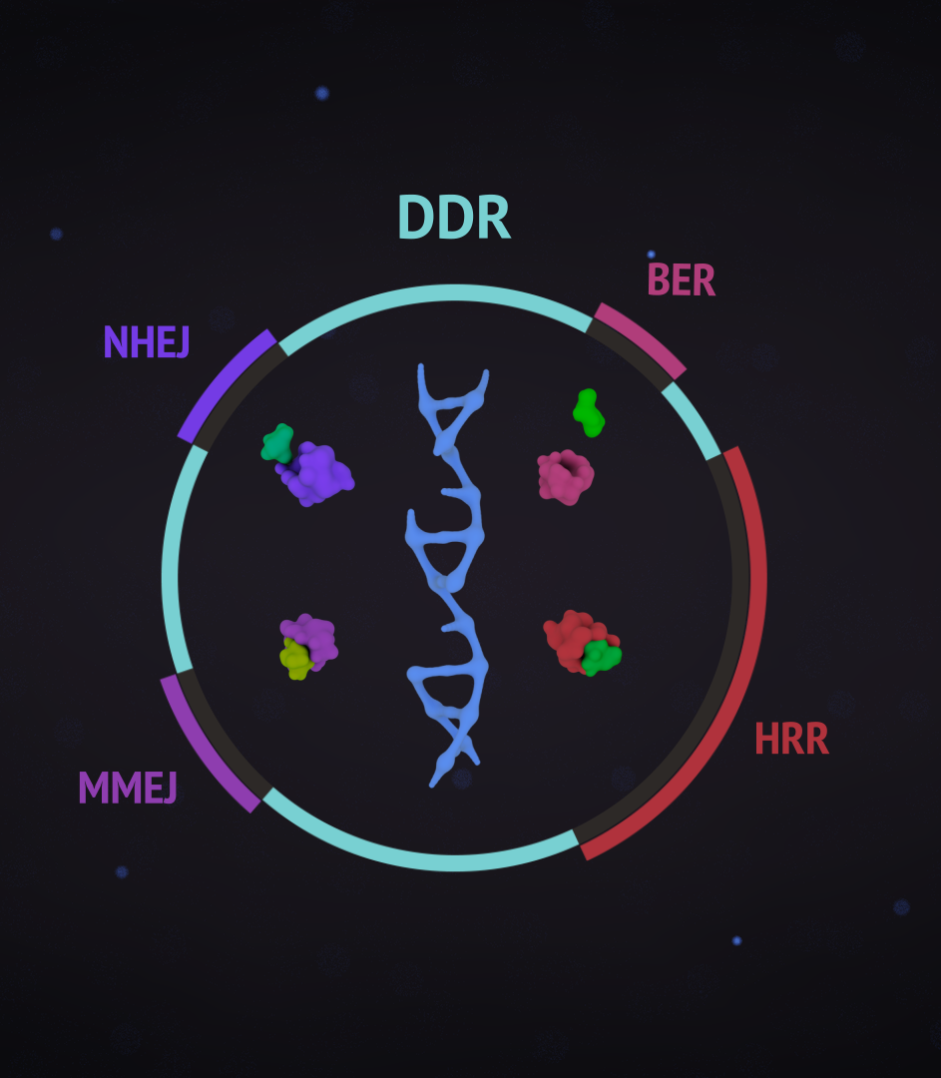
The future of PARP inhibition and targeting DDR
HRR deficiency is seen in a range of cancers, so it is anticipated PARP inhibitors will be effective in various tumour types.
Various other compounds targeting DDR are currently under investigation.
BER, base excision repair; DDR, DNA damage response; HRR, homologous recombination repair; MMEJ, microhomology-mediated end joining; NHEJ, nonhomologous end joining; PARP, poly (ADP-ribose) polymerase Gourley C, et al. J Clin Oncol 2019 May 3:JCO1802050

